Slide 1
Bidding for Antamina
Jianqiu Chen
Meng Tang
November 25, 1996

Slide 2
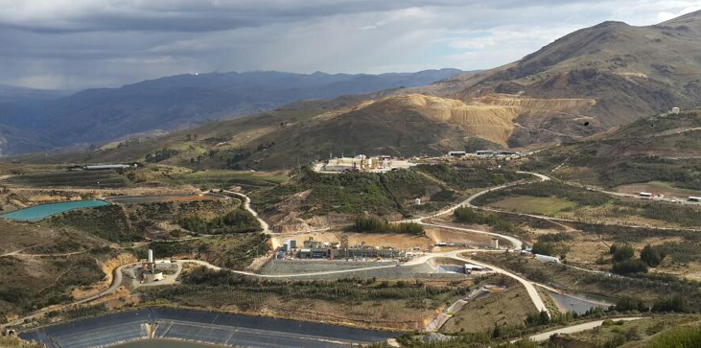
Context
Peruvian Government is auctioning Centromin, Peru’s largest state-owned mining company, to foreign companies
Centromin consists of 11 properties, the first 2 parcels to be sold off are a gold mine and Antamina Parcel
Our company is interested in bidding for the Antamina Parcel, a mine that has vast reserves in copper and zinc

Slide 3
Contents
Objectives
Bidding Process
Pricing Model
Multiple Scenarios
DCF Model
Simulation
Conclusion

Slide 4
Objectives
Our objective is to figure out the optimal bidding strategies
Our presentation attempts to answer the following two questions:
How much is the Antamina mine worth?
How should we bid?

Slide 5
RTZ-CRA Limited
The largest mining group in the world, with revenues of over $8 billion
One of the world’s largest copper producers, with market shares on five continents. Copper production in 1995 reached 640,000 tons, about 7% of world production

Slide 6
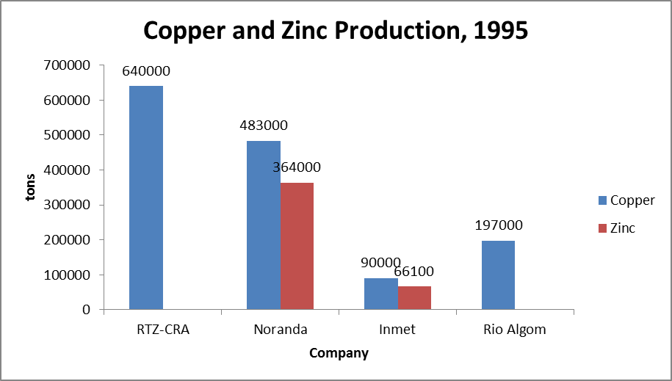
Potential Bidders
RTZ-CRA
Copper mining operations are geographically dispersed, and thus there were no synergies resulting from geographic proximity. Antamina has no unique strategic value to the firm. Primary rationale for purchasing the property is its feasibility as a stand-alone project which generated positive value for the firm.
Noranda Inc. | Inmet Mining Corporation | Rio Algom Limited
Based in Toronto Integrated mining company Mine, smelt, refine, and market copper, zinc, nickel, lead, silver and gold | Based in Toronto Spun off by Metallgesellschaft AG, in 1995 | Based in Toronto Mining and metals distribution company

Slide 7
The Bidding Process for Antamina
Bids evaluated on the basis of the sum of the initial payment plus 30% of the investment commitment.
The highest bid that exceeded the minimum requirements would be awarded the project.
(in USD millions) | Company A | Company B
Initial payment | 17.5 | 18.5
Investment commitment | 135 | 135
Weight of Investment Commitment = 30% | 40.5 | 40.5
Total Bid | 58 | 59

Slide 8
Timeline
Actual investment
<
Commitment
Bid
Feasibility Study
Do Nothing
Develop Property
Return Property to Centromin
Mine (Penalty) - 30% of difference
Do Nothing
Mine (No Penalty)
Win
Spend at least $13.5M
Actual investment
≥
Commitment
Lose
1996
1998
2001
2012
2014
2018

Slide 9
Price Forecast for Copper and Zinc
Big Idea
2 components determine the future price of a commodity:
The drift component
The random component
Drift component measures seasonality, mean reversion, trends, market expectations, time value of money, and cost of carry which can be estimated from the forward curve
Random component measures the random shocks in the supply and demand of the commodity and derivatives

Slide 10
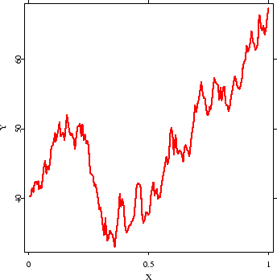
Brownian Motion I
Standard Brownian Motion assumes
The price movements are normally distributed
The price movement does not depend on the past
However, Standard Brownian does not prevent prices from falling below zero
Which is why we need to introduce another model to restrict price from falling below zero

Slide 11
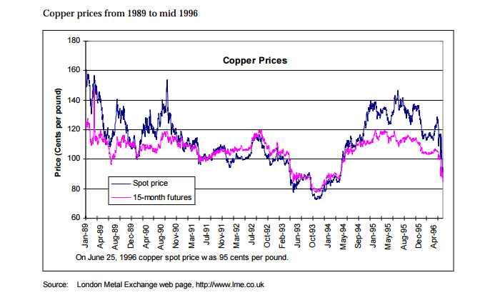
Brownian Motion Model II
Brownian motion consists of:
Future Price = Current price + Drift component + Random Component
Drift component includes all factors that are expected by the market to move the future spot price in a certain direction
Random component includes all factors that cannot be predicted by the market but do contribute to price movements

Slide 12

Brownian Motion Model III
S(t_{i+1}) = S(t_{i})exp[(r-q_{t}-$\frac{1}{2}$σ²)/(t_{i+1}-t_{i}) + σε_{i+1}Sε (t_{i+1}-t_{i})^{0.5}] (Geometric Brownian Motion)
q_{t+1}=q_{t} + α($\overline{q}$-q_{t})+σ_{q}($\frac{1}{12}$)^{0.5}[εσ_{sy}+(1-σ_{sy}²)^{0.5}ε] (Mean Reversion)
Symbols | Meaning
S(t_{i}) | Current Period Spot Price
S(t_{i+1}) | Future Period Spot Price
r | The Average Drift
q_{t} | Current Period Convenience Yield
q_{t+1} | Future Period Convenience Yield
σ | Standard Deviation of the Commodity
σ_{sy} | Correlation Between Spot Price and Convenience Yield
ɛ_{i} | Current Period Unpredictable Factors
ɛ_{i+1} | Future Period Unpredictable Factors
α | Mean Reversion Rate
𝑞 ̅ | Mean Convenience Yield From Past Data

Slide 13

Convenience Yield I
Convenience yield is mathematically defined as q in equation:
F=S$e^{\left(r+u−q\right)T}$
Definition: Measure of premium paid for immediate ownership of the physical commodity
Convenience yield also measures market expectations of future price movements
Symbols | Meaning
F | Forward price
S | Spot price
r | Risk free rate
u | Warehousing and insurance rate
q | Convenience yield

Slide 14
Convenience Yield II
Convenience yield measures the premium paid for immediate ownership of the commodity; also measures market expectations of price movements.
Convenience Yield | Immediate Ownership | Examples | Market expectations | Examples
Large | Urgent need for immediate ownership | Copper manufacturer has urgent need for owning copper to avoid a potential shortage | Market expects the price of the commodity to go down | Sellers want to lock the price at which they sell through forward contracts as they foresee a price fall.
Small | Low need for immediate ownership | If demand slows down, oil refinery does not need immediate ownership of oil (inventory) | Market expects the price of the commodity to go up | Sellers expects the spot price to rise back up in the future, which is reflected on the forward prices

Slide 15
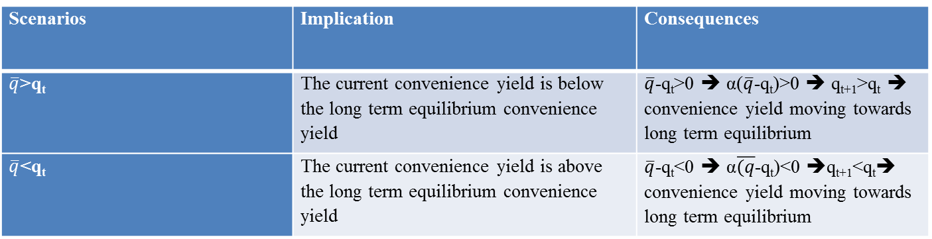

Why Do We Incorporate GBM with MR?
Although GBM captures the drift and randomness inherent in the commodity price movements, it does not capture the Mean Reversion property
Historically, copper and zinc prices exhibit a clear trend of mean reversion. In order to account for that trend, the model uses control terms in the convenience yield equation.
In particular, the term is α($\overline{q}$-qt)
Scenarios | Implication | Consequences
$\overline{q}$>q_{t} | The current convenience yield is below the long term equilibrium convenience yield | $\overline{q}$-q_{t}>0 ➔ α($\overline{q}$-q_{t})>0 ➔ q_{t+1}>q_{t} ➔ convenience yield moving towards long term equilibrium
$\overline{q}$<q_{t} | The current convenience yield is above the long term equilibrium convenience yield | $\overline{q}$-q_{t}<0 ➔ α$\overline{(q}$-q_{t})<0 ➔q_{t+1}<q_{t}➔ convenience yield moving towards long term equilibrium

Slide 16
Put everything together
Standard Brownian Motion allows commodity prices to go below 0
Geometric Brownian Motion captures both market expectations and unpredictable market factors
The Model incorporates MR with GMB to capture the mean reversion property of commodities
Why do commodity prices reverse towards the mean?
Global supply and demand do not change drastically in the absence of technology revolution or fundamental change in the economy
Any speculation eventually ends up with the realization of market fundamentals, which leads to price corrections that bring prices back to equilibrium

Slide 17
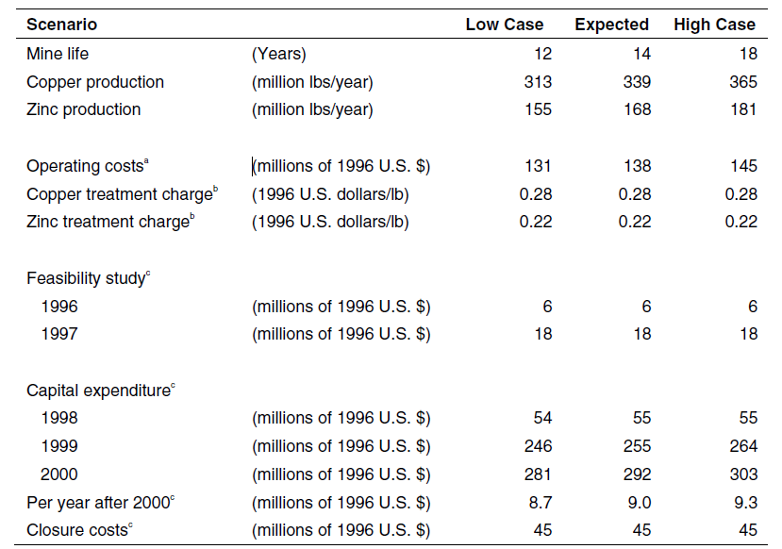
Copper Mine Characteristics: Multiple Scenarios
3 scenarios based on industry standards, conversations with consultants and trade press sources.
Mean ± 1 to 1.5 standard deviations

Slide 18
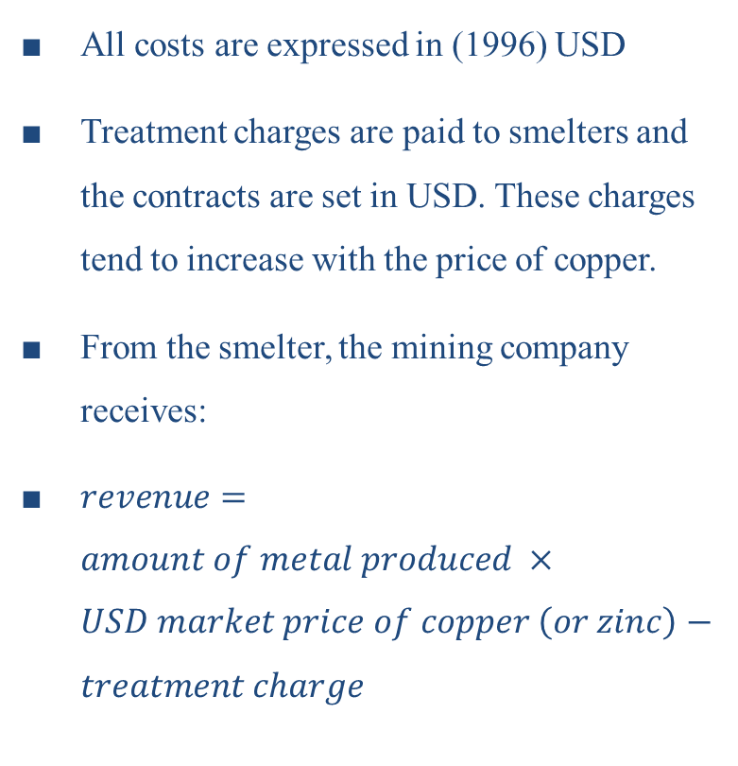
Copper Mine Characteristics: Treatment Costs
All costs are expressed in (1996) USD
Treatment charges are paid to smelters and the contracts are set in USD. These charges tend to increase with the price of copper.
From the smelter, the mining company receives:
$revenue=amount of metal produced ×USD market price of copper \left(or zinc\right)−treatment charge$

Slide 19
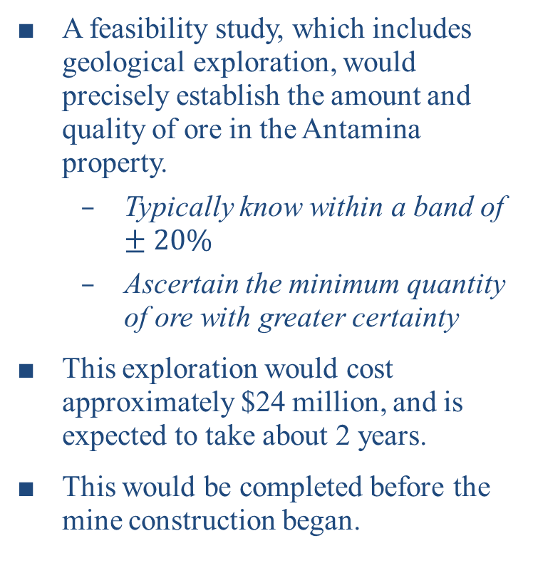
Copper Mine Characteristics: Exploration Costs
A feasibility study, which includes geological exploration, would precisely establish the amount and quality of ore in the Antamina property.
Typically know within a band of $±20\%$
Ascertain the minimum quantity of ore with greater certainty
This exploration would cost approximately $24 million, and is expected to take about 2 years.
This would be completed before the mine construction began.

Slide 20
Copper Mine Characteristics: Capital Costs
The capital expenditure required to develop the mine (excluding the feasibility study) ranges from $581 million to $622 million. It is a function of the amount of ore found.
Closure costs are incurred at the end of the mine life.

Slide 21
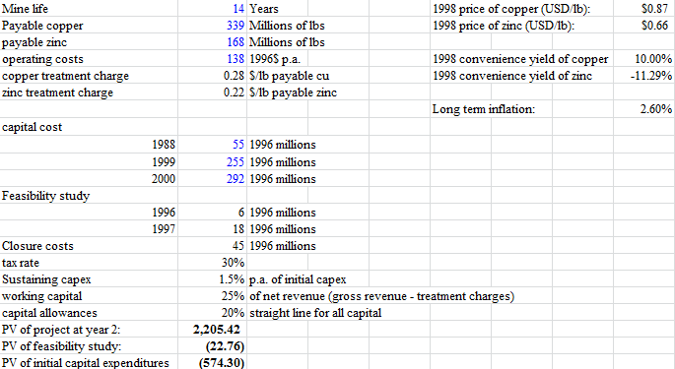
DCF I

Slide 22
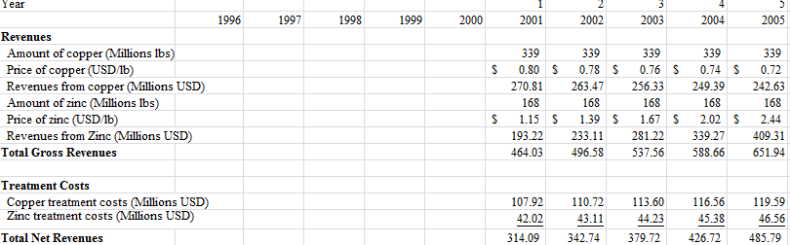
DCF II

Slide 23
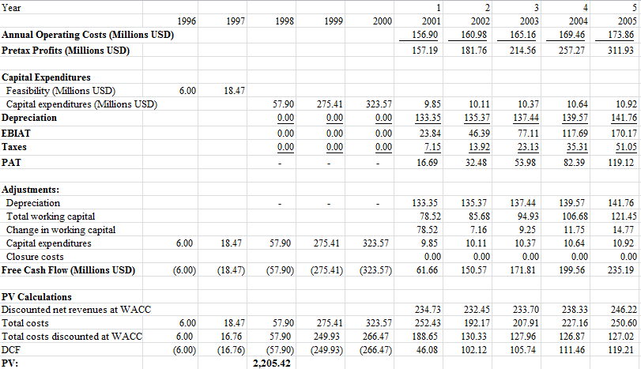
DCF III

Slide 24
Calculating the WACC
Current borrowing cost is 7.65%.
Cost of equity is calculated using the Capital Asset Pricing Model.
The WACC is used to discount the cash flows from the mining project.
DEBT |  |  | EQUITY
Nominal cost of debt: | 7.65% |  | Rf: | 7.0%
Debt: | 2,205 |  | Beta: | 0.53
MV of firm | 15,535 |  | Risk premium: | 7.5%
Tax rate: | 30% |  | Cost of equity: | 11.0%
Cost of debt: | 5.4%
 |  |  | WACC: | 10.2%

Slide 25
Simulation I
OUTCOME PROBABILITIES
Probability of Low Outcome | 0.2
Probability of Expected Outcome | 0.6
Probability of High Outcome | 0.2
TOT PV = PV HI*Prob(HI) + PV EX*Prob(EX) + PV LO*Prob(LO)
PV INVST: Present value of the initial investment
PENALTY: PV INVST < Investment Commitment

Slide 26

Simulation II

Slide 27
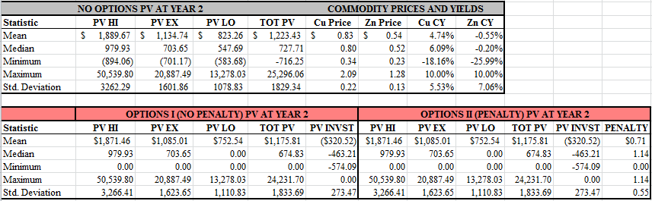
Simulation Summary (5000 Iterations)

Slide 28
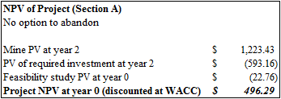
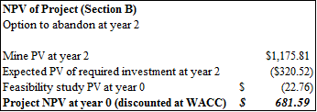
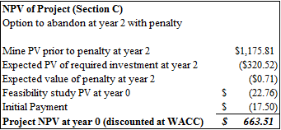
NPV Summary

Slide 29
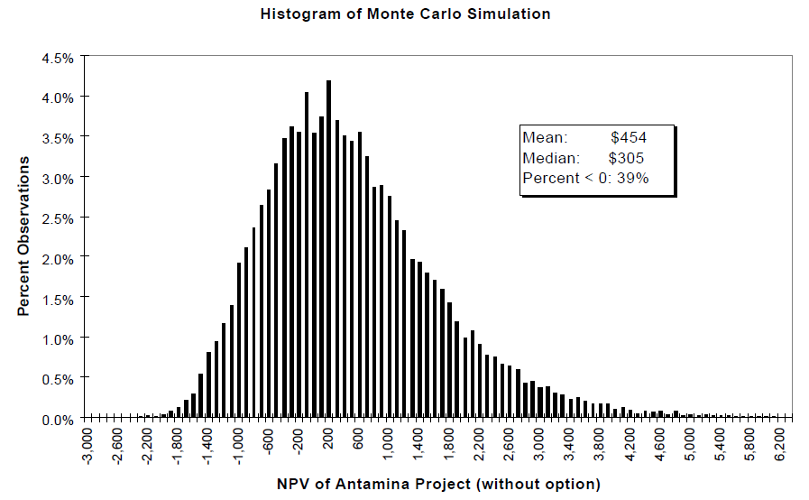
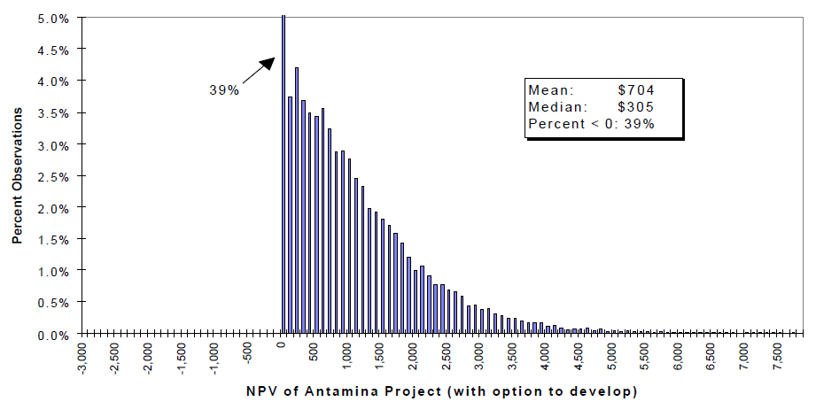
NPV (10,000 Iterations)

Slide 30
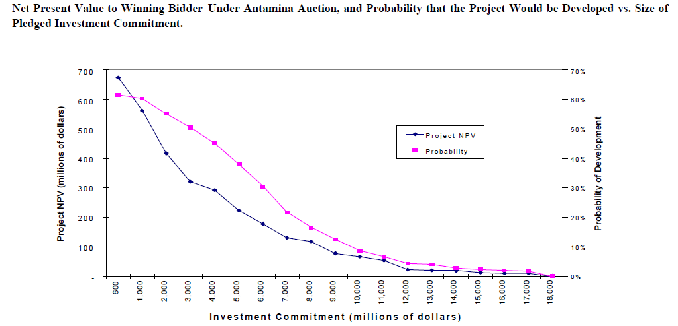
Bidding Strategy

Slide 31
Appendix

Slide 32
The Cost of Debt
Capital Markets and Exchange Rate Data for June 25, 1996
Bond Yields (U.S. Corporate industrial bonds in %)
Maturity (years) | Treasury | AAA | AA | A | BBB | BB+ | BB/BB- | B
1 | 5.76 | 5.91 | 6.00 | 6.01 | 6.27 | 6.51 | 7.28 | 8.21
5 | 6.69 | 7.06 | 7.16 | 7.27 | 7.59 | 8.02 | 9.63 | 10.67
10 | 6.90 | 7.37 | 7.17 | 7.63 | 7.96 | 8.48 | 10.46 | N/A
15 | 7.02 | 7.54 | 7.65 | 7.83 | 8.18 | 8.75 | N/A | N/A
20 | 7.20 | 7.76 | 7.87 | 8.07 | 8.43 | N/A | N/A | N/A
25 | 7.22 | 7.81 | 7.92 | 8.13 | N/A | N/A | N/A | N/A
Source: Compiled from Standard and Poor's Weekly Bond Indexes, August 1996.

Slide 33
Bidding Strategy
There is incentive to increase the pledged investment commitment rather than the initial cash payment
Mean NPV (10,000 iterations) of the scenario - Option with Penalty:
Initial Payment
 | 17.5 | 18.5
600 | 674.58 | 656.27
900 | 634.01 | 631.17
Investment Commitment
-$0.14M
-$18.31M

Slide 34
