Slide 1

Deposit opening classification problem
TEAM MEMBERS:
Stewart Patterson - A20354696
XuE yang– A20224593
Vishwesh purohit- A20399844
Sai Chandrika - A20344789

Slide 2
Data Retrieval and Cleaning
We have data for 41,188 participants in the marketing campaign, with 20 columns of data.
We clean the column headers by replacing the periods in the headers with underscores and To maintain data quality, we checked and found no missing or NULL values in specific columns. This step ensured the reliability of our analysis.
Ran Univariate and Bivariate Distributions of the data, we notice class imbalance and multicollinearity in the data, which were dealt with grouping, transformation and feature selection.
Notes:
We obtained our cryptocurrency price data from the Cryptocompare API, a highly reliable source for both historical and real-time market data.
To fetch the data, we used Python along with the Cryptocompare API and the requests library. We specified the BTC/USD pair and the necessary data points for analysis. An API key was utilized for secure and authenticated data access.
Once we retrieved the data, we converted it into JSON format and securely stored it in Google BigQuery. The use of Google's BigQuery ensured efficient storage and facilitated further analysis. Authentication was achieved through a service account, ensuring data integrity and security.

Slide 3

Univariate Distributions
For numerical variables: Except 'AGE’ (which his near normally distributed) all other variables are not normally distributed.
These variables will be grouped into two categories according to their distribution: PDAYS and EURIBOR3M
Others were normalized using 'StandardScaler'.
For categorical variable: We can see there is high unbalance between categories in certain variables, they are grouped for example:
Education: college VS. non-college
Month: special months (Mar. & Sep. & Otc. & Dec) VS. others

Slide 4
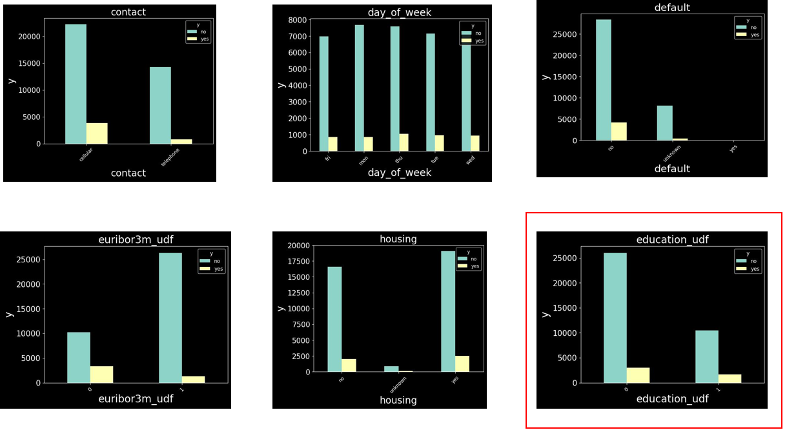
Bivariate Distribution
We check for the impact of different categories on the target variable “y”. From these we could see which categories impact users decision to subscribe, we are able to dwell deeper into building profiles of our customers.
We see that education_udf , maritial status , month can be looked into to provide insights

Slide 5
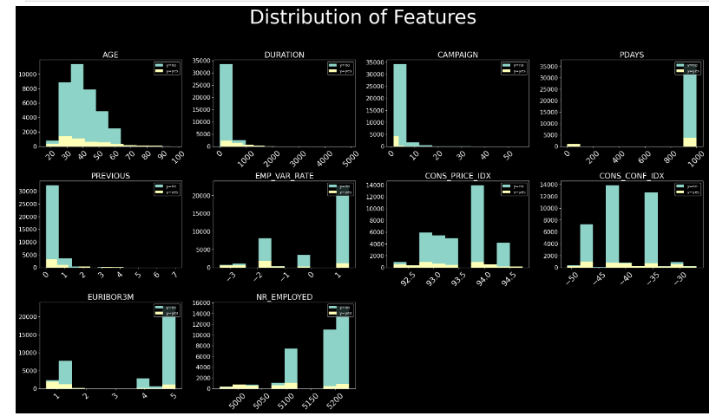
Bivariate Distribution
We see that for every one of the features, there is a class imbalance in each histogram, we see that there is more data for y = no as compared to y = yes.
Because of this we will have to look for evaluation metrics and machine learning models which could take this into consideration

Slide 6
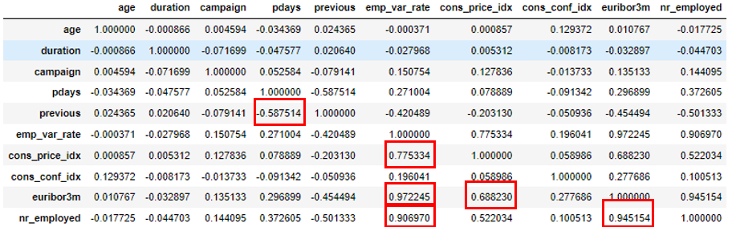
Correlation - Collinearity Problem
We see high linear correlation exist in these 6 pairs:
Emp_var_rate VS. cons_price_idx
Emp_var_rate VS.euribor3m
Emp_var_rate VS. nr_employed
euribor3m VS. cons_price_idx
euribor3m VS. nr_employed
Pdays VS. previous
We deal with these 3 variables to eliminate the collinearity problem:
Emp_var_rate: We remove this variable
Euribor3m: Change to categorical
Pdays: Change to categorical

Slide 7
Feature Engineering
Transforming categorical data:Using string_indexer, LabelIndexer and OneHotEncoderEstimator 12 columns are converted to vectors.
Standardizing the data: We use standard scalar to bring all the predictor variables to the same scale. Make sure no one predictor has a weighted impact due to the scale of measurement
Label target variable: We use Label Indexer to label the target variable.

Slide 8
K means clustering:
Once we complete preparing the data using one-hot encoding and vector assembler, we feed them to a k means clustering model, we assign them to 4 clusters after analysis.

Slide 9

Models
Model 1: Logistic Regression :We select this model since it provides a clear probability estimation for customer subscription, aiding in precise resource allocation for marketing strategies. This model is also easier to explain than many others
Model 2: Decision Tree : We select this model since it offers interpretability by illustrating decision paths, facilitating actionable insights for marketing strategies.

Slide 10
Models
Model 3: Random Forest : We try this model since it would help with reducing overfitting, with the issue of class imbalance, random forest can leverage ensemble learning for more robust predictions
Model 4 Gradient Boosted Tree: We use GBT since it builds sequential models to correct errors of preceding models, improving accuracy and capturing complex relationships we might have missed
Model 5: Factorization Machine Classifier: We use this since it handles sparse data efficiently, from our research we saw that many recommendation systems use this model due to its high accuracy in predicting complex purchasing behaviour.

Slide 11
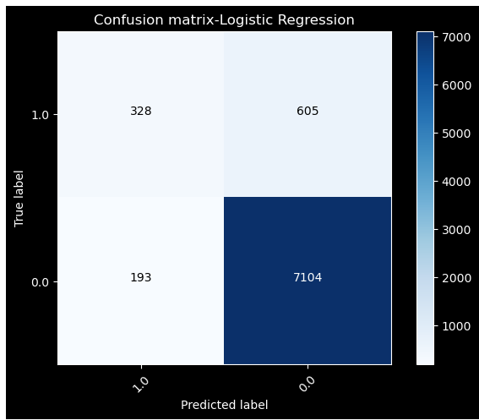
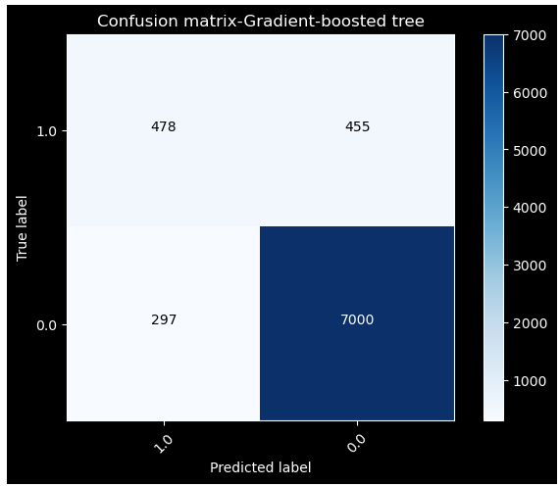


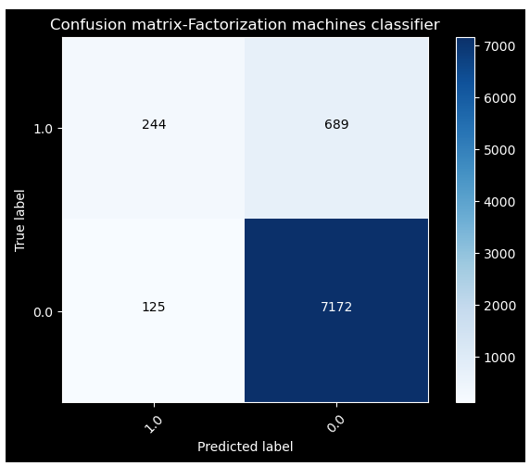
Model Comparision
We show the confusion matrix for the 5 models and we can see the true positives for 5 models, respectively

Slide 12
Model Selection
Model | Accuracy | AUC
Logistic Regression | 0.9030 | 0.9200
Decision Tree | 0.9087 | 0.6452
Random Forest | 0.8995 | 0.9166
Gradient-booted tree | 0.9086 | 0.9307
Factorization machines classifier | 0.9011 | 0.9101
√
We look at the simplest model with the highest AUC values as our model, since logistic regression gives us 92% AUC which is not much lower than GBT at 93% and is easier to explain to stakeholders we select the logistic regression as our final model as a trade-off result between model complexity and performance (AUC).

Slide 13

Champion Model Saved
The champion model was saved for future use.

Slide 14

Conclusion
Based on the EDA, we see a higher loan rate among
Highly educated: Users with higher literacy have higher subscription rates among different categories
Single users: People who have not married even once s score a higher yes rate.
Months: people tend to react better to marketing campaigns during certain months

Slide 15
Recommendations
For highly educated: Target marketing strategies that can help users gain discounts on their future investments, highly educated users also would be tech savy so partnering with tech firms to offer deals could be efficient
For single users: Create campaigns that appeal to their lifestlye, this could include deals adding value to their individual portfolio
For certain months :Plan and time marketing campaigns to coincide with March , September , October and December, this could look like seasonal offers or promotions that align with festivals

Slide 16
THANK YOU

