Slide 1
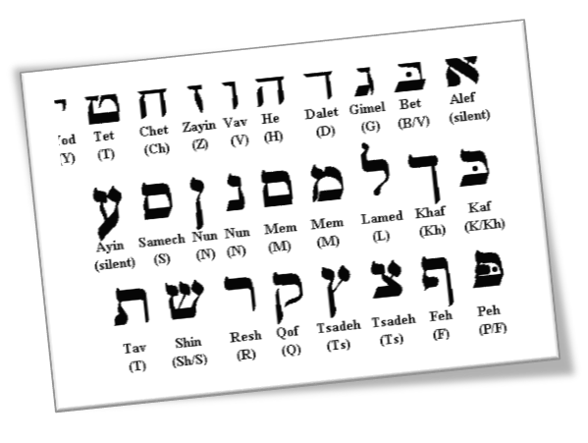
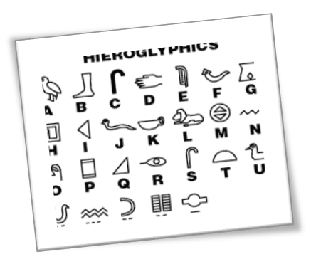
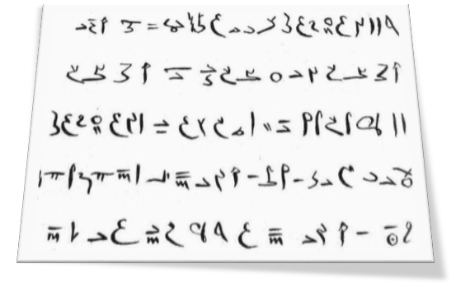
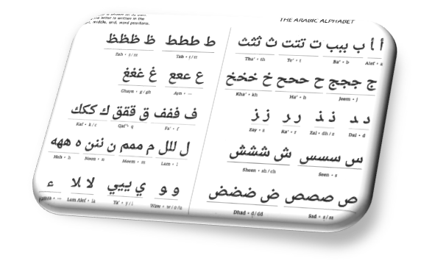
This a sample Fax Document
PPT: OnlineFaxes Fax API enable developers to send, download, list, delete, and get the status of fax on custom or existing applications. OnlineFaxes takes the spirit of 3 ancient scripts.

