Slide 1
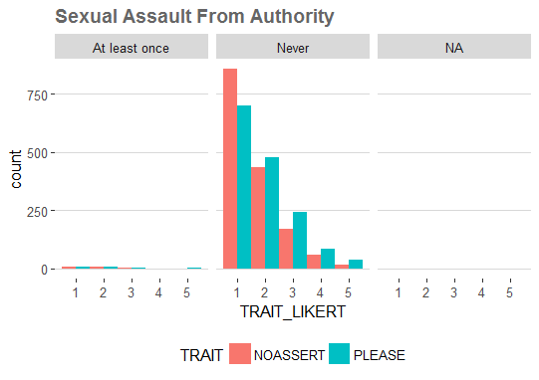
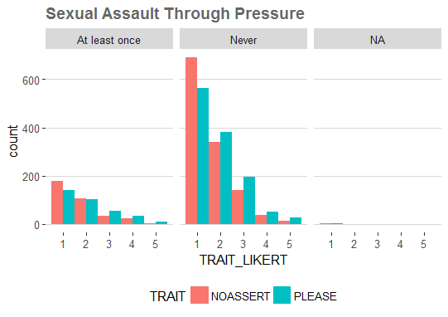
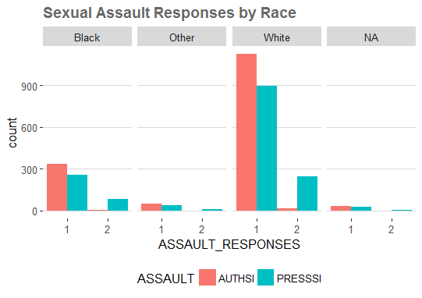
Sexual Violence Against Women in College
Snow Christensen
LEGEND
Research Question
Do specific personality and identity traits affect which women are targeted by sexual predators?
PLEASE
I try to please people and make them like me by giving in to them.
1. Not at all like me 2. A little like me
3. Somewhat like me 4. Mostly like me
5. Very much like me
AUTHSI and PRESSSI
Intercourse because of authority.
Intercourse because of pressure.
1. Never
2. At least Once
NOASSERT
I stay in the background and let other people tell me what to do.
1. Not at all like me 2. A little like me
3. Somewhat like me 4. Mostly like me
5. Very much like me
Background
My project is important because it looks at the occurrences of sexual violence towards young women in college and looks at if there is an association between certain characteristics and who is being targeted by sexual predators. Often times we hear cases of victim blaming that claim that the way a person acts or looks is what led to their attack. This is a test to see if two specific characteristics, wanting to please others (PLEASE) and lack of assertiveness (NOASSERT), are related to who is a victim of sexual violence. Additionally, I am looking to see if race plays a role in who is being targeted. Race is important to consider because often women of color are hypersexualized in the media and dehumanized. My hypotheses was that because of these common narratives there would be a strong association between the two characteristic traits and the two types of assault, and that the distributions would be different depending on the race of the respondent.
Methods
I used histograms to analyze my data because it allowed me to see the distributions of the responses for two variables side-by-side as well as facet these variables by a third to see how they interact. This was especially important for looking at the two characteristic and being able to see the frequencies of each response all in the same visualization and how the distribution of responses looked. Being able to compare distributions of multiple variables side by side allowed me to see if there was an association between the three variables I am looking at in each histogram, and if this changed depending on the facet.
Data
I’m looking at data from one section of an ICPSR longitudinal study of violence against women in college at state universities . This is a large dataset that includes many variables and respondents but for my analysis I am specifically looking at female respondents from the first cohort and their responses for the variables NOASSERT, PLEASE, AUTHSI, PRESSSI, and RACE. These variables address the respondent’s lack of assertiveness, desire to please others, whether they’ve been coerced into sexual intercourse because of authority or pressure, and what race they identify as. For the variables NOASSERT and PLEASE the respondents were given a Likert scale to pick the most appropriate answer from and for PRESSSI, AUTHSI, and RACE they were given multiple choices to choose from. All of my data is coded as categorical data.
1
Findings
My analyses led me to conclude that there is not a strong association between personality traits and who is targeted by sexual predators. There was a small positive association between the two, however, it was not strong enough to generalize to a larger population. Additionally, race had a slightly negative correlation which meant that black women were more likely to have been targeted for sexual violence that white women, however, the distributions were very similar for all of the races in this datatset. This analysis is important because it disproves the common ideology behind victim blaming that supports the notion that certain characteristics in women cause them to be victims of sexual violence. Through my analyses I can see that there is not a strong relationship between lack of assertiveness , desire to please others, and race and who is targeted by sexual predators.
1

