Slide 1
NoSQL as an Application Backend
Intro to DocumentDB-as-a-Service
Bart Loesley
Senior Software Engineer
RDA Corporation
Notes:
Welcome to NoSQL as an Application Backend.
The purpose of this talk is to give an overview of the different technologies that are out there in the NoSQL ecosystem, drawing parallels to Relational databases and an intro into using Azure DocumentDB as a back end.

Slide 2

Transform your business with RDA!
rdacorp.com | 888 441-1278 | marketing@rdacorp.com
Office 365 /
SharePoint
Implementations * Upgrades
Hybrid * Portals
Workflows * Search
Cloud Enterprise Transformation
Hybrid * Platform Services
Mobile * Security
Application Integration
Digital
Marketing
Internet Sites * CMS eCommerce * Sitecore
Data Analytics
Visualization * Warehouse
Big Data * SQL Server
Tableau

Slide 3
Agenda
Introduction
What is SQL?
What is NoSQL?
NoSQL Flavors
Intro To Azure DocumentDB
Azure DocumentDB Demo
Notes:
I’m Bart Loesley, I’ve been working as an IT administrator doing some development for 15 years now. I’ve spent a good portion of that time doing database administration and data modelling. I became interested in BigData and NoSQL technologies. I took the Mongo University classes, the Neo4j classes and I’m working on going through the Datastax Cassandra classes now.
Here’s the agenda for today’s presentation.
First I’ll touch on SQL, give a quick refresh of Relational Database Management Systems
Next I’ll give an introduction to the NoSQL ecosystem.
I’ll touch on the major types of NoSQL databases.
Next, I’ll run through how to use Microsoft Azure’s DocumentDB offering and a quick demo for how it works

Slide 4

Introduction – Bart Loesley
Born/Raised Fairfax (co)
Beautiful wife, 3 kids (twins)
Go Caps! Go Nats! Go…Steelers!
15 year IT Pro – JoAT
SQL admin, Data Designer.
Fascinated by data structures
Studied MongoDB, Neo4j, Cassandra

Slide 5
What is SQL? (RDBMS)
Key features of an RDBMS:
Databases organized into Relational Variables (Tables)
Tables are organized by typed Attributes (Columns)
Data is stored in Tuples (Rows)
Tables have Primary keys
Tables can use Primary keys from other tables to create relationships (Foreign keys)
ACID
Atomicity, Consistency, Isolation, Durability
Schemas
Notes:
So let’s rewind and refresh our memories with what SQL is before contrasting with the NoSQL offerings.
Note the features.
ACID
Atomicity: all or nothing transactions
Consistency: the database is consistent after the transaction is completed
Isolation: Each transaction takes place on it’s own and isn’t affected and doesn’t affect other transactions happening concurrently
Durability: After transaction is committed, the data is stored in non-volatile memory so that it is not lost if the power goes out.

Slide 6
What is SQL? Normal Forms
The goal of Normal Forms:
Prevent insert, update, and deletion anomalies
Minimize redesign when extending database structure
Allow for any kind of querying, anticipated or not
There are 6NFs, BCNF (Boyce-Codd Normal Form), and Domain-Key Normal Form.
3NF is the usual standard for a “normalized” database
Notes:
I’m going to touch on normalization briefly,
Normalization was originally devised as a method of preventing crud anomalies, reducing the amount of redesign when schemas change, and leaving the database open to being queried however the users end up needing to use it.

Slide 7
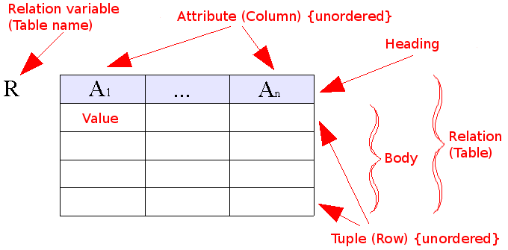
What is SQL? (RDBMS)
Id (PK) | Name | Rank
5 | Ben | 4
6 | Kate | 6
Relationship
Id (PK) | UserID (FK) | Phone Number | Type
1 | 5 | 703-555-5555 | Home
2 | 5 | 703-555-5556 | Cell
3 | 6 | 703-555-5557 | Work
Picture from: http://en.wikipedia.org/wiki/Relational_model#/media/File:Relational_model_concepts.png
Notes:
Here are a couple pictures demonstrating the data structures used by a SQL RDBMS

Slide 8
What is NoSQL?
Not only SQL
Schema Free
Embraces de-normalization (NoREL)
Greater scaling capabilities
Simplicity of design
Storing object that represent your domain
Great for unstructured or semi-structured data
Great for Big Data, Web Scale, IoT, and Cloud Applications
Notes:
Some have said that a better term would be NoREL (or not relational), some have also tossed out the term “Not Only SQL” since some of the databases use a SQL-like languages for projecting and manipulating data.
Over the past decade dozens of systems have popped up, often addressing specific data needs (MongoDB was originally started as a way to store objects, for instance), address speed concerns and percieved problems with scalability.
NoSQL databases tend to be schema free – that is they do not enforce a schema on you. This does not mean that you should unstructure your data. On the contrary, it’s as important as ever to consider how your data is designed so that you can best use it.
NoSQL embraces Denormalization, with relational databases Mr. Codd invented the concept of normal forms (there are now 8, though 3NF is usually as deep as you need to go) as a method of structuring your data to prevent update, insert, and deletion anomalies as well as to not duplicate data. With NoSQL, in order to achieve optimal performance on the various platforms some level of denormalization is required.
Most NoSQL databases were created either before SQL or because SQL had shortcomings that different people had to overcome. With RDBMS, most don’t come with methods to horizontally scale your data effectively. With SQL you could traditionally host different databases on different servers or have clusters. With NoSQL databases they’ve come up with all sorts of clever ways to scale out your data much like RAID did for harddrives.
The designs of most NoSQL stores are remarkably simple, but so effective.
You can chose the NoSQL instance that fits your data domain. You can store data that’s unstructured or just semi structured – like an xml document.
Great for BigData, “Web Scaling”, The Internet of Things, and cloud applications, because of the variety of service offerings, the speed and scalability of the offerings and the processing capabilities that come with them.

Slide 9
What is NoSQL?
Notes:
I’ve brought up the term “ecosystem” before. SQL is a thing. Most SQL DBMSes are pretty standard. They have a few different features differentiating them but for the most part you know what you’re getting with a SQL type system.
NoSQL isn’t a single thing…it’s anything that’s not SQL, it’s a bit of an obfuscating buzz word. There are dozens of different types of NoSQL databases out there, but they can be classified as 4 general types (as far as the data-structures go) (I’ll dive a little deeper into each of these as I go along):
Key-Value Store
Table Store
Document Store
Graph
Some offerings are combinations of the ones above, Cassandra is a little bit of a KVS mixed with a Table store, for instance.

Slide 10
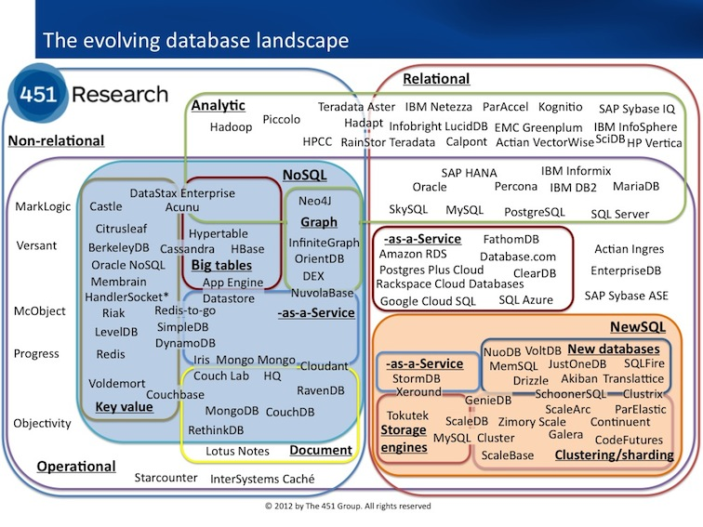
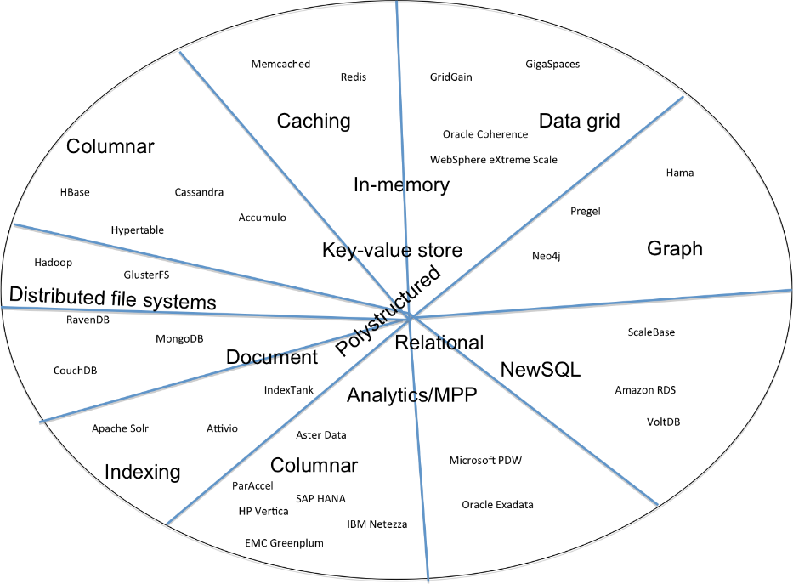
What is NoSQL?
First picture from Arnon Rotem-Gal-Oz: http://arnon.me/2012/11/nosql-landscape-diagrams/
Second picture from 451 Research http://blogs.the451group.com/information_management/2012/11/02/updated-database-landscape-graphic/
Notes:
Here’s a couple of pictures people have put together to demonstrate the different kinds of databases there are and how many different kinds of Database offerings there are.
I’m not going to get deep into the pictures, they’re mainly here to show you just how vast the offerings are in the Current database ecosystem.

Slide 11
NoSQL flavors – Key-Value Store
Stores Data in buckets as a Key and a Value
Each Key must be unique
Values don’t have a type, can contain any value at all.
“Car” : “Chevy”
“Boat”: “Catamaran”
Notes:
Let’s start looking at flavors of the NoSQL Ecosystem. Let’s begin with the simplest, the key-value store.
The key value store simply stores pairs of keys and values.

Slide 12
NoSQL flavors – Key-Value Store
Very fast write performance
Very fast read IF you select based on the key
Very slow if you need to search the values
Works great for:
Flat data
Schemas you can’t model with RDBMS
Consider ini files, Dictionary collections, Hashtable collections

Slide 13


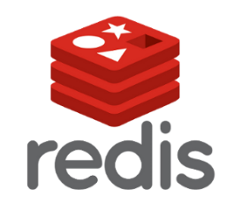


NoSQL Flavors – Key-Value Store
Notes:
Some common installations of Key value stores include: Redis, riak, Azure Table Store, Aerospike and Memcached

Slide 14
NoSQL Flavors – Column Store
Data is stored as “columns”
Columns consist of a key-value pair and (often) a timestamp
Columns are grouped in “rows” or column families
Columns are grouped generally in tables
No Joins are permitted
Notes:
Column stores are are basically single tables that hold all the information. Columns usually consist of a key-value pair and a time stamp (making it a 4-dimensional table). Columns are grouped in column families and data is stored in rows and the rows are stored in tables. Joins aren’t permitted by the DBMS as part of the language.
I’ll get into this more later, it’s part of denormalization, but you can make a choice to normalize some of your data and have join like operations be performed by the application since reading and writing are so fast within the application.

Slide 15
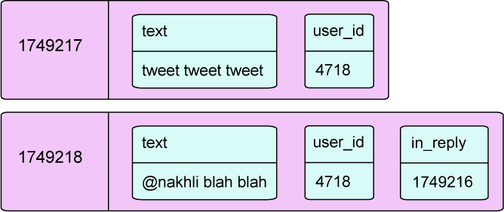
NoSQL Flavors – Wide Columnal Store
No strict schema
Blazing fast processing abilities
Benefits seen through decentralization and scalability
No joins between tables
http://www.sinbadsoft.com/blog/cassandra-data-model-cheat-sheet/
Notes:
There no strict schema, the picture shows that two different rows could have different information
Column stores boast speed, decentralization, and scalability.
Druid boasts being able to process billions of rows per second. Cassandra is incredibly scalable having no centrally managed partitioning system, allowing the data to be spread across massive clusters with no single point of failure.
Here is an example of what a column store looks like, in a sort of a twitter application. We have two rows, with row keys. As you can see they have several key value pairs, the bottom one has a relation to another row in the in_reply field. Notice the top row does not have that field.

Slide 16




NoSQL Flavors – Wide Columnal Store
Notes:
Some of the more popular column store solutions are Cassandra, Hbase, Druid. Google uses a version of this, they kind of kicked the whole column store solution off with their BigTable.

Slide 17
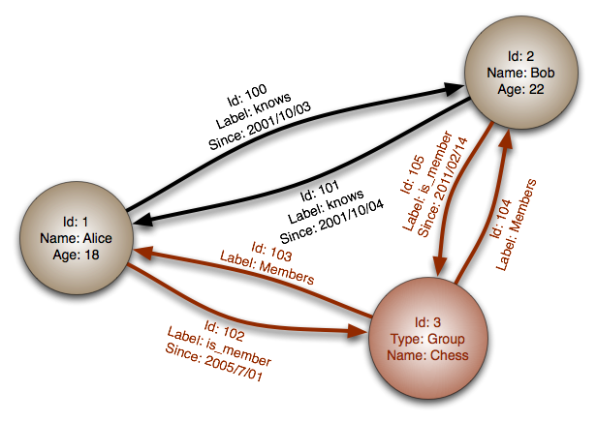
NoSQL Flavors – Graph
Think Mathematics graphs, edges and vertices.
Composed of Nodes and Relationships
Both can have key-value collections
Labels (tags) can be added
Notes:
Graph databases are similar to the mathematical concept of graphs: edges and vertices, only in graph databases they’re referred to as nodes and relationships.
In Neo4j, Nodes and Relationships can have labels, similar to tagging and they can also have key-value pairs associated with them.
For instance, in this picture, you could have group of nodes labelled “person” and a group of nodes labeled “groups” then you have relation ships between the nodes. A relationship between the group and person could be labeled “Member”. A relationship between people could be labeled “knows”. The key-value pairs act as metadata for the people and the relationship.

Slide 18
NoSQL Flavors – Graph
Ideal for when the data you have is defined by relationships
Friend tracking on Facebook
Movie database
Searching for things like:
Friend of a friend of a friend who’s not friends with me
People who worked on a movie with me who haven’t worked with my friend
Find the shortest path between me and this person.
MATCH(a:Person)-[:ACTED_IN]->()<-[:ACTED_IN]-(b:Person)
WHERE a.name <>'Keanu Reeves'
AND NOT (a)-[:ACTED_IN]->()<-[:ACTED_IN]-(b:Person {name:'Keanu Reeves'})
RETURN a.name, count(b) AS Rating
ORDER BY Rating desc
LIMIT 3
Notes:
Graph databases are ideal for data that’s defined by relationships and if you want to do path type searches (how many people am I friends with? What is the closest “friends” path between me and annie? Show me all the people who are friends of my friends but not me. Show me all the people who are friends of friends of friends but not me)
This query here is a sample of Neo4j’s Cypher query language. It matches the top 3 people who have worked with Keanu Reeves in the most movies. It’s simple and pretty expressive.

Slide 19



NoSQL Flavors – Graph

Slide 20
NoSQL Flavors – Document Store
Information stored as “Documents”
Documents are collections of Key-Value pairs
Documents are collected in “collections”
Values can be strings, dates, Boolean, integers, even documents and arrays
Notes:
Document databases store information in “Documents.” Imagine an XML document, except without any attributes, only values. Most document stores use JSON notation (easy to read, very familiar). Some, like mongoDB and Azure DocumentDB use Javascript as it’s command interface.
Like all of the other databases I’ve discussed today, documents are collections of key-value pairs. Documents are grouped in collections. The values of the documents could be just about anything, strings, dates, arrays, embedded documents, even attachments.
Document stores are ideal for storing object data, after all, they are just a collection of values and document DBs encompass most of what you’d see in an object.
They also promote a code first approach to your data design…you don’t have to necessarily bog yourself down in how the data will be stored in the database (though that is important, as I’ll touch on later), first you design your objects and domain and then you figure out the best way to normalize the data.

Slide 21
NoSQL Flavors – Document Store
Fast writing
Flexible indexing for fast value searching
Horizontal scaling
Schema
Great as an Object Store
{ _Id:0,
“name”:”john”,
“phone”:[
{“type”:”mobile”,
“number”:”703-555-7894”
},
{“type”:”home”,
“number”:”703-555-4561”
}]
}
Notes:
The perks of document stores are the same as most other NoSQL types, fast writes, flexible indexing giving you fast searches, the ability to scale out and the schemaless schema letting you do what you need to do.
Document stores also promote the use of horizontal scaling – adding more databases -- rather than vertical scaling – making your servers more powerful – by allowing you to split up the data between the databases.

Slide 22





NoSQL Flavors – Document Store
Azure DocumentDB
Notes:
Some well known document store databases are, mongoDb, Azure DocumentDB, CouchDB, RavenDB and amazon DynamoDB is another cloud based provider.

Slide 23
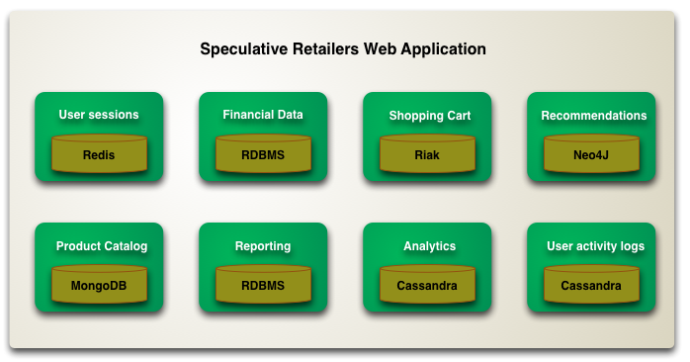
NoSQL Flavors – Polyglot Persistence
Databases are tools
Use them if you need them and where they fit best
Do what makes sense for your project
Image from: http://martinfowler.com/bliki/PolyglotPersistence.html
Notes:
Polyglot performance came from the concept that you don’t have to tie your application down to a single programming language. If there’s an aspect of a language that would work great for one module of your application, use it there.
The same can be said for databases. Each of these databases is a tool, each has strengths, and they all have their shortcomings. You don’t have to use any particular DB to work your entire system.
You could use Cassandra for your audit logs, DocumentDB for storing a chat engine. You could use a document store to handle user registrations and then sync the user information back to a SQL server database. I’m sure some of you do things like this with SQL server, moving things from your OLTP to an OLAP database, transforming the data along the way to a format that’s most useable for that purpose.

Slide 24
NoSQL Recap
Not Only SQL, or Non Relational
Vast Ecosystem
Databases are tools, use them when you need them

Slide 25



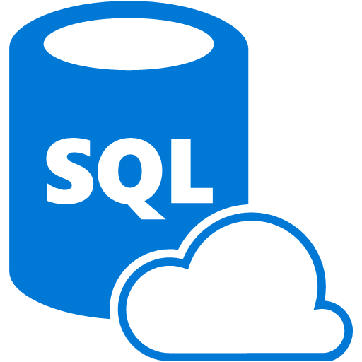
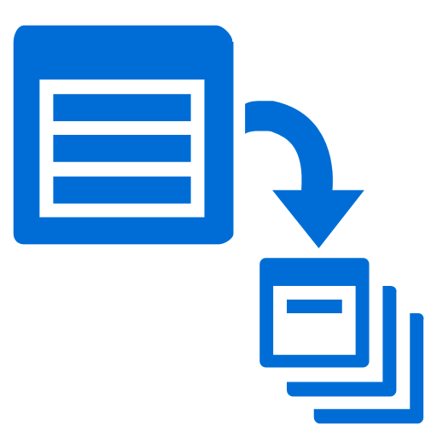

What is Azure DocumentDB
Azure’s NoSQL Database as a Service
Blazingly fast, low latency SSD storage
RESTful HTTP API
SQL like syntax to query documents
Server side programmability
(Stored Procedures, Triggers, UDFs)
Rich consistency and indexing options
ACID transactions within collections
Rich permissions level
Notes:
So let’s get focused in on Azure DocumentDB. What is DocumentDB?
Azure’s documentDB is Azures NoSQL document store database AS A SERVICE.
Some features: It has a RESTful HTTP API for access over the internet
Server side programmability in the form of Stored Procedures, Triggers, and User Defined Functions, using JavaScript
You CAN have ACID guaranteed transactions within collections.
It’s very fast – stored on SSD.
You can use familiar SQL statements to access data (even “joins”!...to access sub documents…)
As mentioned, you CAN have ACID guarantees, but you don’t have to, you can break consistency for better write performance.
And, very important, you can set up special user permissions as needed.

Slide 26


Azure Data Services
SQL Server in a VM
SQL Database
DocumentDB
Tables
Blobs
fully featured RDBMS
transactional processing
rich query
managed as a service
elastic scale
schema-free data model
internet accessible http/rest
arbitrary data formats
Notes:
This is a comparison of the Azure Data services offerings going from a SQL server you install in a VM, the SQL database as a service, DocumentDB, Azure table store, and Azure blob store.
As you can see, DocumentDB is pretty fully featured by this listing, I’d even argue that it can store arbitrary data formats to an extent.

Slide 27
How It Works
Database Account
Database 1
Database 2
Users
Permissions
Collection 1
Users
Permissions
Collection 1
Documents
Documents
Stored Procedures
Triggers
UDFs
Stored Procedures
Triggers
UDFs
Collection 2
Collection 2
Documents
Documents
Stored Procedures
Triggers
UDFs
Stored Procedures
Triggers
UDFs
Notes:
Documents are stored in collections.
A collection provides the scope for document storage, transactions, and query execution, your stored procedures, triggers, and UDFs are stored by collection.
Collections are just that, a collection of documents, the documents stored there have no necessary structure or schema and do not need to be grouped for any reason…you can separate out different types of documents with a type field if you need to.
Collections are grouped by Databases.
Databases hold several collections and managed user accounts and permissions for the collections and documents it contains.
Each database account can have several databases inside it.

Slide 28
JSON Documents
{
"id": "101-102-665544",
"subtotal": 38.63,
"shippingHandling": 0.00,
"tax": 2.80,
"total": 41.43,
"currency": "USD",
"date": "2014-02-08T10:01:36.827",
"items": [
{
"productId": "B0024Y",
"productName": "Green Toys Tea Set",
"quantity": 1,
"price": 19.00
},
{
"productId": "B0014C",
"productName": "Thomas & Friends Make-A-Match Game",
"quantity": 1,
"price": 9.99
}
],
"_etag": "00001d02-0000-0000-0000-5521de7f0000",
"_rid": "sC4fAMp1OQAiAAAAAAAAAA==",
"_self": "dbs/sC4fAA==/colls/sC4fAMp1OQA=/docs/sC4fAMp1OQAiAAAAAAAAAA==/",
"_ts": "1428283007",
"_attachments": "attachments/"
}
Notes:
Here’s a typical JSON document you might find in DocumentDB
The highlighted area are extra metadata added by the system.
https://msdn.microsoft.com/en-us/library/azure/dn782193.aspx
The Etag is an HTTP entity tag. Every DocumentDB resource has an ETag, and DocumentDB clients include their latest read version in write requests. If the ETag is current, the change is committed. If the value has been changed externally, the server rejects the write with a "HTTP 412 Precondition failure" response code. Clients must read the latest version of the resource and retry the request.
The resource ID (_rid) is a unique identifier that is also hierarchical per the resource stack on the resource model. It is used internally for placement and navigation of the user resource.
_self is the unique addressable URI for the resource.
_ts is the timestamp
_attachments are the addressable path to the attachments resource. (attachments are stored separately, but have their own set of properties)
_permissions (not shown) is a system added property denoting the addressable path of the permissions resource.
This data does count against the message limit.

Slide 29
Demo: Setting up DocumentDB
In this demo we will:
Create a new DocumentDB Account
Create a new Database in Account
Create a collection in database
Use Document Explorer to create, query, and update documents

Slide 30
Azure DocumentDB Modelling data
Schema-less does not mean “don’t structure your data”
Plan out your data model with standard tools
Methods of handling related data:
Embedding
Referencing methods (normalization)
Best Practices found here: https://azure.microsoft.com/en-us/documentation/articles/documentdb-modeling-data/
Notes:
The fact that the schema isn’t enforced by the database engine doesn’t mean that you shouldn’t have a schema, it just means that you need to manage the schema programmatically. In fact, it’s even more important that you concern yourself with certain aspects of your data storage, as I’ll go over in the next slide.
There are several methods of handling related data, through embedding documents and by key referencing, or moderately normalizing the data.
There are several best practices to keep in mind when looking into your data storage. Since you only have a relatively small amount of space for each document, it’s recommended that you only embed documents if they are integral to the data and if the related data has a “one to few” relationship. You don’t want it to grow unbounded. For example, if you have a blog post with comments, you don’t want to embed the comments with the post since comments can grow unbounded (unless it’s my blog).
There are a number of ways to handle this, one is to give each comment a separate document with a foreign key to the post. You can’t do joins naturally in the engine, but your application can make two calls to the database, one to get the post and one to get the comments. The application servers are fast and the database is fast so the two calls will usually be quicker than doing a join on the SQL database.

Slide 31
NoSQL Document Store
RDBMS
{
"id": "101-102-665544",
"subtotal": 38.63,
"shippingHandling": 0.00,
"tax": 2.80,
"total": 41.43,
"currency": "USD",
"date": "2014-02-08T10:01:36.827",
"items": [
{
"productId": "B0024Y",
"productName": "Green Toys Tea Set",
"quantity": 1,
"price": 19.00
},
{
"productId": "B0014C",
"productName": "Thomas & Friends Make-A-Match Game",
"quantity": 1,
"price": 9.99
},
{
"productId": "B0296S",
"productName": "2 Pair of Wooden Rhythm Sticks",
"quantity": 2,
"price": 4.82
}
]
}
Notes:
Here we have a typical ER diagram for a Relational Database Management system. We have products that are added to an order via a collection of order details.
And on the right is a sample of how a document store could handle this problem. We’ve put the order and order details tables together while still maintaining a relationship between the product and the order-details. However, we’ve denormalized the productName.
We pull that out there because when you look at your application, anytime that you look at the order details you’ll also be pulling the product name.
One of the benefits of Normalization was you didn’t have to plan as hard when you were creating your data structures. What I mean by this is, the product name can stay in the product table because anytime you need the product name, it’s a simple inner join away and everything is returned to you in a single query.
With a document DB (and most NoSQL database) normalization costs are higher because every time you need to do a join you do it in multiple calls to the database from the application. A lot of the time this isn’t a big deal, but with “web scale” we could be talking tens of thousands of calls. You’ll notice we’re at risk now for update anomalies. It’s possible to update all of the cart items if the name changes, but it’s a more intense process than with relational databases, so that’s a good reason to be careful of only embedding information that doesn’t get updated very often.

Slide 32
Performance and Capacity
Throughput is measured in Request Units
Normalized measure of resources required to complete request
Each collection has reserved RUs
Accurate and predictable performance
RU for each request is returned in x-ms-request-charge header
PERFORMANCE LEVEL | SSD STORAGE | REQUEST UNITS | SCALE OUT LIMITS | SLA | PRICE
S1 | 10 GB | 250 / second | Up to 100 – Call Azure support for more | 99.95% | $0.034/hr (~$25/mo)
S2 | 10 GB | 1000 / second | Up to 100 – Call Azure support for more | 99.95% | $0.067/hr (~$50/mo)
S3 | 10 GB | 2500 / second | Up to 100 – Call Azure support for more | 99.95% | $0.134/hr (~$100/mo)
Notes:
You can create any number of collections to meet the scale requirements of your applications.
Each capacity unit includes a quota of collections, if you reach the collection quota for your account you can purchase additional capacity units.
Each collection supports storage for up to 10GB of document data, including index storage.
Each CU comes with 3 elastic collections, 10GB of SSD backed provisioned document storage and 2000 request units (RU) worth of provisioned throughput
RUs is the processing cost associated with database operations will vary based on the CPU, IO and memory required to complete the operation
Think of a request unit (RU) as a single measure for the resources required to perform various database operations and service an application request
Request unit consumption is evaluated as a rate per second.
Applications that exceed the provisioned request unit rate for their account will be throttled until the rate drops below the reserved level for each collection
If your application requires a higher level of throughput, you can purchase additional capacity units.
A request unit is a normalized measure of request processing cost.
A single request unit represents the processing capacity required to read a single 1KB JSON document consisting of 10 unique property values.
The request unit charge assumes a consistency level set to the default “Session” and all of documents automatically indexed.
A request to insert, replace or delete the same document will consume more processing from the service and thereby more request units.
Each request response from the service includes a custom header (x-ms-request-charge) that measures the request units consumed for the request. This header is also accessible through the SDKs.
In the .Net SDK, RequestCharge is a property of the ResourceResponse object.
There are several factors that impact the request units consumed for an operation against a DocumentDB Database Account. These factors include:
Document size – as document sizes increase the units consumed to read or write the data will also increase.
Property count – assuming default indexing of all properties, the units consumed to write a document will increase as the property count increases
Data consistency – when using data consistency levels of Strong or Bounded Staleness, additional units will be consumed to read documents
Indexed properties – an index policy on each collection determines which properties are indexed by default. You can reduce your request unit consumption by limiting the number of indexed properties
Document indexing – by default each document is automatically indexed, you will consume fewer request units if you choose not to index some of your documents
Queries, stored procedures and triggers will consume request units based on the complexity of the operations being performed.
As you develop your application, inspect the request charge header to better understand how each operation is consuming request unit capacity.
Provisioned throughput for your database account is allocated uniformly across all collections up to the maximum throughput level (Request Units) for a single collection. For example, if you purchase a single capacity unit and create a single collection, all of the provisioned throughput for the CU will be available to the collection. If an additional collection is created the provisioned throughput will be allocated evenly with each collection receiving half of all provisioned throughput.

Slide 33
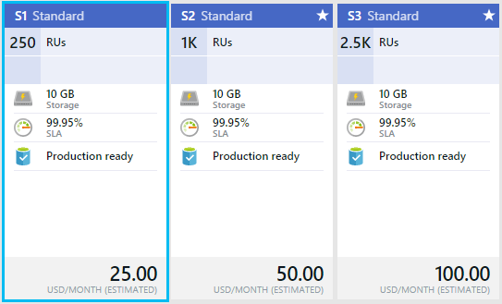
Performance and Capacity
Notes:
You can create any number of collections to meet the scale requirements of your applications.
Each capacity unit includes a quota of collections, if you reach the collection quota for your account you can purchase additional capacity units.
Each collection supports storage for up to 10GB of document data, including index storage.
Each CU comes with 3 elastic collections, 10GB of SSD backed provisioned document storage and 2000 request units (RU) worth of provisioned throughput
RUs is the processing cost associated with database operations will vary based on the CPU, IO and memory required to complete the operation
Think of a request unit (RU) as a single measure for the resources required to perform various database operations and service an application request
Request unit consumption is evaluated as a rate per second.
Applications that exceed the provisioned request unit rate for their account will be throttled until the rate drops below the reserved level for each collection
If your application requires a higher level of throughput, you can purchase additional capacity units.
A request unit is a normalized measure of request processing cost.
A single request unit represents the processing capacity required to read a single 1KB JSON document consisting of 10 unique property values.
The request unit charge assumes a consistency level set to the default “Session” and all of documents automatically indexed.
A request to insert, replace or delete the same document will consume more processing from the service and thereby more request units.
Each request response from the service includes a custom header (x-ms-request-charge) that measures the request units consumed for the request. This header is also accessible through the SDKs.
In the .Net SDK, RequestCharge is a property of the ResourceResponse object.
There are several factors that impact the request units consumed for an operation against a DocumentDB Database Account. These factors include:
Document size – as document sizes increase the units consumed to read or write the data will also increase.
Property count – assuming default indexing of all properties, the units consumed to write a document will increase as the property count increases
Data consistency – when using data consistency levels of Strong or Bounded Staleness, additional units will be consumed to read documents
Indexed properties – an index policy on each collection determines which properties are indexed by default. You can reduce your request unit consumption by limiting the number of indexed properties
Document indexing – by default each document is automatically indexed, you will consume fewer request units if you choose not to index some of your documents
Queries, stored procedures and triggers will consume request units based on the complexity of the operations being performed.
As you develop your application, inspect the request charge header to better understand how each operation is consuming request unit capacity.
Provisioned throughput for your database account is allocated uniformly across all collections up to the maximum throughput level (Request Units) for a single collection. For example, if you purchase a single capacity unit and create a single collection, all of the provisioned throughput for the CU will be available to the collection. If an additional collection is created the provisioned throughput will be allocated evenly with each collection receiving half of all provisioned throughput.

Slide 34
Consistency Options
STRONG | BOUNDED STALENESS | SESSION (Default) | Eventual
Write replication is synchronous | Write replication is asynchronous | Write replication is asynchronous | Write replication is asynchronous
Read is confirmed by majority of read quorum | Read is confirmed by majority of read quorum | Up to 100 – Call Azure support for more | Read from secondary is not confirmed by majority of read quorum
Guarantee of data consistency | High probability that read data is most recent | Guarantees ability to read own writes | No guarantee that read data is most recent
Highest read latency | Highest read latency | Low read latency | Lowest read latency
Highest write latency | Lowest write latency | Lowest write latency | Lowest write latency
Notes:
With documentDB you’re provided with 4 different options for consistency, here’s a comparison chart for each of them. With strong being the slowest, but most consistent and eventual being the fastest, but not guaranteed to be consistent.

Slide 35
Azure DocumentDB Limits*
512KB limit to document size
50 Capacity unit
3 Collections per capacity unit
Complete list here: https://azure.microsoft.com/en-us/documentation/articles/documentdb-limits/
Notes:
A note on some of the current limits. *DocumentDB is a work in progress, as is all of Azure, these will be changing frequently, the 512kb limit was originally 64kb, but was bumped up twice due to demand. (side note, MongoDB supports 16MB documents, AWS Dynamo supports 400kb as of right now)
Documents are limited to 512kb (including sub documents, HOWEVER BLOB attachments are stored outside of the document, they have a limit of 512kb also. The total attachment limit is 2GB per account, right now, during preview.
You can have up to 50 capacity units per Database
3 Collections per CU
3.3 GB per collection

Slide 36
Azure DocumentDB Partitioning
How DocumentDB horizontally scales
Collections are partitions
3 strategies:
Range
Lookup
Hash
Notes:
In order to see scalable performance gains, You can scale your data through what is known as Partitioning or “Sharding”. As mentioned earlier, this is done through putting your data in different collections.
With DocumentDB, Document routing occurs at the application level, so you have to plan out in your application where the data will be going.
To route your data, you need to choose which field will be your partition key. It could be a date, it could be a name, it could be an ID. You’ll ideally want to pick something that will be fairly evenly distributed.
You then create a routing system in your data access layer that handles figuring out which collection you’ll be inserting the data or getting the data from. 3 primary strategies for partitioning your data are: Range, Lookup, and Hash.
Range uses a field like Date and will store certain date ranges in different collections. This is good for slowly growing out your application, but could lead to unbalanced performance if you don’t access different date ranges regularly.
Lookup does data access by something natural, like organizational name, or geographic location, or doctor’s name to organize the data.
Hash uses a calculation on a key field that should generate balanced results across all of your collections.
You could also use combinations of these 3 strategies to figure out how to partition your data. This is one more example of how you will need to plan – and how planning is necessary for scaling your applications. Whatever process you chose should optimize the most common operations. For example, if people are looking for a range of dates and you use the ranged strategy, you wouldn’t want people to do queries that go between multiple collections, if possible.

Slide 37
Indexing
Schema free, really!
By default every document is indexed
Lock free, write optimized indexing
Collections and documents can be marked to not index
Excluding properties or documents also improves the write throughput and storage cost
Hash and Range indexing available
Consistent and Lazy indexing available
Notes:
The 10GB of document storage provisioned per CU includes the documents plus storage for the index
By default, a DocumentDB collection is configured to automatically index all of the documents without explicitly requiring any secondary indices or schema.
Based production usage in consumer scale first party applications using DocumentDB, the typical index overhead is between 2-20%.
The indexing technology used by DocumentDB ensures that regardless of the values of the properties, the index overhead does not exceed more than 80% of the size of the documents with default settings.
You can chose to remove certain documents from being indexed at the time of inserting or replacing a document.
You can configure a DocumentDB collection to exclude all documents within the collection from being indexed.
You can also configure a DocumentDB collection to selectively index only a certain properties or paths with wildcards of your JSON documents
Excluding properties or documents also improves the write throughput – which means you will consume fewer request units.
Automatic indexing of documents is enabled by write optimized, lock free, and log structured index maintenance techniques
Note: The indexing policy of a collection must be specified at the time of creation. Modifying the indexing policy after collection creation is not allowed, but will be supported in a future release of DocumentDB.
Note: By default, DocumentDB indexes all paths within documents consistently with a hash index. The internal Timestamp (_ts) path is stored with a range index.
When indexing is turned off, documents can be accessed only through their self-links or by queries using ID.
There are two supported kinds of index types: Hash and Range. Choosing an index type of Hash enables efficient equality queries. For most use cases, hash indexes do not need a higher precision than the default value of 3 bytes.
Choosing an index type of Range enables range queries (using >, <, >=, <=, !=). For paths that have large ranges of values, it is recommended to use a higher precision like 6 bytes. A common use case that requires a higher precision range index is timestamps stored as epoch time.

Slide 38
Programmability
RESTfull API
SDKs
.NET
Java
Python
Node.js
JavaScript
SQL Syntax
LINQ support in .NET SDK
Notes:
For programming against DocumentDB we have several different SDKs as well as a RESTfull API, so you don’t even really need a back-end.
You can easily query data in a mostly SQL language and it does have LINQ support in .NET.

Slide 39
Demo: Working with DocumentDB
In this demo we will:
Work with the SDK
Query DocumentDB

Slide 40
Stored Procedures
Defining The Stored Procedure
function helloWorld() {
var context = getContext();
var response = context.getResponse();
response.setBody("Hello, World");
}
Creating The Stored Procedure (.NET SDK)
var sproc = new StoredProcedure
{
Id = "helloWorld",
Body = File.ReadAllText(HostingEnvironment.MapPath("~/js/HelloWorld.js"))
};
sproc = await client.CreateStoredProcedureAsync(collection.SelfLink, sproc);
Executing The Stored Procedure (.NET SDK)
var response = await client.ExecuteStoredProcedureAsync<string>(sproc.SelfLink);
Notes:
JavaScript execution within DocumentDB is modeled after the concepts supported by relational database systems, with JavaScript as a modern replacement for T-SQL. All JavaScript logic is executed within an ambient ACID transaction with snapshot isolation. During the course of its execution, if the JavaScript throws an exception, then the entire transaction is aborted.
Domain is limited to the collection
JavaScript can be registered for execution as a trigger, stored procedure or user defined function
Triggers and stored procedures can create, read, update, and delete documents whereas user defined functions execute as part of the query execution logic without write access to the collection

Slide 41
Stored Procedures
Defining The Stored Procedure
var createDocumentStoredProc = {
id: "createMyDocument",
body: function createMyDocument(documentToCreate) {
var context = getContext();
var collection = context.getCollection();
var accepted = collection.createDocument(collection.getSelfLink(),
documentToCreate,
function (err, documentCreated) {
if (err) throw new Error('Error' + err.message);
context.getResponse().setBody(documentCreated.id);
});
if (!accepted) return;
}
}
Notes:
You create stored procedures with javascript, this is a sample stored procedure to create a document.

Slide 42
Triggers
Pre-Trigger
function validateClass() {
var collection = getContext().getCollection();
var collectionLink = collection.getSelfLink();
var doc = getContext().getRequest().getBody();
// Validate/canonicalize the data.
doc.weekday = canonicalizeWeekDay(doc.weekday);
// Insert auto-created field 'createdTime'.
doc.createdTime = new Date();
// Update the request -- this is what is going to be inserted.
getContext().getRequest().setBody(doc);
function canonicalizeWeekDay(day) {
// Simple input validation.
if (!day || !day.length || day.length < 3) throw new Error("Bad input: " + day);
// Try to see if we can canonicalize the day.
var days = ["Monday", "Tuesday", "Wednesday", "Friday", "Saturday", "Sunday"];
var fullDay;
days.forEach(function (x) {
if (day.substring(0, 3).toLowerCase() == x.substring(0, 3).toLowerCase()) fullDay = x;
});
if (fullDay) return fullDay;
// Couldn't get the weekday from input. Throw.
throw new Error("Bad weekday: " + day);
}
}
Trigger trigger = new Trigger
{
Id = "CanonicalizeSchedule",
Body = File.ReadAllText(HostingEnvironment.MapPath("~/js/CanonicalizeSchedule.js")),
TriggerOperation = TriggerOperation.Create,
TriggerType = TriggerType.Pre
};
await client.CreateTriggerAsync(collection.SelfLink, trigger);
var requestOptions = new RequestOptions { PreTriggerInclude = new List<string> { triggerId } };
await client.CreateDocumentAsync(colSelfLink, new
{
type = "Schedule",
name = "Music",
weekday = "mon",
startTime = DateTime.Parse("18:00", CultureInfo.InvariantCulture),
endTime = DateTime.Parse("19:00", CultureInfo.InvariantCulture)
}, requestOptions);
Notes:
Triggers are similar to stored procedures. they are written in JavaScript, but function like events, when a condition is met.
This trigger takes a document that’s about to be inserted and validates it. If it isn’t valid it will throw an error, otherwise it corrects the format for insert.

Slide 43
User Defined Functions (UDFs)
Defining The User Defined Function
function tax(doc) {
// Use simple formula to compute the tax: use income multiplied by factor based on country of headquarters.
var factor =
doc.headquarters == "USA" ? 0.35 :
doc.headquarters == "Germany" ? 0.3 :
doc.headquarters == "Russia" ? 0.2 :
0;
// Check for bad data.
if (factor == 0) {
throw new Error("Unsupported country: " + doc.headquarters);
}
// Use simple formula and return.
return doc.income * factor;
}
Creating The User Defined Function (.NET SDK)
var udf = new UserDefinedFunction
{
Id = "tax",
Body = File.ReadAllText(HostingEnvironment.MapPath("~/js/Tax.js")),
};
await client.CreateUserDefinedFunctionAsync(colSelfLink, udf);
Executing The User Defined Function (.NET SDK)
var results = client.CreateDocumentQuery<dynamic>(colSelfLink,
"SELECT r.name AS company, tax(r) AS tax FROM root r WHERE r.type='Company'");
Notes:
Triggers and stored procedures can create, read, update, and delete documents whereas user defined functions execute as part of the query execution logic without write access to the collection
Using UDF alone in where clause causes a full collection scan

Slide 44
Recap
Azure’s NoSQL Document Store Offering
Fully Managed
Schema free
Collections store documents and are boundaries
SQL like language for searching
Server side programmability
Flexible consistency
Scalable through partitioning

Slide 45


References
Azure DocumentDB http://documentdb.com
Channel 9 https://channel9.msdn.com/
Learning Map http://azure.microsoft.com/en-us/documentation/articles/documentdb-learning-map/
Code Samples https://code.msdn.microsoft.com/Azure-DocumentDB-NET-Code-6b3da8af#content
Query Playground http://www.documentdb.com/sql/demo
Post feedback http://feedback.azure.com/forums/263030-documentdb
Data Migration Tool http://azure.microsoft.com/en-us/documentation/articles/documentdb-import-data/
loesley@rdacorp.com
linkedin.com/in/bartonloesley

