Slide 1





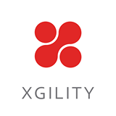




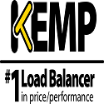



Thanks to our Sponsors!!!

Slide 2

Welcome
Surfacing External Data in SharePoint & Office 365
Bart Loesley
Loesley@rdacorp.com

Slide 3
Housekeeping…
Download EventBoard Mobile and remember to fill out session evaluations…
http://app.spsdc.org
Phasers set to stun, mobile devices set to silent…
You must be present to win at the wrap-up…

Slide 4

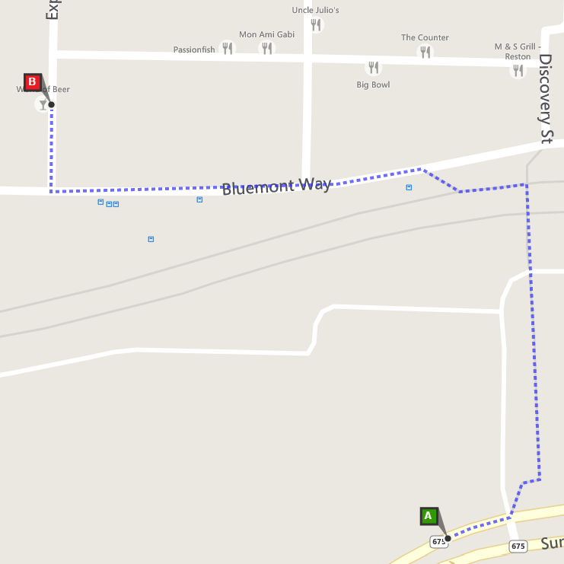

Join us at #SharePint sponsored by Kemp Technologies at World of Beer of Reston in the Towncenter just across the bridge
Why? To network with fellow SharePoint professionals
What? SharePint!!!
When? 6:15 PM
Where?
World of Beer Reston
1888 Explorer Street
Reston, VA 20190
Thanks to
Kemp Technologies

Slide 5

Transform your business with RDA!
rdacorp.com | 888 441-1278 | marketing@rdacorp.com
Office 365 /
SharePoint
Implementations * Upgrades
Hybrid * Portals
Workflows * Search
Cloud Enterprise Transformation
Hybrid * Platform Services
Mobile * Security
Application Integration
Digital
Marketing
Internet Sites * CMS eCommerce * Sitecore
Data Analytics
Visualization * Warehouse
Big Data * SQL Server
Tableau

Slide 6

My Background
Born in Fairfax VA, Still in Fairfax VA
Went to James Madison University
Wife is from Pittsburgh
Fan of Nats, Caps, Wiz, Steelers…and the local Football Team
3 crazy kids
5 year old
2x 3 year olds (twins)

Slide 7
My Background
15 years IT experience
Small Business Admin
DoD Admin and Dev
Private Business

Slide 8
Agenda
What is Business Connectivity Service
Why use Business Connectivity Service
Using Business Connectivity Service for external data
- .Net assemblies
- WCF Service
- SQL Server Connection
- Other methods
Overview & Demo of various external data sources
SQL Server
Azure Tables,
DocumentDB

Slide 9
What is Business Connectivity Services?
SharePoint’s centralized integration service
Allows you to pull in external data from a variety of data sources
Managed authentication
Search indexing

Slide 10
Business Connectivity Services Solutions
On-Premises Solution
The SharePoint farm and the external system are both behind a company’s firewall
Cloud Only Solution
SharePoint Online publishing data from another Azure source https://technet.microsoft.com/en-us/library/jj943762.aspx
Hybrid Solution
A
Publish on-premise data in a SharePoint Online site
https://technet.microsoft.com/en-us/library/dn197239.aspx

Slide 11
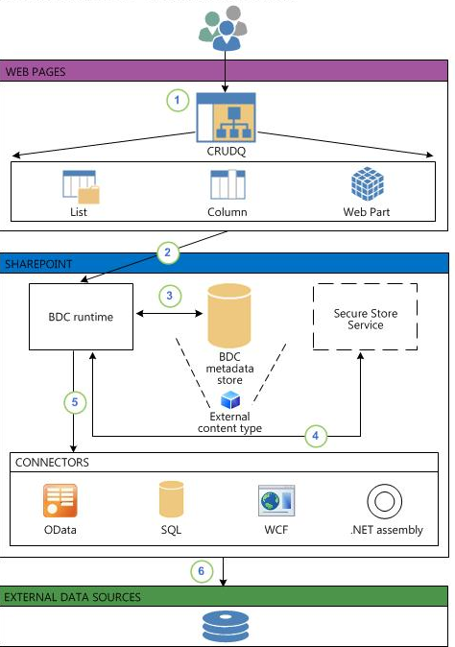
BCS – How it works on-prem
Notes:
1. A user opens a SharePoint web page that contains external data to interact with it. At a minimum, if the user has permissions to access the data, the user will be able to read it. In addition, depending on how the supported operations are defined in the external content type and the level of permissions that the user has to the external content type, the user might be able to create new records, update existing records, and delete existing records. If the user is in an Enterprise Search website, and the user has the necessary permissions, the user can run queries against the records. This data can be in an external list, external data columns, external Web Parts, or apps for SharePoint.
2. A request for the external data is created and passed to the BDC Server-Side Runtime service. The BDC Server-Side Runtime does a variety of jobs. It is the working component of Business Connectivity Services and handles most of the actual activities involved with taking requests for external data, making connections and interacting with the external data, and returning data to the user.
3. The BDC Server-Side Runtime accesses the BDC Metadata Store and retrieves the external content type. The BDC Metadata Store is a database stored in SQL Server. It only contains information about the connections. No external data is stored in the BDC Metadata Store or anywhere else in SharePoint 2013.
4. The BDC Server-Side Runtime reads the external content type to see how to connect to the external data source. The BDC Server-Side Runtime retrieves credentials from the Secure Store if it is necessary. For more information about the Secure Store, see Plan the Secure Store Service (SharePoint Server 2010) in the SharePoint Server 2010 Library.
5. The BDC Server-Side Runtime passes the request to the connector that can communicate with the external system.
6. The connector establishes communication with the external system, retrieves the data, and performs any write actions that might be pending. The external data is filtered and sorted before it is returned back through the chain to the user.

Slide 12
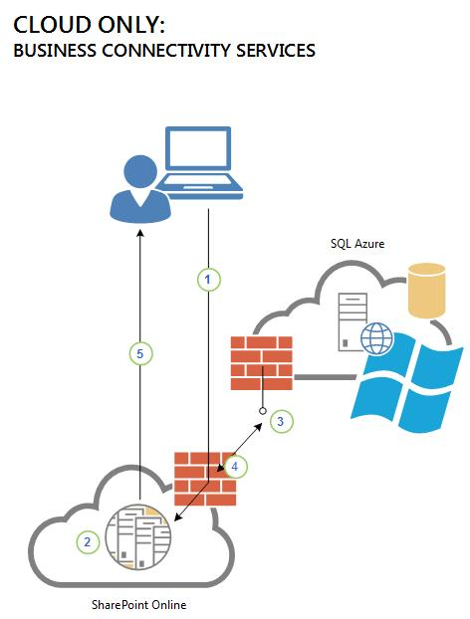
BCS – How it works cloud-only
Notes:
1. The user logs on to SharePoint Online and opens an external list that the user has rights to.
2. The Business Data Connectivity service runtime queries the external content type for the list in the Business Data Connectivity service metadata store to learn how to access the external system, which operations can be performed, and which credentials to use. The external content type tells the Business Data Connectivity service runtime to retrieve the necessary credentials from the Secure Store.
3. The Business Data Connectivity service runtime passes the request (SOAP over HTTP) to the endpoint of the SQL Azure Windows Communication Foundation (WCF) service.
4. The SQL Azure service returns the data in a SOAP envelope.
5. The SharePoint Online site displays the external list in the user’s browser. The user can then perform all the configured operations on the data source for which the user has permissions.

Slide 13
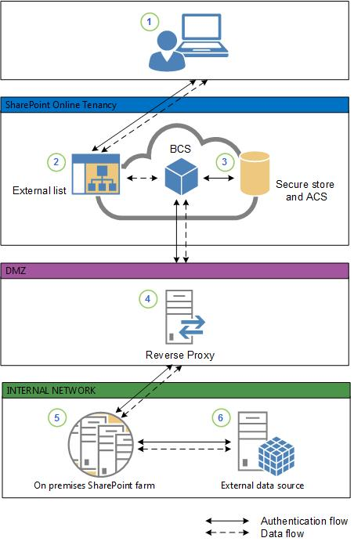
BCS – How it works hybrid
Notes:
1. An information worker logs on to SharePoint Online by using their federated account and opens an app for SharePoint or external list that needs data from an on-premises OData data source.
2.The external list creates a request for the data and sends it to Business Connectivity Services. Business Connectivity Services looks at the connection settings object to see how to connect to the data source and which credentials to use.
3. Business Connectivity Services retrieves two sets of credentials:
The Secure Channel certificate from Secure Store in SharePoint Online. This is used for SharePoint Online authentication to the reverse proxy.
An OAuth token from the Azure AD Service. This is used for user authentication to the SharePoint 2013 on-premises farm. You gain access to the Azure AD service with your SharePoint Online subscription. It is a security token service that manages security tokens for users of SharePoint Online.
4. Business Connectivity Services sends an HTTPS request to the published endpoint for the data source. The request includes the client certificate from Secure Store, the OAuth token, and a request for the data. The reverse proxy authenticates the request by using the client certificate and forwards it to the on-premises SharePoint 2013 farm. For more information about publishing SharePoint to the Internet, see SharePoint publishing solution guide in the Forefront Technical Library.
5. The on-premises farm retrieves the user’s cloud identity from the OAuth token (for example, user123@contoso.com), and through the Client Side Object Model (CSOM) code, maps it to the on-premises identity (for example, contoso\user123). The on-premises credentials are mapped to credentials that have access to the external data via a Secure Store target application.
6. The on-premises Business Connectivity Services forwards the request to the OData Service endpoint. The OData Service authenticates the request (via IIS) and returns the data, which is passed back through the chain to the external list for the user to work with.

Slide 14
Prerequisite software needed to work with external data in Office 2013
Microsoft SQL Server Compact 4.0
Microsoft .NET Framework 4.x
WCF Data Services 5.0 for OData V3
Download it from:
https://support.office.com/en-us/Article/Prerequisite-software-needed-to-work-with-external-data-in-Office-2013-cc974b82-7a2e-4889-9a7b-b0328fc5d1ca

Slide 15
Business Services Connectivity
Authentication Models
- Impersonation and Delegation
Per-user authorization
To enable auditing at the back-end server
- Trusted Subsystem
Access to one account.
It offers connection pooling.
It reduces licensing costs on the back-end server.
It is less complex.

Slide 16
Business Services Connectivity Authentication
Authentication Modes
PassThrough
RevertToSelf
Windows Authentication
Credentials
Digest
Notes:
Pass-Through Authentication
Pass-through authentication refers to the ability of the operating system to pass a client's authentication information to the external system. BCS supports pass-through authentication for database connections and Web/WCF service connections. When you use pass-through authentication, you authenticate as the identity of the end user.
When you access the BDC from a Web page, it runs in the Microsoft Internet Information Services (IIS) worker process, w3wp.exe. The identity of this process is the IIS application pool account impersonating the logged-on user. To avoid losing the logged-on user's identity when BDC authenticates to the back-end server, you must enable Kerberos delegation between the server running IIS and the other computer. Kerberos delegation enables a receiving server to send the authentication request to the proper location.
When you use BDC for crawling, it runs in the filter daemon process, mssdmn.exe. To access the back-end content source, the threads in the filter daemon process impersonate the content access account associated with that back-end content source.
One drawback to using pass-through authentication is that the operating system exposes only the user name and password. Therefore, if a company uses two-factor authentication (if users are required to have some specific—private—information in addition to a user name and password), you cannot use pass-through authentication.
Simplicity of use makes pass-through authentication a good candidate for use in a testing environment. You might also use it if the Web service or the destination server uses anonymous authentication or SSL connections.
RevertToSelf Authentication
If a user logs on with Windows authentication, IIS impersonates that particular account. While IIS runs under the application pool identity, it impersonates the logged-on user, and the request runs under the user's impersonation before it is passed forward.
RevertToSelf authentication enables you to revert this impersonation and authenticate as the underlying account that is configured for the IIS application pool.
CautionIf custom code uses RevertToSelf for authentication, it can grant users system-level privileges on the back-end servers by granting privileges to the application pool identity. Ensure that you thoroughly test any custom code before you run it on a production system.
WindowsCredentials Authentication
Microsoft SharePoint Server 2010 authenticates by using Windows credentials from its provided Secure Store Provider. Use this mode if your Web or WCF service uses Windows authentication. You need to set up Secure Store Service before using this mode. When you use Windows credentials, BDC tries and splits the username field that is returned from Secure Store Service into domain\user and then uses the domain, username, password triad to authenticate.
Credentials Authentication
Microsoft SharePoint Server 2010 authenticates Web/WCF service systems by using credentials other than those from Windows authentication from its provided Secure Store Provider. These credentials are used for basic authentication or digest authentication, depending on the configuration of the Web services server. Because basic authentication and digest authentication do not adequately protect credentials, you should use SSL or IPSec (or both) to secure communication between the Web services server and the server that is running BDC.
Use this mode if your Web service uses credentials other than Windows credentials. You need to set up Secure Store Service before using this mode. When you use Credentials, BDC does not attempt to split the username field that is returned from Secure Store Service into domain\user as in WindowsCredentials mode but rather uses the username, password directly to authenticate.
DigestCredentials Authentication
Microsoft SharePoint Server 2010 can also authenticate WCF service systems by using the HTTP Digest credentials. See ClientCredentials.HttpDigest Property for more details.

Slide 17
Alternatives to BCS?
- JavaScript-based solutions JS Link and other AJAX solutions
- Custom data connections
- Custom-coded Web Parts
- SharePoint Add-ins

Slide 18
Using External Data in SharePoint
Demo

Slide 19
Azure Api Apps, Azure Storage & SharePoint External Data A look at storage features that Azure offers…

Slide 20
Data Storage
Various data storage techniques
SQL Azure
Azure Tables
Blob storage
Document DB

Slide 21



Azure Data Services
SQL Server in a VM
SQL Database
DocumentDB
Tables
Blobs
fully featured RDBMS
transactional processing
rich query
managed as a service
elastic scale
schema-free data model
internet accessible http/rest
arbitrary data formats
Notes:
This is a comparison of the Azure Data services offerings going from a SQL server you install in a VM, the SQL database as a service, DocumentDB, Azure table store, and Azure blob store.
As you can see, DocumentDB is pretty fully featured by this listing, I’d even argue that it can store arbitrary data formats to an extent.

Slide 22
Azure Tables
What are Azure Tables?
NoSQL Column Store/Key-Value Store style database
Tables contain “entities” similar to rows
Entities contain key-value pairs called properties

Slide 23
Azure Table Entities
Azure Storage Account
Azure Storage Account
Entities
Partition Key
Row Key
Timestamp
… other properties
Each entity can have different number and type of properties
Partition Key + Row Key = Unique Identifier
(No support for secondary index in Azure Table)
Employees (Table)
Azure Table
Entity
Entity
Property
Property
<Name,Value>
Property
Entity
Property
Property
Property

Slide 24
Azure Tables Partitions
How do you Partition the data?
EmployeeName or CertName?
PK = EmployeeName
RK = CertName
(Entity)
EmployeeName=…
CertName=…
BirthDate=…
CertNumber=…
EmployeeName=…
CertName=…
BirthDate=…
CertNumber=…
FavoriteTeam=…
(Entity)
CertName=…
EmployeeName=…
CertNumber=…
BirthDate=…
CertName=…
EmployeeName=…
CertNumber=…
BirthDate=…
PK = CertName
RK = EmployeeName
Employees (Table)
Certifications (Table)

Slide 25
Azure Tables
No Fixed Schema for entities
Employee table
EmployeeName | BirthDate | FavoriteTeam
David Anderson | 1/1/1970
Nancy Wilson | 4/15/1965 | Atlanta Falcons
John Doe | April 1, 1989

Slide 26
Azure Tables
Summary
Key-Value/Column store NoSQL as a service
Easy to work with
Built to scale
Great pricing!!

Slide 27
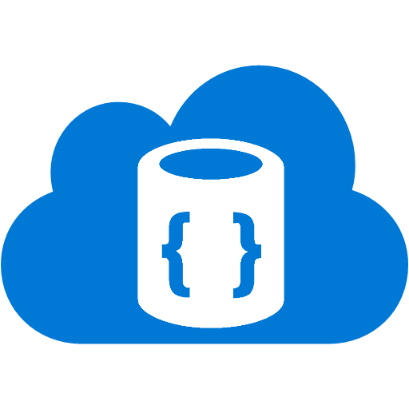


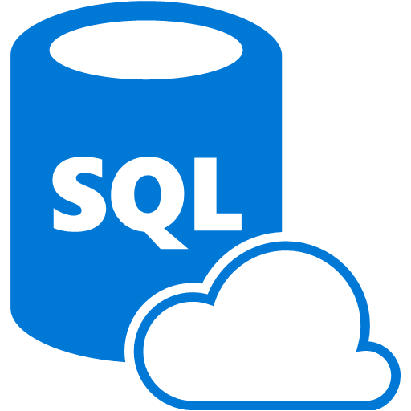
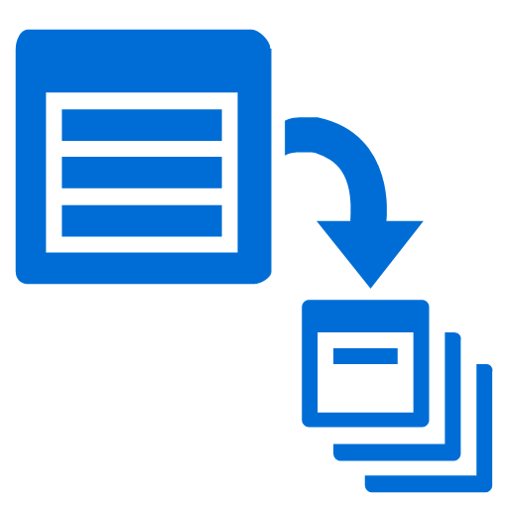

What is Azure DocumentDB
Azure’s NoSQL Database as a Service
Blazingly fast, low latency SSD storage
RESTful HTTP API
SQL like syntax to query documents
Server side programmability
(Stored Procedures, Triggers, UDFs)
Rich consistency and indexing options
ACID transactions within collections
Rich permissions level
Notes:
So let’s get focused in on Azure DocumentDB. What is DocumentDB?
Azure’s documentDB is Azures NoSQL document store database AS A SERVICE.
Some features: It has a RESTful HTTP API for access over the internet
Server side programmability in the form of Stored Procedures, Triggers, and User Defined Functions, using JavaScript
You CAN have ACID guaranteed transactions within collections.
It’s very fast – stored on SSD.
You can use familiar SQL statements to access data (even “joins”!...to access sub documents…)
As mentioned, you CAN have ACID guarantees, but you don’t have to, you can break consistency for better write performance.
And, very important, you can set up special user permissions as needed.

Slide 28
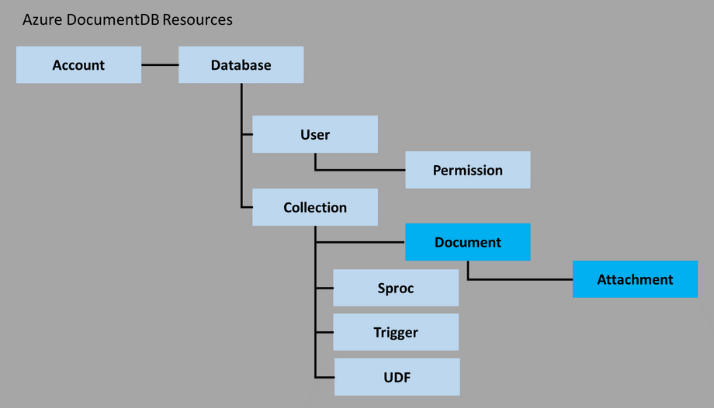
DocumentDB

Slide 29
Azure DocumentDB Modelling data
Schema-less does not mean “don’t structure your data”
Plan out your data model with standard tools
Methods of handling related data:
Embedding
Referencing methods (normalization)
Best Practices found here: https://azure.microsoft.com/en-us/documentation/articles/documentdb-modeling-data/
Notes:
The fact that the schema isn’t enforced by the database engine doesn’t mean that you shouldn’t have a schema, it just means that you need to manage the schema programmatically. In fact, it’s even more important that you concern yourself with certain aspects of your data storage, as I’ll go over in the next slide.
There are several methods of handling related data, through embedding documents and by key referencing, or moderately normalizing the data.
There are several best practices to keep in mind when looking into your data storage. Since you only have a relatively small amount of space for each document, it’s recommended that you only embed documents if they are integral to the data and if the related data has a “one to few” relationship. You don’t want it to grow unbounded. For example, if you have a blog post with comments, you don’t want to embed the comments with the post since comments can grow unbounded (unless it’s my blog).
There are a number of ways to handle this, one is to give each comment a separate document with a foreign key to the post. You can’t do joins naturally in the engine, but your application can make two calls to the database, one to get the post and one to get the comments. The application servers are fast and the database is fast so the two calls will usually be quicker than doing a join on the SQL database.

Slide 30
NoSQL Document Store
RDBMS
{
"id": "101-102-665544",
"subtotal": 38.63,
"shippingHandling": 0.00,
"tax": 2.80,
"total": 41.43,
"currency": "USD",
"date": "2014-02-08T10:01:36.827",
"items": [
{
"productId": "B0024Y",
"productName": "Green Toys Tea Set",
"quantity": 1,
"price": 19.00
},
{
"productId": "B0014C",
"productName": "Thomas & Friends Make-A-Match Game",
"quantity": 1,
"price": 9.99
},
{
"productId": "B0296S",
"productName": "2 Pair of Wooden Rhythm Sticks",
"quantity": 2,
"price": 4.82
}
]
}
Notes:
Here we have a typical ER diagram for a Relational Database Management system. We have products that are added to an order via a collection of order details.
And on the right is a sample of how a document store could handle this problem. We’ve put the order and order details tables together while still maintaining a relationship between the product and the order-details. However, we’ve denormalized the productName.
We pull that out there because when you look at your application, anytime that you look at the order details you’ll also be pulling the product name.
One of the benefits of Normalization was you didn’t have to plan as hard when you were creating your data structures. What I mean by this is, the product name can stay in the product table because anytime you need the product name, it’s a simple inner join away and everything is returned to you in a single query.
With a document DB (and most NoSQL database) normalization costs are higher because every time you need to do a join you do it in multiple calls to the database from the application. A lot of the time this isn’t a big deal, but with “web scale” we could be talking tens of thousands of calls. You’ll notice we’re at risk now for update anomalies. It’s possible to update all of the cart items if the name changes, but it’s a more intense process than with relational databases, so that’s a good reason to be careful of only embedding information that doesn’t get updated very often.

Slide 31
Indexing
Schema free, really!
By default every document is indexed
Lock free, write optimized indexing
Collections and documents can be marked to not index
Excluding properties or documents also improves the write throughput and storage cost
Hash and Range indexing available
Consistent and Lazy indexing available
Notes:
The 10GB of document storage provisioned per CU includes the documents plus storage for the index
By default, a DocumentDB collection is configured to automatically index all of the documents without explicitly requiring any secondary indices or schema.
Based production usage in consumer scale first party applications using DocumentDB, the typical index overhead is between 2-20%.
The indexing technology used by DocumentDB ensures that regardless of the values of the properties, the index overhead does not exceed more than 80% of the size of the documents with default settings.
You can chose to remove certain documents from being indexed at the time of inserting or replacing a document.
You can configure a DocumentDB collection to exclude all documents within the collection from being indexed.
You can also configure a DocumentDB collection to selectively index only a certain properties or paths with wildcards of your JSON documents
Excluding properties or documents also improves the write throughput – which means you will consume fewer request units.
Automatic indexing of documents is enabled by write optimized, lock free, and log structured index maintenance techniques
Note: The indexing policy of a collection must be specified at the time of creation. Modifying the indexing policy after collection creation is not allowed, but will be supported in a future release of DocumentDB.
Note: By default, DocumentDB indexes all paths within documents consistently with a hash index. The internal Timestamp (_ts) path is stored with a range index.
When indexing is turned off, documents can be accessed only through their self-links or by queries using ID.
There are two supported kinds of index types: Hash and Range. Choosing an index type of Hash enables efficient equality queries. For most use cases, hash indexes do not need a higher precision than the default value of 3 bytes.
Choosing an index type of Range enables range queries (using >, <, >=, <=, !=). For paths that have large ranges of values, it is recommended to use a higher precision like 6 bytes. A common use case that requires a higher precision range index is timestamps stored as epoch time.

Slide 32
Azure DocumentDB Limits*
512KB limit to document size
50 Capacity unit
3 Collections per capacity unit
Complete list here: https://azure.microsoft.com/en-us/documentation/articles/documentdb-limits/
Notes:
A note on some of the current limits. *DocumentDB is a work in progress, as is all of Azure, these will be changing frequently, the 512kb limit was originally 64kb, but was bumped up twice due to demand. (side note, MongoDB supports 16MB documents, AWS Dynamo supports 400kb as of right now)
Documents are limited to 512kb (including sub documents, HOWEVER BLOB attachments are stored outside of the document, they have a limit of 512kb also. The total attachment limit is 2GB per account, right now, during preview.
You can have up to 50 capacity units per Database
3 Collections per CU
3.3 GB per collection

Slide 33
DocumentDB
Demo

Slide 34
Recap
Business Data Connectivity Services
JavaScript solutions
Azure Data Storage Solutions - Azure Table Store - Azure DocumentDB

Slide 35


References
Configuring Business Data Connectivity Service https://technet.microsoft.com/en-us/library/jj683118.aspx
Azure DocumentDB http://documentdb.com
Channel 9 https://channel9.msdn.com/
Learning Map http://azure.microsoft.com/en-us/documentation/articles/documentdb-learning-map/
Code Samples https://code.msdn.microsoft.com/Azure-DocumentDB-NET-Code-6b3da8af#content
Query Playground http://www.documentdb.com/sql/demo
Post feedback http://feedback.azure.com/forums/263030-documentdb
Data Migration Tool http://azure.microsoft.com/en-us/documentation/articles/documentdb-import-data/
loesley@rdacorp.com
linkedin.com/in/bartonloesley

