Slide 1
Introduction to Julia: Why are we doing this to you? (Fall 2018)
Steven G. Johnson, MIT Applied Math
MIT classes 18.06, 18.303, 18.330, 18.08[56],
18.335, 18.337, …

Slide 2
What language for teaching scientific computing?
For the most part, these are not hard-core programming courses,
and we only need little “throw-away” scripts and toy numerical experiments.
Almost any high-level, interactive (dynamic) language with easy facilities for linear algebra (Ax=b, Ax=λx), plotting, mathematical functions, and working with large arrays of data would be fine.
And there are lots of choices…

Slide 3
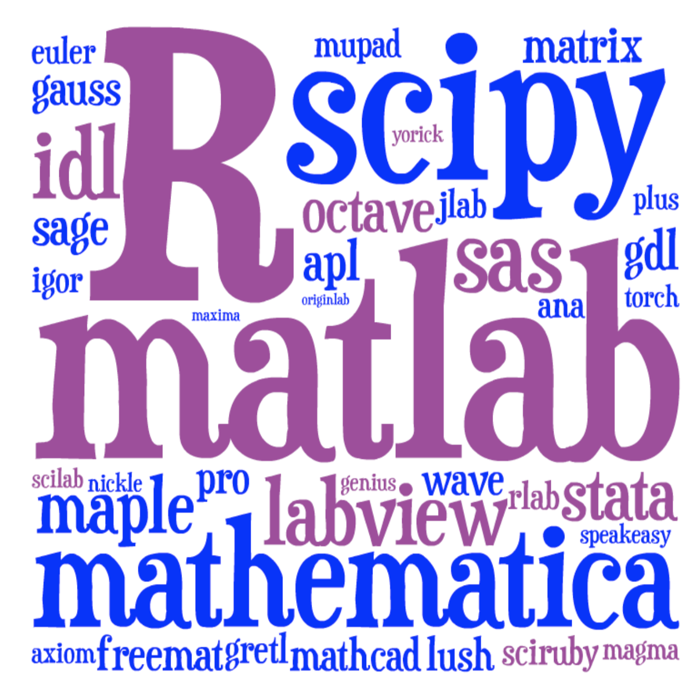
Lots of choices for interactive math…
[ image: Viral Shah ]

Slide 4
Just pick the most popular? Matlab or Python or R?
We feel guilty pushing a language on you that we
are starting to abandon ourselves.
Traditional HL computing languages
hit a performance wall in “real” work
… eventually force you to C, Cython, …

Slide 5





A new programming language?
Viral Shah
Jeff Bezanson
Alan Edelman
[ MIT ]
julialang.org
Stefan Karpinski
[begun 2009, “0.1” in 2013, ~40k commits,
“0.6” release in June 2017,
1.0 release in August 2018 ]
[ 30+ developers with 100+ commits,
1000+ external packages, 4th JuliaCon in 2017 ]
As high-level and interactive as Matlab or Python+IPython,
as general-purpose as Python,
as productive for technical work as Matlab or Python+SciPy,
but as fast as C.

Slide 6
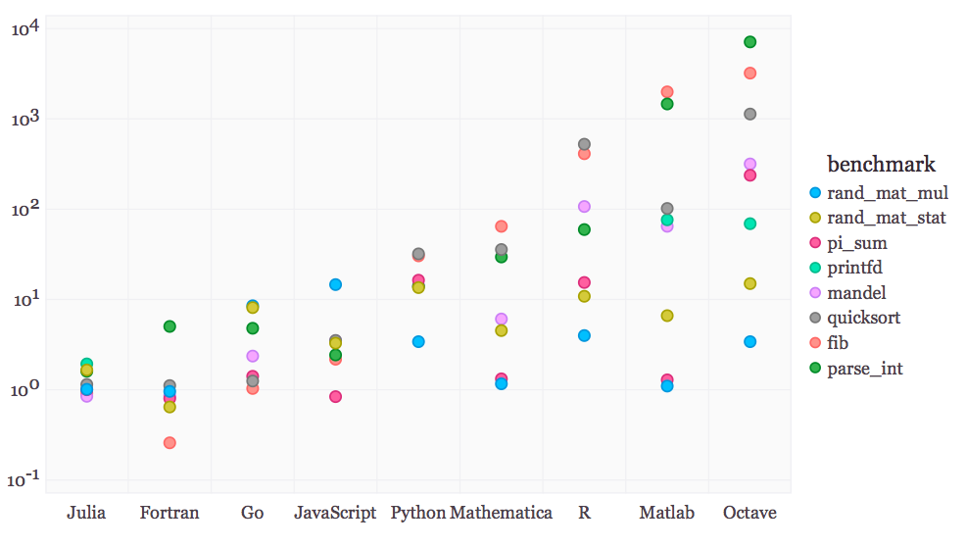
Performance on synthetic benchmarks
[ loops, recursion, etc., implemented in most straightforward style ]
(normalized so that C speed = 1)

Slide 7
Special Functions in Julia
Special functions s(x): classic case that cannot be vectorized well
… switch between various polynomials depending on x
Many of Julia’s special functions come from the usual C/Fortran libraries,
but some are written in pure Julia code.
Pure Julia erfinv(x) [ = erf^{–1}(x) ]
3–4× faster than Matlab’s and 2–3× faster than SciPy’s (Fortran Cephes).
Pure Julia polygamma(m, z) [ = (m+1)^{th} derivative of the ln Γ function ]
~ 2× faster than SciPy’s (C/Fortran) for real z
… and unlike SciPy’s, same code supports complex argument z
Julia code can actually be faster than typical “optimized”
C/Fortran code, by using techniques [metaprogramming/codegen generation] that are
hard in a low-level language.

Slide 8
Pure-Julia FFT performance
(FFTW, MKL: “unfair” factor of ~2 from manual SIMD)
already comparable to FFTPACK
[ probably some tweaks to
inlining will make it better ]
FFTPACK
Julia
FFTW w/o SIMD
FFTW 1.0-like code generation
+ recursion in Julia
~ 1/3 lines of code compared to
FFTPACK, more functionality

Slide 9
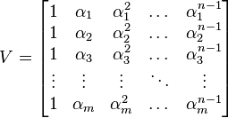
Generating Vandermonde matrices
given x = [α₁, α₂, …], generate:
NumPy (numpy.vander): [follow links]
Python code …wraps C code
… wraps generated C code
type-generic at high-level, but
low level limited to small set of types.
Writing fast code “in” Python or Matlab = mining the standard library
for pre-written functions (implemented in C or Fortran).
If the problem doesn’t “vectorize” into built-in functions,
if you have to write your own inner loops … sucks for you.

Slide 10
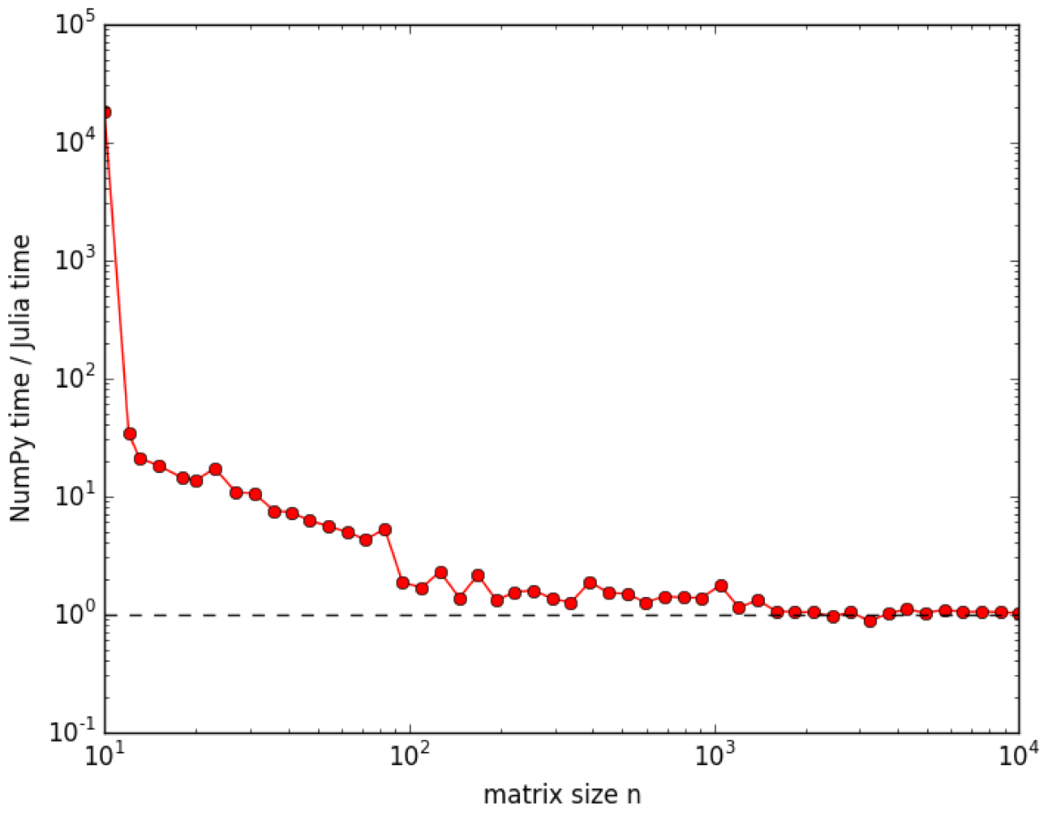
Generating Vandermonde matrices
given x = [α₁, α₂, …], generate:
NumPy (numpy.vander): [follow links]
Python code …wraps C code
… wraps generated C code
type-generic at high-level, but
low level limited to small set of types.
Julia (type-generic code):
function vander{T}(x::AbstractVector{T}, n=length(x))
m = length(x)
V = Array(T, m, n)
for j = 1:m
V[j,1] = one(x[j])
end
for i = 2:n
for j = 1:m
V[j,i] = x[j] * V[j,i-1]
end
end
return V
end

Slide 11
Generating Vandermonde matrices
function vander{T}(x::AbstractVector{T}, n=length(x))
m = length(x)
V = Array(T, m, n)
for j = 1:m
V[j,1] = one(x[j])
end
for i = 2:n
for j = 1:m
V[j,i] = x[j] * V[j,i-1]
end
end
return V
end
note: works for any container
of any type with “*” operation
… performance ≠ inflexibility

Slide 12
But I don’t “need” performance!
For lots of problems, especially “toy” problems in courses, Matlab/Python performance is good enough.
But if use those languages for all of your “easy” problems, then you won’t be prepared to switch when you hit a hard problem. When you need performance, it is too late.
You don’t want to learn a new language at the same time that you are solving your first truly difficult computational problem.

Slide 13
Just vectorize your code? = rely on mature external libraries, operating on large blocks of data, for performance-critical code
Good advice! But…
• Someone has to write those libraries.
• Eventually that person will be you.
— some problems are impossible or
just very awkward to vectorize.

Slide 14
But everyone else is using Matlab/Python/R/…
Julia is still a young, niche language. That imposes real costs — lack of familiarity, rough edges, continual language changes. These are real obstacles.
But it also gives you advantages that Matlab/Python users don’t have.

Slide 15
But I lose access to all the libraries available for other languages?
Very easy to call C/Fortran libraries from Julia, and also to call Python…

Slide 16
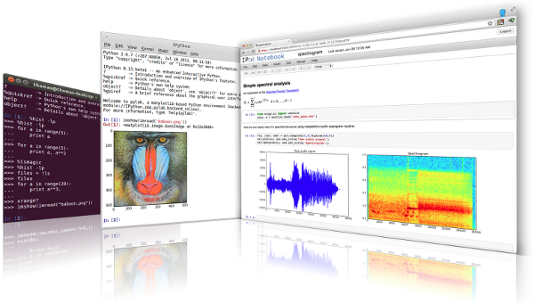
Julia leverages Python…
Directly call Python libraries (PyCall package),
e.g. to plot with Matplotlib (PyPlot package), and also…
via IPython/Jupyter:
Modern multimedia
interactive notebooks
mixing code, results,
graphics, rich text, equations, interaction
“IJulia”
[ jupyter.org ]

Slide 17
goto live IJulia notebook demo…
Go to juliabox.org for install-free IJulia on the Amazon cloud
See also julialang.org for more tutorial materials…

