Slide 1
S&P Global Custom Machine Learning Workshop Kickoff Meeting
Business Science Workshop Dates: September 13-14, 2018
August 10th, 2018

Slide 2
Project Management 4-Week Workshop Build Schedule
Workshop Dates: 9/13 & 9/14
Week 1
Overview
Week 2
Machine Learning
Week 3
Shiny Flexdashboard
Define Key Points
Develop Code
Review 8/17 (Fri)
Develop App
Review 8/27 (Mon)
Week 4
Deep Learning
Develop Code
Review 8/31 (Fri)
Review Topics
Review Pre-req’s
Agree To Meeting Schedule
H2O
Keras LSTM
Shiny
Review 8/10 (Fri)

Slide 3
Workshop Topics
Day 1: Machine Learning
Day 2 (AM): Shiny Flexdashboard
Day 3 (PM): Keras LSTM

Slide 4
ML Workshop Overview
Day 1: Machine Learning
Day 1 will focus on using Machine Learning to predict Default Risk. The data set used comes from the Kaggle Competition Home Credit Default Risk. The question we are trying to answer is how capable each applicant is of repaying a personal loan.
We will follow a systematic data science approach including performing exploratory data analysis (EDA) and machine learning preprocessing, building a high performance machine learning model, measuring performance and comparing multiple models, and interpreting the final model to derive explanations of default risk at an applicant (individual) level.
Attendees will gain extensive experience with the high-performance H2O Modeling Package, using automated machine learning and exploring different modeling approaches including Random Forest, Gradient Boosted Machine, Generalized Linear Models, and Stacked Ensembles.
The attendees will leave Day 1 with significant experience with H2O feeling confident in their ability to create, measure, and explain high-performing H2O models.

Slide 5
ML Workshop Overview
Day 2: Web Application Development & Deep Learning
Day 2 will focus on two topics: (1) Building an interactive web application with Shiny Flexdashboard and (2) Designing a Deep Learning (LSTM) model for time series with Keras.
The objective in the first half of Day 2 is to build a Credit Default Risk Prediction Dashboard. The Shiny Flexdashboard web application integrates the H2O predictive model (from Day 1) in a way that other data scientists, managers, and executives can interactively gain insights.
The objective in the second half of Day 2 is to design a Deep Learning (LSTM) model that can be used to predict time series data. This will be a hands-on introduction to the Keras modeling package. Attendees will gain exposure to working with Keras.
The attendees will leave Day 2 with significant experience with Shiny Flexdashboard as a method of quickly creating interactive web applications using predictive analytics. The attendees will also have exposure to the Keras package for deep learning understanding the key components of a Deep Learning model.

Slide 6
Prerequisites
Reading:
R For Data Science
Chapters 1-8: Essential For Training. Focus on dplyr & ggplot2
Chapters 9-16: Very good to know
Chapters 17+: Really good, but not necessary for training
Setup:
Rstudio (Jonathan Regenstein) to provide cloud-based Rstudio / Shiny servers
Minimizes setup time & maximizes coding
Once code lectures are completed, I will send a full list of R packages for information

Slide 7
Program Modules & Schedule
Day 1 (ML)
Day 2 (Shiny & DL)
Time | Module | Training Time (hr)
9:00 - 9:15 | Agenda & Opening Comments | 0.25
9:15 - 10:00 | Exploratory 1 | 0.75
10:00 - 10:15 | Break 1
10:15 - 11:00 | Exploratory 2 | 0.75
11:00 - 11:30 | Preprocessing | 0.50
11:30 - 12:30 | Break 2 (Lunch)
12:30 - 1:45 | Machine Learning 1 | 1.25
1:45 - 2:00 | Break 3
2:00 - 3:00 | Machine Learning 2 | 1.00
3:00 - 3:15 | Break 4
3:15 - 4:00 | Performance | 0.75
4:00 - 4:30 | LIME | 0.50
Time | Module | Training Time (hr)
9:00 - 9:15 | Agenda & Opening Comments | 0.25
9:15 - 10:00 | Shiny 1 | 0.75
10:00 - 10:15 | Break 1
10:15 - 11:30 | Shiny 2 | 1.25
11:30 - 12:30 | Break 2 (Lunch)
12:30 - 1:45 | Deep Learning 1 | 1.25
1:45 - 2:00 | Break 3
2:00 - 3:00 | Deep Learning 2 | 1.00
3:00 - 3:15 | Break 4
3:15 - 4:15 | Deep Learning 3 | 1.00
4:15 - 4:30 | Closing Comments / Workshop Survey | 0.25

Slide 8
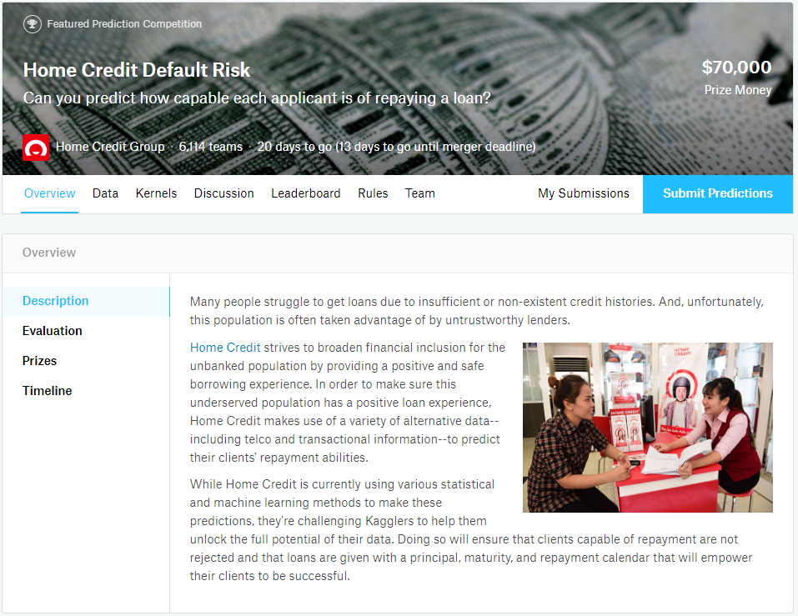
Day 1: Machine Learning
Topics
Kaggle Credit Default Risk
Personal Loans / Applicant Default Prediction
Relatable to S&P Core Business
Goal:
Predict Applicant Default Risk (Probability)
Data Format
Large-ish 688MB (total)
160MB application_train.csv

Slide 9
Day 1: Machine Learning
1-2 Hours
Exploratory
1-2 Hours
Machine Learning
30 Min – 1 Hour
Performance
H2O AutoML
H2O Algorithms
Prec vs Recall
30 Min
Model Interpretability
dplyr, ggplot2
Explore data
Read data
Logistical Regression
ROC
Work with data
Visualize data
Tools
Algorithms
Tree: GBM, RF
Linear: logreg, GLM
LIME
30 Min
Preprocessing
Basic Statistical Transform-ations
Imputation
Tools
recipes
H2O Metrics
H2O Performance
Comparing Models
Curriculum

Slide 10
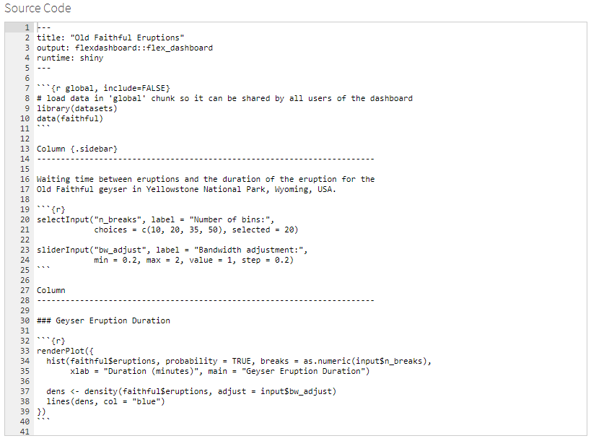
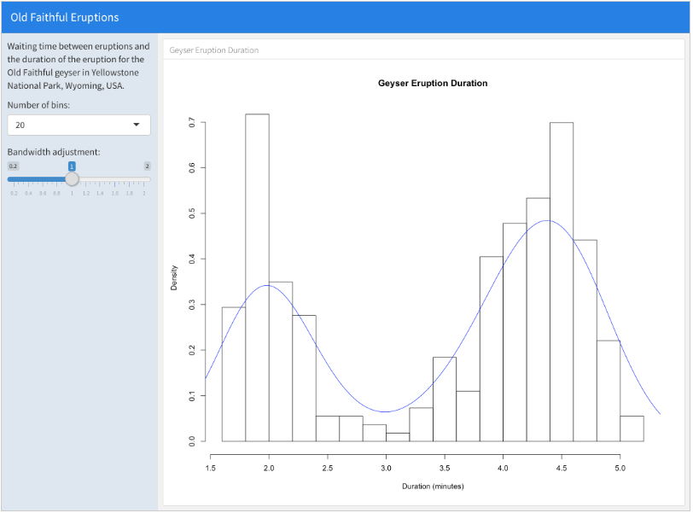
Day 2 (AM): Shiny Flexdashboard
Actual Workshop Product Will Be
Credit Risk Prediction & Explanation
Web App
Topic
Web Applications
Goal
Create a simple credit default risk prediction application
Key Points
Use Rmarkdown / Flexdashboard to minimize learning curve

Slide 11
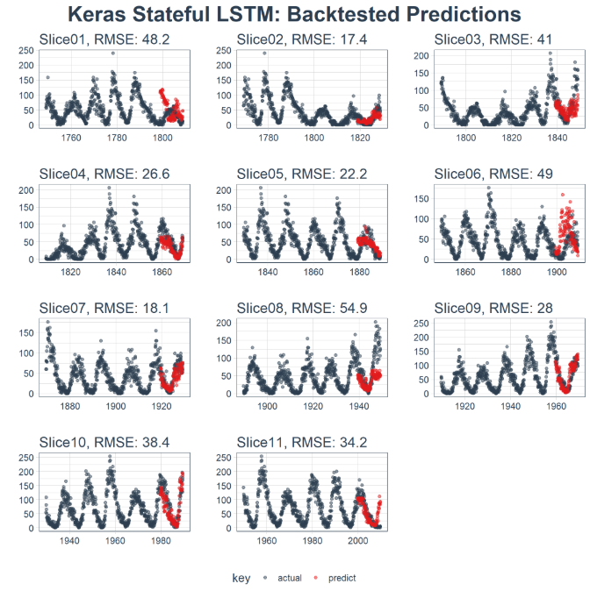
Day 2 (PM): Keras LSTM
Topics
Time Series Prediction
Keras LSTM Modeling
Goal
Develop Keras LSTM Model to predict (forecast) sunspots
Key Points
Expose audience to Keras Deep Learning Modeling

Slide 12
Pre-Training Resources
H2O & LIME Tutorials
KAGGLE COMPETITION IN 30 MINUTES: PREDICT HOME CREDIT DEFAULT RISK WITH R
USING MACHINE LEARNING WITH LIME TO UNDERSTAND EMPLOYEE CHURN
Shiny
https://rmarkdown.rstudio.com/flexdashboard/shiny.html
http://shiny.rstudio.com/gallery/
http://shiny.rstudio.com/gallery/widget-gallery.html
Keras LSTM Tutorial
TIME SERIES DEEP LEARNING, PART 1: FORECASTING SUNSPOTS WITH KERAS STATEFUL LSTM IN R

