Slide 1

短学期第二次答辩成果演示
李智豪

Slide 2
Learning Making a ppt
colors
characters
materials
distribution

Slide 3
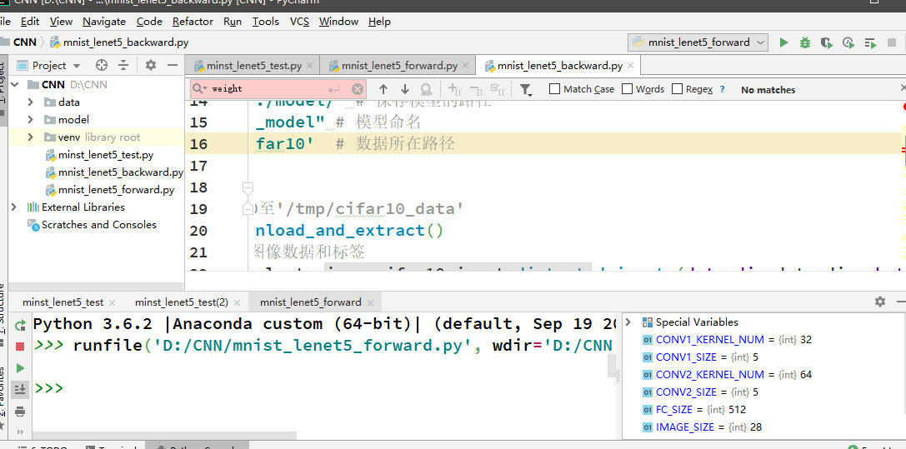
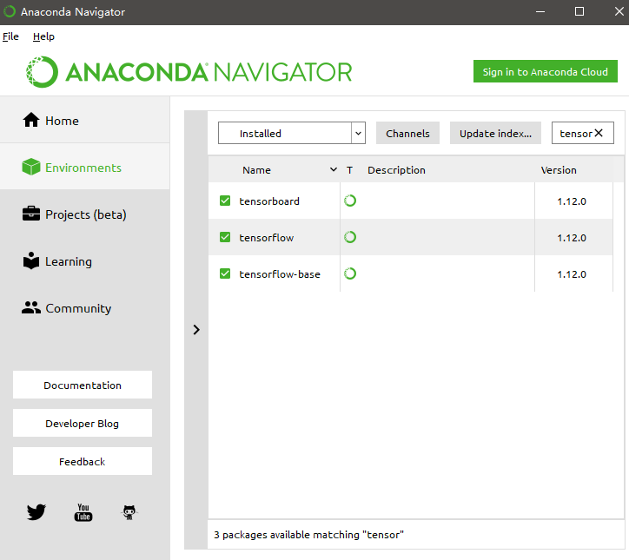
Install My Environment
pycharm
anconda
tensorflow

Slide 4
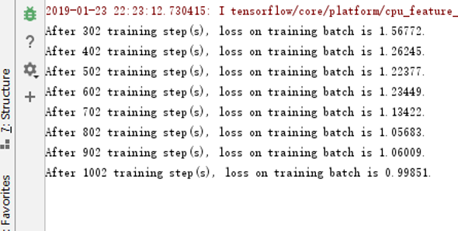
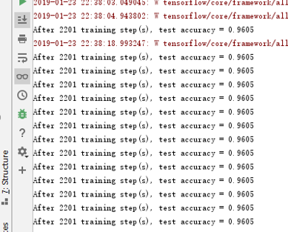
Text2：Uploading The Codes of cnn

Slide 5
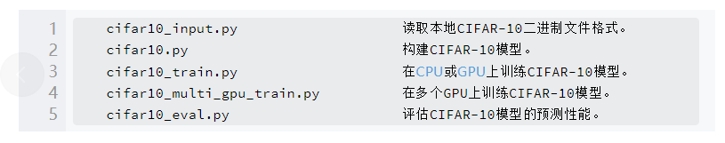
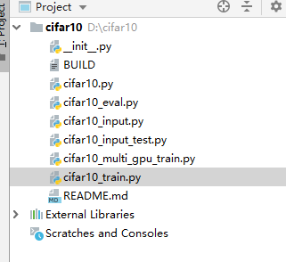
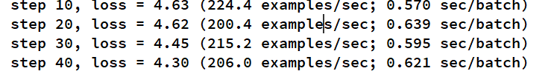
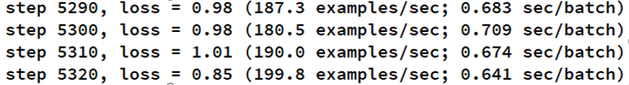
Text3：Classifying CIFAR-10 Basing on CNN

Slide 6
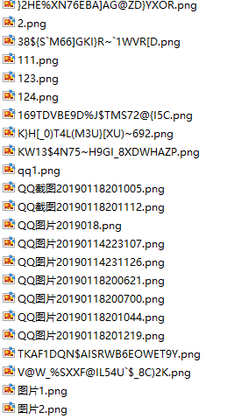
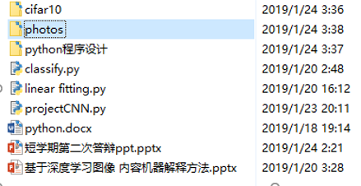
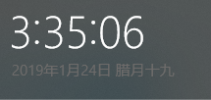
Busy but Meaningful
Limited time
More works
More contents
More theories
More coding
More platform to use
More skills to learn
More…

Slide 7
Thanks you

