Slide 1
Declaration parser
第八组: 朱河勤, 张思聪, 徐瑞, 詹慧悠

Slide 2
Contents
Lexical analysis
Syntax analysis
Show

Slide 3
Lexical analysis
Lexical unit | Regular expression
NAME | [a-zA-Z_][a-zA-Z_0-9]*
NUM | \d*\.\d+|\d+
POINTER | \*
COMMA | \,
SEMICOLON | \;
Open parentheses | \(
Close parentheses | \)
Open Bracket | \[
Close Bracket | \]
White Space | \s+

Slide 4
Syntax analysis
declaration -> declaration_specifiers init_declarator_list ';' ;
init_declarator_list . symType = declaration_specifiers . symType
declaration_specifiers ->type_specifier ;
declaration_specifiers . symType = type_specifie. symType
type_specifier ->VOID | INT ;
type_specifier . symType = lexical value
init_declarator_list ->init_declarator | init_declarator_list ',' init_declarator ;
init_declarator . symType = init_declarator_list . symType

Slide 5
Syntax analysis
declarator -> pointer direct_declarator
declarator. flags = direct_declarator.flags
declarator.flags add (‘pointer’, pointer. num)
direct_declarator -> IDENTIFIER
declarator. flags add (‘id’,identifier)
direct_declarator -> '(' declarator ‘)’
direct_declarator .flags = declarator .flags
direct_declarator -> direct_declarator '[' CONSTANT_INT ‘]’
direct_declarator . flags add (‘array’, CONSTANT_INT. lexical_value)

Slide 6
Syntax analysis
[('id', 'p'), ('array', 2), ('array', 3), ('pointer', 1), ('type', 'INT’)]
Varible p, size: 6, type: array(2,array(3,pointer(INT)))
flags: [('id', 'p'), ('pointer', 1), ('type', 'INT’)]
Varible p, size: 1, type: pointer(INT)
[('id', 'j'), ('array', 2), ('pointer', 0), ('type', 'INT')]
Varible j, size: 2, type: array(2,INT)

Slide 7
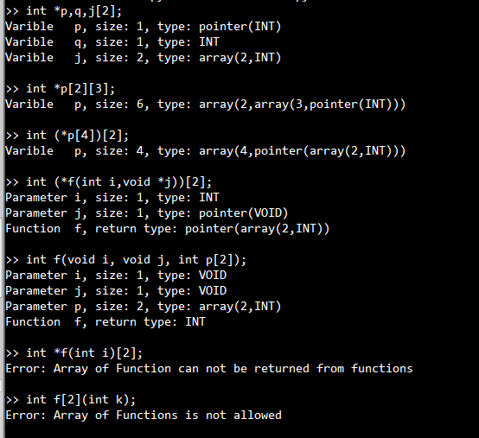
Show
varibles
Function args
Semantics

Slide 8
Thank you!

