Slide 1

elsewhere
Trips, put into motion
Live travel research and booking preparation
powered by TinyFish
Hackathon submission
November 2026
01
Notes:
Opening, 20 seconds. Elsewhere is a live travel concierge powered by TinyFish. It discovers public booking sources, interacts with their date and occupancy controls, and helps the traveller build a plan and prepare the next booking step. Paid checkout remains with the traveller. Photograph: https://images.unsplash.com/photo-1516483638261-f4dbaf036963 (Unsplash, decorative).

Slide 2
The work behind a weekend away
01
02
03
Scattered providers
Repeated checking
A plan still needs action
Hotels, bus operators and
rafting companies each
have their own booking flow.
Dates, prices and terms
need checking on
every site.
A recommendation does not establish availability for the trip.
02
Notes:
Problem, 25 seconds. Use a concrete example: Delhi to Rishikesh, with transport, a stay and rafting. The traveller must reconcile dates and terms across independent providers. This is a product problem statement, not a measured market study. No claim about hours saved or conversion uplift.

Slide 3
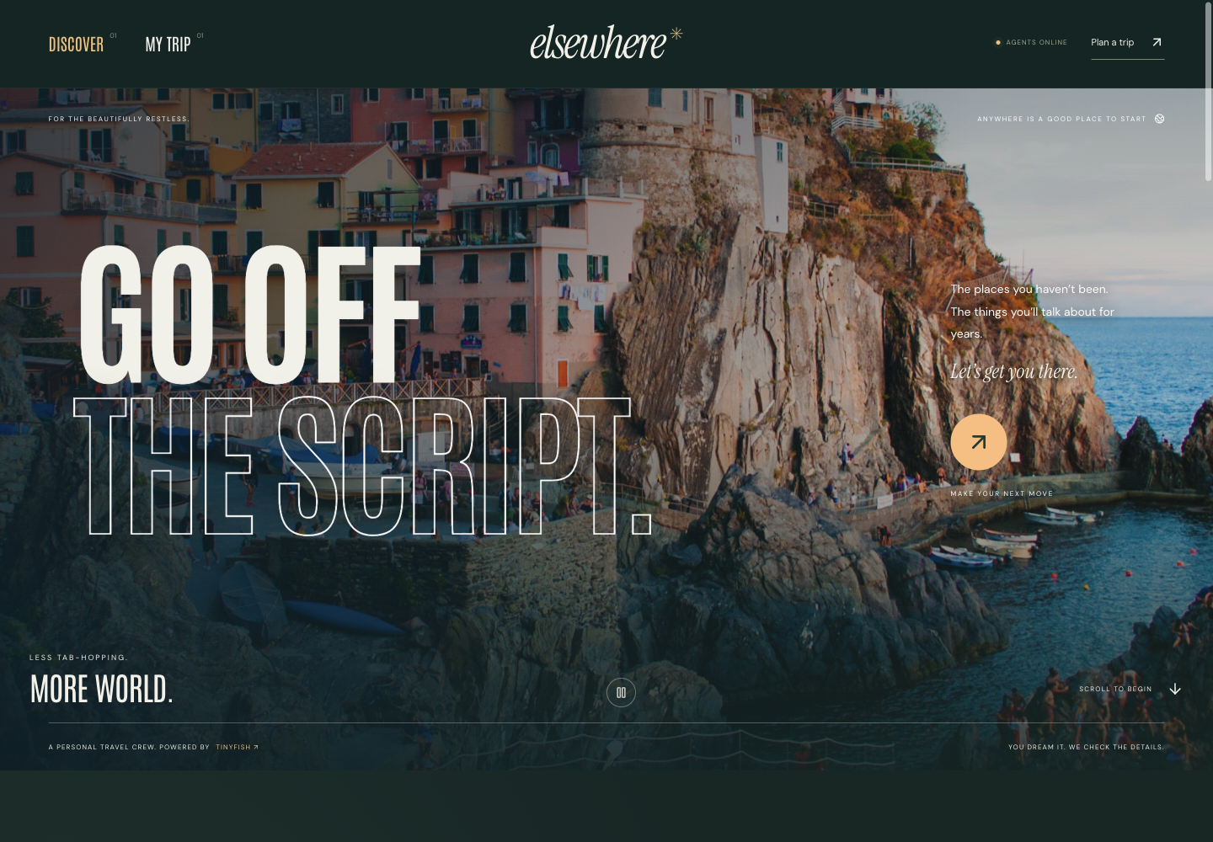
One brief, five kinds of discovery
Anywhere you want to go
Destination and origin
Dates and adult travellers
Budget in rupees
Interests and pace
Stays / transport / experiences
Rentals / restaurants
03
Notes:
Product, 30 seconds. The screenshot shows the actual local application homepage. The planner uses INR budgets. Users choose which of five categories to search. Destination input is open-ended, while successful browser access depends on the provider. A sample trip is an input, not evidence of completed reservations. Source: app/page.tsx and lib/travel.ts.

Slide 4
What the browser agents do
01
02
03
Find sources
Work through the site
Return evidence
Discover relevant public booking pages for the destination.
Open calendars, choose dates and inspect rooms or slots.
Capture source URLs, observed prices, terms and warnings.
Live website interaction is the core of the product.
04
Notes:
TinyFish demonstration, 35 seconds. TinyFish Search discovers up to four distinct candidate provider domains per category. A category browser task attempts at most two sources and returns up to three options. The agent selects dates or occupancy and reads visible booking details. These are bounded research attempts, not exhaustive market comparison. Source: lib/travel-server.ts, discover(), researchGoal(), launch().

Slide 5

Local experiences belong in the trip
Beyond the large travel portals
Discover independent operators
Inspect their public booking flows
Bring the findings into one itinerary
Examples to explore
Rafting, tea ceremonies, tourism tickets,
bike rentals and restaurant tables
05
Notes:
Differentiation, 25 seconds. A state tourism site, independent rafting operator or local rental provider can be discovered dynamically. These are examples of provider categories we can attempt, not established integrations. No guarantee of anonymous access, inventory or provider legitimacy. Photograph: https://images.unsplash.com/photo-1493976040374-85c8e12f0c0e (Unsplash, decorative).

Slide 6
The traveller controls the commitment
RESEARCH
PREPARE
APPROVE
Inspect
Recheck
Approve
Read availability and terms without making a reservation.
Reopen the chosen option and inspect the next booking step.
User handles paid checkout. Eligible free reservations require approval.
Automatic free-reservation submission exists in code. End-to-end validation is pending.
06
Notes:
Booking controls, 35 seconds. Research and preparation must not submit a reservation or payment. The free-reservation path requires explicit approval, a zero total, no deposit/card guarantee/cancellation liability, recent preparation and supported required fields. It is implemented but has not been validated through a completed real reservation. Paid checkout and login remain with the user. Remote browser state does not automatically transfer to the local browser. Sources: lib/travel-server.ts prepareOffer()/reserveOffer(), lib/travel.ts canReserve().

Slide 7
Live validation so far
Lisbon
Kyoto
Hotel date and occupancy selection
Three returned stay options
Room preparation and cancellation terms
Tea-ceremony booking form
Date-specific options inspected
Peak-period price still needs confirmation
No purchase or reservation was made during validation.
07
Notes:
Evidence, 35 seconds. These are real browser checks recorded on 1 November 2026. Lisbon returned three hotel options after selecting Nov 20–23 for two adults. Preparation reopened one room selection and returned cancellation terms plus excluded taxes, stopping before booking. Kyoto reached a MAIKOYA tea-ceremony date form. Its price needs confirmation because peak rates may apply. No reservation or payment occurred. Evidence: README.md; ignored local work/travel-live-check.json and work/travel-preparation-check.json.

Slide 8
The product we built around TinyFish
TinyFish
Elsewhere
Search across the web
Remote browser execution
Page interaction and extraction
Travel-specific tasks and source choices
Evidence checks and durable job state
Editable itinerary and booking controls
Global input. Dynamic discovery. Provider-dependent coverage.
08
Notes:
Implementation contribution, 30 seconds. TinyFish provides search and browser automation. Elsewhere adds task decomposition, dynamic source selection, structured contracts, server-side checks, persistence, itinerary rules and approval gates. There is no separate OpenAI or Claude API call in this travel pipeline. Source: lib/travel-server.ts, lib/travel.ts, app/page.tsx and db/schema.ts.

Slide 9

A live trip walkthrough
Choose a destination
Set dates and a rupee budget
Watch a browser task work
Inspect a returned source
Build the plan and prepare a booking
Local live app
http://127.0.0.1:3004
09
Notes:
Demo transition and close, 30 seconds plus demonstration if time permits. Ask for a destination, set future dates and a rupee budget. For a short presentation, start one category and show actual activity rather than promising a finished five-category run. Open a completed option, show its evidence, add it to the itinerary and prepare its booking flow. Do not pay or submit a reservation during the demo. The localhost link works only on the presenter’s machine. Photograph: local public/images/alpine-lake.jpg, originally sourced from Unsplash, decorative.

Slide 10
Appendix: backend architecture
Browser
Application server
TinyFish
React interface
Trip board in local storage
8-second status polling
Input and evidence validation
Signed source tickets
D1 / SQLite job records
Source discovery
Asynchronous browser jobs
Activity and structured output
Research, preparation and approved submission use separate job phases.
10
Notes:
React 19 and TypeScript use Next-style App Router files, executed through Vinext/Vite. Routes validate input with Zod. TinyFish Search discovers sources. Browser jobs start asynchronously using /v1/automation/run-async. Frontend polls every 8 seconds through the backend. D1-compatible SQLite persists owner-scoped jobs; local preview uses emulation. Browser local storage retains the trip board. No separate model API is present. Sources: package.json, scripts/run-framework.mjs, app/api/travel/, lib/travel-server.ts and db/schema.ts.

Slide 11
Appendix: reliability and boundaries
Implemented checks
Current boundaries
Server-side secrets and job ownership
Signed sources and duplicate-request protection
Date checks and unknown-price handling
Explicit approval before eligible submission
Browser extraction can make mistakes
Provider blocks and logins can interrupt runs
No automatic FX conversion
No universal autonomous paid checkout
16 travel tests pass, plus 32 preserved legacy tests. Live coverage remains limited.
11
Notes:
Security and uncertainty Q&A. Signed tickets bind discovered sources and trip to an owner and expire after 2 hours. Same-origin checks and owner-scoped jobs limit misuse. Request IDs and unique database insertion avoid duplicate starts. Reservation IDs are deterministic per preparation, and ambiguous submissions are not automatically retried. Limits: browser observations can be wrong, prompt-based boundaries are not a universal transaction firewall, website content is untrusted, and source discovery does not certify provider legitimacy. Date checks are deterministic. INR is requested on provider sites, foreign quotes remain in original currency. Sources: lib/travel-server.ts, lib/travel.ts, app/api/travel/jobs/route.ts.

Slide 12
Appendix: performance and next steps
Today
Next
Category results arrive independently
Queue time adds to browser execution
Usage depends on steps and extra runs
Itinerary rules preserve checked dates
Clearer queue states and faster first results
Stronger total-price verification
Validated free-reservation completion
Transfer-aware itinerary scheduling
The next milestone is reliable completion of a narrowly supported booking flow.
12
Notes:
Latency Q&A. Each category task requests 240 seconds of browser execution, excluding queue time. The observed Rishikesh run had two active and three pending jobs. That observation does not establish a permanent two-job account limit. Browser actions and site complexity drive cost; no validated average cost per trip is available. There is a 40-job/day/user guard, not a production-grade billing or rate-limit system. The itinerary uses deterministic date and overlap rules, not route or budget optimisation. Next priorities listed are proposed work, not implemented features. Sources: lib/travel-server.ts launch()/createRow(), app/page.tsx polling and launch logic, lib/travel.ts draftItinerary().

