Slide 1
Spark 学习分享
薛 宇

Slide 2
Spark rdd
Resilient Distributed Datasets (RDD)---A Fault-Tolerant Abstraction for in-memory cluster computing
Features:
a) fault tolerance
b) locality-aware scheduling
c) read-only
d) created from deterministic transform
e) partitioned
f) operated in parallel

Slide 3
Spark rdd
Lazily computed when used in an action, which return a value or export data to a storage system, e.g count, collect , reduce, save
Caching, speed up future reuse
Partitioning, hash and range partitioning

Slide 4
Rdd Caching example
lines = spark.textFile(“hdfs://…”)
errors = lines.filter_.startsWith(“ERROR”)
errors.cache() // cache
errors.count() // action
errors.filter(_contains(“Spark”)).count() //reuse
errors.filter(_contains(“Java”)) //reuse
.map(_.split(‘\t’)(4))
.collect()

Slide 5
Spark rdd
Five main properties
- A list of partitions
- A function for computing each split
- A list of dependencies on other RDDs
- Optionally, A Partitioner for key-value RDDs
- Optionally, a list of preferred locations to compute each split on (e.g. block locations for an HDFS file)

Slide 6
Spark rdd
Abstrct class RDD
MappedRDD
override def compute(split: Partition, context: TaskContext)
= firstParent[T].iterator(split, context).map(f)
FilteredRDD
override def compute(split: Partition, context: TaskContext)
= firstParent[T].iterator(split, context).filter(f)

Slide 7
Spark rdd
Two types of dependencies:
a) Narrow dependencies
Each partition depends on a constant number of partitions of the parent
e.g. map, filter
b) Wide dependencies
Each partition of the child can depend on data from all partitions of the parent
e.g. join ( parent not hash-partitioned)

Slide 8
Spark rdd scheduler
Build a DAG of stages to execute
Stage contains as many pipelined transformations with narrow dependencies as possible
Boundary of the stages are the shuffle operations required for wide dependencies or cached partitions
Checkpointing RDD with long lineage graphs of wide dependencies

Slide 9
Spark rdd
stage1
groupBy
map
union
stage2
join
stage3

Slide 10
Spark app workflow
SparkContext->runJob
DAGScheduler ->submitJob->submitStage
TaskScheduler->submitTask (shuffle or result task)
SchedulerBackend->reviveOffers->launchTasks
CoarseGrainedExectorBackend->launchTask
Executor->launchTask

Slide 11
Spark app workflow
runJob
SparkContext
submitJob
DAGScheduler
submitStage
submitTask
TaskScheduler
reviveOffers
SchedulerBackend
launchTasks
launchTask
CoarseGrainedExecutorBackend
launchTask
Executor

Slide 12
Akka actors
Lightweight, concurrent, event-driven
case class Greeting(who: String)
class GreetingActor extends Actor with ActorLogging {
def receive = {
case Greeting(who) ⇒ log.info("Hello " + who)
}
}
val system = ActorSystem("MySystem")
val greeter = system.actorOf(Props[GreetingActor], name = "greeter")
greeter ! Greeting("Charlie Parker")

Slide 13
Spark deploy (standalone-cluster)
Master-workers (akka actors)
ClusterScheduler
CoarseGrainedSchedulerBackend
master
worker
executorbackend
launchexector
register
scheduler
schedulerbackend
executor
client
taskrunner
registerapp

Slide 14
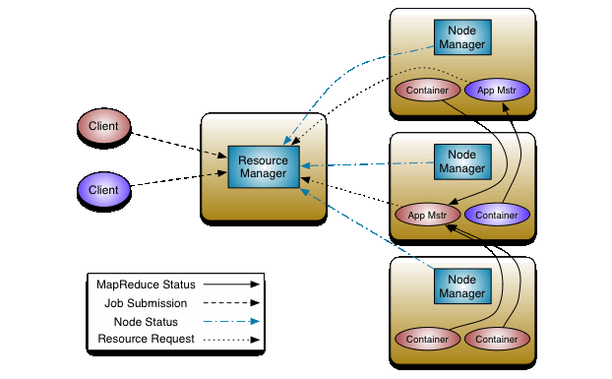
Spark deploy (yarn architecture)

Slide 15
Spark deploy (yarn-cluster)
Yarn-standalone
ApplicationMaster – userclass thread
Driver programs run on yarn cluster
Like mapreduce
Yarn-client
Driver programs run local, execute on yarn
Schedulerbackend starts workerlauncher which allocate worker and exectors

Slide 16
Spark streaming---D-Strem
Discretized streams: an efficient and fault-tolerant model for stream processing
Series of deterministic batch computations on small time intervals
Two types of operators
Transformation (stateless or stateful)
Output
Reuse all of the operators in Spark

Slide 17
Spark streaming --- dstream
pageViews = readStream(“http://a.com”, “ls”)
ones = pageViews.map(event => (event.url, 1))
Counts = ones.runningReduce((a,b) => a+b)
Stateful operators:
a) Windowing
Pairs.window(“5s”).reduceByKey(_+_)
b) Incremental aggregation:
Pairs.reduceByWindow(“5s”, (a,b)=>a+b)
c) Time-skewed joins

Slide 18
Spark stream -- dstream
Fault tolerance,
Replication (not cost-effective)
Upstream backup (long recovery time)
Parallel recover (D-stream method)
Periodically checkpoints some of the state RDDs
Deterministic transformations at the coarse granularity of RDD partitions

Slide 19
谢 谢！

