Slide 1

UART TO HDMI INTERFACE
TEAM GreenTeck
  Thor Smith
  Chun Ta Huang
  Hang Xie
  Xiao Zuguang

Slide 2

Overview
Product:
  UART To HDMI Interface
  Low Level GPU
Purpose
  Allow a simple microcontroller to drive an high definition TV by separating video processing from the microcontroller.
  Provide a cheap, simple, and fast product for use by students and hobbyists.

Slide 3
Overview
Main Features
  UART
  Frame Decoding
  GPU
  2x4MB SRAM Interface
  HDMI Encoder

Slide 4
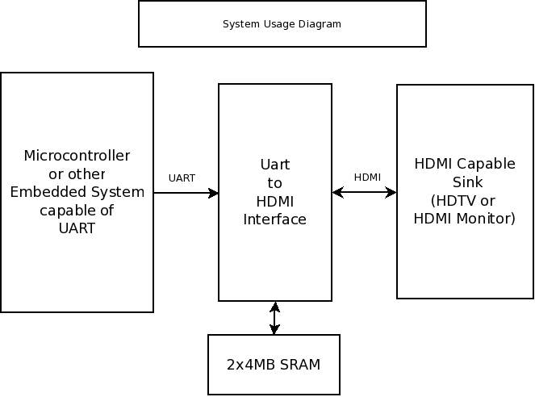
System Level Diagram
HDMI 1.3 Type A
CYM1851
CYM1851
CYM1851
CYM1851

Slide 5
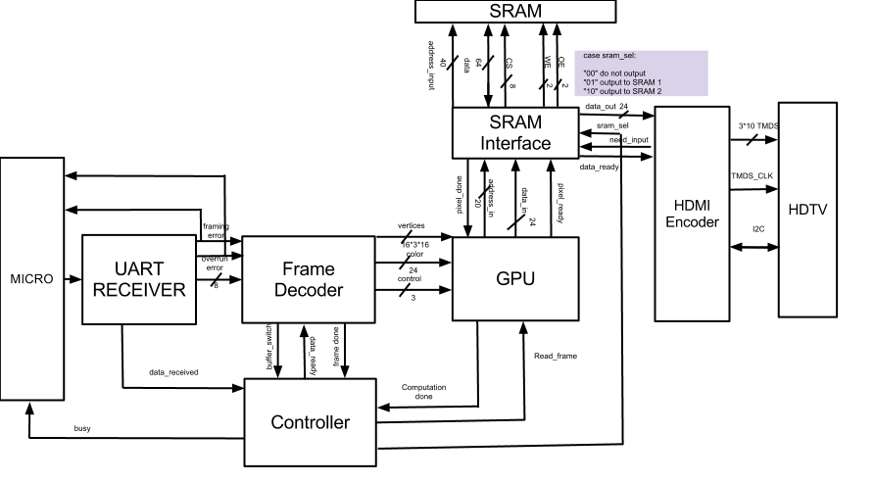
Architecture Diagram

Slide 6
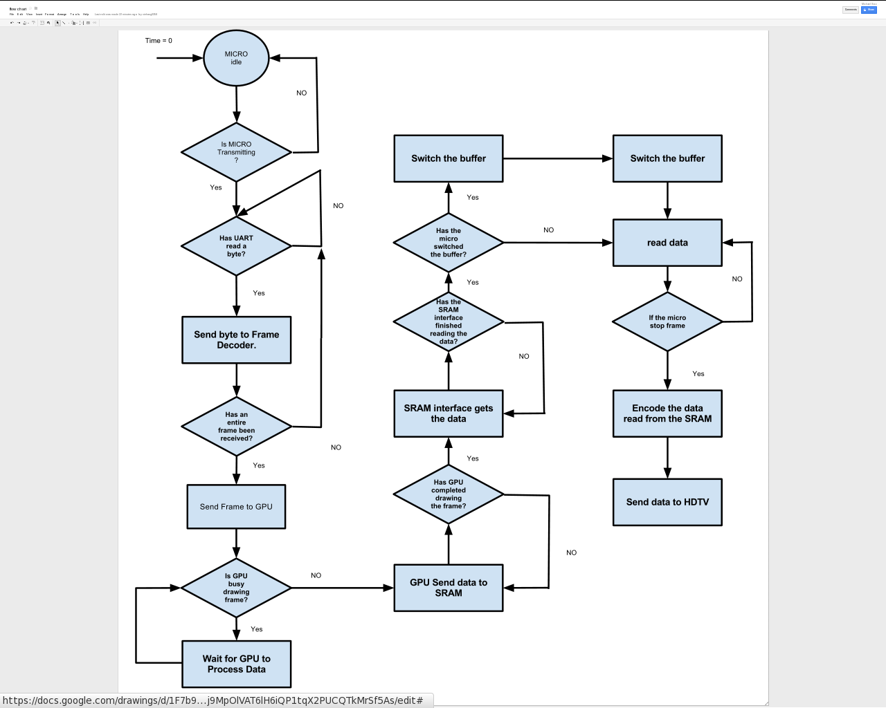
Flowchart

Slide 7
Detailed Diagrams
UART
Frame Decoder
GPU
Controller
SRAM Interface
HDMI Encoder

Slide 8
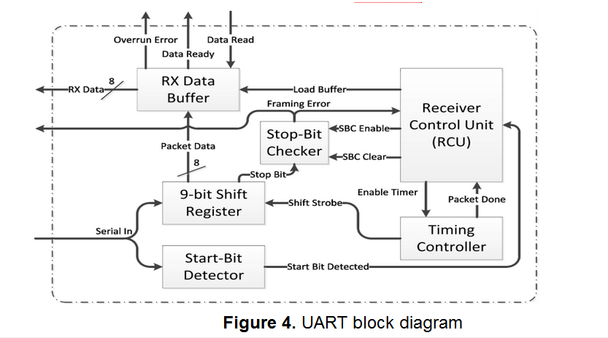
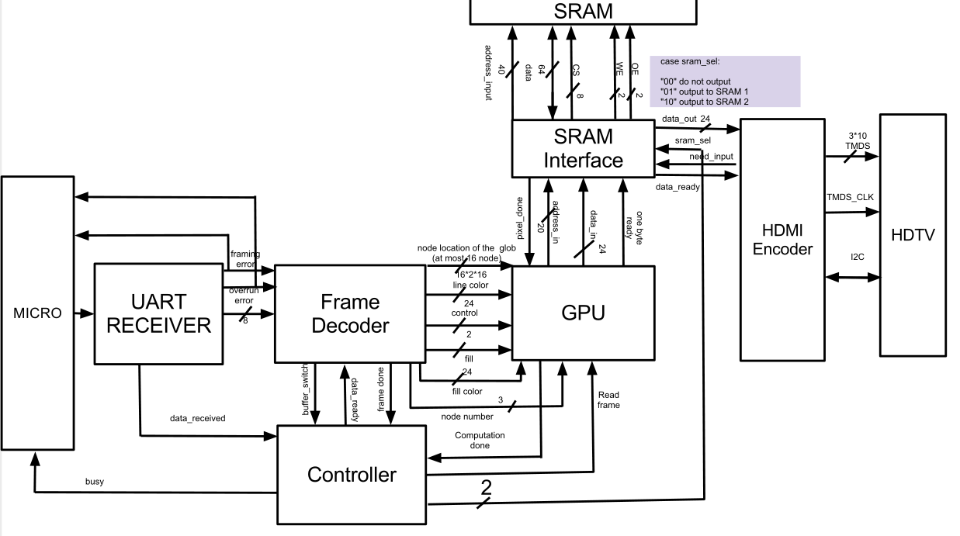
UART
Taken from the lab manual for ECE337 ASIC Design class Lab 5 P.9

Slide 9
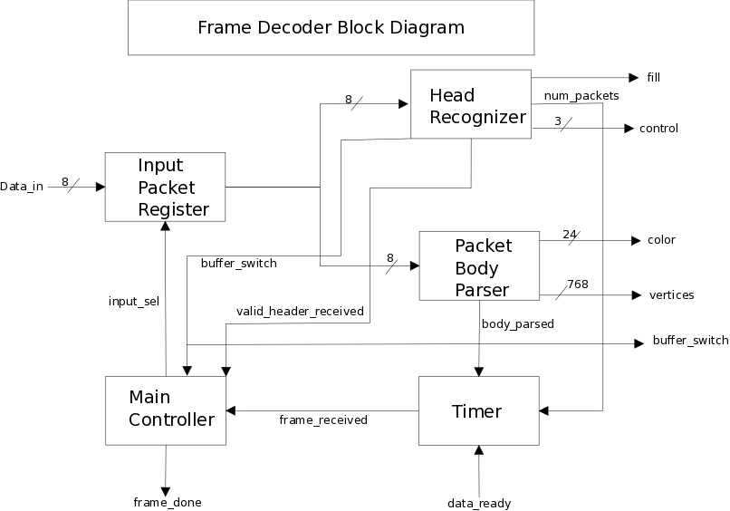
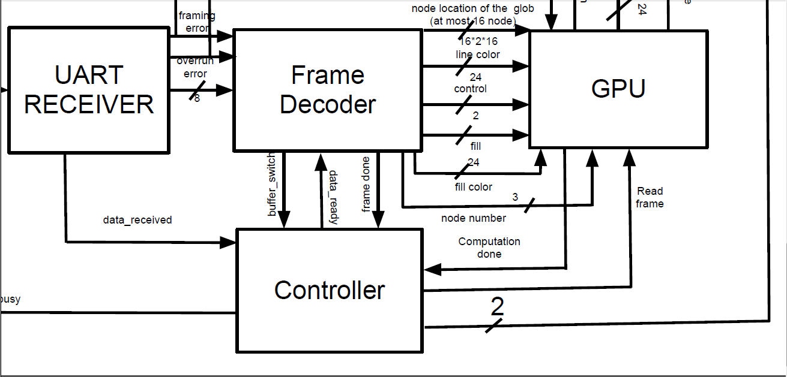
Frame Decoder
The Frame Decoder is not completely specified.
Also, there should be only one color value coming out.

Slide 10
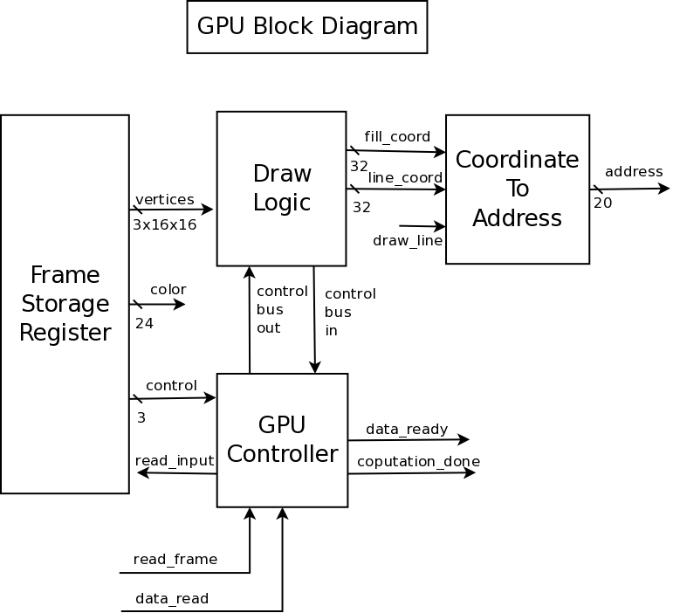
GPU

Slide 11
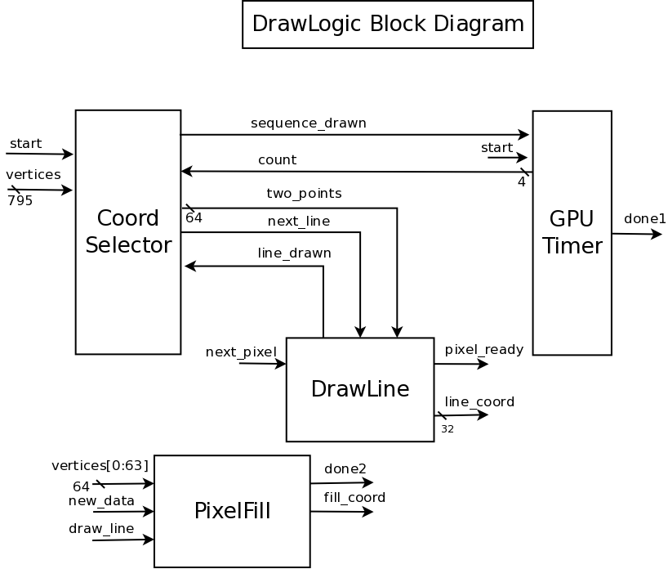
Draw Logic

Slide 12
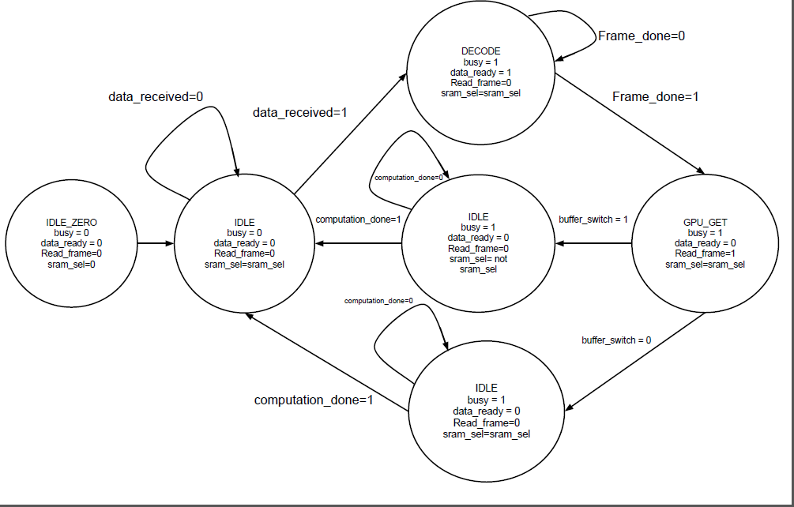
Controller

Slide 13
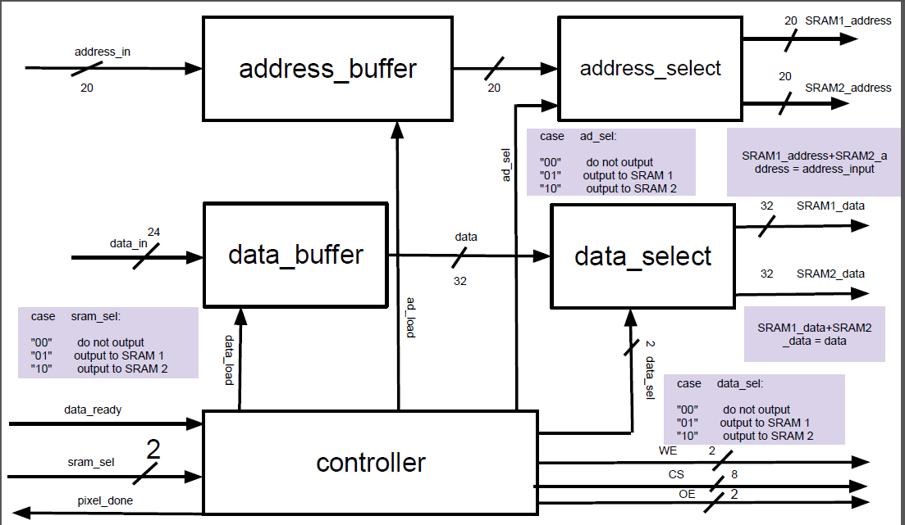
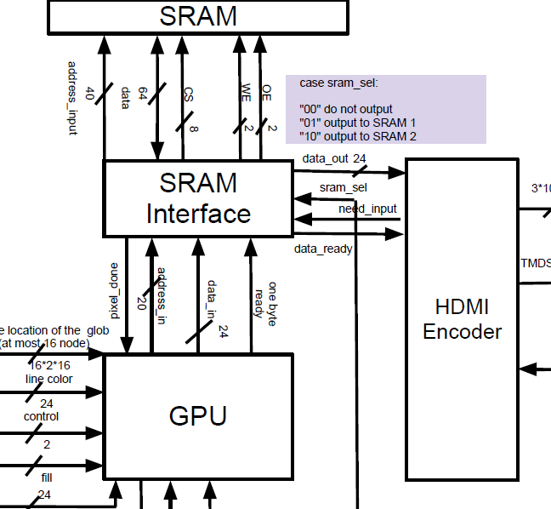
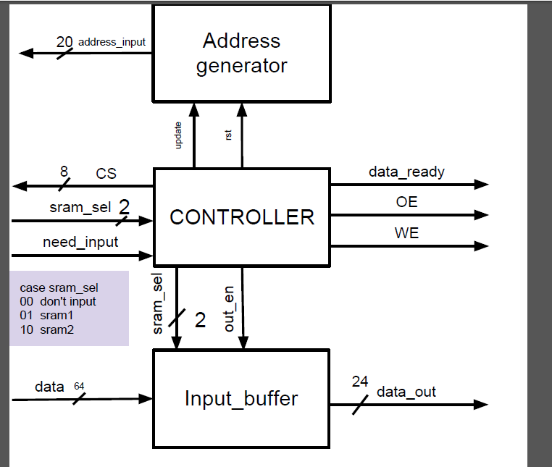
SRAM Interface
Sending data
Sending data
Extracting Data

Slide 14
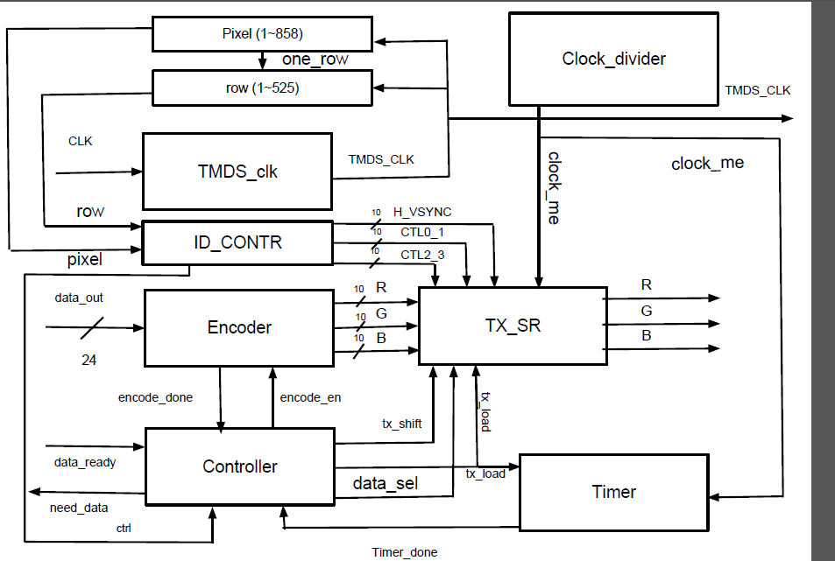
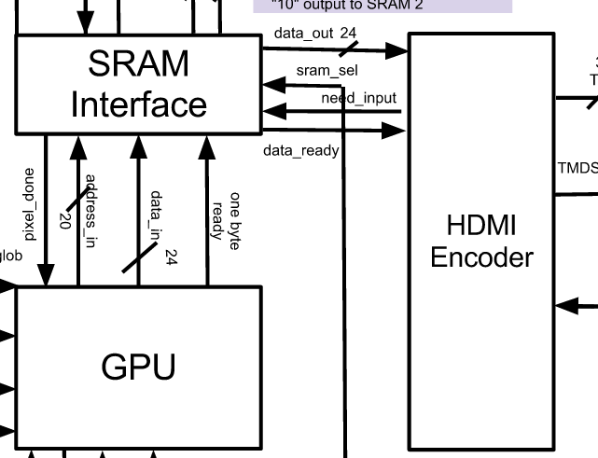
HDMI Encoder

Slide 15
Area Budget
Core Area Calculation
Name of Block | Category | FF count | Area() | Commints
UART RECEIVER | Reg.w/ Reset | 38 | 91200
Frame Decoder | Reg.w/ Reset | 620 | 1488000
GPU | Reg.w/ Reset | 613 | 28448700 | Flip Flop + Combinational Logic
SRAM Interface | Reg. w/ Reset | 80 | 168000
Controller | Reg.w/ Reset | 3 | 7200
HDMI Encoder | Reg. w/ Reset | 56 | 130000

Slide 16
Timing Budget
Starting component | Tp | Combination Logic | Tp | Ending Component | Tsetup/Tp | Total Delay
encoder output | 0.1 ns | 0.3 ns | 0 ns | TX_SR | 0.2 | 0.6 ns
address buffer | 0.1 | 0 ns | 0 ns | address_select | 0.2 | 0.3 ns
controller register output | 0.1 | 0.2 | 0 | controller register input | 0.2 | 0.5ns
UART shift register output | 0.1 | 0.2 | 0 | UART main controller register input | 0.2 | 0.5ns
frame decoder register output | 0.1 | 0.3 | 0 | frame decoder register input | 0.2 | 0.6ns

Slide 17
Q & A

Slide 18
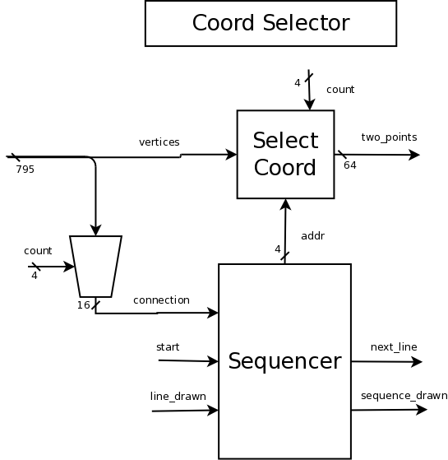
Coord Selector

Slide 19
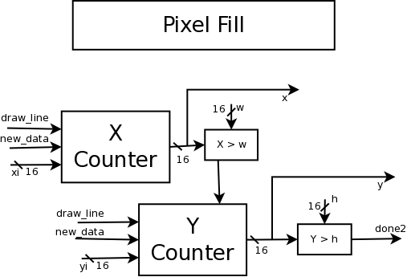
Pixel Fill

Slide 20
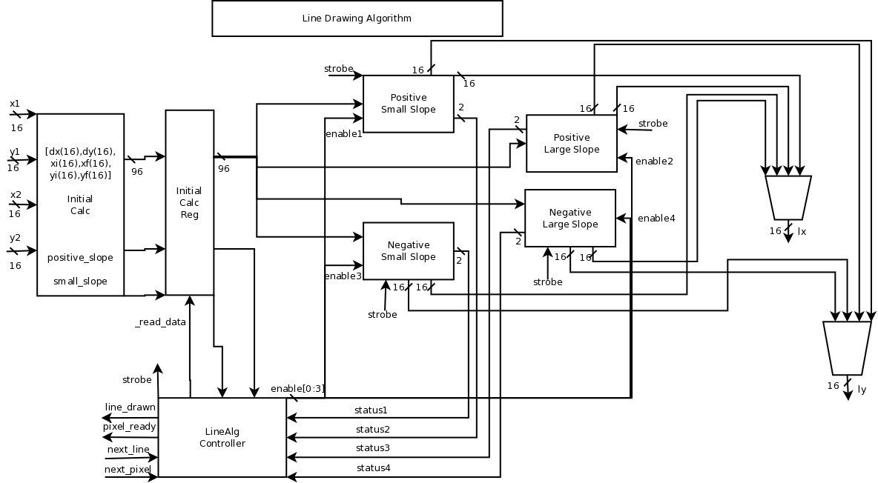
Line Drawing Algorithm

Slide 21
Positive Small Slope
Bresenham's algorithm is used to calculate the points. A variation of the pseudo code below is used:
Increment x from xi to xf
Write x,y pixel to buffer
err += dy
if (err << 1) >= dx
y += 1
err -= dx

Slide 22
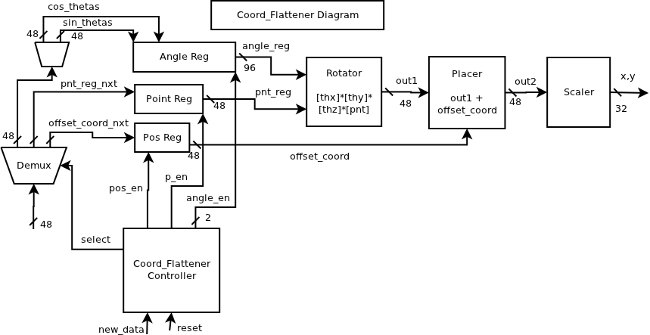
Coord Flattener

