Slide 1
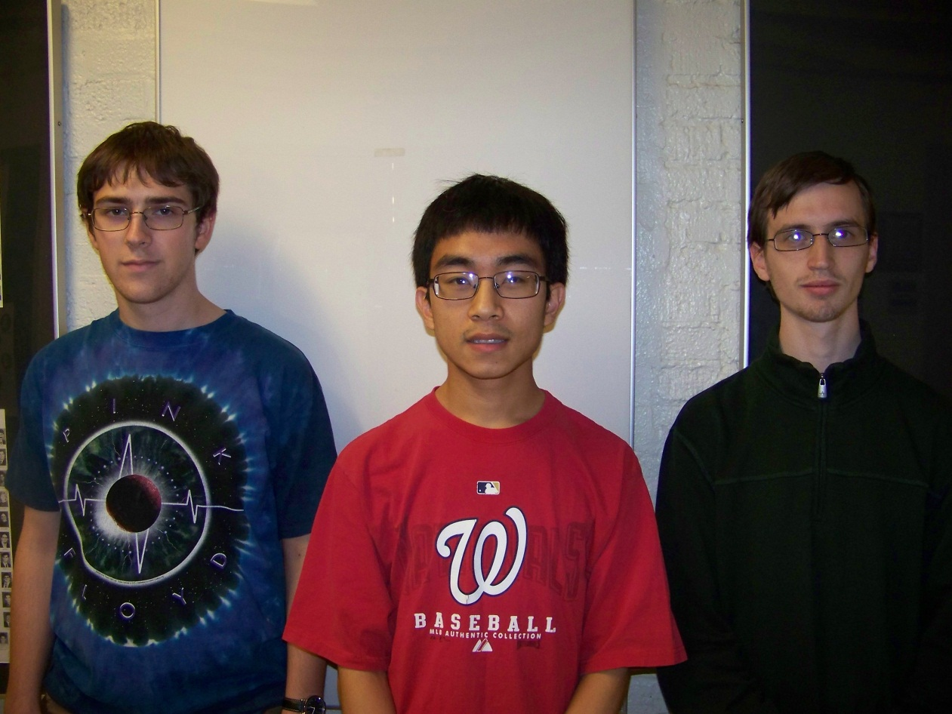
Augmented Reality Cornell Cup Mid Review Fall 2012
Stephen Carlson
Stephen Ellis
Thor Smith
Steven
Ellis
Stephen
Carlson
Thor
Smith

Slide 2
Outline
Challenge Definition
Project Entry Solution
Accomplishments to Date
Technical Ingenuity
Project Execution Overview
Complications
Opportunities
Recommendations and Next Steps

Slide 3
Challenge Definition
Wearable computing is emerging quickly
Google Glass, Samsung Galaxy Gear, and Oculus Rift.
Combine virtual reality with reality to create augmented reality
Provide information
Promote Teamwork
Decrease need for physical objects
The design will need to satisfy the following requirements:
Portable and Comfortable
Track user position and head orientation
Wireless Communication
Easy to set up and use
Transparent display, easy to see

Slide 4
USE cases
Artistic Performance
Performers need to know where to be and when.
Train a New Employee
Show a physical demonstration of equipment
Employee may observe machinery in operation.
Children Playing Games
Children Rely on “imaginary” objects placed in a select location.
Educational Demonstrations
Replace resources with virtual resources placed in appropriate locations.

Slide 5
Project entry solution
Headset:
Provide the display
Mounting point for sensors
Backpack:
Wireless communication
Graphics rendering
Simulation Logic
Will not focus on internet connectivity
Allow for multiple simulations.
Focus on Gaming

Slide 7
Accomplishments To Date
PHASE 1
PHASE 2

Slide 8
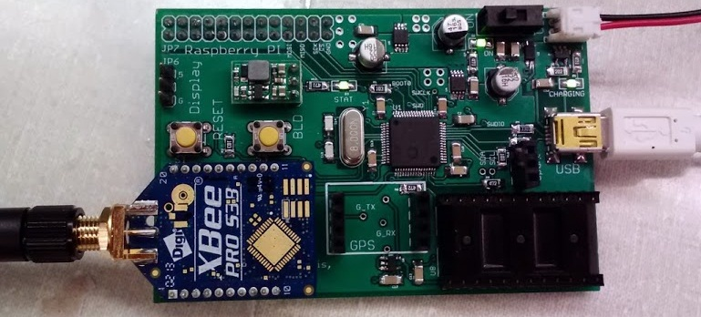
Accomplishments To Date (PHA1)
Hardware
Interfacing to Inertial Measurement Unit
Interfacing to GPS
Power management
Battery charging
Battery fuel gauge
Voltage regulation

Slide 9
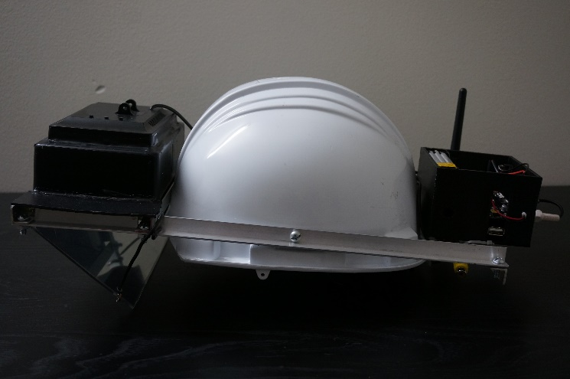
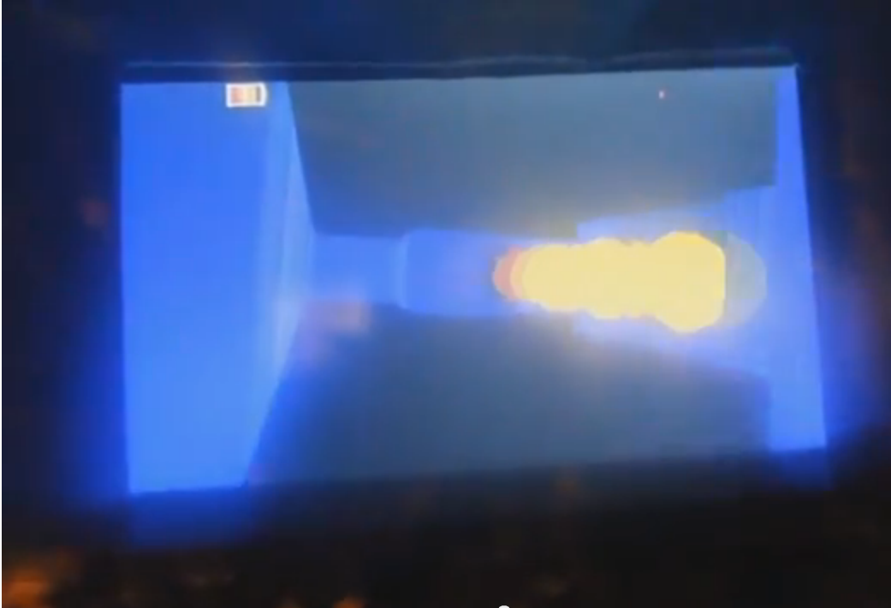
Accomplishments To Date (PHA1)
Self-contained headset
Hard hat with display and all
electronics mounted to rails
Software
OpenGL ES for 3D rendering
Networking: XBees with CCU
SPI communication between Pi and micro
MacPan game

Slide 10
Hardware metrics
Metric | Target | Description
Mass | Headset: 1 kg Backpack: 3 kg | Neither the headset nor the backpack can be too heavy to impede the performance of typical activities by the user.
Power | 3 hours runtime | Augmented reality applications run for long durations, so the device must operate long enough on battery power to be usable. The remaining battery capacity should be displayed to the user.
Location | Minimum 2 meter accuracy and precision | The accuracy of the rendered virtual world depends heavily on the accuracy and precision of the user’s geospatial position.
Wireless | 80 m range, line of sight | A unique feature of this device is the wireless coordination capability of multiple headsets in the same virtual environment. The current wireless signal strength should be reported to the user.
Comfort | No running speed or vision reduction | Ideally, the user would be able to perform actions without a noticeable burden on the user. It is difficult to quantitatively measure comfort, but the user should be able to orient their head, see the environment, and move from place to place as effectively as if the device was not worn.
Durability | Operate from 0 to 40 C indoors and outdoors in dry conditions | Most augmented reality applications involve users walking or running, which will subject the device to vibration and light impacts. In addition, sunlight, humidity, and dust are inherent concerns for a portable device.
Usability | End user can start up and use device without a technician | A user unfamiliar with the device technical details must be able to power on the device, perform start-up procedures such as wireless connection, and load the desired application.

Slide 11
Software metrics
Metric | Target | Description
3D Graphics | Minimum 5000 polygon count | The user will expect to see a good 3d image. Phase 2 offers opportunities to increase graphical performance.
Graphics | Minimum 20 Hz update rate | We will need to render ghosts and the maze walls in real time according to the user’s geospatial location and their head orientation.
Collision Detection | Minimum 2 meter accuracy and precision | The ability of the software to detect collision detection will be affected by the accuracy of the GPS. The minimum required to be meaningful cannot exceed a couple of meters. This means ghosts could be 2 m² to account for accuracy of GPS.
Network User Position Update Rate | Minimum of 20Hz (50ms). | The position and orientation of each headset will need to be communicated wirelessly at least every 50ms to keep up with the GPS and provide meaningful feedback about collisions to each headset.
Network Graphic Position Update Rate | Minimum of 20Hz (50ms) | The position information about positions of ghosts and other virtual objects needs to be updated in a timely manner and should at least be as fast as the update rate of the player’s position.
User Interface Usability | End user can navigate the user interface intuitively. | A user unfamiliar with the operation of the software should be able to figure it out with minimal references to the user manual. For phase 1 this will be displayed from the control unit. In phase 2 the user interface will migrate to the headset’s display.

Slide 12
Accomplishments To Date (PHA2)
Power consumption testing
Provided Terasic board uses 1.2 A typical (14.4 W)
Acceptable battery life with 60 Whr capacity
Hardware design for Phase 2
Power supply design
Battery and regulator selection
Headset interfacing board
Re-use GPS, inertial measurement unit, microcontroller
Packaging
Re-use optics
Selected new display
Selected helmet and backpack
[POWER CONSUMPTION]
[PCB]

Slide 13
Technical Ingenuity
Display virtual environment overlay on real world
Preserves real-world depth perception
Large field of view
Both worlds perceptible simultaneously
User head and position tracking
Filtering algorithm for inertial measurement data
Portability and battery operation
Wireless communication to other headsets
Multi-user augmented reality

Slide 14
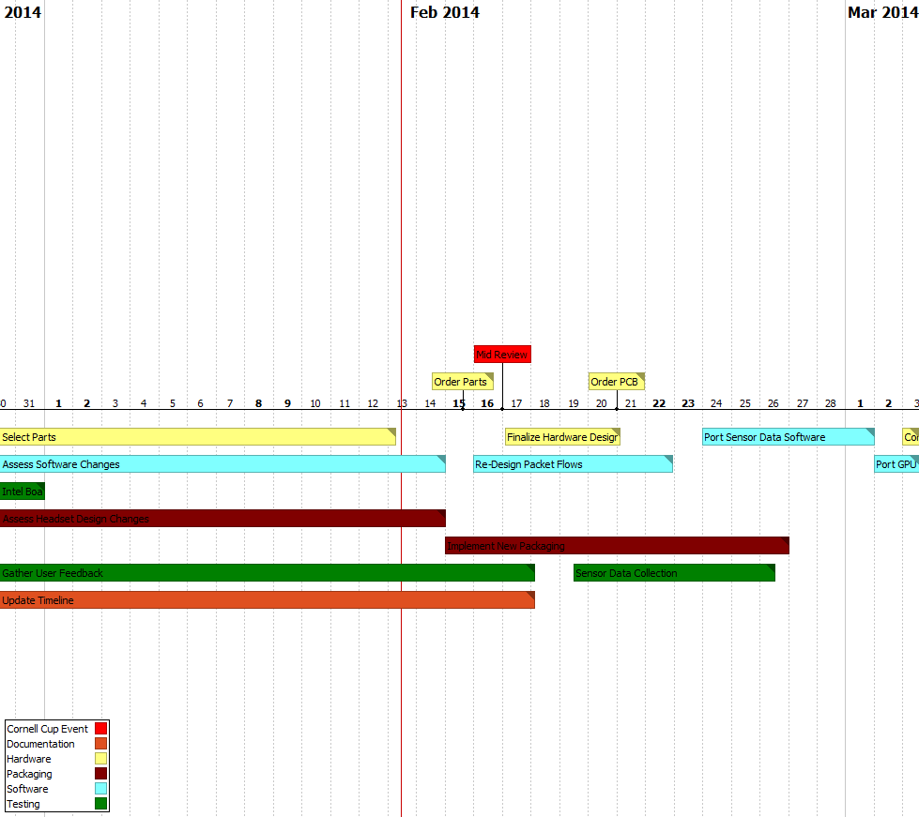
Execution overview – Timeline 1/3

Slide 15
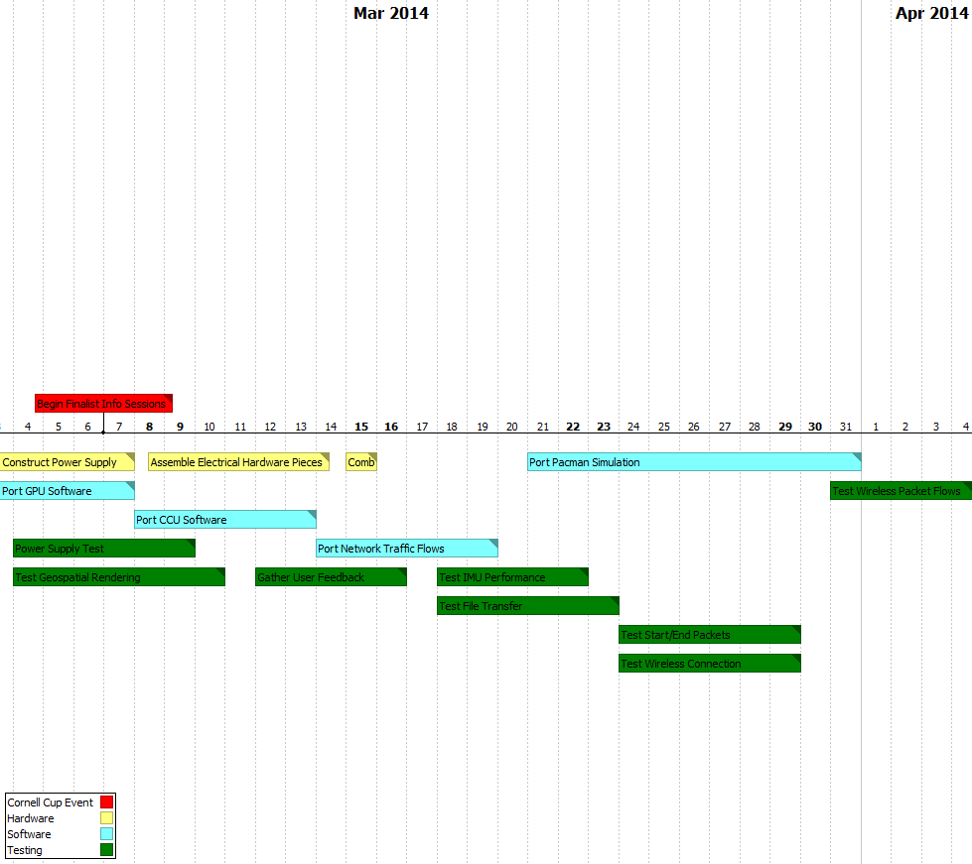
Execution overview – Timeline 2/3

Slide 16
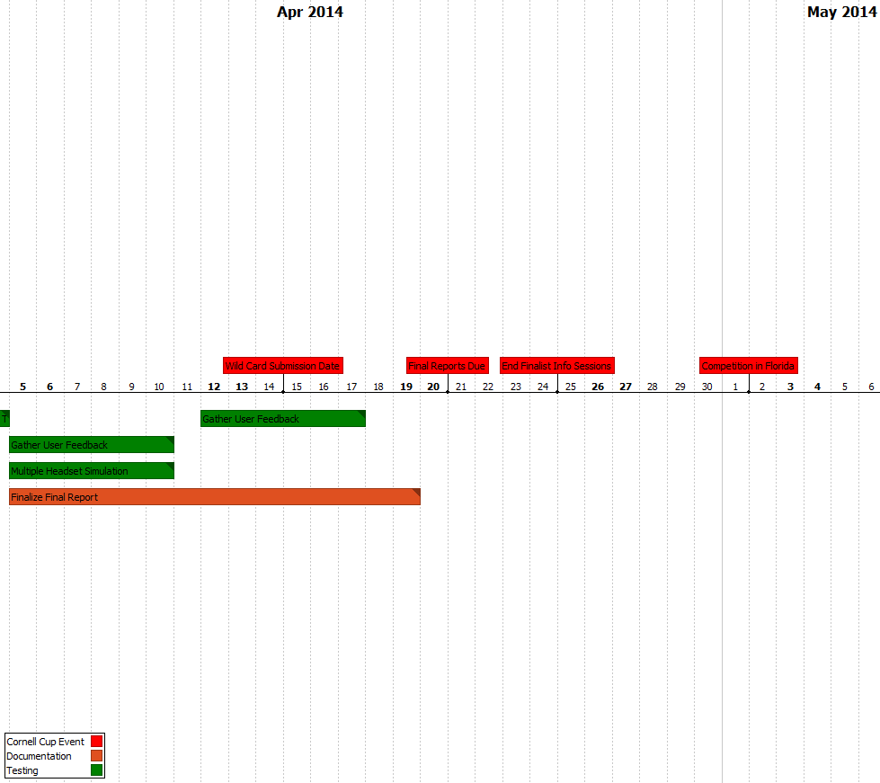
Execution Overview – Timeline 3/3

Slide 17
Execution overview - BUDGET
Name | Item | Vendor | Unit Price | Shipping | Quantity | Price
Battery |  | BatterySpace | 66.95 |  | 2 | 133.9
Screen1 |  | AdaFruit | 139.95 |  | 1 | 139.95
Screen2 |  | AdaFruit | 64.95 |  | 1 | 64.95
IMU |  | Mouser | $28.75 |  | 1 | 28.75
GPS |  | SparkFun | 49.99 |  | 1 | 49.99
Passives |  | Various | 10 |  | 2 | 20
PCB |  | Oshpark | 40 |  | 2 | 80
Microcontroller |  | DigiKey | 11.45 |  | 2 | 22.9
Charger |  | BatterySpace | 39.95 |  | 2 | 79.9
Regulator |  | Mouser | 13.23 |  | 2 | 26.46
Fuel Guage |  | DigiKey | 6.43 |  | 2 | 12.86
3D printed Box |  | Purdue IEEE | 40 |  | 2 | 80
Backpack | Draw String Backpack | Supplied | 10 |  | 0 | 0
Total |  |  | 521.65 |  |  | 739.66

Slide 18
COMPLICATIONS
Patent Liability
Novelty of design avoids many AR patents
Large fraction specifically mention cameras
Licensing may be required
Could file new patents and cross-license
User Safety
LiFePO₄ much safer than other Lithium battery chemistries
Translucent display keeps user aware of environment
Product unsuitable for use while driving, operating heavy machinery

Slide 19
Opportunities
Selling software to users after purchase of device
Need to set up distribution network
Encourage third party development
Anti-piracy solutions

Slide 20
Recommendations and Next Steps
Continued software development
Improve calculation of head orientation
Improve filtering of GPS data
Migrate software to new motherboard
Finalize packaging modifications for larger display
Testing of new hardware
Battery power and charging
Interfacing of Terasic board with existing microcontroller
Display

Slide 21
Questions / Discussion

Slide 22
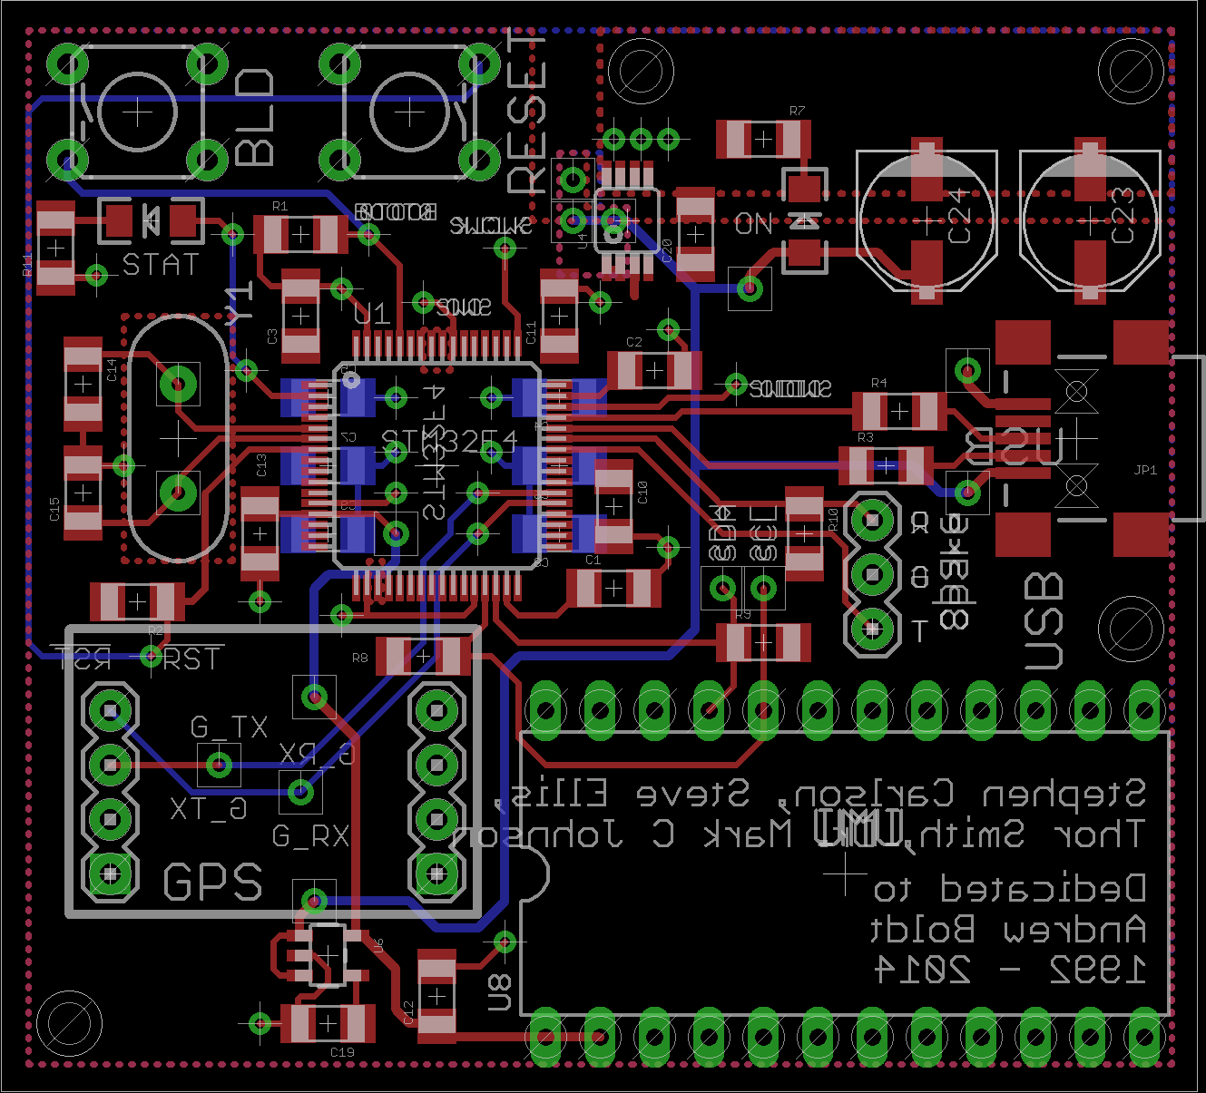
PCB

Slide 23
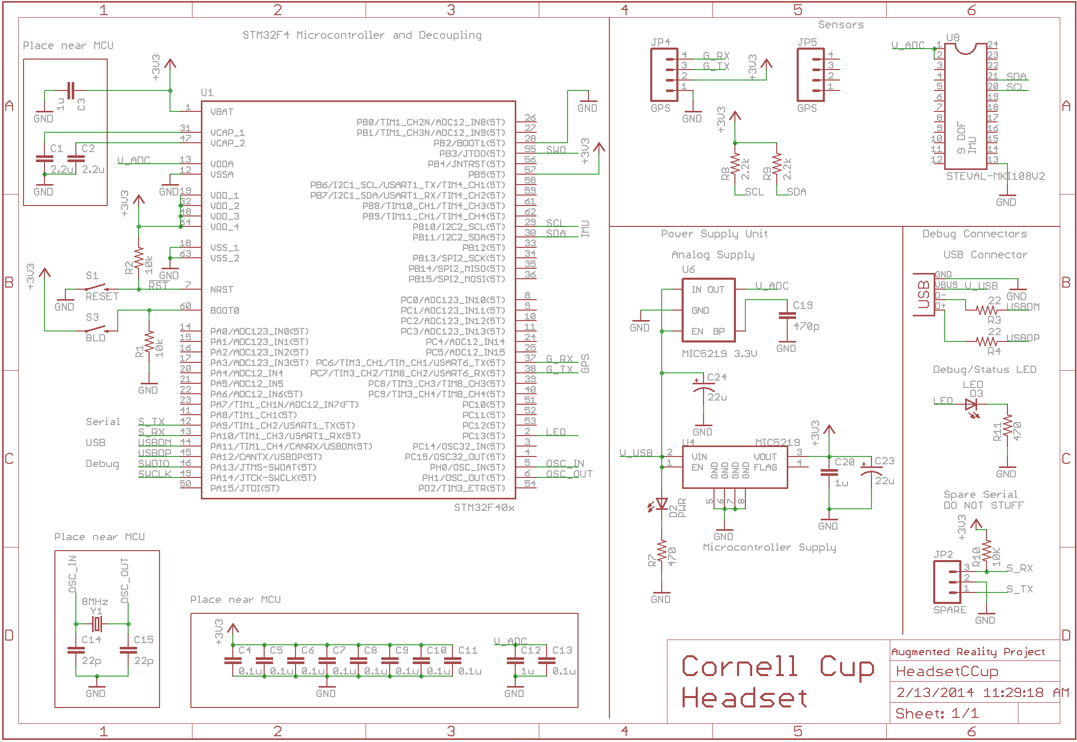
Schematic

