Slide 1
PCB Layout Narrative
Team 05 Augmented Reality Project
TCSP #05
Stephen Carlson, Steven Ellis, Alec Stephen Green, Thor Smith

Slide 2
Abstract
We propose an augmented reality simulator
Allows at least one user to play an electronic game in a mobile, outdoor environment
Intended for gaming and other simulations that require an augmented environment
Contains two primary parts: a headset and a central control unit (CCU)
The headset is worn by the user and overlays images of game objects on the user’s view of the environment
The CCU remains stationary and communicates information to the headset about simulation logic.

Slide 3
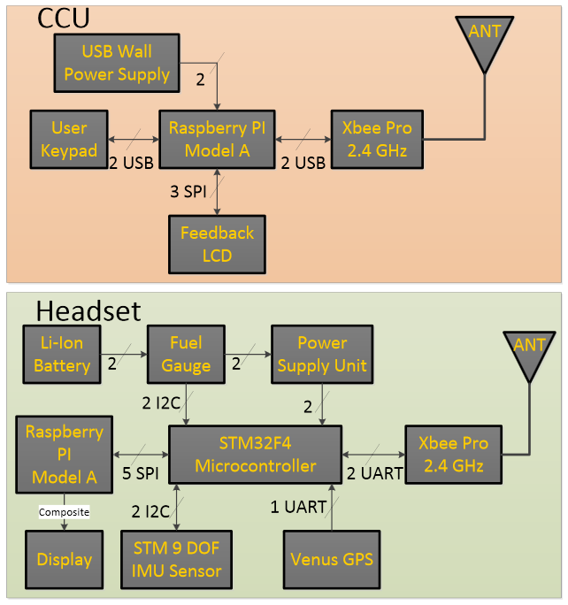
Functional Block Diagram
* CCU will not have a PCB

Slide 4
PSSC Review
An ability to render graphics based on the orientation of the user’s head.
An ability to render graphics based on the user’s current geospatial location.
An ability to monitor and display the battery power level of the headset to the user.
An ability to monitor and display the status and quality of the wireless connection to the central control unit.
An ability to load headset graphics for a new simulation without re-flashing software on the headset’s microcontroller.

Slide 5
Layout Considerations – General
Advanced Circuits/4PCB specs
5mil trace/5mil space
10mil minimum hole size and 5mil tolerance
For manufacturability
10mil trace/8mil space
15mil minimum hole size
No acute angles
Two layers

Slide 6
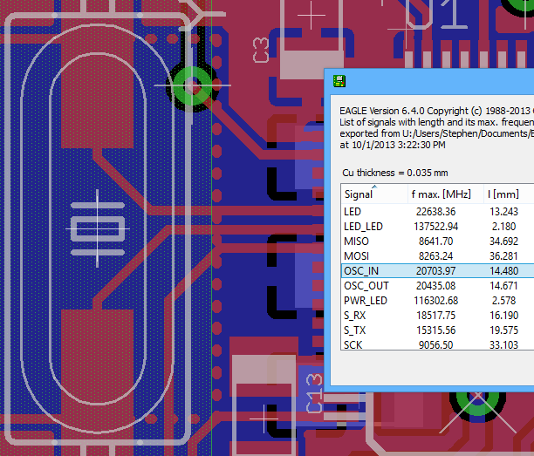

Layout Considerations – MCU
Oscillator and USB lines match impedance
Trace lengths must match
No right angles
Decoupling, oscillator must be adjacent
Place some capacitors underneath chip
Pin locations determine routing success

Slide 7
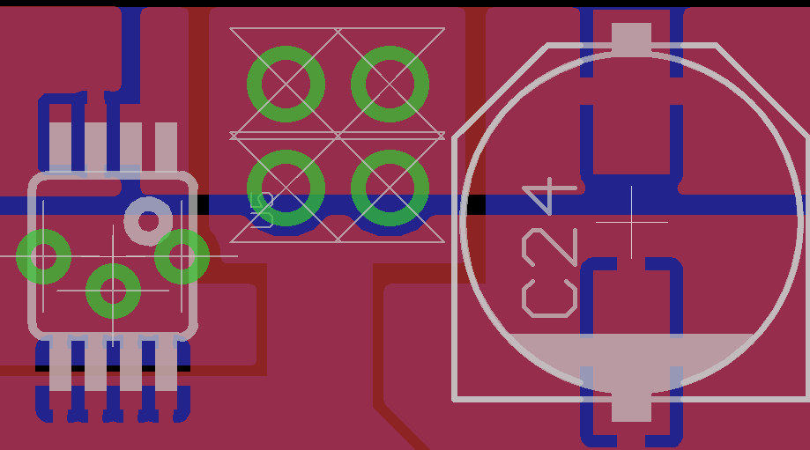
Layout Considerations – Power
Total current could be up to 2A
Use low resistance copper pours
Multiple large vias for transfer between layers
Power from multiple directions (“islands”)
Bulk capacitors near regulator, bypass near loads

Slide 8
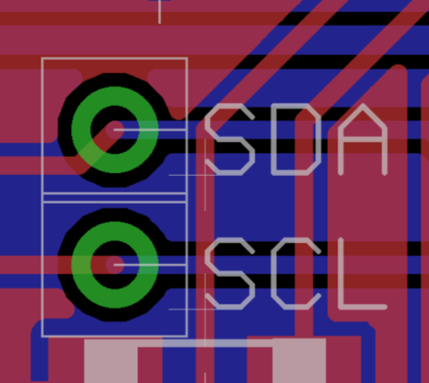
Layout Considerations – Other
Connectors
Raspberry PI connector must match motherboard
Other connectors must be on edges
Route I²C, UART, SPI lines together
Test points
Debug LEDs, spare I/O headers
Place V_ADC regulator near IMU
Reduce interference pickup
Place XBee far away

Slide 9
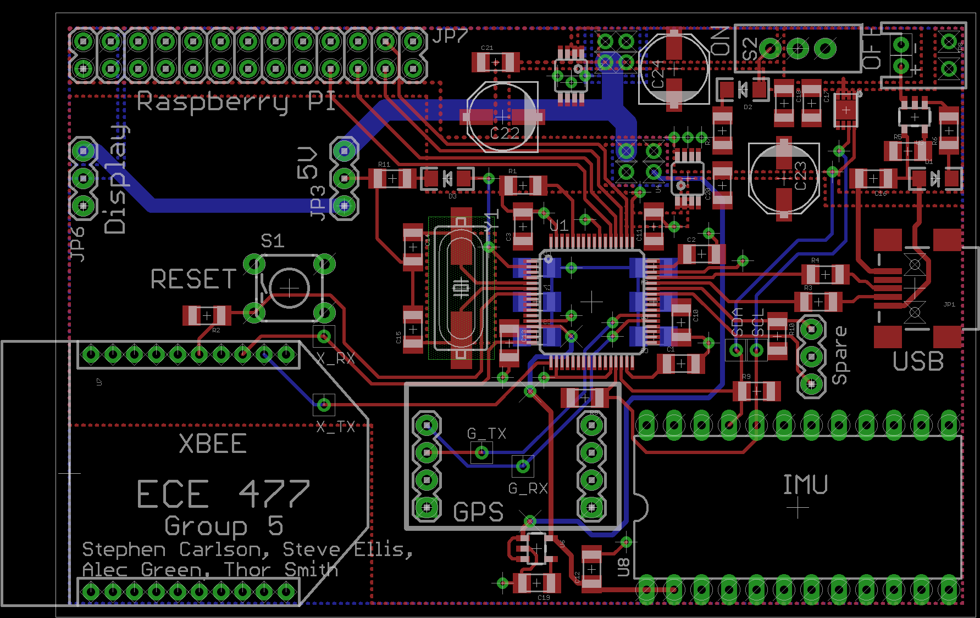
Layout, Full Board

Slide 10
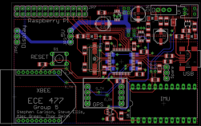
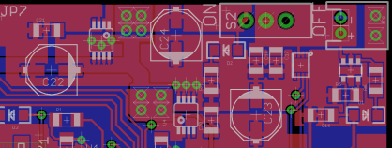
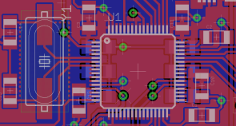
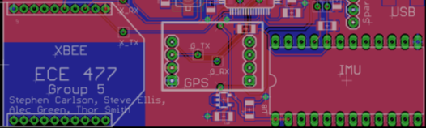
Questions

Slide 11
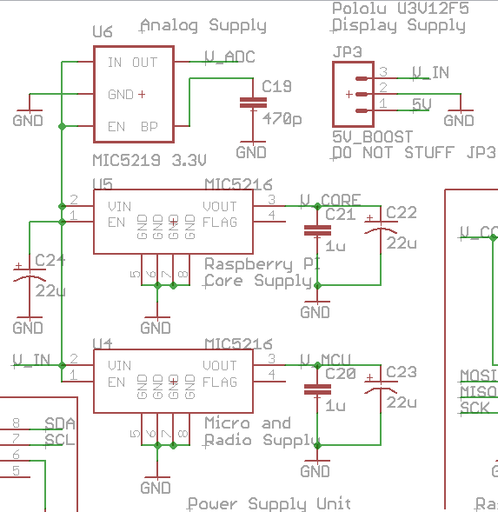

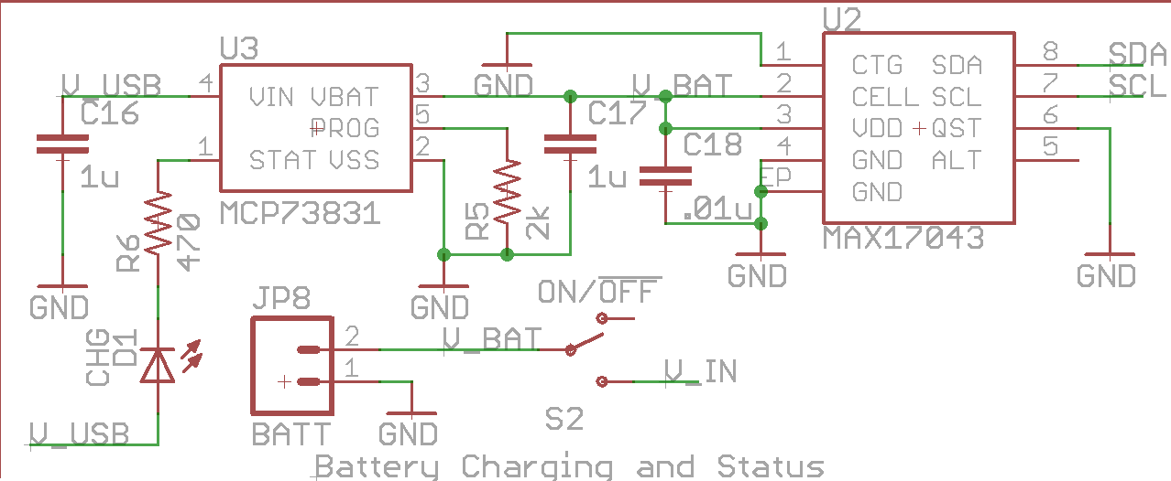
Layout, Power Supply
Power Switch
JST Connector
Fuel Gauge
Charger
Power LED
Core Supply
MCU Supply
Charging LED

Slide 12
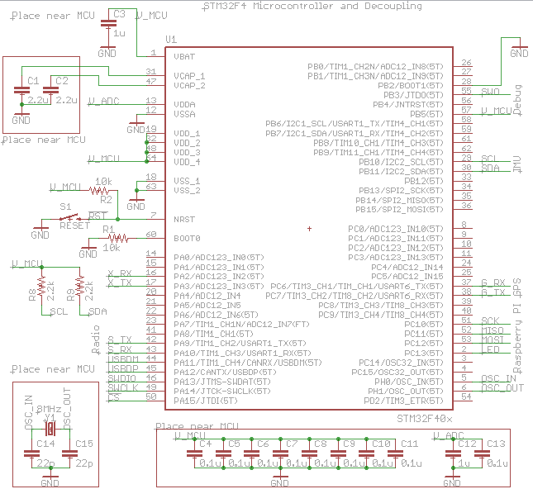
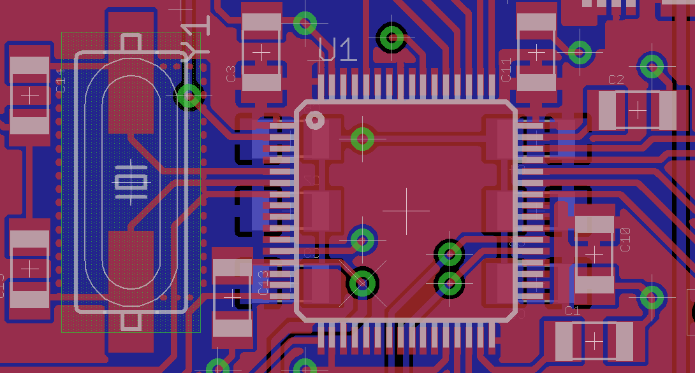
Layout, Microcontroller
SPI to
Raspberry PI
8MHz
Oscillator
To USB
(programming)
STM32F4
Microcontroller
To Reset Button
UART to XBee
UART to GPS
I²C to IMU

Slide 13
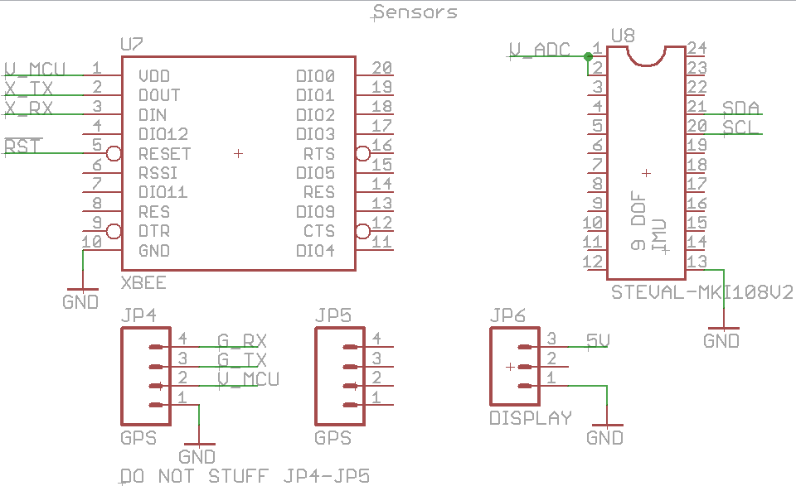
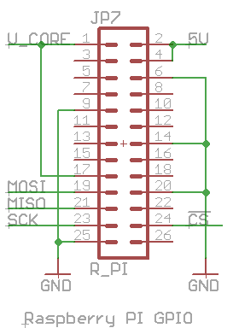
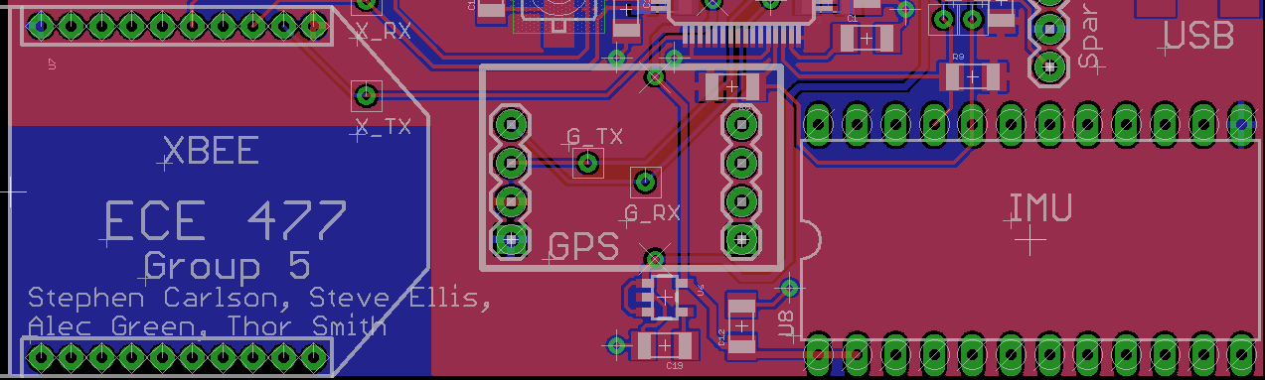
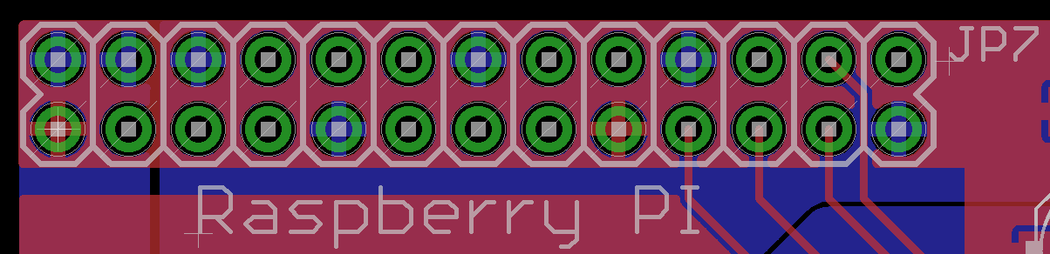
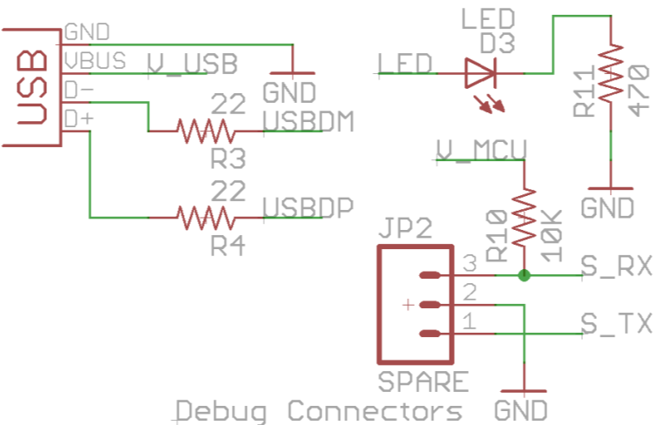
Layout, Peripherals
Venus GPS Breakout
XBee Pro 900
V_ADC
Supply
ST 9-DOF IMU Breakout

