Slide 1
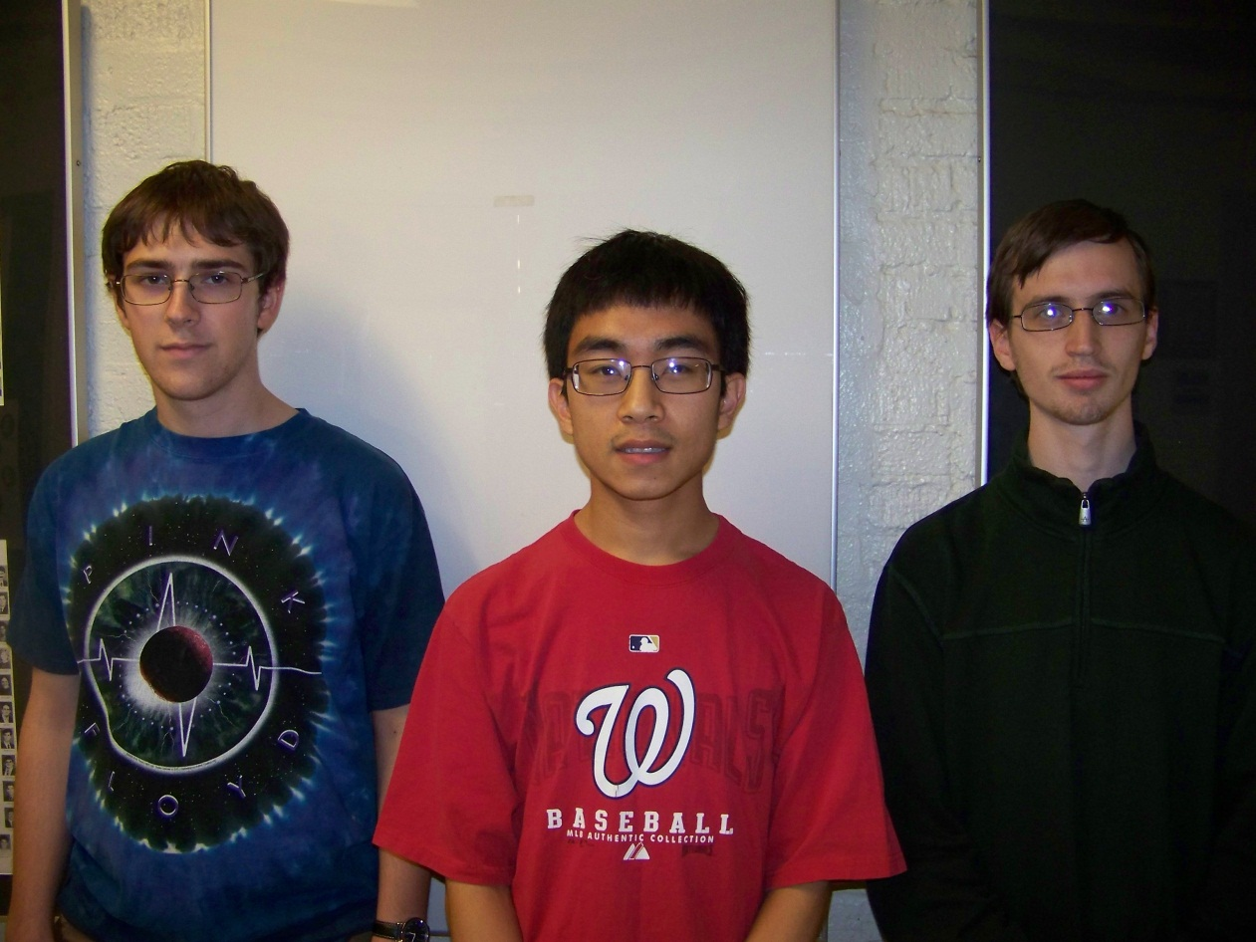
Augmented Reality Cornell Cup Mid Review Fall 2012
Stephen Carlson
Stephen Ellis
Thor Smith
Steven
Ellis
Stephen
Carlson
Thor
Smith

Slide 2
Outline
Challenge Definition
Project Entry Solution
Accomplishments to Date
Technical Ingenuity
Project Execution Overview
Complications
Opportunities
Recommendations and Next Steps

Slide 3
Challenge Definition
Wearable computing is quickly becoming the next step of embedded systems evolution as evidenced by devices like Google Glass, the Samsung Galaxy Gear, and Oculus Rift.
The challenge is to combine virtual reality with reality to create augmented reality in such a way as to enhance one’s ability to work on a team and allow virtual objects to take the place of physical items placed in select locations.
The design will need to satisfy the following requirements:
Portability and Comfortable Use
Determine position of user and orientation of users head
Local Wireless Communication
Easy to set up and use
Display must be transparent and cause minimal eye strain.

Slide 4
USE cases
When practicing for an artistic performance, people to know where they need to be and when.
When training a new employee, the employee may need to be shown a physical demonstration of using the equipment and he or she may need observe how the machinery operates.
Children playing games outside rely on “imaginary” objects placed in a select location.
Educational demonstrations may require lots of equipment placed in appropriate locations.

Slide 5
Project entry solution
We propose a headset and backpack solution. (Just like Incredible HUD, proof concept works)
The headset provides the display for the user and mounting point for head tracking sensors.
The backpack provides wireless communication, graphics rendering, and simulation logic.
Will not focus on internet connectivity (different from Google Glass/Samsung Galaxy)
Allows multiple simulations to be loaded onto the device in a modular fashion.
Will focus on gaming as an open-ended way to push the limits of the technology and generate excitement/creativity for the project development.

Slide 7
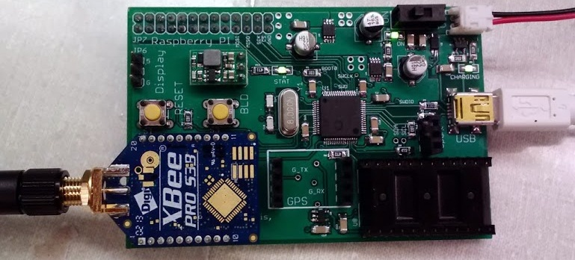
Accomplishments To Date (PHA1)
Hardware
Interfacing to Inertial Measurement Unit
Interfacing to GPS
Power management
Battery charging
Battery fuel gauge
Voltage regulation

Slide 8
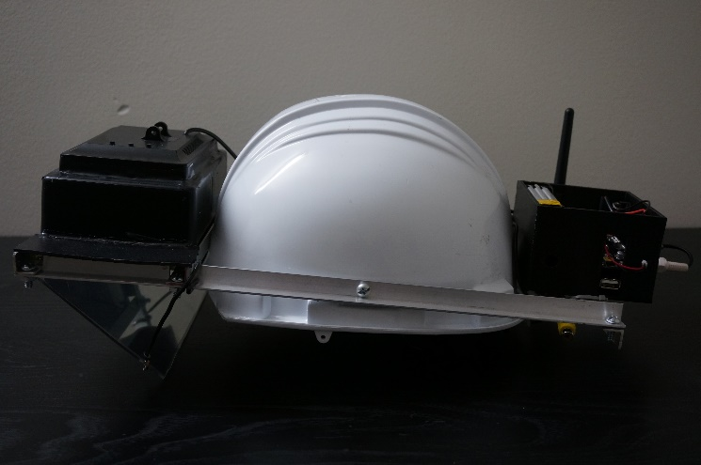
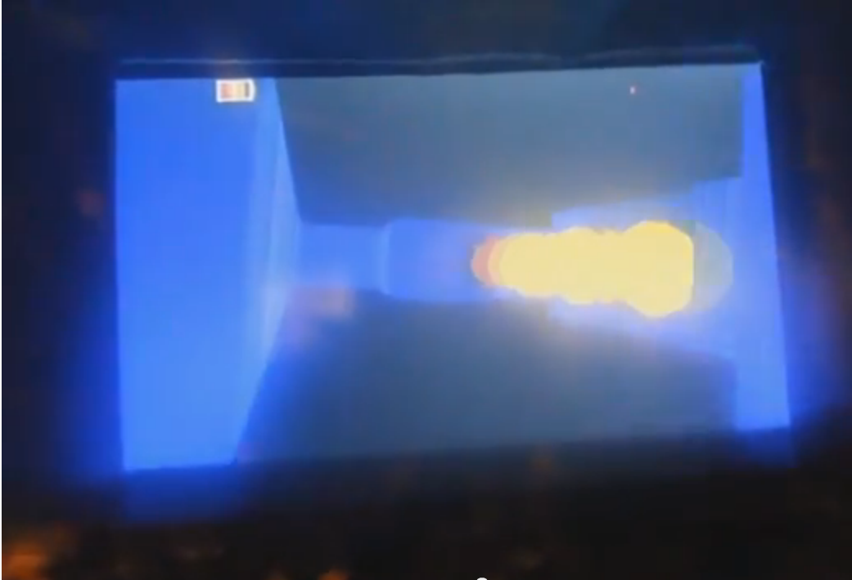
Accomplishments To Date (PHA1)
Self-contained headset
Hard hat with display and all
electronics mounted to rails
Software
OpenGL ES for 3D rendering
Networking: XBees with CCU
SPI communication between Pi and micro
MacPan game

Slide 9
Accomplishments To Date (Pha1)
Performance Metric | Phase One | Target
Weight | 2 kg [???] | 4 kg
Battery life | 3 hours | 5 hours
Framerate | 30 FPS | 60 FPS
Head tracking Latency | [???] | 60 ms
Location accuracy
Display Brightness | 200 nits | 300 nits

Slide 10
Accomplishments To Date (PHA2)
Power consumption testing
Provided Terasic board uses 1.2 A typical (14.4 W)
Acceptable battery life with 60 Whr capacity
Hardware design for Phase 2
Power supply design
Battery and regulator selection
Headset interfacing board
Re-use GPS, inertial measurement unit, microcontroller
Packaging
Re-use optics
Selected new display
Selected helmet and backpack
[POWER CONSUMPTION]
[PCB]

Slide 11
Technical Ingenuity
Display virtual environment overlay on real world
Preserves real-world depth perception
Large field of view
Both worlds perceptible simultaneously
User head and position tracking
Filtering algorithm for inertial measurement data
Portability and battery operation
Wireless communication to other headsets
Multi-user augmented reality

Slide 12
Execution overview – Timeline
Approximately 3 weeks behind expected schedule.
Added more tasks and worked to clarify testing tasks.
Created Explicit task for working on Final Report.

Slide 13
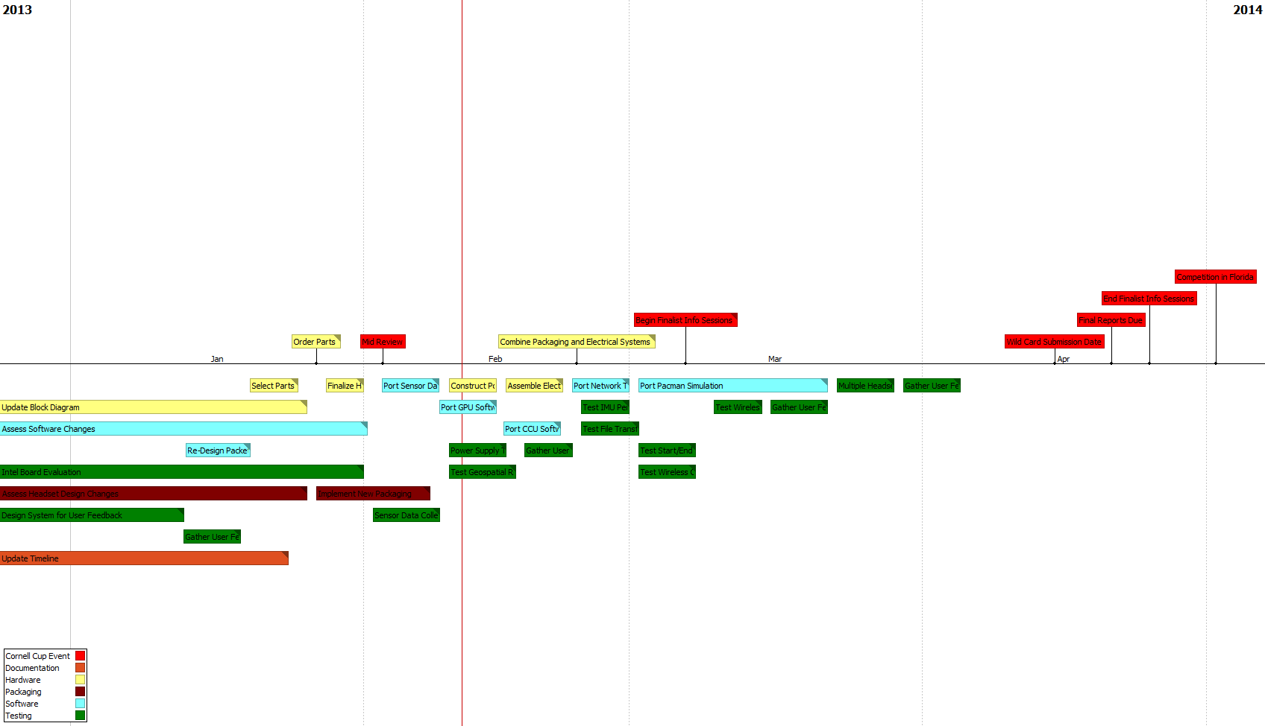
Execution overview – Timeline A

Slide 14
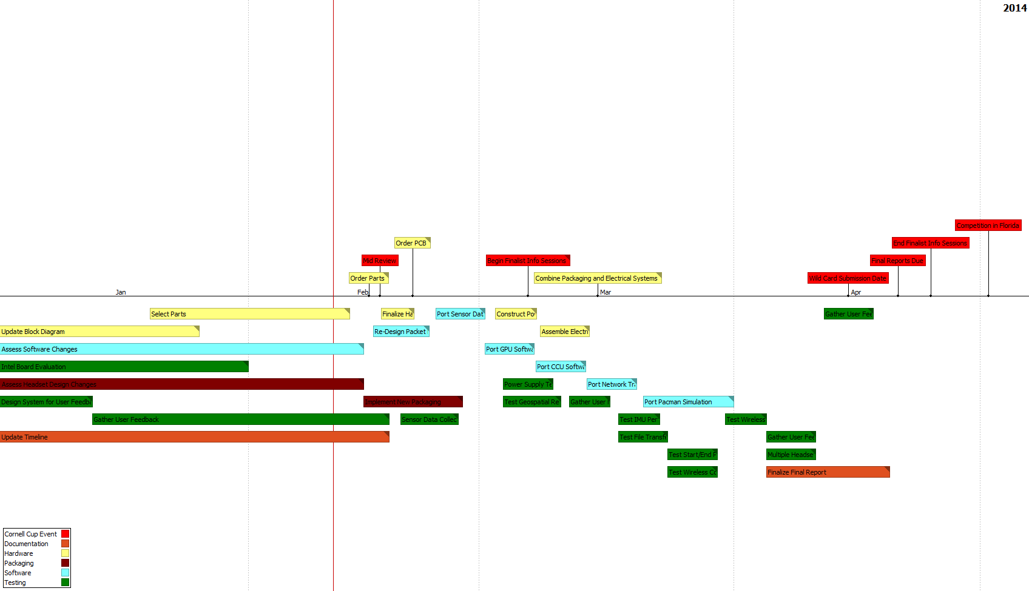
Execution overview – Timeline B

Slide 15
Execution overview - BUDGET
Name | Item | Vendor | Unit Price | Shipping | Quantity | Price
Battery |  | BatterySpace | 66.95 |  | 2 | 133.9
Screen1 |  | AdaFruit | 139.95 |  | 1 | 139.95
Screen2 |  | AdaFruit | 64.95 |  | 1 | 64.95
IMU |  | Mouser | $28.75 |  | 2 | 57.5
GPS |  | SparkFun | 49.99 |  | 2 | 99.98
Passives |  | ????? | 10 |  | 2 | 20
PCB |  | Oshpark | 40 |  | 2 | 80
Microcontroller |  | DigiKey | 11.45 |  | 2 | 22.9
Power Supply |  | ???? | 30 |  | 2 | 60
Charger |  | BatterySpace | 39.95 |  | 2 | 79.9
Regulator |  | Mouser | 13.23 |  | 2 | 26.46
Fuel Guage |  | ???? | 10 |  | 2 | 20
3D printed Box |  | ???? | 40 |  | 2 | 80
Backpack |  | ???? | 10 |  | 2 | 20
Packaging |  | ???? | 50 |  | 2 | 100
Total |  |  | 605.22 |  |  | 1005.54

Slide 16
COMPLICATIONS
Patent Liability
Novelty of design avoids many AR patents
Large fraction specifically mention cameras
Licensing may be required
Could file new patents and cross-license
User Safety
LiFePO₄ much safer than other Lithium battery chemistries
Translucent display keeps user aware of environment
Product unsuitable for use while driving, operating heavy machinery

Slide 17
Opportunities
Selling software to users after purchase of device
Need to set up distribution network
Encourage third party development
Anti-piracy solutions

Slide 18
Recommendations and Next Steps
Continued software development
Improve calculation of head orientation
Improve filtering of GPS data
Migrate software to new motherboard
Finalize packaging modifications for larger display
Testing of new hardware
Battery power and charging
Interfacing of Terasic board with existing microcontroller
Display

Slide 19
Questions / Discussion

