Slide 1
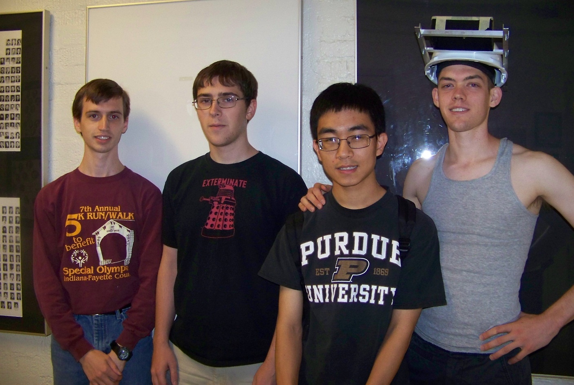
ECE 477 Design Review Team 5 Fall 2012
Stephen Carlson
Stephen Ellis
Alec Green
Thor Smith
Thor
Smith
Steven
Ellis
Stephen
Carlson
Alec
Green

Slide 2
Outline
Project overview
Project-specific success criteria
Block diagram
Component selection rationale
Packaging design
Schematic and theory of operation
PCB layout
Software design/development status
Project completion timeline
Questions / discussion

Slide 3
Project Overview
We propose an augmented reality simulator
Allows at least one user to play an electronic game in a mobile, outdoor environment
Intended for gaming and other simulations that require an augmented environment
Contains two primary parts: a headset and a central control unit (CCU)
The headset is worn by the user and overlays images of game objects on the user’s view of the environment
The CCU remains stationary and communicates information to the headset about simulation logic.

Slide 4
Project Specific Success Criteria
An ability to render graphics based on the orientation of the user’s head.
An ability to render graphics based on the user’s current geospatial location.
An ability to monitor and display the battery power level of the headset to the user.
An ability to monitor and display the status and quality of the wireless connection to the central control unit.
An ability to load headset graphics for a new simulation without re-flashing software on the headset’s microcontroller.

Slide 5
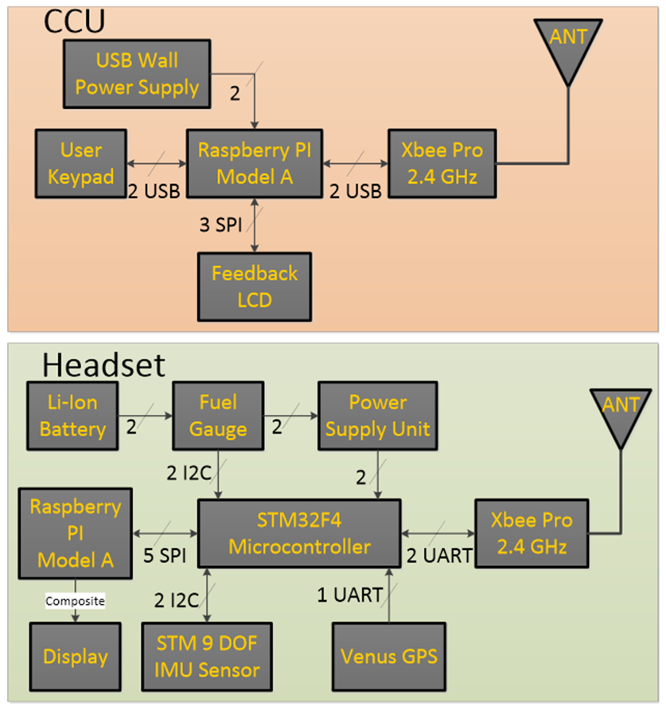
Block Diagram
Figure 1: The block diagram indicates two functional groups that communicate through the Xbee wireless devices.
The CCU will perform simulation logic
The headset will perform graphics rendering and sensor data acquisition.

Slide 6
Component Selection Rationale
Headset
Micro
GPS and IMU interfacing
Wireless communication
Battery monitor interfacing
Motherboard
Render graphics
Central control unit motherboard
Wireless communication
Data storage
Game logic

Slide 7
Microcontroller Constraints
Must be capable of low latency sensor processing
High speed for floating point math
Required external peripherals
2 UART (GPS, Wireless module)
1 SPI (Display/Motherboard connector)
1 I2C (Power Monitor, IMU)
At least 10 additional GPIO pins
Prefer 3.3V supply and 3.3V I/O

Slide 8
Microcontroller Choices
STM32F405RGT6
ARM-Cortex M4F
168 MHz with FPU
192 KB RAM
64 LQFP 51 I/O
$11 single quantity
Selected because
FPU (1 cycle multiply!)
ART Accelerator (instruction cache)
PIC32MX695F512H
MIPS
80 MHz
128 KB RAM
64 TQFP 53 I/O
$10 single quantity
Rejected because
Lower IPC
Slower clock

Slide 9
Motherboard Constraints (CCU)
Uses
Game logic
Store game objects to load onto headsets
Required peripherals
USB for user input device
1 UART (or USB UART) for Wireless module
Display output (HDMI, Composite, VGA)

Slide 10
Motherboard constraints (headset)
Main Constraints
3D graphics rendering needs fast GPU
Required peripherals
1 SPI for microcontroller connection
Display output (HDMI, Composite, VGA)
Other constraints
Power usage should be suitable for batteries

Slide 11
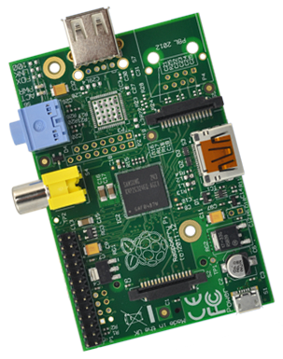
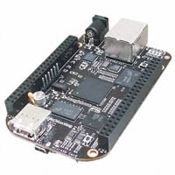
Motherboard Choices
Raspberry PI ModelA
Low-cost ($40 total)
700 MHz ARM11
Low-power (2W)
Selected because
Power consumption
Community support
Cost
BeagleBone Black
$45
1GHz Cortex-A8
Low-power (2.5W)
Rejected because
Slower GPU
No composite video

Slide 12
OTHER CHOICES
GPS
Venus638LPx
High accuracy (claimed 2.5m) and refresh rate (20Hz)
9DOF
LSM303DLHC
Low cost but still high accuracy
More expensive unit has on-chip filtering but requires NDA
Wireless
XBee Pro 900HP
Long range (claimed 6 miles, tested ~300m)

Slide 13
Packaging Design
Requirements
Relatively light weight, balanced
Display focusing and field of view
Materials
Hat/helmet
Enclosures for display, PCB/battery stack
Angle aluminum for mounting frame
Acrylic or polycarbonate sheet
Reflective film
Lenses

Slide 14
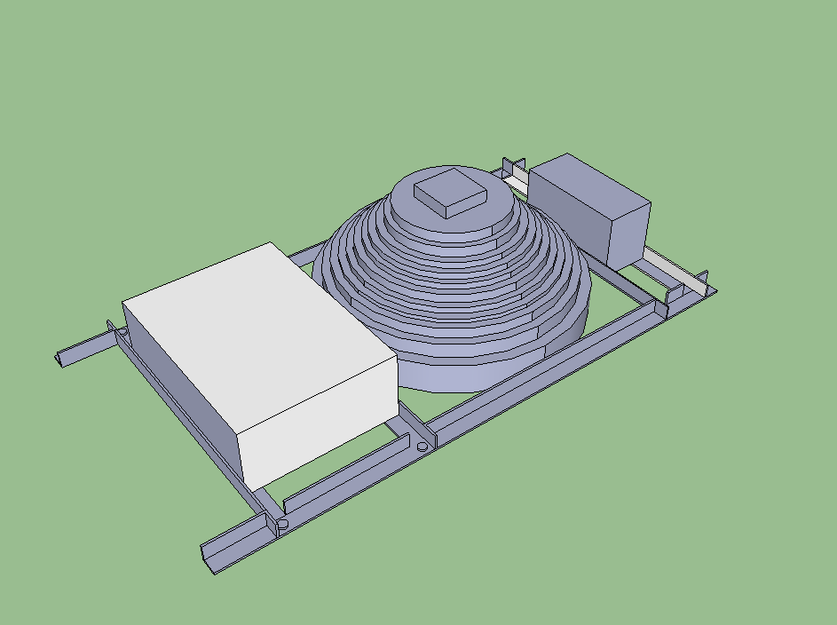

Slide 15
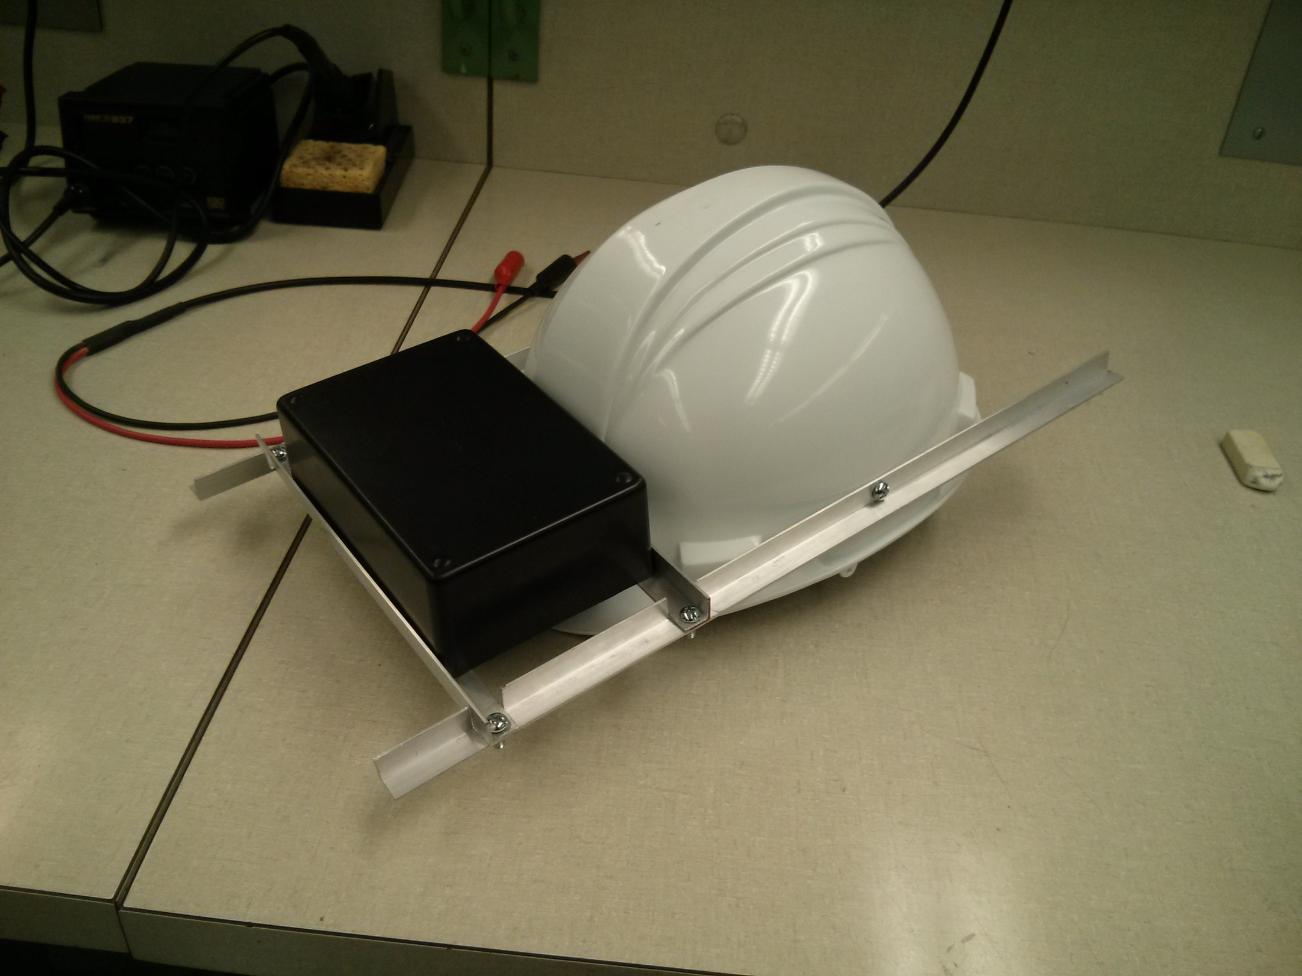

Slide 16
Schematic & Theory of Operation
Accelerometer + Magnetometer (compass) + Gyro determine user orientation
GPS (+ accelerometer) determine geospatial position
All sensor data sent to uC for processing
3.3V: common voltage among all components
168MHz: maximum, performance when processing sensor data, power consumption negligible when compared to other devices

Slide 17
Schematic (1/2)
Ports A and B to avoid crystal-facing Port C
USART: GPS
USART: Xbee
I2C: Accelerometer + Magnetometer + Gyro
I2C: Battery fuel gauge
SPI: Raspberry Pi
168MHz frequency: maximum, sensor processing performance, negligible power consumption

Slide 18
Schematic (2/2)
Power
3.3V .5A Vcore: Raspberry Pi
3.3V .5A Vmcu: uC + Xbee + GPS
3.3V .05A Vadc: IMU (low noise)
Ground: ground pour
Bypass caps: manufacturer recommendations
1x 1uF decoupling on Vbatt
2x 2.2uF bypass for uC core supply internal regulator
10x .1uF decoupling power pins
2x 22uF bulk for regulators

Slide 19
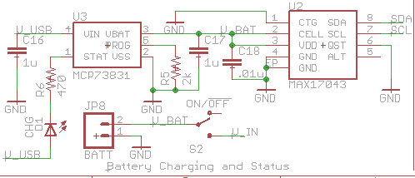
Schematic (Batt charge + Fuel Gauge)

Slide 20
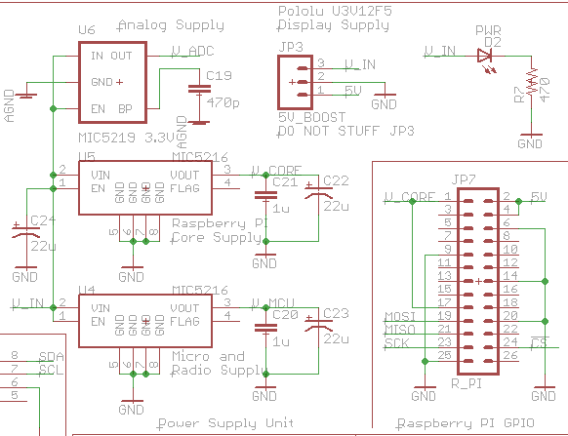
Schematic (Power Supplies)

Slide 21
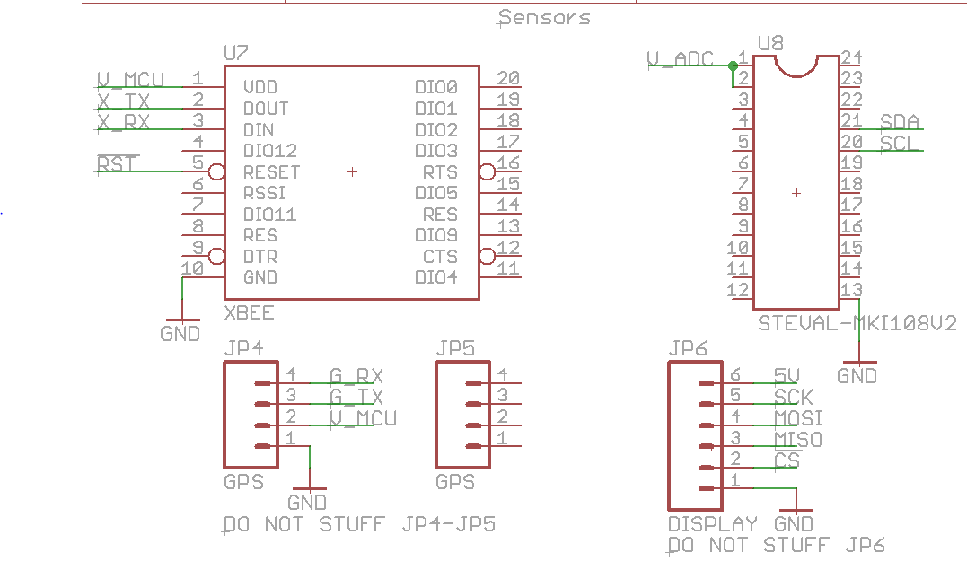
Schematic (Sensors)

Slide 22
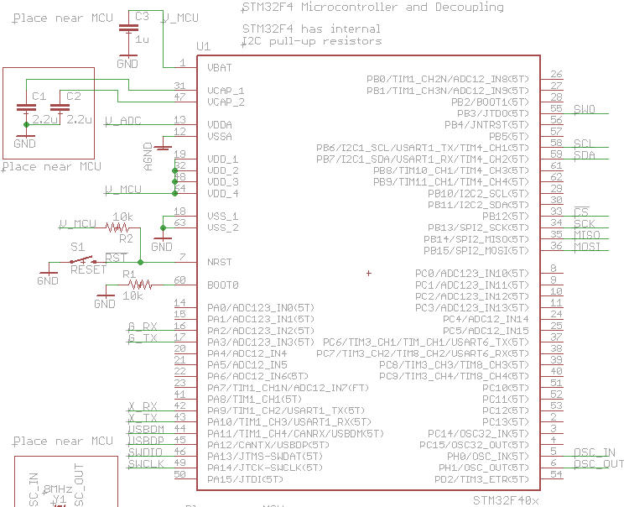
Schematic (uC)

Slide 23
PCB Layout – General
Advanced Circuits/4PCB specs
5mil trace/5mil space
10mil minimum hole size and 5mil tolerance
For manufacturability
10mil trace/8mil space
15mil minimum hole size
No acute angles
Two layers

Slide 24
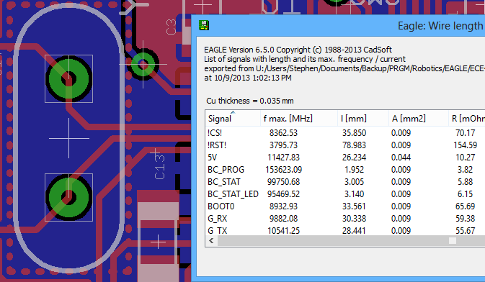

PCB Layout – MCU
Oscillator and USB lines match impedance
Trace lengths must match
No right angles
Decoupling, oscillator must be adjacent
Place some capacitors underneath chip
Pin locations determine routing success
0.2mm = about 7 mil difference
(less than one trace width)

Slide 25
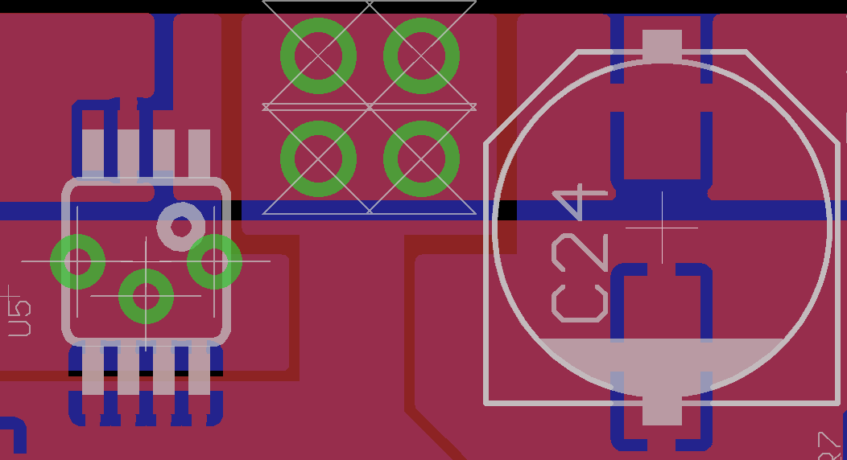
PCB Layout – Power
Total current could be up to 2A
Use low resistance copper pours
Multiple large vias for transfer between layers
Power from multiple directions (“islands”)
Bulk capacitors near regulator, bypass near loads

Slide 26
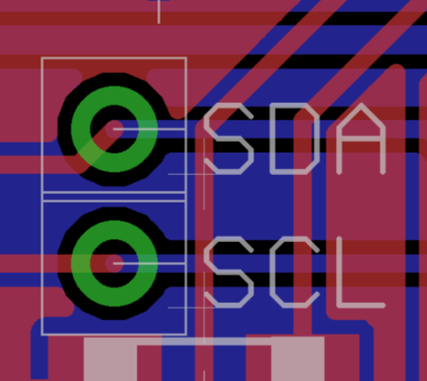
PCB Layout – Other
Connectors
Raspberry PI connector must match motherboard
Other connectors must be on edges
Route I²C, UART, SPI lines together
Test points
Debug LEDs, spare I/O headers
Place V_ADC regulator near IMU
Reduce interference pickup
Place XBee far away

Slide 27
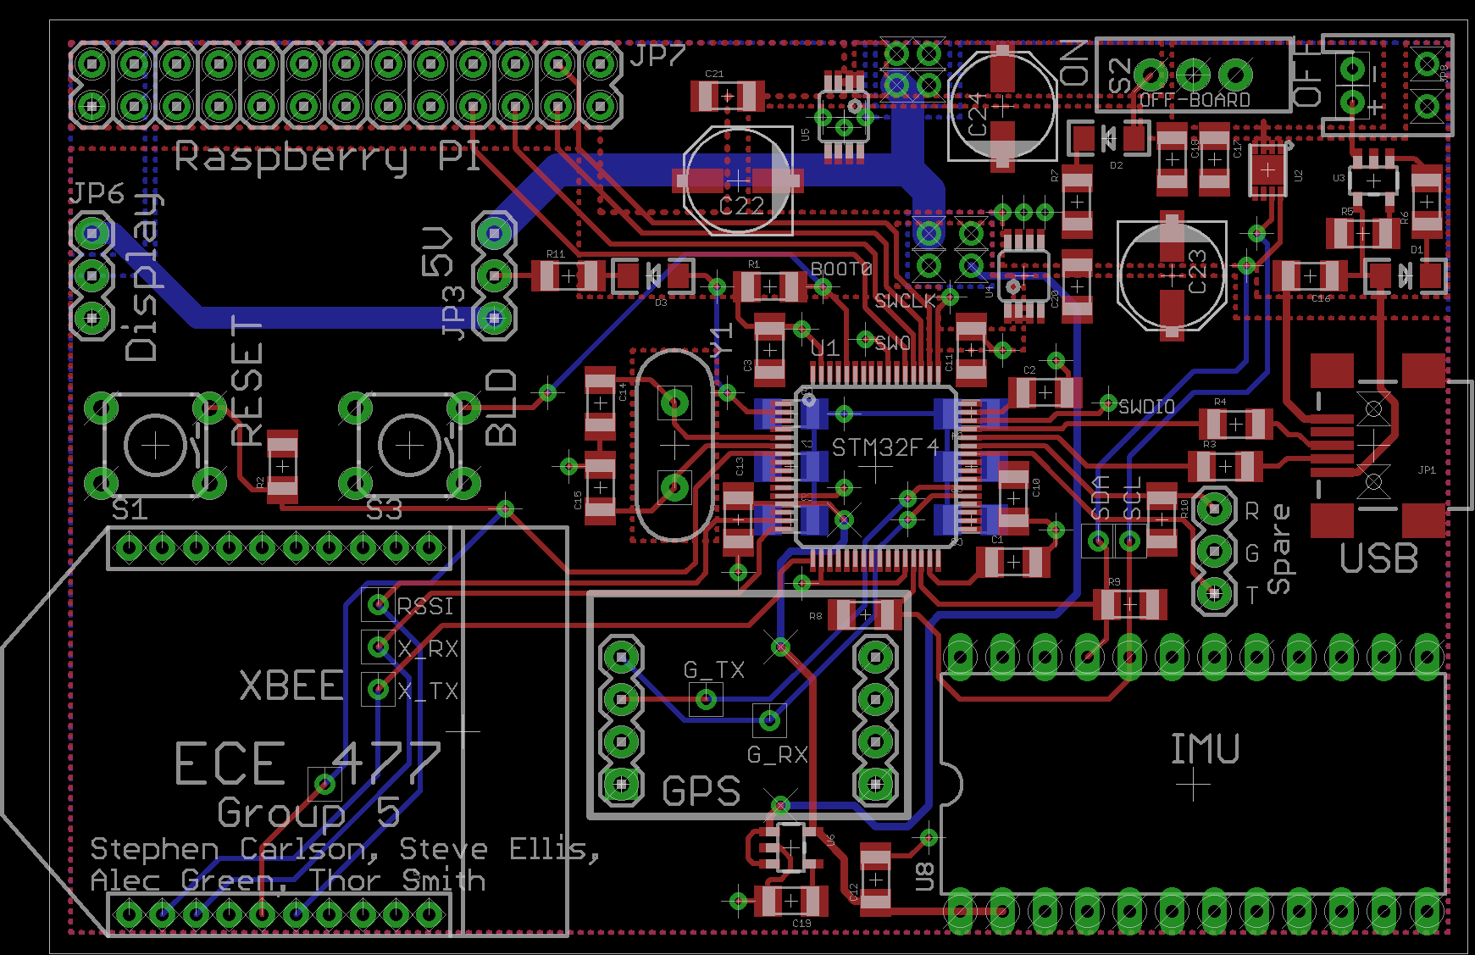
Pcb Layout, Full Board

Slide 28
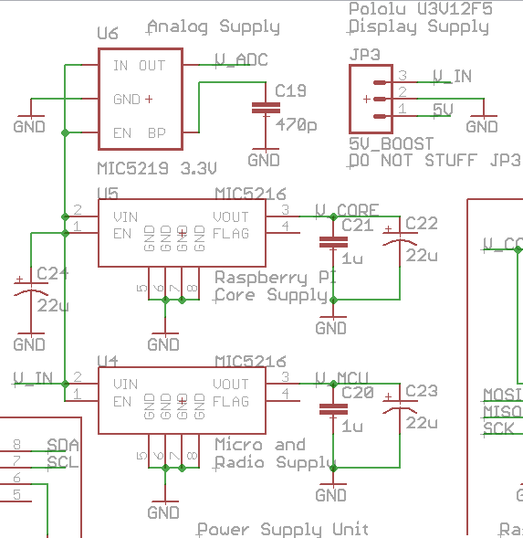
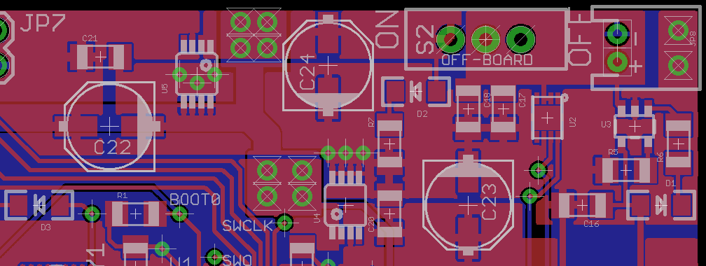
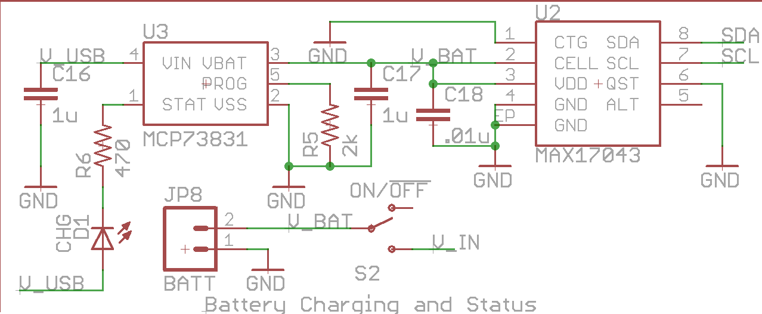
Pcb Layout, Power Supply
Power Switch
JST Connector
Fuel Gauge
Charger
Power LED
Core Supply
MCU Supply
Charging LED

Slide 29
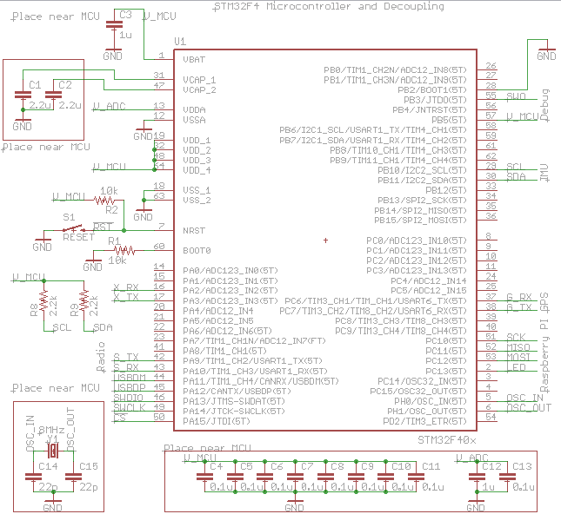
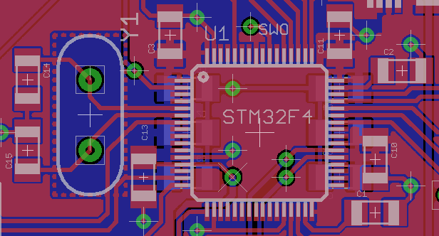
Pcb Layout, Microcontroller
SPI to
Raspberry PI
STM32F4
Microcontroller
8MHz
Oscillator
To USB
(programming)
To Reset Button
UART to XBee
UART to GPS
I²C to IMU

Slide 30
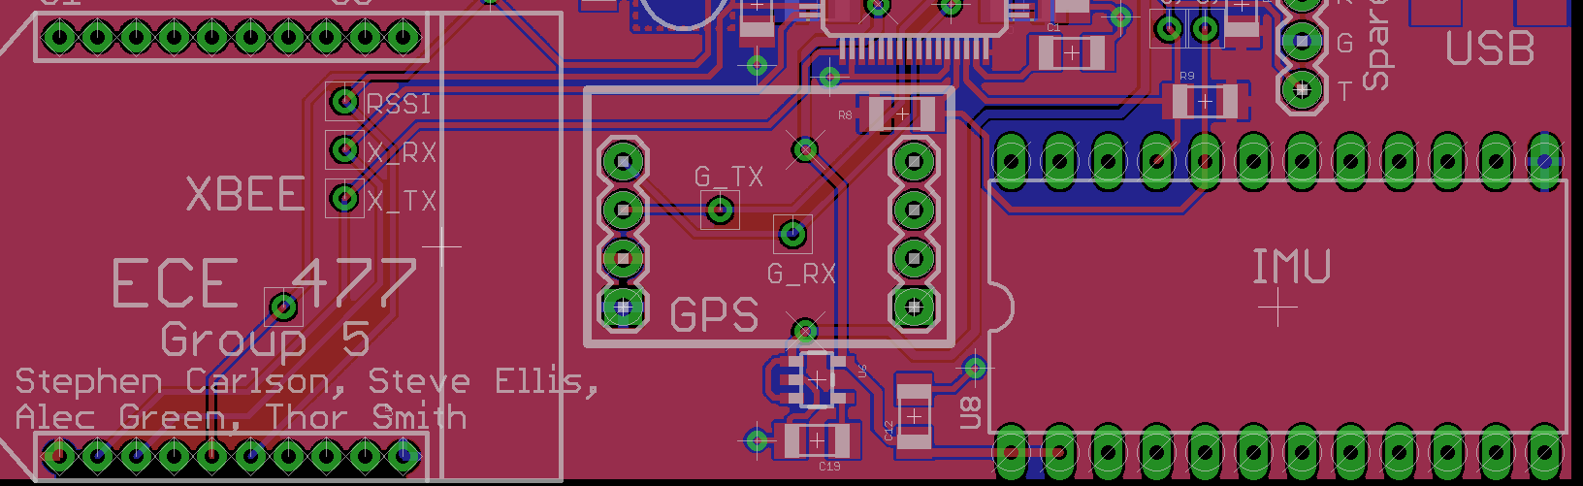
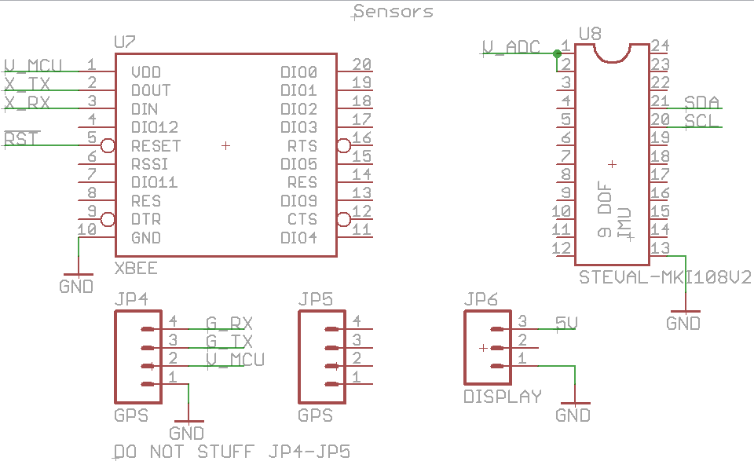
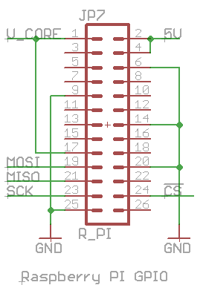
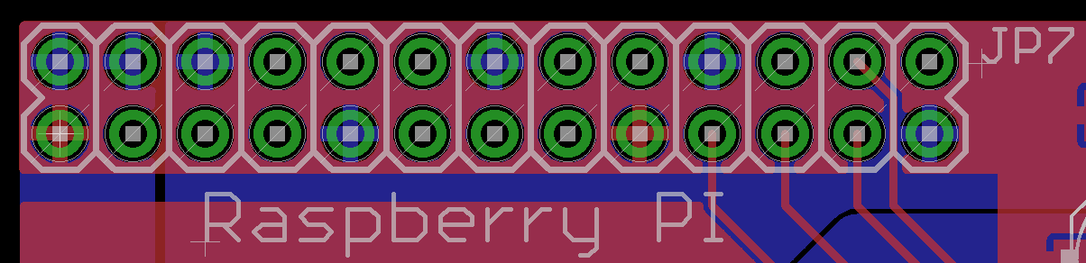
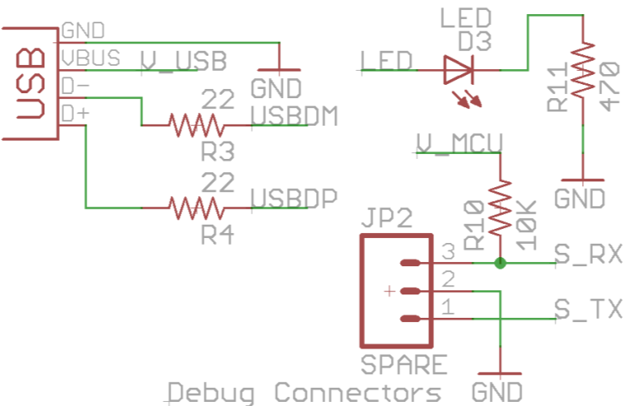
Pcb Layout, Peripherals
Venus GPS Breakout
XBee Pro 900
V_ADC
Supply
ST 9-DOF IMU Breakout

Slide 31
Software Design/Development Status
Preliminary drivers to extract GPS and IMU data has been completed. Next steps to push data to GPU and CCU.
The GPU code will be written in OpenGL.
The CCU will provide a user interface and process game logic. C++ for game logic, python for User Interface.
XBee packets flows defined.
GPS Thread
Convert to Decimeters
on x,y
IMU Thread
Convert to pitch, yaw, roll
Control Logic
* Send IMU/GPS over network to CCU/GPU
* Make Decisions based on packets from CCU
XBee Driver
Send/Queue packets.
Connectivity
Battery Thread
Monitor Battery Life

Slide 32
Team 5 Project Completion Timeline
 | PCB / Hw | GPU | Data | CCU | Packaging
Week 8 | One to One parts check. PCB Verification |  | Data formats Finalized. |  | Finish Building Headset.
Week 9 | Parts Testing | Prelim Animation | Sensor processing complete. | GUI Software complete
Week 10 | Solder Parts to Board Test Power Supply | Animation w/ IMU | Implement network flow.
Week 11 | Test Micro and other components | Animation w/ GPS | Implement Battery Sensing. | Library for simulations | Evaluation of Headset design
Week 12 |  | Integration w/ Micro
Week 13 |  |  |  | Implement PacMan | Revision of Headset design.
Week 14
Week 15

Slide 33
Questions / Discussion

