Slide 1
Team 5: Augmented Reality Simulator
Stephen Carlson
Stephen Ellis
Alec Green
Thor Smith

Slide 2
Abstract
We propose to build an augmented reality simulator
Allows at least one user to play an electronic game in a mobile, outdoor environment
Intended for gaming and other simulations that require an augmented environment
Contains two primary parts: a headset and a central control unit (CCU)
The headset is portable, worn by the user, and displays images over the user’s view of the environment
Headsets will overlay game-object pixels displayed by an LED display onto a half-silvered mirror that is suspended in front of the user’s eyes.
Due to the difference in incident angle between ambient light and the screen brightness, the environment can be seen with only minor dimming, while the majority of the screen pixels can be seen at the same time.
The CCU is not portable. It will communicate information to the headset about simulation logic.

Slide 3
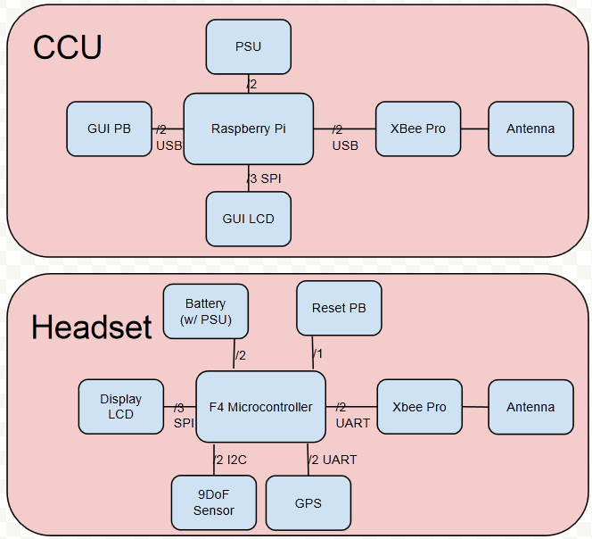
Block Diagram
Figure 1: The block diagram indicates two functional groups that communicate through the Xbee wireless devices.
The CCU will perform simulation logic
The headset will perform graphics rendering and sensor data acquisition.

Slide 4
Project Specific Success Criteria
An ability to render graphics based on the orientation of the user’s head.
An ability to render graphics based on the user’s current geospatial location.
An ability to monitor and display the battery power level of the headset to the user.
An ability to inform the user of a headset about the status and quality of the wireless connection to the central control unit.
An ability to load graphics for a new simulation to the headset without re-flashing the software on the headset’s microcontroller.

