Slide 1
Team 05 Augmented Reality Project TCSP #04 Hardware Design Narrative
Stephen Carlson, Steven Ellis,
Alec Green, Thor Smith

Slide 2
Abstract
Augmented reality system whereby central control unit wirelessly communicates with per-user headsets to overlay pixels on users’ field of view for gaming and other environment-interaction applications

Slide 3
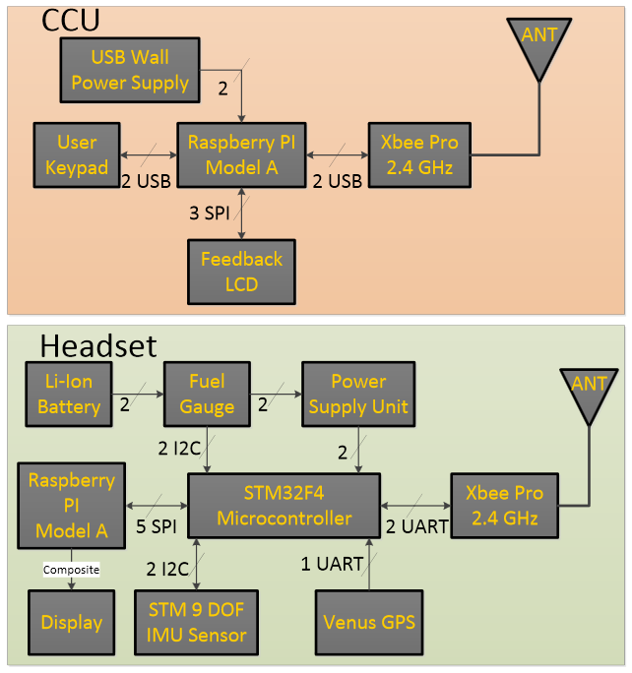
Block Diagram

Slide 4
PSSC
An ability to render graphics based on the orientation of the user’s head.
An ability to render graphics based on the user’s current geospatial location.
An ability to monitor and display the battery power level of the headset to the user.
An ability to monitor and display the status and quality of the wireless connection to the central control unit.
An ability to load headset graphics for a new simulation without re-flashing software on the headset’s microcontroller.

Slide 5
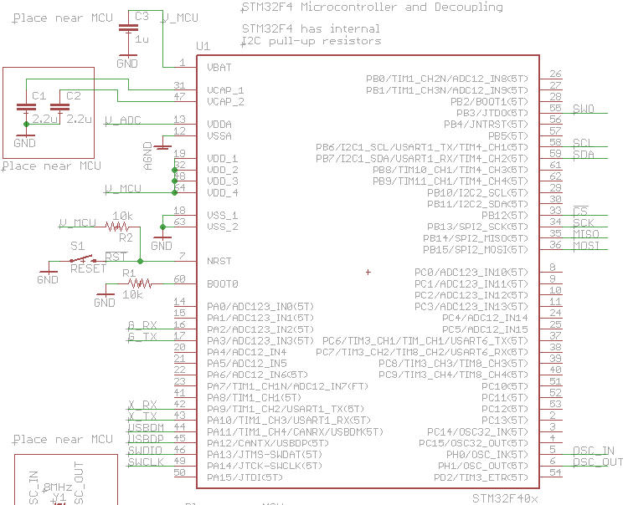
Schematic (uC)

Slide 6
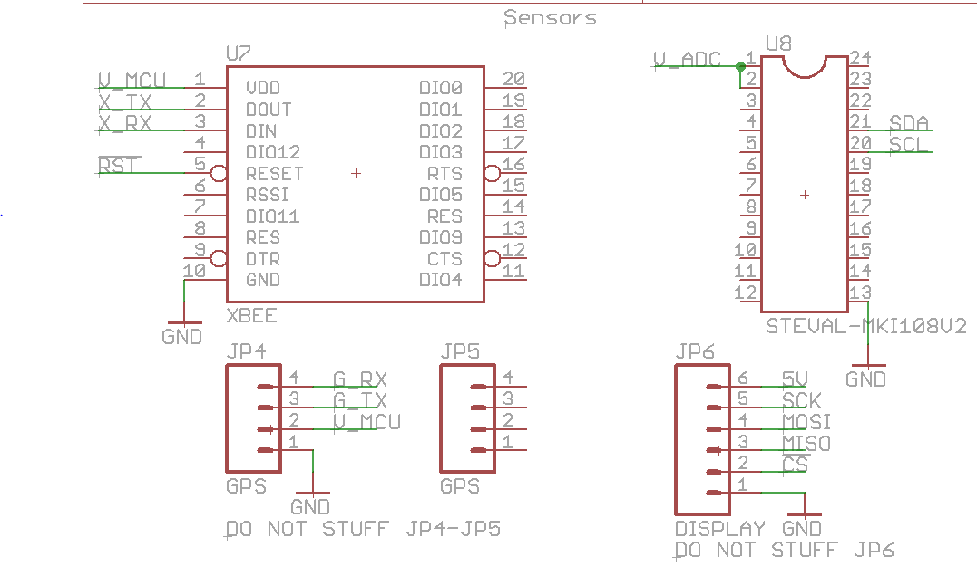
Schematic (Sensors)

Slide 7
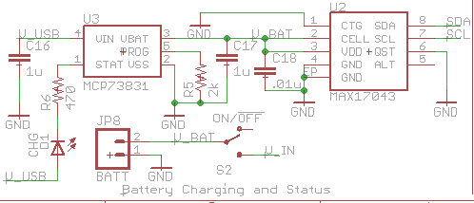
Schematic (Batt charge + Fuel Gauge)

Slide 8
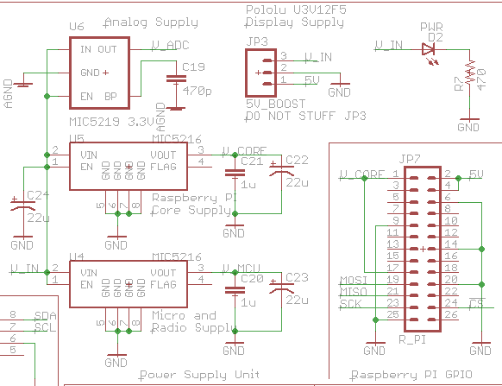
Schematic (Power Supplies)

Slide 9
Theory of Operation
Accelerometer + Magnetometer (compass) + Gyro determine user orientation
GPS (+ accelerometer) determine geospatial position
All sensor data sent to uC for processing
3.3V: common voltage among all components
168MHz: maximum, performance when processing sensor data, power consumption negligible when compared to other devices

Slide 10
HW Design Narrative (1/2)
Ports A and B to avoid crystal-facing Port C
USART: GPS
USART: Xbee
I2C: Accelerometer + Magnetometer + Gyro
I2C: Battery fuel gauge
SPI: Raspberry Pi
168MHz frequency: maximum, sensor processing performance, negligible power consumption

Slide 11
HW Design Narrative (2/2)
Power
3.3V .5A Vcore: Raspberry Pi
3.3V .5A Vmcu: uC + Xbee + GPS
3.3V .05A Vadc: IMU (low noise)
Ground: ground pour
Bypass caps: manufacturer recommendations
1x 1uF decoupling on Vbatt
2x 2.2uF bypass for uC core supply internal regulator
10x .1uF decoupling power pins
2x 22uF bulk for regulators

