Slide 1
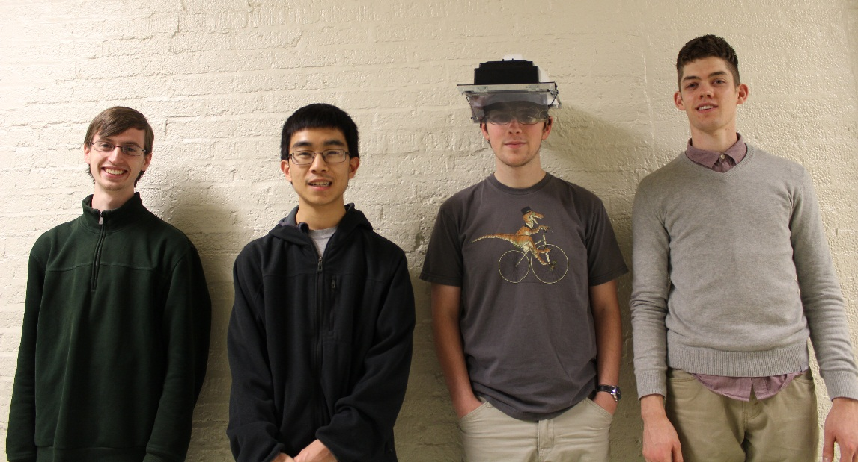
ECE 477 Final Presentation Team 05 − Fall 2013
From left: Thor Smith, Stephen Carlson, Steven Ellis, Alec Green

Slide 2
Outline
Project overview
Block diagram
Design challenges
Individual contributions
Project demonstration
Questions / discussion

Slide 3
Project Overview
Augmented Reality Simulator
Play as Pacman in a mobile, outdoor environment.
Designed to support other simulations that require an augmented environment and multiple users.
Contains two primary parts: a headset and a central control unit (CCU)
The headset is worn by the user and overlays images of game objects on the user’s view of the environment
The CCU remains stationary and communicates information to the headset about simulation logic.

Slide 5
Design Challenges
Packaging
Needs to be lightweight and comfortable
Stability of IMU mounting
Semi-transparent display
Headset Pi Software
3D rendering
SPI communication with µC

Slide 6
Design Challenges
Hardware Design
PCB needs to fit Raspberry Pi footprint
Battery power and power supply
Headset µC Software
XBee communication
Sensor filtering
SPI communication with Raspberry Pi

Slide 7
Individual Contributions
Team Leader - Thor Smith
Team Member 2 - Alec Green
Team Member 3 - Stephen Carlson
Team Member 4 - Steven Ellis

Slide 8
Team Leader - Thor Smith
User interface on the Central Control Unit.
Networking packets sent between the Central Control Unit and the Headset.
Inter-process Communication between user interface, simulation, and packet program.
Worked with Steven Ellis on packaging design and construction.
Organized most team meetings and purchased most parts for project.

Slide 9
Member 2 - Alec Green
Google Maps parsing for automatic map generation
Image process map tiles
GPS location from pixel coordinate
Packet protocol definition
IMU sensors
Calculate Euler angles from sensor readings
Research and design filters
Compiled Video

Slide 10
Member 3 - Stephen Carlson
Design Constraint Analysis
Research parts
Select candidate based on project requirements
Schematic and Theory of Operation
Power supply design
Select pins/ports on microcontroller
PCB Layout
Design for manufacturability
Power handling and impedance matching
Assembly and Soldering

Slide 11
Member 4 - Steven Ellis
Graphics
Created game 3D models
Custom configuration file format
OpenGL code
Raspberry Pi SPI code
Integration with graphics
Packaging
Assembly
Optics research
Model for 3D printed enclosure

Slide 12
Project Demonstration
An ability to render graphics based on the orientation of the user’s head.
An ability to render graphics based on the user’s current geospatial location.
An ability to monitor and display the battery power level of the headset to the user.
An ability to monitor and display the status and quality of the wireless connection to the central control unit.
An ability to load headset graphics for a new simulation without re-flashing software on the headset’s microcontroller.

Slide 13
Questions / Discussion

