Slide 1
Design Constraint Analysis
Team 05 Augmented Reality Project
TCSP #02
Stephen Carlson, Steven Ellis, Alec Stephen Green, Thor Smith

Slide 2
Abstract
We propose to build an augmented reality simulator
Allows at least one user to play an electronic game in a mobile, outdoor environment
Intended for gaming and other simulations that require an augmented environment
Contains two primary parts: a headset and a central control unit (CCU)
The headset is portable, worn by the user, and displays images over the user’s view of the environment
Headsets will overlay game-object pixels displayed by an LED display onto a half-silvered mirror that is suspended in front of the user’s eyes.
The CCU is not portable. It will communicate information to the headset about simulation logic.

Slide 3
Functional Block Diagram
Exploring possibility of using another Raspberry PI Model A for rendering

Slide 4
PSSC Review
An ability to render graphics based on the orientation of the user’s head.
An ability to render graphics based on the user’s current geospatial location.
An ability to monitor and display the battery power level of the headset to the user.
An ability to inform the user of a headset about the status and quality of the wireless connection to the central control unit.
An ability to load graphics for a new simulation to the headset without re-flashing the software on the headset’s microcontroller.

Slide 5
Controller Requirements
Headset
Render graphics (PSSC #1, 2)
GPS (#2) and IMU (#1) interfacing
Wireless communication (#4)
Battery monitor (#3) interfacing
Central control unit
Wireless communication (#4)
Data storage (#5)

Slide 6
Microcontroller
Must be capable of rendering graphics
128 KB or more of RAM
High speed for floating point math
Required external peripherals
2 UART (GPS, Wireless module)
1 SPI (Display/Motherboard connector)
1 I2C (Power Monitor, IMU)
At least 10 additional GPIO pins
Prefer 3.3V supply and 3.3V I/O

Slide 7
Microcontroller
STM32F405RGT6
ARM-Cortex M4F
168 MHz with FPU
192 KB RAM
64 LQFP 51 I/O
$11 single quantity
Selected because
FPU (1 cycle multiply!)
Large RAM
Almost all I/O 5VT
PIC32MX695F512H
PIC 32-bit
80 MHz
128 KB RAM
64 TQFP 53 I/O
$10 single quantity
Rejected because
Inefficient architecture
Slower clock

Slide 8
Motherboard
Run central control unit (CCU)
Game logic
Memory buffer storage for game objects
Potential future use for complex rendering
Power usage should be suitable for batteries
Required peripherals
USB for user input device
1 UART (or USB UART) for Wireless module
Display output (HDMI, Composite, VGA)

Slide 9
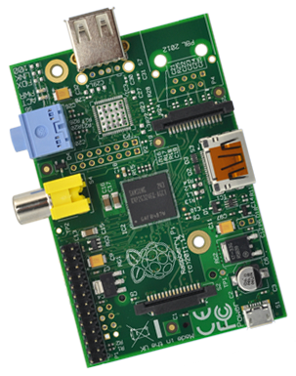
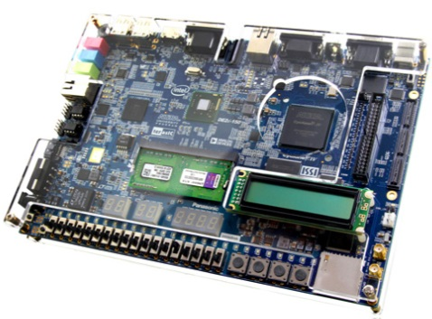
Motherboard/Graphics
Raspberry PI Model A
Low-cost ($40 total)
700 MHz ARMv6T
Low-power (2W)
Selected because
Power consumption
Cost
Intel Atom/FPGA Board
Cornell Cup
Intel Atom processor
On-board FPGA
Rejected because
Physical size
“Over kill”

Slide 10
Questions
Photo credits:
http://www.sparkfun.com/
http://www.digikey.com/

Slide 11
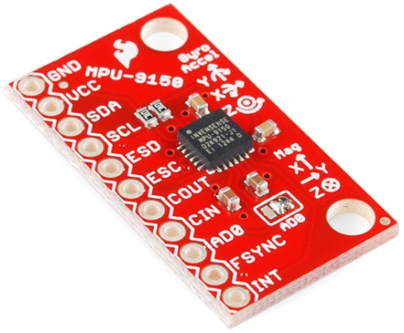

Inertial Measurement Unit
ST-EVALMKI108V2
9 DOF
Low-cost ($27)
16-16-12 bit resolution
Selected because
Low noise density
High resonant frequency
Well-documented
MPU-9150
9 DOF
Single-chip
16-16-13 bit resolution
On-chip DSP
Rejected because
Cost

Slide 12
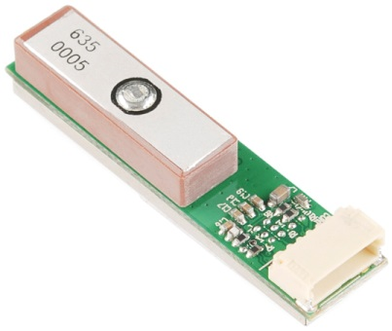
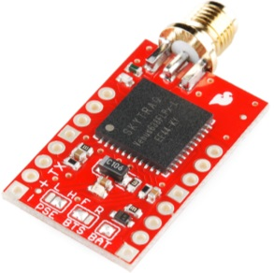
Positioning System
Venus GPS
20Hz Update
$60 (incl. antenna)
External antenna
Selected because
High resolution
Good reception quality
GP-635T
5Hz Update
$40
Integrated antenna
Rejected because
Slow update rate
Difficult to interface

Slide 13
Wireless Communication
Digi Xbee Pro
Self-contained
No need for smartphone
Tested 300m range
$40/unit
Selected because
Simplicity
No phone application required
Bluetooth + Cell Radio
Infrastructure exists
Unlimited range
Use 3G/4G/WiFi
$20/unit + Smartphone
Rejected because
Reliability
Latency

