Slide 1
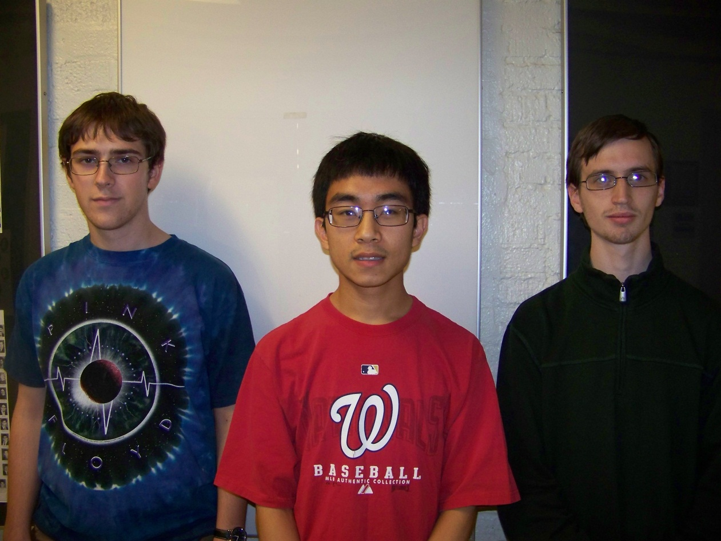
Augmented Reality Cornell Cup Mid Review Spring 2014
Stephen Carlson
Steven Ellis
Thor Smith
Steven
Ellis
Stephen
Carlson
Thor
Smith

Slide 2
Outline
Challenge Definition
Project Entry Solution
Performance Evaluation
Technical Ingenuity
Project Execution Overview
Recommendations and Next Steps

Slide 3
Outline
Phase 1: Senior Design
ECE senior design project
Phase 2: Cornell Cup
Intel/Cornell cup updates

Slide 4
Challenge Definition
Challenge Definition
Design Requirements
Use Cases

Slide 5
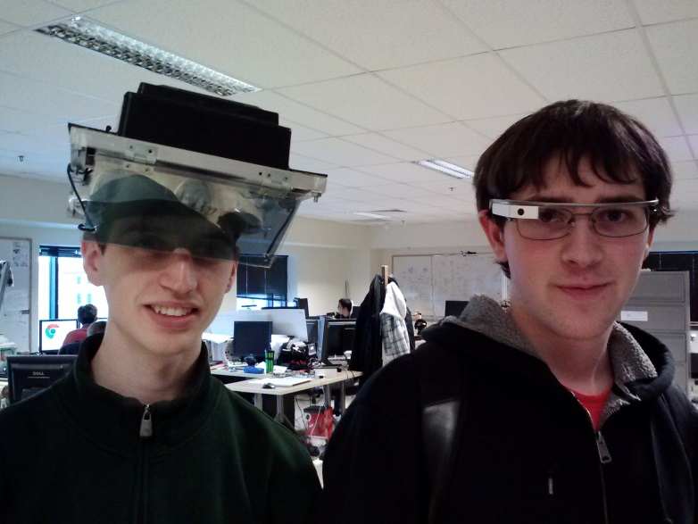
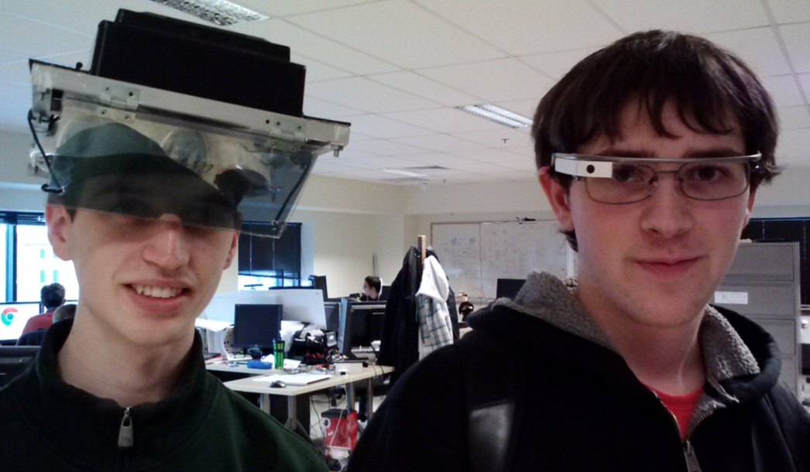
Challenge Definition
Wearable augmented reality
Google Glass, Oculus Rift, Epson BT-100
Promote teamwork
Substitute for physical objects

Slide 6
Design Requirements
Portable, comfortable, easy to use
Track position and head orientation
Wireless communication
Maintain real-world perception

Slide 7
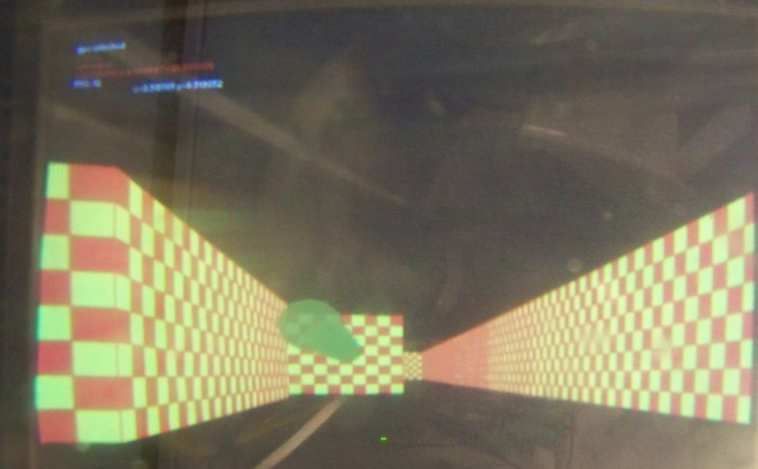
Use Cases
Educational and training
Virtual tour, guide, or navigation
Gaming
Place “imaginary” objects in real world

Slide 8
Project Entry Solution
Project Entry Solution
Solution to The Challenge
Block Diagram
Software Diagram

Slide 9
Project Entry Solution
Multi-user gaming
Multiple games supported
Integrate with real world
Headset:
Display
Orientation tracking
Location tracking
Backpack:
Wireless
Graphics processing
Simulation logic
Battery and power

Slide 10
Solution to The Challenge
Display virtual and real world
No real-world lag unlike camera
Interact with real and virtual objects
Track user position and heading
Update virtual world
Communication with other devices

Slide 11
Block Diagram

Slide 12
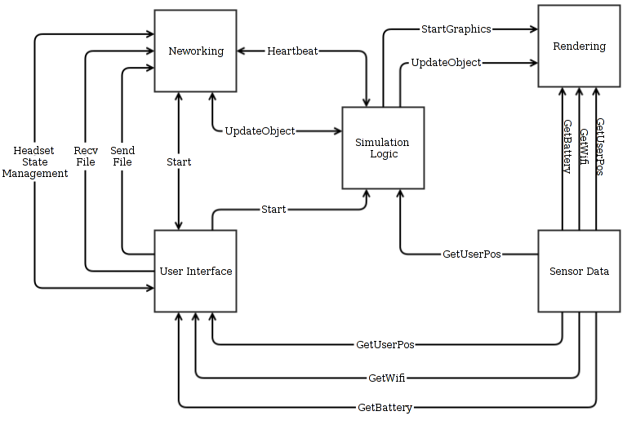
Software Diagram

Slide 13
Performance Evaluation
Performance Metrics
Portability and ease of use
Position and orientation tracking
Wireless communication
Performance Results

Slide 14
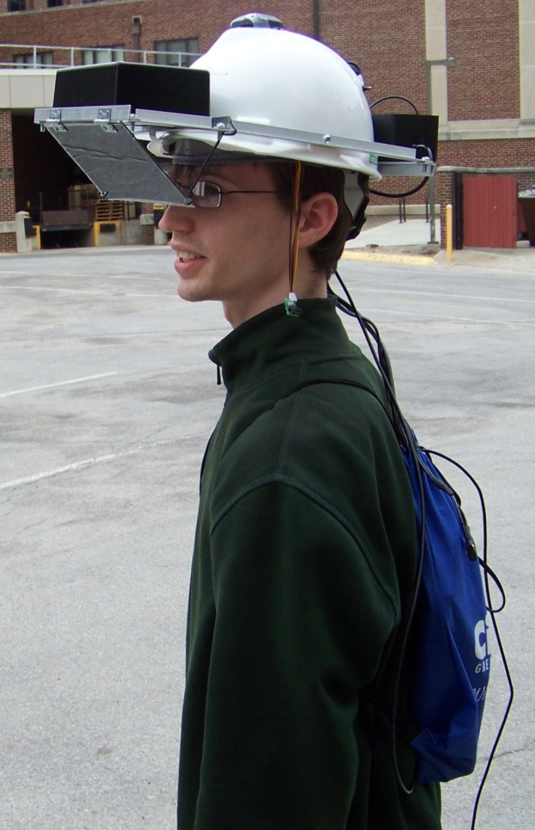
Performance Metrics
Portable, comfortable, easy to use
Mass [kg]
Total runtime [hours]
Virtual image quality
User experience survey

Slide 15
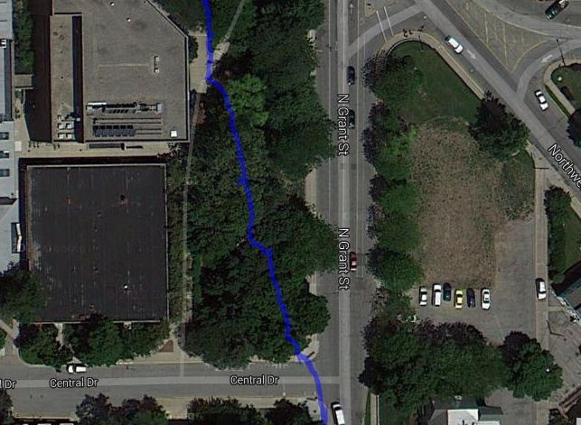
Performance Metrics
Track position and head orientation
Location precision [m]
Head tracking latency [ms]

Slide 16
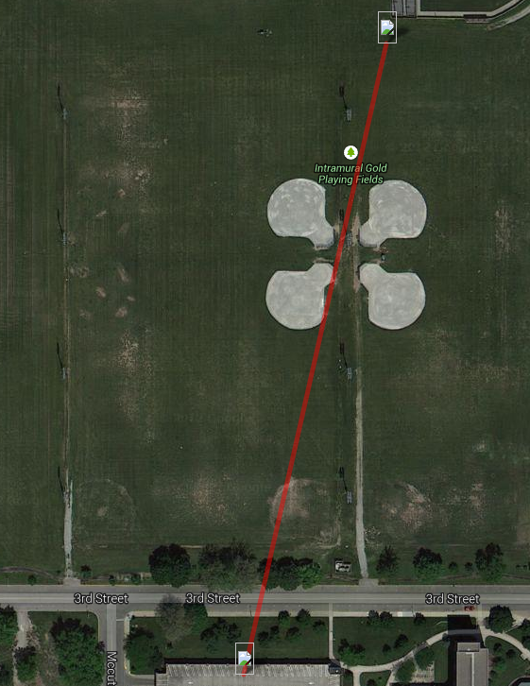
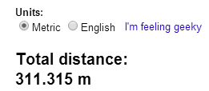
Performance Metrics
Wireless communication
Network refresh [updates per second]
Wireless range, line of sight [m]
Simultaneous device limit

Slide 17
Performance Results
Metric | Phase 1 | Target | Phase 2
Mass [kg] | Headset: 1.3 | Headset: 1 Backpack: 3 | Headset: 1.2 Backpack: 2.5
Total Runtime [hours] | 3 | 3 | 2.5
Location Precision [m] | 1.5 | 2 | 1.5
Wireless Range [m] | 200 | 80 | 110
Display Refresh [FPS] | 10 | 20 | 20
Network Refresh [FPS] | Unimplemented | 20 | 20
Simultaneous Devices | 6 | 16 | 127
Tracking Latency [ms] | 100 | 50 | 50

Slide 18
Technical Innovation
Overlay virtual world
Preserve depth perception
Large field of view (61°)
Reduced eye strain
Head and position tracking
Digital filtering of orientation
Wireless communication
Collaborative augmented reality

Slide 19
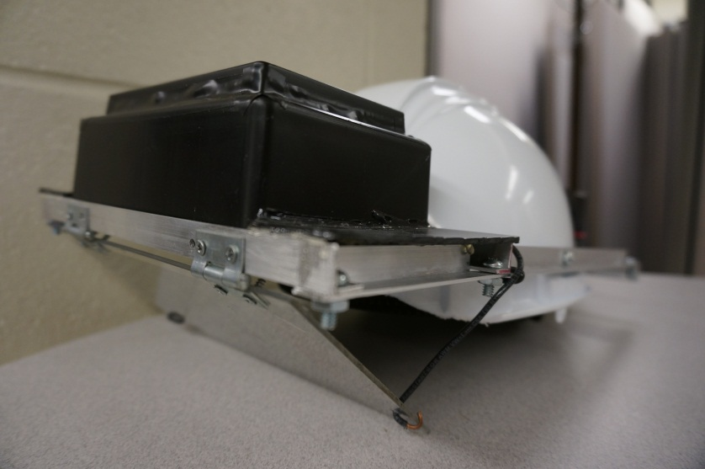
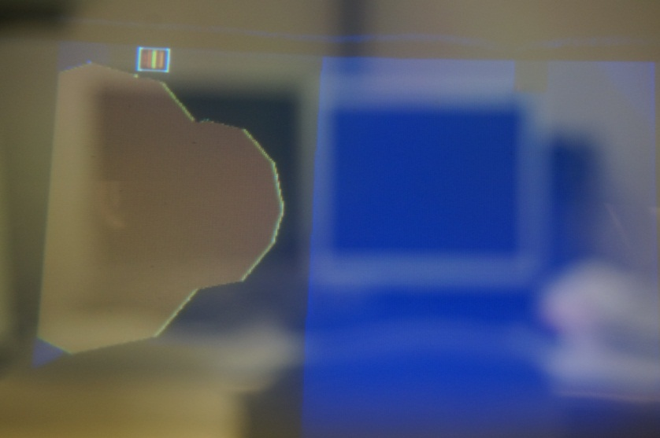
Technical Innovation
Self-contained device
Adjustable
Lightweight, balanced
Functional software
OpenGL rendering
Multi-user
“PacMan” game
Extensible

Slide 20
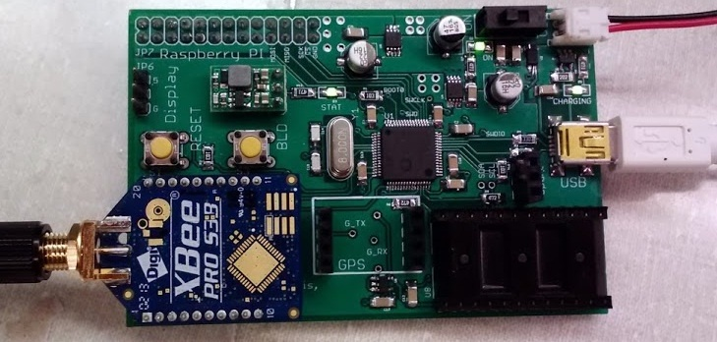
Technical Features (Phase 1)
IMU and GPS interfacing
900 MHz wireless
Requires central server
Efficient power management
Battery charging

Slide 21
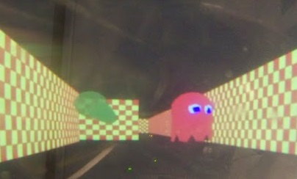
Technical Features (Phase 2)
Wireless N network
Up to 127 devices usable at once
Eliminate dedicated server
Virtual image fidelity
Improve brightness and contrast
Higher resolution
Faster graphics engine

Slide 22
Project Execution Overview
Project Milestones
Challenges
Risk Handling
Budget

Slide 23

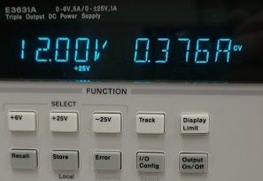
Project Milestones
Phase 1 completion: Dec 2013
Head tracking and GPS
Initial software
Cornell Cup Mid Review: Feb 2014
Increased testing and metrics
Compare to existing devices
Improve display visibility

Slide 24
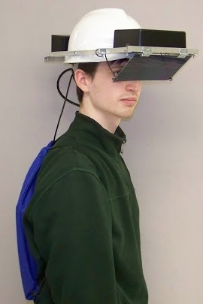
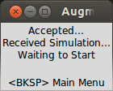
Project Milestones
Final packaging: Apr 2014
Final power supply
Mount new display
Software finalized: Apr 2014
Multiple headsets networking
File transfer
User testing begins

Slide 25
Challenges
DE2i-150 graphics drivers
Power consumption
Required battery for 3 hours unavailable
User testing is subjective

Slide 26
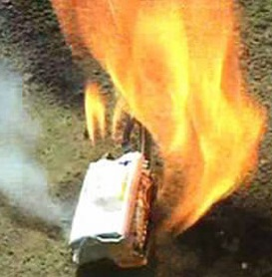
Risk Handling
Patent liability
Many existing virtual reality patents
Licensing may be required
Safety and reliability
LiFePO₄ relatively safe
Redundant power protection
Translucent display allows awareness of environment

Slide 27
Budget
Funding provided by Cornell Cup, Purdue ECE
Major development expenses
Displays - $205
Batteries - $114
Electronics - $130

Slide 28
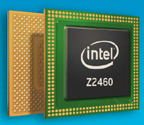
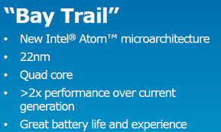
Recommendations and Next Steps
Continued software development
Head tracking and GPS precision
User interface
Upgrade motherboard
Longer battery life
Better graphics performance
High cost (over $100)

Slide 29
Recommendations and Next Steps
Alternative input devices
Capitalization
Software sales, SDK
Sell to schools
Sell to firms for training

Slide 30
Special Thanks To
Senior Design staff
Dr. David Meyer, George Hadley, George Toh
The Incredible HUD team
Aditya B., Blaine Gardner
Dr. Mark Johnson, advisor
Joseph Bougher, ECE lab staff
Dr. Karthik Ramani
Intel and Cornell University

Slide 31
Questions / Discussion

Slide 32
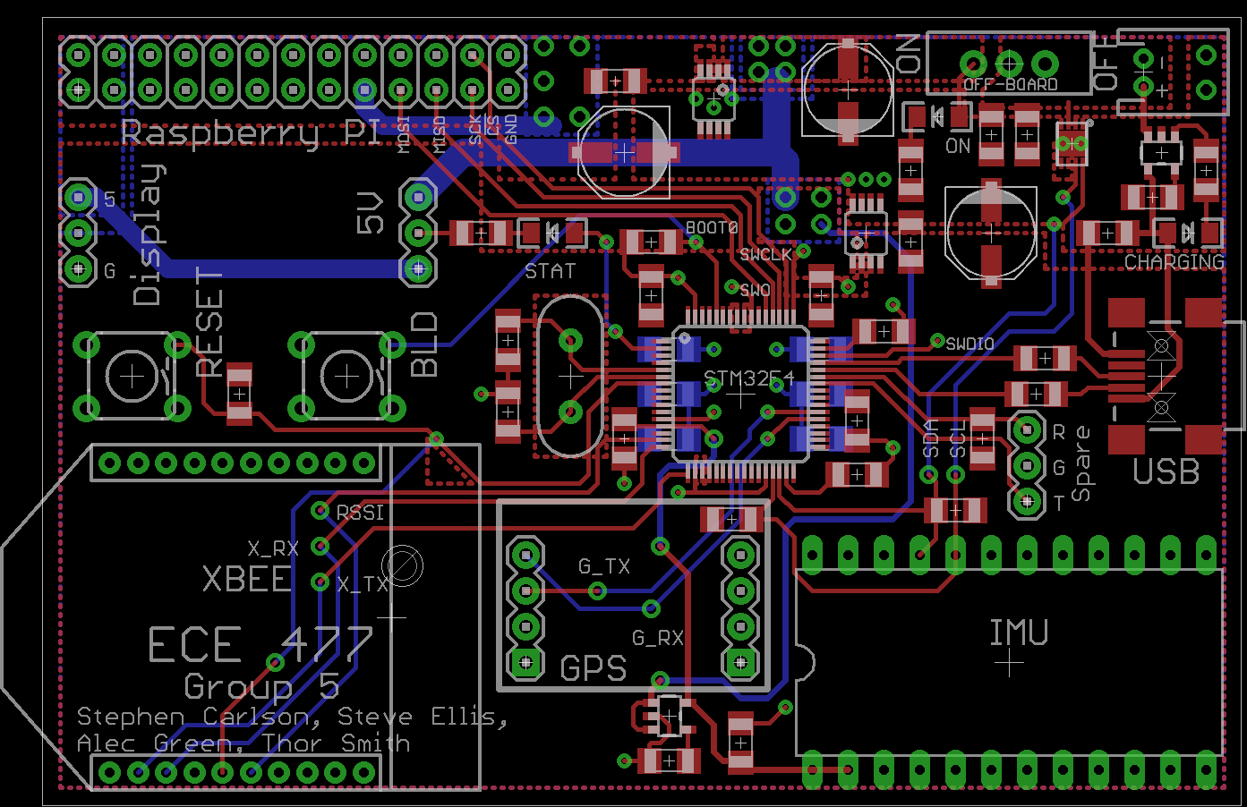
PCB Layout, Phase 1

Slide 33
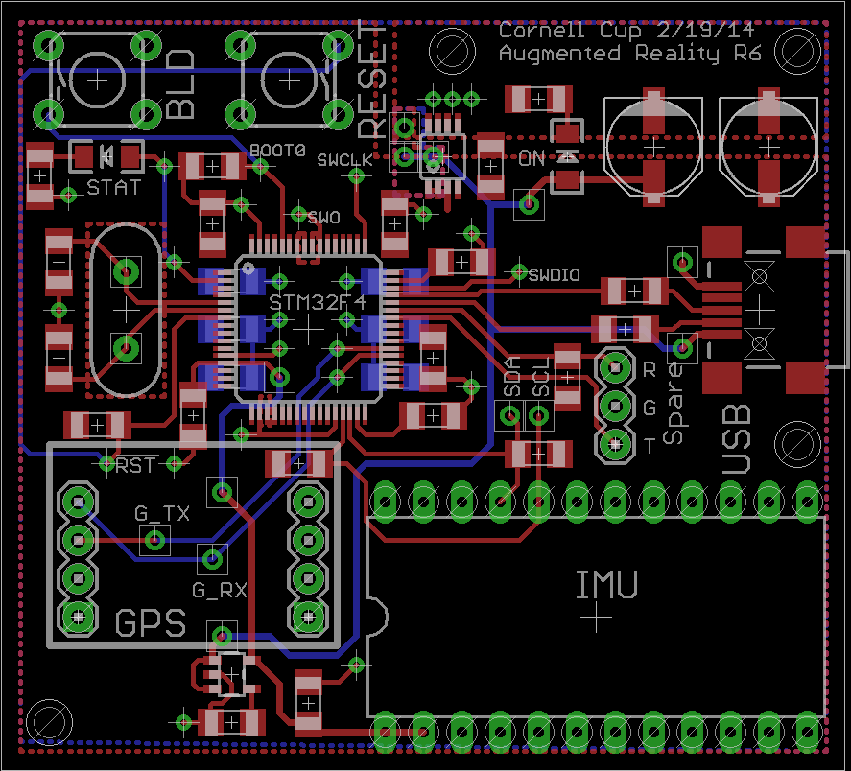
PCB Layout, Phase 2 Sensor

Slide 34
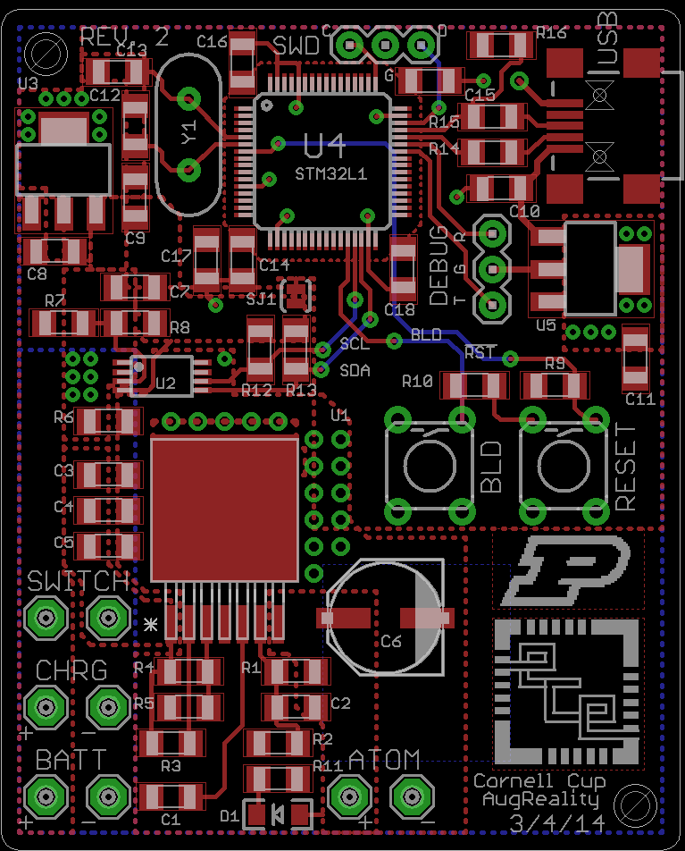
PCB Layout, Phase 2 Power

Slide 35
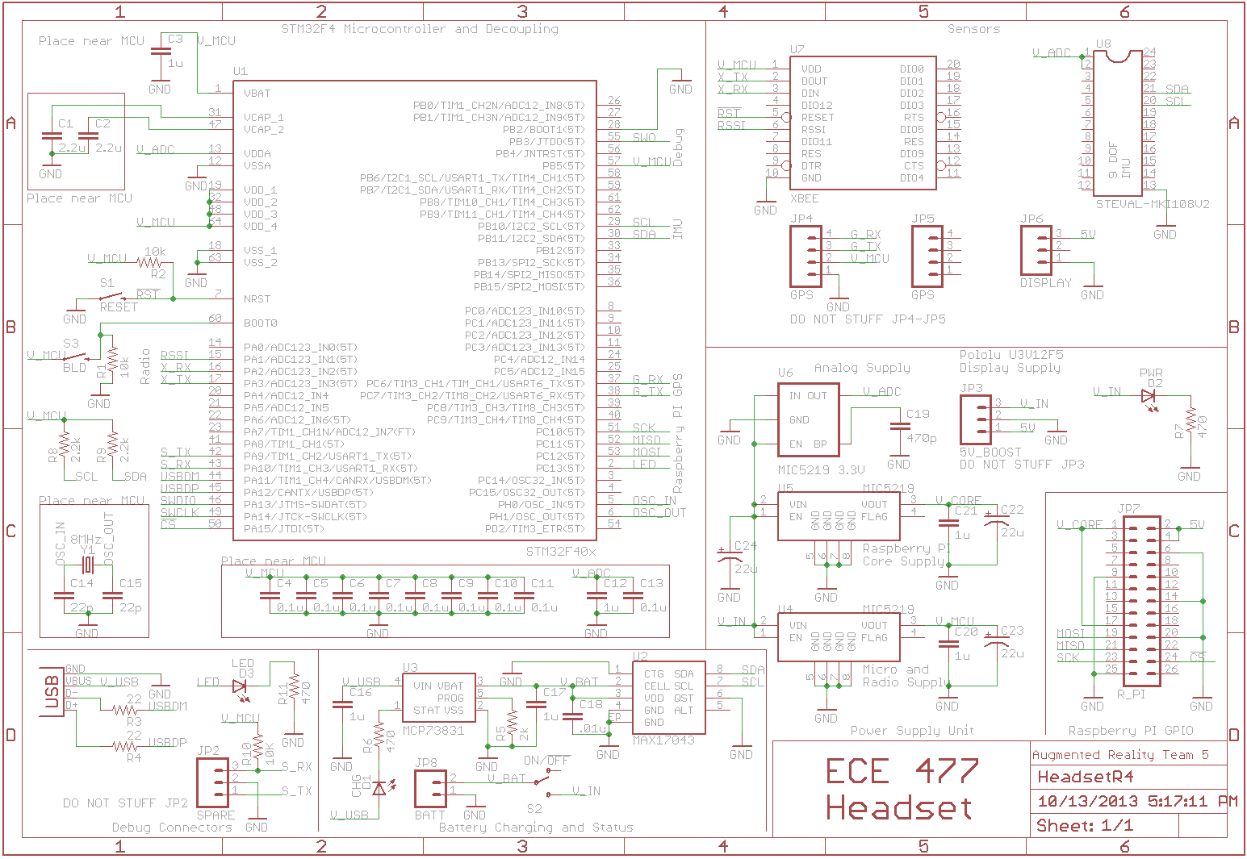
Schematic, Phase 1

Slide 36
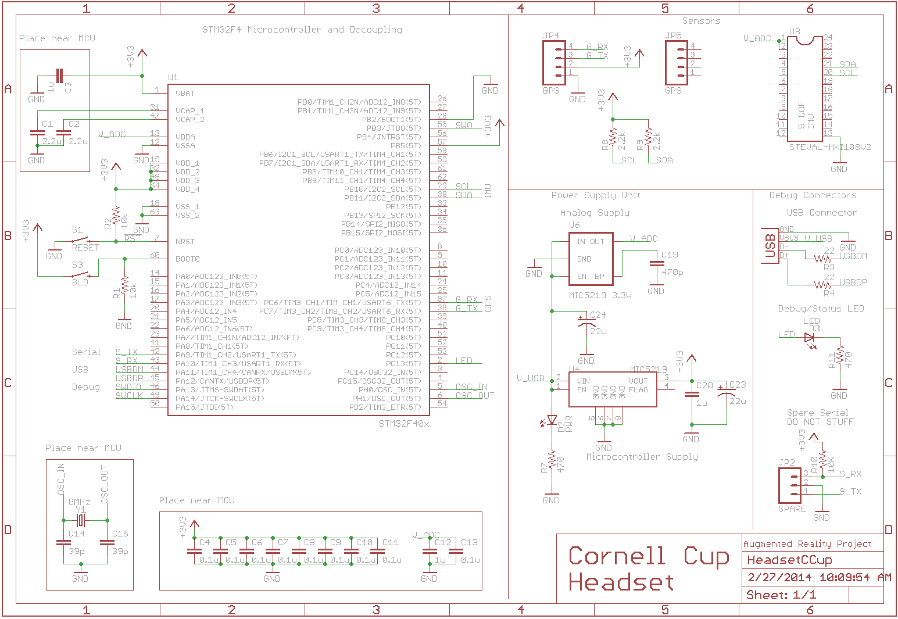
Schematic, Phase 2 Sensor

Slide 37
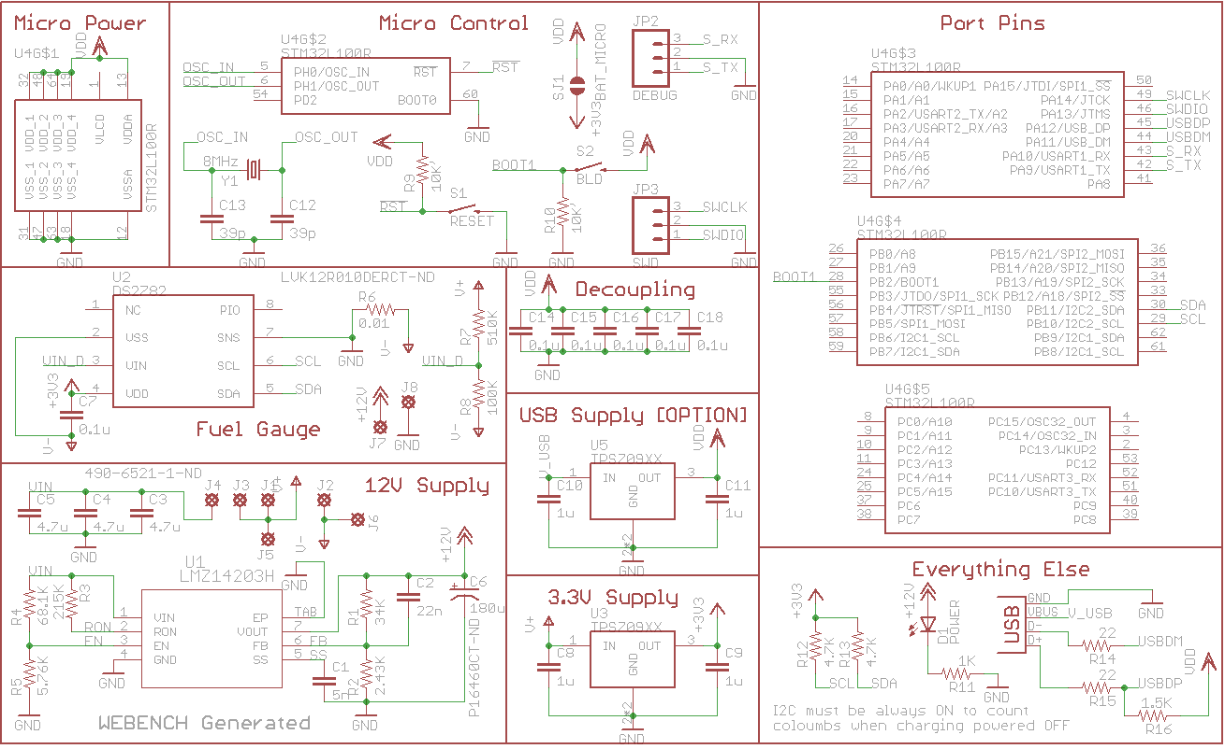
Schematic, Phase 2 Power

Slide 38
Patents
US 8585476 B2
Location-based games and augmented reality systems
US 20130267309 A1 [pending]
Augmented reality and physical games
US 8519844 B2
Augmented reality and location determination methods and apparatus

