Slide 1
Team 05 Augmented Reality Project TCSP #08 Patent Liability Analysis
Stephen Carlson, Steven Ellis,
Alec Green, Thor Smith

Slide 2
Abstract
Augmented reality system whereby central control unit wirelessly communicates with per-user headsets to overlay pixels on users’ field of view for gaming and other environment-interaction applications

Slide 3
PSSC
An ability to render graphics based on the orientation of the user’s head.
An ability to render graphics based on the user’s current geospatial location.
An ability to monitor and display the battery power level of the headset to the user.
An ability to monitor and display the status and quality of the wireless connection to the central control unit.
An ability to load headset graphics for a new simulation without re-flashing software on the headset’s microcontroller.

Slide 4
Sticking Points
Using IMU/GPS to determine orientation/position of user in 3D environment
Use of IMU/GPS data to render images.
Projecting images on semi-transparent display for interactive, real-world applications.

Slide 5
Augmented reality and physical games
Filed Apr 5, 2012
Abstract
Location of physical gaming piece is sent to computing device, which then computes augmentation to project on at least partially transparent display device.
Potentially Infringing Claims
receiving an indication by a computing device of a location of a physical gaming piece of a game
computing an augmentation based on the indication by the computing device to be displayed as part of the game; and
displaying the augmentation by the computing device on a display device that is at least partially transparent such that a physical portion of the game is viewable through the display device concurrently with the augmentation.

Slide 6
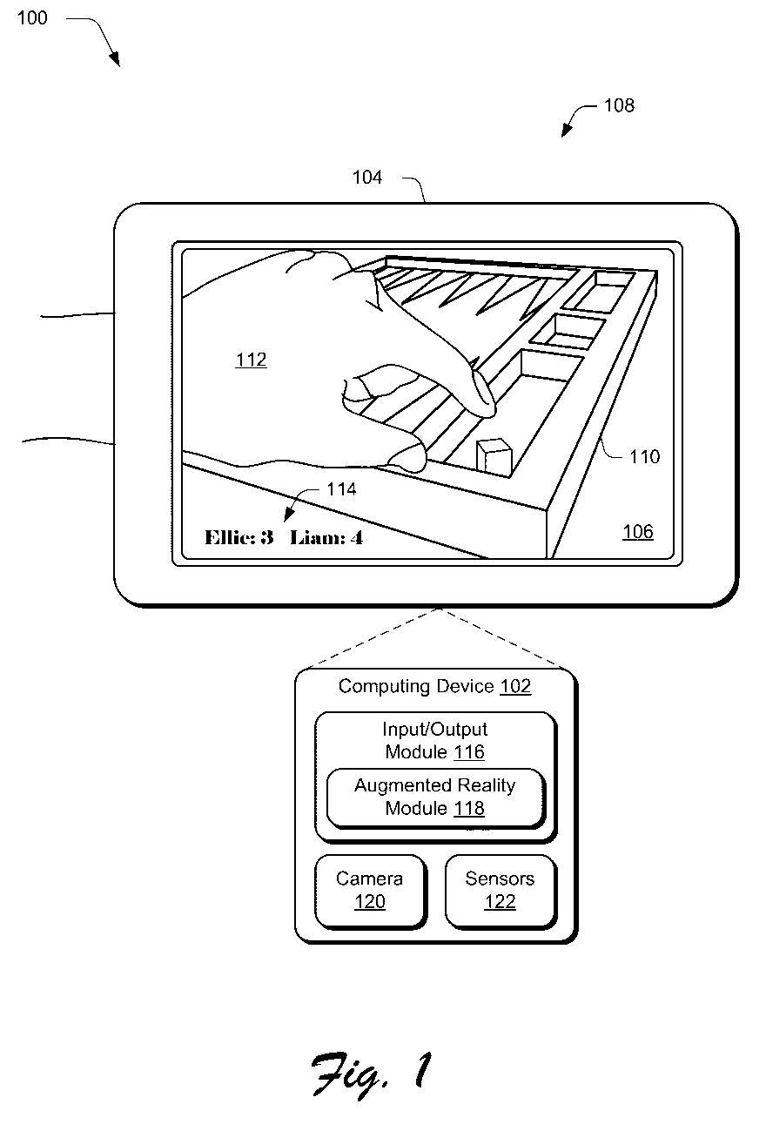
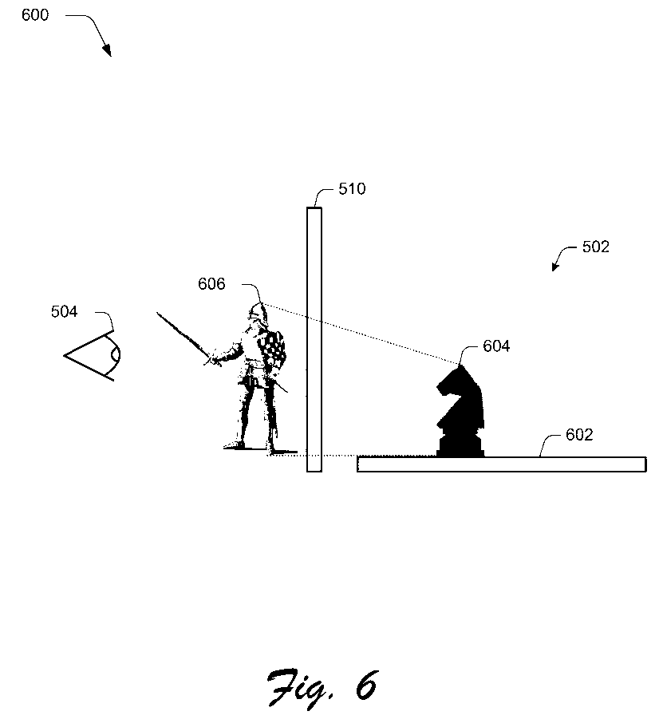
Augmented reality and physical games

Slide 7
Augmented reality and physical games
Literal Infringements:
Doctrine of Equivalents Infringements:
receiving an indication by a computing device of a location of a physical gaming piece of a game
computing an augmentation based on the indication by the computing device to be displayed as part of the game; and
displaying the augmentation by the computing device on a display device that is at least partially transparent such that a physical portion of the game is viewable through the display device concurrently with the augmentation.
Recommended Actions:
Clarify that the user is not a physical gaming piece, but a virtual player.

Slide 8
Augmented reality and location determination methods and apparatus
Filed Jul 30, 2010
Abstract
Determine location of 'user interaction device in a physical world', after which 'the user interaction device is configured to generate an augmented reality representation with respect to the physical world'.
Potentially Infringing Claims
accessing first location information regarding a location of a user interaction device in a physical world
communicating augmented data to the user interaction device, and wherein the augmented data comprises the augmented reality representation

Slide 9
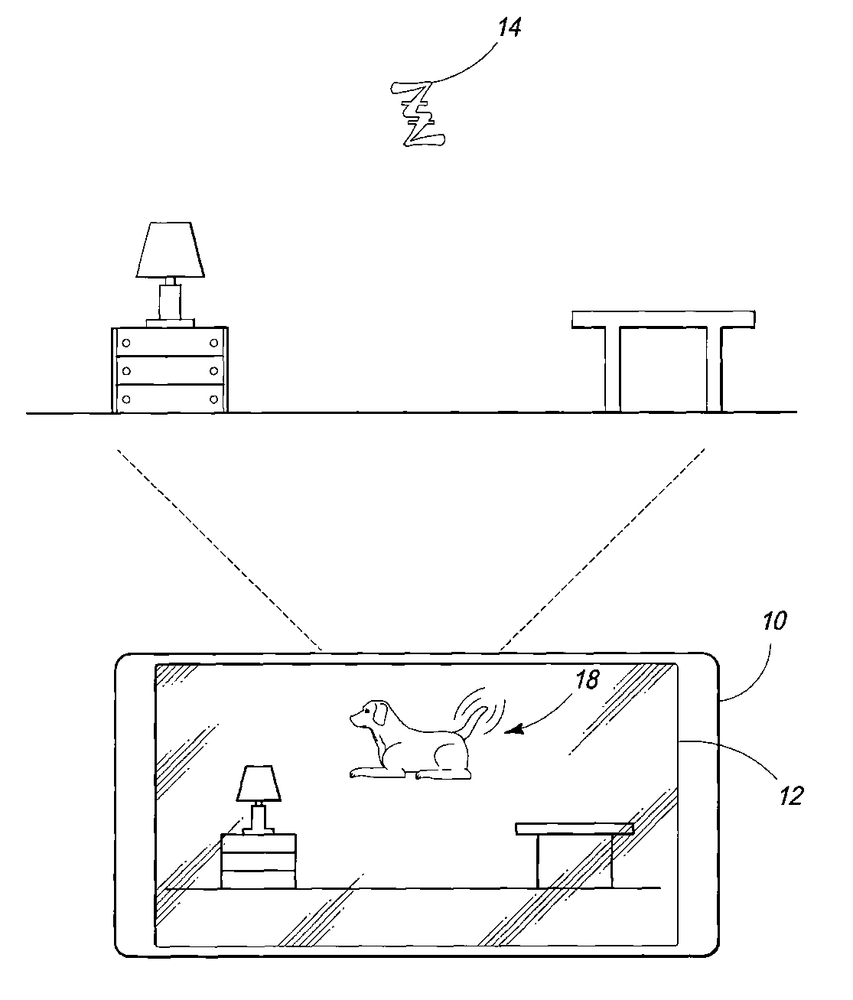
Augmented reality and location determination methods and apparatus

Slide 10
Augmented reality and location determination methods and apparatus
Literal Infringements:
Doctrine of Equivalents Infringements:
accessing first location information regarding a location of a user interaction device in a physical world
communicating augmented data to the user interaction device, and wherein the augmented data comprises the augmented reality representation
Recommended Actions:
Clarify that the headset is not a user interaction device gaming piece, but a measurement/display device.
Claim states: “An augmented reality user interaction device comprising: a camera; …”

Slide 11
Helmet mounted display
Filed Sep 3, 1992
Abstract
N/A
Potentially Infringing Claims
A helmet mounted display apparatus comprising: an optical element to be mounted on an observer and having a surface comprising an at least partially reflecting portion to be arranged in the field of view of the observer, the observer's eye being located in a predetermined position;
an optical projector for projecting an image for reflection from the at least partially reflecting portion

Slide 12
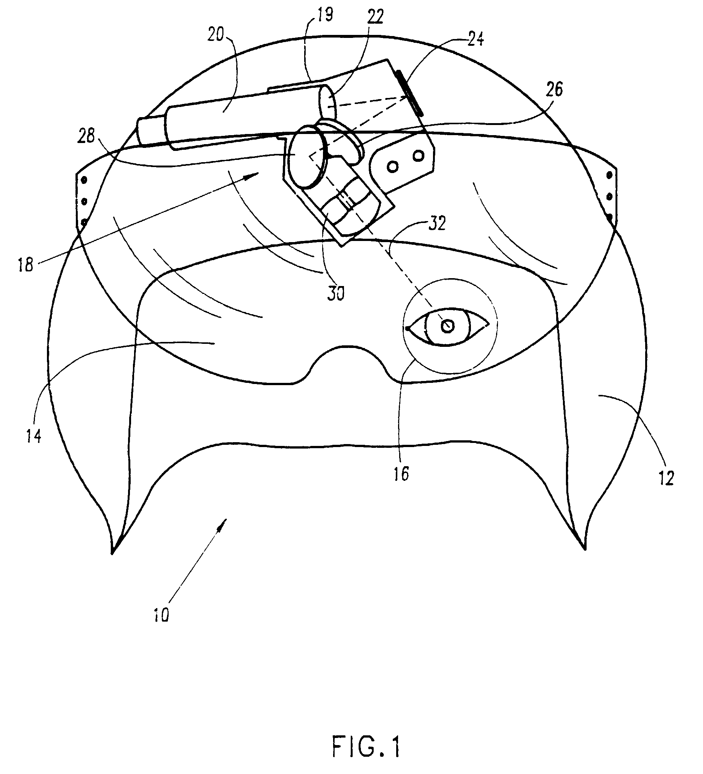
Helmet mounted display

Slide 13
Helmet mounted display
Literal Infringements:
Doctrine of Equivalents Infringements:
A helmet mounted display apparatus comprising: an optical element to be mounted on an observer and having a surface comprising an at least partially reflecting portion to be arranged in the field of view of the observer, the observer's eye being located in a predetermined position;
an optical projector for projecting an image for reflection from the at least partially reflecting portion
Recommended Actions:
The eye is not necessarily in a ‘predetermined position’; the reflective panel can be adjusted.
LCD is not a ‘projector’.

Slide 14
References
[1] Patent US 20130267309 A1 https://www.google.com/patents/US20130267309?dq=augmented+reality+games&hl=en&sa=X&ei=209xUqPwLMT4yQHxxoG4DA&sqi=2&pjf=1&ved=0CDcQ6AEwAA
[2] Patent US 8519844 B2 https://www.google.com/patents/US8519844?dq=augmented+reality&hl=en&sa=X&ei=lUxxUtqvEKSQyAG5xIGwDA&sqi=2&pjf=1&ved=0CEwQ6AEwAw
[3] Patent EP 0531121 B1 https://www.google.com/patents/EP0531121B1?cl=en&dq=projecting+images+on+semi-transparent%27&hl=en&sa=X&ei=-VJxUtftLobkyQGG6YHQBA&ved=0CE4Q6AEwAw

