Slide 1
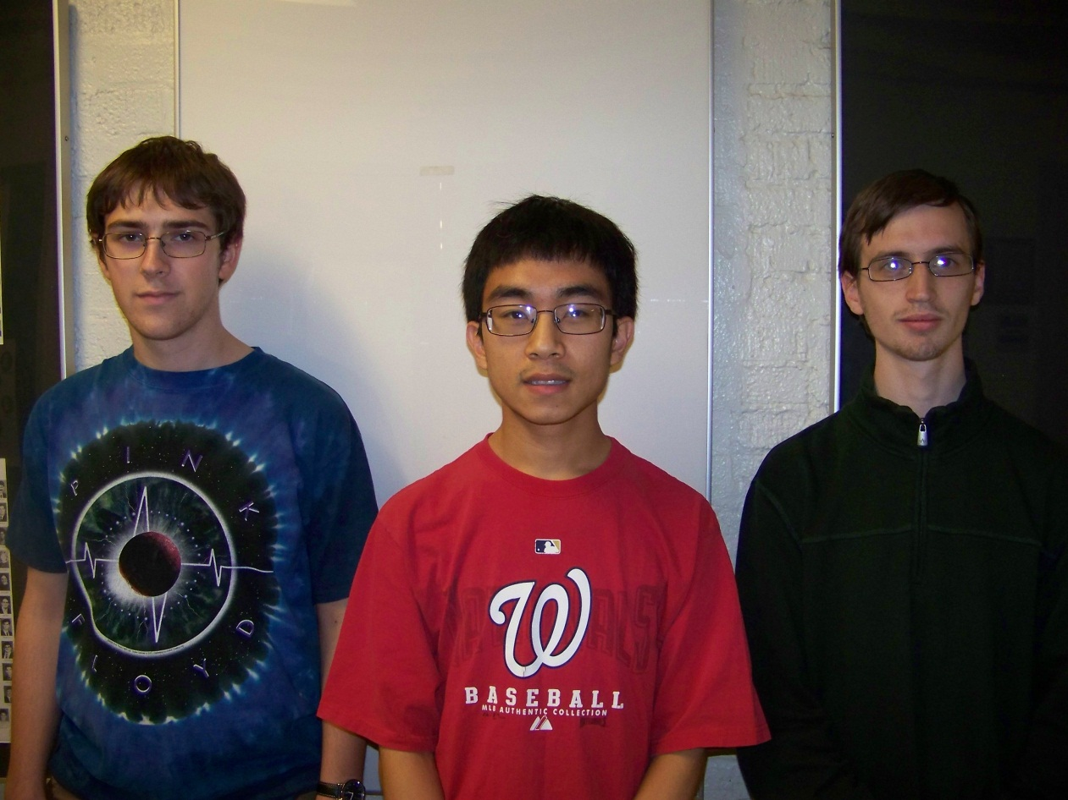
Augmented Reality Cornell Cup Mid Review Fall 2012
Stephen Carlson
Stephen Ellis
Thor Smith
Steven
Ellis
Stephen
Carlson
Thor
Smith

Slide 2
Outline
Challenge Definition
Project Entry Solution
Accomplishments to Date
Technical Ingenuity
Project Execution Overview
Complications
Opportunities
Recommendations and Next Steps

Slide 3
Challenge Definition
Wearable computing is quickly becoming the next step of embedded systems evolution as evidenced by devices like Google Glass [1], the Samsung Galaxy Gear, and Oculus Rift.
The challenge is to combine virtual reality with reality to create augmented reality in such a way as to enhance one’s ability to work on a team and allow virtual objects to take the place of physical items placed in select locations.
The design will need to satisfy the following requirements:
Portability and Comfortable Use
Determine position of user and orientation of users head
Local Wireless Communication
Easy to set up and use
Display must be transparent and cause minimal eye strain.

Slide 4
USE cases
When practicing for an artistic performance, people to know where they need to be and when.
When training a new employee, the employee may need to be shown a physical demonstration of using the equipment and he or she may need observe how the machinery operates.
Children playing games outside rely on “imaginary” objects placed in a select location.
Educational demonstrations may require lots of equipment placed in appropriate locations.

Slide 5
Project entry solution
We propose a headset and backpack solution. (Just like Incredible HUD, proof concept works)
The headset provides the display for the user and mounting point for head tracking sensors.
The backpack provides wireless communication, graphics rendering, and simulation logic.
Will not focus on internet connectivity (different from Google Glass/Samsung Galaxy)
Allows multiple simulations to be loaded onto the device in a modular fashion.
Will focus on gaming as an open-ended way to push the limits of the technology and generate excitement/creativity for the project development.

Slide 7
Accomplishments To Date

Slide 8
Technical Ingenuity

Slide 9
Execution overview

Slide 10
COMPLICATIONS

Slide 11
Opportunities

Slide 12
Recommendations and Next Steps

Slide 13
Questions / Discussion

