Slide 1
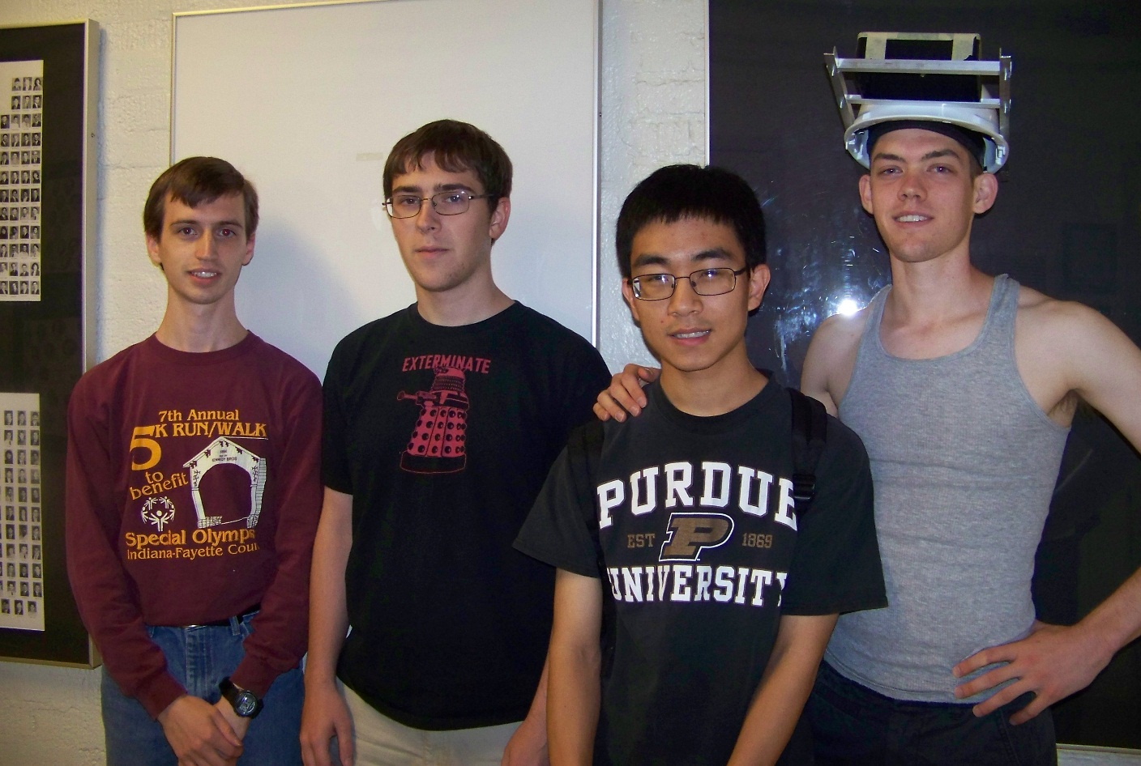
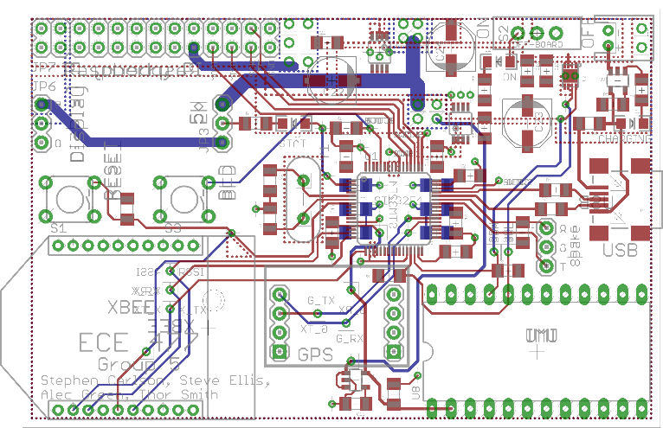
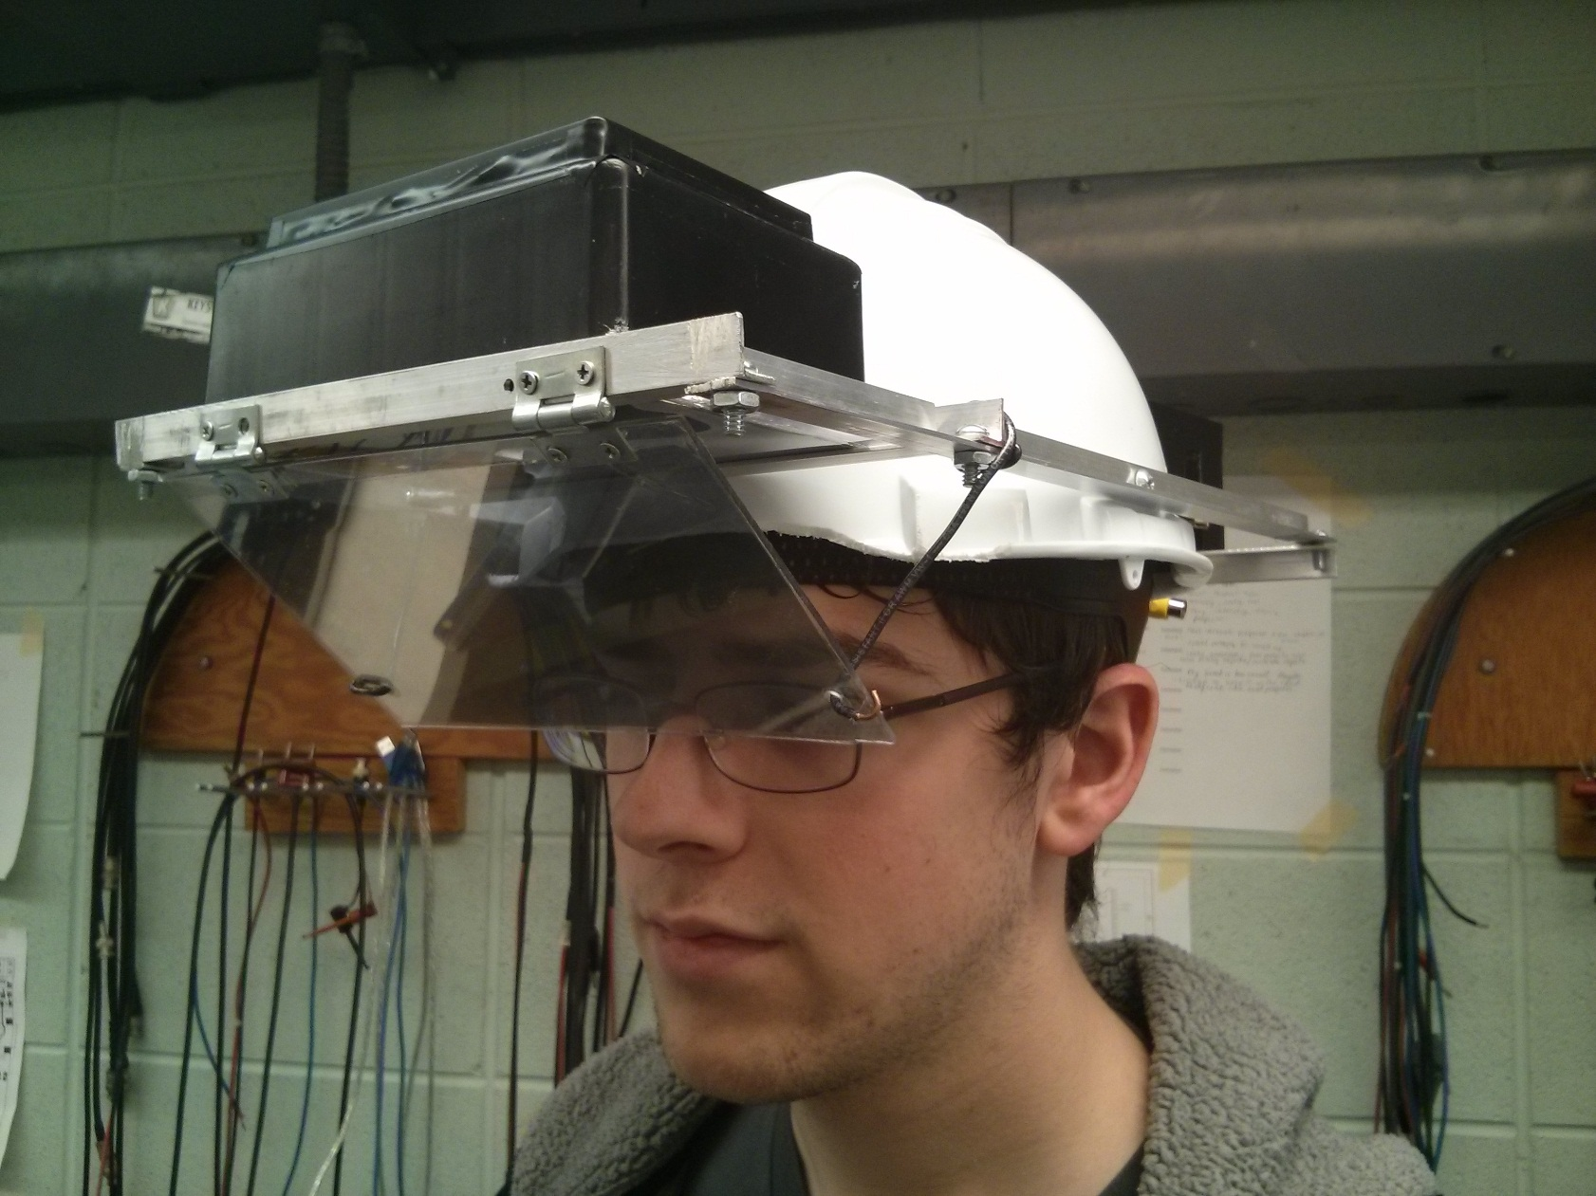
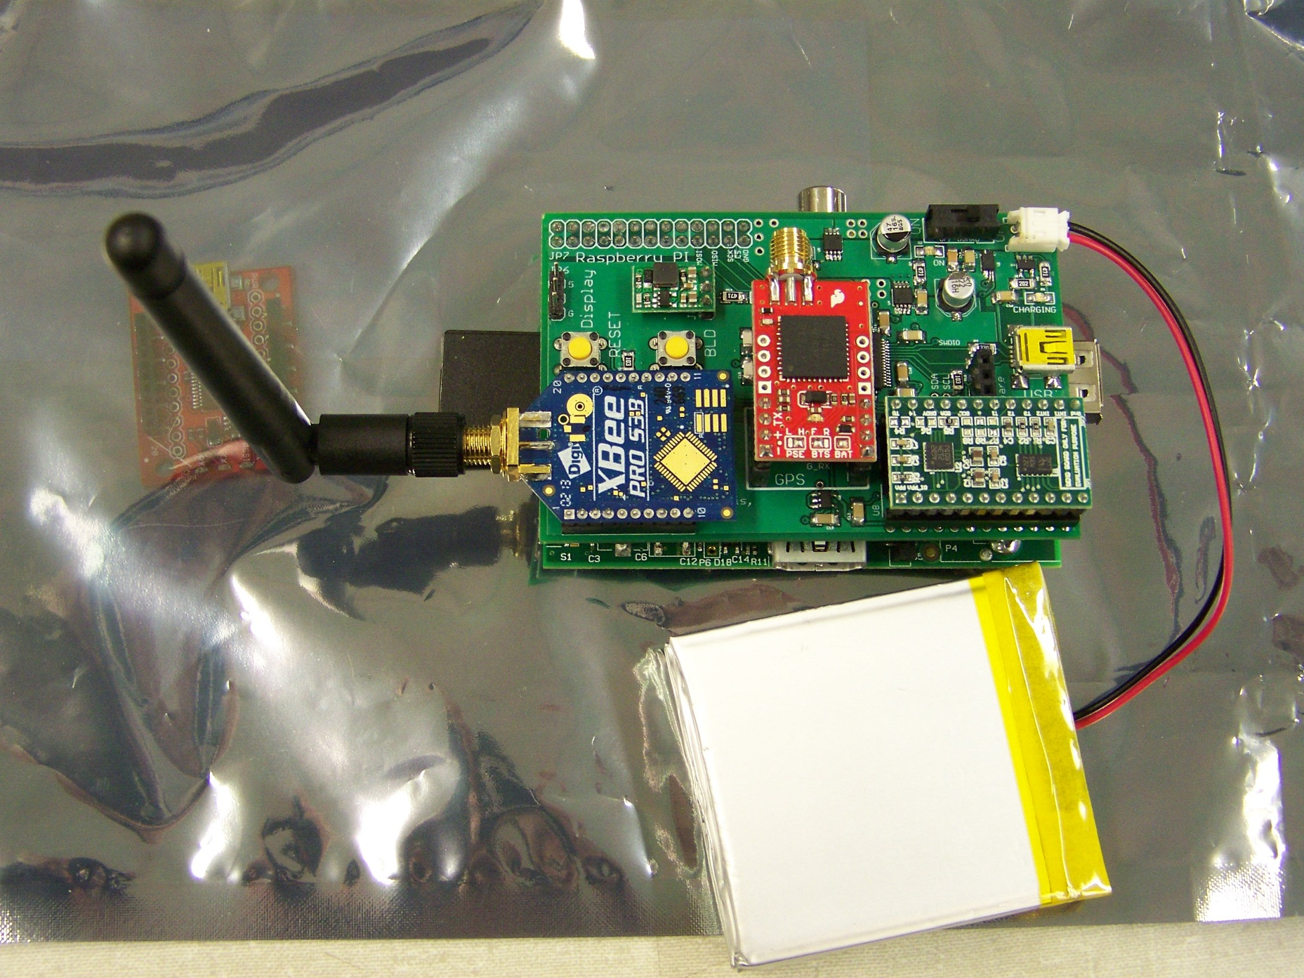
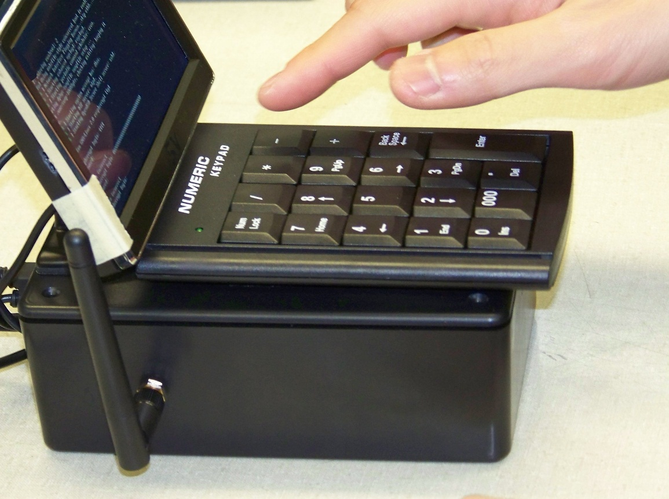
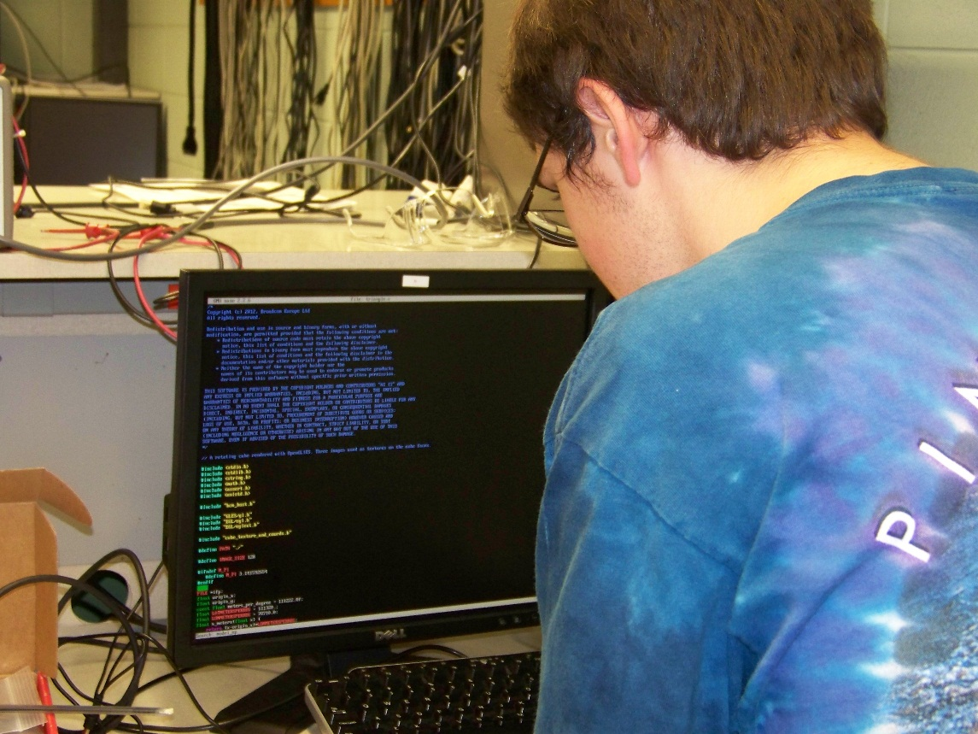
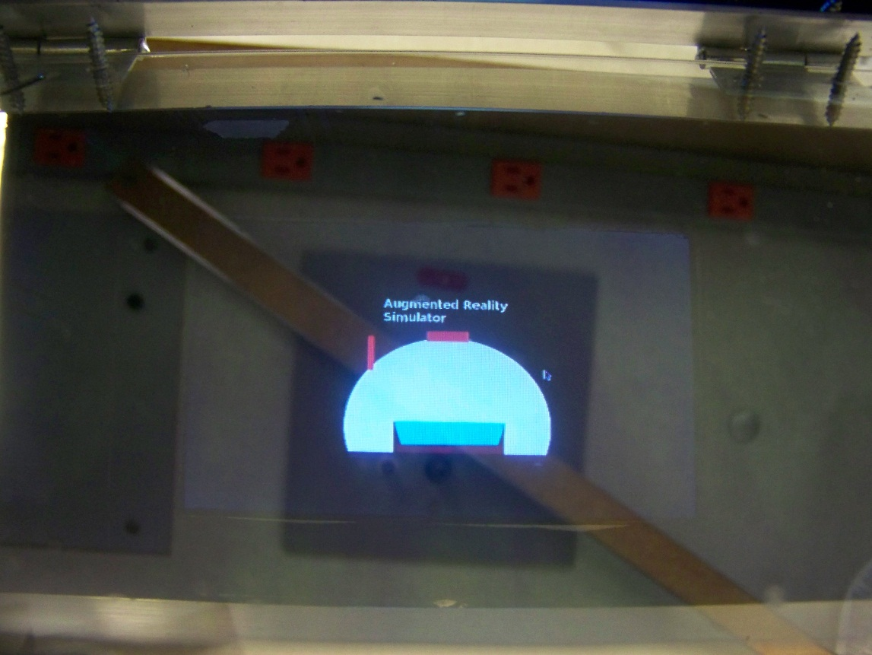

ECE 477 Digital Systems Senior Design Project − Fall 2013
Team 5 – Augmented Reality Simulator
Project Overview:
Players don the headset to experience an immersive multiplayer augmented reality Pacman-like game
The semi-transparent display integrates game objects with the real world
Wireless multiplayer is facilitated by a central control unit
Gameplay is based on geospatial data from GPS and head orientation from an IMU
PCB Layout
Multiple power supplies reduce noise coupling for better sensor performance
Size and form factor designed to fit with Raspberry PI motherboard
Uses STM32F4 microcontroller with FPU.
Battery sensing and charging, GPS, wireless radio, and 9-degree of freedom inertial measurement
Team Members: Thor Smith, Steven Ellis,
Stephen Carlson, Alec Stephen Green
Packaging
Semi-transparent display using an acrylic sheet with reflective film
Fresnel lens increases field of view and focusing distance
Aluminum and plastic construction allows for a lightweight yet rigid frame
Digijock(ette)-Strength Digital System DesignTM
Transforming Ideas Into Reality

