Slide 1
Safety and Reliability Team 5 Fall 2012
Stephen Carlson
Stephen Ellis
Alec Green
Thor Smith

Slide 2
Abstract
We propose an augmented reality simulator
Allows at least one user to play an electronic game in a mobile, outdoor environment
Intended for gaming and other simulations that require an augmented environment.
Contains two primary parts: a headset and a central control unit (CCU)
The headset is worn by the user and overlays images of game objects on the user’s view of the environment
The CCU remains stationary and communicates information to the headset about simulation logic.

Slide 3
Block Diagram
Figure 1: The block diagram indicates two functional groups that communicate through the Xbee wireless devices.
The CCU will perform simulation logic
The headset will perform graphics rendering and sensor data acquisition.

Slide 4
Project Specific Success Criteria
An ability to render graphics based on the orientation of the user’s head.
An ability to render graphics based on the user’s current geospatial location.
An ability to monitor and display the battery power level of the headset to the user.
An ability to monitor and display the status and quality of the wireless connection to the central control unit.
An ability to load headset graphics for a new simulation without re-flashing software on the headset’s microcontroller.

Slide 5
Criticality Levels
High
Causes physical harm to the end user or causes death.
Med
Causes discomfort to the user while using the product.
Low
Causes benign failure of the device. “Doesn’t work” or “No harm to user.”

Slide 6
Components For Analysis
MIC5219 Voltage Regulator
Chosen because failure of any of these devices can generate heat and cause other components on the PCB to fail.
MCP73831 Battery Charger
Chosen because the battery presents the greatest hazard for our product. A failure for this device in conjunction with a battery protection failure could cause harm.
STM32F4 Microcontroller
Chosen because it is the most complex device on the PCB and controls communication between the core sensors.

Slide 7
MIC5219 and MCP73831
Parameter name | Description | Value | Comments
C1 | Die complexity | .20 | Guess a couple hundred Transistors
π_{T} | Temperature coeff. | 28 | TjMax = 110 deg C
C2 | Constant for number of pins | .0025 | Nonhermetic, 5pins
π_{E} | Environmental Constant | .50 | Ground Benign Environment
π_{L} | Learning Factor | 1 | More than 2yrs production
π_{Q} | Quality Factor | 10 | Commercial
Lambda: | (C1* π_{T} +C2* π_{E})π_{Q}π_{L} | 56.0*10⁻⁶ | Charging only a small fraction of use time
MCP73831
Parameter name | Description | Value | Comments
C1 | Die complexity | .20 | Guess a couple hundred Transistors
π_{T} | Temperature coeff. | 2.8 | TjMax = 70 deg C
C2 | Constant for number of pins | .0034 | Nonhermetic, 8pins
π_{E} | Environmental Constant | .50 | Ground Benign Environment
π_{L} | Learning Factor | 1 | More than 2yrs production
π_{Q} | Quality Factor | 10 | Commercial
Lambda: | (C1* π_{T} +C2* π_{E})π_{Q}π_{L} | 5.62*10⁻⁶
MIC5219

Slide 8
STM32F4
Parameter name | Description | Value | Comments
C1 | Die complexity | .56 | 32bit Microcontroller
πT | Temperature coeff. | 0.6 | TjMax = 70 deg C
C2 | Constant for number of pins | .032 | 64 pins
πE | Environmental Constant | .50 | Ground Benign Environment
πL | Learning Factor | 1 | More than 2yrs production
πQ | Quality Factor | 10 | Commercial
Lambda: | (C1* π_{T} +C2* π_{E})π_{Q}π_{L} | 3.52*10⁻⁶

Slide 9
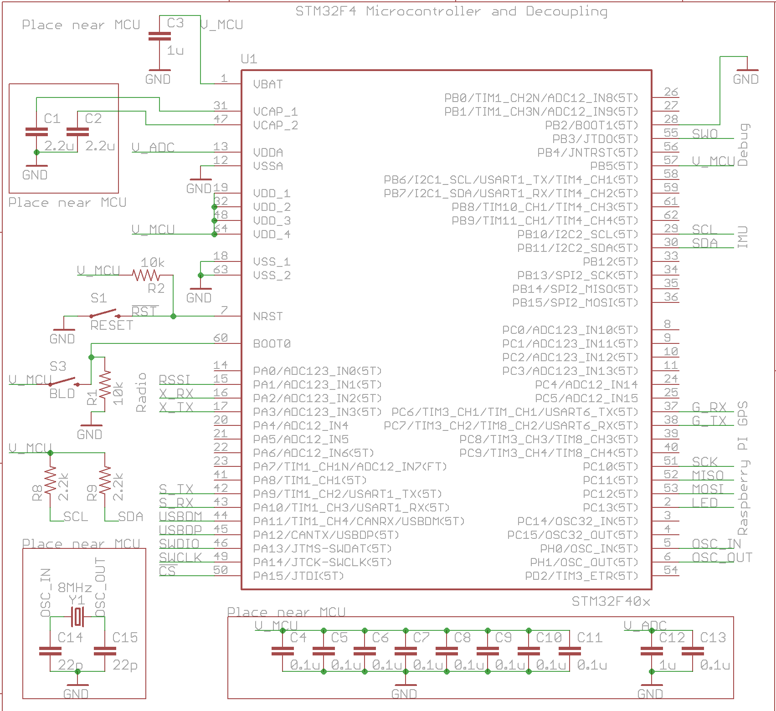
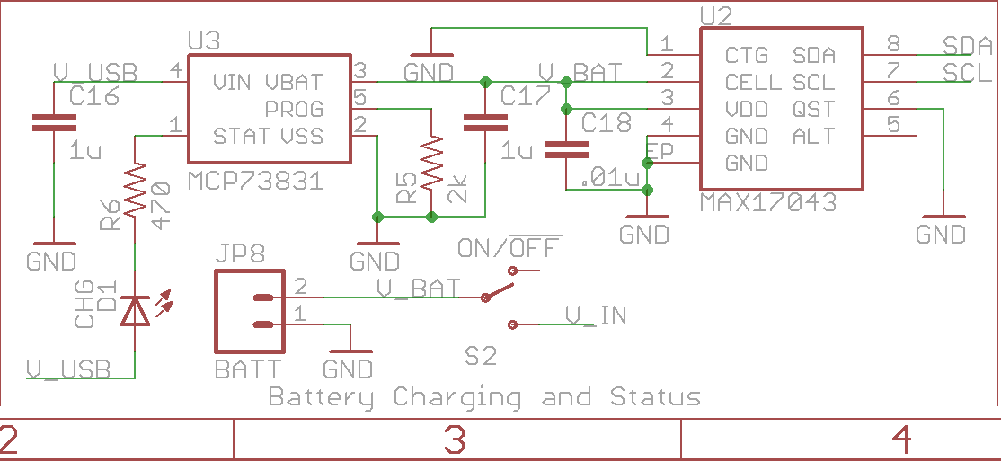
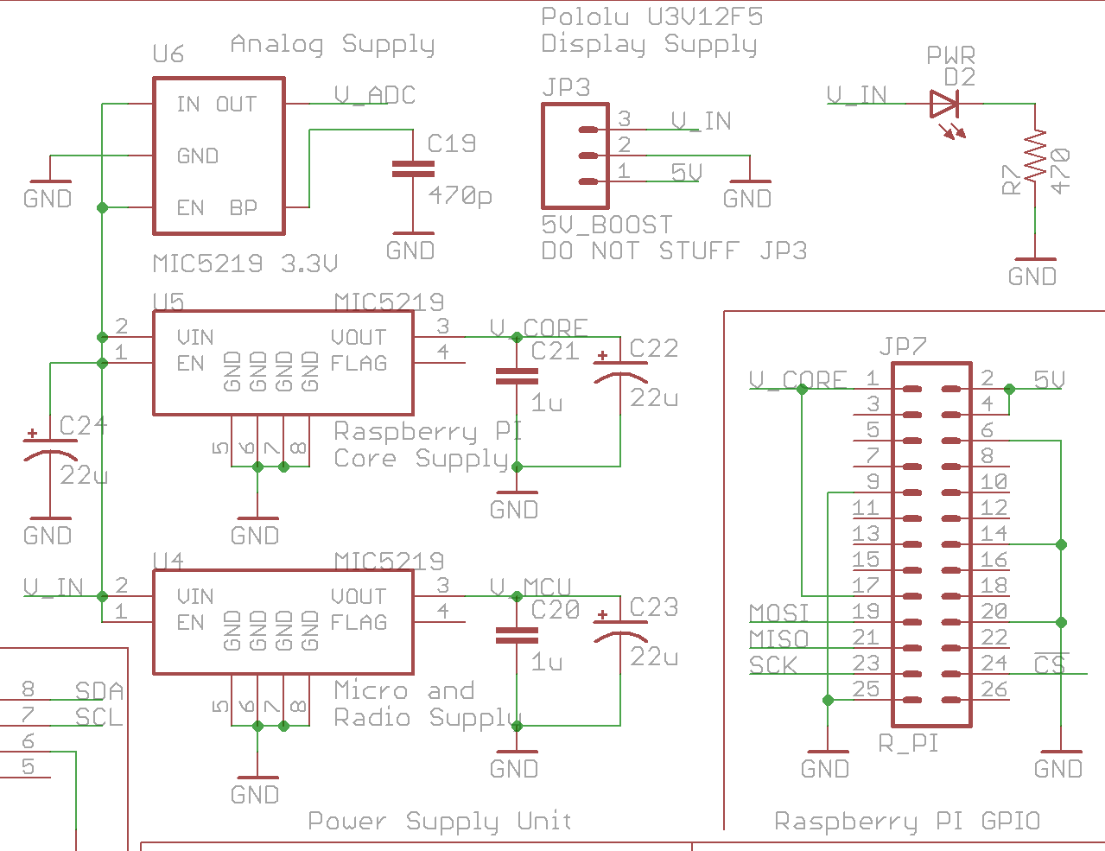
Division into Modules
Microcontroller
Battery Charging
Power Supplies

Slide 10
FMECA Chart – Power Supplies
Power Supplies
Failure No. | Failure Mode | Possible Causes | Failure Effects | Method of Detection | Criticality | Remarks
P1 | Vin shorts to ground and battery protection circuit fails. | Failure of U9, U6, U5, U4, Battery protection circuit | Excessive heat generation from power supply. Fire and or battery explosion. | Observation | High | Low probability because of redundant circuitry
P2 | V_ADC > 3.3V | Failure of U6, VIN shorted to V_ADC | IMU may not report values and may become permanently damaged. | Cannot move “around” virtual objects. | Low
P3 | V_CORE > 3.3V | Failure of U5, VIN shorted to V_CORE | Raspberry Pi may reset repeatedly, work fine, or be permanently damaged. | No display shown. | Low
P4 | V_MCU > 3.3V | Failure of U6, VIN shorted to V_MCU | Micro and Xbee may become permanently damaged. | No display or static display. Objects do not update their location. | Low

Slide 11
FMECA Chart – Battery Charging
Battery Charging
Failure No. | Failure Mode | Possible Causes | Failure Effects | Method of Detection | Criticality | Remarks
B1 | V_USB shorts to V_BAT and battery protection circuit fails | Failure of U3 | Battery could get overcharged and cause heating or explosion. | Observation | High | Unlikely because two components need to fail.
B2 | U2 shorts open | Failure of U2 | Reported battery charge incorrect and does not vary with time. | Observation of battery charge indicator. | Low | User unaware of how much battery life is left. Inconvenience

Slide 12
FMECA Chart – Microcontroller
Microcontroller
Failure No. | Failure Mode | Possible Causes | Failure Effects | Method of Detection | Criticality | Remarks
M1 | Micro fails to run | Failure of C1, C2, C3, C4, C5, C6, C7, C8, C9, C10, C11, C12, C13, R2, Y1, U1 | Display does not change or no display. | Observation | Low | Device just “doesn’t work”
M2 | Micro not functioning properly. | Failure of C1, C2, C3, C4, C5, C6, C7, C8, C9, C10, C11, C12, C13, R2, Y1, U1, Software | Unpredictable Behavior: Intermittent display problems or errors in simulation. | Observation | Med | User could be disoriented by moving pictures.

Slide 13
Questions / Discussion

