Slide 1
Software Design Team 5 Fall 2012
Stephen Carlson
Stephen Ellis
Alec Green
Thor Smith

Slide 2
Abstract
We propose an augmented reality simulator
Allows at least one user to play an electronic game in a mobile, outdoor environment
Intended for gaming and other simulations that require an augmented environment.
Contains two primary parts: a headset and a central control unit (CCU)
The headset is worn by the user and overlays images of game objects on the user’s view of the environment
The CCU remains stationary and communicates information to the headset about simulation logic.

Slide 3
Block Diagram
Figure 1: The block diagram indicates two functional groups that communicate through the Xbee wireless devices.
The CCU will perform simulation logic
The headset will perform graphics rendering and sensor data acquisition.

Slide 4
Project Specific Success Criteria
An ability to render graphics based on the orientation of the user’s head.
An ability to render graphics based on the user’s current geospatial location.
An ability to monitor and display the battery power level of the headset to the user.
An ability to monitor and display the status and quality of the wireless connection to the central control unit.
An ability to load headset graphics for a new simulation without re-flashing software on the headset’s microcontroller.

Slide 5
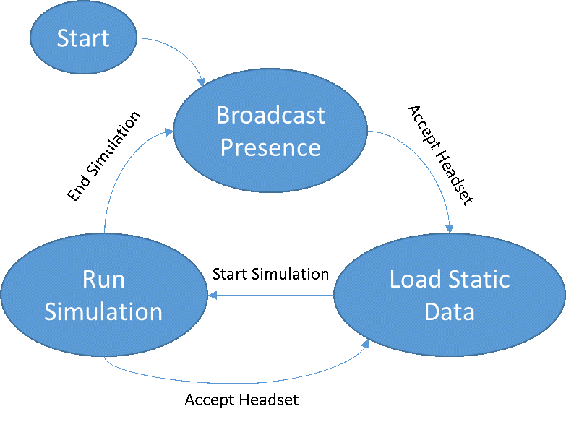
Software Choice: state Machine
Needs to flow between states, so a command or “flag” driven approach was selected.
Data does not need to arrive “as soon as possible”, but needs to be sent on a regular interval. A timer interrupt will determine when IMU, Battery, and GPS data is sent out.
Updates from CCU need to be processed ASAP for good rendering. Thus a wireless IRQ will trigger the main module to process packets.

Slide 6
Software Modules
The GPS, IMU, Xbee, and Battery IRQs provides the control logic with a fresh supply of data.
The Control Logic wakes on a timer interrupt and routes data to either the GPU or the CCU.
GPS IRQ
Convert to Decimeters
on x,y
IMU IRQ
Convert to pitch, yaw, roll
Control Logic
* Send IMU/GPS over network to CCU/GPU
* Make Decisions based on packets from CCU
XBee IRQ
Send/Queue packets.
Connectivity
Battery IRQ
Monitor Battery Life

Slide 7
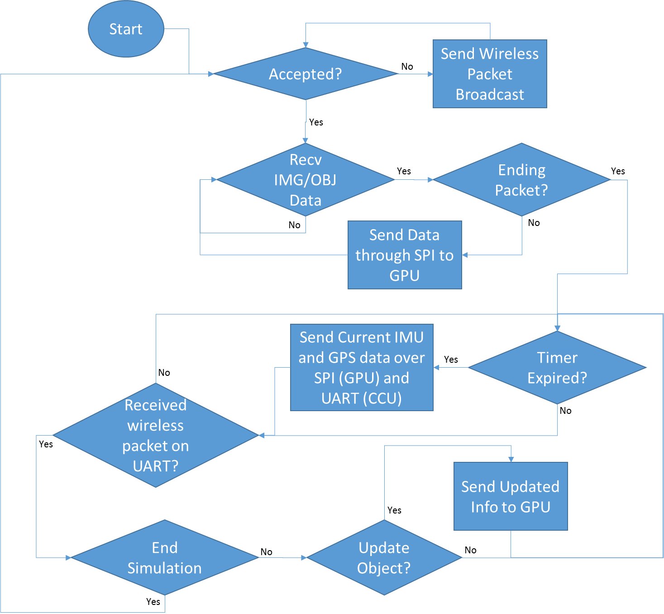
Main Program Flow

Slide 8
Software Design Considerations
Integrated Peripherals used:
Floating Point Unit (FPU)
NVIC (Nested Vectored Interrupt Controller)
SysTick timer (STK)
External Interfaces Used
I2C
400 KHZ (fast mode)
SPI
Slave Mode (clocked by raspberry pi GPU)
UART * 2
115200 baud for XBee
38400 baud for GPS

Slide 9
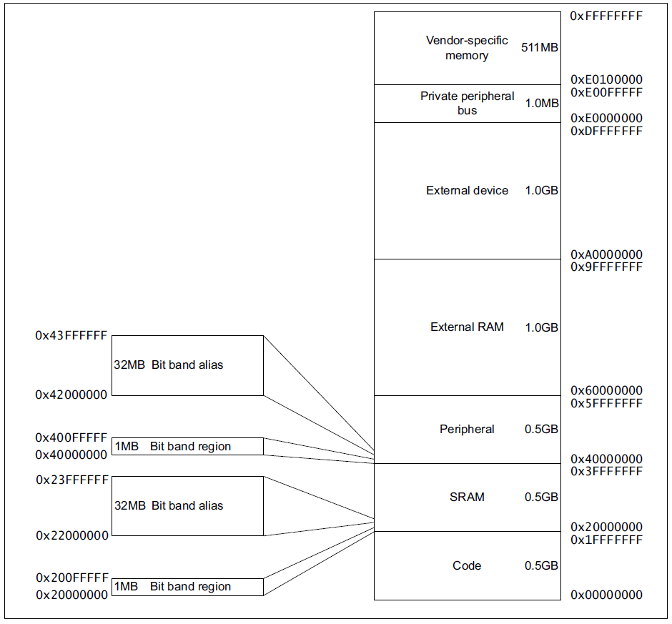
Memory Mapping
SRAM mapped from memory addresses 0x20000000 to 0x20020000; total of 128KB of SRAM.
Stack is descending and positioned at 0x20020000.
Global Variables will start at 0x20000000.
No Heap Currently.
Code will go in flash 0x08000000
Figure 1: Taken from STM32F3xxx and STM32F4xxx Cortex-M4 programming manual
Section 2.2 Memory Model

Slide 10
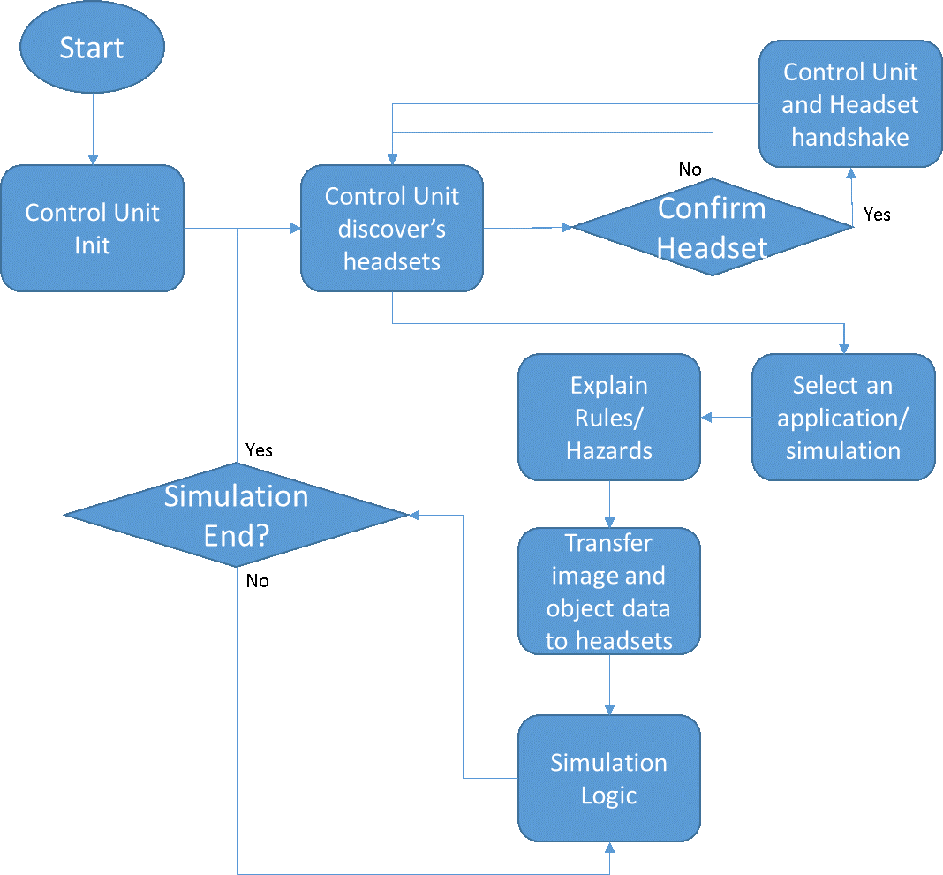
Central Control Unit Software

Slide 11
Debugging
Current Debugging consists of:
Printing messages through the serial port. A library of print functions has been implemented for this purpose.
Working on Breakpoints and single-stepping.
LEDs lighting up to indicate data flow from sensors.

Slide 12
Software sources
Software Libraries for I2C, UART, and other routines from the manufacturer are currently being used.
Python Tkinter will be used on the Central Control Unit for the user interface.
OpenGL is being used on the graphics unit for rendering.

Slide 13
Questions / Discussion

