Slide 1
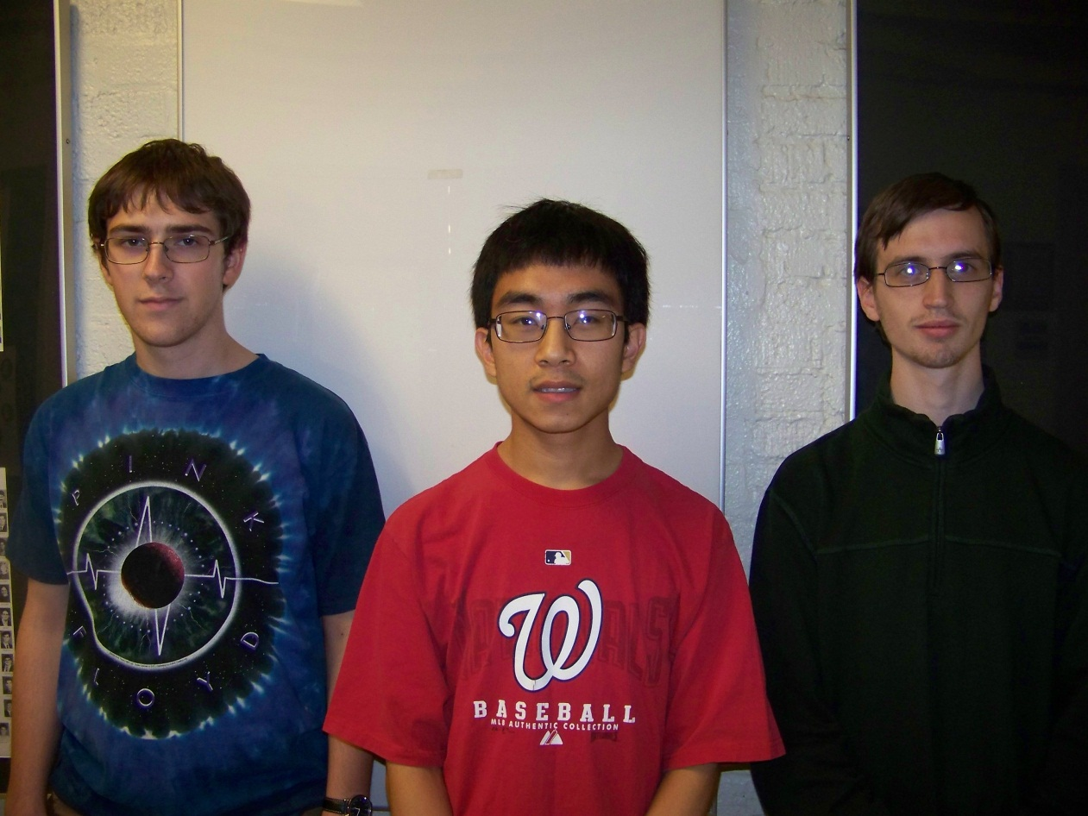
Augmented Reality Cornell Cup Mid Review Spring 2014
Stephen Carlson
Steven Ellis
Thor Smith
Steven
Ellis
Stephen
Carlson
Thor
Smith

Slide 2
Outline
Challenge Definition
Project Entry Solution
Accomplishments to Date
Technical Ingenuity
Project Execution Overview
Complications
Opportunities
Recommendations and Next Steps

Slide 3
Challenge Definition
Wearable augmented reality is emerging quickly
Google Glass, Oculus Rift, Epson BT-100
Provide information
Promote teamwork
Decrease need for physical objects
Design requirements:
Portable and comfortable
Track user position and head orientation
Wireless communication
Easy to set up and use
Maintain peripheral vision

Slide 4
Use cases
Artistic performance
Performers need to know where to be and when
Train a new employee
Show a physical demonstration of equipment
Employee may observe machinery in operation
Educational demonstrations
Place virtual resources in appropriate locations
Virtual tour, guide, or navigation
Gaming
Rely on “imaginary” objects placed in a select location
Artistic performance
Performers need to know where to be and when
Train a new employee
Show a physical demonstration of equipment
Employee may observe machinery in operation
Educational demonstrations
Place virtual resources in appropriate locations
Virtual tour, guide, or navigation
Gaming
Rely on “imaginary” objects placed in a select location

Slide 5
Project entry solution
Headset:
Display
Inertial measurement unit (IMU)
GPS receiver
Backpack:
Wireless communication
Graphics rendering
Simulation logic
Focus on gaming
Allow for multiple simulations
Multiplayer simulation

Slide 7
Accomplishments To Date
Phase 1: Senior Design
Phase 2: Cornell Cup

Slide 8
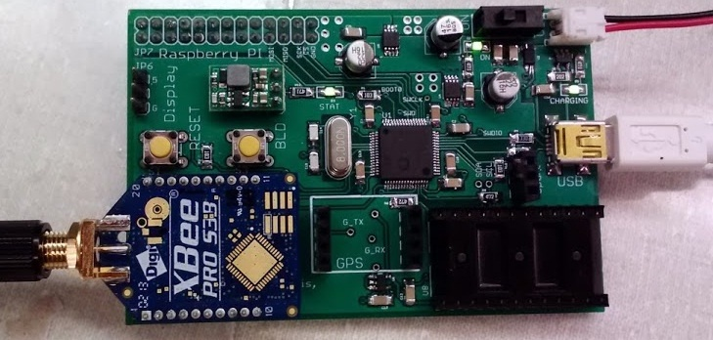
Accomplishments To Date (PHA1)
Hardware
Interfacing to IMU
Interfacing to GPS
Power management
Battery charging
Battery fuel gauge
Voltage regulation

Slide 9
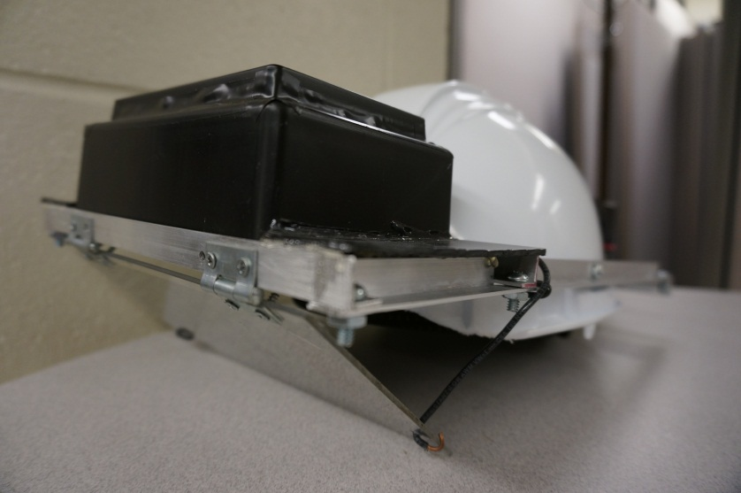
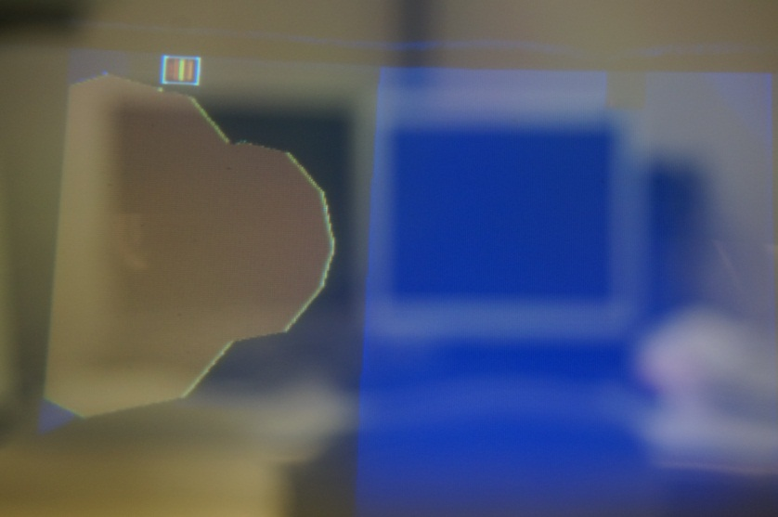
Accomplishments To Date (PHA1)
Self-contained headset
Adjustable hard hat
Display mounted to rails
Electronics in back for balance
Software
OpenGL ES for 3D rendering
Networking using XBees
SPI communication between Raspberry Pi and microcontroller
PacMan-like game

Slide 10
Performance metrics
Metric | Phase 1 (Measured) | Phase 2 Target | Phase 2 (Estimate)
Mass | Headset: 1.3kg | Headset: 1 kg Backpack: 3 kg | Headset: ~1kg Backpack: ~2.5kg
Power | ~3 hours | 3 hours runtime | ~4 hours
Location Precision* | ~1.5 m | 2 meters | ~1.5m
Wireless Range | 200 m | 80 m, line of sight | 200 m
Display Refresh | 10 FPS | 20 FPS | 60 FPS
Network Refresh | Unimplemented | 20 FPS | 60 FPS
Usability | Turnkey startup | User can start and use without a technician | Turnkey startup
Simultaneous Device Limit | 5-6 | 16 | 32+
Head Tracking Latency | ~100ms | 50ms* | >=16ms
User survey for subjective measures like comfort, eye strain

Slide 11
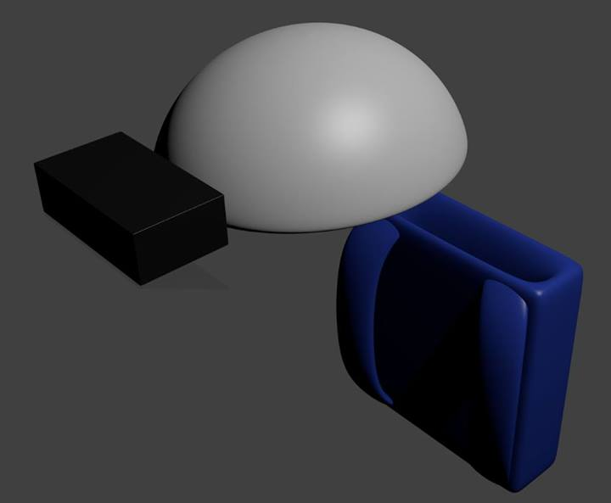
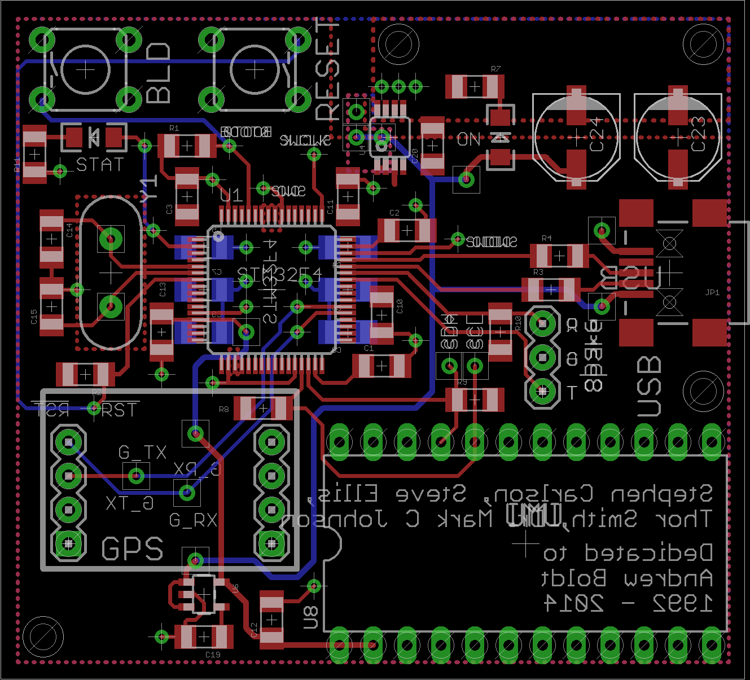
Accomplishments To Date (PHA2)
Power consumption testing
Provided Terasic board uses 1.2 A typical (14.4 W)
Acceptable battery life with 60 Wh capacity
Hardware design for Phase 2
Power supply design
Battery and regulator selection
Headset interfacing board
Re-use GPS, inertial measurement unit,
microcontroller
Packaging
Re-use optics
Selected new display
Selected helmet and backpack

Slide 12
Technical Ingenuity
Display virtual environment overlay on real world
Preserves real-world depth perception
Large field of view
Both worlds perceptible simultaneously
Image perceptible to both eyes
User head and position tracking
Filtering algorithm for inertial measurement data
Portability and battery operation
Wireless communication to other headsets
Multi-user augmented reality

Slide 13
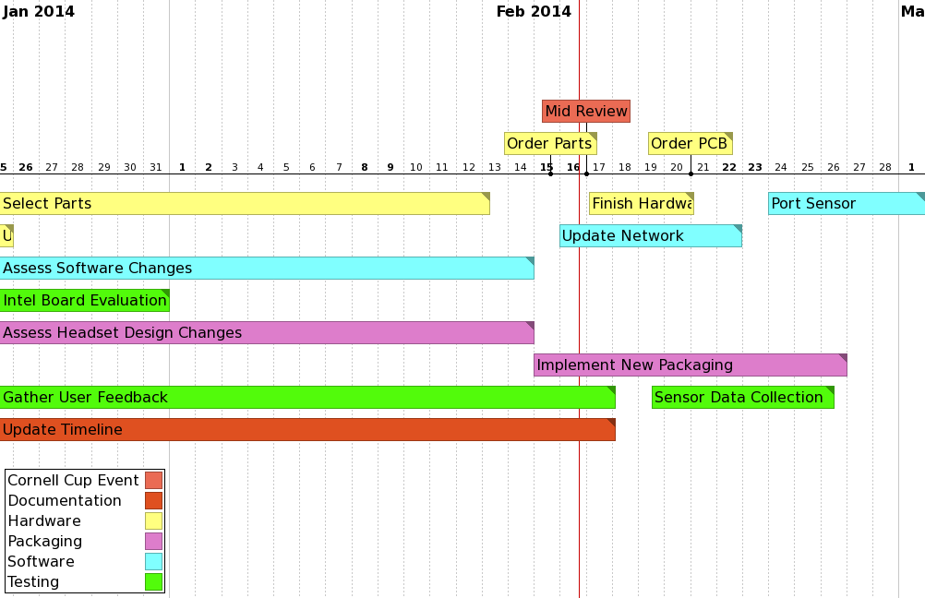
Execution Overview – Timeline 1/3

Slide 14
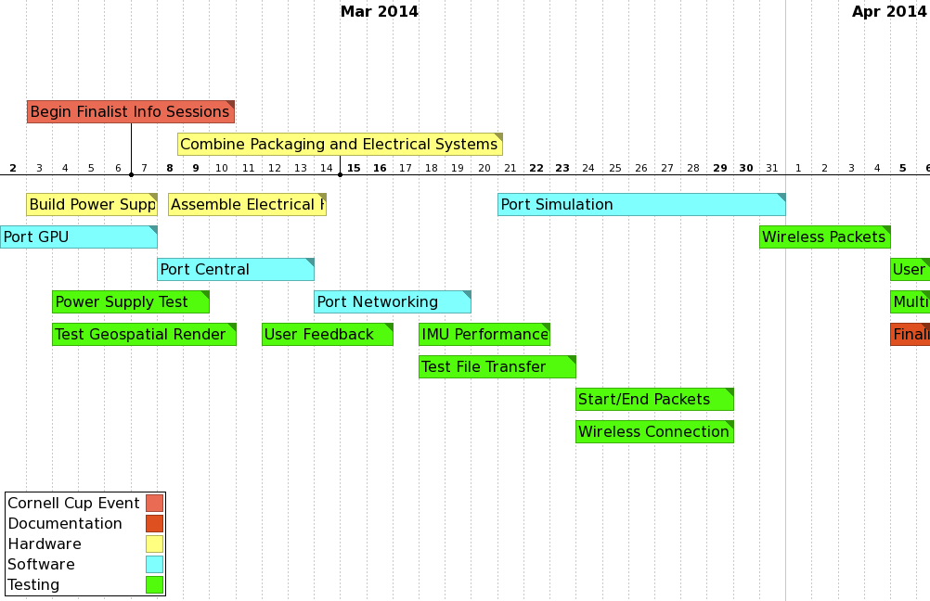
Execution Overview – Timeline 2/3

Slide 15
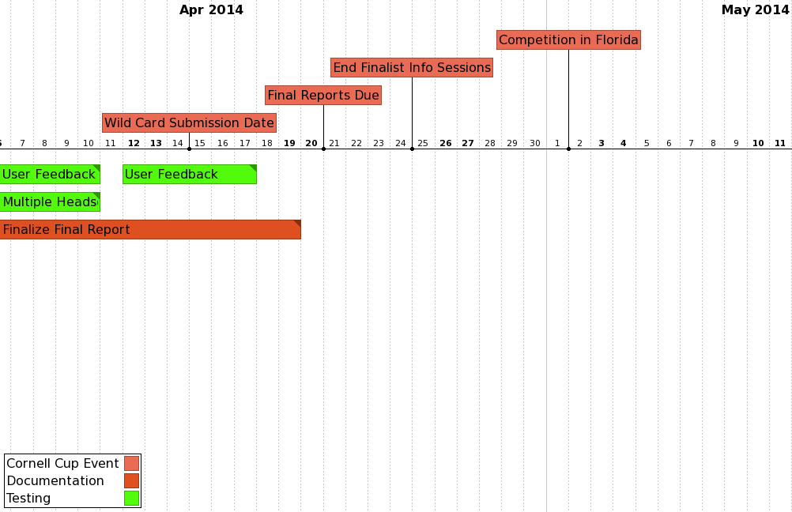
Execution Overview – Timeline 3/3

Slide 16
Execution Overview - BUDGET
Name | Vendor | Unit Price | Quantity | Total
Battery | BatterySpace | 66.95 | 2 | 133.90
Screen 1 | Adafruit | 139.95 | 1 | 139.95
Screen 2 | Adafruit | 64.95 | 1 | 64.95
IMU | Mouser | 28.75 | 0 | 0.00
GPS | Sparkfun | 49.99 | 0 | 0.00
Passive Components | Various | 10.00 | 2 | 20.00
Circuit Board (PCB) | OSH Park | 40.00 | 2 | 80.00
Microcontroller | DigiKey | 11.45 | 2 | 22.90
Battery charger | BatterySpace | 39.95 | 2 | 79.90
Voltage regulator | Mouser | 13.23 | 2 | 26.46
Fuel gauge | DigiKey | 6.43 | 2 | 12.86
3D printed box | Purdue IEEE | 40.00 | 2 | 80.00
Backpack | N/A | 10.00 | 0 | 0.00
Development Cost |  |  |  | 739.66

Slide 17
Complications
Patent Liability
Many AR patents exist
Licensing may be required
Could file new patents and cross-license
User Safety
LiFePO₄ much safer than other Lithium battery chemistries
Translucent display keeps user aware of environment
Product unsuitable for use while driving, operating heavy machinery

Slide 18
Opportunities
Software sales after device purchase
Create app store
Encourage third party development
Creation of alternative input devices
Gloves for tracking hand movement
Business to business sales
Sell to schools for education
Sell to businesses for employee training

Slide 19
Recommendations and Next Steps
Continued software development
Improve response time of head orientation
Improve filtering of GPS data (location precision)
Large “jumps” in position
Migrate software to new motherboard
Finalize packaging modifications for larger display
Testing of new hardware
Battery power and charging
Interfacing of Terasic board with existing microcontroller
Display

Slide 20
Questions / Discussion

Slide 21
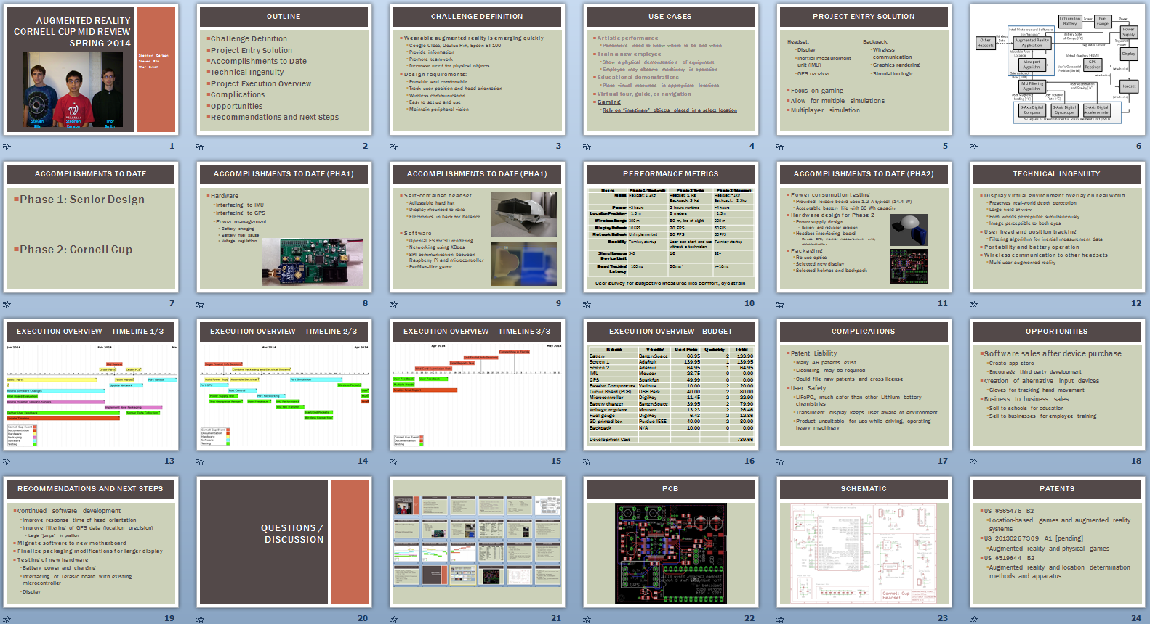

Slide 22
PCB

Slide 23
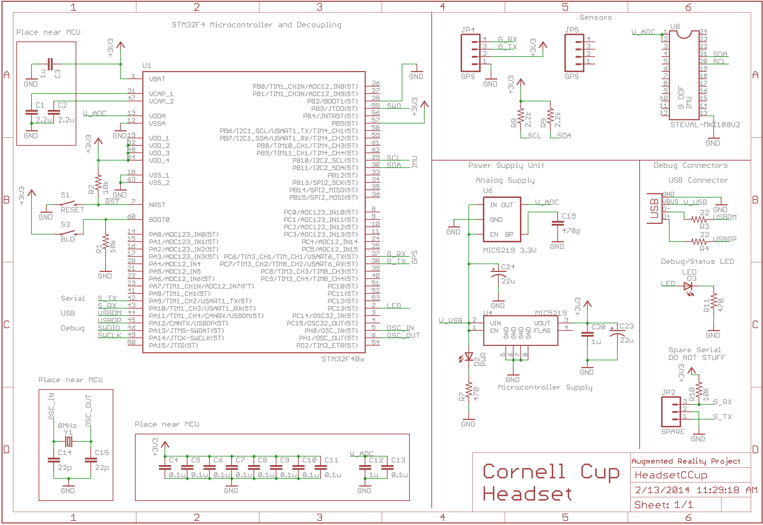
Schematic

Slide 24
Patents
US 8585476 B2
Location-based games and augmented reality systems
US 20130267309 A1 [pending]
Augmented reality and physical games
US 8519844 B2
Augmented reality and location determination methods and apparatus

