Slide 1
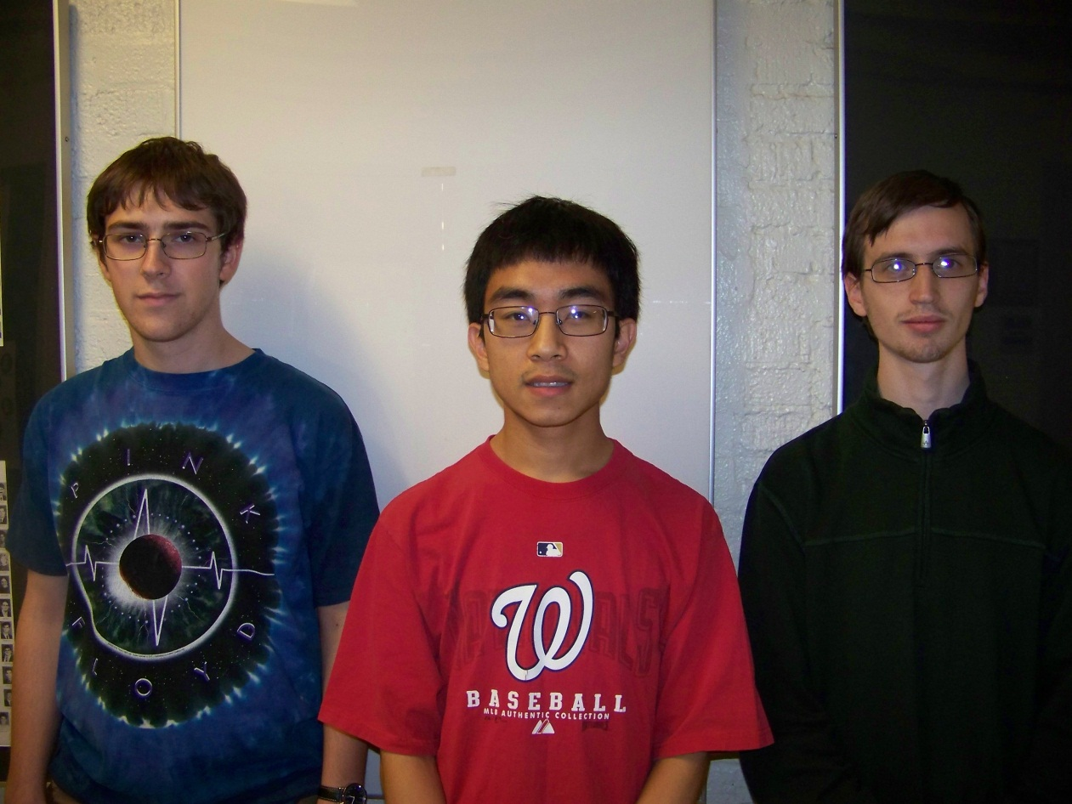
Augmented Reality Cornell Cup Mid Review Fall 2012
Stephen Carlson
Stephen Ellis
Thor Smith
Steven
Ellis
Stephen
Carlson
Thor
Smith

Slide 2
Outline
Challenge Definition
Project Entry Solution
Accomplishments to Date
Technical Ingenuity
Project Execution Overview
Complications
Opportunities
Recommendations and Next Steps

Slide 3
Challenge Definition
Wearable computing is emerging quickly
Google Glass, Samsung Galaxy Gear, and Oculus Rift.
Combine virtual reality with reality to create augmented reality
Provide information
Promote Teamwork
Decrease need for physical objects
The design will need to satisfy the following requirements:
Portable and Comfortable
Track user position and head orientation
Wireless Communication
Easy to set up and use
Transparent display, easy to see

Slide 4
USE cases
Artistic Performance
Performers need to know where to be and when.
Train a New Employee
Show a physical demonstration of equipment
Employee may observe machinery in operation.
Children Playing Games
Children Rely on “imaginary” objects placed in a select location.
Educational Demonstrations
Replace resources with virtual resources placed in appropriate locations.

Slide 5
Project entry solution
Headset:
Provide the display
Mounting point for sensors
Backpack:
Wireless communication
Graphics rendering
Simulation Logic
Will not focus on internet connectivity
Allow for multiple simulations.
Focus on Gaming

Slide 7
Accomplishments To Date
PHASE 1
PHASE 2

Slide 8
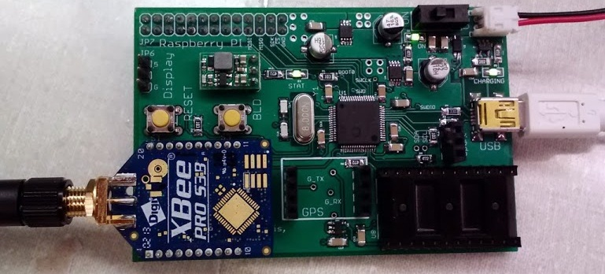
Accomplishments To Date (PHA1)
Hardware
Interfacing to Inertial Measurement Unit
Interfacing to GPS
Power management
Battery charging
Battery fuel gauge
Voltage regulation

Slide 9
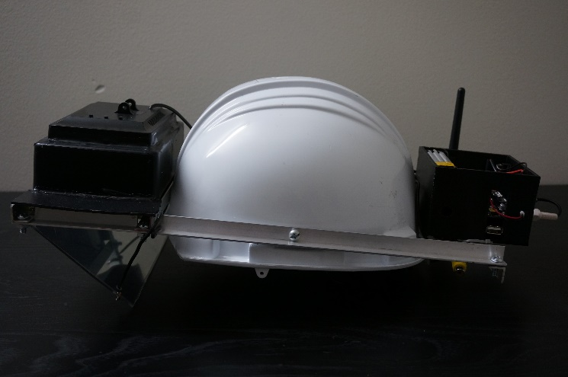
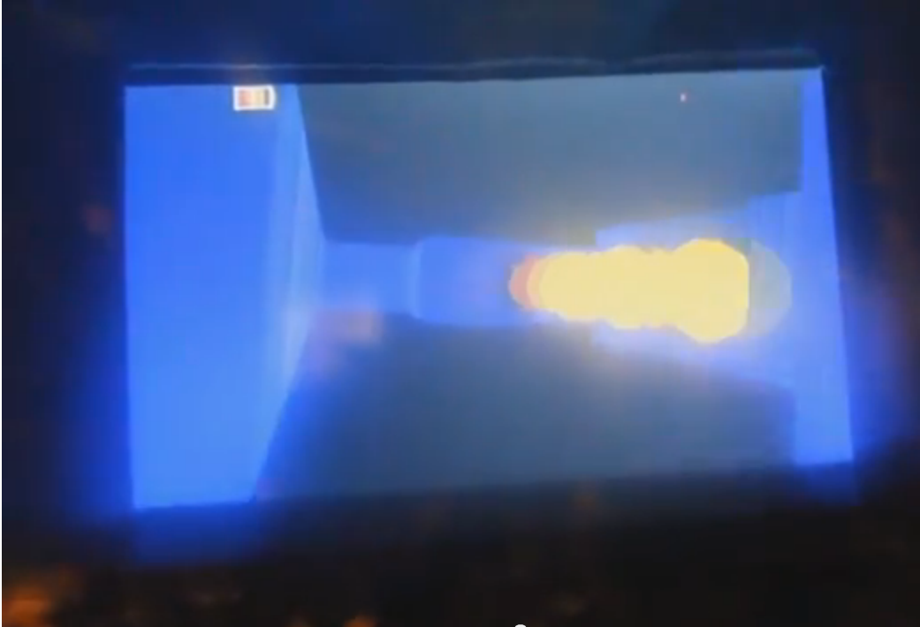
Accomplishments To Date (PHA1)
Self-contained headset
Hard hat with display and all
electronics mounted to rails
Software
OpenGL ES for 3D rendering
Networking: XBees with CCU
SPI communication between Pi and micro
MacPan game

Slide 10
Performance metrics
Metric | Initial Target | Phase 1 (Measured) | Phase 2 (Current Estimate)
Mass | Headset: 1 kg Backpack: 3 kg | Headset: 1.3kg Backpack: N/A | Headset: ~1kg Backpack: ~2.5kg
Power | 3 hours runtime | ~3 hours | ~4 hours
Location Accuracy | 2 meters | TODO | Same as Phase 1
Wireless Range | 80 m range, line of sight | TODO | TODO
Display Refresh Rate | 20 FPS | 30 FPS | 60 FPS
Network Refresh Rate | 20 FPS | N/A | 60 FPS
Usability | End user can start up and use device without a technician | Turnkey startup | Turnkey startup

Slide 11
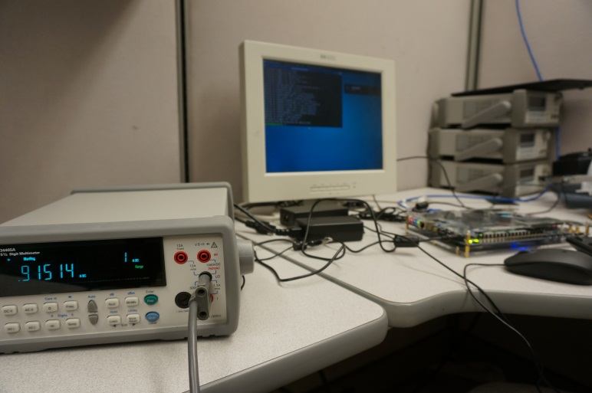
Accomplishments To Date (PHA2)
Power consumption testing
Provided Terasic board uses 1.2 A typical (14.4 W)
Acceptable battery life with 60 Whr capacity
Hardware design for Phase 2
Power supply design
Battery and regulator selection
Headset interfacing board
Re-use GPS, inertial measurement unit,
microcontroller
Packaging
Re-use optics
Selected new display
Selected helmet and backpack
[POWER CONSUMPTION]
[PCB]

Slide 12
Technical Ingenuity
Display virtual environment overlay on real world
Preserves real-world depth perception
Large field of view
Both worlds perceptible simultaneously
User head and position tracking
Filtering algorithm for inertial measurement data
Portability and battery operation
Wireless communication to other headsets
Multi-user augmented reality

Slide 13
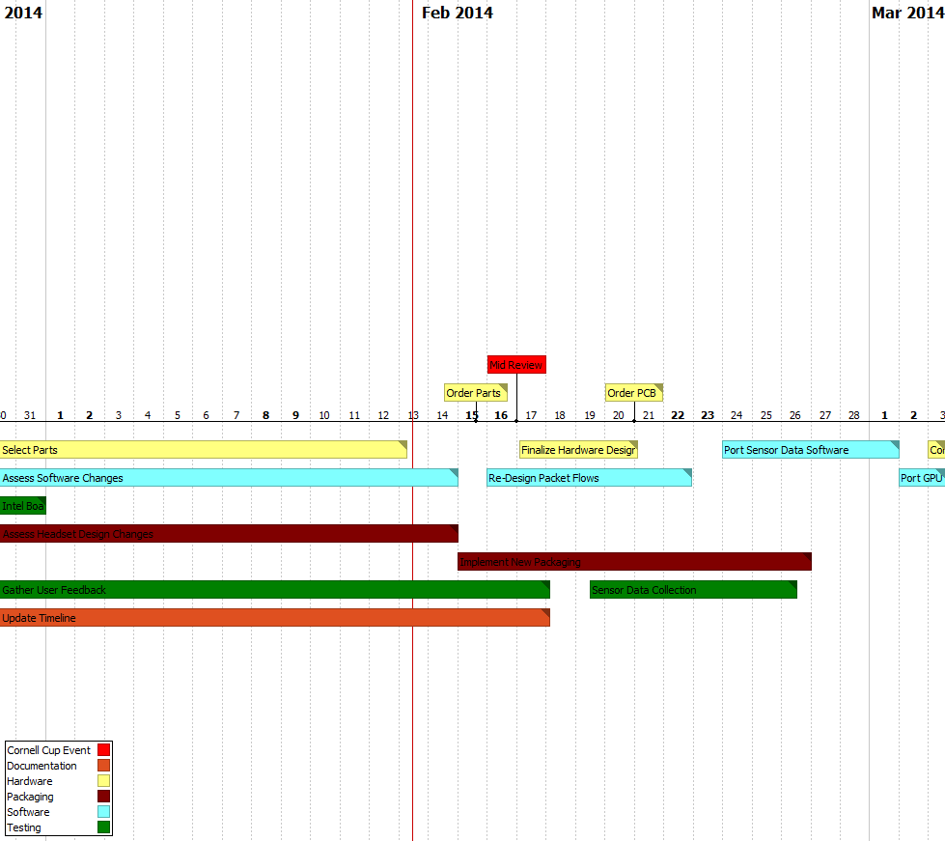
Execution overview – Timeline 1/3

Slide 14
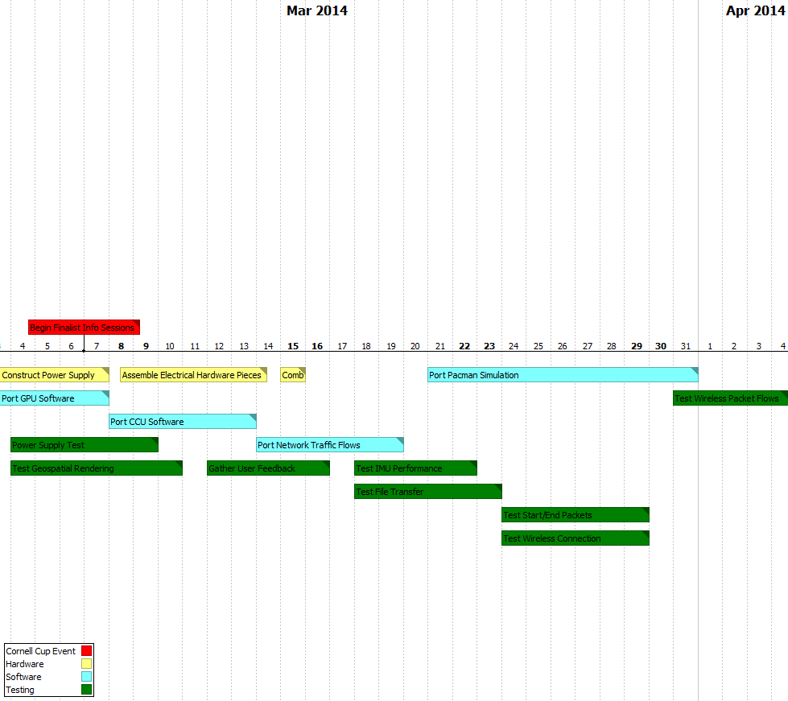
Execution overview – Timeline 2/3

Slide 15
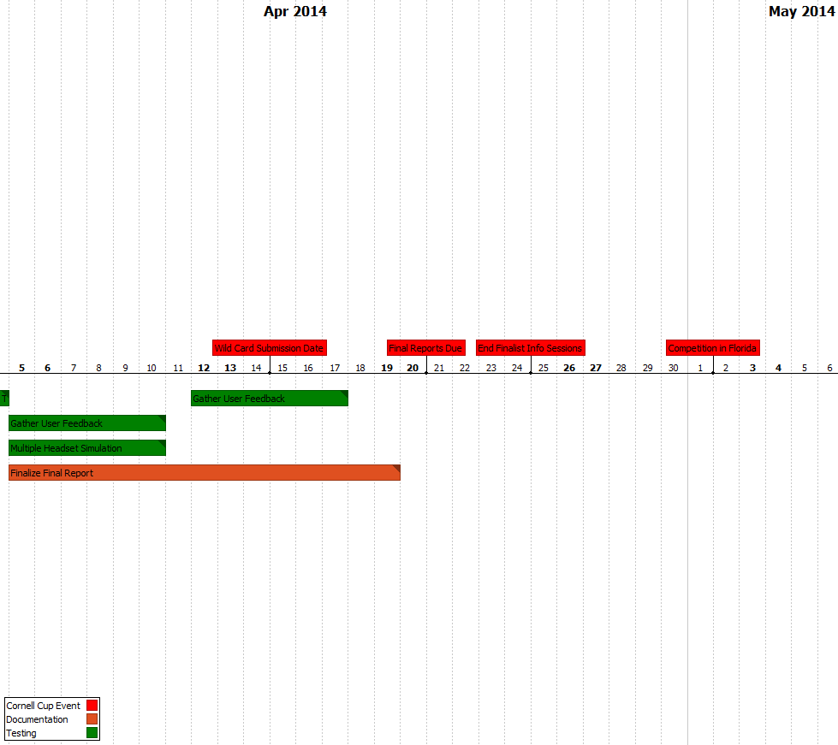
Execution Overview – Timeline 3/3

Slide 16
Execution overview - BUDGET
Name | Item | Vendor | Unit Price | Shipping | Quantity | Price
Battery |  | BatterySpace | 66.95 |  | 2 | 133.9
Screen1 |  | AdaFruit | 139.95 |  | 1 | 139.95
Screen2 |  | AdaFruit | 64.95 |  | 1 | 64.95
IMU |  | Mouser | $28.75 |  | 1 | 28.75
GPS |  | SparkFun | 49.99 |  | 1 | 49.99
Passives |  | Various | 10 |  | 2 | 20
PCB |  | Oshpark | 40 |  | 2 | 80
Microcontroller |  | DigiKey | 11.45 |  | 2 | 22.9
Charger |  | BatterySpace | 39.95 |  | 2 | 79.9
Regulator |  | Mouser | 13.23 |  | 2 | 26.46
Fuel Guage |  | DigiKey | 6.43 |  | 2 | 12.86
3D printed Box |  | Purdue IEEE | 40 |  | 2 | 80
Backpack | Draw String Backpack | Supplied | 10 |  | 0 | 0
Total |  |  | 521.65 |  |  | 739.66

Slide 17
COMPLICATIONS
Patent Liability
Novelty of design avoids many AR patents
Large fraction specifically mention cameras
Licensing may be required
Could file new patents and cross-license
User Safety
LiFePO₄ much safer than other Lithium battery chemistries
Translucent display keeps user aware of environment
Product unsuitable for use while driving, operating heavy machinery

Slide 18
Opportunities
Selling software to users after purchase of device
Need to set up distribution network
Encourage third party development
Anti-piracy solutions

Slide 19
Recommendations and Next Steps
Continued software development
Improve calculation of head orientation
Improve filtering of GPS data
Migrate software to new motherboard
Finalize packaging modifications for larger display
Testing of new hardware
Battery power and charging
Interfacing of Terasic board with existing microcontroller
Display

Slide 20
Questions / Discussion

Slide 21
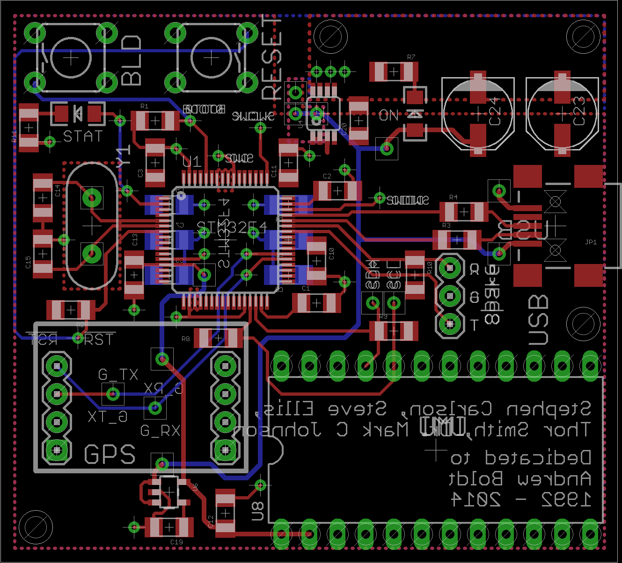
PCB

Slide 22
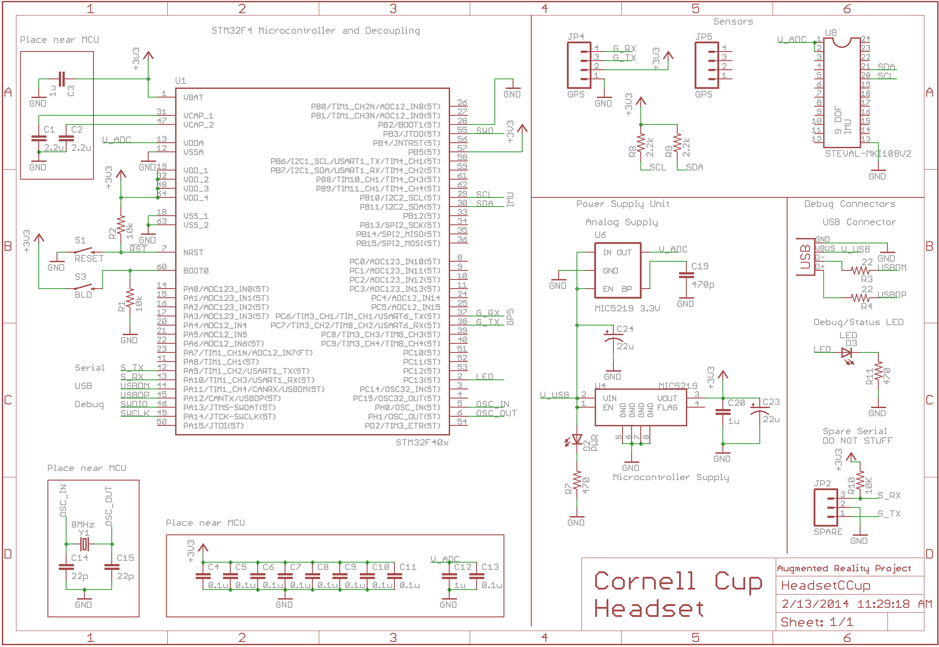
Schematic

