Slide 1
SKILL-BASED QA PLANNING
From Manual to LLM-Assisted
Before LLM
After LLM
Orchestrator
Why It Works
Evaluation & Evolution
Limitations

Slide 2
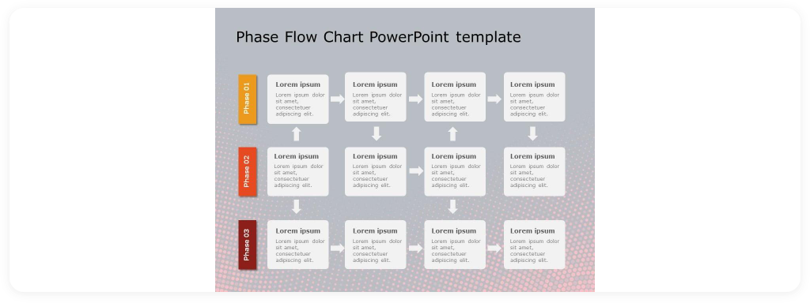
BEFORE LLM: MANUAL QA PLANNING
Manual, fragmented, analyst-dependent
Scattered materials
Manual reading
Experience-driven
Slow mapping
Inconsistent structure

Slide 3
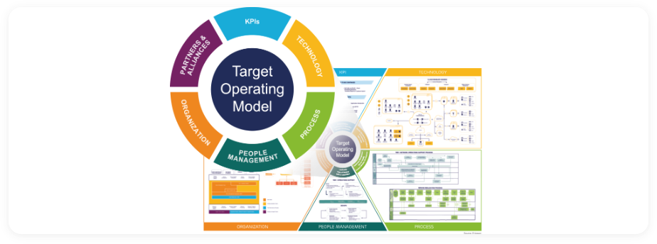
AFTER LLM: PROMPT + SKILL + CONSTRAINTS
Structured generation workflow
Prompt
Skill
Requirements
Materials
Context
Structured QA Plan
Prompt
Skill
Requirements
Materials
Context
→
Structured QA Plan
Explicit prompt specifies skill, requirements, materials, output

Slide 4
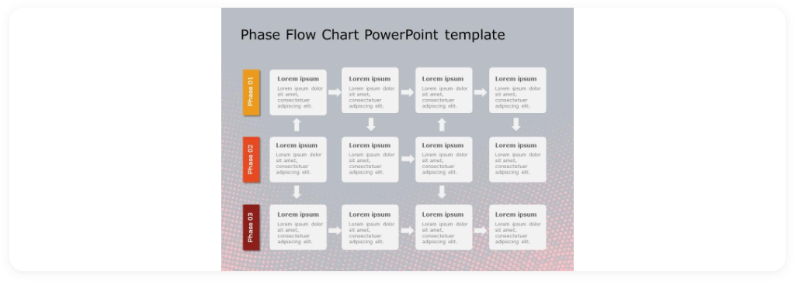
HOW QA-PLAN-ORCHESTRATOR WORKS
Phased, gated workflow
Phase 0 Setup
Phase 1 Evidence
Phase 2 Artifact Index
Phase 3 Research & Coverage
Phase 4 Drafting
Phase 5 Review Checkpoints
Phase 6 Quality Pass
Phase 7 Finalize
phase1_spawn_manifest.json
coverage_ledger
qa_plan_final.md

Slide 5
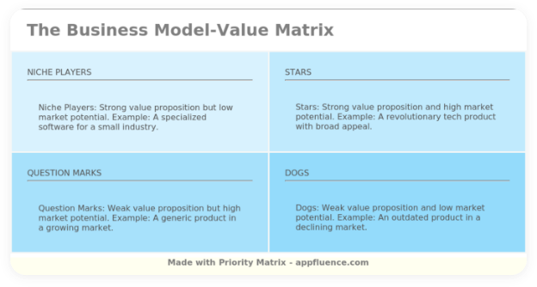
WHY THIS SKILL
Workflow discipline drives quality
Script-driven
Phase gates
Reusable evidence
Review checkpoints
Structured outputs
More consistent planning

Slide 6
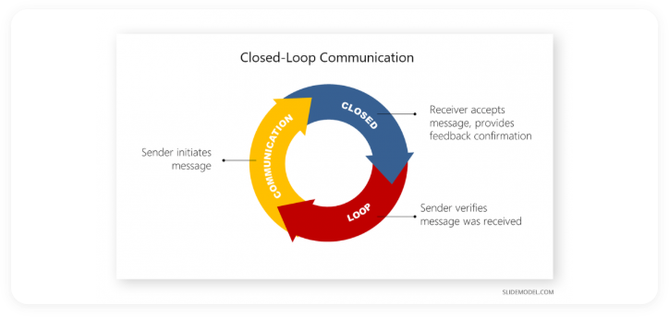
EVALUATE AND EVOLVE
Champion-vs-challenger iteration
Blocking cases
Defect replay
Checkpoint enforcement
Holdout regression

Slide 7
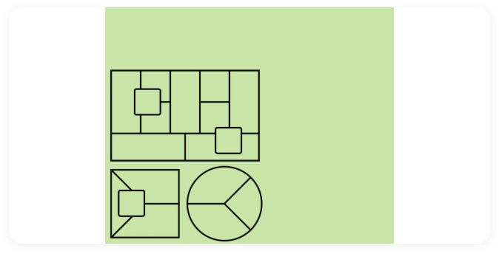
CURRENT LIMITATIONS
Strong but scoped
Tailored to E2E workflow features
Sensitive to prompt quality
Depends on input/context
Coverage varies by knowledge pack
→
Evolving with feature maturity and context depth.

