Slide 1
Routing and Switching
2020-2021

Slide 2
Introduction to Transmission Media

Slide 3
Upon completion of this section, you will be able to:
Explain what constitutes a network.
Identify the basic components of a network.
Describe the primary mechanisms for communication over a network.

Slide 4

Simple Point-to-Point Ethernet Networks
Networks are comprised of at least two end stations, and a medium over which data can be carried.
End Station
End Station
Physical Medium
Notes:
A network can be understood to be the capability of two or more entities to communicate over a given medium. The development of any network relies on this same principle for establishing communication. Commonly the entities within a network that are responsible for the transmission and reception of communication are known as end stations, while the means by which communication is enabled is understood to be the medium. Within an enterprise network, the medium exists in a variety of forms from a physical cable to radio waves.

Slide 5
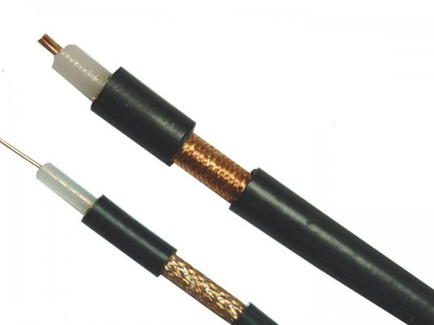
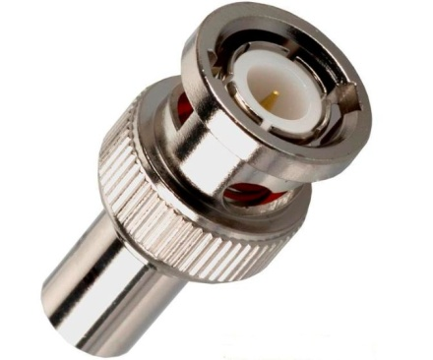
Coaxial
Copper coaxial cabling commonly used to support users as part of a shared network.
Standard | Cables | Maximum Transmission Distance
10Base2 | Thin coaxial | 185m
10Base5 | Thick coaxial | 500m
Notes:
Baseband technology transmits a single data signal/stream/channel at a time while broadband technology transmits multiple data signals/streams/channels simultaneously at the same time. ... Same as a highway, in the broadband transmission, multiple data signals can be transmitted at the same time.
10 Mbps baseband 2oo m
The coaxial cable represents a more historic form of transmission medium that may today be limited in usage within the enterprise network. As a transmission medium, the coaxial cable comprises generally of two standards, the 10Base2 and 10Base5 forms, that are known as Thinnet or Thinwire, and Thicknet or Thickwire respectively.
The standards both support a transmission capacity of 10Mbps transmitted as baseband signals for respective distances of 185 and 500 meters. In today’s enterprise networks, the transmission capacity is extremely limited to be of any significant application. The Bayonet Neill-Concelman (BNC) connector is the common form of connector used for thin 10Base2 coaxial cables, while a type N connector was applied to the thicker 10Base5 transmission medium.

Slide 6
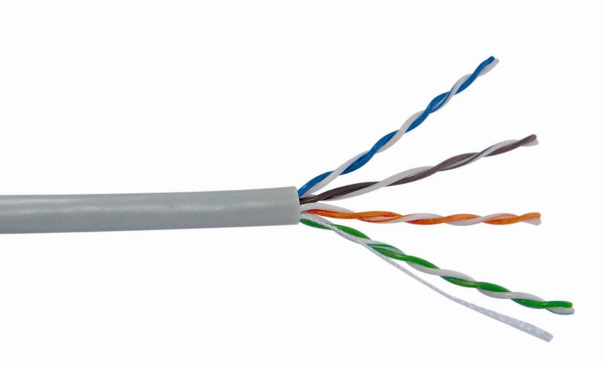
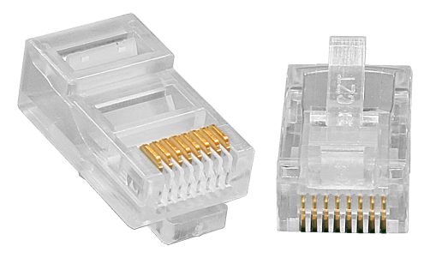
Ethernet
The primary physical medium used in enterprise networks.
Standard | Physical Medium | Distance
10Base-T | Two pairs of Category 3/4/5 twisted pair cables | 100m
100Base-TX | Two pairs of Category 5 twisted pair cables | 100m
1000Base-T | Four pairs of Category 5e twisted pair cables | 100m
Notes:
Ethernet cabling has become the standard for many enterprise networks providing a transmission medium that supports a much higher transmission capacity. The medium supports a four copper wire pair contained within a sheath which may or may not be shielded against external electrical interference. The transmission capacity is determined mainly based on the category of cable with category 5 (CAT5) supporting Fast Ethernet transmission capacity of up to 100Mbps, while a higher Gigabit Ethernet transmission capacity is supported from Category 5 extended (CAT5e) standards and higher.
The transmission over Ethernet as a physical medium is also susceptible to attenuation, causing the transmission range to be limited to 100 meters. The RJ-45 connector is used to provide connectivity with wire pair cabling requiring specific pin ordering within the RJ-45 connector, to ensure correct transmission and reception by end stations over the transmission medium.

Slide 7
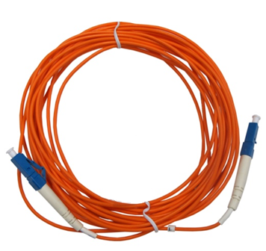
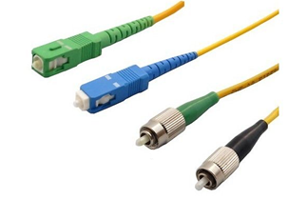
Fiber Optic
Standard | Physical Medium | Distance
10Base-F | Two strand fiber | 2000m
100Base-FX | Two strand multi-mode fiber | 2000m
1000Base-LX | Single-mode fiber or multi-mode fiber | 316 - 5000m
1000Base-SX | Multi-mode fiber | 275 - 550m
Notes:
Square connector(SC),lossent connector (LC)
Optical media uses light as a means of signal transmission as opposed to electrical signals found within both Ethernet and coaxial media types. The optical fiber medium supports a range of standards of 10Mbps, 100Mbps, 1Gbps and also 10Gbps (10GBASE) transmission. Single or multi-mode fiber defines the use of an optical transmission medium for propagating of light, where single mode refers to a single mode of optical transmission being propagated, and is used commonly for high speed transmission over long distances.
Multi mode supports propagation of multiple modes of optical transmission that are susceptible to attenuation as a result of dispersion of light along the optical medium, and therefore is not capable of supporting transmission over longer distances. This mode is often applied to local area networks which encompass a much smaller transmission range. There are an extensive number of fiber connector standards with some of the more common forms being recognized as the ST connector, LC connector and SC, or snap connector.

Slide 8
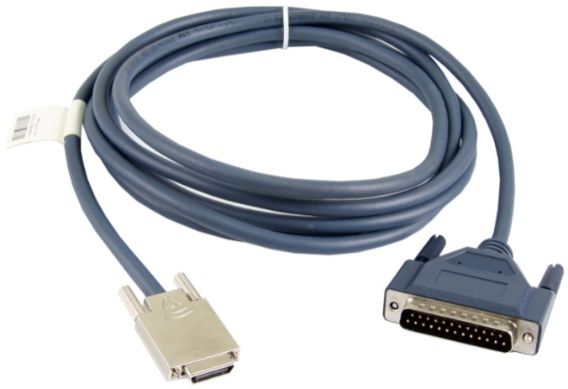
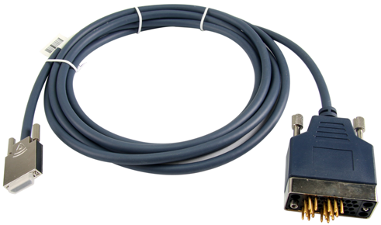
Serial
Serial supports reliable transmission between devices.
The serial connection is designed to support the transmission of data as a serial stream of bits
Standard | Speed
RS-232 | Standards define up to 20000bps, but can reach 1Mbit/s
RS-422 | 100Kbit/s ~ 10Mbit/s+
Notes:
Kol eli fat can LAN dh b2a WAN fe mno anwa3 mnha el smart serial
Serial represents a standard initially developed over 50 years ago to support reliable transmission between devices, during which time many evolutions of the standard have taken place. The serial connection is designed to support the transmission of data as a serial stream of bits. The common standard implemented is referred to as (Recommended Standard) RS-232 but it is limited somewhat by both distance and speed. Original RS-232 standards define that communication speeds supported be no greater that 20Kbps, based on a cable length of 50ft (15 meters), however transmission speeds for serial is unlikely to be lower than 115 Kbps. The general behavior for serial means that as the length of the cable increases, the supported bit rate will decrease, with an approximation that a cable of around 150 meters, or 10 times the original standards, the supported bit rate will be halved.
Other serial standards have the capability to achieve much greater transmission ranges, such as is the case with the RS-422 and RS-485 standards that span distances of up to 4900ft (1200 meters) and are often supported by V.35 connectors that were made obsolete during the late 1980’s but are still often found and maintained today in support of technologies such as Frame Relay and ATM, where implemented. RS-232 itself does not define connector standards, however two common forms of connector that support the RS-232 standard include the DB-9 and DB-25 connectors. Newer serial standards have been developed to replace much of the existing RS-232 serial technology, including both FireWire and the universal serial bus (USB) standards, that latter of which is becoming common place in many newer products and devices.

Slide 9
Signal Data Encoding
Signal patterns used for interpretation of communication.
Encoding is used to synchronize transmission.
1
0
1
0
1
0
1
0
1
0000 | 0001 | 0010 | 0011 | 0100
0 | 1 | 2 | 3 | 4
Notes:
In order to enable communication over physical links, signals must be transmitted between the transmitting and receiving stations. This signal will vary depending on the medium that is being used, as in the case of optical and wireless transmission. The main purpose of the signal is to ensure that synchronization (or clocking) between the sender and receiver over a physical medium is maintained, as well as support transmission of the data signal in a form that can be interpreted by both the sender and receiver.
A waveform is commonly recognized as a property of line encoding where the voltage is translated into a binary representation of 0 and 1 values that can be translated by the receiving station. Various line coding standards exist, with 10Base Ethernet standards supporting a line encoding standard known as Manchester encoding. Fast Ethernet with a frequency range of 100MHz invokes a higher frequency than can be supported when using Manchester encoding.
An alternative form of line encoding is therefore used known as NZRI, which in itself contains variations dependant on the physical media, thus supporting MLT-3 for 100Base-TX and 100Base-FX together with extended line encoding known as 4B/5B encoding to deal with potential clocking issues. 100Base-T4 for example uses another form known as 8B/6T extended line encoding. Gigabit Ethernet supports 8B/10B line encoding with the exception of 1000Base-T which relies on a complex block encoding referred to as 4D-PAM5.

Slide 10


Collision Domains
Signals in a shared network are susceptible to collisions.
A collision detection mechanism is used to identify collisions.
Notes:
Ethernet represents what is understood to be a multi-access network, in which two or more end stations share a common transmission medium for the forwarding of data. The shared network is however susceptible to transmission collisions where data is forwarded by end stations simultaneously over a common medium. A segment where such occurrences are possible is referred to as a shared collision domain.
End stations within such a collision domain rely on contention for the transmission of data to an intended destination. This contentious behavior requires each end station monitor for incoming data on the segment before making any attempt to transmit, in a process referred to as Carrier Sense Multiple-Access Collision Detection (CSMA/CD). However, even after taking such precautions the potential for the occurrence of collisions as a result of simultaneous transmission by two end stations remains highly probable.

Slide 11
Duplex Modes
Duplex modes support simultaneous and non-simultaneous bidirectional communication.
Half Duplex
Full Duplex
Notes:
Half and full duplex communication
Transmission modes are defined in the form of half and full duplex, to determine the behavior involved with the transmission of data over the physical medium.
Half duplex refers to the communication of two or more devices over a shared physical medium in which a collision domain exists, and with it CSMA/CD is required to detect for such collisions. This begins with the station listening for reception of traffic on its own interface, and where it is quiet for a given period, will proceed to transmit its data. If a collision were to occur, transmission would cease, followed by initiation of a backoff algorithm to prevent further transmissions until a random value timer expires, following which retransmission can be reattempted.
Full duplex defines the simultaneous bidirectional communication over dedicated point-to-point wire pairs, ensuring that there is no potential for collisions to occur, and thus there is no requirement for CSMA/CD.

Slide 12
Which forms of cabling can be used to support Gigabit Ethernet transmissions within an enterprise network?
What is a collision domain?
What is the purpose of CSMA/CD?
Notes:
Gigabit Ethernet transmission is supported by CAT 5e cabling and higher, and also any form of 1000Base Fiber Optic cabling or greater.
A collision domain is a network segment for which the same physical medium is used for bi-directional communication. Data simultaneously transmitted between hosts on the same shared network medium is susceptible to a collision of signals before those signals reach the intended destination. This generally results in malformed signals either larger or smaller than the acceptable size for transmission (64 bytes – 1500 bytes), also know as runts and giants, being received by the recipient.
CSMA/CD is a mechanism for detecting and minimizing the possibility of collision events that are likely to occur in a shared network. CSMA requires that the transmitting host first listen for signals on the shared medium prior to transmission. In the event that no transmissions are detected, transmission can proceed. In the unfortunate circumstance that signals are transmitted simultaneously and a collision occurs, collision detection processes are applied to cease transmission for a locally generated period of time, to allow collision events to clear and to avoid further collisions from occurring between transmitting hosts.

Slide 13
Ethernet Framing

Slide 14
Upon completion of this section, you will be able to:
Explain the application of reference models to networks.
Describe how frames are constructed.
Explain the function of MAC addressing at the data link layer.
Describe Ethernet frame forwarding and processing behavior.

Slide 15





Managing Network Communication
Networks are primarily managed by upper and lower layer protocols.
TCP/IP
OSI
Novell
IBM
LANs
WANs
IEEE 802
Ethernet
PPP
HDLC
Notes:
Communication over networks relies on the application of rules that govern how data is transmitted and processed in a manner that is understood by both the sending and receiving entities. As a result, multiple standards have been developed over the course of time with some standards becoming widely adopted. There exists however a clear distinction between the standards that manage physical data flow and the standards responsible for logical forwarding and delivery of traffic.
The IEEE 802 standards represent a universal standard for managing the physical transmission of data across the physical network and comprises of standards including the Ethernet standard 802.3 for physical transmission over local area networks.
Alternative standards exist for transmission over wide area networks operating over serial based media, including Ethernet, PPP and HDLC. TCP/IP has been widely adopted as the protocol suite defining the upper layer standards, regulating the rules (protocols) and behavior involved in managing the logical forwarding and delivery between end stations.

Slide 16
Layered Models - OSI
7
Application
Provision of communications
between applications
6
Presentation layer
Data formatting &
encryption/decryption
5
Session layer
Establish, maintain and
manage sessions
4
Transport layer
Establish, maintain and
manage end-to-end connection
3
Network layer
Addressing and routing
2
Data link layer
Provision of link medium access & link management
1
Physical layer
Bit flow transmission
Notes:
Although the TCP/IP reference model is primarily supported as the standard model based on TCP/IP protocol suite, the focus of the TCP/IP reference model does not clearly separate and distinguish the functionality when referring lower layer physical transmission.
In light of this, the open systems interconnection, or OSI reference model is often recognized as the model for reference to IEEE 802 standards due to the clear distinction and representation of the behavior of lower layers which closely matches the LAN/MAN reference model standards that are defined as part of the documented IEEE 802-1990 standards for local and metropolitan area networks. In addition, the model that is generally in reference to the ISO protocol suite, provides an extended breakdown of upper layer processing.

Slide 17
Encapsulation
7
Application
Data
6
Presentation layer
Data
5
Session layer
Data
4
Transport layer
Data
3
Network layer
Data
2
Data link layer
Data
1
Physical layer
Notes:
As upper layer application data is determined for transmission over a network from an end system, a series of processes and instructions must be applied to the data before transmission can be successfully achieved. This process of appending and pre-pending instructions to data is referred to as encapsulation and for which each layer of the reference model is designed to represent.
As instructions are applied to the data, the general size of the data increases. The additional instructions represent overhead to the existing data and are recognized as instructions to the layer at which the instructions were applied. To other layers, the encapsulated instructions are not distinguished from the original data. The final appending of instructions is performed as part of the lower layer protocol standards (such as the IEEE 802.3 Ethernet standard) before being carried as an encoded signal over a physical medium.

Slide 18

Layered Models - TCP/IP
Application
TCP/IP
Transport
Network
Ethernet
Network Interface
Notes:
The TCP/IP reference model primarily concerns with the core principles of the protocol suite, which can be understood as the logical transmission and delivery of traffic between end stations. As such the TCP/IP protocol reference model provides a four layer representation of the network, summarizing physical forwarding behavior under the network interface layer, since lower layer operation is not the concern of the TCP/IP protocol suite.
Primary focus remains on the network (or Internet) layer which deals with how traffic is logically forwarded between networks, and the transport (sometimes referred to as host-to-host) layer that manages the end-to-end delivery of traffic, ensuring reliability of transportation between the source and destination end stations. The application layer represents an interface through a variety of protocols that enable services to be applied to end user application processes.

Slide 19
Communication Between Two End Stations
Data link layer frames are used to govern transmission over the communications medium.
Host A
Host B
Frame
Header
Data
Trailer
Notes:
As part of the IEEE 802.3 Ethernet standard, data is encapsulated with instructions in the form of a header and a trailer before it can be propagated over physical media on which Ethernet is supported. Each stage of encapsulation is referred to by a protocol data unit or PDU, which at the data link layer is known as a frame.
Ethernet frames contain instructions that govern how and whether data can be transmitted over the medium between two or more points. Ethernet frames come in two general formats, the selection of which is highly dependant on the protocols that have been defined prior to the framing encapsulation.

Slide 20
Frame Formats
Host A
Host B
Ethernet II
D.MAC
S.MAC
Type
Data
FCS
IEEE802.3
D.MAC
S.MAC
Length
LLC
SNAP
Data
FCS
Field Value >= 1536 (0x0600) Ethernet II
Field Value <= 1500 (0x05DC) IEEE802.3
Notes:
Two frame formats are recognized as standard for Ethernet based networks. The DIX version 2 frame type standard was originally developed during the early 1980’s, where today it is recognized as the Ethernet II frame type. Ethernet II was eventually accepted and integrated into the IEEE 802 standards, highlighted as part of section 3.2.6 of the IEEE 802.3x-1997 standards documentation. The IEEE 802.3 Ethernet standard was originally developed in 1983, with key differences between the frame formats including a change to the type field that is designed to identify the protocol to which the data should be forwarded to once the frame instructions have been processed. In the IEEE 802.3 Ethernet format, this is represented as a length field which relies on an extended set of instructions referred to as 802.2 LLC to identify the forwarding protocol.
Ethernet II and IEEE 802.3 associate with upper layer protocols that are distinguished by a type value range, where protocols supporting a value less than or equal to 1500 (or 05DC in Hexadecimal) will employ the IEEE 802.3 Ethernet frame type at the data link layer. Protocols represented by a type value greater than or equal to 1536 (or 0600 in Hexadecimal) will employ the Ethernet II standard, and which represents the majority of all frames within Ethernet based networks.
Other fields found within the frame include the destination and source MAC address fields that identify the sender and the intended recipient(s), as well as the frame check sequence field that is used to confirm the integrity of the frame during transmission.

Slide 21
Ethernet II Frame
The Ethernet II frame type is associated with protocols with a type value greater than 1536 (0x600).
6 bytes
6 bytes
2 bytes
46-1500 bytes
4 bytes
D.MAC
S.MAC
Type
Data
FCS
0x0800
IP 2048 (0x0800)
0x0806
ARP 2054 (0x0806)
Notes:
The Ethernet II frame references a hexadecimal type value which identifies the upper layer protocol. One common example of this is the Internet Protocol (IP) which is represented by a hexadecimal value of 0x0800. Since this value for IP represents a value greater than 0x0600, it is determined that the Ethernet II frame type should be applied during encapsulation. Another common protocol that relies on the Ethernet II frame type at the data link layer is ARP, and is represented by the hexadecimal value of 0x0806.

Slide 22
IEEE802.3 Frame
The IEEE 802.3 frame type is associated with protocols with a type value less than 1500 (0x05DC).
6 bytes
6 bytes
2 bytes
38-1492 bytes
4 bytes
D.MAC
S.MAC
Length
LLC
SNAP
Data
FCS
1 byte
1 byte
1 byte
3 bytes
2 bytes
D.SAP
S.SAP
Control
Org Code
Type
STP
0x03
3 (0x03)
Notes:
For the IEEE 802.3 frame type, the type field is contained as part of the SNAP extension header and is not so commonly applied the protocols in today’s networks, partially due to the requirement for additional instructions which results in additional overhead per frame. Some older protocols that have existed for many years but that are still applied in support of Ethernet networks are likely to apply the IEEE 802.3 frame type. One clear example of this is found in the case of the Spanning Tree Protocol (STP) that is represented by a value of 0x03 within the type field of the SNAP header.

Slide 23
Frame Forwarding
Media Access Control (MAC) addressing facilitates data link layer communication.
Host A
Host B
MAC：10-0B-A9-23-38-10
MAC：10-0B-A9-9D-C9-B8
D.MAC
MAC：10-0B-A9-9D-B9-C8
Notes:
Ethernet based networks achieve communication between two end stations on a local area network using Media Access Control (MAC) addressing that allows end systems within a multi access network to be distinguished. The MAC address is a physical address that is burned into the network interface card to which the physical medium is connected. This same MAC address is retrieved and used as the destination MAC address of the intended receiver by the sender, before the frame is transferred to the physical layer for forwarding over the connected medium.

Slide 24


The Ethernet MAC Address
MAC addresses are comprised of an organizationally unique identifier and a vendor assigned address value.
48 bits
24 bits
24 bits
OUI
Assigned by each organization
Notes:
Each MAC address is a 48 bit value commonly represented in a hexadecimal (base 16) format and comprised of two parts that attempt to ensure that every MAC address is globally unique. This is achieved by the defining of an organizationally unique identifier that is vendor specific, based on which it is possible to trace the origin of a product back to its vendor based on the first 24 bits of the MAC address. The remaining 24 bits of the MAC address is a value that is incrementally and uniquely assigned to each product (e.g. a Network Interface Card or similar product supporting port interfaces for which a MAC is required).

Slide 25
Unicast Frame Forwarding
48 bits
7 bits
0
Host A
Host B
unicast
Host C
Host D
Notes:
The transmission of frames within a local network is achieved using one of three forwarding methods, the first of these is unicast and refers to the transmission from a single source location to a single destination. Each host interface is represented by a unique MAC address, containing an organizationally unique identifier, for which the 8th bit of the most significant octet (or first byte) in the MAC address field identifies the type of address. This 8th bit is always set to 0 where the MAC address is a host MAC address, and signifies that any frame containing this MAC address in the destination MAC address field is intended for a single destination only.
Where hosts exist within a shared collision domain, all connected hosts will receive the unicast transmission but the frame will be generally ignored by all hosts where the MAC address in the destination MAC field of the frame does not match the MAC value of the receiving host on a given interface, leaving only the intended host to accept and process the received data. Unicast transmissions are only forwarded from a single physical interface to the intended destination, even in cases where multiple interfaces may exist.

Slide 26
Broadcast Frame Forwarding
48 bits
FF
FF
FF
FF
FF
FF
Host A
Host B
broadcast
Host C
Host D
Notes:
Broadcast transmission represents a forwarding method that allows frames to be flooded from a single source received by all destinations within a local area network. In order to allow traffic to be broadcasted to all hosts within a local area network, the destination MAC address field of the frame is populated with a value that is defined in hexadecimal as FF:FF:FF:FF:FF:FF, and which specifies that all recipients of a frame with this address defined should accept receipt of this frame and process the frame header and trailer.
Broadcasts are used by protocols to facilitate a number of important network processes including discovery and maintenance of network operation, however also generate excessive traffic that often causes interrupts to end systems and utilization of bandwidth that tend to reduce the overall performance of the network.

Slide 27
Multicast Frame Forwarding
48 bits
7 bits
1
Host A
Host B
multicast
Host C
Host D
Notes:
A more efficient alternative to broadcast that has begun to replace the use of broadcasts in many newer technologies is the multicast frame type. Multicast forwarding can be understood as a form of selective broadcast that allows select hosts to listen for a specific multicast MAC address in addition to the unicast MAC address that is associated with the host, and process any frames containing the multicast MAC address in the destination MAC field of the frame.
Since there is no relative distinction between unicast MAC addresses and multicast MAC address formats, the multicast address is differentiated using the 8th bit of the first octet. Where this bit value represents a value of 1, it identifies that the address is part of the multicast MAC address range, as opposed to unicast MAC addresses where this value is always 0.
In a local area network, the true capability of multicast behavior at the data link layer is limited since forwarding remains similar to that of a broadcast frame in which interrupts are still prevalent throughout the network. The only clear difference with broadcast technology is in the selective processing by receiving end stations. As networks expand to support multiple local area networks, the true capability of multicast technology as an efficient means of transmission becomes more apparent.

Slide 28
Carrier Sense
Host A
Host B
Host C
Carrier Sense (Network Occupied)
Host A
Host B
Host C
Data
Notes:
As traffic is prepared to be forwarded over the physical network, it is necessary for hosts in shared collision domains to determine whether any traffic is currently occupying the transmission medium. Transmission media such as in the case of 10Base2 provides a shared medium over which CSMA/CD must be applied to ensure collisions are handled should they occur. If the transmission of a frame is detected on the link, the host will delay the forwarding of its own frames until such time as the line becomes available, following which the host will begin to forward frames from the physical interface towards the intended destination.
Where two hosts are connected over a medium capable of supporting full duplex transmission as in the case of media such as 10BaseT, it is considered not possible for transmitted frames to suffer collisions since transmission and receipt of frames occurs over separate wires and therefore there is no requirement for CSMA/CD to be implemented.

Slide 29
Frame Processing
Data link (frame) instructions are received, processed and discarded.
Host A
Host B
MAC B
MAC A
0x0800
Data
FCS
IP
Data
ETH_II
Data
FCS
Notes:
Once a frame is forwarded from the physical interface of the host, it is carried over the medium to its intended destination. In the case of a shared network, the frame may be received by multiple hosts who will assess whether the frame is intended for their interface by analyzing the destination MAC address in the frame header. If the destination MAC address and the MAC address of the host are not the same, or the destination MAC address is not a MAC broadcast or multicast address to which the host is listening for, the frame will be ignored and discarded.
For the intended destination, the frame will be received and processed, initially by confirming that the frame is intended for the hosts physical interface. The host must also confirm that the integrity of the frame has been maintained during transmission by taking the value of the frame check sequence (FCS) field and comparing this value with a value determined by the receiving host. If the values do not match, the frame will be considered as corrupted and will be subsequently discarded.
For valid frames, the host will then need to determine the next stage of processing by analyzing the type field of the frame header and identify the protocol to which this frame is intended. In this example the frame type field contains a hexadecimal value of 0x0800 that identifies that the data taken from the frame should be forwarded to the Internet Protocol, prior to which, the frame header and trailer are discarded.

Slide 30
How does Ethernet determine the protocol to which a processed frame should be delivered?
How is it determined whether a frame should be processed or discarded upon being received by an end device?
Notes:
Data link layer frames contain a Type field that references the next protocol to which data contained within the frame should be forwarded. Common examples of forwarding protocols include IP (0x0800) and ARP (0x0806).
The destination MAC address contained within the frame header is analyzed by the receiving end station and compared to the MAC address associated with the interface on which the frame was received. If the destination MAC address and interface MAC address do not match, the frame is discarded.

