Slide 1
Soniya Munda
B.E-Computer Science and Engineering

Slide 2
Exploring Visual Creativity : DeepDream Algorithm for Surreal Image Generation

Slide 3


AGENDA
Problem Statement
Project Overview
End Users
Solutions
Wow Content
Modelling
Results
3/21/2024 Annual Review

Slide 4

PROBLEM STATEMENT
The DeepDream project explores neural network capabilities through the DeepDream algorithm.
It amplifies and manipulates patterns and features detected within images.
The project's primary objective is to investigate DeepDream's potential in creating captivating and surreal visual artworks.

Slide 5

PROJECT OVERVIEW
DeepDream, developed by Google, generates captivating images by leveraging neural networks.
Through the InceptionV3 model, we aim to create surreal visual artworks.
It implement DeepDream to enhance input images iteratively, emphasizing interesting patterns.
Key components include understanding neural networks, preprocessing, applying DeepDream, and post-processing.
The goal is to foster creative expression and experimentation in computational art.
We'll optimize parameters and evaluate outcomes, contributing to digital media advancement.
we aim to revolutionize art by pushing creative boundaries with technology.

Slide 6
WHO ARE THE END USERS?
Our project offers a user-friendly platform for unleashing creativity through the DeepDream algorithm. Users can effortlessly transform their images into mesmerizing artworks, exploring new dimensions of digital artistry. With intuitive controls, they customize their creations, sharing and inspiring a global community of artists. Join us in democratizing art and empowering creative expression for all. In addition to providing intuitive controls for customizing artworks, our platform facilitates seamless sharing and collaboration among users.

Slide 7

YOUR SOLUTION AND ITS VALUE PROPOSITION
Our solution integrates the DeepDream algorithm into a user-friendly platform, democratizing art and enabling effortless creativity. By simplifying the process, users can easily create captivating visual artworks, regardless of their technical expertise. Our platform fosters a global community of artists, promoting collaboration and sharing. Join us in unlocking your creative potential and connecting with fellow artists worldwide.

Slide 8

THE WOW IN YOUR SOLUTION
The "wow" factor in our solution lies in its ability to transform the way people perceive and engage with art. By seamlessly integrating the DeepDream algorithm into a user-friendly platform, we're breaking down barriers to creativity and making art accessible to everyone. What's truly remarkable is how effortlessly users can create mesmerizing visual artworks, regardless of their technical expertise or artistic background. Our platform not only empowers individuals to unleash their creativity but also fosters a global community of artists, where collaboration, sharing, and inspiration thrive.
3/21/2024 Annual Review

Slide 9
MODELLING
Algorithm Implementation: We translate the DeepDream algorithm, which is a complex computer vision technique, into executable code that can be run on our platform. This includes defining the mathematical operations involved in modifying input images to enhance visual patterns.
Model Integration: We integrate the InceptionV3 model, a pre-trained convolutional neural network developed by Google, into our platform. This model serves as the backbone of the DeepDream algorithm, providing the necessary feature extraction capabilities.
Parameter Configuration: We fine-tune various parameters of the DeepDream algorithm, such as the step size, number of iterations, and octave scale, to achieve optimal results. This involves experimentation and testing to determine the most effective settings for generating captivating visual artworks.

Slide 10
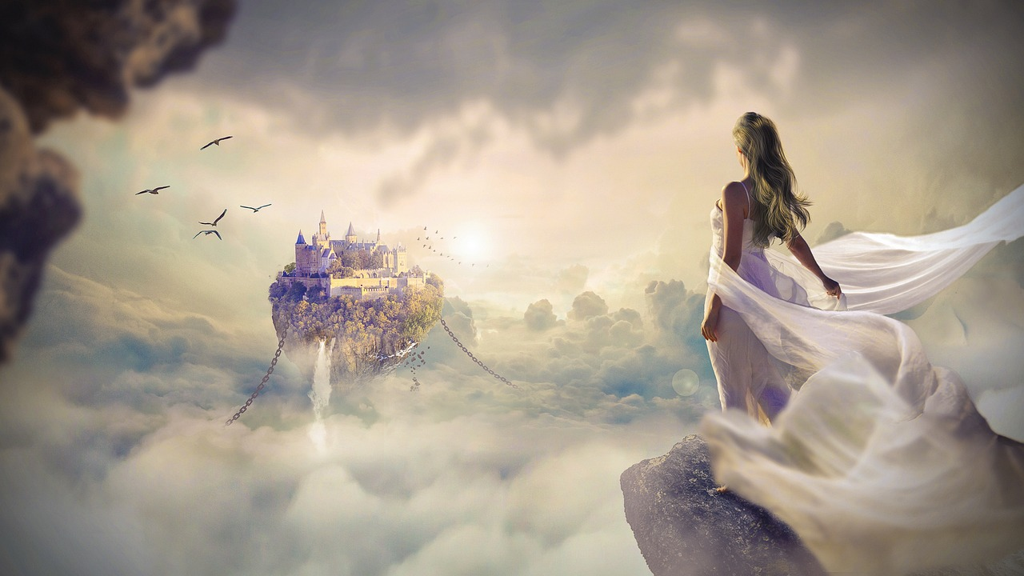
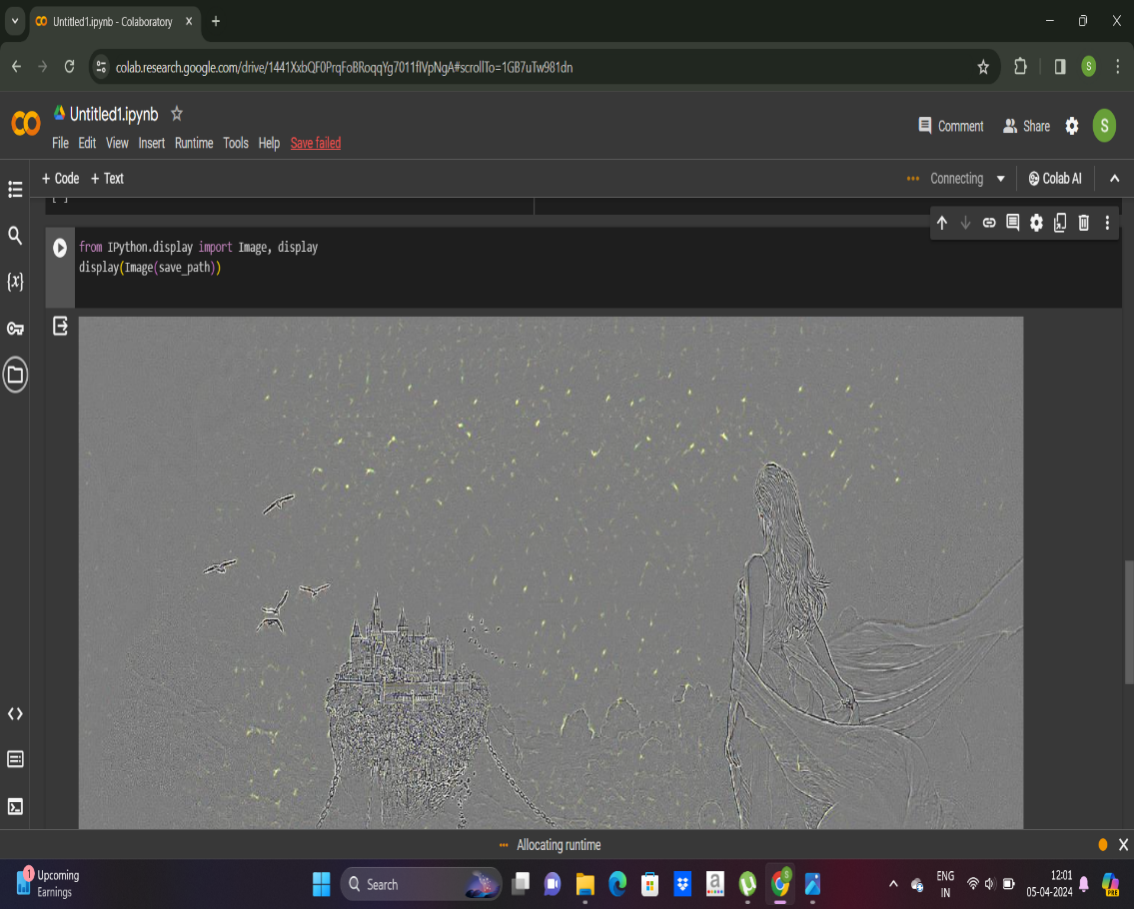
RESULTS
In the result phase, we unveil visually captivating artworks produced by our platform using the DeepDream algorithm, showcasing the creative potential of neural networks in generating surreal visual effects.

