Slide 1

E-Medicine Hub
Presented By
Komal Sahu(240841220082)
Amruta Thore(240841220018)

Slide 2
Introduction
E-Medicine Hub: A Comprehensive Inventory Management and E-Commerce Solution. It is a comprehensive platform designed to integrate inventory management with e-commerce functionalities.
It allows businesses to efficiently track and manage their inventory while providing customers with a seamless online shopping experience of medicine.

Slide 3
Technology Used
We used Java Spring- Boot as backend nd React Js as frontend in Our Project
Spring Boot-
The main goal of the Spring Boot framework is to reduce overall development time and increase efficiency. React has become the first choice for frontend because it gives developers the ability to work with a virtual browser (more friendly than the real browser). Also, a JavaScript developer can become a productive developer in a few hours because there is a small API to learn, a few functions, and how to use them…

Slide 4
Technology Used
React-
React allows developers to create large web applications that can change data, without reloading the page. The main purpose of React is to be fast, scalable, and simple.

Slide 5
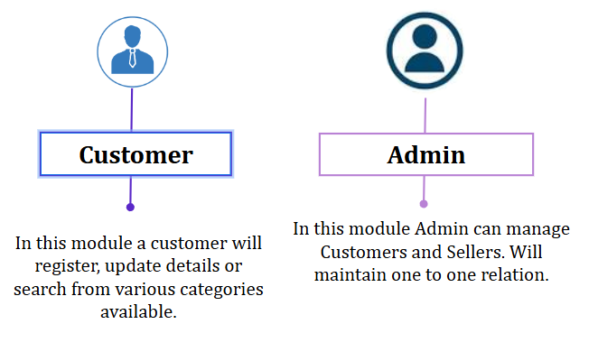
User Classes

Slide 6
Objective
Enable customers to order medicines online from anywhere, ensuring availability even in remote areas.
Provide a secure platform for users to upload prescriptions, ensuring compliance with medical regulations.
Assist pharmacies in tracking stock levels, preventing shortages, and managing orders efficiently.
Implement a robust payment gateway with multiple payment options for hassle-free transactions.

Slide 7
Customer Module
After successful registration ,the Customer can
Search for Medicines available.
Can edit his/her profile ,
Delete account and
Can maintain a cart for reference.

Slide 8
Admin Module
After successful registration and authentication ofAdmin
Upload new products. Apart from this,
seller can edit his/her profile ,
Can Delete their account
can change price of products
He /she can see User details ,
Manage account and delete Customer account.

Slide 9
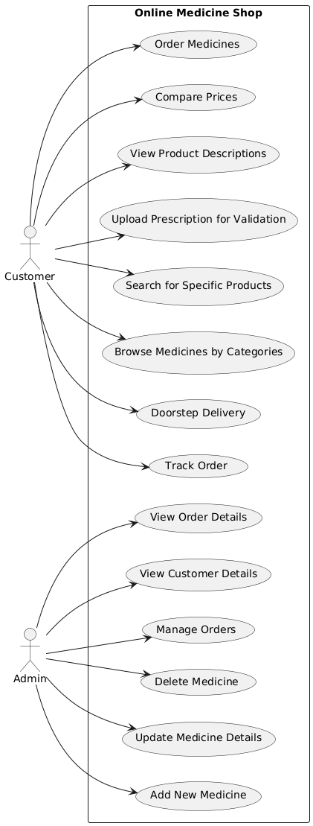
Use Case -

Slide 10
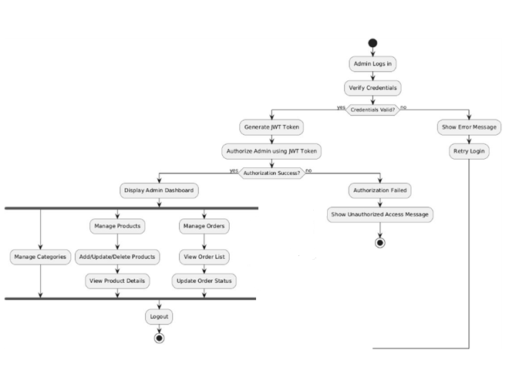
Activity Diagram:Admin

Slide 11
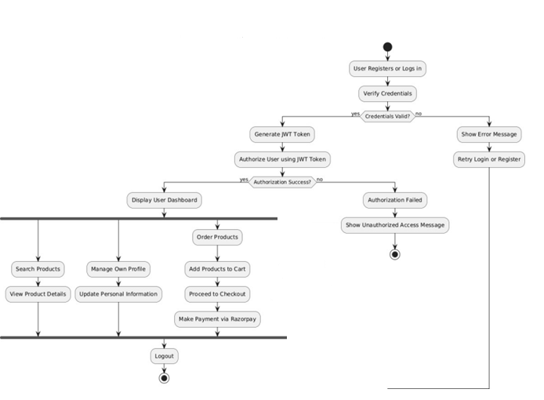
Activity Diagram:User

Slide 12
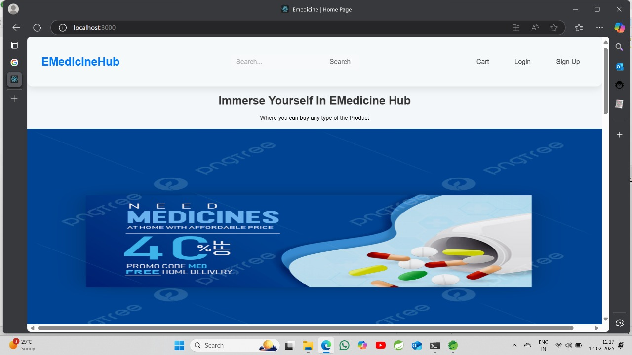
Home page:

Slide 13
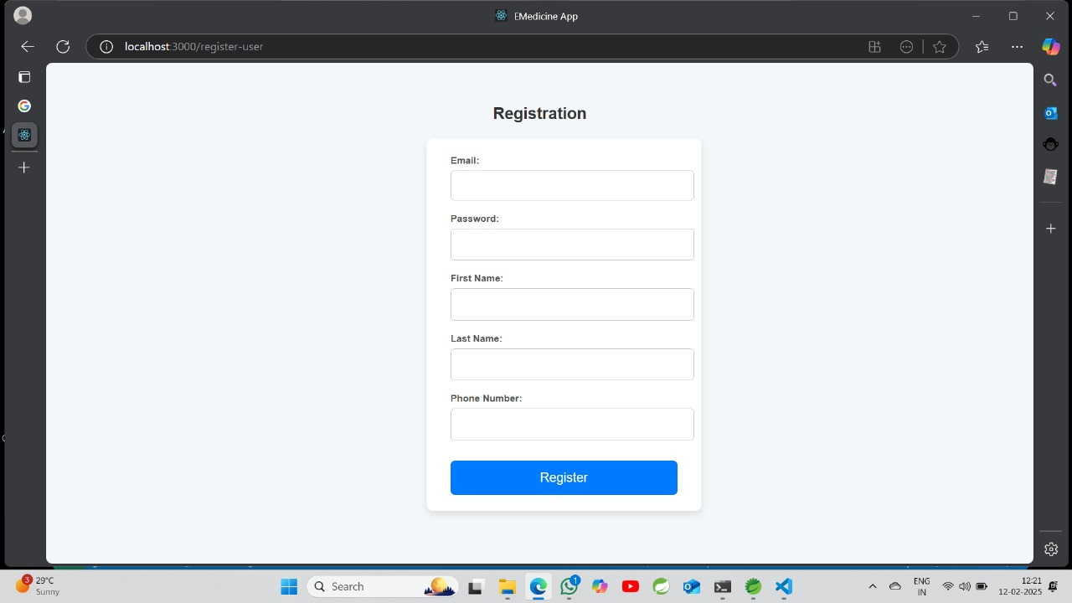
Sign Up:

Slide 14
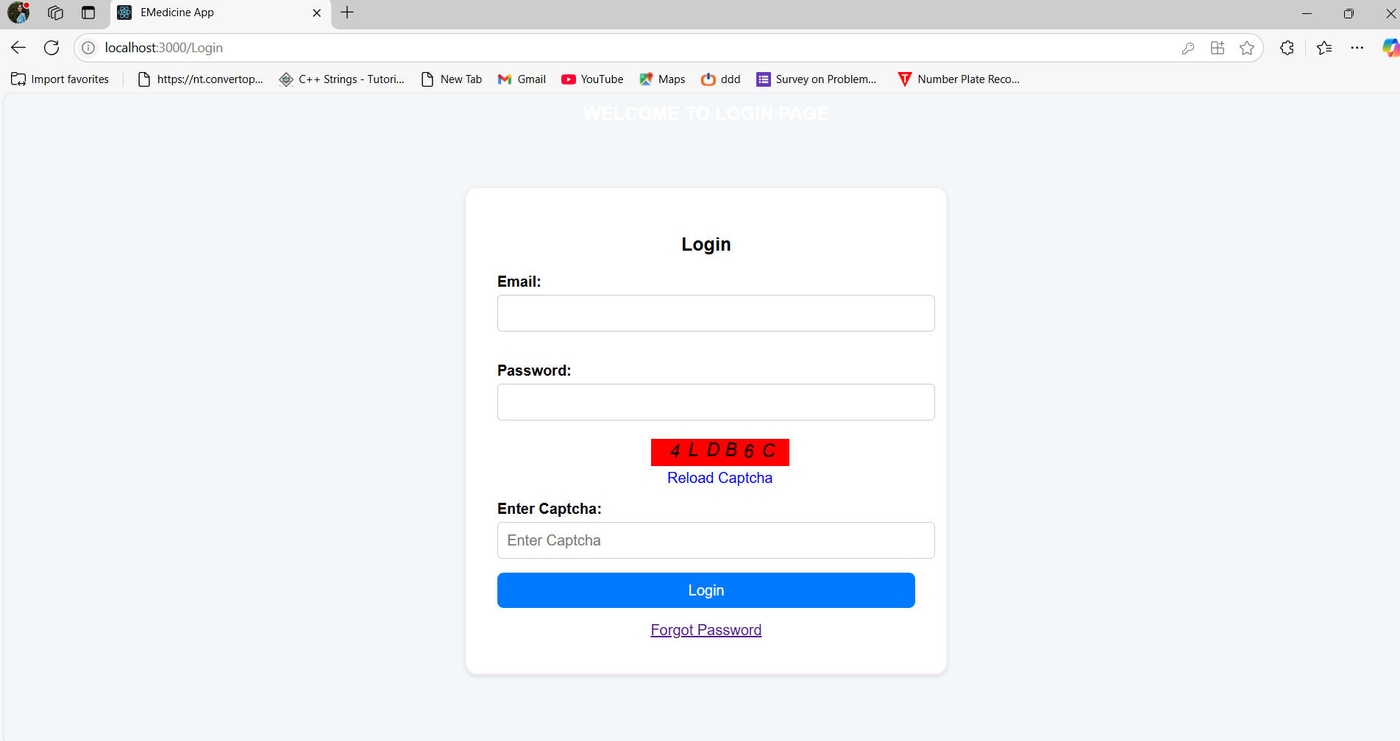
Log In:

Slide 15
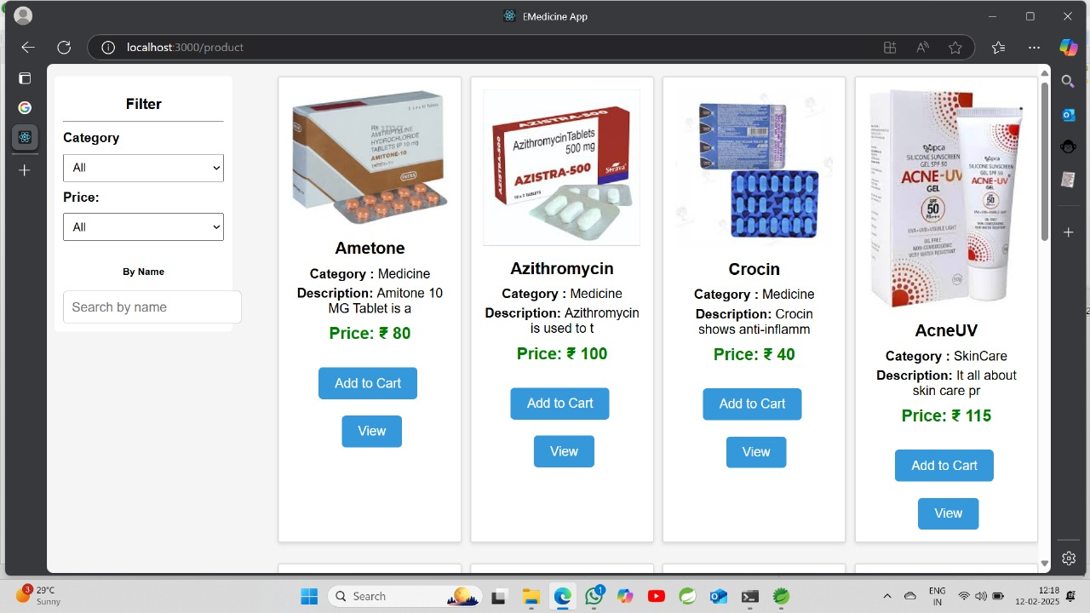
Product Page:

Slide 16
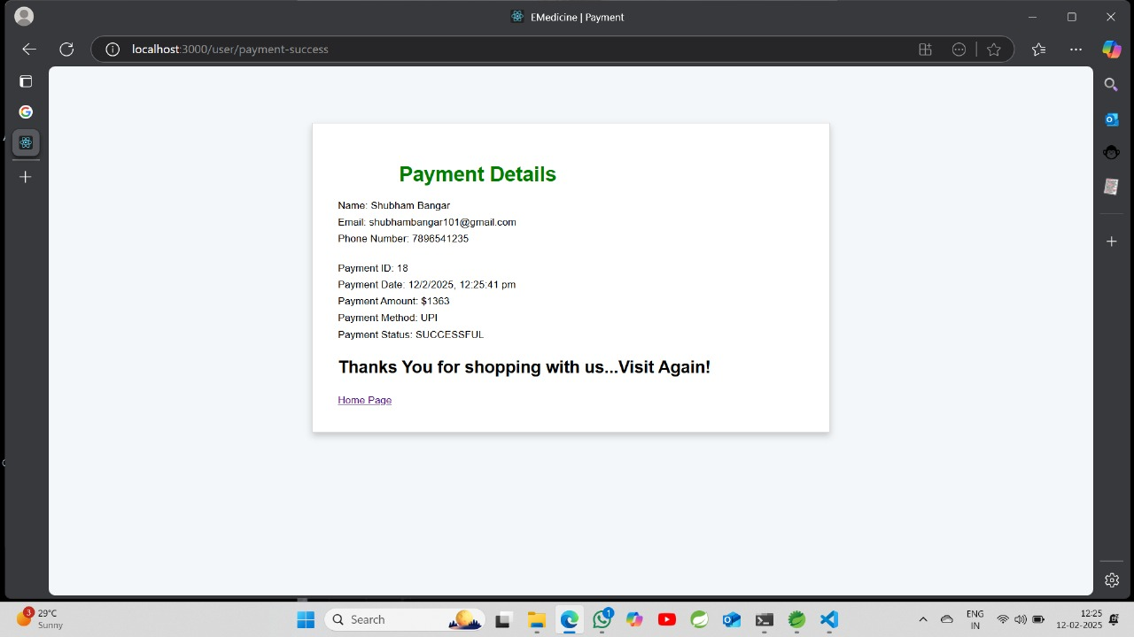
Payment page:

Slide 17
Thank You!

