Slide 1
Hadoop 101: Basics & best practice
March 2017
Qadriyyah Lane
Andrea Bacon

Slide 2
overview
SAS Code Examples: Hadoop_Basics_2017.sas
Getting Started with Hadoop
Suggested Options
Suggested Libname Statements
Query Examples
Schema Table List & Descriptions
Guidelines for Creating Hadoop Tables
Moving Data Between SAS & Hadoop
Implicit vs Explicit
Using Count Distinct for Multiple Variables
Analytics & Reporting Central (ARC)
HUE (Hive editor)
Looker SQL Runner
Recommendations for Use
Notes and Recommendations
Helpful Links
NOTE: in Normal View, right click on links and choose “open hyperlink” option to access

Slide 3
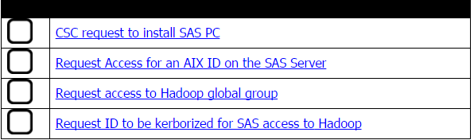
Getting Started with Hadoop
Cigna’s Data University has a SAS/Hadoop checklist to get started:
There is a walkthrough for access requests at the following link: https://confluence.sys.cigna.com:8443/confluence/pages/viewpage.action?pageId=81298796
CIMA training and tutorials are available using this link: https://ycl.cigna.com/en/Enterprise/Our_Business_Units/cima/CIMA%20LDR/Pages/Hadoop.aspx
CSC request to install SAS EG
Request access for an AIX ID on the SAS Server
Request access to Hadoop global group
Request ID to be kerborized for SAS access to Hadoop

Slide 4
Suggested Options
Specifies that all SQL statements that were sent to the data source are sent to the log. Can turn this option off once you’re sure the code runs properly
Specifies the level of detail in messages written to the SAS log. “I” = standard notes + additional notes on index, merging, sorting
OPTIONS COMPRESS = YES DBIDIRECTEXEC OBS = Max
SASTRACE=',,,ds'
SASTRACELOC=Saslog nostsuffix
MSGLEVEL = I
SQL_IP_TRACE = SOURCE
Debug=DBMS_Timers
DBIDIRECTEXEC
SQLGENERATION = DBMS;
Tells SAS to write tracing to program log. The log output is easier to read if NOSTSUFFIX is specified
Provides additional notes on the Implicit Pass-through (IP) from Proc SQL
Another request for timing information
Avoids downloads when creating tables via IP; not a default
Allows SAS to attempt to re-write SQL in host syntax

Slide 5
Suggested Libname Statements
Hive language examples
Identify the specific Hadoop schema in each statement
Align each connection to the CIMA job queue for faster processing
libname default hadoop PORT=25006 server='hive.sys.cigna.com'
subprotocol=hive2 HDFS_TEMPDIR='/saseg/' schema=default
dbconinit="set hive.exec.parallel=true;
set mapred.job.queue.name=sas.g_hadoop_p_cima";
libname cima hadoop PORT=25006 server='hive.sys.cigna.com'
subprotocol=hive2 HDFS_TEMPDIR='/saseg/' schema=cima
dbconinit="set hive.exec.parallel=true;
set mapred.job.queue.name=sas.g_hadoop_p_cima";
libname scratch hadoop PORT=25006 server='hive.sys.cigna.com'
subprotocol=hive2 HDFS_TEMPDIR='/saseg/' schema=cima_scratch
dbconinit="set hive.exec.parallel=true;
set mapred.job.queue.name=sas.g_hadoop_p_cima";
A sandbox schema may also be assigned for your use
libname sandbox hadoop PORT=25006 server='hive.sys.cigna.com'
subprotocol=hive2 HDFS_TEMPDIR='/saseg/' schema= &userid._sandbox
dbconinit="set hive.exec.parallel=true;
set mapred.job.queue.name=sas.g_hadoop_p_cima";

Slide 6
Query Example – Schema Table List & Descriptions
Produce a list of all tables within a schema:
proc sql;
connect to hadoop (port=25006 server='hive.sys.cigna.com');
execute(set mapred.job.queue.name=sas.g_hadoop_p_cima) by hadoop;
select * from connection to hadoop
(show tables in cima);
disconnect from hadoop;
quit;
Produce a list of columns and formats within a table:
proc sql;
connect to hadoop (port=25006 server='hive.sys.cigna.com');
execute(set mapred.job.queue.name=sas.g_hadoop_p_cima) by hadoop;
select * from connection to hadoop
(describe formatted cima.ccdm_mart_prof_etg_epsde_clm);
disconnect from hadoop;
quit;
Using “show tables” allows you to view tables with names longer than 32 characters
Using “describe formatted” allows you to view true Hadoop formats
Use the cima queue in each explicit query to expedite the processes

Slide 7
Query Example – Guidelines for Creating Hadoop Tables
Tables can be written to the CIMA Scratch schema or a Sandbox schema (if you have access to one)
Use naming conventions that are consistent and personally identifiable:
Consider including either your initials or LAN ID, the type of project/work, and an indication of the table’s timeframe – ex. m76982_CACclaims_temp_2016q3
Use a drop table statement before you execute a create table statement; Hadoop will not overwrite an existing table
proc sql;
connect to hadoop (port=25006 server='hive.sys.cigna.com');
execute (set mapred.job.queue.name=sas.g_hadoop_p_cima) by hadoop;
execute (drop table cima_scratch.&userid._pregepsd_temp_2015q4) by hadoop;
execute (create table cima_scratch.&userid._pregepsd_temp_2015q4) as
select memberid,
masterepisodeid
from opensae_eoc.episodelevelassociation
where episodeacronym = 'PREGN'
group by memberid, masterepisodeid) by hadoop;
quit;
Include statements for deletion of these tables in your code when they are no longer required; these statements can be commented out until needed:
proc sql; drop table scratch.&userid._pregepsd_temp_2015q4; quit;

Slide 8
Query Example – Moving Data Between SAS & Hadoop
Run the necessary libname statements to activate your libraries
Move data from SAS to Hadoop to utilize in Hadoop processes:
proc sql;
create table scratch.&userid._mrktmbrs_temp_2016q3 as
select indiv_enterprise_id,
rpt_end_dt,
alignmnt_cd,
period
from work.cac_alignmnt;
quit;
Pulling data from Hadoop to SAS for processing:
proc sql;
connect to hadoop (port=25006 server='hive.sys.cigna.com');
execute(set mapred.job.queue.name=sas.g_hadoop_p_cima) by hadoop;
create table work.risk_scores as select * from connection to hadoop
(select a.indiv_enterprise_id,
a.membr_age,
a.gendr_cd,
a.retrsp_risk,
a.rptng_end_dt
from cima.ccdm_mart_prof_erg_risk a inner join cima_scratch.&userid._mrktmbrs_temp_2016q3 b
on (a.indiv_enterprise_id = b.indiv_enterprise_id) and
(to_date(a.rptng_end_dt) = to_date(b.rpt_end_dt)));
disconnect from hadoop;
quit;
2.7 MM Records / 2.5 Minutes

Slide 9
Query Example - Implicit vs Explicit
Proc Sql; Create table tmp_epsd_preg as Select memberid, masterepisodeid, episodeacronym, childmasterepisodeid, childepisodeacronym From hdp_eoc.episodelevelassociation_base Where episodeacronym = 'PREGN' AND level = 5 AND associationpoint = 1 AND subset_run_date = '2017-01-24' AND market_subset = 'BOB' AND report_begin_date = '2013-04-01' AND report_end_date = '2016-03-31' Order by masterepisodeid; Quit;
Proc Sql NOERRORSTOP; Connect to hadoop (PORT=25006 server='hive.sys.cigna.com'); Execute(set mapred.job.queue.name=sas.g_hadoop_p_cima) by hadoop; Create table tmp_epsd_preg as Select * From CONNECTION TO hadoop (Select memberid, masterepisodeid, episodeacronym, childmasterepisodeid, childepisodeacronym From opensae_eoc.EpisodeLevelAssociation_base Where episodeacronym = 'PREGN' AND level = 5 AND associationpoint = 1 AND subset_run_date = '2017-01-24' AND market_subset = 'BOB' AND report_begin_date = '2013-04-01' AND report_end_date = '2016-03-31' Order by masterepisodeid ); Disconnect from hadoop; Quit;
IMPLICIT
NOTE: PROCEDURE SQL used (Total process time):
real time 45.12 seconds
cpu time 0.55 seconds
Explicit 32% Faster
EXPLICIT
NOTE: PROCEDURE SQL used (Total process time):
real time 30.49 seconds
cpu time 0.43 seconds

Slide 10
Query Example – Using Count Distinct for Multiple Variables
Multiple instances of count distinct will fail within 1 select statement
This can be resolved using the Hive analytics function PARTITION BY:
proc sql;
connect to hadoop (server='cilhdedp0201.sys.cigna.com');
execute(set mapred.job.queue.name=sas.g_hadoop_p_cima) by hadoop;
select * from connection to hadoop
(select count(distinct mbr_num) as mbr_cnt,
count(distinct clm_num) over (partition by clm_num) as clm_cnt
from ids.clinical_med_claims_tst);
disconnect from hadoop;
quit;
Or you can use multiple select statements with a CROSS JOIN:
proc sql;
connect to hadoop (server='cilhdedp0201.sys.cigna.com');
execute(set mapred.job.queue.name=sas.g_hadoop_p_cima) by hadoop;
select * from connection to hadoop
((select count(distinct mbr_num) as mbr_cnt
from ids.clinical_med_claims_tst limit 100) t1
cross join
(select count(distinct clm_num) as clm_cnt
from ids.clinical_med_claims_tst limit 100) t2);
disconnect from hadoop;
quit;

Slide 11
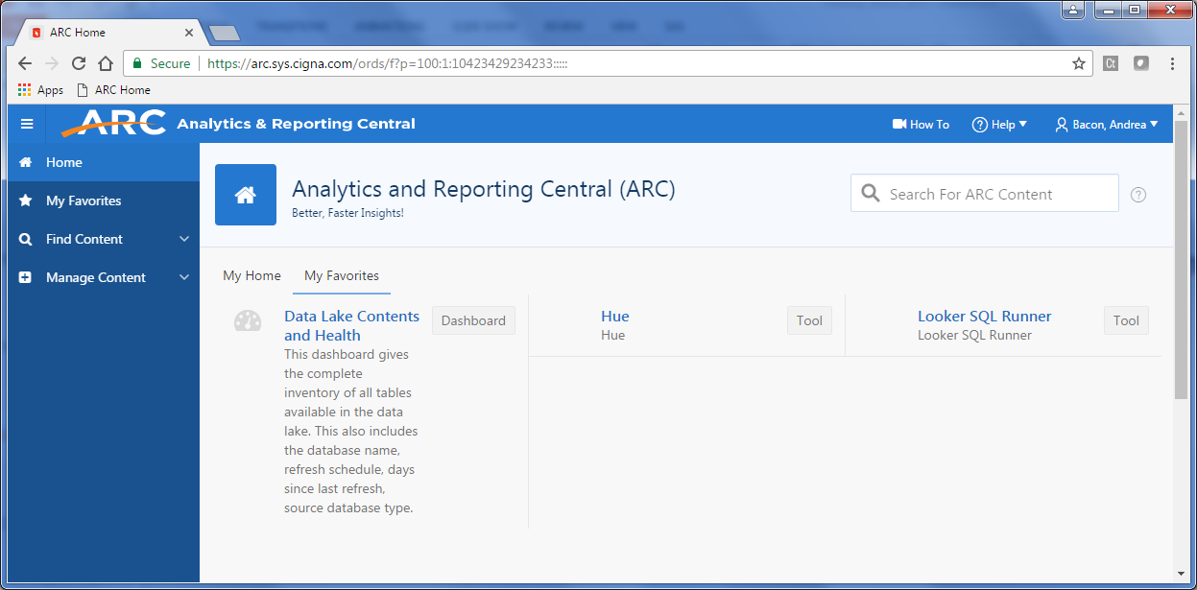
Analytics & Reporting Central (ARC)
https://arc.sys.cigna.com
Available Tools for Hadoop – Hue and Looker SQL Runner

Slide 12
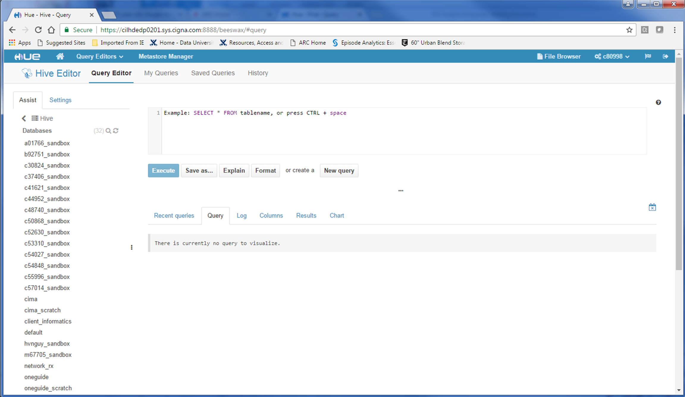
ARC – HUE (Hive editor)
Hive, accessed through Hue, is a query editor than can be used to examine Hadoop tables and refine Hadoop queries
1. Use Settings tab to set the queue
3. Create SQL
queries or use
Select * to view existing Hadoop
tables; include LIMIT 100 to restrict results to 100 observations
(Key: mapred.job.queue.name =sas;
Value: g_Hadoop_p_cima)
2. Select Hadoop database (schema)
4. Execute statement to view query results in pane below

Slide 13
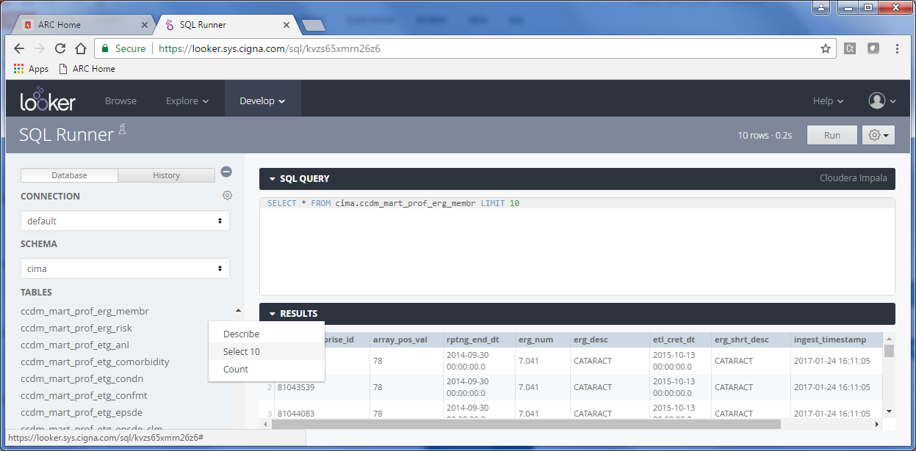
ARC – Looker SQL Runner
Easy settings to Describe tables, Select 10 results or Count records
Use to troubleshoot your Hadoop query without running in SAS

Slide 14
ARC – Recommendations for Use
SAS EG will continue to be our primary data query tool, but analytics using the tools available through ARC can be especially helpful
The Hadoop schemas are easy to navigate in Hue and Looker SQL Runner, allowing you to browse tables and review their contents and column formats
Looker SQL Runner has simple point-and-click queries available to the right of the table listing; these produce the SQL query within the editor window
Select 10 example:
If there is an error returned from your code submission, the error message within Hue or Looker SQL Runner is more informative and actionable than the error message produced within the SAS log
So if you’re having an issue with a piece of Hadoop extract code, it’s recommended to try that code in one of these ARC editor tools
If you have any questions about using Analytics and Reporting Central (ARC), please review the Help options available on the website

Slide 15
Notes and Recommendations
Hadoop connectivity is on wdc6002a SAS EG
Hadoop libname statements are case sensitive; so if you change the case the libname connection may not work – ex. //nameservice1/saseg/
When using both explicit and implicit sql in the same program, just remember when to use schema names (explicit), and when to use libname references (implicit)
Use explicit joins whenever you have multiple schemas within a single Hadoop query
IMPORTANT: Don’t cross join between platforms (ex. Teradata and Hadoop)
Try to keep output datasets in Hadoop until you need to pull it into SAS; this takes advantage of the faster processing that Hadoop offers
Formats between SAS and Hadoop will trip you up; different formats of like data columns will impact the ability to successfully join tables – use SHOW and DESCRIBE to correctly identify formats

Slide 16
Notes and Recommendations (cont.)
Use the limit or obs option when testing your queries. Trying to stop a SAS/Hadoop query is almost impossible
SAS trace options offer important functionality to see how SAS/Hadoop are working together and are especially helpful for troubleshooting; however these options can also add overhead to query execution, and can be shut off using options sastrace=off
Use the TO_DATE function to avoid issues with datetime formats (values are read as yyyy-mm-dd)
where to_date(c.rslt_timestmp) between '2015-10-01' and '2016-09-30'
Use the CAST function to set formats with a defined length and avoid warning messages when creating a new field
cast(a.rx_acct_num as varchar (14)) as midsu_acct_num

Slide 17
Helpful Links
Cheat Sheet – Hive for SQL Users
http://hortonworks.com/wp-content/uploads/2016/05/Hortonworks.CheatSheet.SQLtoHive.pdf
Hive Function Cheat Sheet
https://www.qubole.com/resources/cheatsheet/hive-function-cheat-sheet/
Big Data Confluence – Hadoop ABC’s and Hadoop overview
Use the page tree on the left side of the browser to navigate
https://confluence.sys.cigna.com:8443/confluence/display/BD/Big+Data
Brown Bag presentation – Hadoop Tips and Tricks 3
\\wdcnap532\reposit2\WA_New6\Deap\_Tips_Tricks_4code\brown_bag_session\Hadoop tips and Tricks-3.pptx

Slide 18
Questions?

Slide 19
Offered by: Connecticut General Life Insurance Company or Cigna Health and Life Insurance Company.
“Cigna” and the “Tree of Life” logo are registered service marks, and “Together, all the way.” is a service mark, of Cigna Intellectual Property, Inc., licensed for use by Cigna Corporation and its operating subsidiaries. All products and services are provided by or through such operating subsidiaries, including Connecticut General Life Insurance Company and Cigna Health and Life Insurance Company, and not by Cigna Corporation. All models are used for illustrative purposes only.
882693 03/15 © 2017 Cigna. Some content provided under license.

