Slide 1

Macro Grocery Guide app
Group 4
Anis Abushagor
Ibrahim Omar
Max Fuzzey
Victoria White

Slide 2

TABLE OF conents
I - Introduction
II – Log Book
III – Vision and Scope
IV – Proposed System Functionalities
V – Software Development Methodology
VI – Actor-Goal List
VII – Use Case
VIII – Feasibility
IX – Business Value
X – Hardware/Software Requirements
XI – Proposed Iteration 2 Work

Slide 3
Introduction
There is a need for an application that will calculate your daily / weekly macro nutrient goals and then give you the amounts of those macros to buy for the week at the grocery store
Sticking to a nutrition plan is hard if you do not know what you need to buy at the grocery store or the amounts for the week
Our application will allow the average person to go to the grocery store knowledge so that they can increase their rate of success for sticking to the calculated nutrition recommendation.

Slide 4

Project log book
DATE | TASKS / ASSIGNMENTS
9/1/2020 | Came up with initial use case diagram Discussed problem we are working on Submitted project idea
9/8/2020 | Started iteration 1 pptx Instructor went over possible changes to initial use case diagram On trello assigned portions of iteration 1 pptx Unified process Discussed possible technology – android or web app

Slide 5
Vision
To streamline and simplify the process of shopping for and adhering to a specific diet. After establishing a profile with your physical information and macro nutrient goals, this app will tell you exactly how much of a certain food item you need to purchase to meet your daily/weekly nutrition goals. This should eliminate confusion and make purchasing groceries for a nutrition plan more convenient as well as educational.
Scope
A 3-Tier Android app that saves and accesses profile information. Takes User input to save and display the desired information

Slide 6
Proposed system functionalities
Create Profile
Request Daily/Weekly 'Grocery List'
Daily/Weekly nutrition log
Meal plan
Look at past Grocery Lists

Slide 7
software development methodology
Unified Process
The unified software development process is an iterative and incremental software development process.
We believe we will be able to deliver the best application using this use-case driven process. We will reference the use-cases to make sure we have built in all the requirements for the application and can deliver a useful product for the customers.

Slide 8
Actor-Goal List
User | Login Logout Establish Profile Update Profile Calculate Macro Totals Set Caloric Baseline Generate Grocery List Edit Grocery List
Admin - optional | Login Logout Account Management Database Management – (if not using SQLite)

Slide 9


Use Case
Actors: User
The user will install the application from the Google play store. They will start by creating a login and performing the initial nutrition assessment. The user will then be able set their preferred caloric intake to - gain, sustain, or lose weight. After initial setup the user will be able to adjust their metrics after the creation of thier account. The user will then be met with the shopping cart function of the app. They will select food items from the 3 different macronutrient categories - fats, carbohydrate, and protein. The shopping cart function will then help the user with their grocery purchases throughout the week.

Slide 10
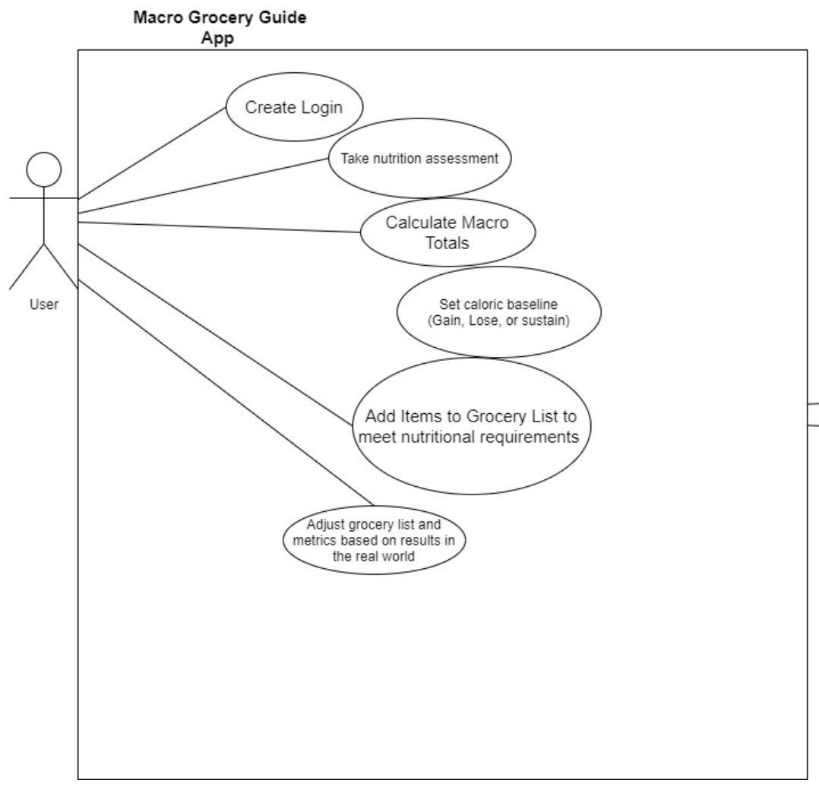

Slide 11
FEASIBILITY STUDY
Market outlook for application
-Any health conscious individual that wants to know what their body and lifestyle needs on a Macronutrient basis.
The attraction here is that this is not a diet but more of a mathematical translation of what an optimal balance of Protein, Carbohydrates, and fats looks like for an individual.
Marketing strategy
Promoted use within the dietetics communities and other health professionals.
In house grocery store promotion.
Organization/staffing
-Team of 4 to create and maintain the application to be distributed through the google play store.

Slide 12
FEASIBILITY STUDY
Description
Our Macro Grocery Guide Application will help users perform a self-evaluation for their macronutrient needs (Protein, Carbohydrates, Fats).
The system will be able to calculate the amount of grams needed of given food based on this information.
Users will be able to adjust their caloric needs to their liking and the nutrition plan will adjust along with them.
Applied Technology
Android operating system.
The application will be created with Android studio and utilize the built in SQLite infrastructure.

Slide 13
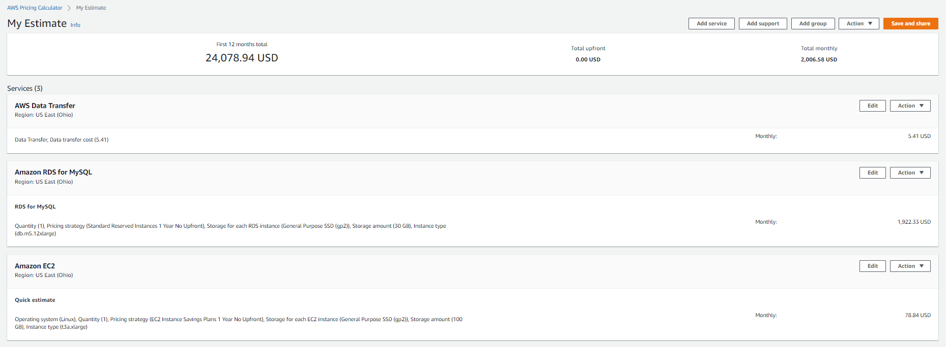
BUSINESS VALUE

Slide 14
BUSINESS VALUE
AWS costs: 2,000 per month
Employee Salaries: 4 employees, 30$ an hour, 4800 a month * 3 = 14,400
Total costs: 16,400 per month

Slide 15

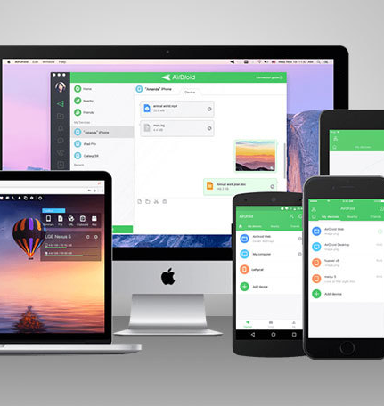
Hardware requirement
4 GB RAM minimum, 8 GB RAM recommended
2 GB of available disk space minimum, 4 GB Recommended (500 MB for IDE + 1.5 GB for Android SDK and emulator system image)
1280 x 800 minimum screen resolution

Slide 16
Software Requirements
Latest version of JDK
Android SDK
Android Studio
Java
Kotlin
Gradle - An advanced build toolkit that manages dependencies and allows you to define custom build logic
SQLite - Embedded database, common usage is to provide local data storage capabilities on mobile phones.

Slide 17
Proposed iteration 2 work
Start working on Client Application and Database
Project report
Use case diagram, sequence diagram, class diagram for the new use case
Any update to Mission, Scope, Requirements, and Goals
Any update to project description
Next project log

