Slide 1
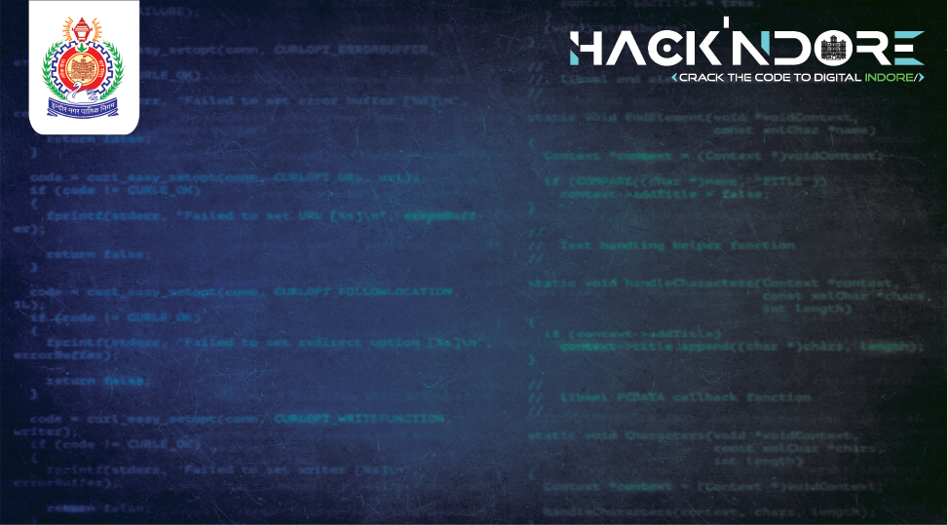
Water Supply Management
Team : RozgaarRahi
Kunal Singh
Shreyas Namdeo
Jeet Verma
Yash Upadhyay

Slide 2
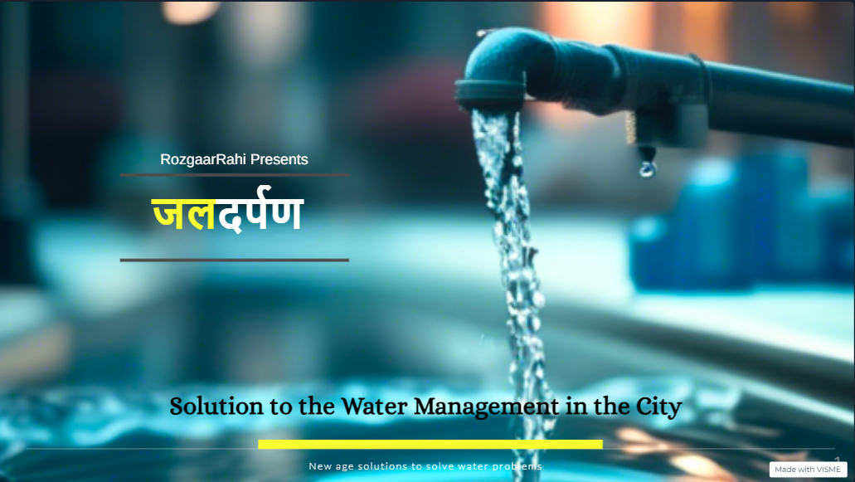

Slide 3
Viewing the Problems
• Leakage in Pipelines
• No data to enable detailed analysis and reporting
• Unequal distribution of water across all wards/regions

Slide 4
WHAT WE HAVE TO OFFER
A full-proof system to detect Leak in Pipelines
Maintenance and Repair Management Alerts at right time
Complete Water Distribution Monitoring and Analysis.
Further Helping in taking conservative actions and all.

Slide 5
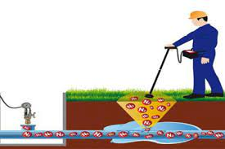
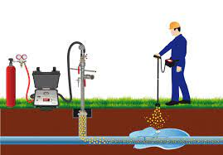
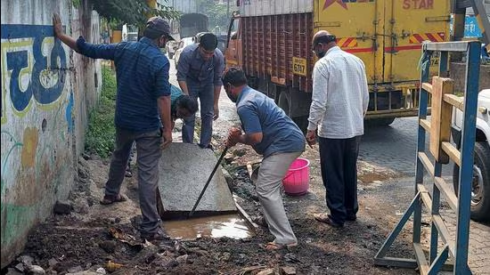
ALREADY EXISTING SOLUTIONS FOR DETECTION OF LEAKAGE IN PIPELINES
Acoustic testing devices: through sound of broken pipe (hissing, gurgling).
Tracer gas detection: This method can help find leaks that can't be heard.
देसी Method
Drawbacks
Too expensive
2. Time consumed in identifying there’s a leakage

Slide 6
1.
WHAT WE WORKED ON
Self Identification of a leakage in pipeline
Concept : There is a general time taken by the main tanker to supply water, if the tank becomes empty sooner, means there is an added supply of water somewhere
Tank
IOT
Thus, identifying there is leakage in this locality, and triggers and alarm
Pipeline

Slide 7
2.
WHAT WE WORKED ON
Concept : Once we have information about the locality where the leakage has happened, the IOT devices in the pipelines start to operate and give us the data
Identifying the location of leakage
Hence that particular pipeline has a potential leakage
Thus, the data received from the devices tell us where is the difference in water inlet and outlet is in the pipe

Slide 8
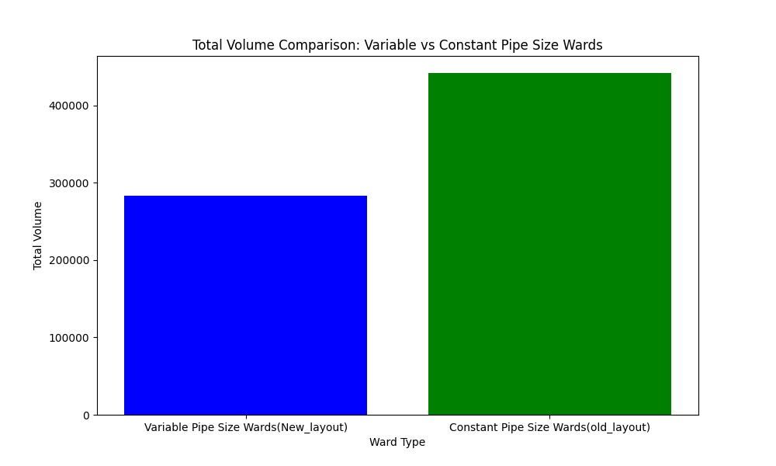
3.
WHAT WE WORKED ON
Size of Pipelines as per need
Concept : currently the size of pipelines distributing water in all lines of houses in indore is same, varying them as per requirement solves many problems
Water conservation : saving a large amount of water
Equal Distribution of water in localities

Slide 9
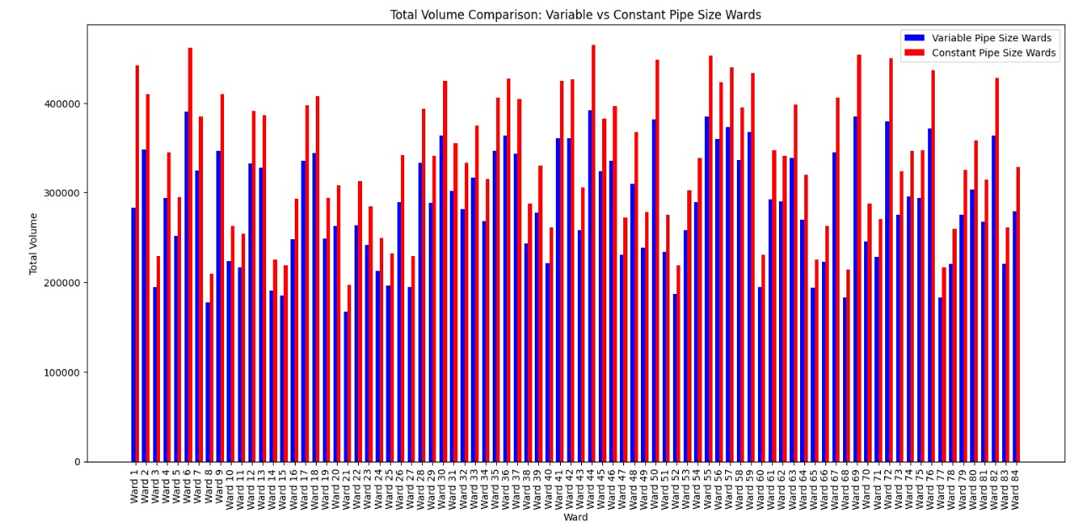
Representation of wards receiving more water than the actual requirement, and how it can be balanced just by varying the size of pipelines

Slide 10
ADDITIONALS
Real-Time Monitoring
Purpose: Track water flow, pressure, and quality in real-time.
Types of Sensors: Pressure sensors, flow meters, and leak detectors.
Predictive Analytics and ML
Purpose: Forecast water usage and identify potential issues before they occur.
Usage: Predict future water needs and pipeline requirements based on historical data.
GIS Mapping
Purpose: Visualize pipeline routes, household connections, and infrastructure conditions.
Benefits: Helps in managing and upgrading the pipeline network effectively.

Slide 11
FOR SCALING THE CONCEPT
GIS Mapping
Pipeline Visualization:
Example: A digital map showing all pipeline routes and connections.
Explanation: Helps in visualizing the entire network, making it easier to identify issues and plan upgrades.
Aging Infrastructure:
Example: Highlighting old or deteriorating pipeline sections on the map.
Explanation: Prioritizes maintenance and replacement of aging infrastructure.

Slide 12
System Architecture
4.1 Azure IoT Central Integration
Purpose: Manage IoT devices and data.
Features:
Device command and control.
Monitoring and alerting.
Configurable dashboards.
Integration with Power Automate for workflow automation.

Slide 13


