Slide 1

Final Project Biomedical Named Entity Recognition Using a Hybrid BiLSTM, Transformer Encoder, and CRF
Daniel R. Russell
CSCI S-89B Introduction to Natural Language Processing
Fall 2025
Harvard Extension School

Slide 2
Generative AI Disclosure
Portions of this project were developed with reference to Generative AI tools (Copilot; ChatGPT, OpenAI, 2025 version), used in accordance with the course AI Technologies Policy including conceptual clarification, methodological guidance, validating code logic, identifying and resolving exceptions, and generating text and code segments. All substantive decisions regarding problem formulation, dataset selection, model design, feasibility analysis, and implementation strategy are my own. All AI-generated code was independently reviewed, debugged, and validated for correctness before inclusion.

Slide 3
Motivation and Problem Context
Why is this problem challenging?
Biomedical literature contains dense, irregular language that complicates automated analysis.
Disease mentions often span multiple tokens and exhibit inconsistent morphology.
Reliable extraction of disease entities enables large scale clinical analytics and discovery workflows.
Standard NER models struggle with long range dependencies and precise span boundaries.

Slide 4
Project Objectives
To build a hybrid NER model combining BiLSTM, transformer encoding, and CRF decoding.
To create a reliable preprocessing pipeline with exact character to token alignment.
To evaluate performance at both token and span levels.
To develop visualization tools that expose error structure and model behavior.

Slide 5
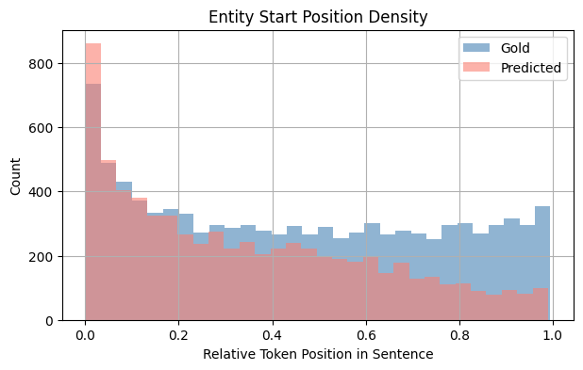
Dataset and Preprocessing Constraints
Gold disease entities cluster near early token positions.
Predicted start positions flatten across the sentence due to mild positional bias.
Alignment quality directly affects downstream span errors.

Slide 6
Preprocessing Architecture Overview
Tokenize sentences and record exact character offsets for each token.
Map expert annotated spans to token indices with strict validation.
Construct BIO labels for every token and verify reconstruction.
Pad sequences and create attention masks for variable-length inputs.
Raw Text
↓
Tokenization + Offsets
↓
Span Alignment + Validation
↓
BIO Label Construction
↓
Padding + Attention Masks
Original text: "patients with chronic renal failure"
Tokenization: ["patients", "with", "chronic", "renal", "failure"]
Gold span: chronic renal failure
Token span: tokens 2 to 4
BIO sequence: O O B-Disease I-Disease I-Disease

Slide 7
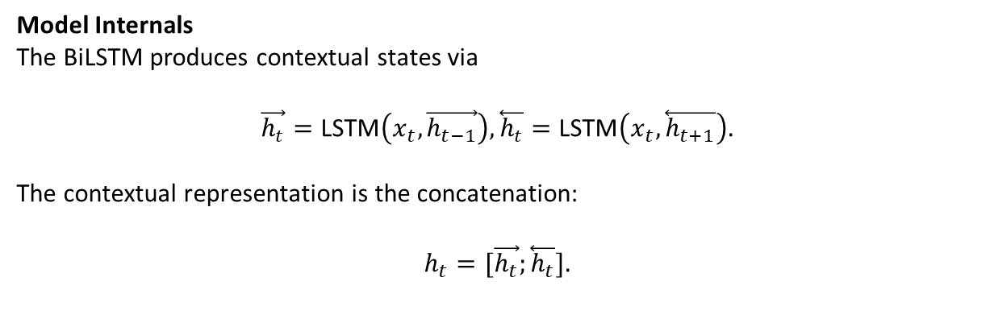
Hybrid Model Architecture
Token embeddings form the initial representation for each word.
A BiLSTM captures local sequential patterns and short-range dependencies.
A transformer encoder models broader contextual interactions across the sentence.
A linear layer produces BIO emission scores which the CRF decodes into valid label sequences.
Model Internals The BiLSTM produces contextual states via
$$\vec{h_{t}}=\text{LSTM}\left(x_{t},\vec{h_{t−1}}\right),\overset{⃖}{h_{t}}=\text{LSTM}\left(x_{t},\overset{⃖}{h_{t+1}}\right).$$
The contextual representation is the concatenation:
$$h_{t}=[\vec{h_{t}};\overset{⃖}{h_{t}}].$$
Embeddings → BiLSTM → Transformer Encoder → Linear Layer → CRF Decoder

Slide 8
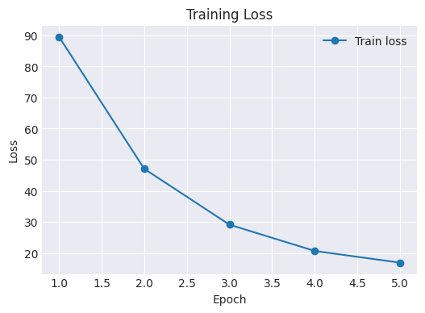
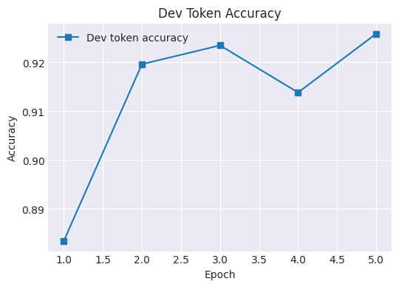
Training Behavior and Convergence
Loss decreases smoothly across epochs, indicating stable optimization.
Development accuracy improves early and remains consistently high.
No signs of divergence or overfitting within the training window.
Model captures structural regularities quickly due to strong supervision.

Slide 9
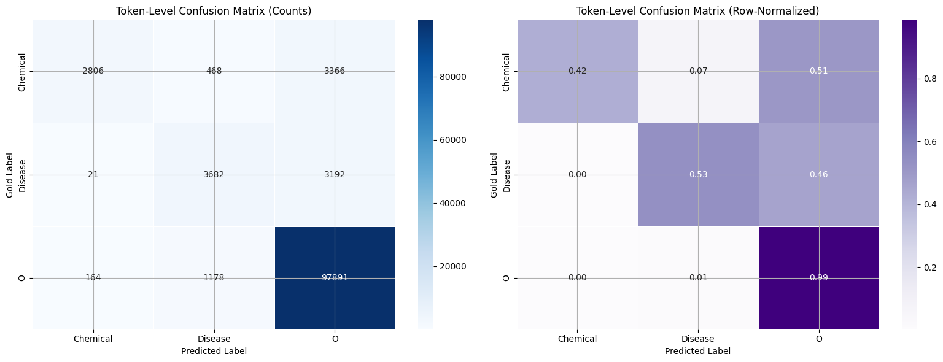
Token-Level Confusion Patterns
Most errors occur at transitions between entity tokens and the O class.
Disease and Chemical labels show limited cross-confusion.
High diagonal mass indicates strong token-level discrimination.
Normalized values confirm consistent boundary sensitivity across classes.

Slide 10
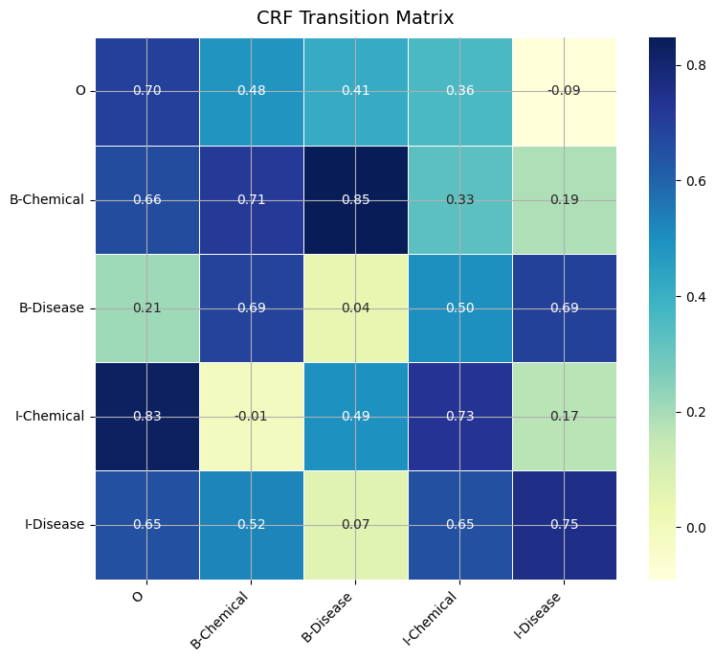
CRF Transition Dynamics
Strong B→I and I→I transitions reflect stable span continuation.
Weak or negative scores for invalid transitions enforce lawful BIO structure.
O→entity transitions remain moderate, matching real entity frequency.
CRF acts as a structural regulator, reducing fragmented or inconsistent spans.

Slide 11
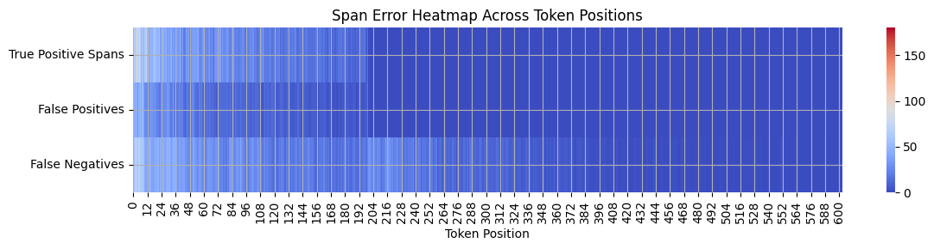
Positional Span Error Analysis
True positives cluster strongly at early token positions.
False positives appear more frequently in early and mid-sentence regions.
False negatives spread across the sentence, reflecting boundary uncertainty.
Positional patterns reveal how context length affects span reconstruction.

Slide 12
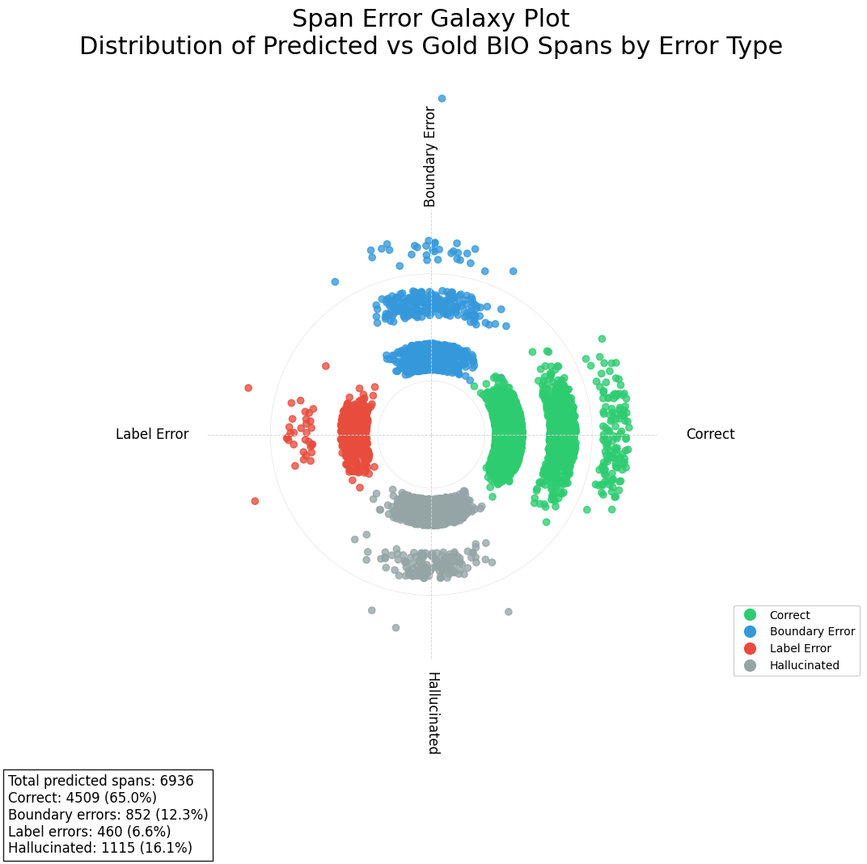
Span Error Galaxy Visualization

Slide 13
Video Presentation:
The final project video presentation can be found here or via the URL:
https://harvard.zoom.us/rec/play/vTXn_FgF7njoMpwqZkaC-PFPT-y5-6XCglUFkE8c5-jssH7nb3nVOCNU4770gonUpV5r11_aWl3xKWXz.dnL-p7zpr8m9Emgi?eagerLoadZvaPages=sidemenu.billing.plan_management&accessLevel=meeting&canPlayFromShare=true&from=my_recording&startTime=1765760584000&componentName=rec-play&originRequestUrl=https%3A%2F%2Fharvard.zoom.us%2Frec%2Fshare%2F90Wo3k5q8g5Ss1yYGkCPPHDU7Iv54GEbO5DDtgmbuBylGwZnRQbXptjvQHg-0TkA.2os0ehmbOj1k8iko%3FstartTime%3D1765760584000

