Slide 1
CSCI-E-116 | Final Project
Temporal Clinical Risk Forecasting in SNPTX with eICU
Hospital-grouped early-window mortality forecasting on eICU-CRD demo
Daniel R. Russell
Instructor: William Yu · Harvard Extension School · May 2026
Python 3.11.14 · eICU-CRD demo v2.0.1 · SNPTX core venv

Slide 2
Problem & Question
Can early ICU vitals support reproducible, hospital-grouped mortality forecasts?
OUTCOME
Cohort at a glance
In-hospital mortality
Cohort statistic | Value
ICU stays (cohort) | 2,520
Hospitals | 186
Mortality events @ 24h | 204
Base mortality rate | 8.6%
Held-out hospitals | 47
Held-out stays | 639
Held-out events | 55
Random seed | 1337
Binary label derived from discharge status. Base rate 8.6% on the demo cohort.
HORIZON
6, 12, and 24 hour windows
Three early-warning forecasts; only data observed before each window boundary is used.
VALIDATION
Hospital-grouped GroupShuffleSplit
Each hospital appears in either train or test, never both. Closes the most common leakage path on multi-site EHR data.
LINEAGE
Single-notebook reproducibility
Every figure, table, and metric regenerates from one notebook against versioned eICU-CRD demo files in the SNPTX framework.
CSCI-E-116 | Daniel R. Russell | May 2026 | Final Project
02 / 10

Slide 3
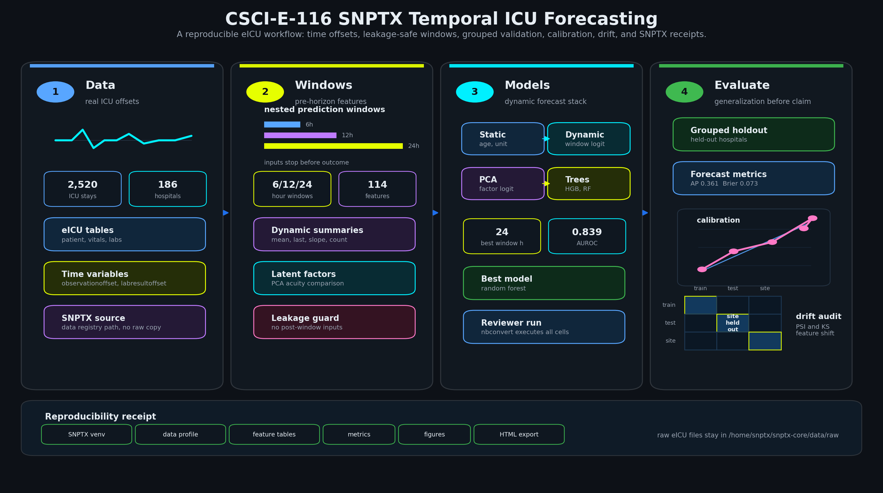
Methodology
Raw eICU tables → cohort → windowed features → hospital-grouped models → calibration & drift receipts.
CSCI-E-116 | Daniel R. Russell | May 2026 | Final Project
03 / 10

Slide 4
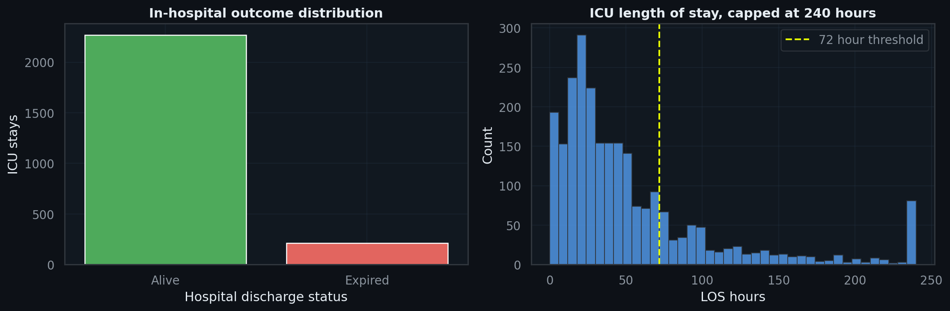
Cohort & Prediction Targets
Three leakage-safe windows; mortality and long-LoS labels derived before each window boundary.
Hospital-grouped split receipts
RISK
A random split lets the same hospital leak across folds.
Window | Stays train / test | Events train / test | Hospitals train / test
6h | 1,687 / 633 | 149 / 55 | 138 / 47
12h | 1,697 / 637 | 149 / 55 | 138 / 47
24h | 1,700 / 639 | 149 / 55 | 138 / 47
DEFENCE
Hospital-grouped split forces every test stay into an unseen site.
STANDARD
This is the minimum honest evaluation for a multi-site EHR model.
CSCI-E-116 | Daniel R. Russell | May 2026 | Final Project
04 / 10

Slide 5
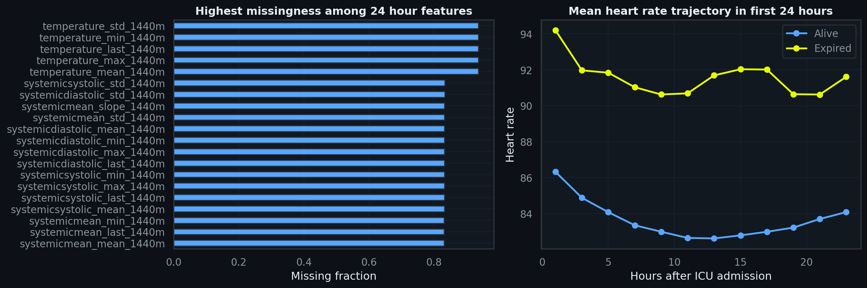
Exploratory Trajectories
Vital-sign missingness sets the feature ceiling; mean heart-rate trajectories already separate by 24h outcome.
CSCI-E-116 | Daniel R. Russell | May 2026 | Final Project
05 / 10

Slide 6
Model Suite — Complexity Ladder
Each rung isolates one source of predictive capacity. No hyperparameter tuning on this cohort.
Six models, deliberately layered
Why no hyperparameter tuning?
Majority baseline
Predicts marginal mortality rate. Pins floor; AUROC=0.500 by construction.
THE CONSTRAINT
The held-out partition is small — 47 hospitals and roughly 55 mortality events per window. Any tuning loop would either leak information across the boundary or burn a separate hospital block this study cannot afford.
Static logit
Admission descriptors only. Tests if static context alone is enough.
Dynamic logit
Adds windowed vital + lab summaries. Isolates value of intra-stay signal.
THE STANCE
PCA-factor logit
Compresses dynamic block to ~8 latent acuity factors.
Hyperparameters are fixed at scikit-learn-guidance defaults. The reported numbers are an honest first-pass evaluation; production deployment would require nested cross-validation on a much larger cohort.
Histogram GB
Tests whether non-linear interactions add signal a linear model can't reach.
Random forest
Independent ensemble; agreement with GB = predictive ceiling reached.
CSCI-E-116 | Daniel R. Russell | May 2026 | Final Project
06 / 10

Slide 7
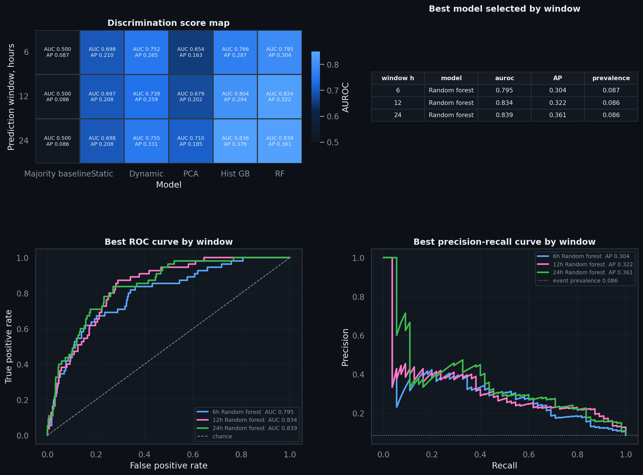
Discrimination Results
Random forest @ 24h: AUROC 0.839, AP 0.361 — a 4.2x lift over an 8.6% base rate. Histogram GB is statistically tied.
Held-out leaderboard
Win | Best model | AUROC | AP
6h | Random forest | 0.795 | 0.304
12h | Random forest | 0.834 | 0.322
24h | Random forest | 0.839 | 0.361
24h | Baseline | 0.500 | 0.086
Reading the dashboard
HEATMAP
AUROC and AP paired in one cell so the rank-vs-retrieval trade-off is visible at a glance.
PR CURVE
Sits above the 0.086 prevalence reference until the last fifth of recall.
OPERATING POINT
Top-of-list precision ≈ 0.5 at recall ≈ 0.2 — a 5–6x lift over base rate.
CSCI-E-116 | Daniel R. Russell | May 2026 | Final Project
07 / 10

Slide 8
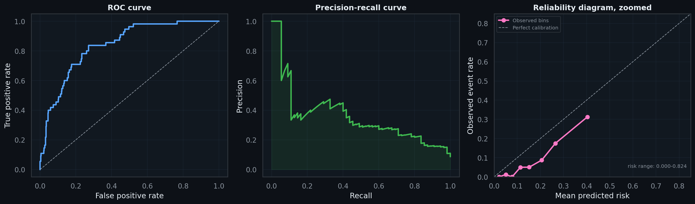
Calibration & Risk Range
Well-ordered, not well-calibrated: random forest overpredicts mid-range risk — the textbook case for Platt or isotonic recalibration.
Realised risk range 0.000 – 0.824. Reliability curve sits below the diagonal across most of the range; bias is largest in the mid-risk band.
CSCI-E-116 | Daniel R. Russell | May 2026 | Final Project
08 / 10

Slide 9
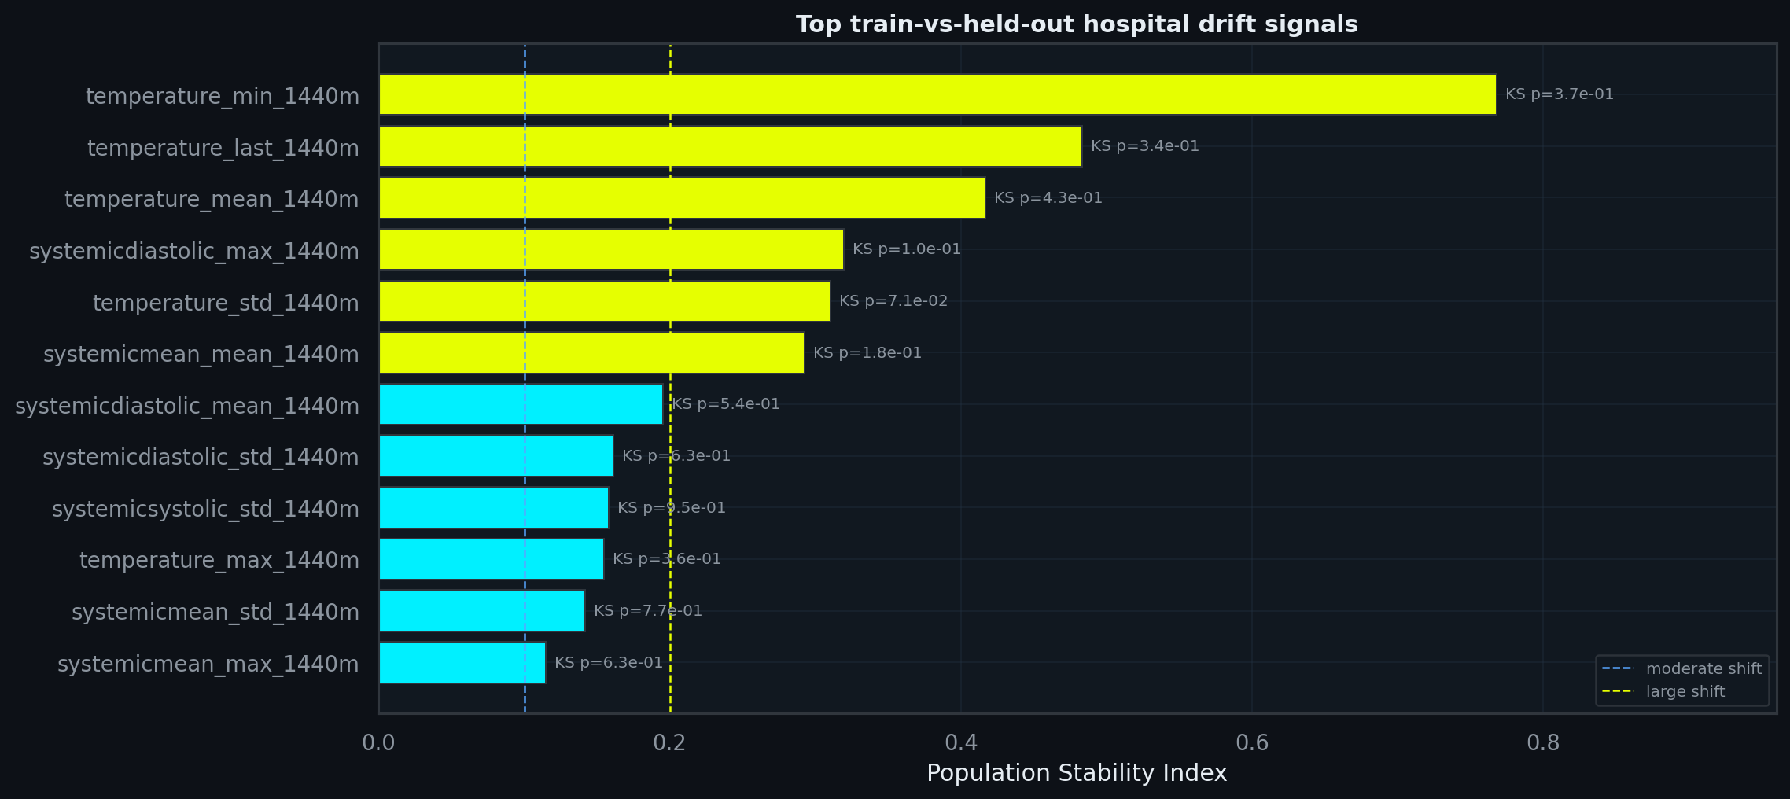
Cross-Hospital Drift
The top six features all exceed PSI 0.20 (large-shift threshold). PSI is the load-bearing signal; KS p-values are limited by held-out cohort size.
Temperature summaries dominate the drift profile (PSI 0.31–0.77) — a deployment-grade evaluation has to surface exactly this kind of shift.
CSCI-E-116 | Daniel R. Russell | May 2026 | Final Project
09 / 10

Slide 10
Operational Translation & Limits
What the numbers mean for a clinical triage workflow — and what stops them being deployable today.
TOP-DECILE ALERT
TOP-QUARTILE ALERT
CALIBRATION RULE
~64 stays
~160 stays
Use π̂, not p
Flags <10% of the held-out cohort yet captures roughly one third to one half of all eventual mortality events — a 4–5x concentration of clinical effort onto the highest-risk patients.
Captures the majority of events at the cost of a higher false-positive rate. This is the regime where the mid-risk calibration bias matters most.
Any threshold-based escalation must use the calibrated probability — a Platt or isotonic step on the raw model output — not the raw RF score.
LIMITS & NEXT STEPS
LITERATURE ANCHORS
Cohort
eICU-CRD demo only (2,520 stays / 186 hospitals).
eICU benchmarks
Pollard 2018 · Sheikhalishahi 2020
Labels
Retrospective discharge status; no clinician adjudication.
Calibration
Calibration
Not clinically calibrated; mid-risk bias documented.
Niculescu-Mizil & Caruana 2005
External validity
Needs validation on a second health system + per-subgroup calibration audit.
PR-vs-ROC
Davis & Goadrich 2006
CSCI-E-116 | Daniel R. Russell | May 2026 | Final Project
10 / 10

