Slide 1

Nuclear equation of state in relativistic Hartree approximation & neutron star properties
蒋维洲
学生：李牛等
东南大学物理学院

Slide 2
目录
1
相对论Hartree方法、真空效应
2
相对论Hartree方法的中子星性质
3
小结：进展、问题与展望

Slide 3
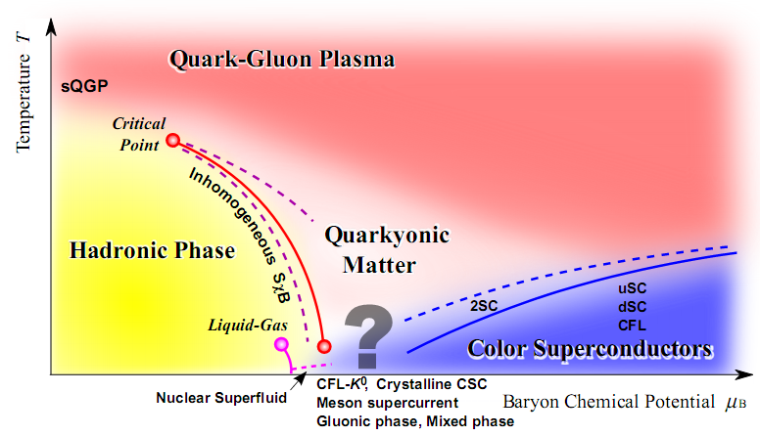
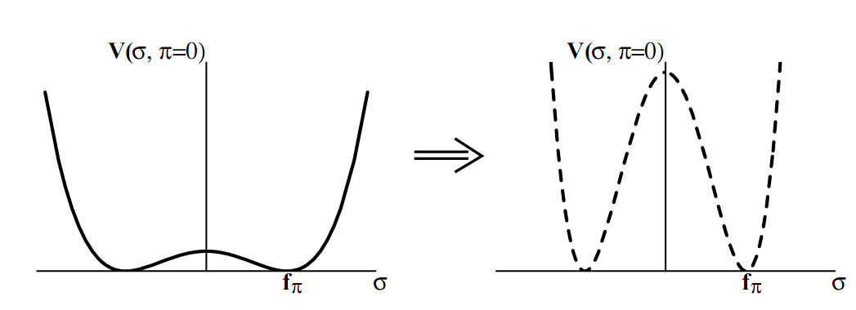
真空、手征对称性、退禁闭相变
物质在真空之中
真空结构：真空凝聚
真空的自发破缺：手征相变、退禁闭相变
重整化，Dirac海的有限贡献：
真空效应
真空影响手征凝聚
Fukushima et al, Rep Prog Phys 74, 014001(10)

Slide 4
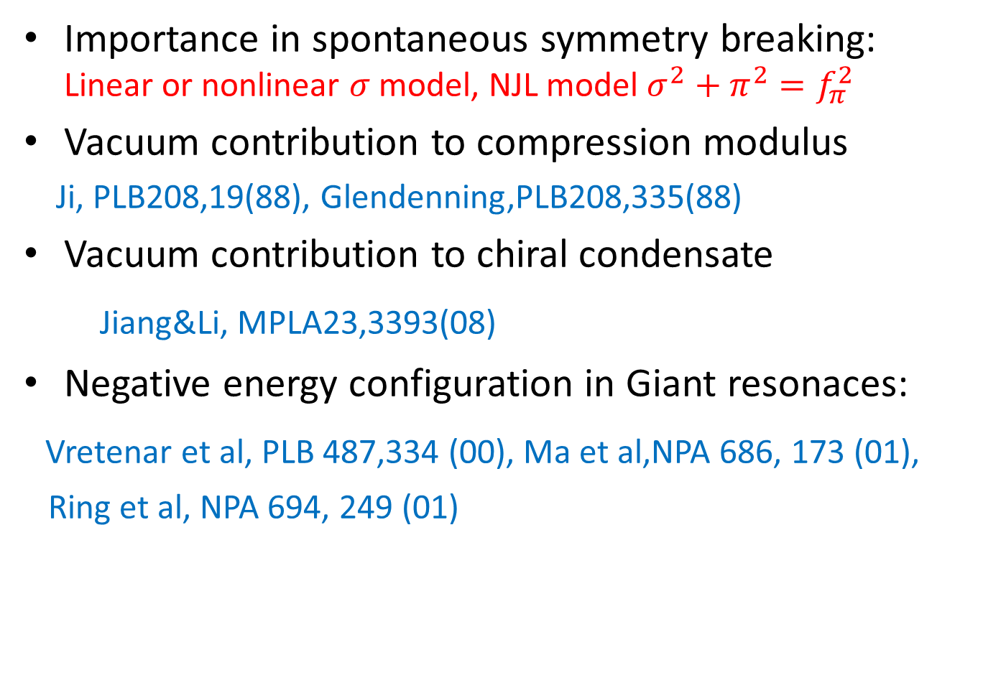
Vacuum effects
Importance in spontaneous symmetry breaking: Linear or nonlinear $σ$ model, NJL model $σ^{2}+π^{2}=f_{π}^{2}$
Vacuum contribution to compression modulus
Ji, PLB208,19(88), Glendenning,PLB208,335(88)
Vacuum contribution to chiral condensate
Jiang&Li, MPLA23,3393(08)
Negative energy configuration in Giant resonaces:
Vretenar et al, PLB 487,334 (00), Ma et al,NPA 686, 173 (01),
Ring et al, NPA 694, 249 (01)

Slide 5
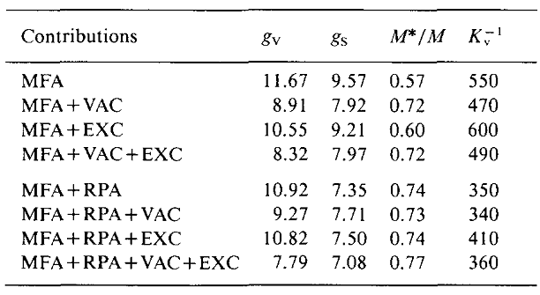
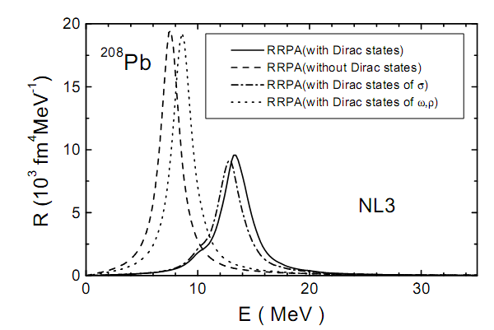
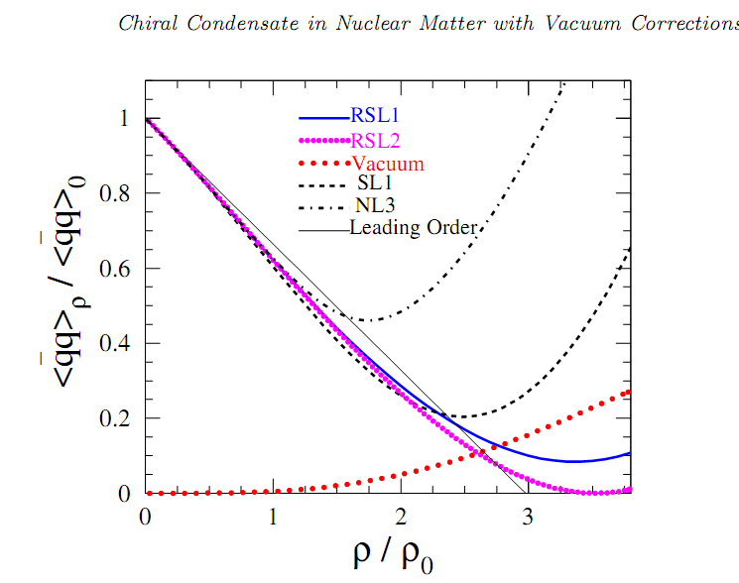
Ji, PLB208,19(88)
Ma, et al, NPA 686, 173 (01)
Jiang, Li, MPLA23,3393(08)
Wang et al, Nuclear matter in relativistic Brueckner-Hartree-Fock theory with Bonn potential in the full Dirac space, PRC103,054319 (2021)

Slide 7
Our aims
Vacuum effects on bulk matter properties
Vacuum effects on the nuclear EOS, especially on the symmetry energy ( from ring energy)
Similar to the EM radiative correction, it is a quantum effect of the meson field beyond RMF

Slide 8
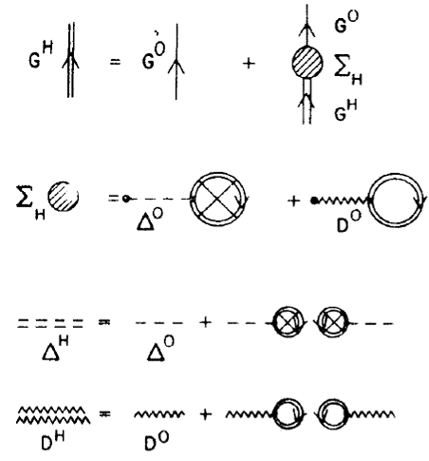
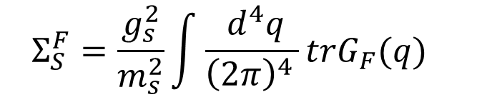
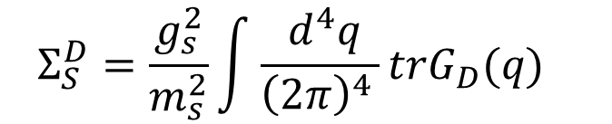
Relativistic mean-field & Hatree approximations
$$Σ_{S}^{H}=Σ_{S}^{F}+Σ_{S}^{D}$$
$$Σ_{S}^{D}=\frac{g_{s}^{2}}{m_{s}^{2}}\int{\frac{{ d}^{4}q}{{\left(2π\right)}^{4 }}}trG_{D}(q)$$
$$Σ_{S}^{F}=\frac{g_{s}^{2}}{m_{s}^{2}}\int{\frac{{ d}^{4}q}{{\left(2π\right)}^{4 }}}trG_{F}(q)$$

Slide 9

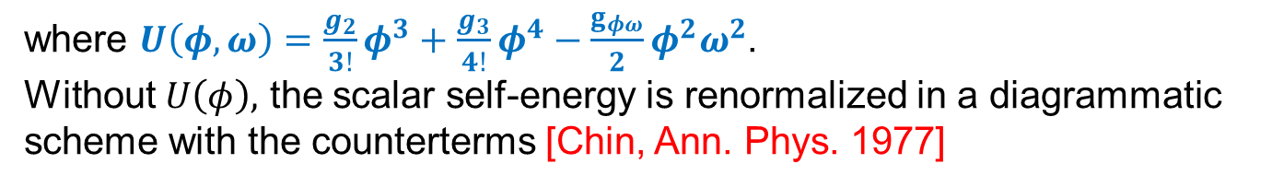
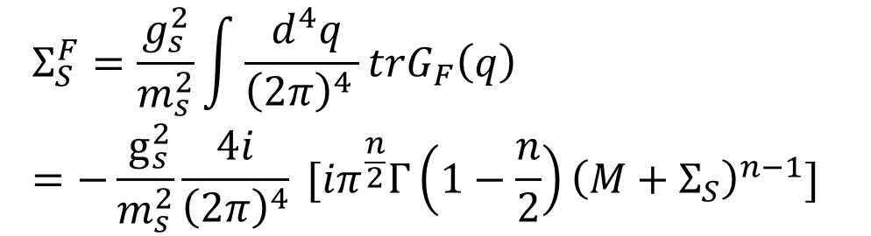
Relativistic Hartree Approximation (RHA)
The interacting lagrangian reads
where $U\left(φ,ω\right)=\frac{g_{2}}{3!}φ^{3}+\frac{g_{3}}{4!}φ^{4}−\frac{g_{φω}}{2}φ^{2}ω^{2}$.
Without $U\left(φ\right),$ the scalar self-energy is renormalized in a diagrammatic scheme with the counterterms [Chin, Ann. Phys. 1977]
$$Σ_{S}^{F}=\frac{g_{s}^{2}}{m_{s}^{2}}\int{\frac{{ d}^{4}q}{{\left(2π\right)}^{4 }}}trG_{F}\left(q\right)=−\frac{{ g}_{s}^{2}}{m_{s}^{2}}\frac{4i}{{\left(2π\right)}^{4}} [{iπ}^{\frac{n}{2}}Γ\left(1−\frac{n}{2}\right){\left(M+Σ_{S}\right)}^{n−1}]$$

Slide 10
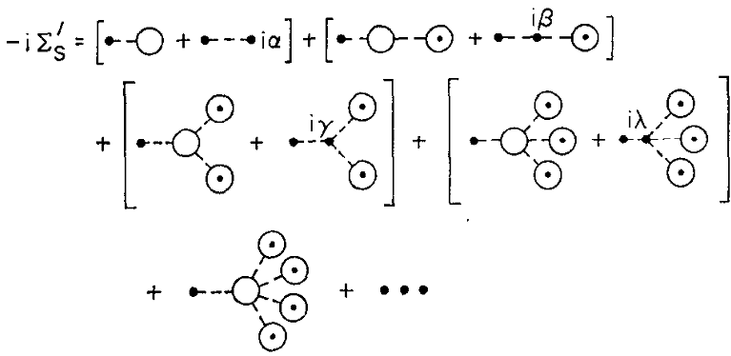
Isolate the finite part;
Subtract off the divergent terms to retain the finite part.
With the inclusion of the nonlinear self-interactions, the divergent terms are subtracted using the techniques of the path integral method[ See Serot&Walecka, Adv. Nucl. Phys. 16(86)].

Slide 11
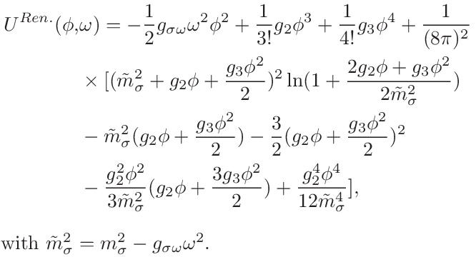
Renormalized meson self-interactions
The effective σ mass is defined $m_{σ}^{∗2}=∂^{2}U^{Ren.}(φ,ω)/∂φ^{2}$.

Slide 12
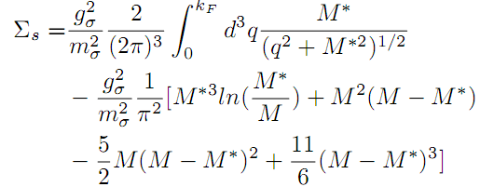
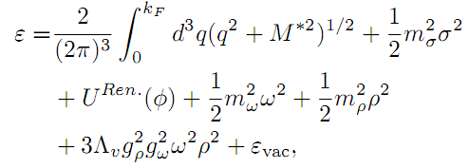
Nucleon self-energy & energy density
$ε_{vac}$ is given in the work [Chin, Ann. Phys. 108,301(1977)].

Slide 13


Energy density
$ℰ=ℰ_{H}+ℰ_{vac}+ℰ_{ex}+ℰ_{RPA}$

Slide 14
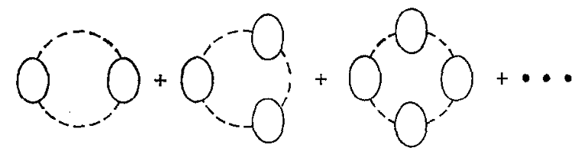
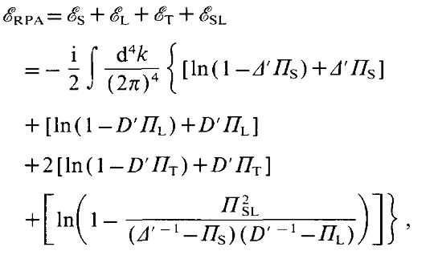
Ring energy

Slide 15
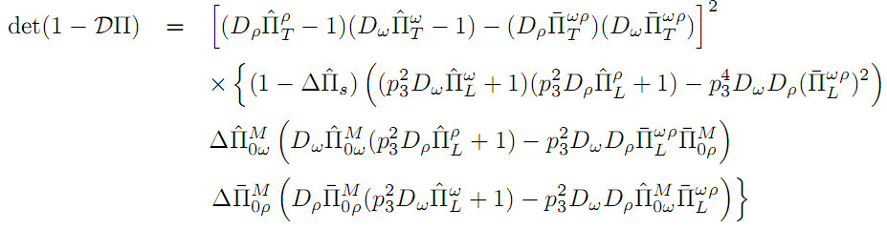

Addition of ρ meson
${(DΠ)}_{5×5}−→{(DΠ)}_{9×9}$
It was aimed to study the symmetry energy with the vacuum effect.
Numeric is in progress, with the divergent problem

Slide 16
进展与问题
真空贡献导致大的核子有效质量，对支持大质量中子星需要找到降低有效质量的方法
对Ring energy积分，尝试了不同的方法，有发散的，有在类空动量空间积分收敛的
考虑ρ介子的圈图贡献，计算还在进展之中

Slide 17
Observable effects in neutron stars
Core-crust transition density
Mass-radius trajectory including large-mass star constraints and radius measurement with NICER
Star deformability

Slide 18
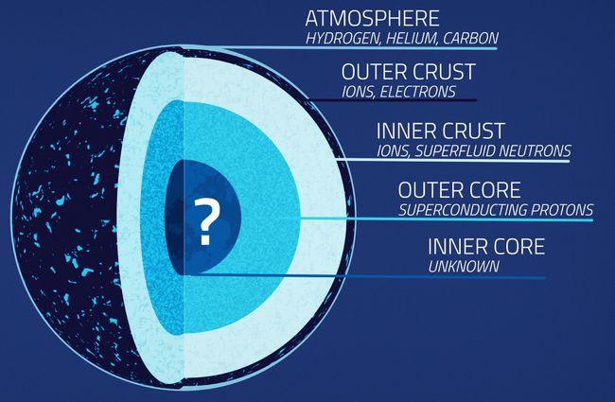
Introduction of core-crust transition density
core-crust transition density：When the density lower than a specific value, the outer core of neutron star becomes unstable under the density fluctuation.

Slide 19
Method for transition density
Hydrodynamic method: Vlasov equation, Master equation
Chomaz et al PR389,263(04), Ducoin, et al.NPA 789, 403 (07), Zheng & Chen, PRD 85, 043013(12)
Thermodynamic method: P&μ instability condition
Douchin & Haensel, PLB 485, 107 (00), Li, et al, NPA 699, 493 (02), Kubis, PRC 76, 025801 (07).
Relativistic RPA: Dyson equation
Lim &Horowitz, NPA 501, 729(89), Carriere, Horowitz, et al, ApJ 593, 463 (03); Ma, et al, NPA 686, 173 (01)
No vacuum effect or no self-consistent vacuum treatment

Slide 20

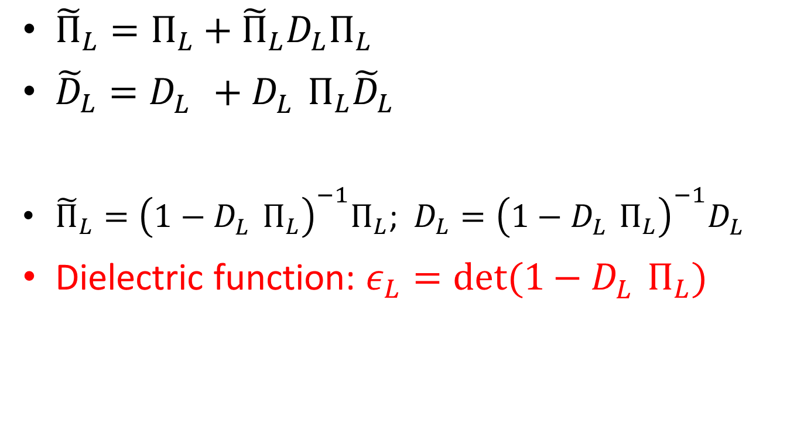
Dyson equation
Formulas of the RRPA method
${\tilde{Π}}_{L}=Π_{L}+{\tilde{Π}}_{L}D_{L}Π_{L}$
${\tilde{D}}_{L}=D_{L}^{}+D_{L}^{}Π_{L}{\tilde{D}}_{L}$
${\tilde{Π}}_{L}={\left(1−D_{L}^{}Π_{L}\right)}^{−1}Π_{L}$; $D_{L}={\left(1−D_{L}^{}Π_{L}\right)}^{−1}D_{L}^{}$
Dielectric function: $ε_{L}=det(1−D_{L}^{}Π_{L})$
The transition density $ρ_{t}$, the largest density determined by

Slide 21
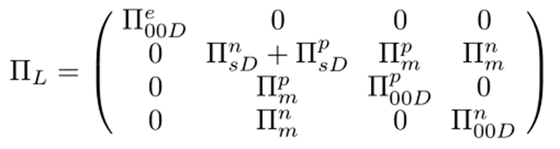

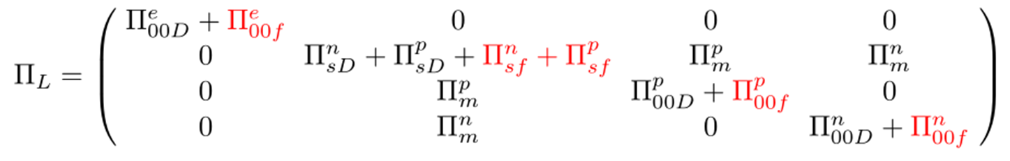
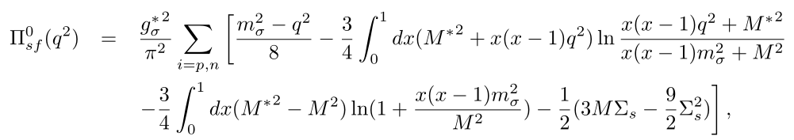

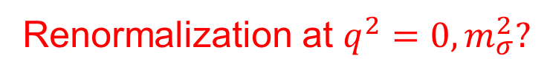
Formulas of the RRPA method
Renormalization at $q^{2}=0, m_{σ}^{2}?$

Slide 22
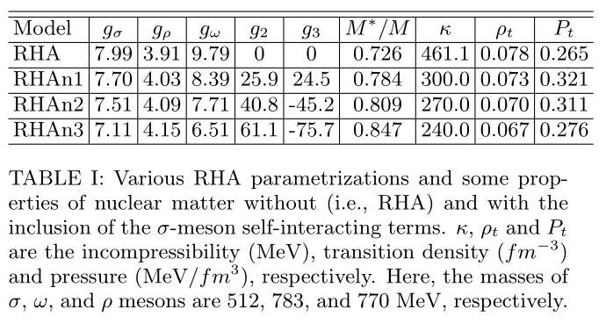
Results and discussion
Where

Slide 23
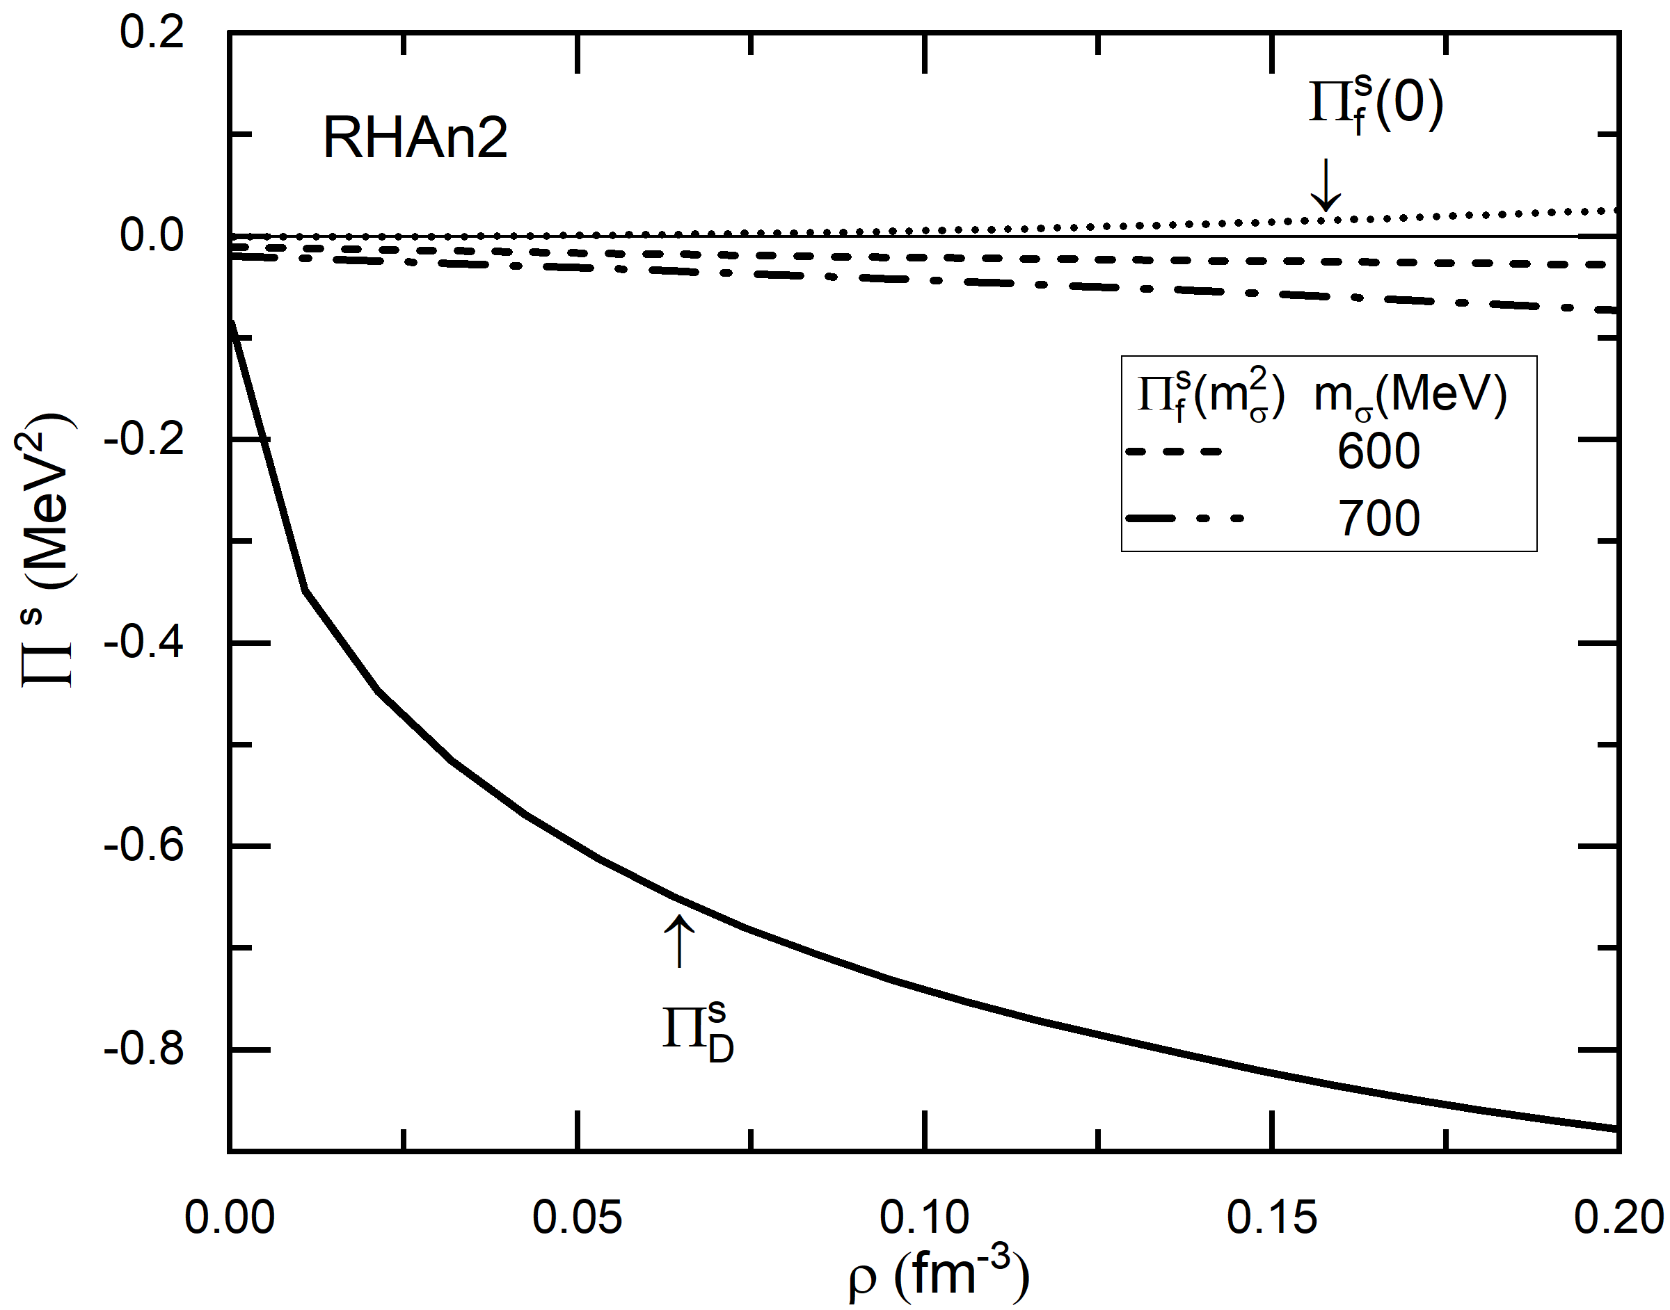
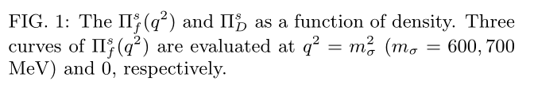
Calculation results and discussion

Slide 24
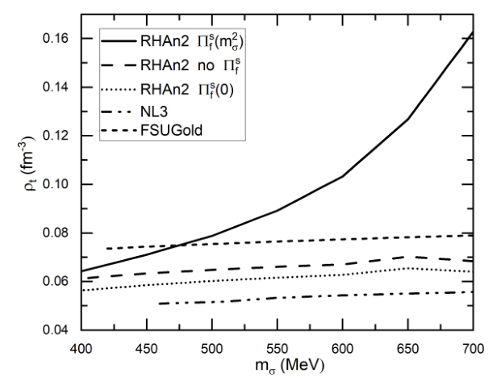

Calculation results and discussion

Slide 25

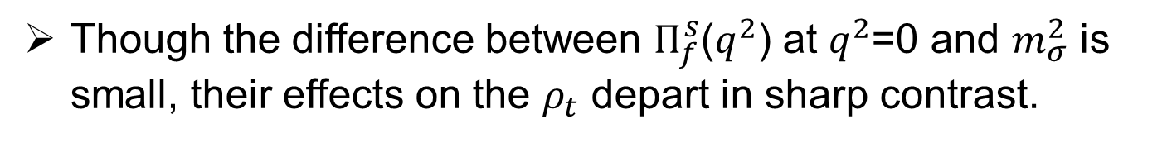
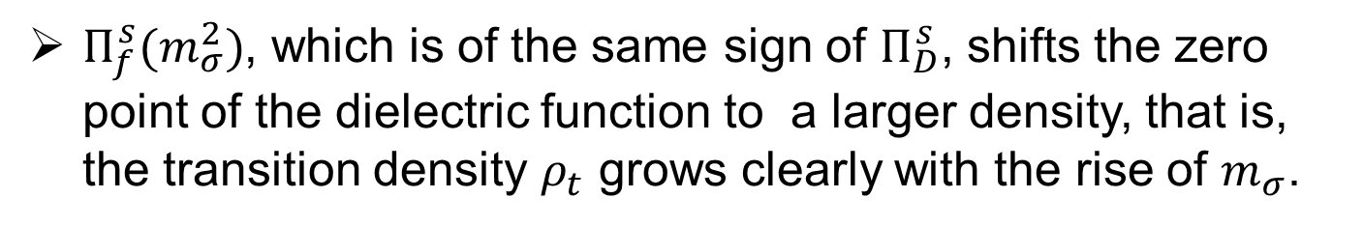
Results and discussion
Though the difference between $Π_{f}^{s}$($q^{2}$) at $q^{2}$=0 and $m_{σ}^{2}$ is small, their effects on the $ρ_{t}$ depart in sharp contrast.
$Π_{f}^{s}(m_{σ}^{2})$, which is of the same sign of $Π_{D}^{s}$, shifts the zero point of the dielectric function to a larger density, that is, the transition density $ρ_{t}$ grows clearly with the rise of $m_{σ}$.

Slide 26
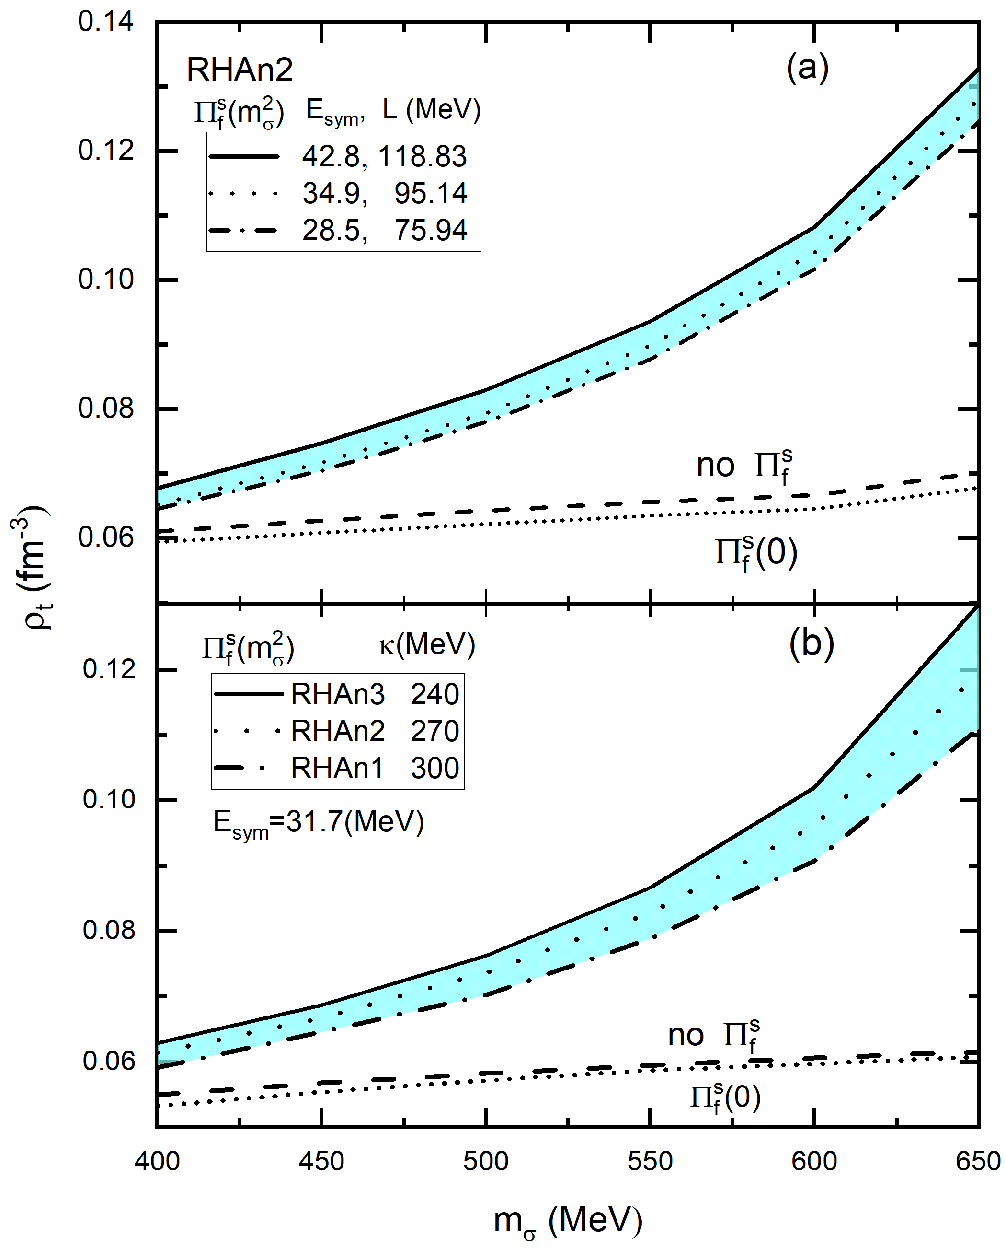
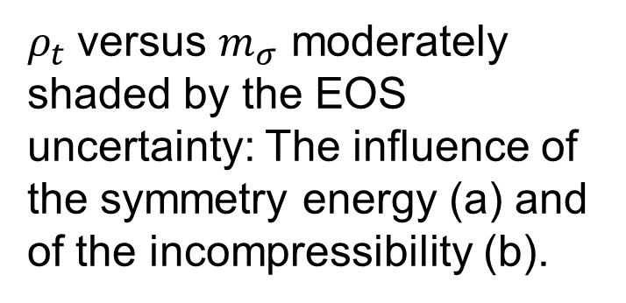
Results and discussion
$ρ_{t}$versus $m_{σ}$ moderately shaded by the EOS uncertainty: The influence of the symmetry energy (a) and of the incompressibility (b).
Li, Jiang,et al. PLB839,137765(23)

Slide 27
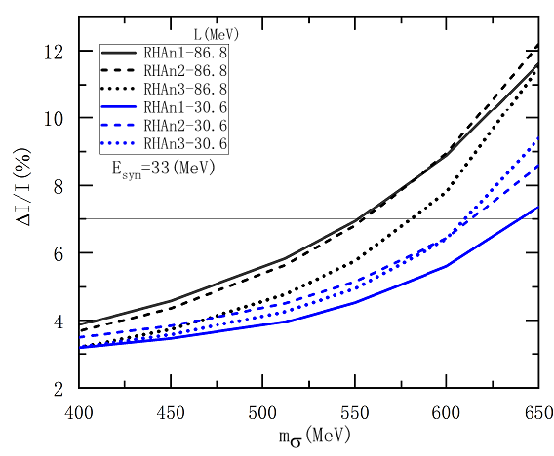
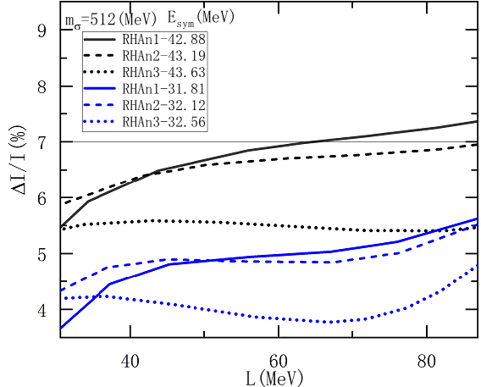
Glitch of Vela pulsar

Slide 28
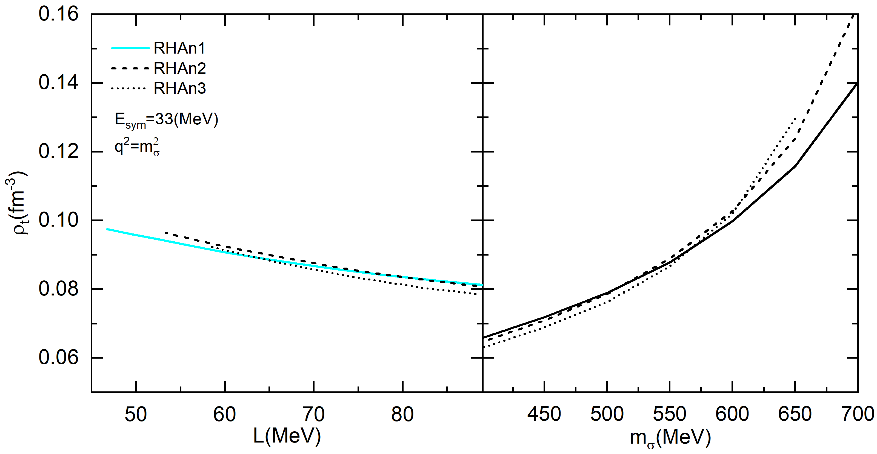

Results and discussion
This figure compares the dependence of $ρ_{t}$ on L with the renormalization point $q^{2}$=${ m}_{σ}^{2}$.

Slide 29
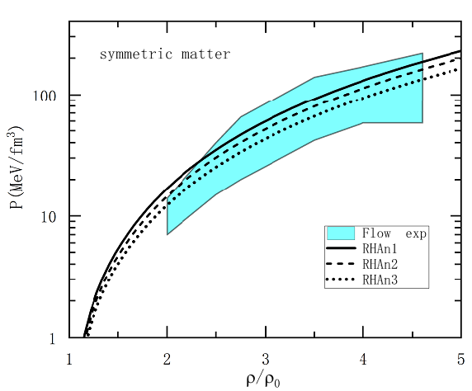

Slide 30
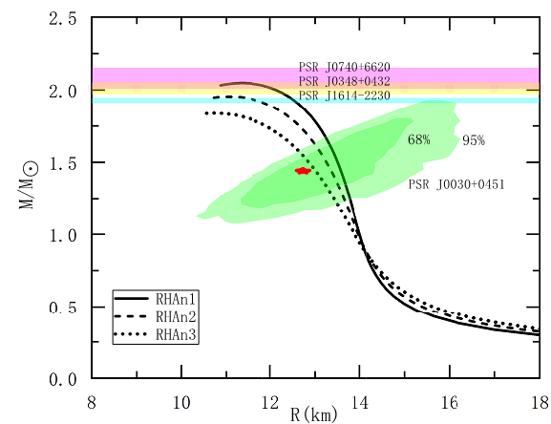

Slide 31
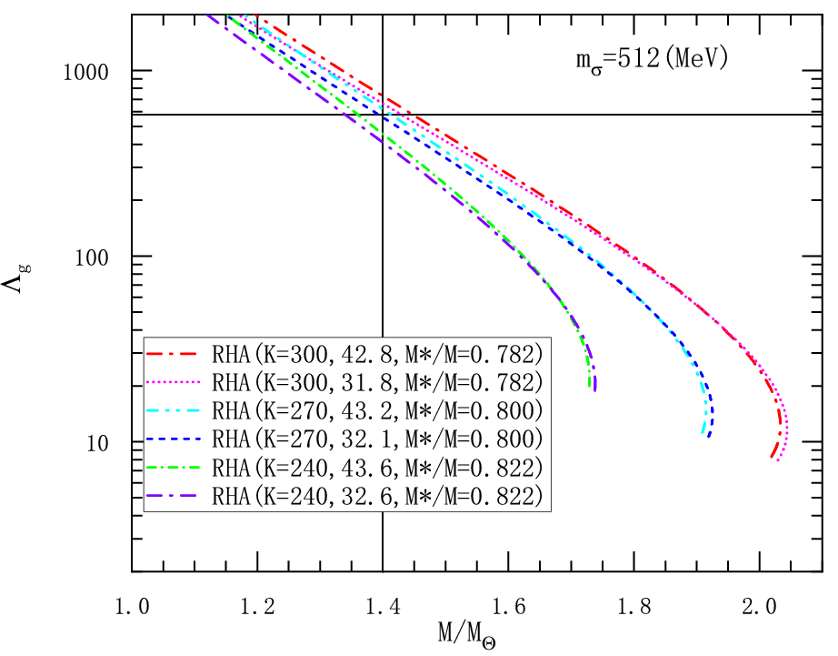
NS deformability vs Mass

Slide 32
小结
相对论Hartree近似、重整化
圈图能量：平均场的量子效应
一些进展：真空效应对核态方程、中子星性质如中子星芯冠的转变密度的影响
考虑模型的手征对称性+真空效应研究退禁闭相变以及QCD结构相图
待解决的问题……

Slide 33
Thank you for your attention！

