Slide 1


Universal relations in neutron stars
文德华
【1】Shen Yang, Dehua Wen∗, Jue Wang and Jing Zhang, Exploring the universal relations with the correlation analysis of neutron star properties, Phys. Rev. D 105, 063023 (2022)
【2】 Yuxi Li, Jue Wang, Zehan Wu and Dehua Wen*, Inferring the gravitational binding energy and moment of inertia of PSR J0030 + 0451 and PSR J0740 + 6620 from new universal relations, Class. Quantum Grav. 39, 035014(2022)
【3】Y. X. Li, H. Y. Chen, D. H. Wen* and J. Zhang, Constraining the nuclear symmetry energy and properties of the neutron star from GW170817 by Bayesian analysis, Eur. Phys. J. A, 57, 31(2021)
【4】W. J. Sun, D. H. Wen* and J. Wang, New quasi-universal relations for static and rapid rotating neutron stars, Phys. Rev. D 102, 023039 (2020)
【5】R. R. Jiang, D. H. Wen* and H. Y. Chen, Universal behavior of compact star based upon gravitational binding energy, Phys. Rev. D, 100, 123010 (2019).
【6】N. Zhang, D. H. Wen* and H. Y. Chen，Imprint of the speed of sound in nuclear matter on global properties of neutron stars，Phys. Rev. C 99, 035803 (2019)
【7】D. H. Wen, B. A. Li, * H. Y. Chen and N. B. Zhang, GW170817 implications on the frequency and damping time of f -mode oscillations of neutron stars, Phys. Rev. C 99, 045806 (2019)
【8】H. Y. Chen, D. H. Wen* and N. Zhang, Suitable resolution of EOS tables for neutron star investigations, Chin. Phys. C 43, 054108(2019)
【9】B. A. Li, P. G. Krastev, D. H. Wen and N. B. Zhang, Towards understanding astrophysical effects of nuclear symmetry energy, Eur. Phys. J. A 55, 117 (2019)
【10】Jue Wang, Shen Yang, and Dehua Wen*, Constraining Properties of Massive Neutron Star through R-Mode , Eur. Phys. J. A, accepted (2022)

Slide 2
CONTENT
Brief introduction to neutron star research
Universal relations (UR) and correlations of NS
UR of f-mode
UR of gravitational binding energy
UR of rotational neutron star
UR and correlation analysis
Conclusion

Slide 3
CONTENT
Brief introduction to neutron star research
Universal relations (UR) and correlations of NS
UR of f-mode
UR of gravitational binding energy
UR of rotational neutron star
UR and correlation analysis
Conclusion

Slide 4
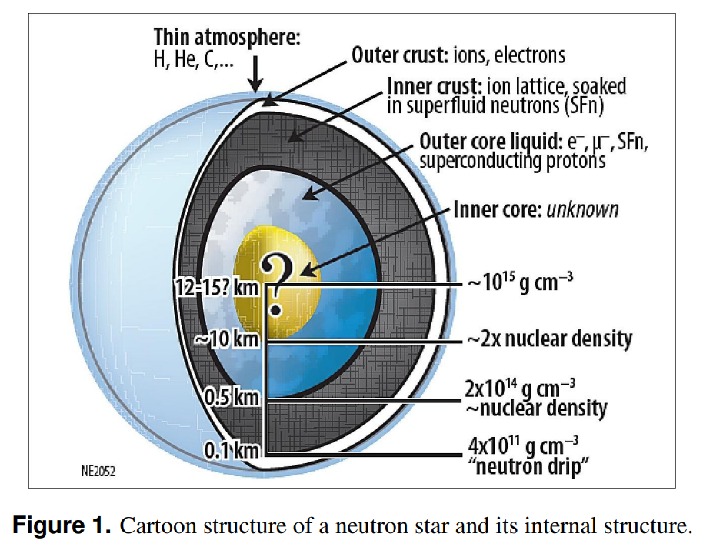
中子星基本结构
大气层：厚度仅有数厘米。
外壳层：ρ=1×10⁴g/cm³~4×10¹¹g/cm³
在此区域内，电子作为自由费米气可以在壳层内自由移动。随着密度不断增大，电子和质子将通过中子化过程产生中子并发射中微子，以降低能量。晶格内的原子核变得更加丰中子。
内壳层：ρ=4×10¹¹g/cm³~2×10¹⁴g/cm³
密度高于中子滴出密度，晶格将被中子气笼罩，晶格内的原子核将在库仑斥力下变形为“pasta-like”结构。
内核：ρ>2×10¹⁴g/cm³
由轻子，质子和中子组成。随密度增大，能量升高，超子或将产生。甚至在中心处夸克可能解禁闭，从而产生夸克胶子等离子体。
内壳层及内核高密部分的物态方程还具有很大的不确定性

Slide 5

Accurate observations of massive neutron stars
PSR J1614—2230 (original mass measurement in Demorest et al. 2010 and current mass measurement in Arzoumanian et al. 2018)
PSR J0348+0432 (Antoniadis et al. 2013)
Possible observations of massive neutron stars：
GW190814
2.50 M⊙ —2.67 M⊙
PSR J0740+6620 (Cromartie et al. 2019)
$$修正后：M={2.08}_{−0.07}^{+0.07}M_{⊙}$$
B. P. Abbott et al:, Astrophys. J. Lett. 896, L44 3 (2020)
[1] Demorest, P. B., Pennucci, T., Ransom, S. M., et al., 2010, Nature, 467, 1081
[2] Arzoumanian, Z., Baker, P. T., Brazier, A., et al. 2018, ApJ, 859, 47
[3] Antoniadis, J., Freire, P. C. C., Wex, N., et al. 2013, Science, 340, 448
[4] Cromartie, H. T., Fonseca, E., Ransom, S. M., et al. 2020, NatAs, 4，27

Slide 6
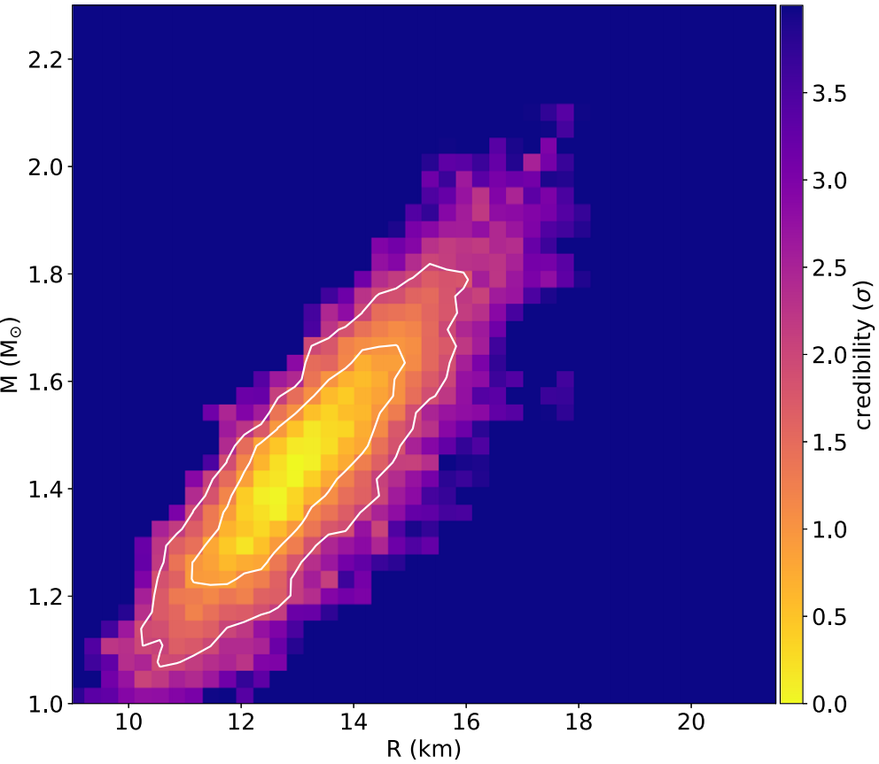
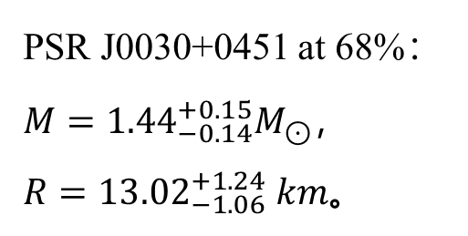
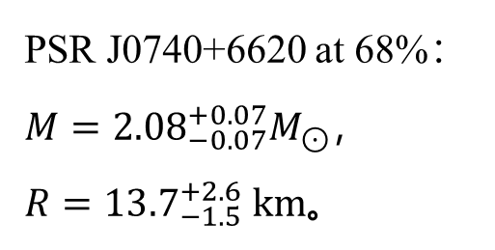
Mass radius observation constraints from NICER
PSR J0030+0451
PSR J0030+0451 at 68%：
$M={1.44}_{−0.14}^{+0.15}M_{⊙}$，
$R={13.02}_{−1.06}^{+1.24} km$。
M. C. Miller et al., Astrophys. J. Lett. 887, L24 (2019)；Riley T E, Watts A L, Bogdanov S, et al，Astrophys. J. Lett. 2019, 887(1): L21.
PSR J0740+6620 at 68%：
$M={2.08}_{−0.07}^{+0.07}M_{⊙}$，
$R={13.7}_{−1.5}^{+2.6} km$。
M. C. Miller et al 2021 ApJL 918 L28
Neutron Star Interior Composition Explorer (NICER)

Slide 7
Main observation conclusions of GW170817
Take from J.M.Lattimer PPT
Phys. Rev. Lett. 121, 161101 (2018).
New:70<Λ_{1.4}<580

Slide 8
Observation constraints on the M-R relation
Mass–radius relations, where the gray area denotes the range of maximum mass accurately observed so far. The light red area denotes the marginalized posterior (Mg, R) of the merged binary neutron star released by LIGO and VIRGO collaboration in GW170817. The light blue and green areas denote the marginalized posterior (Mg, Re) released by NICER for PSR J0030 + 0451 and PSR J0740 + 6620, respectively.
Yuxi Li, Jue Wang, Zehan Wu and Dehua Wen*, Inferring the gravitational binding energy and moment of inertia of PSR J0030 + 0451 and PSR J0740 + 6620 from new universal relations， Class. Quantum Grav. 39 (2022) 035014

Slide 9
Constraints of GW170817 observations on neutron star property
From Horowitz PPT

Slide 10
Universal relations among neutron star property (such as I-LOVE-Q)
Universal relation reflects the nature that some relations between the global properties of NS are not dependent on the EOS. This relation can be used to constrain the properties that cannot be directly observed (such as the gravitational binding energy) or cannot be accurately observed (such as the radius), and can be further reversely constrain the parameters of EOS (such as the symmetry energy).
These universal relations can be used to learn about neutron star deformability through observations of the moment of inertia, distinguish neutron stars from quark stars, and test general.
Kent Yagi* and Nicolás Yunes, Science 341, 365 (2013)

Slide 11
Observation of GW from oscillation modes in NS
The neutron star signals considered are f-mode emissions…The sensitivities achieved by this search for generic bursts are still not suficient to be able to detect such high-frequency transients at the energy scale of pulsar glitches from e.g., the Vela Pulsar at high confidence. Nevertheless the outlook is promising, since the expected improvements of the GW detectors in the high-frequency band for the next observation run are quite relevant …
All-sky search for short gravitational-wave bursts in the third Advanced LIGO and Advanced Virgo run, arXiv:2107.03701v1 [gr-qc]

Slide 12
CONTENT
Brief introduction to neutron star research
Universal relations (UR) and correlations of NS
UR of f-mode
UR of gravitational binding energy
UR of rotational neutron star
UR and correlation analysis
Conclusion

Slide 13
Basic equations of f-mode
Static perturbation

Slide 14




Definition and calculation of tidal deformability
PHYSICAL REVIEW D 81, 123016 (2010)
Cause：gravitational action from outside the star
Effect：density disturbance inside star
Causal correlation: linear
Definition of Tidal Love Number
Tidal deformability is a detectable quantity that both astrophysics and nuclear physics are concerned about

Slide 15
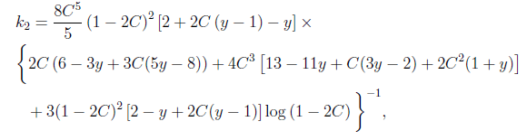
Definition and calculation of tidal deformability
PHYSICAL REVIEW D 81, 123016 (2010)
where

Slide 16
Parametric EOS model for neutron-rich nucleonic matter
N. B. Zhang, B. A. Li, and J. Xu，The Astrophysical Journal 859, 90 (2018)
The nucleon specific energy of neutron-rich matter with isospin asymmetry
δ = (ρ_{n} − ρ_{p})/ρ can be well approximated by the empirical parabolic law
where
Parameters near the saturation density are constrained by existing knowledge as

Slide 17
Universal relation between f-mode frequency and tidal deformability for 1.4M ⊙ NS
The frequency of f-mode for a neutron star with mass of 1.4M⊙ are constrained by the tidal polarizability [70<Λ_{1.4}<580] of GW170817 in 1.67~2.18kHz;
D. H. Wen, B. A. Li, H. Y. Chen and N. B. Zhang, Phys. Rev. C 99, 045806 (2019)

Slide 18
Universal relation between f-mode DT and tidal deformability for 1.4M ⊙ NS
The damping time (DT) of f-mode for a neutron star with mass of 1.4M⊙ are constrained by the tidal deformability [70<Λ_{1.4}<580] of GW170817 in 0.155~0.255s.
D. H. Wen, B. A. Li, H. Y. Chen and N. B. Zhang, Phys. Rev. C 99, 045806 (2019)

Slide 19
Constraints of f-mode on symmetric energy of nuclear matter
It is shown that if a lower frequency (1.640±0.016 kHz) is observed, there is a higher symmetry energy (54.5±6.5 MeV) at 2ρ₀; if a higher frequency (1.800±0.018 kHz) is observed, there is a lower symmetry energy (43.0 ± 6.5 MeV).
D. H. Wen, B. A. Li, H. Y. Chen and N. B. Zhang, Phys. Rev. C 99, 045806 (2019)

Slide 20
CONTENT
Brief introduction to neutron star research
Universal relations (UR) and correlations of NS
UR of f-mode
UR of gravitational binding energy
UR of rotational neutron star
UR and correlation analysis
Conclusion

Slide 21
Definition of gravitational binding energy and related quantities
Definition of the mass:
Gravitational mass
Proper mass
Baryon mass
Definition of the binding energy (BE):
Total BE
Gravitational BE
Nuclear BE
Normally, the total BE and gravitational BE are negative, and the nuclear BE are positive (quark stars are excluded).

Slide 22
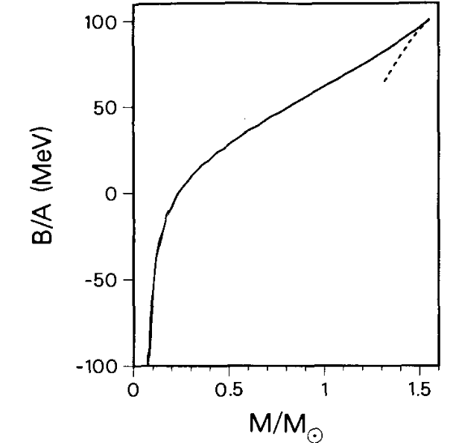
Binding energy per baryon of neutron star sequence
Compact stars, N.K. Glendenning, Second Edition, P123
The dashed line represents the unstable configurations with central densities higher than that of the limiting mass star. The negative binding energy for stars with M<0.2M_{sun.}

Slide 23
Binding energies for 1.4M ⊙ NS under different EOSs
R. R. Jiang , DHW* and H. Y. Chen, PRD 100, 123010 (2019)

Slide 24
Universal relation of gravitational binding energy
Eur. Phys. J. A (2016) 52: 18
APJ, 550(2001)426

Slide 25
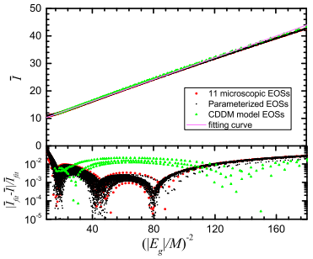
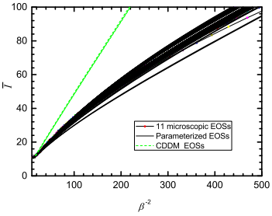
Universal relation between gravitational binding energy and moment of inertia
R. R. Jiang , DHW* and H. Y. Chen, PRD 100, 123010 (2019)
There is a perfect linear universal relation between the dimensionless inertial and the dimensionless gravitational binding energy; the normal neutron stars and quark stars follow the same universal relation.
It is sufficient to estimate the gravitational binding energy if the stellar mass M and the moment of inertia I are measured simultaneously, whether the compact star is a quark star or a neutron star.

Slide 26
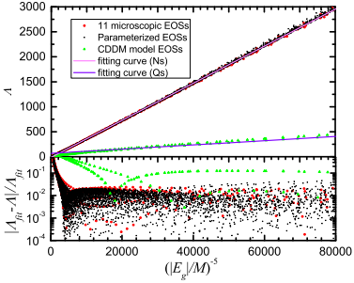
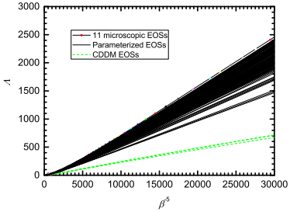
Universal relation between gravitational binding energy and tidal deformability
R. R. Jiang , DHW* and H. Y. Chen, PRD 100, 123010 (2019)
There exist ideal linear universal relations between dimensionless gravitational binding energy (negative fifth power) and the tidal deformability Λ. provide a potential way to distinguish normal neutron stars (with crust) and the quark stars (without crust) .

Slide 27
CONTENT
Brief introduction to neutron star research
Universal relations (UR) and correlations of NS
UR of f-mode
UR of gravitational binding energy
UR of rotational neutron star
UR and correlation analysis
Conclusion

Slide 28
The ten fastest-spinning known radio pulsars
Science, 311(2006)190

Slide 29
Universal relation among I, Z and E_{g}— static case
W. J. Sun, D. H. Wen* and J. Wang, Phys. Rev. D 102, 023039 (2020)

Slide 30
Universal relation for the rotating neutron stars
W. J. Sun, D. H. Wen* and J. Wang, Phys. Rev. D 102, 023039 (2020)
Rotating at Keplerian frequency

Slide 31
CONTENT
Brief introduction to neutron star research
Universal relations (UR) and correlations of NS
UR of f-mode
UR of gravitational binding energy
UR of rotational neutron star
UR and correlation analysis
Conclusion

Slide 32
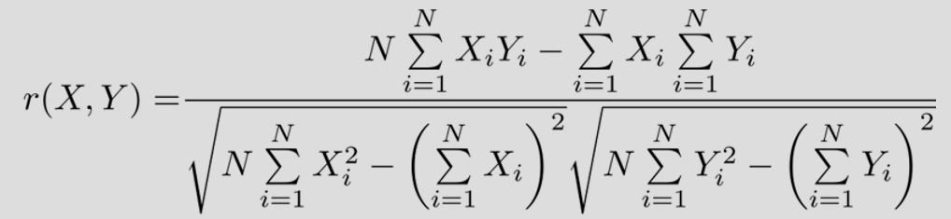
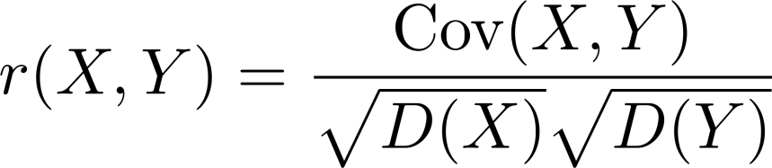
Universal relations and correlation analysis
Shen Yang, Dehua Wen∗, Jue Wang and Jing Zhang, Phys. Rev. D 105, 063023 (2022)
The linear correlation, which reflects the strength between two quantities, can be expressed as
简记为
Pearson相关系数
The closer the absolute value of the correlation coefficient |r| is to 1, the greater the correlation strength between the two quantities will be.
M. Ferreira, M. Fortin, T. Malik, B. K. Agrawal, and C. Providencia, Phys. Rev. D 101, 043021 (2020).

Slide 33
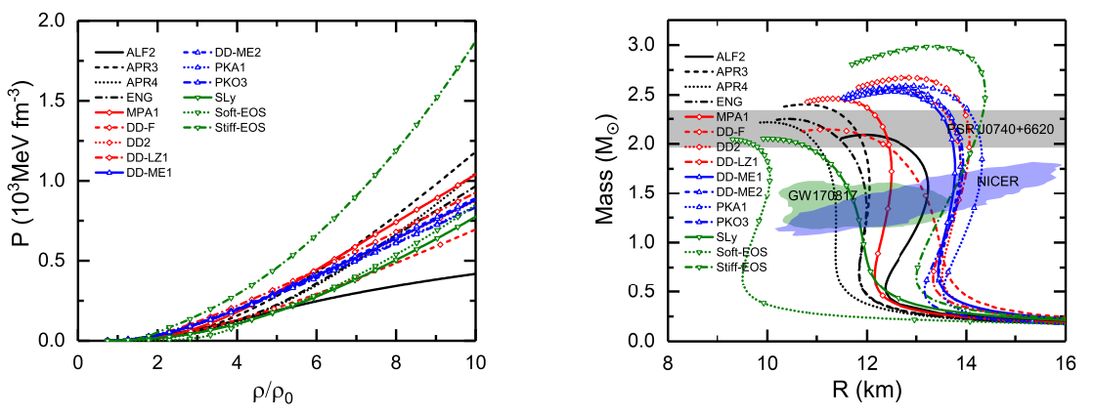
物态方程及对应的质量半径关系
Shen Yang, Dehua Wen∗, Jue Wang and Jing Zhang, Phys. Rev. D 105, 063023 (2022)
采用15组代表性EOS。除Soft EOS外，其它EOS的M-R关系均符合GW170817, NICER以及 PSR J0740+6620（最大质量）的观测约束。

Slide 34
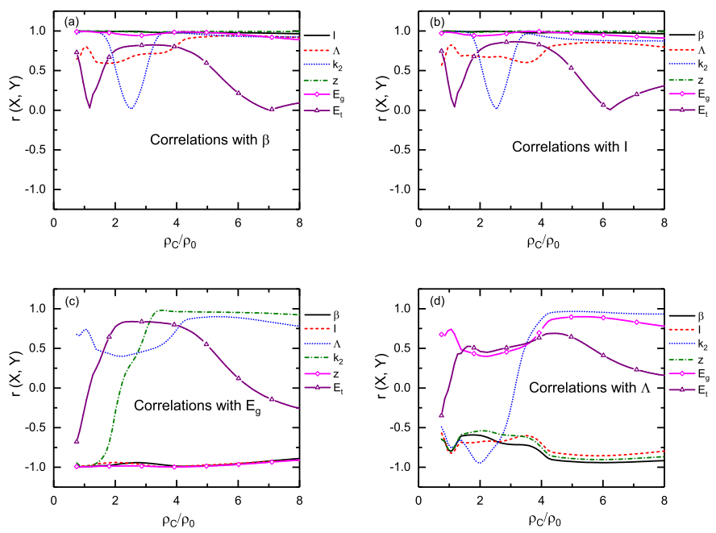
Universal relations and correlation analysis
Shen Yang, Dehua Wen∗, Jue Wang and Jing Zhang, Phys. Rev. D 105, 063023 (2022)
Linear correlation properties of the neutron star properties. It is shown that the quantities possessing desired linear correlation properties are the compactness β, moment of inertia I, gravitational redshift z and gravitational binding energy Eg.

Slide 35
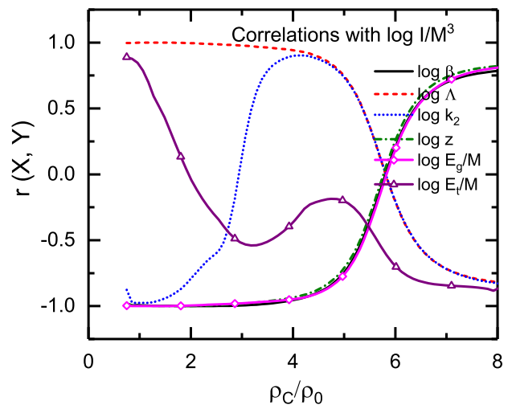
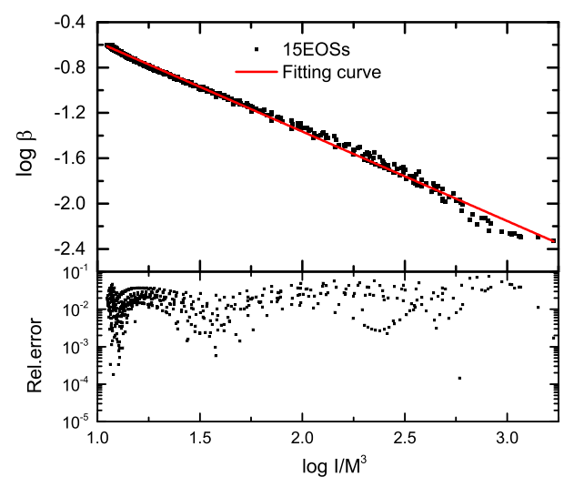
Universal relations and correlation analysis
Shen Yang, Dehua Wen∗, Jue Wang and Jing Zhang, Phys. Rev. D 105, 063023 (2022)
Predicting the new universal (I/M^{3_} β) relations based on the linear correlation analysis
The universal relation I/M³- β can be expressed as

Slide 36
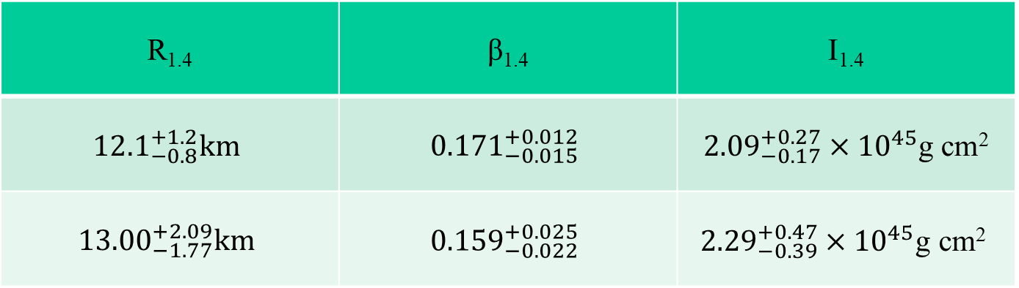
Universal relations and correlation analysis
Shen Yang, Dehua Wen∗, Jue Wang and Jing Zhang, Phys. Rev. D 105, 063023 (2022)
According to the universal relation I/M³- β，
The moment of inertia of PSR J0030+0451 can be constrained as :
R_{1.4} | β_{1.4} | I_{1.4}
$${12.1}_{−0.8}^{+1.2}km$$ | $${0.171}_{−0.015}^{+0.012}$$ | ${2.09}_{−0.17}^{+0.27}×{10}^{45}$g cm²
$${13.00}_{−1.77}^{+2.09}km$$ | $${0.159}_{−0.022}^{+0.025}$$ | $${2.29}_{−0.39}^{+0.47}×{10}^{45}\text{g} \text{cm}\text{2}$$

Slide 37
CONTENT
Brief introduction to neutron star research
Universal relations (UR) and correlations of NS
UR of f-mode
UR of gravitational binding energy
UR of rotational neutron star
UR and correlation analysis
Conclusion

Slide 38
Conclusion
The frequency and damping time of f-mode for NS with 1.4M⊙ can be effectively constrained by the universal relation and observation of GW 170817.
Gravitational binding energy is an ideal quantity to construct the universal relations. These general relations can be used to constrain global quantities of NS that are difficult to observe or cannot be observed directly.
linear correlation analysis can be used to predict new universal relations and constrain the properties of NS.

Slide 39
Thanks!

Slide 40
附录

Slide 41
Neutron Star Interior Composition Explorer (NICER)
The main idea behind measuring stellar radii with NICER, or more appropriately the stellar compactness, is the identification and monitoring of "hot spots" on the stellar surface. Magnetic fields in pulsars are so strong and complex that charged particles that are ripped away from the star often crash back into the stellar surface creating hot spots, namely, regions within the star that glow brighter than the rest of the star.
As the neutron star spins, the hot spots come in and out of view producing periodic variations in the brightness that are recorded by NICER.
And just as the Shapiro delay takes advantage of general relativistic effects, so does NICER. Indeed, the gravitational field around the neutron star is so strong, that x-rays emitted from the back of the star get bent and are eventually detected by NICER's sophisticated instruments. For a highly compact neutron star, the hot spots never disappear: NICER actually sees the back of the star!
arXiv:2202.13191v1

Slide 42
arXiv:2202.13191v1

Slide 43
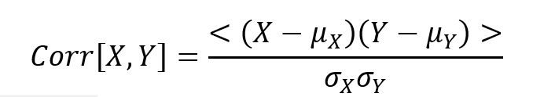
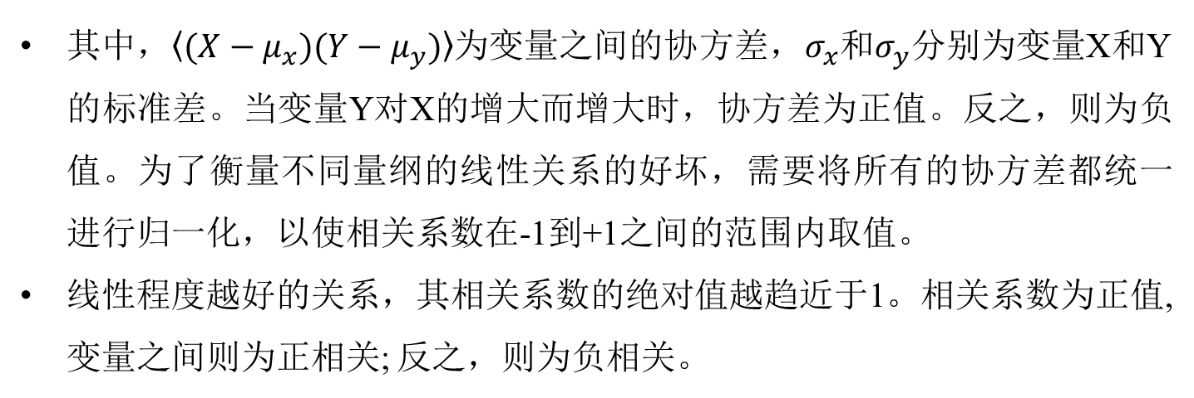
宏观可观测量通过Pearson相关系数的方法量化相关性
其中，$〈(X−μ_{x})(Y−μ_{y})〉$为变量之间的协方差，$σ_{x}$和$σ_{y}$分别为变量X和Y的标准差。当变量Y对X的增大而增大时，协方差为正值。反之，则为负值。为了衡量不同量纲的线性关系的好坏，需要将所有的协方差都统一进行归一化，以使相关系数在-1到+1之间的范围内取值。
线性程度越好的关系，其相关系数的绝对值越趋近于1。相关系数为正值,变量之间则为正相关; 反之，则为负相关。

