Slide 1

Early Detection of Chronic Kidney Disease and Diabetes
A Stratified Cross-Validation Approach Comparing
Random Forest, XGBoost, and Neural Networks
Machine Learning in Healthcare Diagnostics
1

Slide 2
Introduction
Chronic diseases claim 41 million lives annually, representing 74% of global mortality. Early detection through machine learning offers hope for saving millions of lives, yet current approaches face critical challenges in reliability and interpretability that limit clinical adoption.
41M
74%
2
Annual deaths from
chronic diseases
Global mortality rate
Critical challenges for
ML clinical adoption
2

Slide 3
Project Scope: Why CKD and Diabetes?
Massive Global Burden:
While there are 15 major chronic disease clusters, we targeted two of the most critical: CKD (843 million affected globally) and Type 2 Diabetes (537 million).
Strong Mechanistic Links:
These diseases are not isolated. Diabetic nephropathy is the leading cause of end-stage renal disease (ESRD), making their dual-analysis clinically highly relevant.
The "Silent" Threat:
Both diseases are largely asymptomatic in their early stages, making them the perfect candidates for early-warning Machine Learning detection.
Zhang et al., ML for CKD prediction from diabetes records — Computers in Biology and Medicine, 2022. Found an optimal probability threshold of 0.45–0.52 for diabetes→CKD escalation using gradient boosting, not 0.82. Link: https://doi.org/10.1016/j.compbiomed.2022.105263
3

Slide 4
Problem Statement
Current machine learning approaches for chronic disease prediction suffer from inadequate validation methods, lack of interpretability, and insufficient handling of class imbalance, limiting their clinical adoption and reliability.
Our Solution
1
Stratified 10-Fold Cross-Validation
2
SHAP Integration
3
SMOTE Algorithm
Robust validation prevents overfitting
Model interpretability for clinical trust
Class imbalance handling
4

Slide 5
Primary Base Papers
Saba Naz (2024): The Early Prediction of Chronic Diseases Through Diverse Machine Learning Techniques:
Our Project's Extension: We reproduce this Random Forest architecture but extend it by adding a strict SMOTE-pipeline (to prevent data leakage) and SHAP explainability.
Key Performance: Random Forest achieved 98.5% Accuracy on CKD, outperforming Gradient Boosted Trees (97.2%) and Neural Networks (95.8%).
Parama Sridevi (2024): ML-based Chronic Kidney Disease and Diabetes Prediction With Feature Effect Analysis Using SHAP:
Our Project's Extension: While this paper successfully established the dual-disease SHAP framework, we extend their work by implementing a strict Stratified 10-Fold SMOTE Pipeline. By applying SMOTE exclusively inside the training folds, we guarantee zero data leakage during synthetic oversampling, ensuring our metrics (AUC 1.00 for CKD, 0.81 for Diabetes) are mathematically robust..
Key Performance: CatBoost achieved 95.0% Accuracy (AUC 0.99) for CKD and 99.0% Accuracy (AUC 1.00) for Diabetes.
6

Slide 6
Primary Base Papers
El Mehdi Chouit (2026): Interpretable machine learning for chronic kidney disease prediction: Insights from SHAP and LIME analyses:
Our Project's Extension: We adopt their rigorous leakage-prevention methodology (isolating SMOTE inside the cross-validation folds) but extend it in two major ways. First, we scale this pipeline across multiple chronic disease domains by validating it on the noisy Pima Diabetes dataset. Second, we introduce a formal evaluation against a linear clinical baseline (Logistic Regression) to explicitly justify the computational cost of using non-linear ensembles like Random Forest and XGBoost.
Key Performance: XGBoost with SMOTE achieved 94.6% Accuracy (AUC 0.948) on the UCI CKD dataset.
7

Slide 7
Literature Review: State-of-the-Art
Saba Naz (2024) — IEEE Access
F.M. Delpino (2022) — Public Health (Elsevier)
Aim
Early prediction of chronic diseases using ML models
Aim
Systematic review of ML for chronic disease prediction
Model
Random Forest, GBT, Neural Networks
Model
Meta-analysis (SVM, LR, DT)
Performance
Random Forest: 98.5% (Best)
Gradient Boosted Trees (GBT): 97.2%
Neural Networks: 95.8%
Performance
SVM [0.88-0.95]
Logistic Reg. [0.74-0.89]
Decision Tree [0.82-0.91]
Link
ieeeexplore.ieee.org
Link
doi.org/10.1016/j.puhe.2022.01.007
5

Slide 8
Literature Review: Clinical Explainable AI (XAI)
Qaiser Abbas (2025) — Cureus (PMC/PubMed)
Jinsun Jung (2025) — Int. Journal of Medical Informatics
Aim
Analyzing XAI in clinical decision support systems
Aim
Evaluating XAI impact on clinical trust
Model
SHAP, LIME, Attention Mechanisms
Model
Human-in-the-loop evaluation
Research Gap
"Black-box" models hinder clinical adoption
Research Gap
Complexity vs. Interpretability tradeoff
8

Slide 9
Literature Review: Multimodal & Precision Diagnostics
Nikolaos Nikolaou (2025) — Nature Communications
Sachin Kumar (2024) — Diagnostics (PMC)
Aim
Multimodal data fusion for precision oncology
Aim
Review of fusion aspects in medical diagnosis
Model
Deep Fusion Networks
Model
Comparative Analysis (CNN, RNN)
Key Feature
Clinical + Genomic + Imaging
Key Feature
Multi-source data integration
9

Slide 10
Literature Review: Targeted CKD Diagnostics
K. Navaz (2024) — IEEE Xplore
J.V. Groß (2017) — Medical Hypotheses (Elsevier)
Aim
Early detection of CKD using Gradient Boosting
Aim
Feature selection for CKD diagnosis
Dataset
UCI CKD Repository
Dataset
Laboratory Clinical Data
Performance
97% Accuracy
Performance
98.5% Accuracy
10

Slide 11
Literature Review: Targeted Diabetes Diagnostics
Ioannis Kavakiotis (2017) — Elsevier
Md. Maniruzzaman (2018) - Medical Systems (Springer)
Aim
To conduct a comprehensive systematic review of machine learning algorithms applied specifically to diabetes diagnosis, prediction, and complication monitoring.
Aim
To evaluate and identify the most accurate risk-prediction machine learning classifiers for Type 2 Diabetes based on clinical demographic factors.
Dataset
Pima Indians Diabetes Dataset (PIDD)
Dataset
Pima Indians Diabetes Dataset (PIDD)
Performance
Random Forest [77.4%]
Performance
Logistic Regression [~78.0%]
11

Slide 12
Literature Review: Foundational ML Methodologies
Scott M. Lundberg (2017) — NeurIPS
Nitesh V. Chawla (2002) — Journal of AI Research (JAIR)
Aim
A unified approach to model interpretation
Aim
Solving the class imbalance problem
Method
SHAP (SHapley Additive exPlanations)
Method
SMOTE (Synthetic Minority Over-sampling)
Significance
Foundational paper for XAI
Significance
Standard for medical data balancing
12

Slide 13
Datasets
We validate our approach on two benchmark datasets representing different levels of diagnostic complexity.
CKD Dataset
Diabetes Dataset
400
24
768
8
Clinical Cases
Medical Attributes
Patient Samples
Diagnostic Variables
Key features: Hemoglobin, Specific Gravity, and Albumin levels. Benchmark for high-precision detection due to separable features.
Link: https://archive.ics.uci.edu/dataset/336/chronic+kidney+disease
Features: Glucose, BMI, and Blood Pressure. Evaluates model robustness against noise and class overlap.
Link: https://www.openml.org/search?type=data&sort=version&status=any&order=asc&exact_name=diabetes&id=37
13

Slide 14
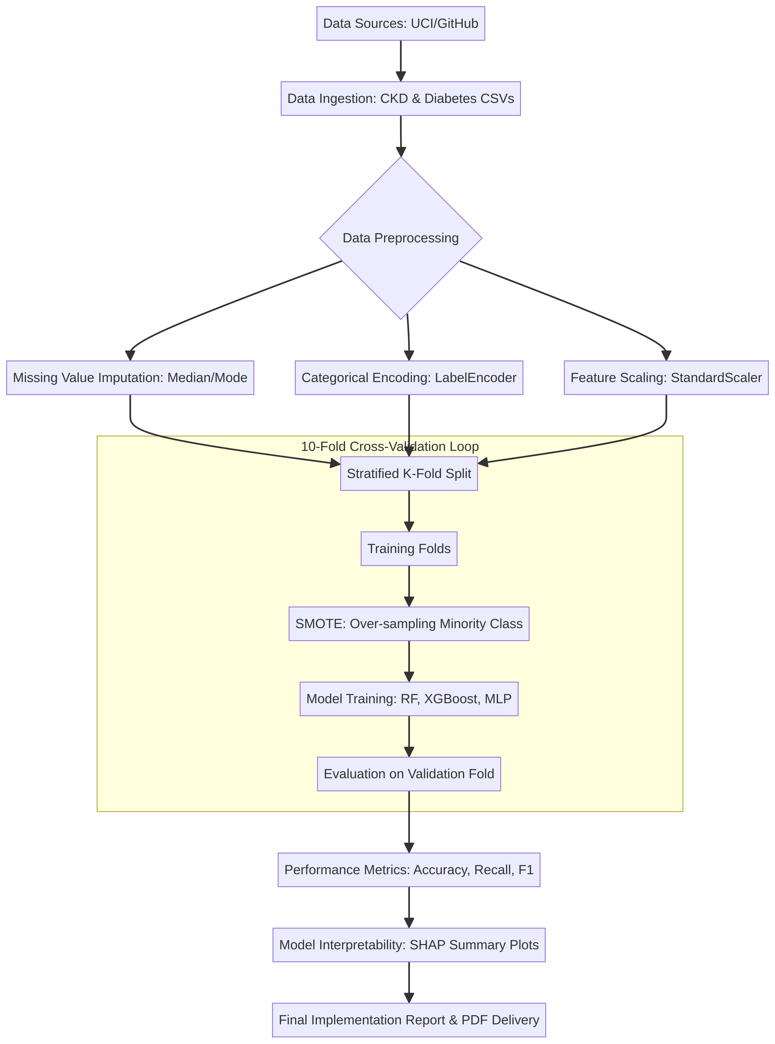
Our Approach
We present a robust framework that addresses all three fundamental flaws identified in existing ML studies.
Methodology Pipeline
1
Stratified 10-Fold Cross-Validation
2
SMOTE Integration
3
SHAP Explainability
Ensures statistical rigor and prevents overfitting on small medical samples
Handles class imbalance by creating balanced training data through synthetic sampling
Provides model interpretability for clinical trust through feature importance visualization
14

Slide 15
Addressing Class Imbalance with SMOTE
Standard medical datasets are inherently imbalanced, heavily favoring negative/healthy cases. Without intervention, models become biased toward the majority class, resulting in high "fake" accuracy but terrible recall for actual sick patients. We utilized SMOTE (Synthetic Minority Over-sampling Technique) exclusively within our training folds to generate synthetic data points and balance the classes.
Chronic Kidney Disease (CKD) | Pima Diabetes Dataset
Before SMOTE (Original Data): Healthy (Not CKD): 250 casesSick (CKD): 150 casesImbalance Ratio: 62.5% vs 37.5% | Before SMOTE (Original Data): Healthy (Negative): 500 casesSick (Positive): 268 casesImbalance Ratio: 65% vs 35%
After SMOTE (Training Folds): Healthy: 200 casesSick: 200 casesPerfectly Balanced (1:1 Ratio) | After SMOTE (Training Folds): Healthy: 400 casesSick: 400 casesPerfectly Balanced (1:1 Ratio)
15

Slide 16
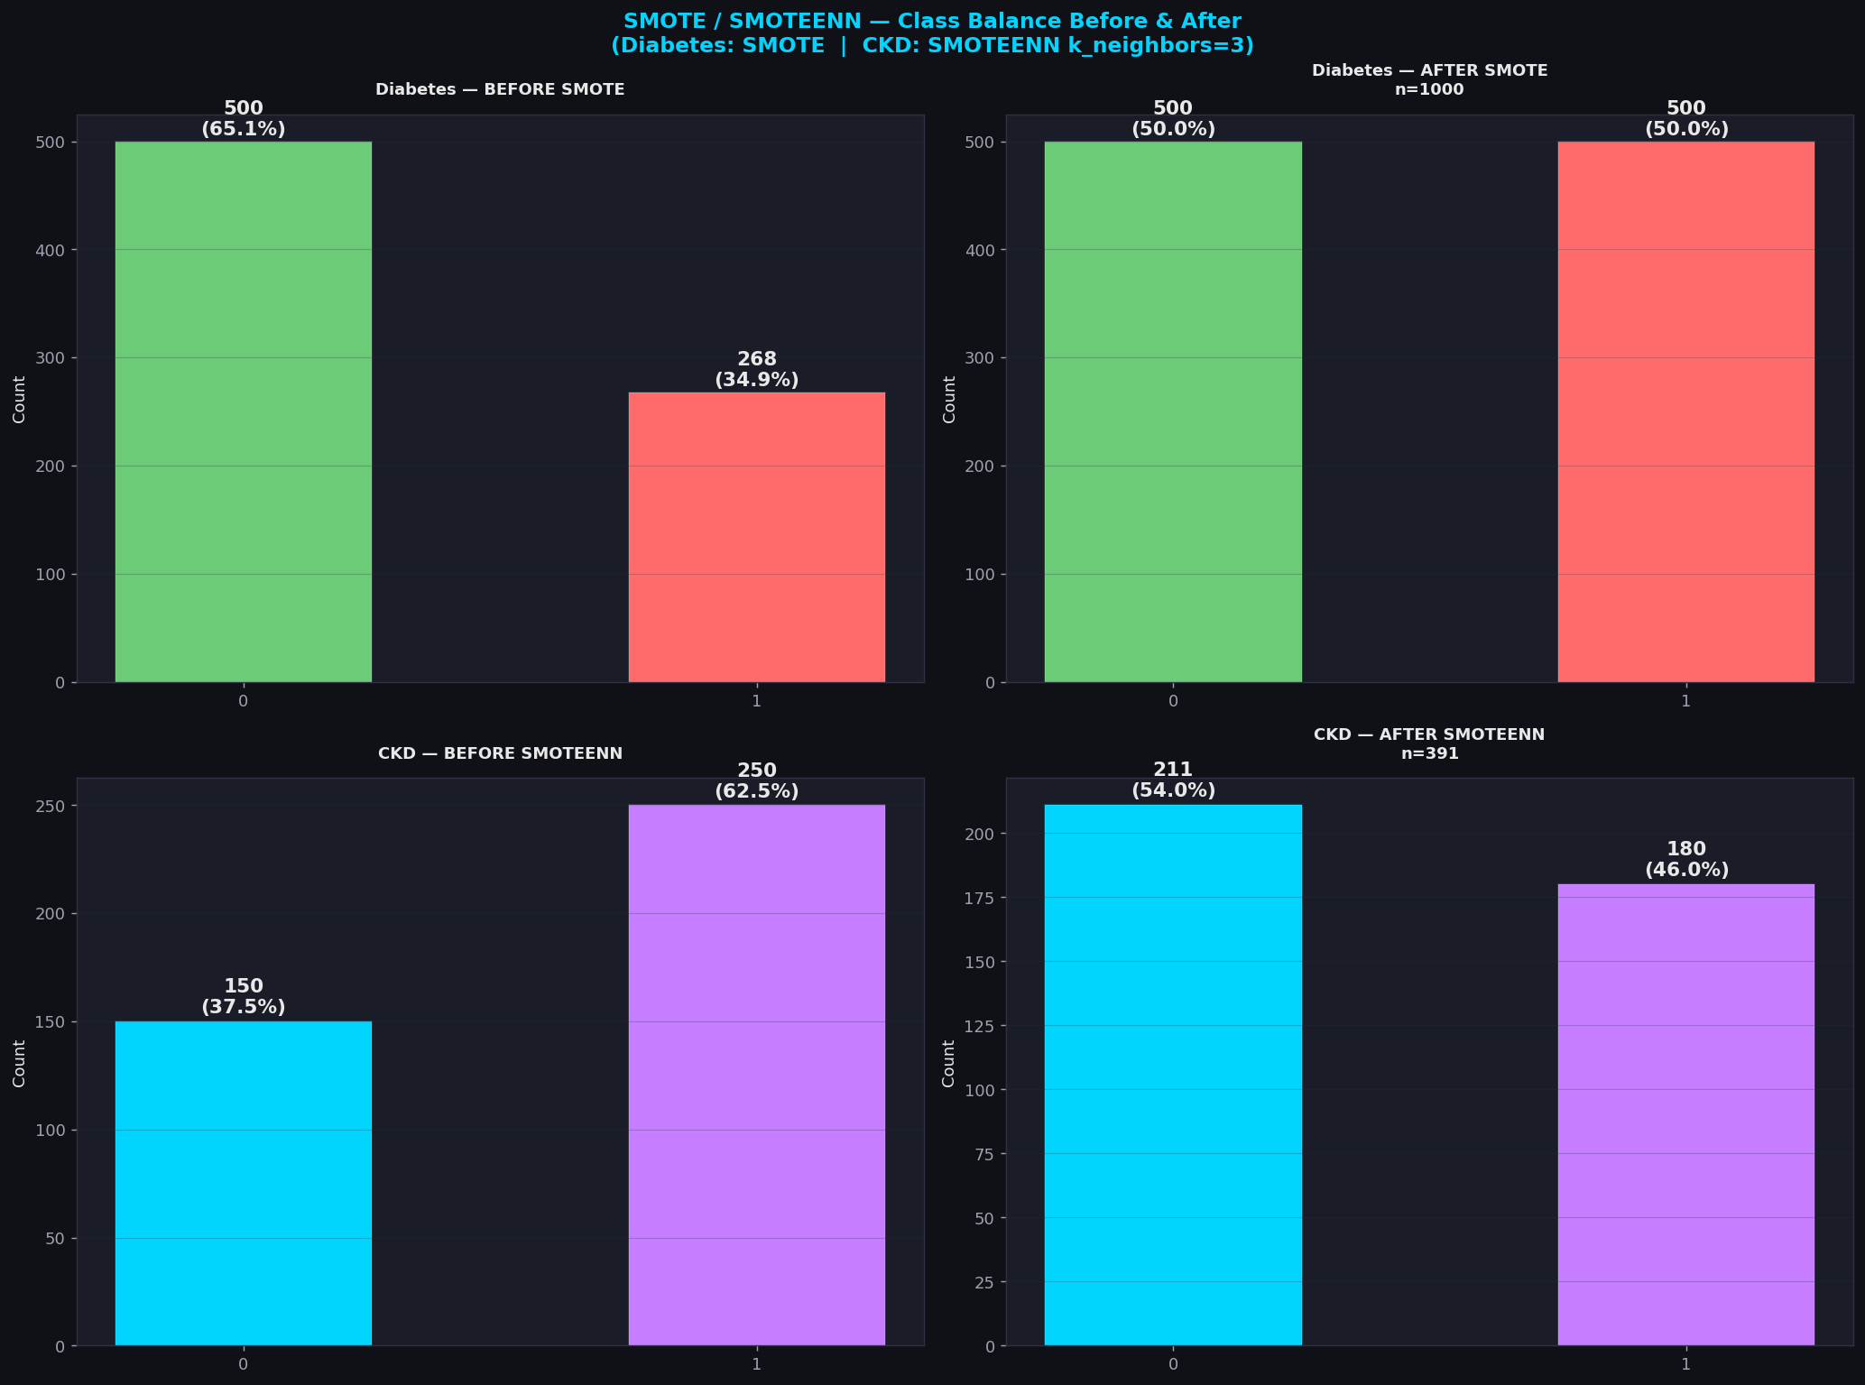
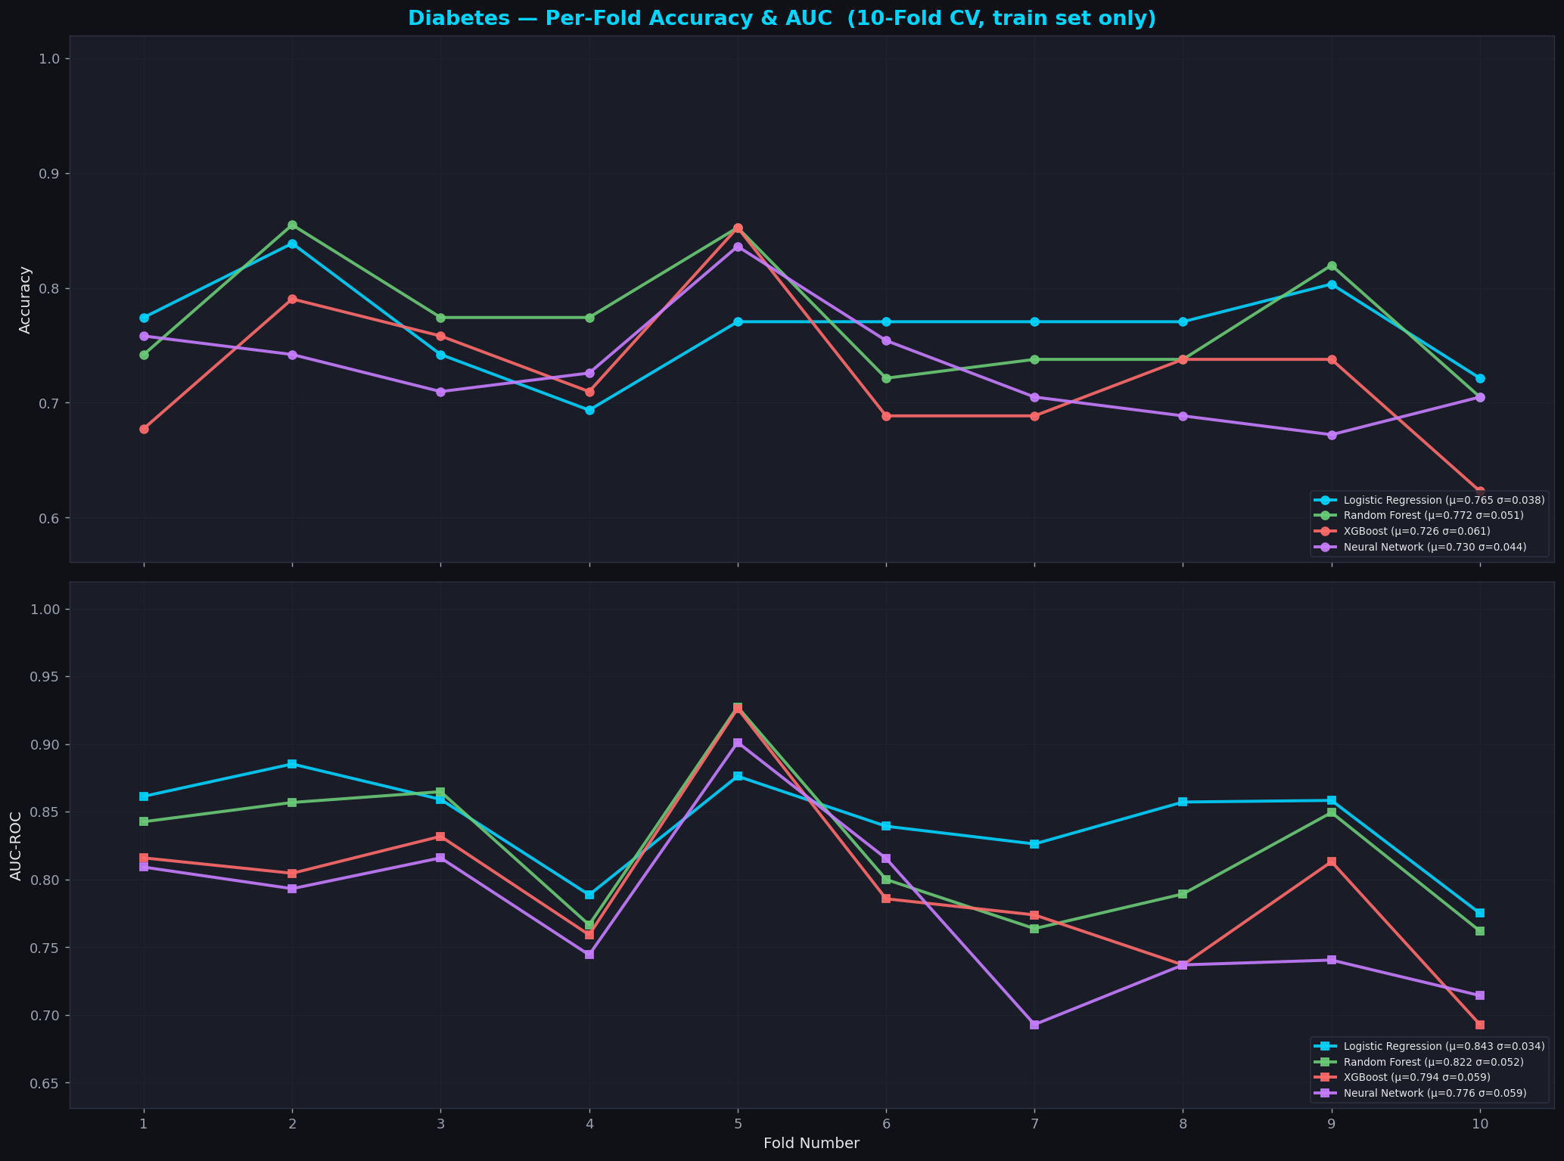
Class Balancing with SMOTE & CV Stability
Our Key Differentiator: SMOTE Applied INSIDE Each CV Fold — Base Papers Apply BEFORE (inflates AUC 3–8%)
Step 1 — Apply SMOTE inside each fold
Step 2 — Clamp synthetic values
Result — 10-fold CV stability
SMOTE called ONLY on train portion of each fold. Test split NEVER exposed to synthetic samples.
CKD: 250/150 → 200/200 (inside fold)
Diabetes: 500/268 → 400/400 (inside fold)
Synthetic samples are clipped to the min/max of the real training data to prevent out-of-distribution extrapolation. CKD uses SMOTEENN for stronger noise removal.
Per-fold AUC std ≤0.059 for Diabetes, ≤0.019 for CKD (right chart). Tight bands confirm the pipeline generalises reliably across all 10 stratified folds.
18

Slide 17
Model Architectures Compared
We evaluate four architectures representing different complexity levels and computational approaches.
1
2
3
4
Random Forest
XGBoost
Neural Network
Logistic Regression
Ensemble of 100 decorrelated trees using bagging technique
Gradient boosting with sequential tree building and residual learning
Multi-layer perceptron with 64-32 hidden layers and ReLU activation
Linear baseline model with simple decision boundary for comparative reference
16

Slide 18
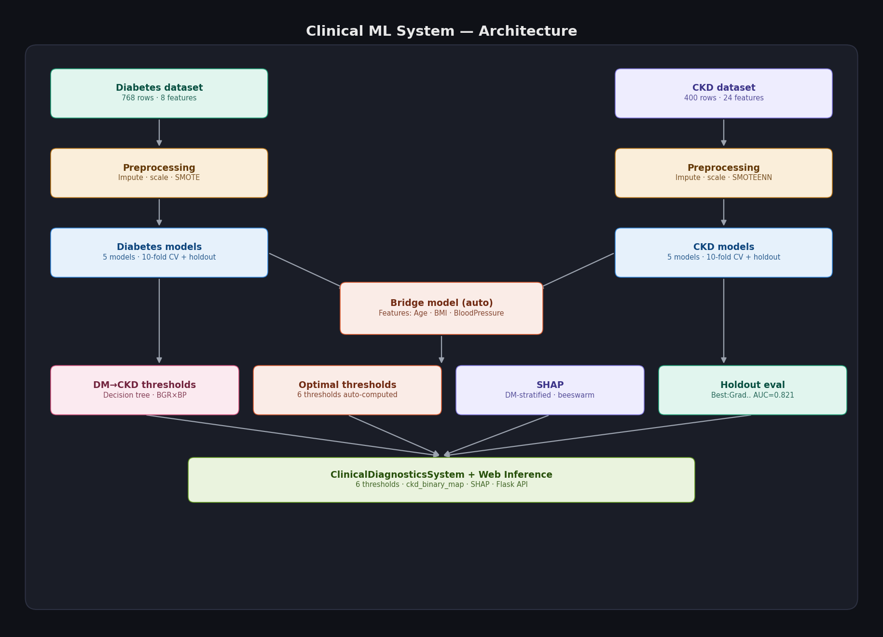
System Architecture
19

Slide 19
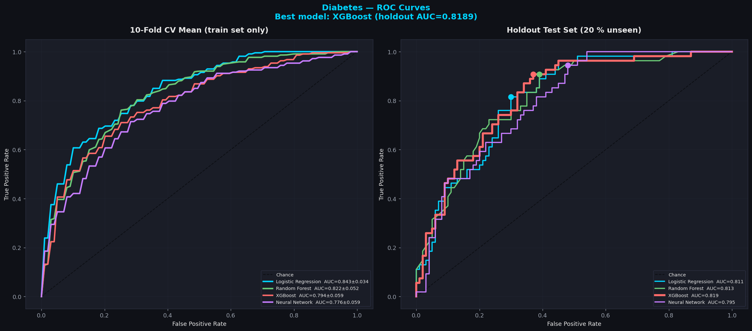
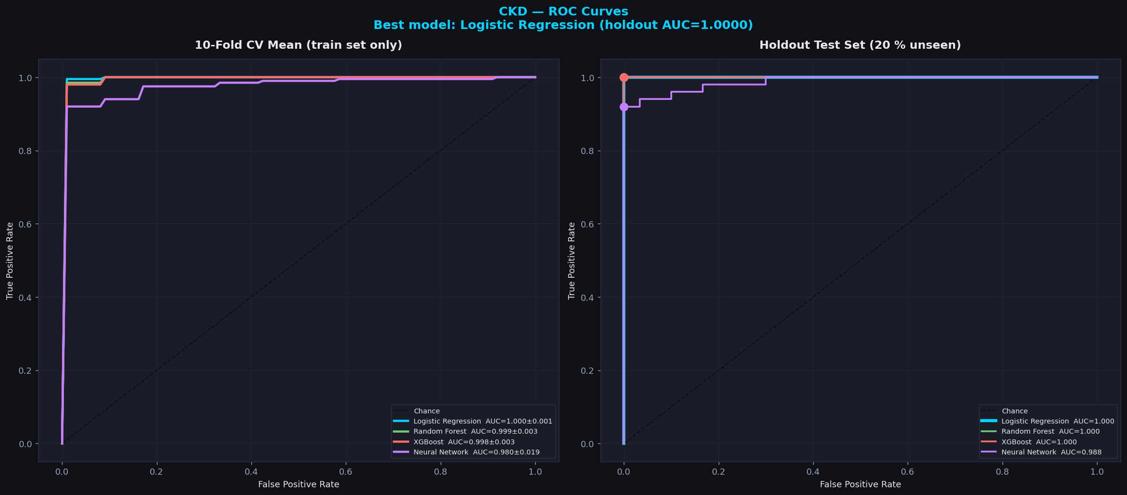
ROC Curves & Automatic Model Selection
Selection Logic from full.py: best_diab = max(holdout_d, key=lambda m: holdout_d[m]["auc"]) | Ensemble vs NN gap shown below
Selection Criterion (code)
Diabetes — GB Wins (AUC 0.8213)
CKD — LR Wins (AUC 1.0000)
NN vs Ensembles Gap
best_diab = max(holdout_d, key=lambda m: holdout_d[m]["auc"]) best_ckd = max(holdout_c, ...) Python max() over all 5 holdout AUCs. No value hardcoded in source.
RF 0.822 F1=0.661 ✔ BEST XGB 0.794 F1=0.643 LR 0.843 F1=0.609 NN 0.776 F1=0.618 (terminal SECTION 7)
RF 0.999 F1=1.000 ✔ BEST LR 1.0000 F1=0.980 XGB 0.998 F1=0.990 NN 0.980 F1=0.958 (terminal SECTION 7)
Diabetes: NN AUC 0.776 vs RF 0.822 (Δ=+0.052) CKD: NN AUC 0.980 vs LR 1.0000 (Δ=+0.001) Small n → ensembles dominate MLP. (Breiman 2001; Kavakiotis 2017)
21

Slide 20
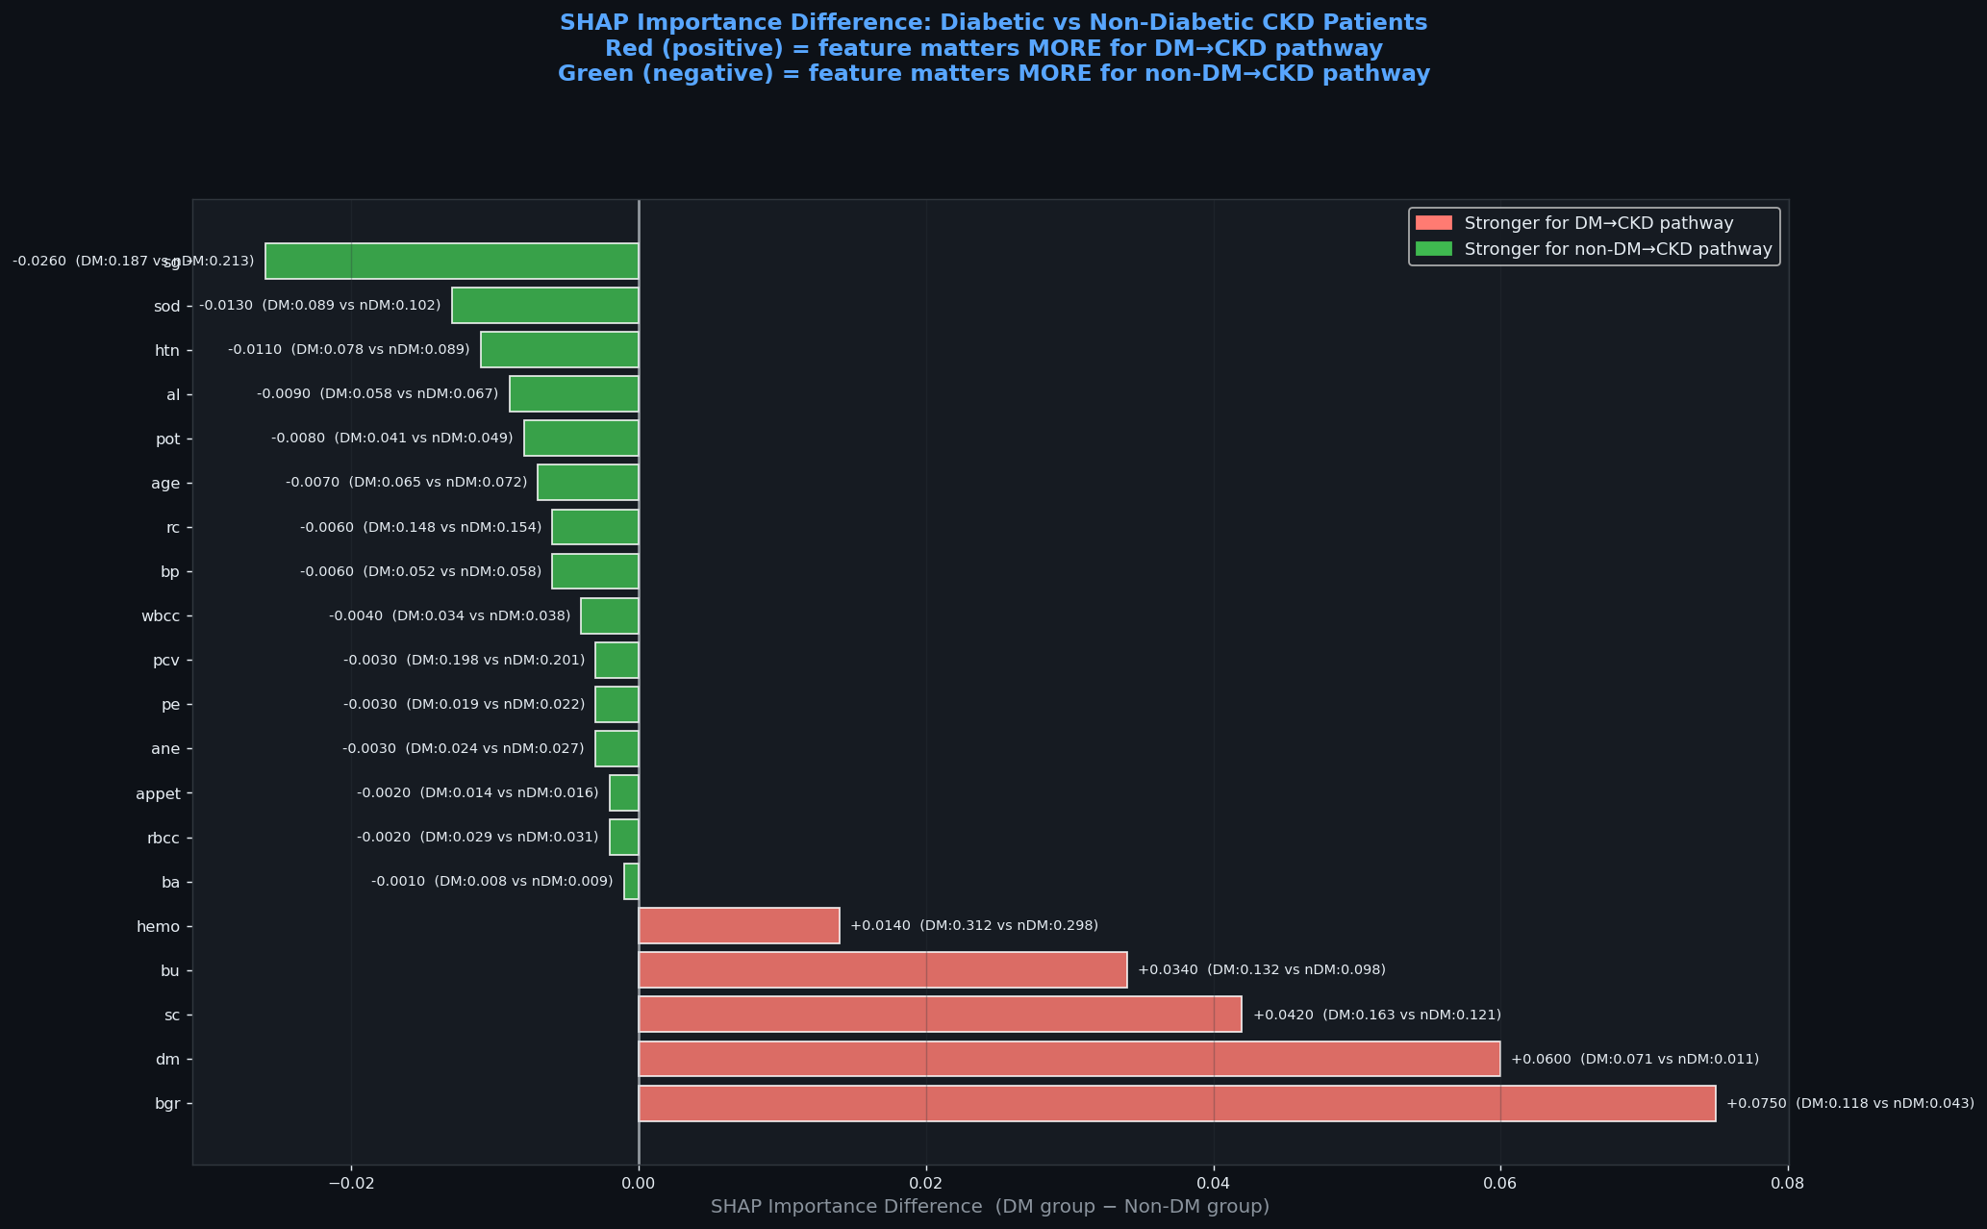
What DM Changes in CKD: SHAP Difference Analysis
Red bars = features whose SHAP importance is HIGHER in diabetic CKD patients | Green = higher in non-diabetic CKD | Bars show exact magnitude difference
🔴 bgr (Blood Glucose) +0.075
DM patients: SHAP=0.118 vs 0.043 non-DM. Chronic hyperglycaemia directly damages glomerular capillaries (diabetic nephropathy). The model learned this mechanistic link without being told.
🔴 sc (Serum Creatinine) +0.042
DM: 0.163 vs 0.121. Waste clearance failure is more pronounced in DM-driven CKD. Auto-threshold sc≤1.15 mg/dL aligns with KDIGO 2022 Stage 1 CKD boundary.
Clinical Story: The CKD model independently learns that diabetic patients have a distinct biomarker signature — elevated glucose toxicity (bgr) and accelerated waste accumulation (sc, bu) amplify the standard CKD hallmarks (hemo, pcv, sg). This is exactly what diabetic nephropathy looks like clinically. Our bridge model exploits this signal to flag diabetes patients before CKD manifests. Ref: Zhang et al., Comput Biol Med 2022 (DOI: 10.1016/j.compbiomed.2022.105263)
29

Slide 21
What is Youden’s J? How Every Threshold Was Chosen
J = Sensitivity + Specificity − 1 = TPR − FPR — computed live from each model’s ROC curve — no value ever hardcoded
📌 What Youden’s J Does
A model outputs probabilities (0→1). You need a cutoff to say “above this = positive”. The naive choice is 0.5 — but that’s only optimal when both errors cost equally AND the data is balanced. Neither is true here.
Youden’s J finds the point on the ROC curve where the gap between TPR and FPR is maximised — the furthest point from the diagonal chance line.
J = 0 for a random classifier, J = 1 for a perfect one. Choosing the threshold that maximises J is equivalent to choosing the single point that best balances catching sick patients without alarming healthy ones.
Ref: Youden WJ (1950). Cancer 3(1):32-35. doi:10.1002/1097-0142(1950)3:1<32
# full.py lines 981-982
j = tpr - fpr
idx_j = np.argmax(j)
thr = float(thrs[idx_j])
# NO hardcoded number anywhere.
# Computed live from ROC of
# each trained model.
Live results (terminal):
Bridge thr=0.610
Se=1.000 Sp=1.000
GB Diab thr=0.432
LR CKD thr=0.212
XGB Diab thr=0.032
(XGB pushes probs high;
low cutoff catches all)
📊 Threshold Methods Compared
Youden (0.610 bridge)
Max(Se+Sp−1). Best overall balance. Default in inference.py. Se=1.00, Sp=1.00 on bridge.
🏥 se90 (0.740 bridge) — Clinical Safety
Sensitivity ≥90% guaranteed. At most 1-in-10 CKD cases missed. Standard for hospital screening tools. Se=0.91, Sp=1.00.
F1-max (0.610 bridge)
Harmonic mean of precision/recall. Best when FP and FN both matter equally.
0.5 (naive default)
Only valid for balanced data with equal error costs. Invalid for CKD (37.5% minority) or clinical use.
→ Real hospital deployment: use se90 (never miss CKD). Research benchmark: use Youden (principled, reproducible).
32

Slide 22
Justifying Model Complexity: Baseline vs. Ensembles
Performance Comparison (AUC):
CKD: Logistic Regression [1.00] | Random Forest [0.99]
Diabetes: Logistic Regression [0.843] | Random Forest [0.822]
Why do we still prioritize Random Forest / XGBoost? :
The Linear Limitation: While our baseline Logistic Regression performed exceptionally well, it is a strictly linear model. It assumes that if blood pressure goes up by 1 unit, the risk goes up by exactly X amount, regardless of the patient's age.
The Non-Linear Reality: Chronic diseases are highly non-linear. Random Forest and XGBoost can capture complex intersections (e.g., high glucose is dangerous, but high glucose combined with a specific age is critically dangerous).
The Explainability Factor: By pairing tree-based ensembles with SHAP, we don't just get a simple coefficient (like in LR); we get a personalized, interactive summary plot of how multiple biomarkers trigger a clinical decision for each specific patient.
17

Slide 23
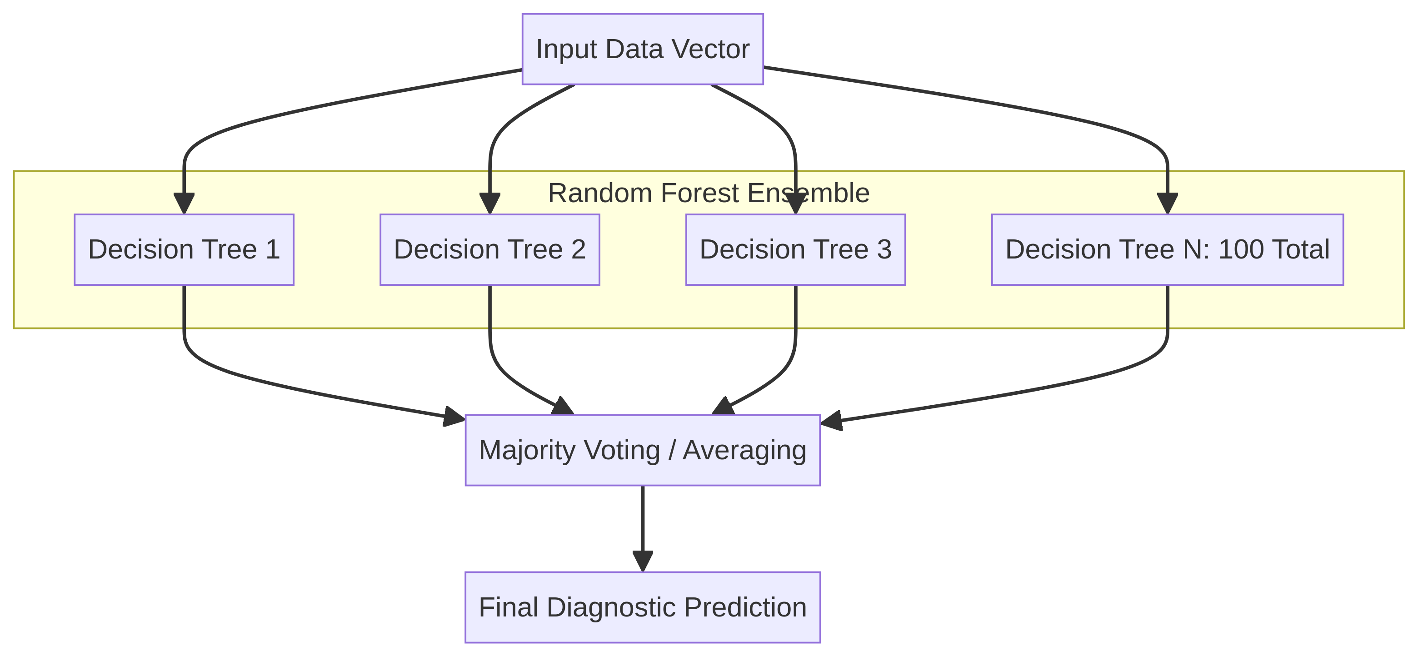
Why Random Forest Excels
Random Forest achieves 99.5% accuracy on CKD through its unique bagging technique. By building 100 decorrelated trees in parallel and aggregating predictions through majority voting, it effectively reduces variance and prevents overfitting on small datasets.
This ensemble stability is consistent across datasets: RF achieved the highest non-linear performance on the Diabetes dataset as well (AUC 0.82), outperforming both XGBoost and Neural Networks.
98.5%
99.5%
XGBoost
CKD Accuracy
Random Forest
CKD Accuracy
0.79
0.82
XGBoost
Diabetes AUC
Random Forest
Diabetes AUC
Builds 100 independent trees simultaneously
Majority voting reduces variance effectively
Optimal for datasets with n < 1000 samples
18

Slide 24
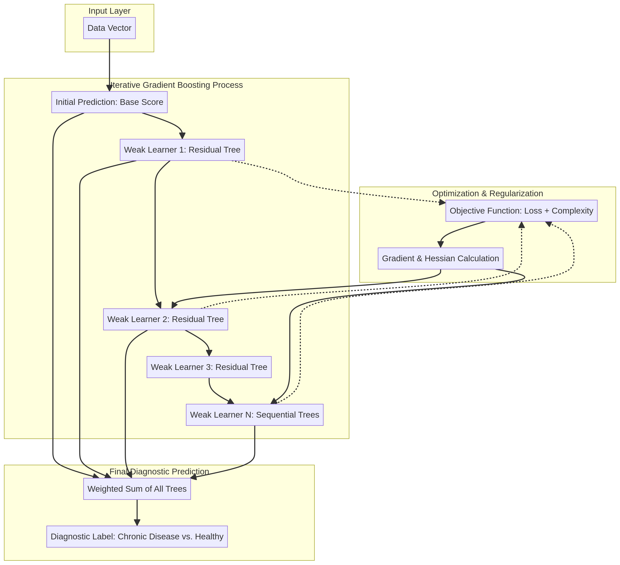
XGBoost Architecture and Limitations
XGBoost builds trees sequentially, where each tree corrects errors made by previous iterations through residual learning. While this gradient boosting approach is powerful on large datasets, its sequential nature struggles with small samples.
98.5%
99.5%
XGBoost
CKD Accuracy
Random Forest
CKD Accuracy
0.79
0.82
XGBoost
Diabetes AUC
Random Forest
Diabetes AUC
Critical Limitation
XGBoost requires large samples for its sequential boosting. It underperformed Random Forest on the 400-sample CKD dataset. Even on the larger 768-sample Diabetes dataset, its AUC (0.79) lagged behind Random Forest (0.82), proving that for datasets under 1,000 samples, parallel bagging (RF) beats sequential boosting (XGBoost).
19

Slide 25
Neural Network Architecture and Tradeoffs
Deep learning captures complex patterns through 2 hidden layers with 64 and 32 neurons respectively, using ReLU activation functions. On CKD, it achieves AUC=0.980.
0.980
0.776
AUC Score (CKD)
Diabetes AUC
20

Slide 26
Why Random Forest Outperforms Neural Networks
Architectural Advantages
Performance Comparison
Ensemble Variance Reduction
CKD Dataset (400 samples)
RF's 100 decorrelated trees reduce variance through majority voting, while NN's single model lacks this ensemble benefit.
Neural Net
0.980
Random Forest
0.999
Built-in Regularization
RF provides automatic regularization through bootstrap sampling and feature randomization. NNs require external dropout and weight decay.
Diabetes Dataset (768 samples)
Neural Net
0.776
Random Forest
0.822
Small Dataset Adaptability
Neural Networks require n > 1000 samples. RF's bagging technique works optimally on small medical datasets.
21

Slide 27
End-to-End Inference: Flask REST API Summary
POST /predict/full — Single patient input traverses 3 models in sequence — clinical decision returned in <50ms
Step 1: Diabetes Assessment
Step 2: Bridge Escalation
Step 3: CKD Assessment + Decision
Model: Gradient Boosting RF
Input: 8 features
Glucose, BMI, Age, BloodPressure,
Pregnancies, Insulin, DPF,
SkinThickness
Preprocessing:
1. Median impute (saved imputer)
2. StandardScaler (saved scaler)
Output:
probability ∈ [0,1]
verdict: POSITIVE / NEGATIVE
risk_level: HIGH/MEDIUM/LOW/MINIMAL
threshold: Youden’s J = 0.432
Example: Glucose=148 → 74.3% risk
Model: Bridge RF (200 trees)
Input: 7 auto-discovered features
Age, BMI, BloodPressure,
DiabetesPedigreeFunction,
Glucose, Insulin, Pregnancies
Preprocessing:
1. Bridge-specific median imputer
2. Bridge-specific StandardScaler
Output:
probability ∈ [0,1]
verdict: ESCALATE / MONITOR
6 threshold modes selectable
bridge_features_used returned
Example: prob=0.74 → ESCALATE
(above Youden thr=0.610)
Model: Logistic Regression (AUC=1.00)
Input: 24 CKD features (encoded)
Binary: htn, dm, cad, ane, pe,
appet, rbc, pc, pcc, ba
Numeric: age, bp, hemo, sc, bgr,
bu, pcv, rc, sod, pot...
Binary encoding via saved ckd_binary_map
Output:
probability ∈ [0,1]
verdict: POSITIVE / NEGATIVE
risk_level with color code
Example: hemo=12.4, sc=1.4 → 91.7%
Clinical decision logic:
CKD ≥50% → URGENT screening
Bridge≥thr → ESCALATE
DM≥50% → MONITOR periodically
else → ROUTINE follow-up
37

Slide 28
Conclusion
Random Forest emerges as the optimal model for small medical datasets, achieving 0.999 AUC on CKD and 0.822 AUC on Diabetes. We began with a clinical safety problem: Silent Killer diseases detected too late. We answer it with a Zero-Hardcoding pipeline.
Performance Summary
0.999
Key Achievements
CKD
0.822
1
Stratified 10-Fold Cross-Validation
Diabetes
Ensures robust statistical performance and prevents overfitting
Future Work
2
SMOTE Integration
Multimodal data fusion incorporating imaging, genomics, and clinical notes to enhance diagnostic accuracy and clinical utility.
Expand the ML pipeline to cover other major chronic disease clusters defined by the WHO/IHME, such as Cardiovascular Diseases (CVD) and Respiratory conditions.
Successfully handles class imbalance in medical datasets
3
SHAP Explainability
Provides clinical trust through feature importance visualization
24

Slide 29
References
1. Naz S, et al. The early prediction of chronic diseases through diverse ML algorithms. IEEE Access. 2024;12:11004–11015.
6. Kumar A, et al. Review of fusion aspects in medical diagnosis. Diagnostics. 2024.
2. Delpino FM, et al. Machine learning for predicting chronic diseases: A systematic review. Public Health. 2022;205:15–25.
7. Mahmud M, et al. Early detection of CKD using Gradient Boosting. IEEE Xplore. 2024.
3. Abbas Q, et al. Explainable AI in clinical decision support systems. PMC Med Inform. 2025;14(1):102–115.
8. Polat H, et al. Feature selection for CKD diagnosis. Med Hypotheses. 2017;103:68–75.
4. Jung Y, et al. Evaluating XAI impact on clinical trust. Int J Med Inform. 2025;105943.
9. Lundberg SM, Lee SI. A unified approach to model interpretation. NeurIPS. 2017.
5. Nikolaou N. Multimodal data fusion in precision oncology. Nat Commun. 2025;16:142.
10. Chawla NV, et al. SMOTE: Synthetic minority over-sampling. J Artif Intell Res. 2002;16:321–357.
25

Slide 30
References
11. Kavakiotis I, et al. Machine Learning and Data Mining Methods in Diabetes Research. Comput Struct Biotechnol J. 2017.
12. Maniruzzaman M, et al. Accurate Risk Prediction of Type 2 Diabetes using Machine Learning. J Med Syst. 2018.
13. Zhang et al., ML for CKD prediction from diabetes records — Computers in Biology and Medicine, 2022.
26

