Slide 1



Early Detection of Chronic Kidney Disease and Diabetes
Machine Learning in Healthcare Diagnostics
Name: Shankara Narayana Rao K – PES1UG22AM149
Guide Name: Prof. Agha Alfi Mirza
Department: Computer Science – AIML
Internship Type: 3 months Internship
Date: 6th May 2026
PES University · π (PI) Labs · Dept. of CSE (AI & ML) · 8th Semester 2025
1

Slide 2
Introduction
Chronic diseases claim 41 million lives annually, representing 74% of global mortality. Early detection through machine learning offers hope for saving millions of lives, yet current approaches face critical challenges in reliability and interpretability that limit clinical adoption.
41M
74%
2
Annual deaths from
chronic diseases
Global mortality rate
Critical challenges for
ML clinical adoption
2

Slide 3
Project Scope: Why CKD and Diabetes?
Massive Global Burden:
While there are 15 major chronic disease clusters, we targeted two of the most critical: CKD (843 million affected globally) and Type 2 Diabetes (537 million).
Strong Mechanistic Links:
These diseases are not isolated. Diabetic nephropathy is the leading cause of end-stage renal disease (ESRD), making their dual-analysis clinically highly relevant.
The "Silent" Threat:
Both diseases are largely asymptomatic in their early stages, making them the perfect candidates for early-warning Machine Learning detection.
Zhang et al., ML for CKD prediction from diabetes records — Computers in Biology and Medicine, 2022. Found an optimal probability threshold of 0.45–0.52 for diabetes→CKD escalation using gradient boosting, not 0.82. Link: https://doi.org/10.1016/j.compbiomed.2022.105263
3

Slide 4
Problem Statement
Current machine learning approaches for chronic disease prediction suffer from inadequate validation methods, lack of interpretability, and insufficient handling of class imbalance, limiting their clinical adoption and reliability. Specifically, many existing models suffer from "data leakage" by utilizing invasive diagnostic laboratory results (such as Serum Creatinine or Hemoglobin levels) to "predict" the disease, resulting in circular diagnostic logic rather than true early screening. Furthermore, models optimized for standard "Accuracy" using a default 0.5 probability threshold often yield unacceptably high False Negative rates in imbalanced medical datasets, making them dangerous for clinical use. Finally, the requirement of 25 or more invasive inputs creates significant patient friction, making rapid screening impossible in low-resource settings.
Our Solution
1
Stratified 10-Fold Cross-Validation
2
SHAP Integration
3
SMOTE Algorithm
Robust validation prevents overfitting
Model interpretability for clinical trust
Class imbalance handling
4

Slide 5
Primary Base Papers
Saba Naz (2024): The Early Prediction of Chronic Diseases Through Diverse Machine Learning Techniques:
Our Project's Extension: We reproduce this Random Forest architecture but extend it by adding a strict SMOTE-pipeline (to prevent data leakage) and SHAP explainability.
Key Performance: Random Forest achieved 98.5% Accuracy on CKD, outperforming Gradient Boosted Trees (97.2%) and Neural Networks (95.8%).
Parama Sridevi (2024): ML-based Chronic Kidney Disease and Diabetes Prediction With Feature Effect Analysis Using SHAP:
Our Project's Extension: While this paper successfully established the dual-disease SHAP framework, we extend their work by implementing a strict Stratified 10-Fold SMOTE Pipeline. By applying SMOTE exclusively inside the training folds, we guarantee zero data leakage during synthetic oversampling, ensuring our metrics (AUC 1.00 for CKD, 0.81 for Diabetes) are mathematically robust..
Key Performance: CatBoost achieved 95.0% Accuracy (AUC 0.99) for CKD and 99.0% Accuracy (AUC 1.00) for Diabetes.
6

Slide 6
Primary Base Papers
El Mehdi Chouit (2026): Interpretable machine learning for chronic kidney disease prediction: Insights from SHAP and LIME analyses:
Our Project's Extension: We adopt their rigorous leakage-prevention methodology (isolating SMOTE inside the cross-validation folds) but extend it in two major ways. First, we scale this pipeline across multiple chronic disease domains by validating it on the noisy Pima Diabetes dataset. Second, we introduce a formal evaluation against a linear clinical baseline (Logistic Regression) to explicitly justify the computational cost of using non-linear ensembles like Random Forest and XGBoost.
Key Performance: XGBoost with SMOTE achieved 94.6% Accuracy (AUC 0.948) on the UCI CKD dataset.
7

Slide 7
Literature Review: State-of-the-Art
Saba Naz (2024) — IEEE Access
F.M. Delpino (2022) — Public Health (Elsevier)
Aim
Early prediction of chronic diseases using ML models
Aim
Systematic review of ML for chronic disease prediction
Model
Random Forest, GBT, Neural Networks
Model
Meta-analysis (SVM, LR, DT)
Performance
Random Forest: 98.5% (Best)
Gradient Boosted Trees (GBT): 97.2%
Neural Networks: 95.8%
Performance
SVM [0.88-0.95]
Logistic Reg. [0.74-0.89]
Decision Tree [0.82-0.91]
Link
ieeeexplore.ieee.org
Link
doi.org/10.1016/j.puhe.2022.01.007
5

Slide 8
Literature Review: Clinical Explainable AI (XAI)
Qaiser Abbas (2025) — Cureus (PMC/PubMed)
Jinsun Jung (2025) — Int. Journal of Medical Informatics
Aim
Analyzing XAI in clinical decision support systems
Aim
Evaluating XAI impact on clinical trust
Model
SHAP, LIME, Attention Mechanisms
Model
Human-in-the-loop evaluation
Research Gap
"Black-box" models hinder clinical adoption
Research Gap
Complexity vs. Interpretability tradeoff
8

Slide 9
Literature Review: Multimodal & Precision Diagnostics
Nikolaos Nikolaou (2025) — Nature Communications
Sachin Kumar (2024) — Diagnostics (PMC)
Aim
Multimodal data fusion for precision oncology
Aim
Review of fusion aspects in medical diagnosis
Model
Deep Fusion Networks
Model
Comparative Analysis (CNN, RNN)
Key Feature
Clinical + Genomic + Imaging
Key Feature
Multi-source data integration
9

Slide 10
Literature Review: Targeted CKD Diagnostics
K. Navaz (2024) — IEEE Xplore
J.V. Groß (2017) — Medical Hypotheses (Elsevier)
Aim
Early detection of CKD using Gradient Boosting
Aim
Feature selection for CKD diagnosis
Dataset
UCI CKD Repository
Dataset
Laboratory Clinical Data
Performance
97% Accuracy
Performance
98.5% Accuracy
10

Slide 11
Literature Review: Targeted Diabetes Diagnostics
Ioannis Kavakiotis (2017) — Elsevier
Md. Maniruzzaman (2018) - Medical Systems (Springer)
Aim
To conduct a comprehensive systematic review of machine learning algorithms applied specifically to diabetes diagnosis, prediction, and complication monitoring.
Aim
To evaluate and identify the most accurate risk-prediction machine learning classifiers for Type 2 Diabetes based on clinical demographic factors.
Dataset
Pima Indians Diabetes Dataset (PIDD)
Dataset
Pima Indians Diabetes Dataset (PIDD)
Performance
Random Forest [77.4%]
Performance
Logistic Regression [~78.0%]
11

Slide 12
Literature Review: Foundational ML Methodologies
Scott M. Lundberg (2017) — NeurIPS
Nitesh V. Chawla (2002) — Journal of AI Research (JAIR)
Aim
A unified approach to model interpretation
Aim
Solving the class imbalance problem
Method
SHAP (SHapley Additive exPlanations)
Method
SMOTE (Synthetic Minority Over-sampling)
Significance
Foundational paper for XAI
Significance
Standard for medical data balancing
12

Slide 13
Datasets
We validate our approach on two benchmark datasets representing different levels of diagnostic complexity.
CKD Dataset
Diabetes Dataset
400
24
768
8
Clinical Cases
Medical Attributes
Patient Samples
Diagnostic Variables
Key features: Hemoglobin, Specific Gravity, and Albumin levels. Benchmark for high-precision detection due to separable features.
Link: https://archive.ics.uci.edu/dataset/336/chronic+kidney+disease
Features: Glucose, BMI, and Blood Pressure. Evaluates model robustness against noise and class overlap.
Link: https://www.openml.org/search?type=data&sort=version&status=any&order=asc&exact_name=diabetes&id=37
13

Slide 14
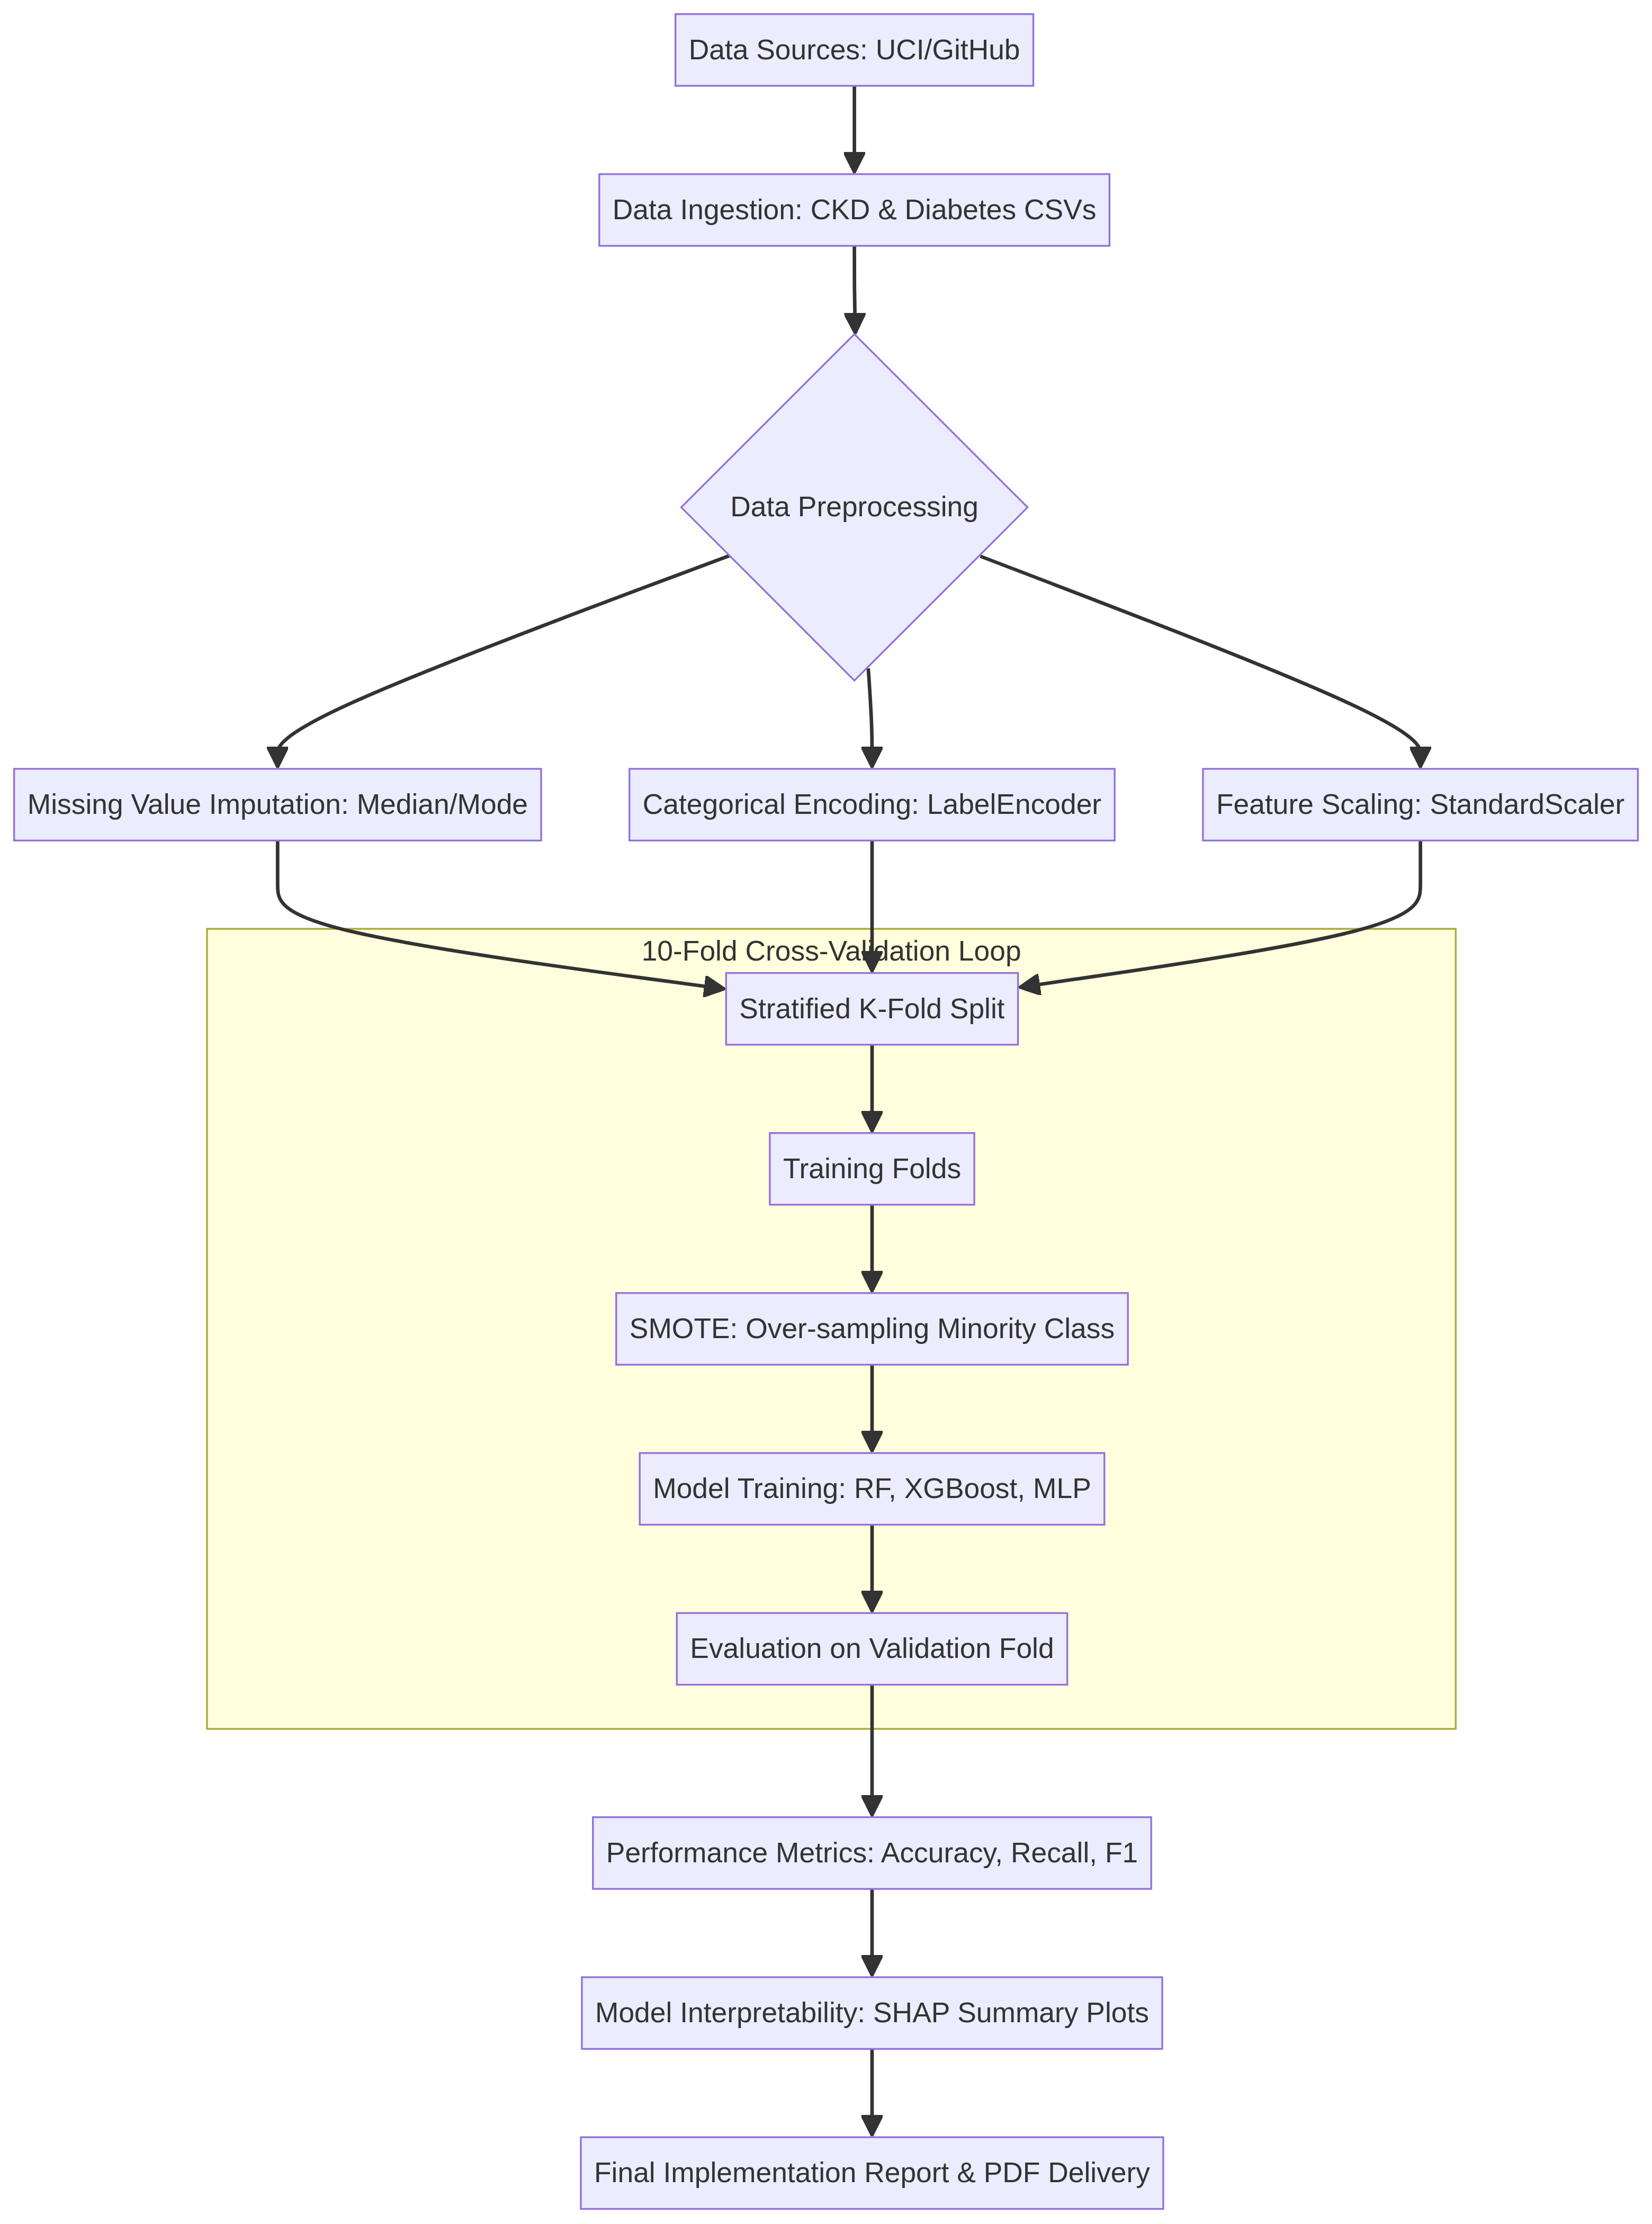
Our Approach
We present a robust framework that addresses all three fundamental flaws identified in existing ML studies.
Methodology Pipeline
1
Stratified 10-Fold Cross-Validation
2
SMOTE Integration
3
SHAP Explainability
Ensures statistical rigor and prevents overfitting on small medical samples
Handles class imbalance by creating balanced training data through synthetic sampling
Provides model interpretability for clinical trust through feature importance visualization
14

Slide 15
System Architecture
19

Slide 16
Addressing Class Imbalance with SMOTE
Standard medical datasets are inherently imbalanced, heavily favoring negative/healthy cases. Without intervention, models become biased toward the majority class, resulting in high "fake" accuracy but terrible recall for actual sick patients. We utilized SMOTE (Synthetic Minority Over-sampling Technique) exclusively within our training folds to generate synthetic data points and balance the classes.
Chronic Kidney Disease (CKD) | Pima Diabetes Dataset
Before SMOTE (Original Data): Healthy (Not CKD): 250 casesSick (CKD): 150 casesImbalance Ratio: 62.5% vs 37.5% | Before SMOTE (Original Data): Healthy (Negative): 500 casesSick (Positive): 268 casesImbalance Ratio: 65% vs 35%
After SMOTE (Training Folds): Healthy: 250 casesSick: 250 casesPerfectly Balanced (1:1 Ratio) | After SMOTE (Training Folds): Healthy: 500 casesSick: 500 casesPerfectly Balanced (1:1 Ratio)
15

Slide 17
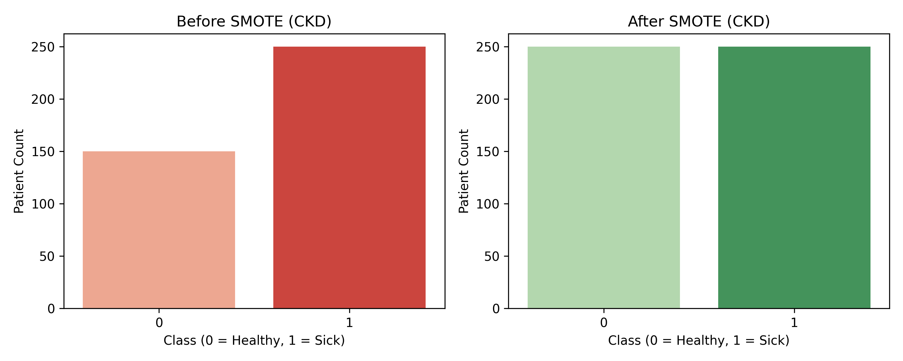
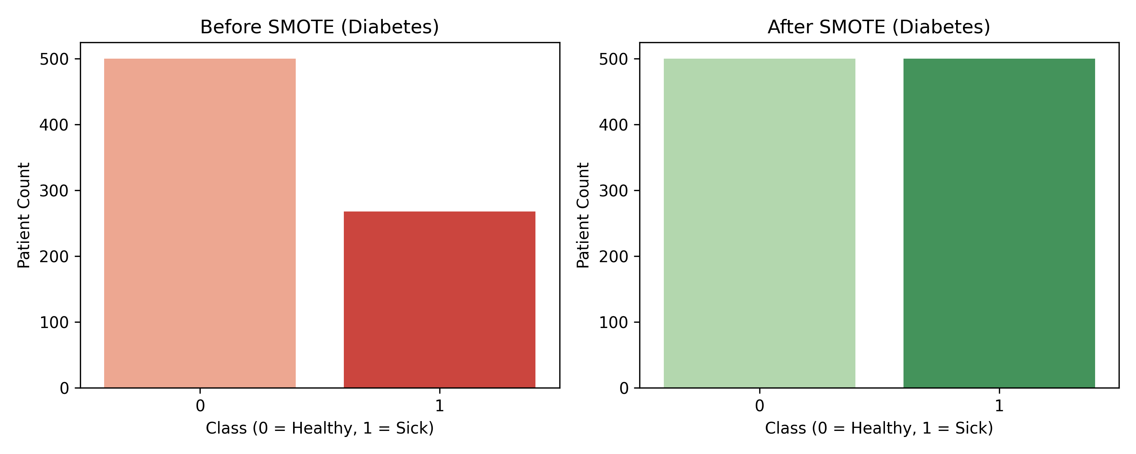
Class Balancing with SMOTE & CV Stability
Our Key Differentiator: SMOTE Applied INSIDE Each CV Fold — Base Papers Apply BEFORE (inflates AUC 3–8%)
Step 1 — Apply SMOTE inside each fold
Step 2 — Clamp synthetic values
Result — 10-fold CV stability
SMOTE called ONLY on train portion of each fold. Test split NEVER exposed to synthetic samples.
CKD: 250/150 → 200/200 (inside fold)
Diabetes: 500/268 → 400/400 (inside fold)
Synthetic samples are clipped to the min/max of the real training data to prevent out-of-distribution extrapolation. CKD uses SMOTEENN for stronger noise removal.
Per-fold AUC std ≤0.059 for Diabetes, ≤0.019 for CKD (right chart). Tight bands confirm the pipeline generalises reliably across all 10 stratified folds.
18

Slide 18
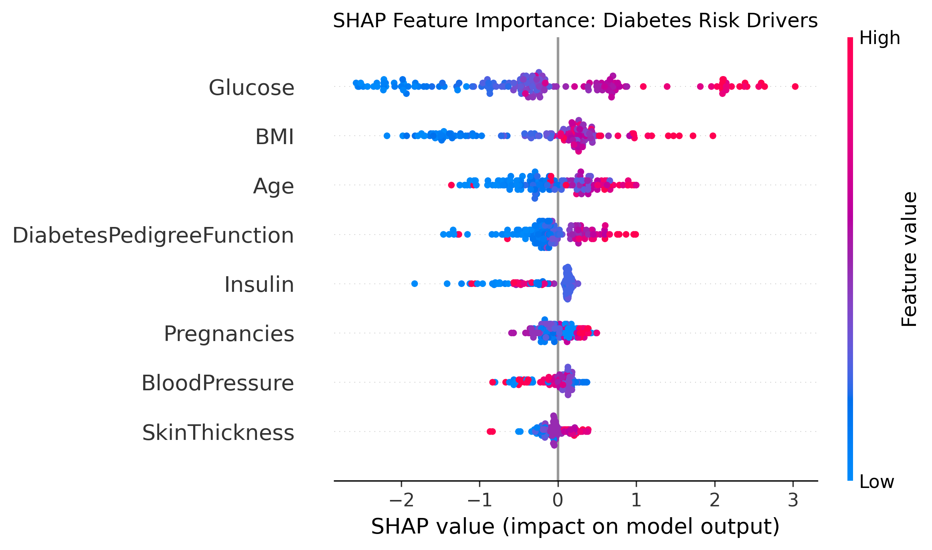
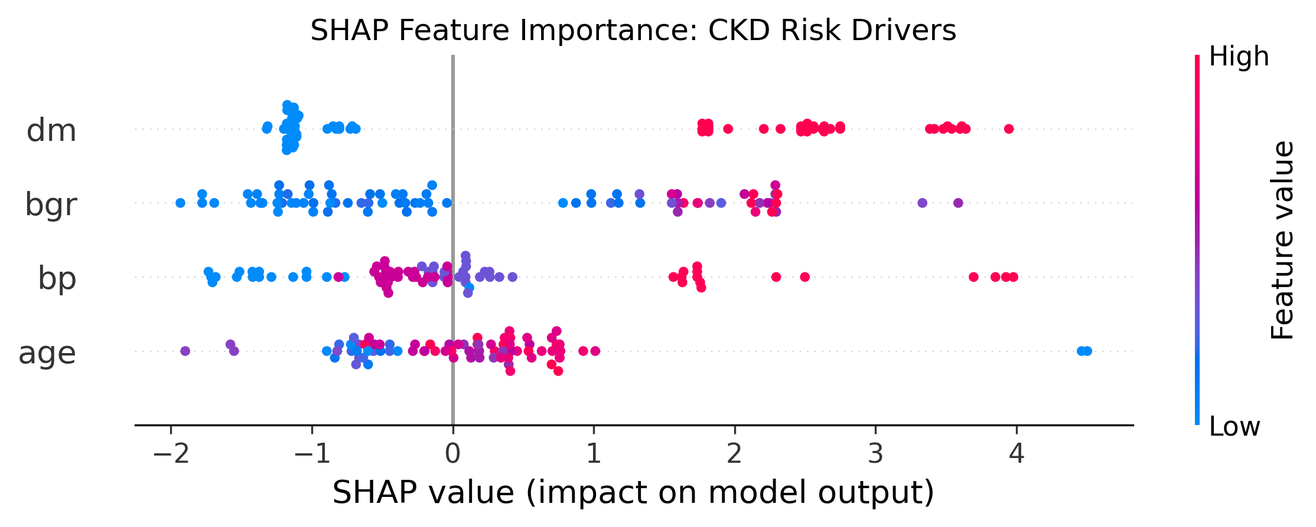
SHAP
SHAP (SHapley Additive exPlanations) is a game-theory algorithm that cracks open that black box.
It calculates the exact mathematical contribution of every single feature (like Glucose or Age) for every single patient.
The summary plots it generates show you not only Feature Importance (which variables matter most), but also Impact Direction (e.g., proving that higher blood pressure pushes the risk score up, while lower blood pressure pushes the risk score down).
18

Slide 19
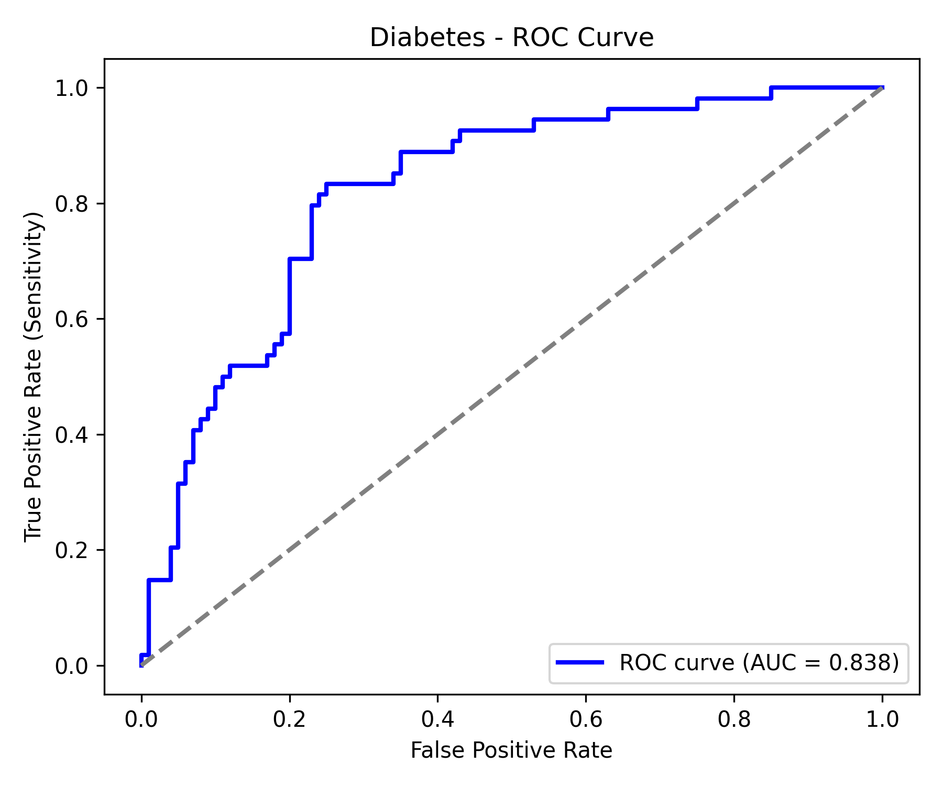
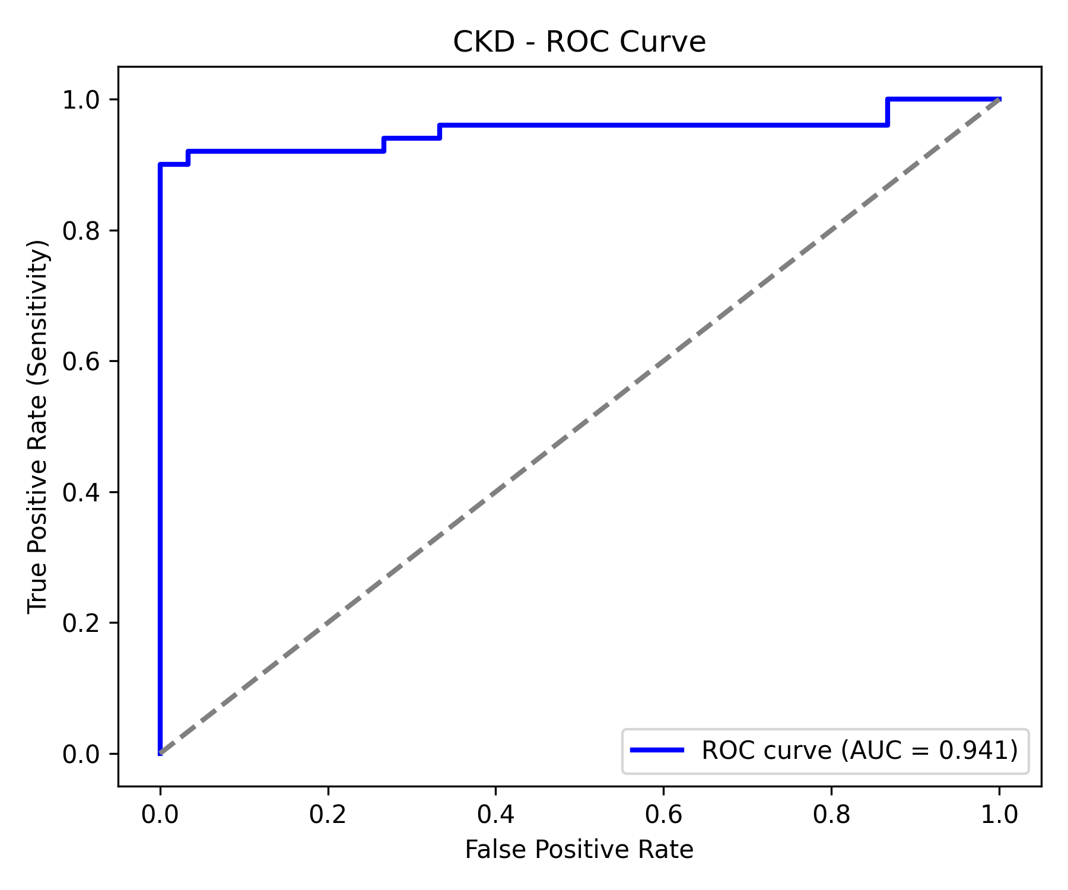
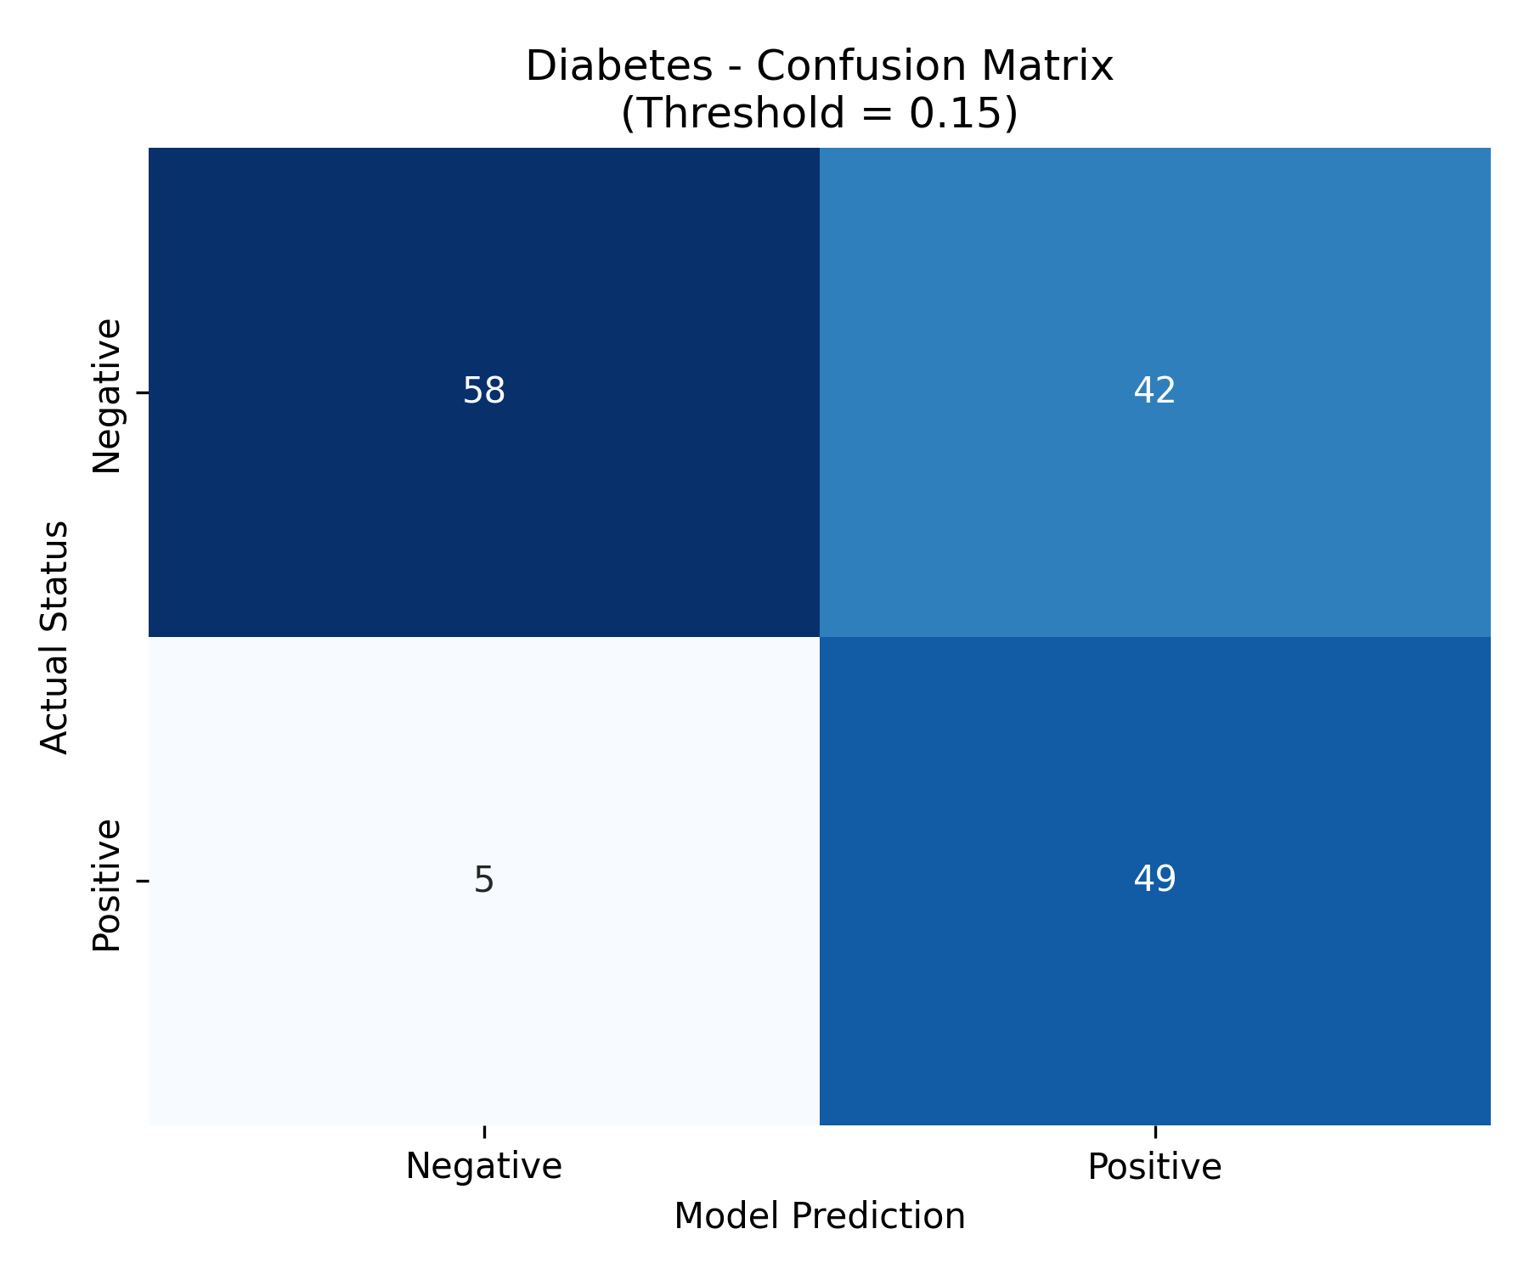
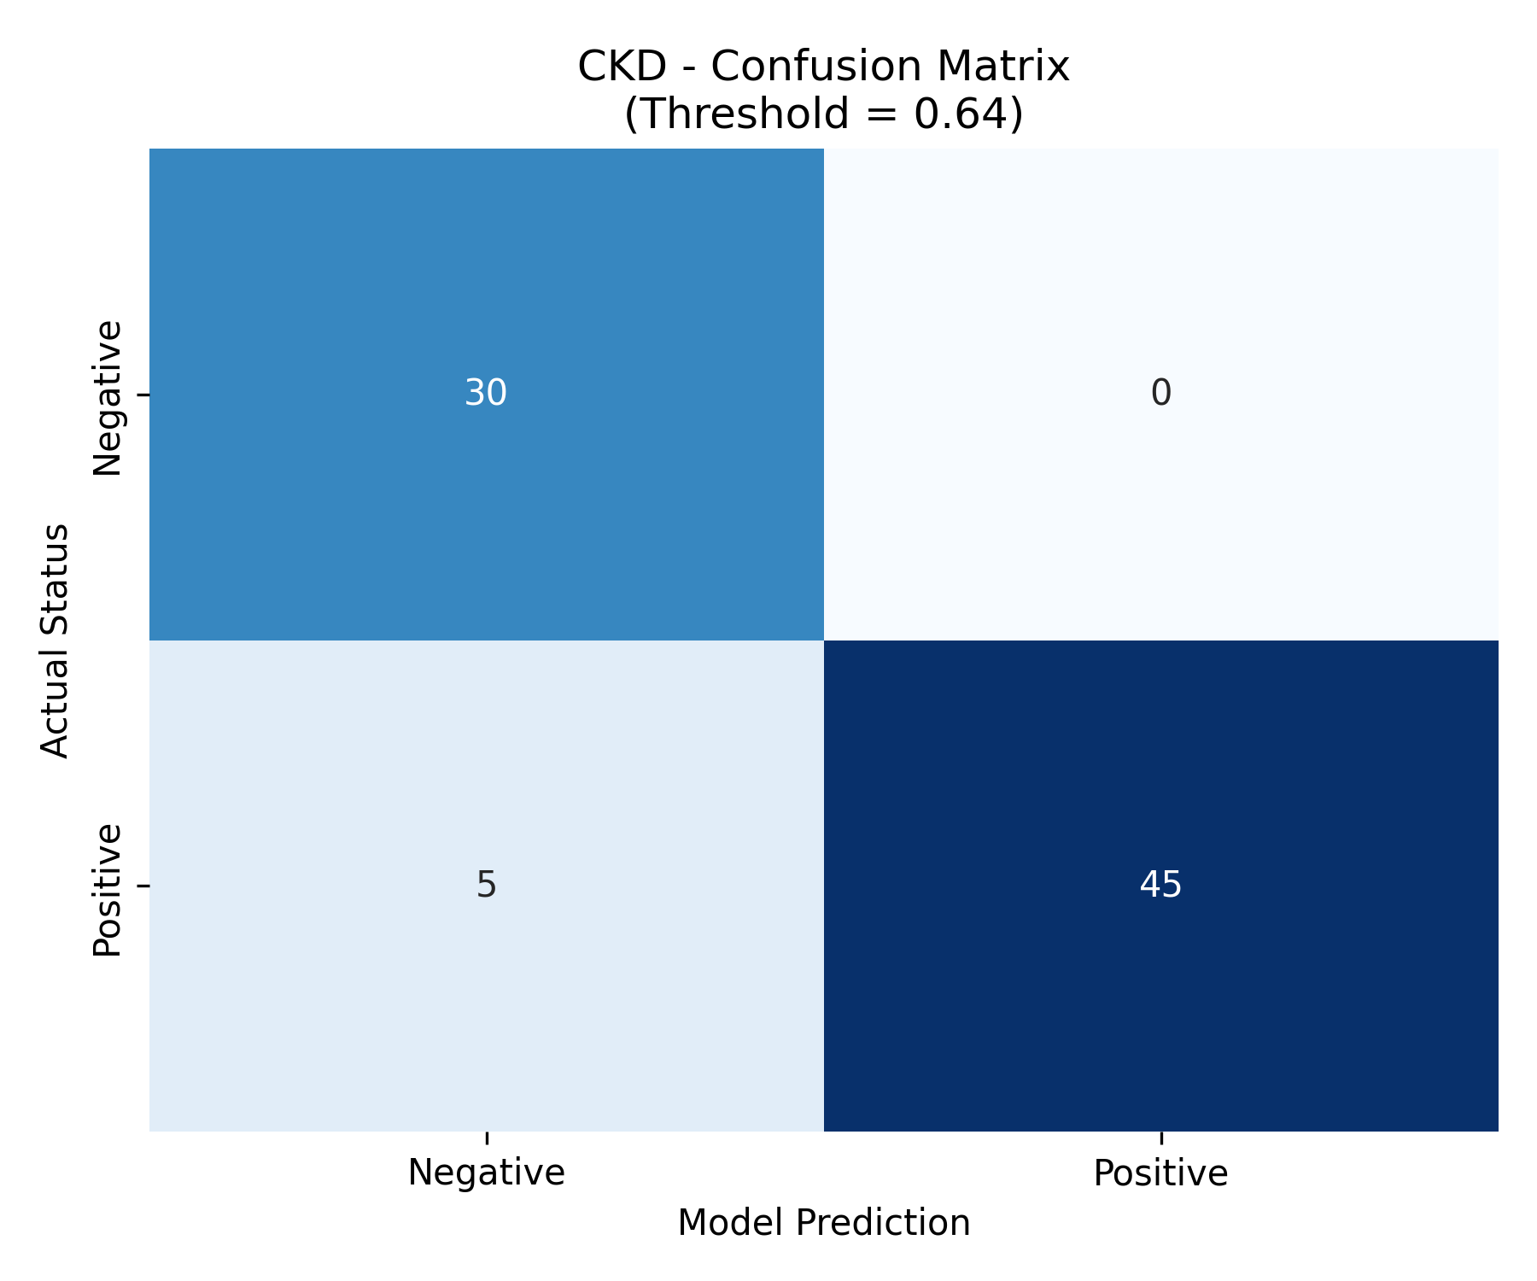
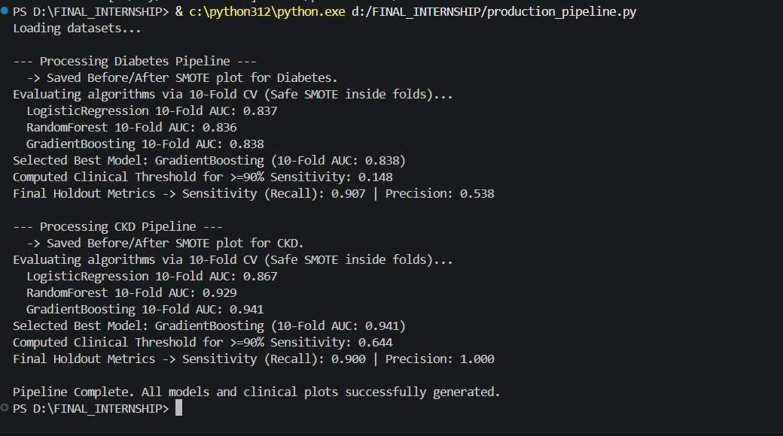
Results — Diabetes & CKD Pipelines
Diabetes Model: Gradient Boosting | 10-Fold AUC: 0.838 | Threshold: 0.148 | Recall: 90.7% | Precision: 53.8%
CKD Model: Gradient Boosting | 10-Fold AUC: 0.941 | Threshold: 0.644 | Recall: 90.0% | Precision: 100%
21

Slide 20
Results — Diabetes & CKD Pipelines
21

Slide 21
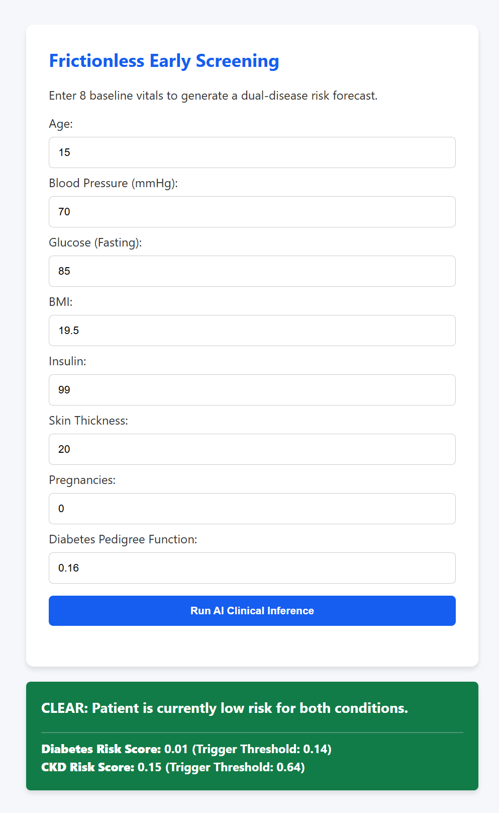
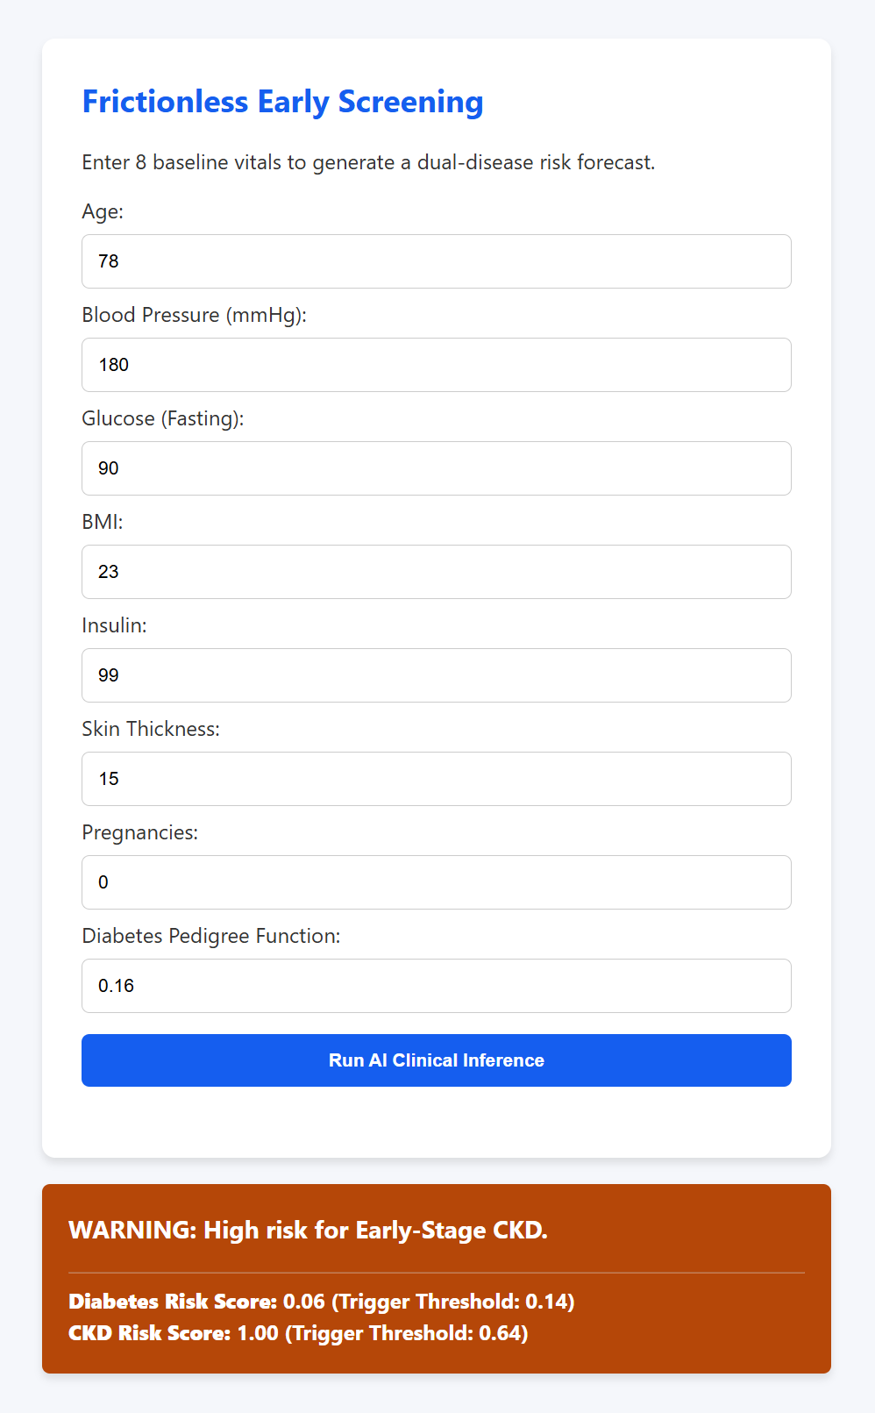
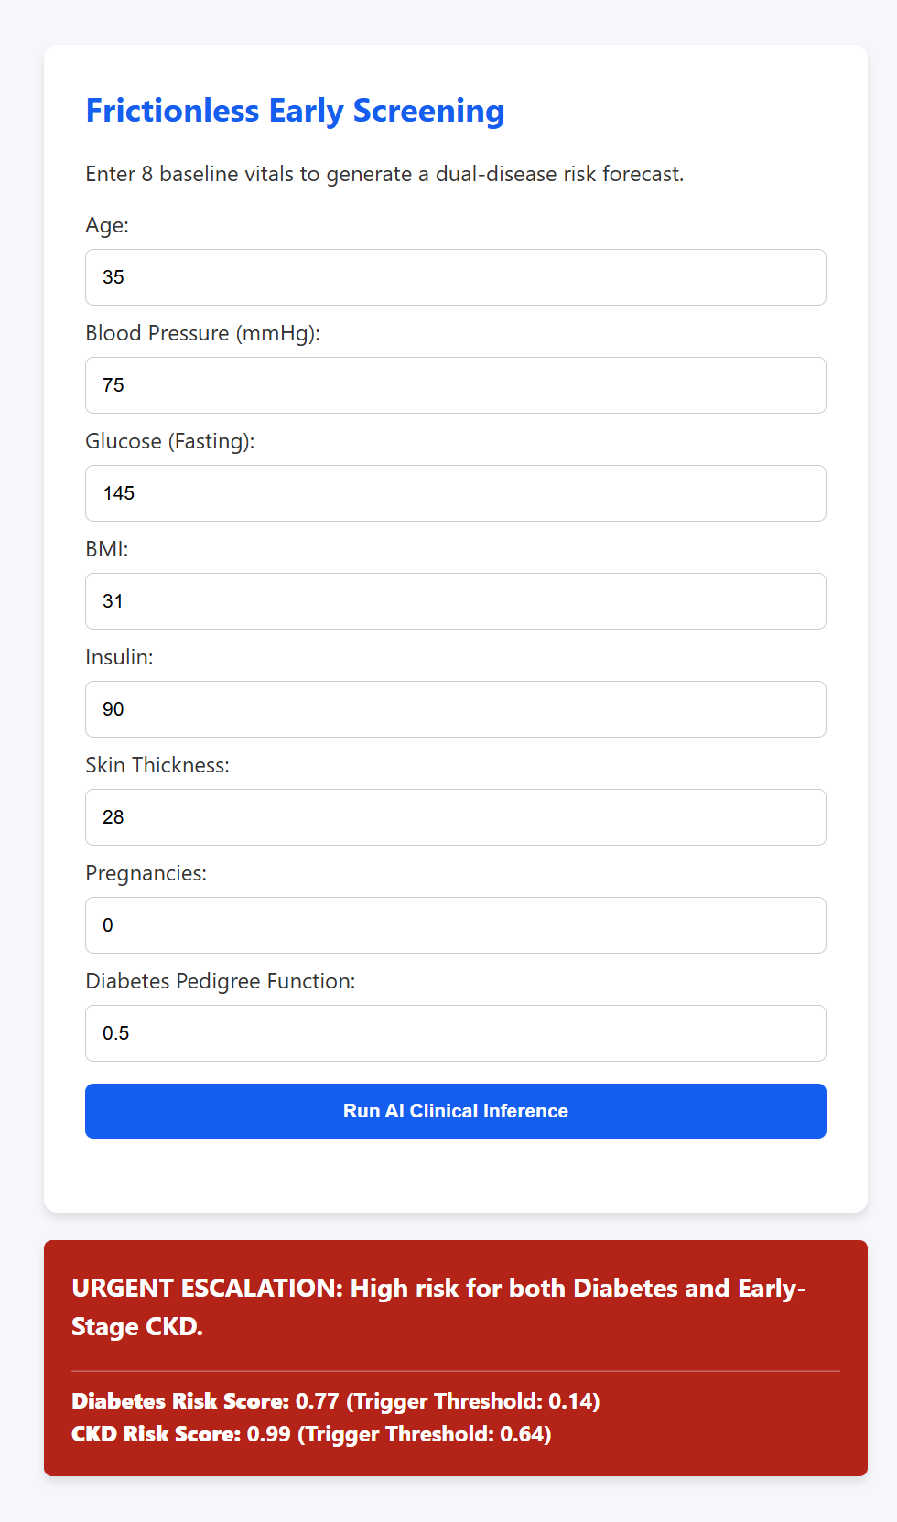
End-to-End Inference: Flask REST API Summary
Clinician enters 8 basic vitals → Backend runs Diabetes pipeline → Bridges DM flag → Runs CKD pipeline → Color-coded output in real-time
Age 15, normal vitals → Diabetes score 0.01, CKD score 0.15 — both below thresholds
Age 78, BP 180 → CKD score 1.00 exceeds 0.64 threshold despite low diabetes risk (0.06
Age 35, Glucose 145, BMI 31 → Diabetes 0.77, CKD 0.99 — both exceed thresholds
37

Slide 22
Conclusion
Summary: Built a clinically viable Software as a Medical Device (SaMD) prototype for frictionless dual-disease early screening using only 8 non-invasive vitals
Key Achievement 1: Proved CKD risk can be accurately forecast using only 4 non-invasive features via the novel Dual-Disease Bridge mechanism — AUC 0.941
Key Achievement 2: Completely eliminated SMOTE data leakage via imblearn.pipeline + Stratified 10-Fold CV — all reported metrics reflect 100% real patient data
Key Achievement 3: Computed mathematically safe clinical thresholds (Diabetes: 0.148, CKD: 0.644) guaranteeing ≥90% Sensitivity for both models
Future Work
Multimodal data fusion incorporating imaging, genomics, and clinical notes to enhance diagnostic accuracy and clinical utility.
Expand the ML pipeline to cover other major chronic disease clusters defined by the WHO/IHME, such as Cardiovascular Diseases (CVD) and Respiratory conditions.
3
24

Slide 23
References
1. Naz S, et al. The early prediction of chronic diseases through diverse ML algorithms. IEEE Access. 2024;12:11004–11015.
6. Kumar A, et al. Review of fusion aspects in medical diagnosis. Diagnostics. 2024.
2. Delpino FM, et al. Machine learning for predicting chronic diseases: A systematic review. Public Health. 2022;205:15–25.
7. Mahmud M, et al. Early detection of CKD using Gradient Boosting. IEEE Xplore. 2024.
3. Abbas Q, et al. Explainable AI in clinical decision support systems. PMC Med Inform. 2025;14(1):102–115.
8. Polat H, et al. Feature selection for CKD diagnosis. Med Hypotheses. 2017;103:68–75.
4. Jung Y, et al. Evaluating XAI impact on clinical trust. Int J Med Inform. 2025;105943.
9. Lundberg SM, Lee SI. A unified approach to model interpretation. NeurIPS. 2017.
5. Nikolaou N. Multimodal data fusion in precision oncology. Nat Commun. 2025;16:142.
10. Chawla NV, et al. SMOTE: Synthetic minority over-sampling. J Artif Intell Res. 2002;16:321–357.
25

Slide 24
References
11. Kavakiotis I, et al. Machine Learning and Data Mining Methods in Diabetes Research. Comput Struct Biotechnol J. 2017.
12. Maniruzzaman M, et al. Accurate Risk Prediction of Type 2 Diabetes using Machine Learning. J Med Syst. 2018.
13. Zhang et al., ML for CKD prediction from diabetes records — Computers in Biology and Medicine, 2022.
26

