Slide 1
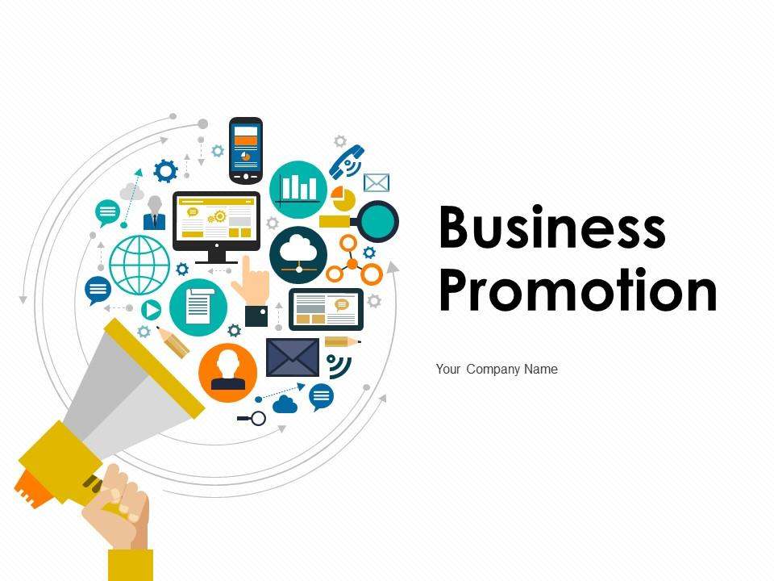

Slide 2
Contents
Introduction to business
Objectives of business
Promotion of business
Business promotion working structure
Business promotion strategy fundamentals
Business promotion overview
Whereabouts of promotion
Conclusion

Slide 3
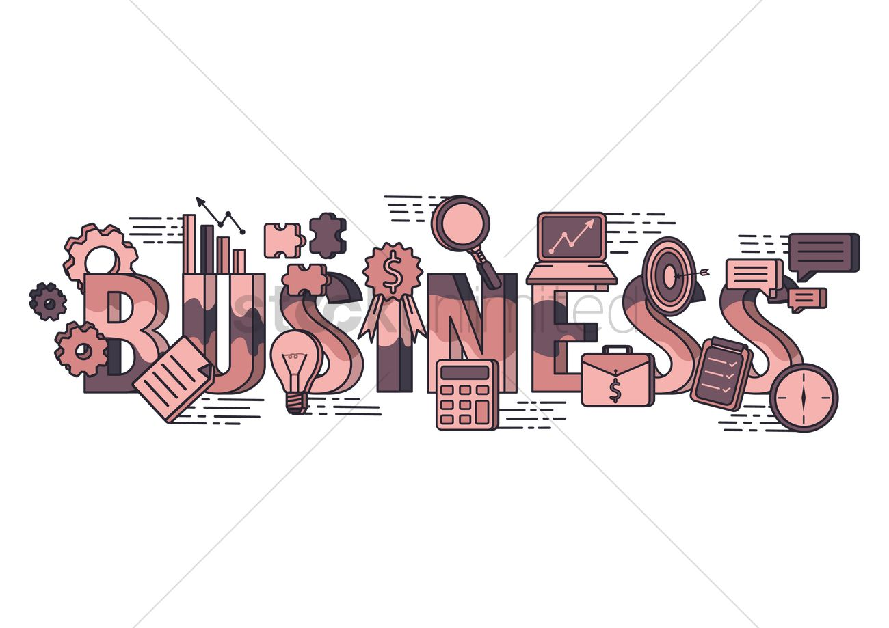

Slide 4
Introduction to business
Business is an economic activity that involves the exchange, purchase, sale or production of goods and services with a motive to earn profits and satisfy the needs of customers. Businesses can be both profit or non-profit organizations that function to gain profits or achieve a social cause respectively.
Everything that surrounds us is a chain of business, from a laptop to the chair we sit. With every change in technology, human being demand also changes. Giving business persons to grow their business or start a new venture.

Slide 5
Objectives of business
Objectives are needed in every area where performance and results directly affect the survival and prosperity of a business. The objectives of a business can be classified into two main categories, which are Economics and Social objectives.
The economics objectives of business is to show economic result i.e profit earning, creation of customers, utilization of resources, increasing productivity, etc. Meanwhile the social objectives is to comprise supply of quality goods in sufficient quantity at reasonable prices, fair deal to workers, fair returns to investors, etc.
In order to accomplish those objectives businesses should have fine number of customer with satisfaction toward acquired services. So businesses need to promote themselves to consumer or public for their survival and prosperity which makes promotion of business a primary objectives to business.

Slide 6
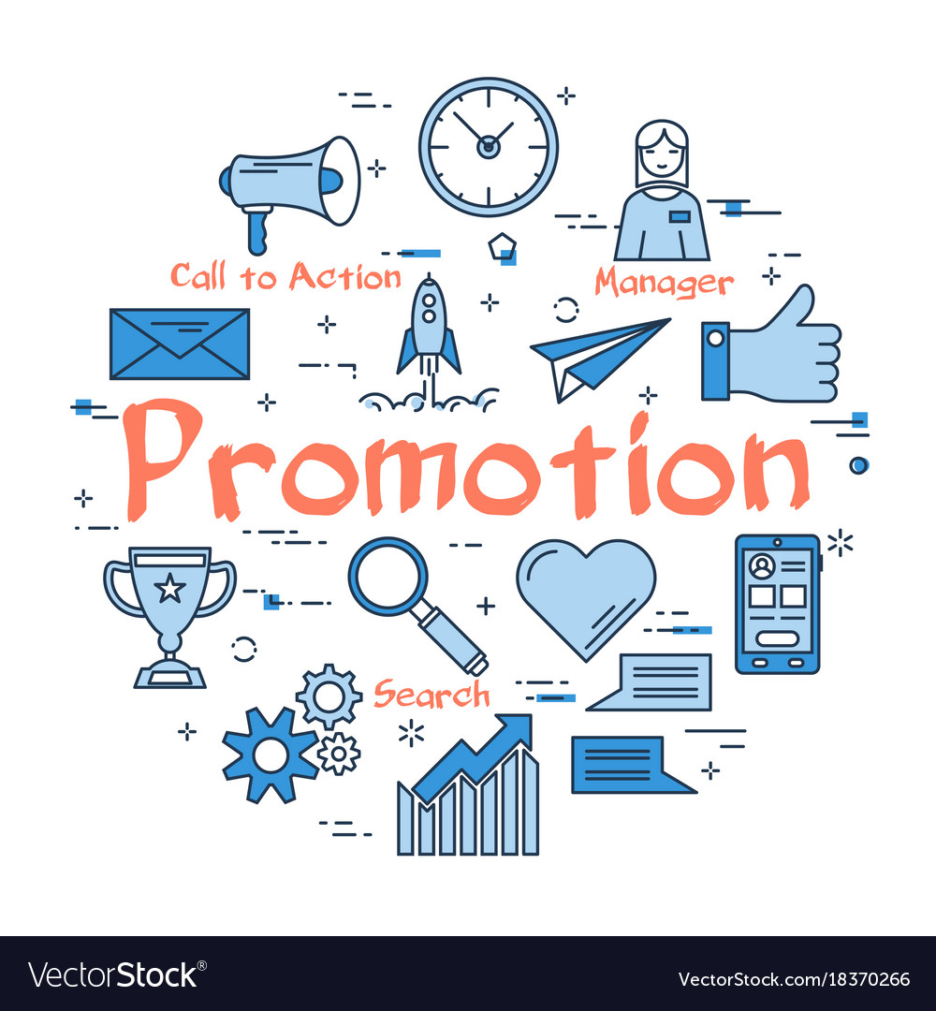

Slide 7
Promotion of business
Business promotion describes a series of marketing practices that businesses use to boost sales and enhance brand visibility. It is a broad marketing term that includes all methods companies use to promote visibility for products, services, events, and brands. It includes concepts like advertisements, efforts like campaigns, and items like branded giveaway products.

Slide 8
Business promotion working structure
Promotion is what keeps companies in business and gaining revenue. But all businesses don’t use the same kinds or levels of promotion. This is because each one has its own unique needs. Many factors such as company size, store location, or customer and audience preference to determine those needs. New businesses, start-ups, and small businesses may go through a trial-and-error period to understand exactly which promotional styles work for them. This can include experimentation, testing, and research to create the right balance.
Once promotions circulate out in the public, their purpose is to show customers or potential customers how your business differs from your competitors. They can also show how choosing your company may be a better value. For example, a candy bar company may offer buy-one-get-one-free coupons to get two of their products for the price of one. This may be a better value than a competitor’s company that doesn’t provide similar incentives, and the coupon-providing company may gain a bigger customer base they wouldn’t have otherwise.

Slide 9
Business promotion strategy fundamentals
Business promotion is one of the 4 Ps of marketing, along with price, products, and placement. A promotional strategy is a plan you create to get influence in the market and reap the benefits discussed in the previous section. There are four fundamentals of promotion, including:
Building awareness: This fundamental makes your target audience aware that your company, products, and services exist. It comes from identifying your ideal consumers and connecting with them through marketing messages and outreach.
Developing interest: Once you identify the audience, get them interested in what you provide. This means capturing their curiosity, providing value, displaying the differences between you and the competition, and nurturing new leads.
Creating demand: The availability of products and services isn’t enough to create conversions. Make people want—or better yet—need your products in their daily lives by using emotional language in your promotions and lead nurturing tactics.
Promoting action: Use calls-to-action (CTAs) to make your audience recognize not only that they need your products or services, but they can take action to gain them. Any place where you can make a conversion, such as your website, email, social media, or other advertising, is a good place to add a CTA.

Slide 10
Business promotion overview
Having a promotional strategy helps you navigate the path to reaching your marketing goals. Use these steps to help you create one for your organization:
1. Set Promotional Goals
Setting achievements for your promotion guides the strategy. The process can help you stay productive and make smarter choices when deciding which tactics work best for your business. Align the goals with your overall marketing strategies.
2. Create a Budget
Creating a balanced budget for promotions can help you invest in strategies that help you reach your goals. The budget determines which paid promotional method fits into your overall business plan. It can also help you determine how much labor and resources you need to meet each marketing goal.
3. Define the Target Market
Knowing exactly who you plan to target with your promotions can help you make smarter decisions. It can also save you money and help ensure you’re prioritizing efforts that reach the right people.

Slide 11
4. Choose Promotion Types
Once you’ve done the research, you can pick promotion types that resonate with your audience and work with your budget. The first time you create a promotional strategy, you may enter a trial-and-error process to determine which ones work best. Make sure you select promotions that lend themselves to achieving your goals.
5. Incorporate Marketing Messages
Your marketing message is one of the most important parts of the promotion strategy. It gives the audience the information they need to understand why your company, product, or service meets their needs. It also explains the value and presents the call to action to get them to take the next step. You can develop a good marketing message by looking at the problems your audience needs solved and understanding how what you offer can fix them.
6. Build Your Promotion Schedule
Determine how and when you’re going to push your promotions to the public. This includes both in-person and digital calendars for content, events, and advertisements. Using a traditional calendar and scheduling tools can be a good way to visualize your promotion schedule as a whole. Research the best times to post content online so you can maximize your promotion abilities. You can also create urgency with your promotions by using emotional or otherwise engaging language to show limited-time offers or low stock.
7. Measure Your Efforts
The only way you can tell if your promotions are working is if you track their progress. Set metrics to track your goals and review milestones regularly. Collect as much data as possible to make sure you’re seeing the full picture of your promotions rather than just a small piece. This can tell you what’s working and what isn’t. Stay flexible with your plan and change the strategy in real time if something isn’t working. This can get you closer to achieving goals and save you time and money.

Slide 12
Whereabouts of promotion
After figuring out all the important strategy and fundamental to promotion , we can promote our business by the help of following medium or platform:-
Business Documents
Charity Events
Direct Marketing
Discounts
Elevator Pitch
Flyers
Social Media
Paid Advertising
Sponsorships

Slide 13
conclusion
In business, promotion can increase the visibility of company or services. Finding the right promotional tactics for organization and budget may take some experimentation. Once you have a plan, it can help expand your audience and gather more leads which enhance the operating activity of business.

Slide 14
