Slide 1

OPEN IIT
DATA ANALYTICS
Team- 39
Welcomes you to our Presentation

Slide 2
Problem Statement
A major record label wants to purchase the rights to a music track.
Wants to mitigate losses with the promotion and distribution of the track.
It needs to decide on the royalties to be paid to the artists and composers.

Slide 3
Objective
We need to predict the popularity of the music tracks based on the features provided in the dataset.
Popularity | Bid Price | Expected Revenue
Very High | 5 | 10
High | 4 | 8
Average | 3 | 6
Low | 2 | 4
Very Low | 1 | 2

Slide 4
Data Description
Acousticness
Danceability
Energy
Explicit
Valence
Instrumentality
Key
Liveness
Loudness
Year
Mode
Release Date
Speechiness
Tempo
Duration-min

Slide 5
Road Map
Exploratory Data Analysis
Feature Engineering
Model Implementation
Results

Slide 6
Data Exploration

Slide 7
Exploratory Data Analysis
The Visualizations used for EDA are:
Correlation Matrix
Pair Plots
Violin plot
The inferences drawn were then used to feature engineer the data that improved the baseline score for many models.

Slide 8
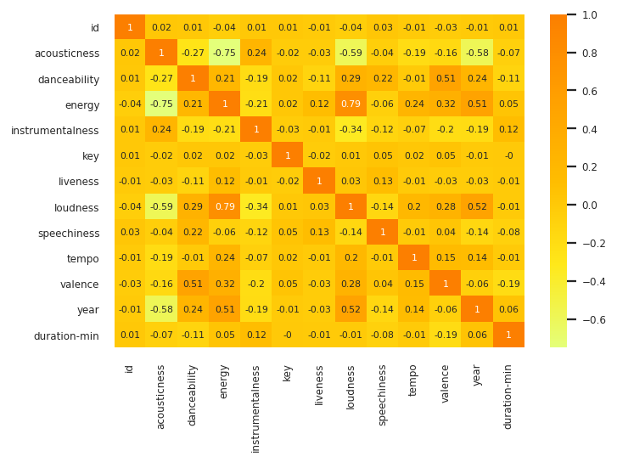
Correlation Matrix

Slide 9
Inferences from Correlation Matrix
Loudness and energy are highly correlated.
In recent years, such energetic music has gotten more popular.
Valent songs tend to have high danceability.
Acoustic songs are generally less energetic.

Slide 10
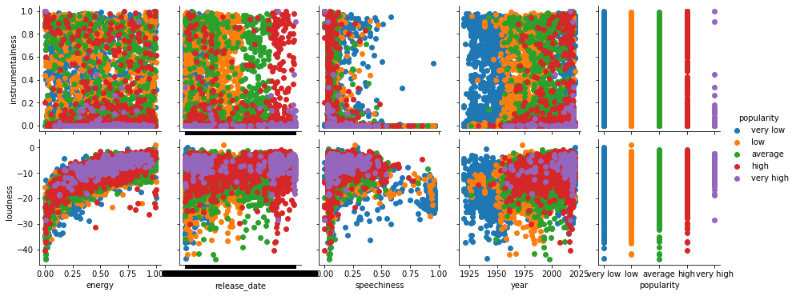
PAIR PLOTS - 1

Slide 11
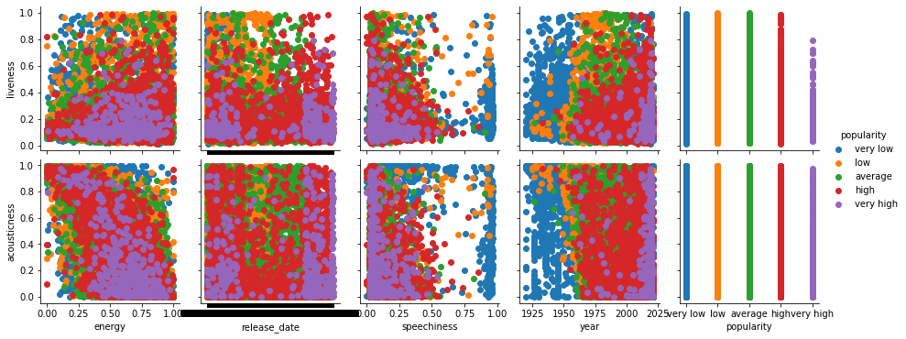
PAIR PLOTS - 2

Slide 12
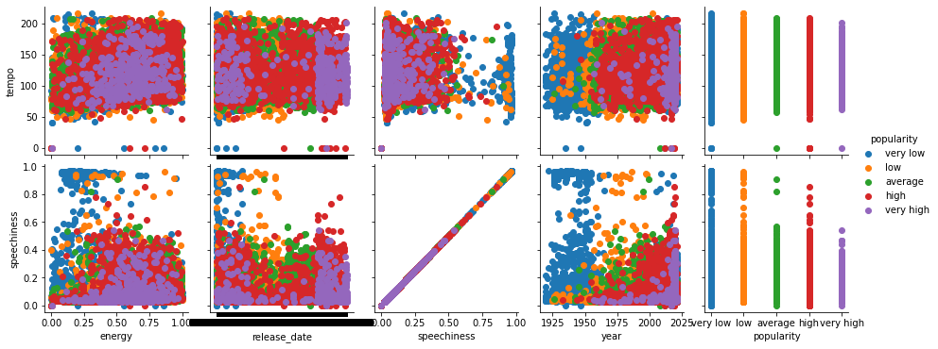
PAIR PLOTS - 3

Slide 13
Inferences from pair plots - 1
Duration of the song is important .
Songs of durations close to 3 minutes do better.
Modern music in general tends to be much more popular than older music (<1960s).
More songs tend to be loud and have less instrumentalness.
Songs with low instrumentalness are usually popular.

Slide 14
Inferences from the pair plots - 2
Most songs have low liveness.
Loud songs with low acoustic-ness are popular.
Loud and danceable songs are popular.
Liveness score of about 0.2 with medium to high energy correlate with popularity.
Popular songs also tend to have low acoustic-ness and low instrumental ness.
Danceable songs having low instrumental-ness do very well in terms of popularity.

Slide 15
Inferences from pair plots 3
Songs with very high speechiness do very poorly.
Loud songs with low speechiness do well.
Songs with high-tempo and low instrumentalness also tend to be popular.
Songs with low speechiness and and liveness do well in general.

Slide 16
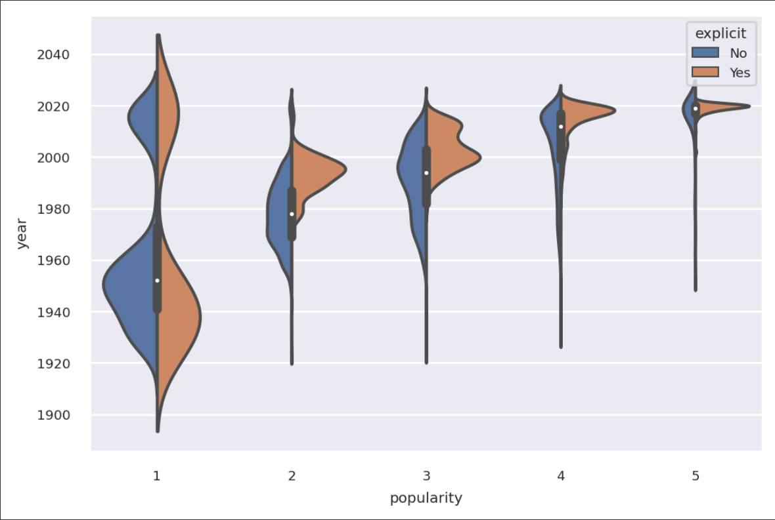
Violin Plots

Slide 17
Inferences from Violin Plot
Number of explicit songs coming out every year has grown tremendously.
The popularity of such songs has also grown.
The graph shows peculiar behaviour around 1980s, this could be due to the implementation of the parental advisory tag and rising tension around explicit songs.

Slide 18
Feature Engineering

Slide 19
Features added
Month of the release was added. This information was extracted from the release date .
9 new features containing a value for genre of music were added.
3 features containing the numerical deviation of tempo of the song from standard tempos of 70,100,150 were added.

Slide 20
Genres
Objective : To measure a songs tendency to fall into one or the other musical genre.
These features were decided after some simple observations from the data and referring research articles already existing on the subject.
Reference:
https://medium.com/latinxinai/discovering-descriptive-music-genres-using-k-means-clustering-d19bdea5e443

Slide 21
Genres defined
G0:
Slow and Somber Acoustics
G1:
Happy and Danceable Instrumentals
G2: Sad Instrumentals
G3:
Upbeat Songs With Cheerful Vocals
G4:
Fast and Danceable
Instrumentals
G5:
Fast, Upbeat and Cheerful
G6:
Slow Dance
G7:
Happy and Slow
G8:
Happy and Upbeat Instrumentals

Slide 22
Model Implementation and Results

Slide 23
Models Used
S. No. | Model Name | Accuracy on Train Set | Accuracy on Validation Set
1 | XGboost | 0.62580 | 0.6255
2 | Random Forest | 0.58388 | 0.57196
3 | Neural Network with custom class weights | 0.6187 | 0.5856
4 | Ensemble Model | 0.7390 | 0.6321
Ensemble model gave the highest accuracy, so it was chosen for the predictions.

Slide 24
Custom metric for ensemble model
This calculates the ratio of successful bids.
a) Train set ratio of successful bids: 0.829
b) Cross validation set ratio of successful bids: 0.756

Slide 25
Revenue Estimation
Data | Maximum Possible Revenue | Revenue Generated | Difference | Percentage Difference
Train Set | 148808 units | 139740 units | 9068 units | 6.093%
Cross Validation Set | 36838 units | 33546 units | 3382 units | 9.180%
Comparisons of the predicted and the maximum possible revenue as predicted by our model on train and cross validation set respectively.

Slide 26
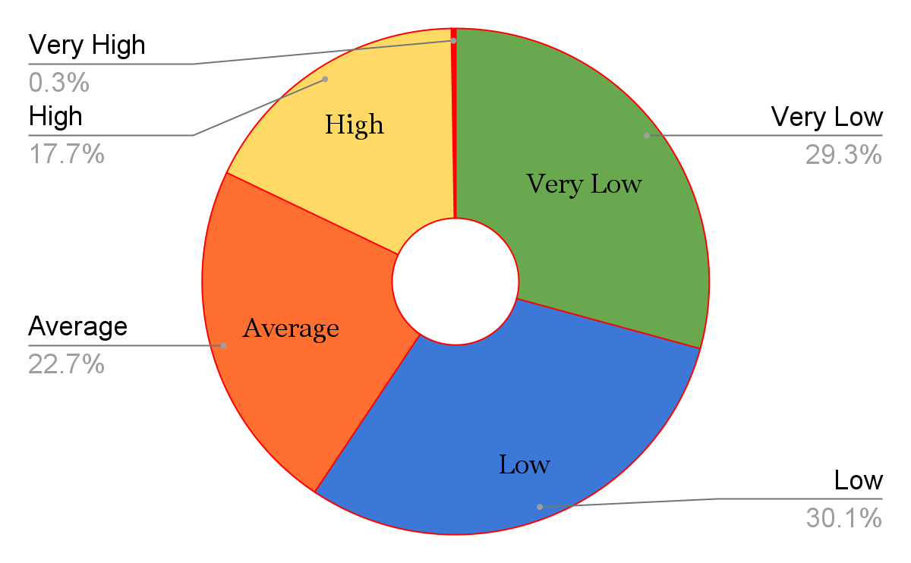
Predicted Song Labels
S.No | Popularity | Number of Songs
1 | Very Low | 1170
2 | Low | 1205
3 | Average | 907
4 | High | 707
5 | Very High | 11

Slide 27
THANK YOU!

