Slide 1
TANAFFUS · SMARTER TEACHER WORKFLOW
Give teachers their time back.
AI drafts. The teacher decides.
tanaffus.
AICA & AI Alliance · Case A · Working prototype and proposed business model
01 / 18
Notes:
Tanaffus means break. The prototype uses synthetic sample data and simulated analysis. We have no measured traction or production AI integration to claim.
AICA & AI Alliance · Case A · Working prototype and proposed business model

Slide 2
THE PROBLEM AND THE VALUE PROPOSITION
The work after the school day
The repeated work
Our mission
Our vision
Checking answers, writing similar feedback, recording grades and assembling reports compete with lesson planning.
Reduce repetitive grading and administration while keeping the teacher responsible for every academic decision.
Teachers spend more time responding to learning needs and less time transferring information between tools.
Pilot hypothesis: one 28-paper assignment takes less teacher time with assisted review. This is not yet a measured result.
02 / 18
Notes:
Problem statement comes from the supplied IT Case A criteria. Baseline and savings must be validated by observation, not by the speed of this simulated demo.
Pilot hypothesis: one 28-paper assignment takes less teacher time with assisted review. This is not yet a measured result.

Slide 3
THE PRODUCT
A complete teacher-controlled workflow
Prepare and analyze
Review and approve
Report and teach
Choose a class, set the rubric, and upload student work. Analysis proposes scores with evidence and confidence.
Trust Light separates routine papers from uncertain ones. Edit scores and feedback. Manually grade unclear work.
Export approved grades and feedback. Mistake Radar connects common errors to a short classroom activity.
The local prototype implements this journey using sample papers. No real OCR, AI grading, messaging or school sync is connected.
03 / 18
Notes:
The local prototype implements this journey using sample papers. No real OCR, AI grading, messaging or school sync is connected.

Slide 4
UZBEKISTAN SECONDARY SCHOOLS
An initial market we can reach
11,118
551
145
general secondary schools
non-state schools
non-state schools in Tashkent city
Start with mathematics departments in Tashkent’s non-state schools. Smaller pilots let us test handwriting accuracy, willingness to pay and teacher adoption before broader procurement.
Official counts: start of academic year 2025/26. Non-state schools increased 21.1% year over year.
04 / 18
Notes:
National Statistics Committee, published 31 March 2026, pages 1–3. School counts are institutions, not teacher users. TAM price scenario: 11,118 × $1,080 = $12,007,440 annual revenue ceiling if every institution bought one 30-seat plan, an unrealistic upper bound rather than a forecast. SAM scenario: 551 × $1,080 = $595,080. Initial city segment: 145 × $1,080 = $156,600. National scaling requires curriculum, procurement and infrastructure validation.
Official counts: start of academic year 2025/26. Non-state schools increased 21.1% year over year.
https://stat.uz/img/news/general-secondary-education_p67901.pdf

Slide 5
MARKET TRENDS AND COMPETITIVE POSITIONING
Existing tools validate the category
Alternative | Verified role | Tanaffus positioning hypothesis
Gradescope | Rubric workflows and AI-assisted answer grouping | Teacher review organized by uncertainty; local mathematics pilot
MagicSchool | Rubric creation and writing feedback tools | One paper-to-approval-to-lesson workflow
Manual grading + spreadsheets | Teacher’s existing workflow; no new tool to learn | Less repeated feedback and grade entry
AI-assisted assessment is an established category. Differentiation is a hypothesis to test, not a claim that competitors lack every similar feature.
05 / 18
Notes:
Official product descriptions checked 27 September 2026. Avoid asserting feature exclusivity. Broader AI teaching tools make workflow quality, local evaluation and institutional trust more important than a generic AI claim.
AI-assisted assessment is an established category. Differentiation is a hypothesis to test, not a claim that competitors lack every similar feature.
https://www.gradescope.com/get_started
https://www.magicschool.ai/magic-tools

Slide 6
TARGET USERS AND ADOPTION
Teachers use it. Schools sponsor it.
Primary user
Buyer and champion
Reason to stay
Mathematics teachers in grades 8–10 who repeatedly mark short written assignments. Start with one department.
A school principal or academic coordinator pays. A lead teacher recruits colleagues and owns the pilot’s rubric.
Reusable rubrics, clear teacher overrides, exportable reports and useful follow-up lessons. Measure repeat use rather than sign-ups.
Adoption plan: 20-minute onboarding, one assignment graded alongside the existing method, then a weekly feedback session.
06 / 18
Notes:
Adoption plan: 20-minute onboarding, one assignment graded alongside the existing method, then a weekly feedback session.

Slide 7
THE LIVE DEMO
One assignment, all the way through
01
Create an assignment and choose the grading rubric.
02
Load 28 sample papers and watch the analysis pipeline.
03
Bulk approve 25 high-confidence papers. Review two uncertain papers.
04
Manually check the red paper, edit feedback, and approve.
05
Download the class report. Open Mistake Radar’s five-minute lesson.
Demonstration only. Time-saving illustration: 28 × (4 − 0.5) minutes = 98 minutes, excluding setup and exceptional cases.
07 / 18
Notes:
Run npm run dev and open http://127.0.0.1:5173. Reset the demo in Settings if needed. The sample class uses 25 green, 2 yellow and 1 red paper. Confidence percentages are synthetic, not calibrated probabilities.
Demonstration only. Time-saving illustration: 28 × (4 − 0.5) minutes = 98 minutes, excluding setup and exceptional cases.

Slide 8
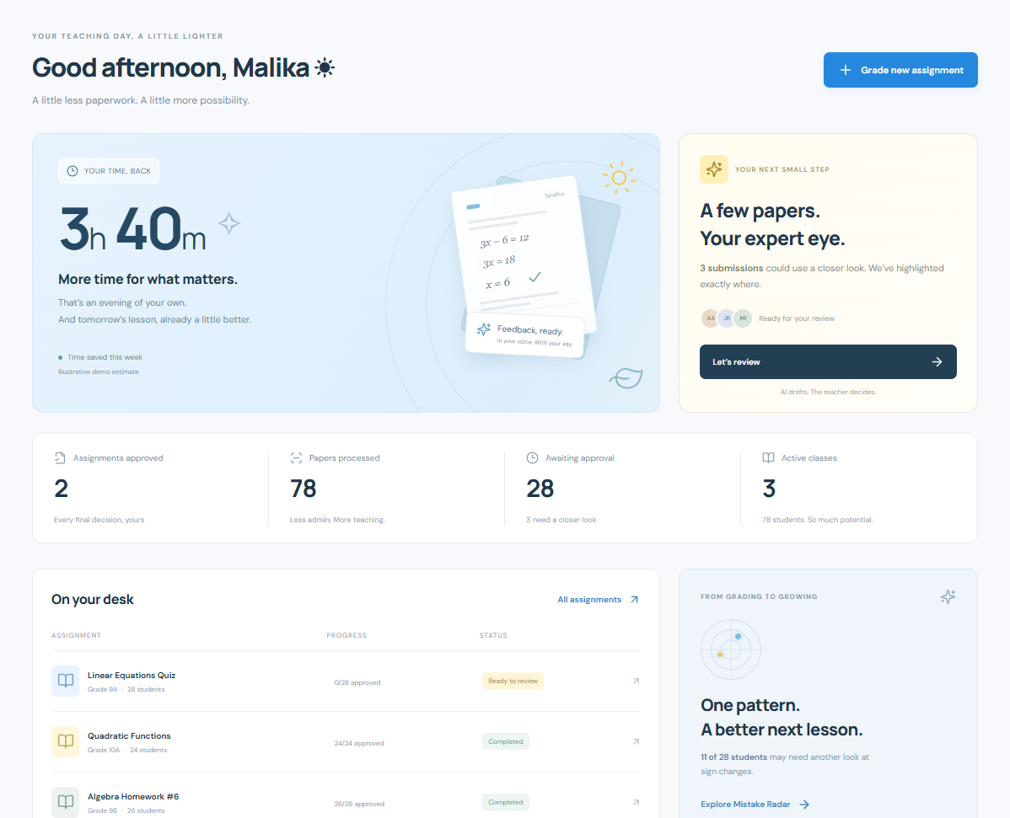
SAMPLE SCREEN 1
A calmer teaching dashboard
Time savings are labeled illustrative. Pending work and quick actions share the same application state.
08 / 18
Notes:
Time savings are labeled illustrative. Pending work and quick actions share the same application state.

Slide 9
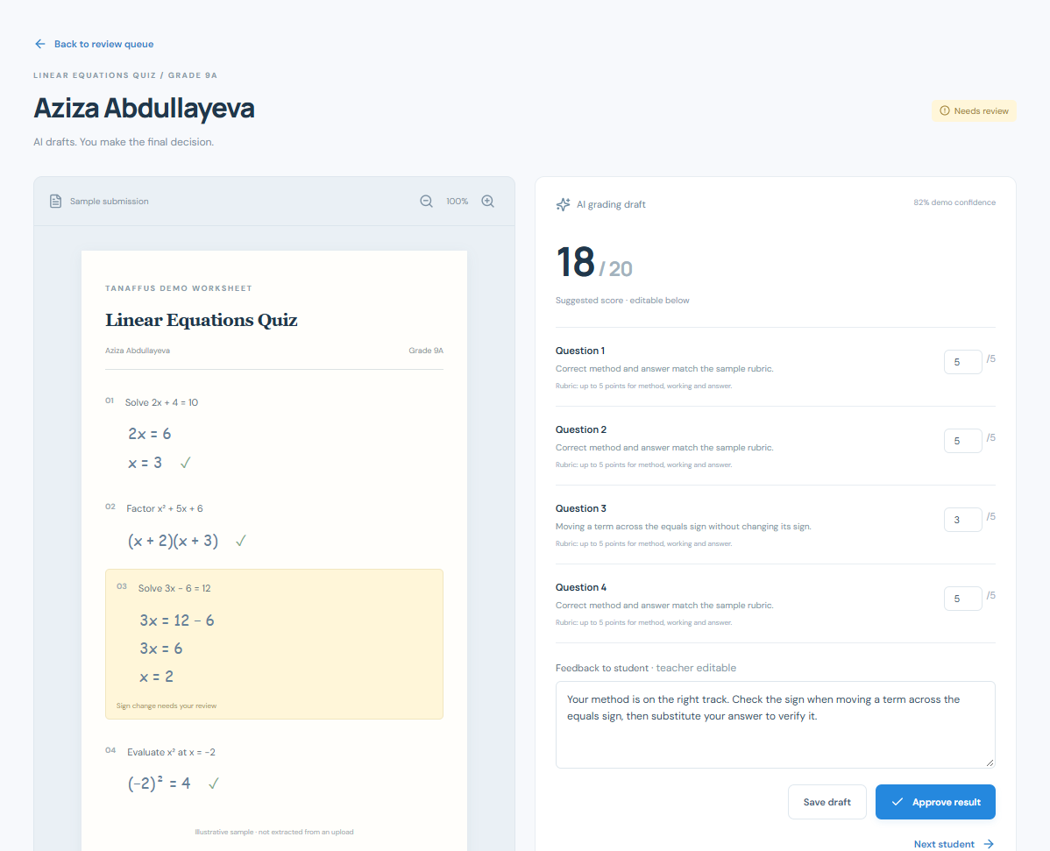
SAMPLE SCREEN 2
Evidence beside the student’s work
Scores and feedback are editable. A manual-review paper cannot be approved until the teacher confirms their judgment.
09 / 18
Notes:
Scores and feedback are editable. A manual-review paper cannot be approved until the teacher confirms their judgment.

Slide 10
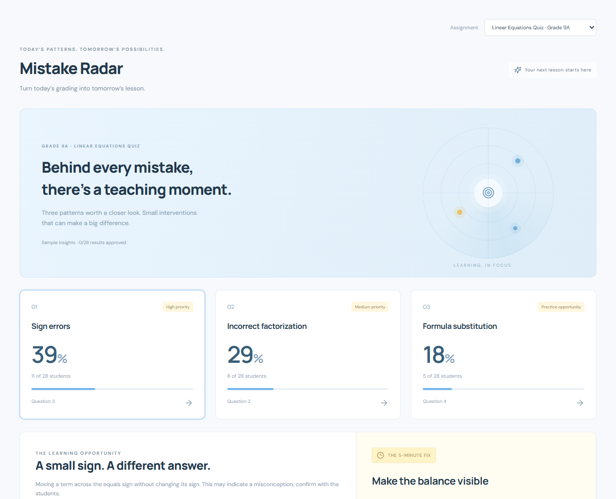
DIFFERENTIATING FEATURE AND SAMPLE SCREEN 3
Mistake Radar makes grading useful tomorrow
11 of 28 sample students show sign errors (39%, rounded). Teachers can open their work and prepare a five-minute explanation.
10 / 18
Notes:
Mistake Radar combines affected students, example answers, likely misconceptions and a short teaching response. The connection between reviewed evidence and the next lesson is the proposed differentiation. All patterns in this demo are synthetic.
11 of 28 sample students show sign errors (39%, rounded). Teachers can open their work and prepare a five-minute explanation.

Slide 11
PROPOSED MONETIZATION
A school plan with predictable costs
Free trial
School plan · $1,080/year
Usage and service
30 sample or consented papers for an evaluation. No open-ended free AI usage. Conversion follows a teacher time study.
30 teacher seats at an effective $3 per seat per month. Shared annual allowance: 18,000 single-page papers.
Optional prepaid 1,000-paper blocks at $40. Onboarding and enterprise support priced separately after pilot validation.
All prices are hypotheses in USD equivalents, not local quotes. Forecast excludes overages and services; willingness to pay remains untested.
11 / 18
Notes:
Pooling papers across teachers reduces unused quotas and makes school budgeting easier. Forecast assumes 30 activated seats per school, 50 papers per teacher per month, and 12 months of normalized consumption including reporting usage. Actual school seasonality must be measured. Test annual versus academic-year contracts. Full allowance yields $360 annual inference cost at $0.02 per paper; retries and multi-page papers need metering.
All prices are hypotheses in USD equivalents, not local quotes. Forecast excludes overages and services; willingness to pay remains untested.

Slide 12
PRODUCT ROADMAP
The first six months test the hard parts
Stage | Timing | Deliverable and release gate
Prototype | Now | Clickable workflow, sample evidence, approvals and exports
Evaluated MVP | Months 1–3 | Secure upload, OCR, math rubric scoring and audit log; 500 consented papers checked by two teachers
School pilot | Months 4–6 | 3 schools, 30 teachers; Uzbek/Russian feedback review and measured time study
Paid rollout | Months 7–12 | Reporting, admin controls and reliability; convert pilot only when safety and value gates pass
Expansion | Year 2 onward | Other subjects, regional schools and approved integrations after separate evaluations
Planning assumption: two engineers plus part-time teaching, design and privacy support. Complex open-ended grading stays out of the first MVP.
12 / 18
Notes:
Planning assumption: two engineers plus part-time teaching, design and privacy support. Complex open-ended grading stays out of the first MVP.

Slide 13
GO-TO-MARKET AND EXPANSION
School pilots create the first reference users
First 90 days
Months 4–12
Year 2 and 3
Recruit 3 schools through lead teachers and direct demos. Obtain school approval and consent before real student work.
Run six-week pilots with paired manual and assisted grading. Publish consented case studies. Target 10 paid schools at year-end.
Use teacher referrals and academic coordinator outreach. Expand across regions, then evaluate universities and neighboring language markets.
Illustrative Year 1 funnel: 100 qualified school contacts, 25 demos, 15 pilots, 10 paid schools. Conversion is a target, not evidence.
13 / 18
Notes:
A first pilot is three schools; later cohorts bring the annual pilot total to fifteen. No relationships, contracts, letters of intent or customer validation have been secured in this task. Partnerships and integrations remain proposed.
Illustrative Year 1 funnel: 100 qualified school contacts, 25 demos, 15 pilots, 10 paid schools. Conversion is a target, not evidence.

Slide 14
THREE-YEAR OPERATING SCENARIO · USD, BEFORE TAX
A modest scale still needs early funding
Planning metric | Year 1 | Year 2 | Year 3
Schools at year-end | 10 | 50 | 150
Average paid schools | 5 | 30 | 100
Average licensed teachers | 150 | 900 | 3,000
Subscription revenue | 5,400 | 32,400 | 108,000
AI + hosting + support | 3,000 | 15,600 | 48,000
Product team + sales + admin | 36,000 | 54,000 | 72,000
Total operating cost | 39,000 | 69,600 | 120,000
Operating result | −33,600 | −37,200 | −12,000
Assumptions: $1,080 per school per year; 30 seats; $0.02 per paper. Three-year operating funding gap: $82,800, before contingency.
14 / 18
Notes:
Average paid schools approximate linear ramp: (0+10)/2=5, (10+50)/2=30, (50+150)/2=100. Revenue uses average schools, not year-end schools. Papers: 90,000; 540,000; 1,800,000 (average teachers × 50 × 12). AI costs: $1,800; $10,800; $36,000. Hosting/support: $1,200; $4,800; $12,000. Product team: $27,000; $38,000; $48,000. Sales: $4,000; $10,000; $16,000. Admin: $5,000; $6,000; $8,000. These are lean founder-led cash budgets, not market salary benchmarks. No taxes, FX effects, financing costs or capital expenditure are included. Salaries and implementation costs require local quotes. $82,800 × 1.2 = $99,360 with 20% contingency.
Assumptions: $1,080 per school per year; 30 seats; $0.02 per paper. Three-year operating funding gap: $82,800, before contingency.

Slide 15
KEY METRICS AND DOWNSIDE SENSITIVITY
Value, accuracy and retention decide expansion
Pilot release gates
Adoption targets
Cost sensitivity
Median teacher review time at least 50% lower, including setup. At least 95% of scores within one point of an adjudicated 20-point rubric. Zero unapproved grade transfers.
70% monthly active paid teachers. 80% annual school retention. Audit corrections by language and handwriting quality. Aim for fully loaded school CAC below $600.
At $0.04 per paper, Year 3 cost rises by $36,000 and loss reaches $48,000. Reprice limits or reduce cost before expanding. Lower retention also worsens the model.
All thresholds are proposed pilot targets. Teacher time and scoring agreement require measurement, including uncertainty and subgroup error rates.
15 / 18
Notes:
At Year 3 steady economics: annual revenue/school $1,080 less $360 AI, $48 hosting/support = $672 contribution, a 62.2% contribution margin. $600 CAC / $56 monthly contribution ≈ 10.7-month payback, before fixed team cost. Year 2 gross new schools with 80% retention: 50 − 8 = 42. Year 3: 150 − 40 = 110. Sales-budget-only CAC is not fully loaded and is not presented as observed CAC. Retention targets do not imply achieved outcomes.
All thresholds are proposed pilot targets. Teacher time and scoring agreement require measurement, including uncertainty and subgroup error rates.

Slide 16
RISKS AND PRACTICAL RESPONSES
Trust must survive the difficult cases
Risk | Mitigation before production
Wrong or biased grading | Adjudicated test set, visible evidence, teacher overrides, subgroup audits and confidence abstention
Student data exposure | Minimize identity, school-approved storage, restricted access, audit logs, deletion schedule and legal review
Teacher resistance | Co-design rubrics, demonstrate one assignment, keep manual controls, measure actual time saved
Poor handwriting or internet | Mark unreadable work for manual grading; resumable uploads and local drafts
Cost or slow procurement | Meter usage, run small pilots, use annual caps and monitor inference cost per paper
School integration failure | Export approved grades first; partner-approved API only after testing and explicit school authorization
These are production requirements and proposed controls. The demo itself uses sample data and local browser persistence.
16 / 18
Notes:
These are production requirements and proposed controls. The demo itself uses sample data and local browser persistence.

Slide 17
THE PILOT ASK AND LONG-TERM OPPORTUNITY
The next milestone is evidence
Recruit three pilot schools and 30 mathematics teachers for a six-week evaluation after the secure MVP is ready.
What we will measure
What we need
What comes next
Time saved per assignment, rubric agreement, correction rate and continued teacher use.
School champions, consented sample work, teaching advisers and funding for the evaluated MVP.
Expand only after a reliable local workflow earns trust. Add subjects and languages through separate evaluations.
Planning funding requirement: approximately $100,000 over three years including 20% contingency. Validate salaries, pricing and unit costs first.
17 / 18
Notes:
Planning funding requirement: approximately $100,000 over three years including 20% contingency. Validate salaries, pricing and unit costs first.

Slide 18
REFERENCE NOTES
Sources and submission guide
01
National Statistics Committee of Uzbekistan: General secondary education 2025/26, published 31 March 2026, pages 1–3.
02
Gradescope: official Get Started documentation, AI-Assisted Answer Groups.
03
MagicSchool: official teacher tool catalog, rubric creation and writing feedback.
04
Source criteria: IT Case Competition, Case A, AICA & AI Alliance, supplied by the user.
05
Demo: run npm install, then npm run dev. Open the local address and use Help or Grade new assignment.
External sources checked 27 September 2026. All business numbers, savings, targets and pricing are illustrative assumptions; no real traction is claimed.
18 / 18
Notes:
External sources checked 27 September 2026. All business numbers, savings, targets and pricing are illustrative assumptions; no real traction is claimed.
https://stat.uz/img/news/general-secondary-education_p67901.pdf
https://www.gradescope.com/get_started
https://www.magicschool.ai/magic-tools

