Slide 1
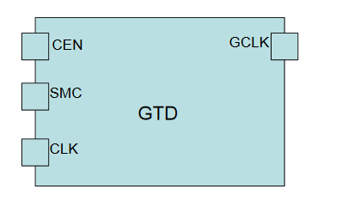
Detail about error/warning
DFT013: Enable signal of Gated Clock cell
Purpose of this checking item:
O To check whether the clock can go through gate clock cell during test or not (shift
mode/capture mode)
CEN is active in capture mode
SMC is active in shift mode
O Also checked that the clock is used in capture mode/shift mode is the same

Slide 2
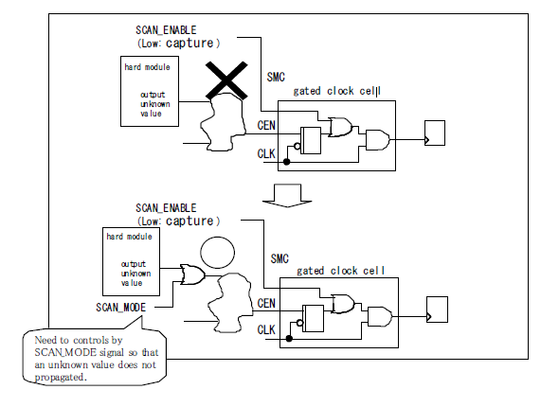
Detail about error/warning
DFT013: Enable signal of Gated Clock cell
ERROR DFT013 -1:Clock Gated Cell Enable Check (Propagating an unknown value is not permitted)
At shift scan mode, SCAN_ENABLE is fixed high, so, clock is always propagated to F/F.
On the other hand, capture mode, SCAN_ENABLE is fixed Low, clock is decided by the value of CEN signal.
When an unknown value goes into this CEN signal, in a simulator, the output value of F/F becomes unknown.
Therefore, it is necessary to make an unknown value not propagated CEN signal.

Slide 3
Detail about error/warning
DFT013: Enable signal of Gated Clock cell
ERROR DFT013 -2:Clock Gated Cell Enable Check (Connected external ports is not permitted).
When CEN terminal has connected with an external port, the pattern for a test is added to enable signal but racing happens from a timing problem

Slide 4
Detail about error/warning
DFT013: Enable signal of Gated Clock cell
ERROR DFT013 -3 : Check whether enable signal fixes Low.
When CEN terminal of a gated clock cell is fixed “Low”, F/F controlling in this gated clock does not work at
capture mode.
But it is not checked when scan F/F does not connect with the output of a gated clock cell
Notes:
Vi du chan CEN noi dat fixed 0. ko sua dc, va FF bi fix 0->> ko detect dc lỗi chỗ chân D FF nối sau GTD. Và giảm coverage.
Discuss FE nếu gặp nhiều lỗi.
Hay gặp
Nguyên nhân : Chân CEN
Hậu quả : ko

Slide 5
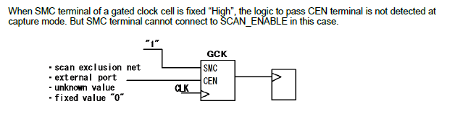
Detail about error/warning
DFT013 -4 : Check whether SMC signal fixed High (The connection cannot change to SCAN_ENABLE)
Notes:
Issue : SMC fixed 1
Ko detect đc logic chân CEN và lảm giảm coverage
Ko sửa đc. Do cannot connect

Slide 6
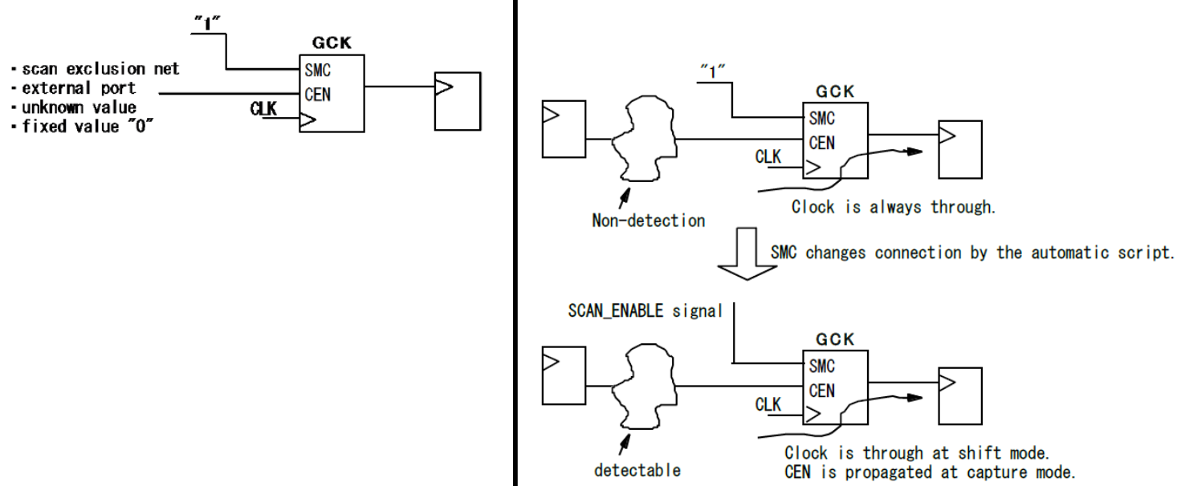
Detail about error/warning
DFT013 -5 : Check whether SMC signal fixed High (The connection can change to SCAN_ENABLE)
Cannot confirm fault of logic pass through CEN: When SMC is fixed to 1’b1, the clock always propagated to scan FF. If there is a fault on CEN pin logic, it cannot be detected in this case.
Notes:
SMC = 1 : clock đc cung cap cho shift mode
SMC = 0 : capture mode va clock dc dieu khien
Giống số 4 nhưng có thể sửa noiis vs chân SENG của SENGEN. Tùy thuộc vào customer yêu cầu coverage

Slide 7
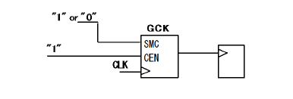
Detail about error/warning
DFT013 -6 Check whether enable signal fixes High.
When CEN terminal of a gated clock cell is fixed “High”, clock becomes the through state regardless of SMC
Notes:
SMC = 1 : clock đc cung cap cho shift mode
SMC = 0 : capture mode va clock dc dieu khien
Ko ảnh hưởng do con FF sau vẫn đủ 2 mode.

Slide 8
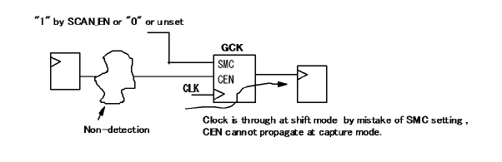
Detail about error/warning
DFT013 -7 : Check whether SMC signal fixes High or does not fix Low by SCAN_EN.
When SMC terminal of a gated clock cell is fixed “High” or it is not fixed Low by SCAN_EN, the logic to pass CEN terminal is not detected.
Notes:
SMC = 1 : clock đc cung cap cho shift mode
SMC = 0 : capture mode va clock dc dieu khien
SMC =1 : CEN ko detect →>> như các lỗi trc
Lỗi do chân SMC fixed 0 , ko có clock đi qua clock và confirm lại DFT003 do clock , nếu setting clock đúng thì xem xét con FF phía sau ko phải là Scan FF. (phải mở mạch ra trace)

Slide 9
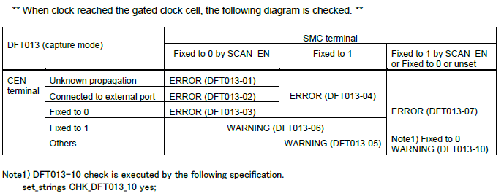
Detail about error/warning
DFT013 -8 : Check whether clock reaches the gated clock cell.
Because clock is unconnected, F/F controlling in this gated clock cell does not work.
Notes:
SMC = 1 : clock đc cung cap cho shift mode
SMC = 0 : capture mode va clock dc dieu khien
Chân clk ko nối với clk của GCK ->

Slide 10
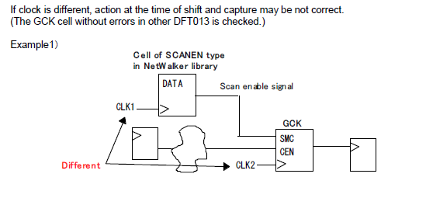
Detail about error/warning
DFT013 -9: Check whether clock is the same as clock generating SCAN_EN.
Notes:
SMC = 1 : clock đc cung cap cho shift mode
SMC = 0 : capture mode va clock dc dieu khien

Slide 11
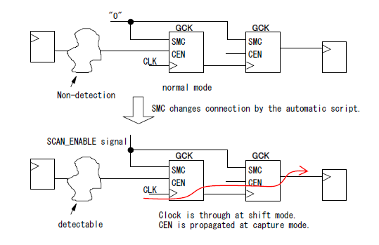
Detail about error/warning
DFT013 -10: Check whether SMC signal fixes Low.(The connection can change to SCAN_ENABLE).
Notes:
SMC = 1 : clock đc cung cap cho shift mode
SMC = 0 : capture mode va clock dc dieu khien

Slide 12
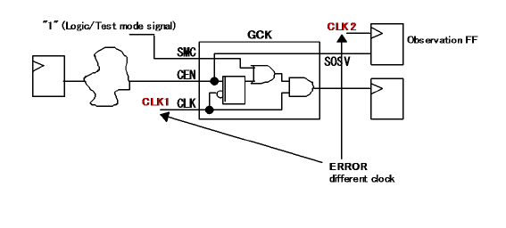
Detail about error/warning
DFT013 -11: Check whether clock of the observation FF is different from GCK clock.
Notes:
SMC = 1 : clock đc cung cap cho shift mode
SMC = 0 : capture mode va clock dc dieu khien

Slide 13
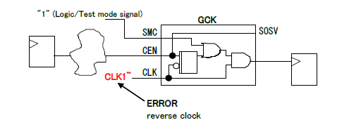
Detail about error/warning
DFT013 -12: GCK clock was reverse.
When -CHECK_013_12 is specified, this check is executed.
Because the reverse clock cannot execute AC test in SHINGEN, DC test is executed about output GCK.
Notes:
SMC = 1 : clock đc cung cap cho shift mode
SMC = 0 : capture mode va clock dc dieu khien
Clk đảo bị cấm làm cho các con scanFF sau ko hoạt động.

Slide 14
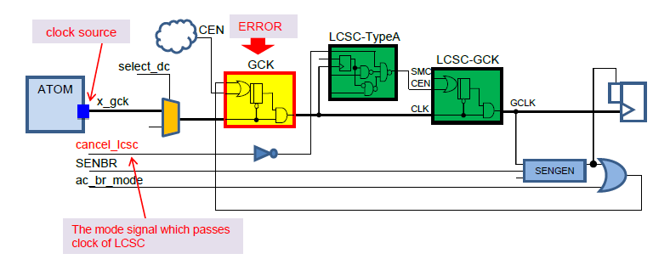
Detail about error/warning
DFT013 -13: GCK exists behind MUX switching the clock. (At the time of LCSC use)
When GCK cell exists behind MUX which is switched by select_dc signal on the clock line using LCSC, GCK which the mode signal does not propagate is detected as error.
Notes:
SMC = 1 : clock đc cung cap cho shift mode
SMC = 0 : capture mode va clock dc dieu khien

Slide 15
SCAN - MuxScan
Mentor: LongVo
Mentee: TriHo, TuanNg, ThongVo
MiddleEnd 1 Group
Backend Department
Renesas Design Vietnam

Slide 16
1. Concept of Scan Method
Memory element (FF/Latch) in the sequential logic cannot be controlled /monitored if the procedure is not carried out sequentially. The port of each memory element is modeled as a virtual I/O port by monitoring/controlling the internal state of memory element, and the entire unit is treated as a combinational circuit as a method of facilitating auto-generation of the test pattern and improving the testability.

Slide 17
1. MuxScan Method
In the MuxScan method, the multiplexer is attached to data input part of FF, and the path (Scan_Chain) that serially connects FF and user path together is controlled by the Scan control signal (Scan_enable).

Slide 18
1. Features of MuxScan Method and Main Design Constraints
Features
• It is most suitable for synchronous design circuits with edge-trigger FF.
• The area overhead is comparatively small. (Increase of 10% - 20% in the entire chip)
• Delay overhead: only with increase in the setup time.
• Scan_Clock is used in combination with System_Clock.
Main Design Constraints
• Feedback-Loops configured only of combinational circuits are disabled.
• Only edge-trigger type FF can be used.
• All FF should be simultaneously operating during testing.
• All Clock/Set/Reset of all FF should be directly controlled from outside the chip.
• Hold time error must not occur between FF during Scan_Shift as well.

Slide 19
1. MuxScan Design Flow
Test design strategy determination. Design policy considering the design constraints.
• Exclusive/ combined pin determination.
• Clock / set / reset policy design.
• Test mode policy design.
Design considering design constraints. Structure of design constraints, excluding the circuit.
• Clock / set / reset design.
• Design with limited FF use.
• Test mode design.
Consideration of design constraints.
• Consideration of timing at the time of testing.
• Limited use of FF.

Slide 20
1. MuxScan Design Flow
Design constraints check. (Timing not considered)
• Return to upper-class design for corrections in case of violation.
(Scanning may not be possible and fault coverage may decrease during violation.)
Substitution of memory element for Scan cell. Scan_Chain connection.
Design constraints check. (Timing not considered.)
• Return to upper-class design for corrections in case of violation
(Pattern generation may not be possible and fault coverage may decrease during violation.)
Test pattern generation. Confirmation of fault coverage.
• Return to upper-class design for corrections in case of violation.
Layout considering timing.

Slide 21
1. MuxScan Design Flow
Scan circuit correction in Layout. (Scan_Chain reordering, etc.)
• Return to upper-class design for corrections in case of violation.
● Confirmation of timing constraints (including Scan operation).
• Return to upper-class design for corrections in case of violation.
● Corrections considering the Test design.
• Corrections considering Scanning when there is change in FF.
• Return to upper-class design for corrections in case of changes in port or
test mode.
● Timing consideration.
● Design constraints check. (Timing not considered)
• Return to ECO modifications for corrections in case of violation.
(Pattern generation may not be possible and fault coverage may decrease during violation.)
● Test pattern generation. Confirmation of fault coverage.
• Return to ECO modifications for corrections in case of violation.

Slide 22
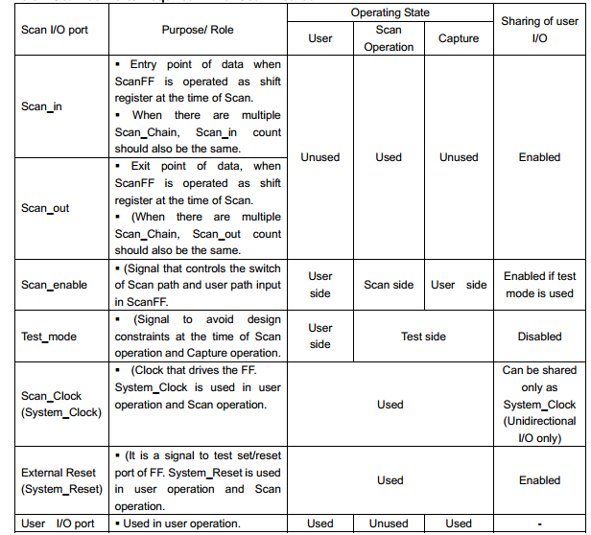
1. Sharing of Scan I/O Port and User I/O Port

Slide 23
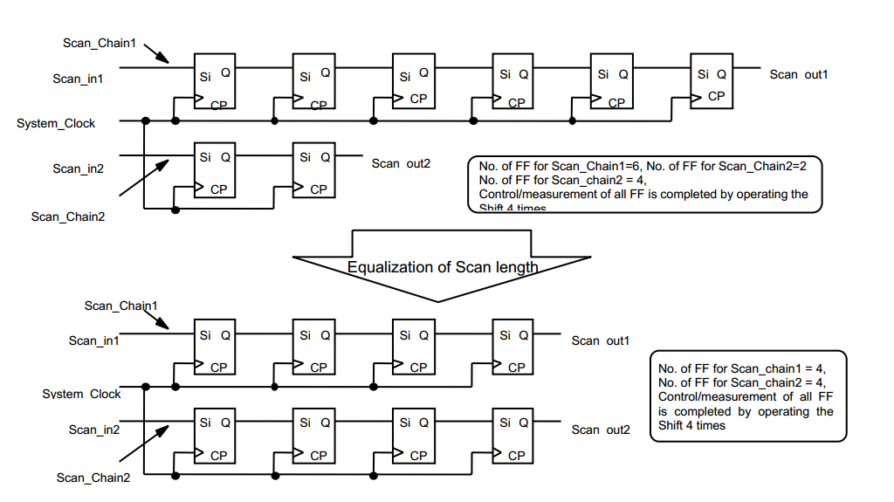
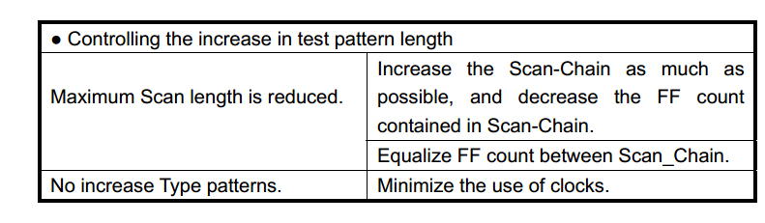
1. Test Pattern Length Consideration
Scan_Chain must be configured after considering Testing time and steps limit for each tester.
Testing time is total number of steps required for testing patterns multiplied by time taken for 1 cycle.
The total number of steps of test patterns is the sum of Scan operation and Capture operation multiplied by the number of type patterns.
Type patterns indicate the cycles configured by multiple shifts and captures at the time of generation of test patterns when FF I/O port is set as virtual I/O port.

Slide 24
1. MuxScan Design Rules
Feedback-Loop configured with combinational circuit only prohibited.
If there is Feedback-Loop configured only with combinational circuits in the circuit that is to be scanned, the entire unit cannot be modeled as combinational circuit and Testability decreases. Feedback-Loop is prohibited even through a bidirectional I/O buffer.

Slide 25
1. MuxScan Design Rules
Use edge trigger type FF only.
If there is a memory element other than edge trigger type FF such as level latch in the circuit that is to be scanned, entire unit cannot be modeled as combinational circuit and Testability decreases. Since actually usable FF should be replaced with Multiplexer FF, there are restrictions on it. (Depending upon the used technology library)

Slide 26
1. MuxScan Design Rules
Direct control of all FF clocks from outside should be enabled.
FF on the Scan_Chain are operated as shift registers. The basic idea is that FF from the same Scan_Chain is connected to same clock tree. When there are multiple clocks, Scan_Chain are divided with respect to each clock. Mixing rising and falling edges is also prohibited. Each FF clock should be directly controlled from outside during Scan operation in order to carry out user shift operation. Also the FF using the clocks that cannot be controlled from the outside such as internally generated clocks are excluded from Scanning objects.
Un-scanned FF cause decreased Testability.

Slide 27
1. MuxScan Design Rules
Set/Reset of all FF should be directly controlled from outside or Set/Reset operation should be disabled at the time of Scan.
For user shift operation the set/reset of each FF should be directly controlled during Scan operation or should not be operable during Scan. FF that uses the set/reset that violate this condition by generating internally, etc. is removed as object of Scanning. Un-scanned FF cause decreased Testability.

Slide 28
1. MuxScan Design Rules
There should not be any hold time violation in between FF at the time of Scan_Shift.
If the skew of the clock supplied to FF of Scan_Chain is greater than FF delay, the FF output of the previous step changes. This happens before the FF of next step incorporates the value. Here, the hold time violation is generated. In fact, shift timing pushes through the mismatched data.

Slide 29
1. MuxScan Design Rules
There should not be any hold time violation in the entire path (including false path) at the time of test.
Since automatic test pattern generator (ATPG) cannot understand the timing constraints, it also detects faults in paths that are recognized as false paths. Therefore, there should not be any hold time violations even in false paths. Moreover, when there are multiple clocks and there is transmission of data in between different clocks, there are methods such as ‘Activate only one clock at the time of capture’ and ‘Decide the order of activating the clock at the time of capture and activate each clock by applying a
difference greater than pass through’. In the former case, since only one clock is struck at the time of capture, there is an increase in the number of patterns, whereas in the latter case, there is a decrease in fault coverage as, faults are transmitted in the opposite direction of the clock activating order and thus are not detected.

Slide 30
1. MuxScan Design Rules
Only one internal bi-directional bus should be active at the time of test.
When the internal bidirectional bus cannot be controlled directly (configured only by combined circuit) from outside, there is possibility of bus collision at the time of test. Since even in the user logic i.e. logic of non-generation of bus collision, each FF sets the values freely and thus there is bus collision

Slide 31
1. MuxScan Design Rules
BlackBox Handling.
If a circuit/element is treated as BlackBox, input is not used and output is handled by the module where “X” is output normally. Therefore, input side of the BlackBox cannot be observed, output side cannot be controlled and fault detection of the surrounding area is obstructed.

Slide 32
1. MuxScan Design Rules
Crystal I/O should not be used at the time of test.
When the crystal I/O is used as scan clock input, FF clock becomes contra-phased due to crystal I/O and it may become unusable depending on the frequency of test pattern operation.

Slide 33
1. MuxScan Design Rules
Clock should not be propagated to data input port of FF.
If signal affected by clock is propagated to FF data input port, data and clock racing occurs, and normal capture operation cannot be executed. In the common ATPG (Automatic test pattern generator) tool for combinational circuit, pattern is generation that can either capture or cannot capture the data leading to expected value mismatch.

Slide 34
1. Comparison of Fault Models
[Single Stuck-at(Stuck-at) fault model]
In this model the node is fixed to “0" and “1" at the time of fault.
It does not depend on the test frequency.
The fault is assumed in entire chip and fault coverage is handled.
[Transition (Transition)fault model]
In this model, transition of “0 ->1” and “1->0” of node is not propagated at the time of fault.
Though it depends on the test frequency, path of fault propagation is not fixed.
The fault is assumed in entire chip and fault coverage is handled.
[PathDelay(PathDelay) fault model]
In this model the path value is not propagated by delay at the time of fault.
It depends on the test frequency. Each path can be set.
The pattern is generated by specifying path. It cannot be handled as coverage for the entire chip.

Slide 35
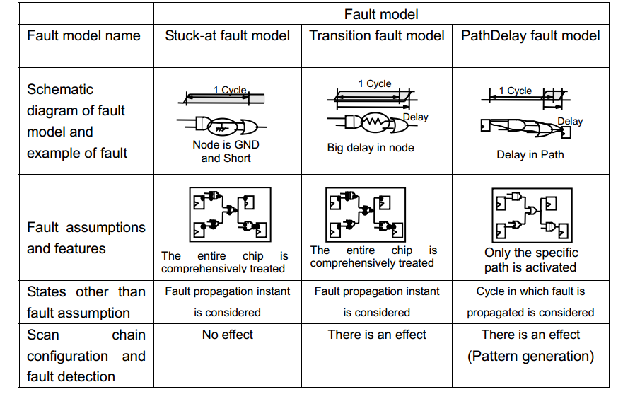
1. Comparison of Fault Models

Slide 36
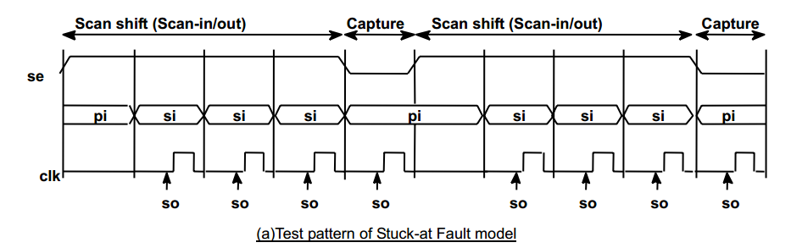
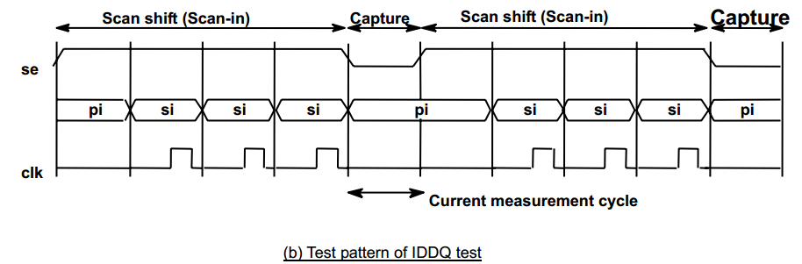
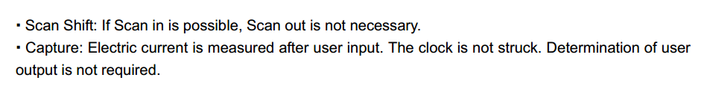
1. IDDQ Test
Since there is no DC path in the power supply system of entire CMOS structure, the static operating current does not flow. IDDQ is tested using this principle. The overview of Scan based IDDQ test is given below.
(1) In Scan based IDDQ test, 0/1 value is set in the internal node by Scan-in. Also, clock pulse and Scan out at the time of capture, are not required to measure the electric current.
(2) Although comparison of output expected values is not required, there is an expected value as a test pattern.
(3) The clock is not struck in the electric current measurement cycle to facilitate the conflict / floating control of internal path and the measurement with the tester.

Slide 37
1. Fault Categories
The fault categories of SINGEN (manufactured in house by Renesas) , FastScan and TestKompress (manufactured by Mentor) , and TetraMAX (manufactured by Synopsys) are given in a outside table.
The difference between “Undetected” and “Excluded from Scan test”:
(1) Undetected
These are fault locations that cannot be detected by ATPG tool algorithm or in the pattern under the set test constraints. It is necessary to examine the test point circuit insertion that can improve the control an observation for the circuits in which fault detection is difficult.
(2) Excluded from Scan test
These are locations in which faults cannot be detected because the logic is excluded from the Scan test or the logic is redundant. The fault coverage can be improved by reviewing the circuit.
The difference between the test_coverage and fault_coverage is as follows.
test_coverage: The value obtained by subtracting Excluded from Scan test faults from the total faults
as denominator.
fault_coverage: Denominator of total faults

Slide 38
1. Examples of Undetected Faults and Circuits Excluded from Scan Test
Unused (Excluded from Scan test)
Faults cannot be detected as port is not used. Includes nets connected to unused output ports or to input ports of BlackBox. AU fault according to BlackBox model.
Fixed to Power Supply (Excluded from Scan test)
Cannot be detected as it is connected to power supply in netlist. At the time of ATPG execution, the fault of port fixed constraints cannot be included.
Block (Excluded from Scan test)
Cannot be detected as it is fixed to power supply and blocked. Includes faults in which the logic propagation of other input ports is blocked by propagation of same logical value. The following are examples of the selected ports of the selector

Slide 39
1. Examples of Undetected Faults and Circuits Excluded from Scan Test
Redundant (Excluded from Scan test)
Cannot be detected due to redundant logic.
ATPG undetected (Excluded from Scan test)
Cannot be detected due to the settings specified at time of ATPG execution. Includes logic that cannot be detected due to fixed constraints of the port and irregular propagation in BlackBox etc.
The logic 0 that is connected to the 0 port side of the selector when the test mode signal is fixed to 1 at the time of test is not detected.

Slide 40
1. Coverage Improvement and Countermeasure Examples
Response to improvements in Test controls and Observation Capability
When memory and analog cells are treated as BlackBox,
-The input port observation should be enabled
-The propagation of irregularity is controlled by adding the selector to the output port and bypassing data at the time of Scan test
The following circuits (FF observation and by-pass logical addition) are added before scanning as an example.
Gate overhead should be considered at the time of circuit addition.

Slide 41
1. Coverage Improvement and Countermeasure Examples
ATPG undetected
a/ The fixed constraints of the port at the time of ATPG execution should be reduced. Do not design test modes that fix the logic with deep-seated logic hierarchy. Care should be taken while setting the minimum combinational logics before the gate that fixes logic for the test.
b/ The undetected locations in ATPG are reduced by adding circuit shown in (1) on the periphery of BlackBox.
In the following example the propagation of combinational logic is obstructed by setting 0 at the time of test mode and with the combinational logic being AU.
When the combinational logic part is large, the AU count also increases leading to decrease in the fault coverage.
The device that decreases the number of stages of logic between FF and AND is necessary

Slide 42
1. Coverage Improvement and Countermeasure Examples
Countermeasures for irregular propagation
NonScanFF
As shown in figure below, the before and after combinational logics are undetected if there are NonScanFF, and measures are required to set Scan FF.
The latch that is not transparent at the time of Test may be a cause for irregularity.

Slide 43
1. Coverage Improvement and Countermeasure Examples
RTL description
It is possible to control the increase in man-hour and reduction in gate area for test simplification measure in each netlist update by implementing test simplification measures in the RTL stages.
(a) Avoid latch generation description
Avoid latch generation by describing all conditions. It is necessary confirm that latch is not generated by scrutinizing the messages of RTL parser and logic synthesis tool.
(b) Avoid generation of input fixed FF
FF with fixed input may be generated depending on the description of RTL leading to decrease in fault coverage. FF with fixed input is generated by optimization of logic synthesis tool when a fixed value is entered from high-ranking hierarchy. Elaborate check of messages is necessary as there may be pointers by RTL parser in the messages.
(c) Reduce redundant logics
Logic with high redundancy may be generated by the logic synthesis tool depending on the description method of RTL such as ‘case’ sentence or ‘if’ sentence, etc. In addition to increasing the area and decreasing the operation speed, the redundant logic also turns into an undetected fault or redundant fault and has a negative effect on the fault coverage. Therefore, use RTL Design Style Guide or RTL Parser so that high redundancy logic is not generated.

Slide 44
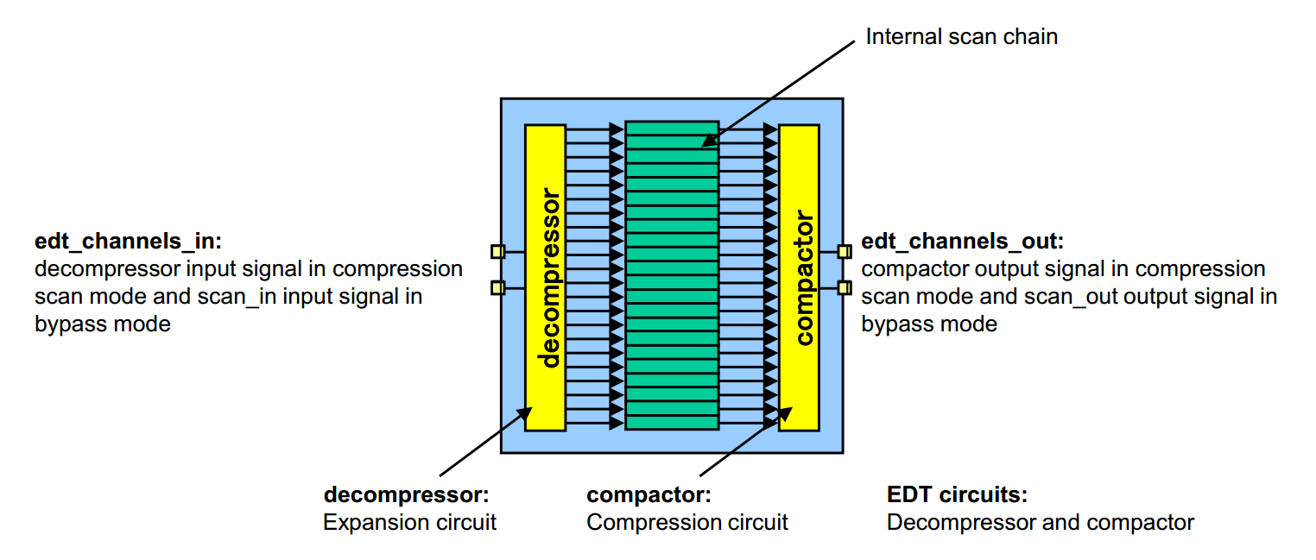
Overview of the EDT Circuit

Slide 45
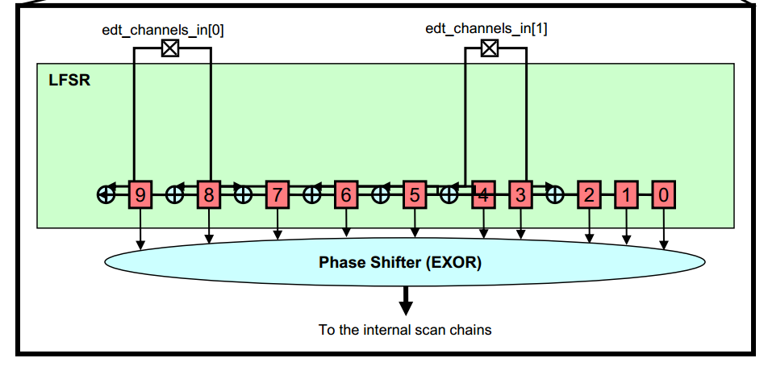
Compression Method in the input side

Slide 46
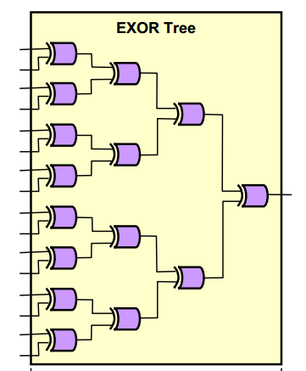
Compression Method in the output side
The compactor generated by TestKompress is composed of EXOR trees. It compresses the output data by bundling its output signals with the EXOR. The expected values are generated with the same compression system as the compactor.

Slide 47
Compression Method in the output side
The use of EXOR in the output side compactor :
Reduce the fault detection possibility due to uncertain value propagation
Decrease fault coverage due to the failure to detect the even number of simultaneous faults.
Countermeasures:

Slide 48
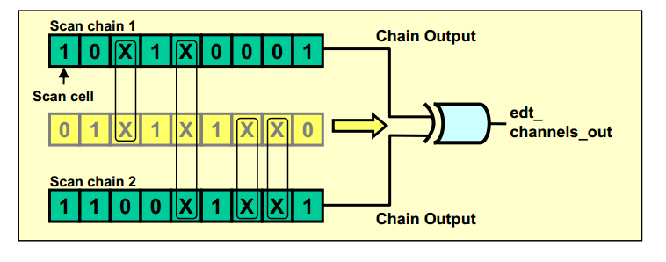
Compression Method in the output side
Countermeasures against the reduction in detection opportunity due to the propagation of an uncertain value
If the "X" value exists in a scan cell, the “X” value prevents the other scan chains connected to the same edt_channels_out from the observation of the values, thus the fault coverage is decreased.

Slide 49
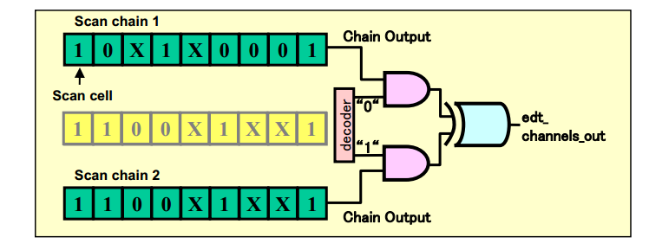
Compression Method in the output side
If the "X" value exists in a scan chain, the AND gates are controlled with the decoder circuit and the scan chains are masked to sent to edt_channels_out so that the captured data of the scan chains can be output to edt_channels_out.

Slide 50
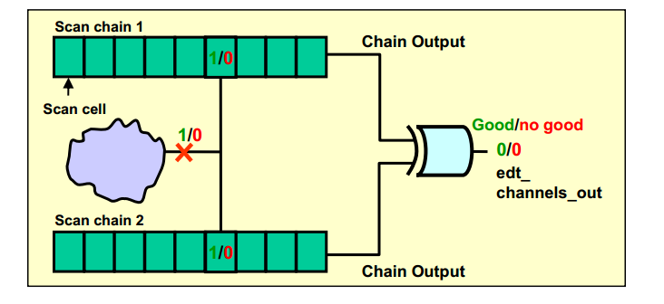
Compression Method in the output side
Countermeasures against the failure to detect an even number of simultaneous faults
The fault detection fails if incidents of a certain fault occur in different scan chains on the same edt_channels_out at the same time
Notes:
Incident: tinh co xay ra

Slide 51
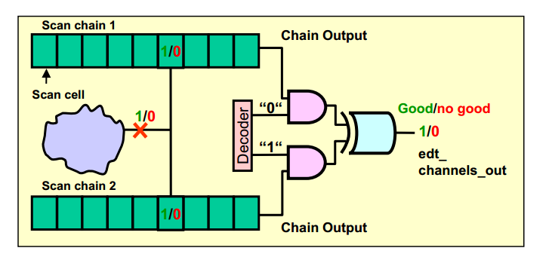
Compression Method in the output side
One scan chain is masked so that the fault on the other scan chain can be detected as with the countermeasure to minimize the reduction in fault detection chance due to the propagation of an uncertain value
Notes:
Incident: tinh co xay ra

Slide 52
TestKompress Major Design Constraints
MuxScan design constraints
3 EDT dedicated pins
Synopsys library
Re-creation of the EDT circuits
Suppression of the uncertain value ("X") propagation
Requirements of the layout
Notes:
Incident: tinh co xay ra

Slide 53
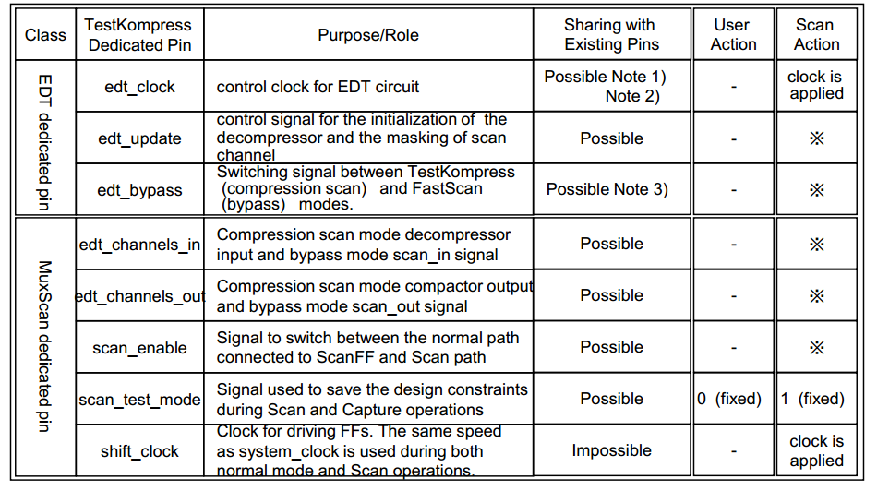
TestKompress Major Design Constraints
Notes:
Incident: tinh co xay ra

Slide 54
Overall Execution Flows Follow file excel The execution of TestKompress consists of 5 steps. 1. Scan chains as the internal scan chains are constructed by DFTAdvisor. 2. The compression scan chains are configured. Then, the EDT circuit of RTL is generated and the script files for synthesis and test pattern generation are output. 3. The EDT circuit is synthesized and connected to the net list after executing DFTAdvisor by Design Compiler. 4. The compression scan test patterns are generated by TestKompress. 5. The bypass mode test patterns for fault diagnosis (analysis) are created by FastScan

