Slide 1
Splunk
Machine Data Analytics at Scale

Slide 2
What Is Splunk?
Splunk is a data platform for machine-generated data.
"Machine-generated data" means any data produced automatically by software systems:
  application logs
  server logs
  network traffic records
  database audit trails
  container stdout/stderr streams
  IoT sensor readings
  security events.

Slide 3
What Is Splunk?
Collecting logs from every source — servers, containers, applications, network devices — and centralizing them
Indexing that data so you can search billions of events in seconds
Visualizing patterns through dashboards and charts
Alerting when thresholds or anomalies are detected

Slide 4
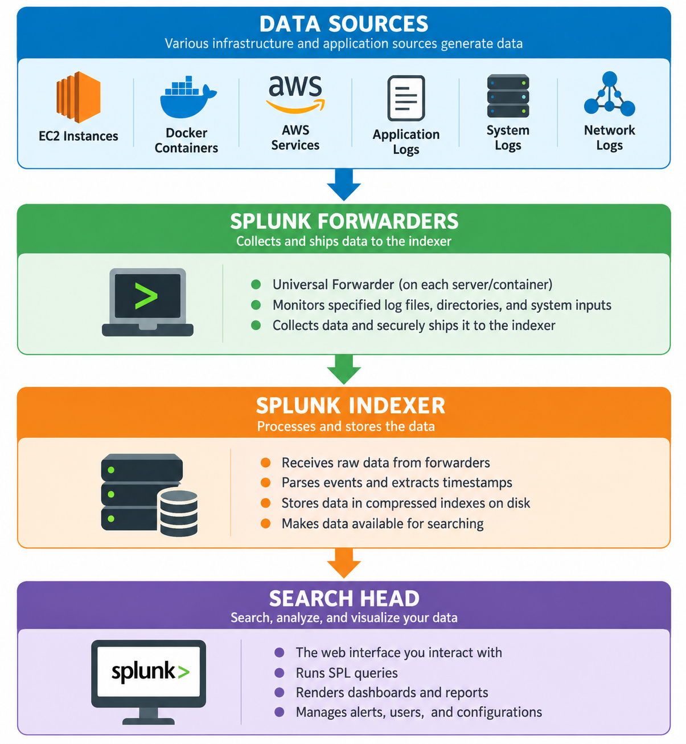
Splunk Architecture Overview

Slide 5
Splunk Enterprise vs Splunk Cloud
Splunk Enterprise
Splunk software that you download, install, and manage on your own infrastructure — on-premises servers, your own cloud VMs, or a hybrid of both.
Who manages it: Your team (or your company's operations team) is responsible for installation, upgrades, scaling, backup, and disaster recovery.
Splunk Cloud Platform
Splunk delivered as a fully managed Software-as-a-Service (SaaS). Splunk, Inc. runs the infrastructure; you send data and use the interface.
Who manages it: Splunk manages the backend infrastructure, upgrades, scaling, and availability. You manage your data inputs, searches, dashboards, and users.

Slide 6
The Three Pillars of Splunk Use Cases

Slide 7
Pillar 1: IT Operations and Application Monitoring (AIOps/Observability)
This is where most development teams first encounter Splunk. You are building and running applications, and you need visibility into their behavior.
What it looks like in practice:
  Your Spring Boot API is deployed in a Docker container on ECS. During peak hours, response times spike. With Splunk, you can:
  Search application logs for slow queries, stack traces, and error messages
  Build a dashboard showing request rates, error rates, and latency percentiles over time
  Set an alert that notifies your on-call engineer when the error rate exceeds 1% of requests
  Correlate application errors with infrastructure events (did a memory spike precede the errors?)
Key metrics and signals monitored:
  Application error logs (exceptions, stack traces)
  Request latency (how long requests take)
  Throughput (requests per second)
  Availability (is the service up?)
  Infrastructure metrics (CPU, memory, disk I/O)

Slide 8
Pillar 2: Security Information and Event Management (SIEM)
Security teams use Splunk as their command center for detecting threats, investigating incidents, and meeting compliance requirements.
What it looks like in practice:
  Your application is receiving authentication requests. Splunk can:
  Detect brute-force attacks (hundreds of failed logins from the same IP in a short time)
  Track privileged user activity (who accessed sensitive data, when, and from where)
  Correlate events across systems (failed login followed by a successful login from a different geography)
  Generate compliance reports (who accessed what data over the past 90 days)
Splunk's security product line includes:
Splunk Enterprise Security (ES): A premium app providing pre-built correlation rules, dashboards, and workflows for security operations centers (SOCs)
Splunk SOAR (Security Orchestration, Automation and Response): Automates response actions (block an IP, disable an account, create a ticket) when threats are detected

Slide 9
Pillar 3: Business Analytics
Beyond IT and security, Splunk can answer business questions using operational data.
What it looks like in practice:
  An e-commerce company uses Splunk to track:
  Which product pages have the highest abandon rates
  How purchase completion rates correlate with page load times
  Whether a marketing campaign drove measurable increases in checkout conversions
  Geographic distribution of orders

Slide 10
Observability in Cloud-Native Environments
The term observability comes from control theory and means: can you understand the internal state of a system by examining its external outputs? In software, those outputs are:
Logs: Structured or unstructured text records of events ("2024-01-15 14:23:01 ERROR DatabaseConnectionException: Connection timed out")
Metrics: Numerical measurements over time (CPU at 87%, 342 requests/second, heap memory at 2.1 GB)
Traces: Records of a single request's journey through multiple services (the request hit the API gateway, went to the user service, called the database, returned in 450ms)
These three are known as the three pillars of observability. Splunk addresses all three

Slide 11
Using Splunk

Slide 12
The Splunk Web Interface

Slide 13
The Index: Splunk's Data Organization Unit
An index is Splunk's primary data storage unit. It is analogous to a database in a relational system — a named repository where events are stored. When Splunk receives data, it parses the raw text into discrete events, extracts fields, and stores them in an index.
Key characteristics of an index:
  Data lives in indexes permanently (until a retention policy expires it)
  Indexes are searched by name — you can restrict a search to one or more indexes
  Indexes have retention settings — how many days or gigabytes of data to keep before the oldest data is deleted
  Indexes have access controls — certain users or roles may only be able to read specific indexes

Slide 14
Default Indexes
Splunk ships with several built-in indexes:
Index Name | Purpose
main | The default index — data goes here if no index is specified
_internal | Splunk's own operational logs (search activity, indexer performance, forwarder connections)
_audit | Audit trail of Splunk user activity
history | Search history
Rather than dumping all data into main, most organizations create dedicated indexes:
index=prod_payments # Payment service logs
index=prod_auth # Authentication service logs
index=prod_api_gateway # API gateway access logs
index=staging_all # All staging environment logs
index=security_events # Security-relevant events

Slide 15
Searching Across Indexes
Search a single index
index=prod_api_gateway
Search multiple indexes
index=prod_payments OR index=prod_auth
Search all indexes (avoid in production -- very slow and expensive)
index=*

Slide 16
Data Inputs: Getting Data Into Splunk
Splunk supports multiple mechanisms for ingesting data. The right choice depends on where your data lives and how it is generated.
File and Directory Monitoring : Splunk can watch a file or directory on the local filesystem and continuously read new content as it is appended.
HTTP Event Collector (HEC) : HEC allows applications to send events directly to Splunk over HTTP or HTTPS, using a simple REST API with
JSON payloads.
Splunk Forwarders : A Splunk Forwarder is a lightweight Splunk agent installed on a server, VM, or container. It monitors local files and system metrics, then ships the data to a Splunk indexer over an encrypted
TCP connection.

Slide 17
Using Search in Splunk
Search is the primary interface between you and your data in Splunk.

Slide 18
The Search & Reporting App Interface
The Search Bar : The search bar is the most prominent element — a wide text field at the top of the page. This is where you type SPL (Search Processing Language) queries.
The Time Range Picker : Located immediately to the right of the search bar, the time range picker controls which time window your search covers.
The Event Timeline : Below the search bar and time picker, after a search runs, you see a bar chart called the event timeline (also called the timeline histogram).
The Fields Sidebar : To the left of the event results (or accessible via a sidebar toggle), the fields sidebar shows every field Splunk has extracted from your search results.
Raw vs Table View

Slide 19
Search Types: Keyword vs Field-Value
Keyword Search : The simplest form of Splunk search is a free-text keyword search — you type a word or phrase and Splunk returns all events containing that text anywhere in the raw event.
error
Field-Value Search : Field-value searches use the field=value syntax to search specific extracted fields. This is more precise and generally faster than keyword search.
status=500

Slide 20
Combining Keyword and Field-Value Search
We can freely mix keyword and field-value search in the same query:
Example : Search the prod_payments index for ERROR-level events that also contain the phrase "database connection" anywhere in the raw text.
index=prod_payments level=ERROR "database connection"

Slide 21
Search Modes
Search Mode | What it does | Trade-off
Fast Mode | Splunk returns only the minimum data needed. It focuses on returning events quickly and skips field extraction for fields not explicitly referenced in your search. | Fastest searches, but the fields sidebar may be empty or incomplete. Event details may not show all extracted fields.
Smart Mode (Default) | Splunk automatically chooses the level of field extraction based on what your search requires. For a simple keyword search, it behaves like Fast mode. If your search uses SPL commands that require field data, such as stats or table, it performs full field extraction. | Balanced speed and functionality, making it the best choice for most use cases.
Verbose Mode | Performs full field extraction for every event returned. Every extractable field is populated, and the fields sidebar shows the complete picture of all fields present in your data. | Slowest mode and requires significantly more processing, especially for large result sets.

Slide 22
Events in Splunk
Searches return lists of events.

Slide 23
What Is a Splunk Event?
An event is a single record in Splunk. It is the atomic unit of data — the equivalent of one row in a database table.
In practice, an event often corresponds to:
  One line in a log file
  One HTTP request in an access log
  One JSON object sent via HEC
  One Windows Event Log entry
  One network connection record
Multi-Line Events : Not all events are single lines. Some log formats span multiple lines — Java stack traces are the classic example:
2024-01-15 14:23:01.847 INFO 12345 --- [nio-8080-exec-3] c.company.api.PaymentController : Payment processed successfully | orderId=ORD-84729 | userId=usr_4821 | amount=99.99 | durationMs=342
2024-01-15 14:23:05.123 ERROR 12345 --- [nio-8080-exec-7] c.company.api.PaymentController : Payment failed
java.sql.SQLException: Connection timed out
at com.zaxxer.hikari.pool.HikariPool.getConnection(HikariPool.java:213)
at com.zaxxer.hikari.pool.HikariPool.getConnection(HikariPool.java:163)
at com.company.api.repository.PaymentRepository.save(PaymentRepository.java:87)
at com.company.api.service.PaymentService.processPayment(PaymentService.java:142)
at com.company.api.controller.PaymentController.processPayment(PaymentController.java:67)

Slide 24
Default Metadata Fields
Every Splunk event has four default fields automatically populated at
index time.
These fields are always present — you do not need to extract them from
the log content.
  _time — The Timestamp : The Unix timestamp representing when the event occurred.
  host — The Source Machine : The hostname or IP address of the machine that generated the event.
  source — The Data Origin : The specific file path, network port, or input name that the event came from.
  sourcetype — The Data Format Classification : Splunk's classification of what kind of data the event is. The sourcetype determines which parsing rules (timestamp recognition, line breaking, field extraction) Splunk applies to the data.

Slide 25
Automatic Field Extraction
Splunk automatically extracts fields from events based on the sourcetype's configuration.

Slide 26
JSON Automatic Extraction
For JSON-formatted data, Splunk automatically extracts every key-value pair as a field.
This is the biggest reason to use structured JSON logging in your applications — zero configuration needed.
{"timestamp":"2024-01-15T14:23:01.847Z","level":"ERROR","service":"payment-service","message":"Payment failed","orderId":"ORD-84729","userId":"usr_4821","errorCode":"DB_TIMEOUT","durationMs":5021}
Automatically extracted fields:
  timestamp = 2024-01-15T14:23:01.847Z
  level = ERROR
  service = payment-service
  message = Payment failed
  orderId = ORD-84729
  userId = usr_4821
  errorCode = DB_TIMEOUT
  durationMs = 5021
You can immediately search these fields with no configuration:
  index=prod_payments sourcetype=payment_json errorCode=DB_TIMEOUT
  index=prod_payments sourcetype=payment_json durationMs>5000

Slide 27
Key-Value Pair Automatic Extraction
For unstructured logs that use consistent key=value formatting, Splunk's built-in KV extraction often works automatically:
2024-01-15 14:23:01 INFO orderId=ORD-84729 userId=usr_4821 amount=99.99 status=SUCCESS durationMs=342
Splunk automatically extracts: orderId, userId, amount, status, durationMs as fields.
Access Log Automatic Extraction
  The access_combined sourcetype automatically extracts:
  clientip — the requester's IP address
  method — HTTP method (GET, POST, etc.)
  uri — the requested URI path
  status — HTTP status code
  bytes — response size in bytes
  referrer — the referring URL
  useragent — the client's User-Agent string
-- Find all POST requests returning 500 errors
index=prod_api sourcetype=access_combined method=POST status=500
-- Find slow requests
index=prod_api sourcetype=access_combined | where bytes > 1000000

Slide 28
Manual Field Extraction
When Splunk's automatic extraction does not capture a field you need — because your log format is custom or non-standard — you can create manual field extractions.

Slide 29
Search Processing Language (SPL)
SPL is Splunk's query language — the tool that transforms raw log data into answers.

Slide 30
The Pipe Concept — The Heart of SPL
A search starts with an initial search that fetches events from the index, then pipes those events through a series of commands that transform, filter, or aggregate them:
Each | passes the entire dataset to the next command. Commands do not fetch from disk — they operate on the in-memory dataset passed to them by the previous step.
index=prod_api level=ERROR
| stats count by endpoint
| sort –count
| head 10
"Get all ERROR-level events from prod_api..."
"...count them, grouped by endpoint..."
"...sort descending by count..."
"...keep only the top 10 rows."

Slide 31
Categories of SPL Commands
Streaming commands — operate on one event at a time and pass each event through immediately.
  Examples: where, eval, rename, rex.
  These can handle any volume of data.
Transforming commands — consume ALL events from the previous step and produce a NEW, summarized dataset.
  Examples: stats, chart, timechart, top.
  After a transforming command, you are no longer working with individual events — you are working with summary rows.

Slide 32
The Initial Search (Before the First Pipe)
The part of an SPL query before the first | is the initial search. It retrieves events from Splunk's indexes using keyword and field-value search syntax.
Best practices for initial searches:
  Always specify index= — restricts the search to relevant data
  Specify sourcetype= when you know it — further narrows scope
  Use the most specific field-value filters you can — the narrower the initial search, the fewer events are passed to downstream commands, and the faster everything runs
  Use time range from the picker OR earliest/latest in the query — but not both (they can conflict)

Slide 33
Core SPL Commands

Slide 34
Splunk Knowledge Objects
Splunk Knowledge Objects are reusable, saved configurations that apply automatically to your searches.

Slide 35
Knowledge Objects
A knowledge object is any saved configuration in Splunk that adds structure, context, or meaning to your data. Knowledge objects are:
  Reusable: Defined once, available in every search, dashboard, and alert
  Shared: Can be shared with specific users, roles, or all users of an app
  Persistent: Stored in Splunk's configuration system, not inside individual search queries
  Cumulative: Multiple knowledge objects layer on top of each other to progressively enrich your data

Slide 36
Primary Types Of Knowledge Objects
Saved Searches (and Reports) : A saved search is a stored SPL query, complete with a time range, that you can re-run on demand or on a schedule.
Field Extractions : Field extractions define how Splunk pulls structured fields out of raw event text. They are applied automatically at search time whenever the matching sourcetype is queried.
Lookups (Lookup Table Files + Lookup Definitions + Automatic Lookups) : As a knowledge object, a lookup is a stored reference table that can be applied automatically without being typed in every search.
Event Types : An event type is a saved search filter that categorizes events. It gives a meaningful label to events matching specific criteria, letting you refer to a set of events by name rather than by the search expression that finds them.
Tags : Tags are labels you assign to specific field-value pairs. Once tagged, you can search for events using the tag rather than the original field-value expression.
Field Aliases : A field alias creates an alternate name for an existing field. When you alias field A to B, searching for B=value returns events where A=value.

Slide 37
Reports, Alerts, and Dashboards in Splunk

Slide 38
Reports
A report in Splunk is a saved search that can be scheduled to run automatically and whose results can be delivered via email, stored for later viewing, or used to drive summary indexes.

Slide 39
Alerts
An alert is a saved search that runs on a schedule (or in real time) and triggers one or more actions when specified conditions are met.
Unlike reports (which always deliver results), alerts only fire when a threshold is crossed.

Slide 40
Dashboards
A Splunk dashboard is a page containing one or more panels.
Each panel displays the results of a search as a visualization (chart, table, single value, etc.).
Dashboards give teams a real-time view of system health without requiring SPL knowledge.

