Slide 1
Gosu Classes
18 September 2013
Notes:
Guidewire training materials contain Guidewire proprietary information that is subject to confidentiality and non-disclosure agreements. You agree to use the information in this manual solely for the purpose of training to implement Guidewire software solutions. You also agree not to disclose the information in this manual to third parties or copy this manual without prior written consent from Guidewire. Guidewire training may be given only by Guidewire employees or certified Guidewire partners under the appropriate agreement with Guidewire.

Slide 2
Lesson objectives
By the end of this lesson, you should be able to:
Describe the general capabilities of a Gosu class
Create packages and classes
Create static class methods
Reference class methods
This lesson uses the notes section for additional explanation and information. To view the notes in PowerPoint, choose View→Normal or View→Notes Page. If you choose to print the notes for the lesson, be sure to select “Print hidden slides.”

Slide 3
Lesson outline
Overview of classes
Gosu classes
Creating packages and classes
Working with methods

Slide 4



Object-oriented programming (OOP)
Object-oriented programming is a programming approach in which developers:
Create groups of objects know as classes
Create and manipulate individual objects, known as instances
Card (class)
currentCard (instance of Card)
nextCard (instance of Card)
lastDiscardedCard (instance of Card)
Notes:
In the example above, there is a class known as Card, which perhaps is used for some sort of card game software. There are also three specific instances of the class: currentCard, nextCard, and lastDiscardedCard.

Slide 5

Properties and methods
Typically, each object has:
Properties, which are individual values defining the nature or state of the object
Methods, which are blocks of code defining actions related to the object
currentCard
Properties suit = "clubs" rank = "9" isFaceUp = true
Methods turnFaceDown()
Notes:
All instances of the same class have the same properties and methods. The only time you would encounter an instance without properties (or methods) is if the instance's class definition did not specify any properties (or methods) for instances of that class.

Slide 6
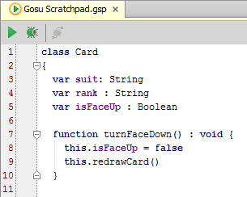
Class definitions
Every class is created by a class definition, which specifies (among other things):
Name of class
Properties that every instance of the class has
Methods that every instance of the class has
Notes:
In a Card class used for an actual program, the suit and rank properties would probably have more constrained datatypes. For example, suit would be limited specifically to "hearts", "diamonds", "clubs" and "spades". They are shown as strings in the screenshot above to simplify the example.
There is a variety of object-oriented programming languages, each with variations in syntax. The syntax implied from the screenshot above is meant to be an example of possible class syntax. It is not necessarily accurate syntax for any specific language.

Slide 7
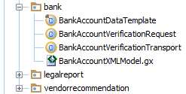
Packages
packages
A package is a collection of classes grouped together because:
They perform related logic, and/or
They should have access to each other while classes outside package should not
Packages are often arranged in a hierarchy
Classes in bank package
Notes:
Packages are referenced by their fully qualified name. For example, the StandardDeck package above is typically referenced in code as "CardGames.StandardDeck". This gives programmers the freedom to reuse package names in multiple places in a package hierarchy.
In the example above, the folder icon has been used to represent a package, and the file icon has been used to represent a class. However, this type of representation will vary based on the integrated development environment (IDE) one uses.

Slide 8
Lesson outline
Overview of classes
Gosu classes
Creating packages and classes
Working with methods

Slide 9
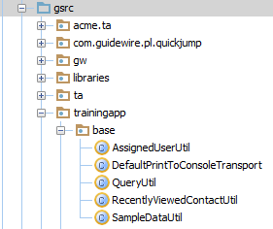
Classes in Gosu
Gosu is an OOP language
Classes in Gosu are:
Displayed under Studio's Classes nodes
Stored in .gs files
Written within Studio

Slide 10
Static methods
A static method is a method that belongs to the class in which it is declared (as opposed to belonging to each instance of the class)
Static methods can be called even when there is no instance
For configuration developers, most of the work with Gosu classes is limited to static methods
Therefore, this lesson focuses on static class methods
Notes:
In Gosu (as well as in many other OOP languages), you can define methods that belong to the class itself, rather than instances of the class. This is useful when you want to define a library of methods of similar purpose. The class encapsulates the methods but there will never be a need to create an instance of the class. You can create static methods on a class independent of whether any code ever creates an instance of the class. You are not forced to choose between the two design styles.
For configuration work, Gosu classes are used to gather together functionality that cannot be placed in individual PCF files and either cannot or should not be created as entity enhancements. Determining where to locate a given type of logic is discussed later in this lesson.

Slide 11
Examples of static class methods
ClaimCenter
Dynamic assignment (usable when assignment is based on dynamic value such as each user's workload)
SIU lifecycle (to determine which step of process to set given object at)
PolicyCenter
Validation (used to determine if a draft policy is quotable or bindable)
Forms inference (used to determine which forms should be attached to a policy)
BillingCenter
Approval (used to determine approval of commissions, disbursements, and charge reversals)
Notes:
SIU stands for Special Investigations Unit, which is the part of a claims processing organization that evaluates potentially fraudulent claims.
The examples referenced above can be found in the following packages for the given product's package hierarchy:
ClaimCenter dynamic assignment: gw.api.assignment.examples package
ClaimCenter SIU lifecycle: libraries package
PolicyCenter validation: gw.validation package
PolicyCenter forms inference: gw.lob.<specific line of business>.forms packages
BillingCenter approval: gw.approval package

Slide 12
Gosu classes for integration developers
Most integration work involves full utilization of OOP capabilities, including:
Extending existing classes
Implementing interfaces
Creating instances of classes
Overriding methods
Using try/catch blocks to handle exceptions
These topics fall outside of "fundamental configuration" and are not discussed in detail in this course

Slide 13
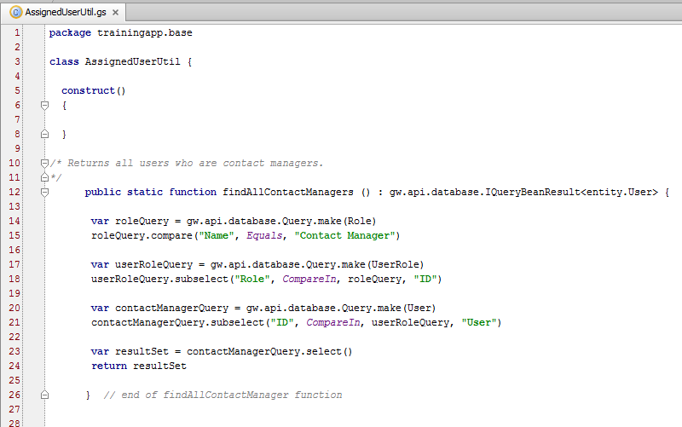
Contents of simple Gosu class
package declaration (identifies package this class belongs to)
class name
constructor method (does not appear by default)
static class method
Notes:
In the code above:
Line 1 declares the package in which the class exists.
Line 3 declares the class name.
Lines 5 through 8 declare a constructor method. Because "configuration-level" classes typically consist only of static methods, instances of the class are never created and there is no need to specify anything in the constructor method.
Lines 12 through 26 declare a static method in the class

Slide 14



Where should I declare my code?
PCF methods useful for code that...
Is needed by only one PCF
Manipulates current location
Entity enhancements useful for code that...
Is always tied to instances of given entity
Determines derived entity values
"Feels like" something instances of that entity would do
Gosu class methods useful for code that...
Cannot be easily tied to single entity
Should be declared with other methods that perform similar business tasks

Slide 15
Lesson outline
Overview of classes
Gosu classes
Creating packages and classes
Working with methods

Slide 16
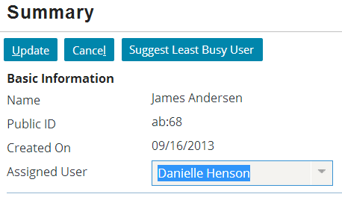
Example business requirement: Suggesting least busy user
As a sample business requirement, TrainingApp needs several methods that influence one or more contact's assigned user
One method returns user with least number of contacts assigned to him/her
Because several methods of this type are needed, methods will be declared in Gosu class

Slide 17
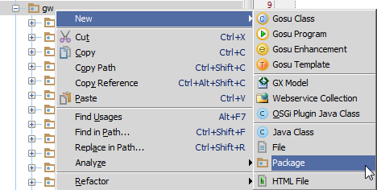
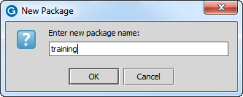
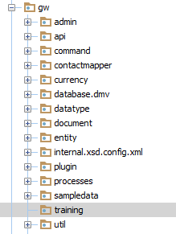
Creating packages
Right-click package that is to be parent of new package
Name must be unique for given parent
Notes:
In some cases, configuration work involves altering methods or creating new methods in existing classes (and therefore in existing packages).
In other cases, configuration work involves creating new methods that should be in their own packages.

Slide 18
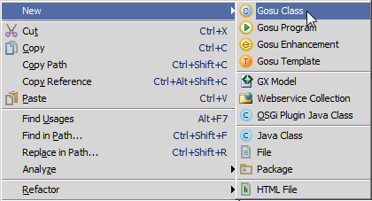
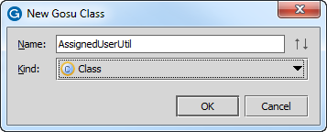
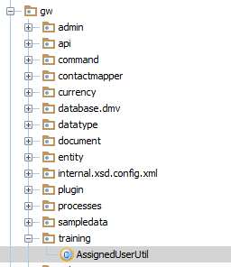
Creating classes
Right-click package which is to contain new class
Name must be unique for given package

Slide 19
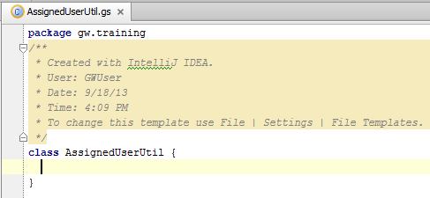
New classes
New classes have two components
Package declaration
Fully qualified name of package
Class name
Notes:
Package names and class names are required to be unique within their given parents, but they are not required to have globally unique names. Therefore, packages and classes are always referenced by their fully qualified package name. For example, if one references the "training" package, the compiler will assume this is a top-level package. If there is no such package, then an error results. References to the training package shown in the screenshot above must be "gw.training". Similarly, references to the AssignedUserUtil class must be written as "gw.training.AssignedUserUtil" to distinguish the class from any other identically named class in a different package.
Note that when you create a new class, a constructor is not added automatically. If you intend to create instances of the class and include non-static methods, you must add a construct() {} method.

Slide 20
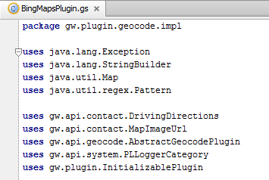
uses keyword
uses keyword identifies package in which some other class is declared
Lets developer reference classes in other packages using "unqualified" reference
Typically appears immediately after package declaration
compiler knows DrivingDirections is in gw.api.contact, so code can reference just "DrivingDirections", not "gw.api.contactDrivingDirections"

Slide 21
Lesson outline
Overview of classes
Gosu classes
Creating packages and classes
Working with methods

Slide 22
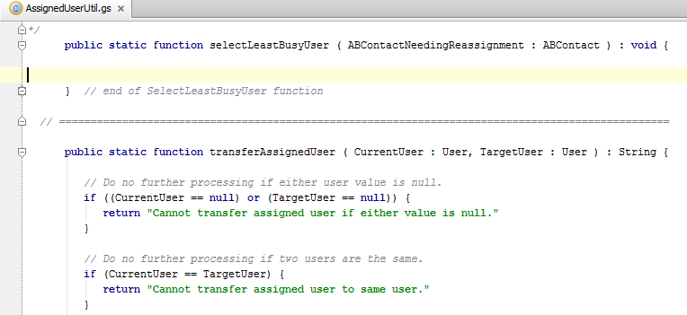
Static class method syntax
Syntax: public static function functName (inputvar : datatype) : returnType { // code to execute method return returnValue // when returnType not void }
Notes:
You can precede the function keyword with one or more modifier keywords. Guidewire modifiers include public and private, which are access modifiers. A method is public by default, meaning that it can be referenced from anywhere in a Guidewire application that uses Gosu. In contrast, a private method can be referenced only within the class within in which it is defined. Because static methods are typically used throughout the application, they should be public. The convention is to explicitly declare them as public (by including the public key word). Omitting the keyword, however, causes the method to default to public access.
The static keyword identifies that the method belongs to the class (as opposed to each instance of the class). This gives other code the ability to call the method even when there is no instance of the class.
For Gosu classes that make full use of Gosu's object-oriented design features, the common practice is to omit the word public as it is the default modifier. These types of Gosu classes are typically used for integration work. Gosu classes written for configuration work typically contain only static methods. The practice for these classes is to include the word public to make it more evident that the class is simply a collection of static methods.
The recommended capitalization convention for methods is to use CamelCase with an initial lower-case letter (such as selectLeastBusyUser or transferAssignedUser).
A method can return any type of value found in Gosu, including:
Boolean
String
Integer
Object from the data model
Arrays
Void (no value returned)

Slide 23
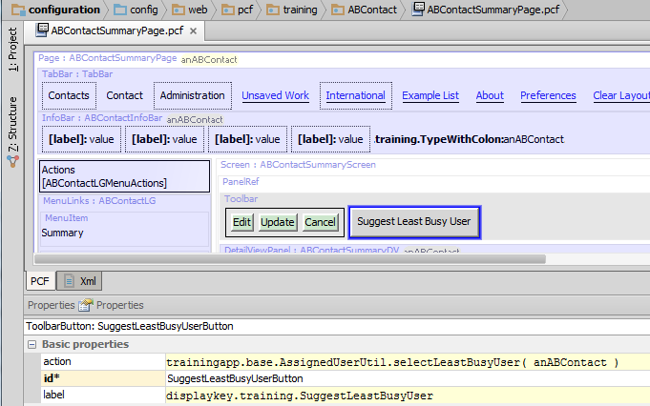
Referencing method syntax
Syntax: fullPackagePath.className.function (inputParameters)
Notes:
The screenshot above shows the action attribute for the Suggest Least Busy User button. This property references the package, class, and method created on the previous slide.

Slide 24
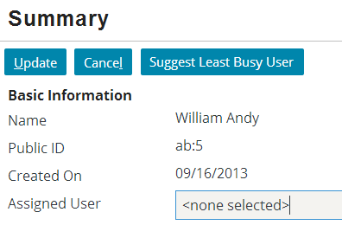
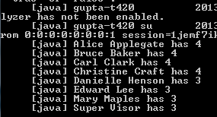
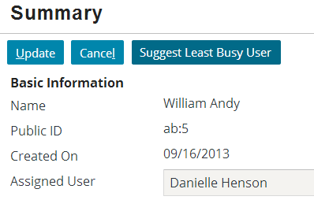
Example method in action
Number of assigned contacts per user
Notes:
The runtime output shown in the right screenshot is not information output by the actual method. It has been provided only to illustrate the state of the data at the time the method was executed. Several users have 0 assigned contacts. Because Carl Clark is the first one alphabetically by last name, he is the one to whom the contact is assigned.

Slide 25
Lesson objectives review
You should now be able to:
Describe the general capabilities of a Gosu class
Create packages and classes
Create static class methods
Reference class methods

Slide 26
Review questions
What is a package?
When you reference a method, do you need to know which package the method is in?
For what reasons might you decide to put logic in a Gosu class method (as opposed to a PCF method or entity enhancement)?
What two keywords typically appear in the declaration of a Gosu class method used for configuration work? What does each of them mean?
Notes:
Answers
1. A package is a group of classes gathered together either because they execute a common business task, or because access to the classes must be limited only to the classes in the package, or both.
2. Yes. When you use a Gosu method from a particular package, you must either:
Reference the package path in a "uses" statement prior to using the method (such as "uses gw.training.AssignedUserUtil"), OR
Reference the package path with the method call (such as "gw.training.AssignedUserUtil.selectLeastBusyUser(anABContact)")
3. Possible answers: The logic will be reused and involves multiple entities; the logic consists of several methods spanning several entities that you want to gather together into a single place.
4. public, which identifies that the method is available to any code that must call it (as opposed to just other methods in the same class or package); and static, which identifies that the method belongs to the class itself and can be declared even if there is no instance of the class.

