Slide 1
Script Parameters
19 Sept 2013
Notes:
Guidewire training materials contain Guidewire proprietary information that is subject to confidentiality and non-disclosure agreements. You agree to use the information in this manual solely for the purpose of training to implement Guidewire software solutions. You also agree not to disclose the information in this manual to third parties or copy this manual without prior written consent from Guidewire. Guidewire training may be given only by Guidewire employees or certified Guidewire partners under the appropriate agreement with Guidewire.

Slide 2
Lesson objectives
By the end of this lesson, you should be able to:
Describe the role of script parameters
Create and update script parameters
Reference script parameters
This lesson uses the notes section for additional explanation and information. To view the notes in PowerPoint, choose View→Normal or View→Notes Page. If you choose to print the notes for the lesson, be sure to select “Print hidden slides.”

Slide 3
Lesson outline
Script parameter basics
Creating and referencing script parameters
Updating script parameters

Slide 4
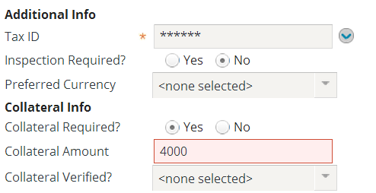
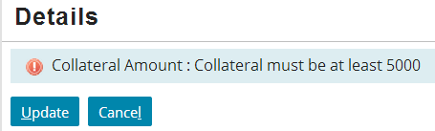
Script parameters
A script parameter is an application-wide global constant
Value maintained by administrator
Can be referenced in any Gosu code
Typically used for values that may change over time and therefore should not be hard-coded

Slide 5
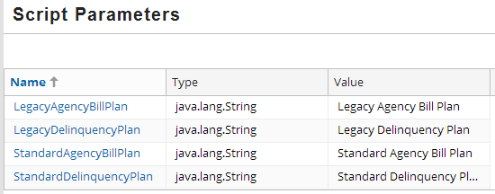
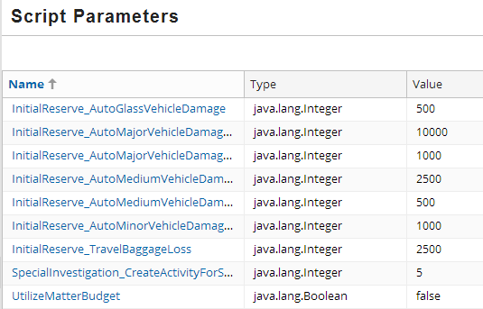
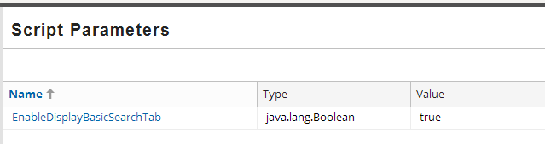
Examples from base applications
BillingCenter
ClaimCenter
PolicyCenter
Notes:
PolicyCenter 8.0 has a single script parameter to enable a search tab.
BillingCenter 8.0uses script parameters primarily to manage values pertaining to delinquency and agency bills.
ClaimCenter 8.0 uses script parameters primarily to manage values pertaining to initial reserves.

Slide 6
Lesson outline
Script parameter basics
Creating and referencing script parameters
Updating script parameters

Slide 7
Steps to create a script parameter
In Studio, open Script Parameters xml file
Create the parameter in xml
Specify parameter name
Specify datatype
Specify initial value

Slide 8
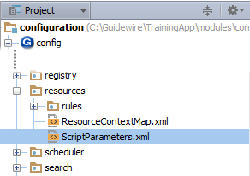
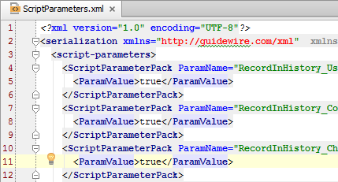
Step 1: open Script Parameters xml file
Notes:
There is no dedicated UI to add or edit script parameters. However, you can directly edit the ScriptParameters.xml file using the standard XML editor in Guidewire Studio. The physical file path is ...\configuration\config\resources\ScriptParameters.xml.

Slide 9
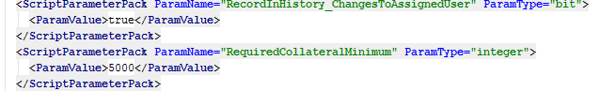
Step 2: Create the parameter
Specify
Parameter name → “RequiredCollateralMinimum”
Parameter type → “integer”
Parameter initial value → 5000
Notes:
Contexts Checkboxes
The Contexts checkboxes are used for tagging a script parameter for inclusion when a set of rules is exported. For example, if you select "Guidewire claims history rules" when creating a script parameter, that parameter will be included in the export file whenever claims history rules are exported.

Slide 10
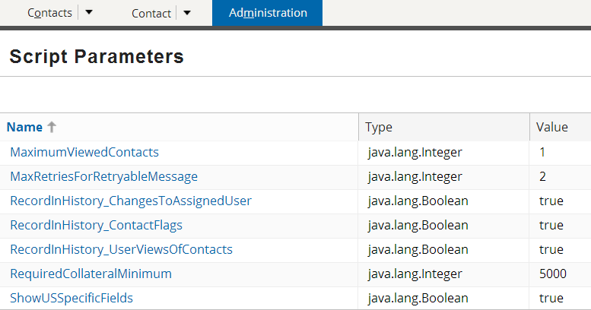
The completed script parameter
Script parameter and its initial value are listed on Administration tab's Script Parameters screen
If Studio is connected to the application, new parameters show up immediately
Notes:
If Studio is connected to the application when a new script parameter is created, then the new script parameter is immediately known to the application. However, you may need to refresh the Script Parameters screen to get the new parameter to show.
If Studio is not connected to the application when a new script parameter is created, then the new script parameter is known to the application when either Studio is connected to the application or when the application is restarted.

Slide 11
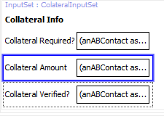
Referencing script parameters
Syntax: ScriptParameters.parameterName
Notes:
ScriptParameter is a global object available to all Gosu code, including business rules, enhancements, Gosu classes, and PCF files.
The example above makes use of the requestValidationExpression property. This property is used to enforce field-level validation. The condition in the property is evaluated when the user attempts to commit data changes. If the expression returns null, then the value is considered valid. If the expression returns a string, then the value is considered invalid, the save is prevented, and the string is displayed. This example has an expression that checks to see if the value (denoted by the keyword VALUE) is greater than or equal to the current value of the RequiredCollateralMimimum script parameter. If it is, then null is returned, which allows the save to occur. If it is not, then the string "Collateral must be at least X" is returned, where X is the current value of the RequiredCollateralMimimum script parameter. Because this string is a non-null value, the save is prevented and this message is displayed on the screen.

Slide 12
Example 1: Field-level validation
Notes:
The example above shows the RequiredCollateralMinimum script parameter, which was defined on the previous slide, in action.

Slide 13

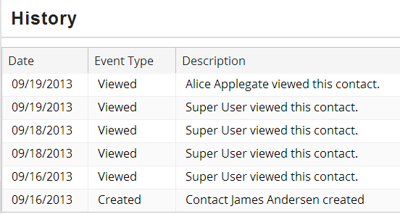
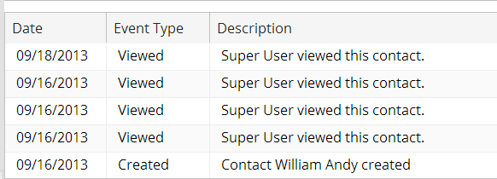
Example 2: Toggling application behavior
when set to true...
when set to false...
Notes:
Script parameters can be boolean values. In some cases, these script parameters are used to determine whether or not to execute a block of code that accomplishes an application behavior.
In the example above, the RecordInHistory_UserViewsOfContacts parameter is used to determine whether or not a user's viewing a contact will be recorded in the contacts history. If the value is true, the method is fully executed and "Viewed" events are added to each contact's history. If the value is false, the bulk of the method code is not executed and "Viewed" events are not added to each contact's history.

Slide 14
Lesson outline
Script parameter basics
Creating and referencing script parameters
Updating script parameters

Slide 15
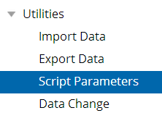
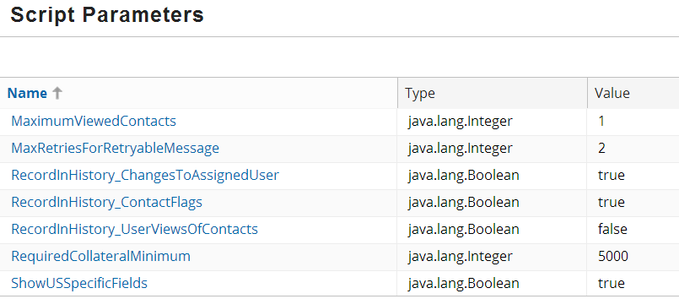
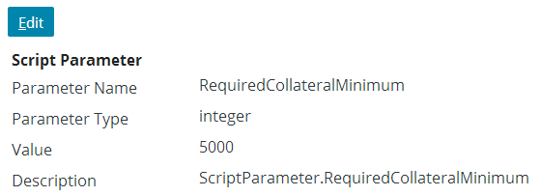
Access script parameter values
Notes:
To update a script parameter:
Navigate to the Administration tab's Script Parameters screen.
Click the name of the script parameter.
Click the Edit button.

Slide 16
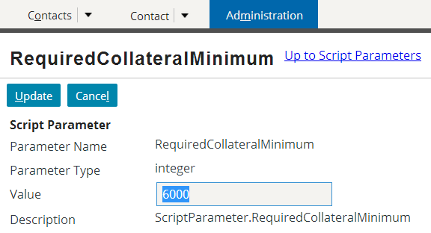
Update the script parameter value
After they are created, parameter values in Studio are ignored
Manage values exclusively through application's Admin tab
Notes:
4. Modify the value of the script parameter.
5. Click the Update button.
Changes to script parameter values take effect immediately.
After a script parameter resides in the database, you manage it solely in the Script Parameters administration screen from within ClaimCenter itself. Studio does not propagate any changes made in the Script Parameters dialog box.

Slide 17
Lesson objectives review
You should now be able to:
Describe the role of script parameters
Create and update script parameters
Reference script parameters

Slide 18
Review questions
When is it appropriate to use a script parameter?
After you have created a script parameter, what must you do to fully deploy it?
Where can a script parameter be referenced?
Where are the values of script parameters updated?
Notes:
Answers
Script parameters are appropriate for values that may change over time and therefore should not be hard-coded, such as BillingCenter delinquency and agency bill settings, or ClaimCenter initial reserve settings.
You must restart the server to deploy the script parameter.
A script parameter can be referenced anywhere that Gosu can be used (including business rules, enhancements, Gosu classes, and PCF files).
On the application Administration tab's Script Parameters screen.

