Slide 1
PolicyCenter Overview
20 May 2014
Notes:
Guidewire training materials contain Guidewire proprietary information that is subject to confidentiality and non-disclosure agreements. You agree to use the information in this manual solely for the purpose of training to implement Guidewire software solutions. You also agree not to disclose the information in this manual to third parties or copy this manual without prior written consent from Guidewire. Guidewire training may be given only by Guidewire employees or certified Guidewire partners under the appropriate agreement with Guidewire.

Slide 2
Lesson objectives
By the end of this lesson, you should be able to:
Describe the role of PolicyCenter in the Guidewire InsuranceSuite products
Describe the process of logging on to PolicyCenter
Describe the structure and functionality of the user interface
Describe the typical implementation team members and tools that they use
This lesson uses the notes section for additional explanation and information. To view the notes in PowerPoint, choose View→Normal or View→Notes Page. If you choose to print the notes for the lesson, be sure to select “Print hidden slides.”

Slide 3
Lesson outline
PolicyCenter overview
Logging in
User Interface
PolicyCenter implementations
Notes:
PolicyCenter Overview - 3

Slide 4
Guidewire product landscape
Guidewire provides core systems used by carriers as operational systems of record
Core Operations Support
External Access
Data Management & Business Intelligence
Monitoring & Guidance
Operational Systems of Record
Notes:
Guidewire builds software products that help property and casualty (P&C) insurers replace their legacy core systems and transform their business. Guidewire provides core systems and data management/business intelligence tools used by insurers as operational systems of record. Additional products provide support for anytime/anywhere access and guidance and monitoring.
Who uses Guidewire products?
Everything in the blue circle is targeted at internal users at insurance companies—claims adjusters, underwriters, risk managers, customer service representatives, billing clerks, and so on.
External Access includes two types of users:
Third-party users such as policyholders and vendors, who can't log in to the core systems but need to access some of the data that lives in those systems.
Authorized users of the core systems who have special requirements, such as an adjuster who is currently mobile after a catastrophe and has no internet access but needs to take pictures and take notes to upload later.
Monitoring and Guidance describes a variety of hosted services that enable carriers to use cloud-based applications in their day-to-day workflow. Hosted services include geographic visualization, catastrophe capture, and comparison of peer insurer benchmarks, among others.
PolicyCenter Overview - 4

Slide 5







Guidewire products
Mobile & Portals
Guidewire Live
InfoCenter
DataHub
Notes:
Operational Systems of Record
In the area of Core Operations Support, Guidewire InsuranceSuite provides a complete set of applications to support a carrier's core operations—underwriting, policy administration, billing, and claim management. The slide provides a high-level view of the core Guidewire products. It is not an exhaustive list of all applications and licensed features. Therefore, some features and products, such as ContactManager, Client Data Management, PolicyCenter Rating, PolicyCenter Reinsurance, and the ISO Standards-Based templates, are not shown.
In the area of Data Management and Business Intelligence, Guidewire DataHub is an operational data store that unifies, standardizes, and stores data from a carrier's own systems as well as external sources. Guidewire InfoCenter is a business intelligence warehouse that is purpose-built for P&C insurance. It provides easy-to-use reporting formats for business intelligence, analysis, and enhanced decision making. Using InfoCenter, carriers gain operational insight across the enterprise.
Monitoring and Guidance
Guidewire Live is a network that connects peer insurers, core systems data, external sources of information (such as weather services), and expert tools. Users access Guidewire Live through applications hosted by Guidewire and designed for specific challenges faced by P&C insurance professionals.
External Access
Mobile & Portals is a new set of applications that feature add-on products to the Guidewire core suite, providing self-service transactions through various mobile channels.
PolicyCenter Overview - 5

Slide 6
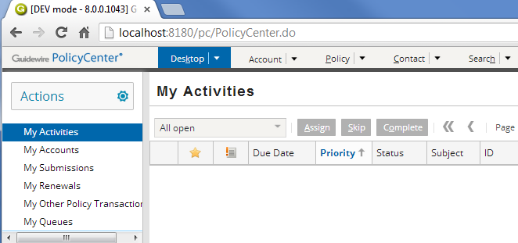
PolicyCenter
producer
underwriter
supervisor
Browser-based application
Supports multiple types of users, such as:
Producers (who refer accounts to carrier)
Underwriters (who create and manage policies)
Supervisors (who supervise users and approve work)
Notes:
PolicyCenter is a browser-based application that enables multiple users to participate in policy processing.

Slide 7
Value proposition of PolicyCenter
PolicyCenter makes the processing of policies:
insured
contacts
locations
forms
payments
trans- actions
risk analysis
product model
Policy-centric
Collaborative
Configurable
Notes:
PolicyCenter is a policy-centric solution. All of the data pertaining to a policy is centralized in the policy file. This includes information on the insured, the policy locations, the payment history, any recorded risk analysis (such as previous claims filed), points to the product model used to build the policy, policy transactions for the policy (such as submissions, changes, and renewals), endorsement forms, and contacts. All users have an integrated and holistic view of the policy.
PolicyCenter facilitates collaboration among policy workers by providing one centralized location where all information needed to process the policy can be uniformly worked on and shared.
PolicyCenter provides a wide span of configuration options. The base application provides a robust starting point, but carriers can make changes as needed to the data model, the user interface, the business rules, and the product model.

Slide 8


Guidewire applications architecture
Users
Operational Database
Guidewire Application
Claims Admin.
Authen- tication
Reporting
Address Book
Billing Admin
Notes:
PolicyCenter Overview - 8
Three-tier architecture is a client-server architecture in which the operational data, application logic, and user interface are developed and maintained as independent modules on separate platforms. Three-tier architecture is one of the industry-standard software architectures.
The data tier contains the business and operational database. It is hosted in an Oracle or SQL Server database or cluster of databases.
The application tier contains the functional process logic. It is hosted in an application server such as WebLogic, WebSphere, Apache Tomcat, or JBoss EAP.
The presentation tier contains the user interface. The Guidewire user interface is supported in these web browsers: Google Chrome, Mozilla Firefox, and Microsoft Internet Explorer.
Refer to the "Guidewire Platform Support Matrix" for the latest and most complete information about the software Guidewire supports. You can access it from the customer portal by navigating to http://guidewire.hivelive.com/pages/home, selecting "Resources -> Documentation", and clicking "Platform Matrix".
Each application is typically integrated with a number of external systems.

Slide 9
Common points of integration
External System
Policy Processing
Legacy policy admin.
Document production
Document storage
Billing
Policy Pricing
ISO
Credit rating
Claims
Rating
User Management
Authentication
Agent Management System
Contact Manager
Miscellaneous
Address normalization
Reporting
Notes:
A definition for each integration point appears below:
Legacy policy administration system - This external system maintains policies created prior to the implementation of PolicyCenter (or policies for which PolicyCenter is not the system of record but for which PolicyCenter needs information).
Document production system - This is an external system used to store document templates and create documents.
Document storage system - This is an external document storage system which is used for storage and document retrieval.
Billing system - This is an external billing system which sends bills to the insured (so that they pay the premium) and reports when accounts are overdue.
ISO - (This integration point is common only for American carriers.) This is an American company which maintains rating information for fire protection for every place in the United States. A city can have many fire protection classes, therefore the information is defined at the location/address level. ISO also maintains Building Code Effectiveness grades of how well any community enforces their building codes. This is used for fire, EQ and wind/storm rating.
Credit rating system - This is a system which maintains credit rating information about the insured, such as Dun and Bradstreet.
Claims system - This is the system that managed claims for the carrier and is relevant at renewal time to determine if the policy should be renewed and if the rates should be raised.
(continued)

Slide 10
(Notes only slide)
Notes:
Rating - This is a system which is used to determine quotes and premiums for policies. PolicyCenter also has its own licensed Rating module.
Authentication system - This system takes a user name and either a token or a password and verifies if the two match.
Agent Management System (AMS) - This system tracks either a person or company that is authorized by an insurance company to transact business. This typically includes the authority to bind the insurer, issue policies, authorize producing agents, perform administrative functions, and even adjust claims.
Address normalization service - This is an external service which verifies address validity (with regards to the existence of a street address, the appropriateness of a given postal code for a given city, and so on). In the United States, this information is promulgated by the United States Postal Service (USPS), which has standardized abbreviations (such as "ste" for suite and "ln" for lane) and a complete range of numeric addresses per street, streets and addresses per postal code, and postal code per state.
Reporting system - This system provides reports on PolicyCenter business and user data.
Contact management system - This is an integration point to an external address book application for managing contacts.

Slide 11
Lesson outline
PolicyCenter overview
Logging in
User Interface
PolicyCenter implementations
Notes:
PolicyCenter Overview - 11

Slide 12
Accessing PolicyCenter
Users must have:
Google Chrome or Mozilla Firefox or Microsoft Internet Explorer
The PolicyCenter URL
A user name and password
Notes:
To access PolicyCenter, a user must have:
An instance of Google Chrome or Mozilla Firefox or Microsoft Internet Explorer
The URL for connecting to PolicyCenter
A valid user name and password
Google Chrome is the recommended web browser and Mozilla FireFox and Microsoft Internet Explorer are also supported by PolicyCenter.

Slide 13
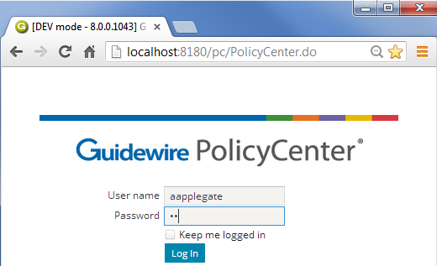
Login page
Because the pages are generated dynamically:
Back is not supported
You cannot create bookmarks or favorites to pages (other than the login page)
Notes:
To log in to an application, end users must open an instance of Google Chrome and access the system through the appropriate URL (Universal Resource Locator, also more commonly known as a "web address"). The URL is:
http://machine:port#/instanceName/PolicyCenter.do, where:
machine is the name of the host machine, and
port# is the port which Internet Explorer should use to access the application, and
instanceName is the name of the instance of PolicyCenter (typically "pc").
Connections to PolicyCenter are usually initiated using one of the following methods:
Providing users with a “Favorite” that links to the URL
Providing users with a shortcut on the computer desktop that invokes Chrome with the URL
Creating a web link on a readily accessible web page that links to the URL
Even though the Back button and favorites to non-login pages are not supported, navigation within PolicyCenter is rarely if ever cumbersome. PolicyCenter contains a number of navigation features to make it easy for users to view commonly referenced information and recently viewed information. These features are discussed through this section.

Slide 14



Authentication and authorization
username and password
Desktop: Activities
authenticated? what permissions? which start page?
Yes! View policy, ... Desktop: Activities
pc data
Notes:
Authentication is the process of verifying a user is who he or she claims to be. Authorization is the process of determining which objects a user is allowed to view and edit and what actions a user is allowed to take.
When an end user attempts to log on to an application, the following occurs:
The user supplies their user name and password to PolicyCenter via the login page.
PolicyCenter queries the authentication system (which could be a separate system accessed through an integration point or the PolicyCenter database itself) to authenticate the user.
PolicyCenter queries the PolicyCenter database to determine which permissions are assigned to the user and what the user's start page is. Permissions determine which screens the user can navigate to and which actions the user can perform. The startup view is the first page rendered after log in.
PolicyCenter renders the appropriate startup view with permissions appropriate for that user.
Out-of-box, authentication is managed through the PolicyCenter database. There is a table in the database which stores user names and password. (The system can also be configured to authenticate against an existing user domain structure, as discussed on the next slide.)
PolicyCenter can be configured to lock an account after a user attempts to log in a certain number of times without providing the correct password. (This feature is designed to prevent someone circumventing the authentication process to illegal log on to the application.) When an account is locked, it must be unlocked by a manager. In the base application, the number of attempts before locking the account is 3, but this number can be configured.

Slide 15
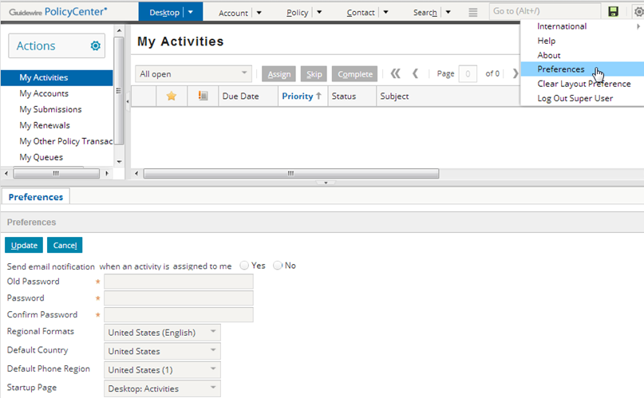
Startup view
Notes:
Each user has a startup view, which is what is first displayed when the user logs in. This is sometimes referred to as the user's "landing page".
In the base application, a new user's startup view is set to "DesktopActivities". This page lists all open activities that have been assigned to that user.
Users can change their startup view by clicking the Preferences menu action under the Options menu (gear icon) accessible from the Desktop. This opens a worksheet in the workspace frame. In this worksheet, they can select a different view as their startup view. (The workspace frame displays information that is "stand-alone" from a navigation perspective. The information could be user preferences (which has no impact on business data), or it could be a new note or new activity (which, once created, does not require any change to the data displayed in the screen area). The workspace frame is visible only when a worksheet is rendered. Most of the time, it is collapsed.)
The "look and feel" of PolicyCenter is controlled by a series of cascaded style sheets (CSS), fonts, and other configuration files. These can be configured if a given instance requires the use of different fonts and/or colors.

Slide 16
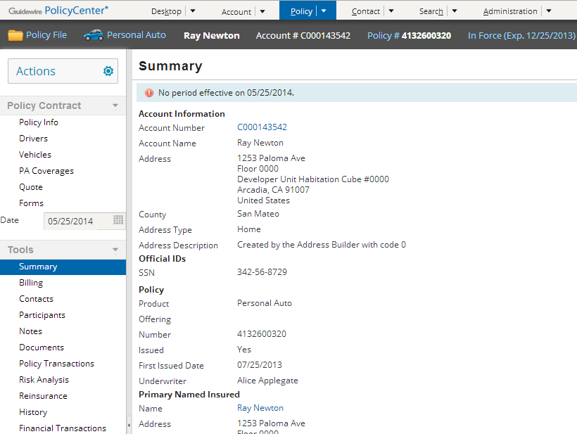
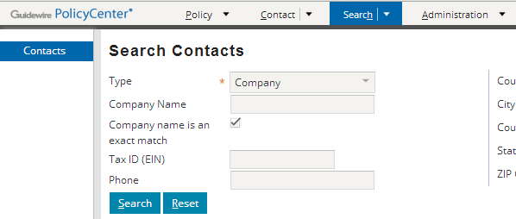
User permissions
Alice Applegate (Underwriter)
Percival Processor (Producer Clerical)
Does not get Desktop and Account tab
Notes:
A permission is a granular ability to see or do something within PolicyCenter, such as "create submissions" or "edit accounts".
A role is a named collection of permissions. Typically, a role maps to a job function or job title. For example, the "underwriter" role would contain the set of permissions appropriate to someone who was an underwriter. (This role might, for example, have the "create submissions" or "edit accounts" permissions, but it would not have the "create users" permission. Similarly, a "producer clerical" role might have only "create submissions" and not "edit accounts".)
Administrators can assign roles to users. They can also create new roles and modify existing roles (to add or remove permissions to them).
In the example above, Percival Processor (who is a producer clerical user and is shown in the right screenshot) does not have an Desktop and Account tab. She cannot access user accounts.
Alice Applegate (who is an underwriter and is shown in the left screenshot) has access to all of the tabs.
User permissions are discussed later in the course.

Slide 17
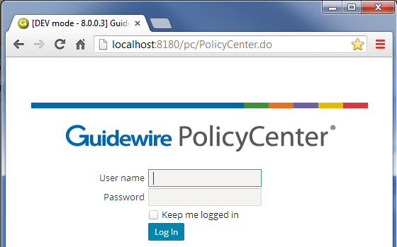
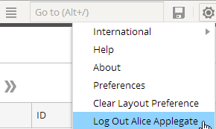
Logging out
After configured period of inactivity, OR when you click...
Notes:
When a user is finished interacting with PolicyCenter, he or she can log out using the Logout link.
The timeout period can be configured in the config.xml file. The default value is 10800 seconds (3 hours).

Slide 18
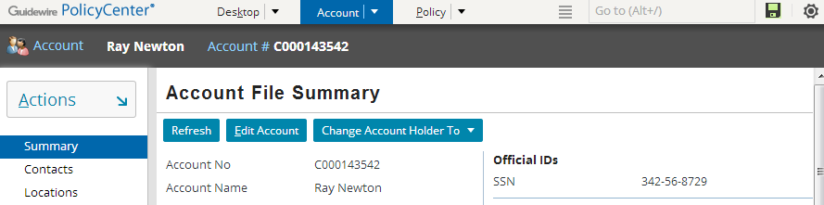
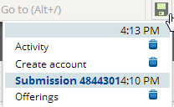
Unsaved work list
unsaved work exists (icon is green)
All of your unsaved work is automatically listed in the Unsaved Work list
unsaved work on previously visited accounts or policies
discard unsaved work
Notes:
"Unsaved work" refers to either work in a screen for a new object which you created but did not save or work in a screen for an existing object which you put into edit mode without updating or cancelling. In other words, unsaved work refers to any work which you navigated away from without clicking the Update or Cancel button. When the unsaved work list icon turns from gray to green, “unsaved work” exists.
From the unsaved work list, you can either navigate to the screen where the unsaved work is (by clicking the link) or discard the work (by clicking the corresponding trash icon).
The Unsaved Work icon appears green only when you have unsaved work. If the icon is grayed, then you have Updated or Canceled all changes you have made so far.

Slide 19
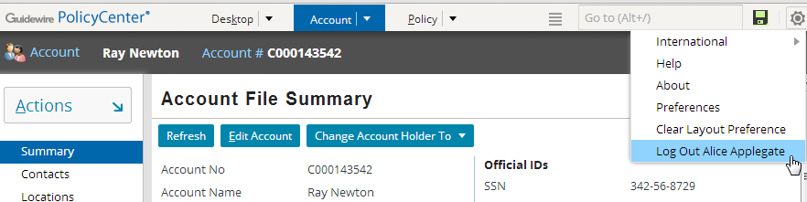
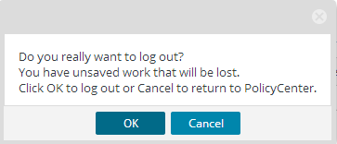
Logging off with unsaved work
If user attempts to log out and there is unsaved work...
... user must verify it is okay to discard unsaved work.
Notes:
If you attempt to log off with unsaved work, you are warned that all unsaved work will be discarded. If you click Ok, then all unsaved work is discarded.

Slide 20
Lesson outline
PolicyCenter overview
Logging in
User Interface
PolicyCenter implementations
Notes:
PolicyCenter Overview - 20

Slide 21
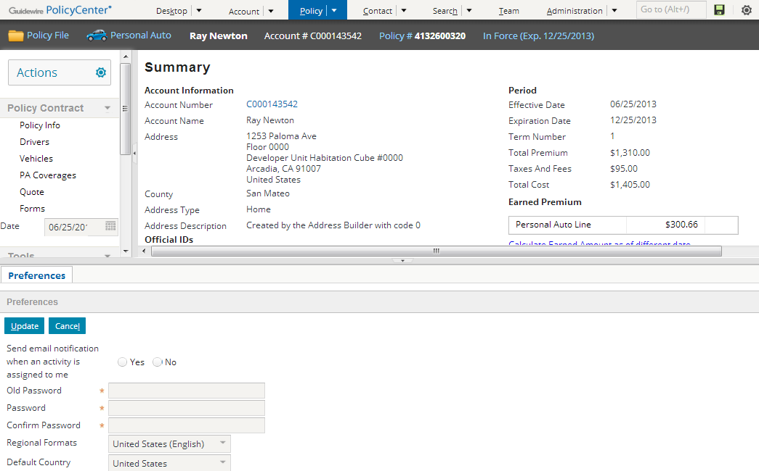
Main areas of the user interface
Tab Bar
Screen Area
Info Bar
Side Bar
Workspace Frame
Notes:
The PolicyCenter user interface can be broken down into the following main areas.
The tab bar is the top portion of the screen. It contains the tabs, the QuickJump box, the Unsaved Work list and the Options menu (gear icon).
The info bar is the horizontal dark gray strip between the tab bar and the screen area. It is not always visible. (In the base application, it is visible only on the Account and Policy tabs.) When it is visible, it contains summary information about the primary object displayed in the screen area.
The side bar is the vertical bar running down the left side of the user interface. The side bar contains menu links and menu actions that navigate the user to different parts of the application and let the user create new objects and initiate new jobs.
The screen area is the rectangular area to the right of the side bar. When the workspace frame is collapsed, the screen area occupies the lower right corner of the user interface. This is where the majority of the business data is displayed and acted upon.
The workspace frame displays information that is "stand-alone" from a navigation perspective. The information could be user preferences (which has no impact on business data), or it could be a new note or new activity (which, once created, does not require any change to the data displayed in the screen area). The workspace frame is visible only when a worksheet is rendered. Most of the time, it is collapsed.

Slide 22
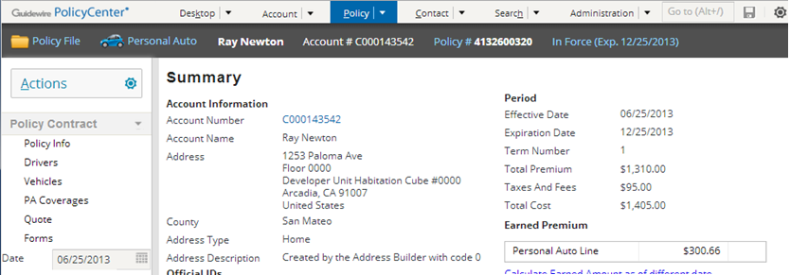
Tab bar
Changes to green when you have unsaved work
QuickJump box
Options menu
Collection of tabs, QuickJump box, Unsaved Work list, and Options menu
Each tab has:
Its own side bar and its own info bar
One major area of functionality
Notes:
The tab bar is the top portion of the screen. Each tab has its own side bar, its own info bar (though in some cases it is hidden) and its own set of screens (which are displayed in the screen area). When you click a tab, the associated side bar (if it is visible), and one of its screens are displayed.
The tabs shown above are the tabs that underwriters have access to when they first log into PolicyCenter. There can be additional tabs (such as Team) that are available only to users with permissions greater than that of an underwriter.

Slide 23
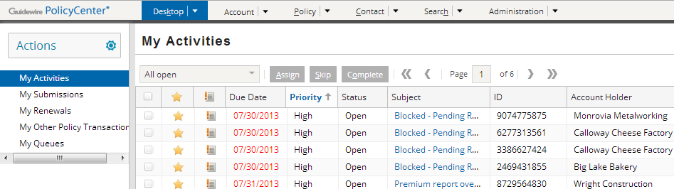
Desktop tab
User-centric, listing work, you as the user are responsible for (regardless of which account or policy it pertains to)
Notes:
The Desktop tab is a series of lists of objects for which the user has some responsibility, including:
Activities assigned to the user.
Accounts on which the user has a role, has an assigned activity, or has closed an activity. Displayed for super-users only.
Submissions on which the user has a role, has an assigned activity, or has closed an activity.
Renewals on which the user has a role, has an assigned activity, or has closed an activity.
Other Policy Transactions on which the user has a role, has an assigned activity, or has closed an activity.
Queues the user has access to (which contain activities that no user has taken ownership of yet)

Slide 24
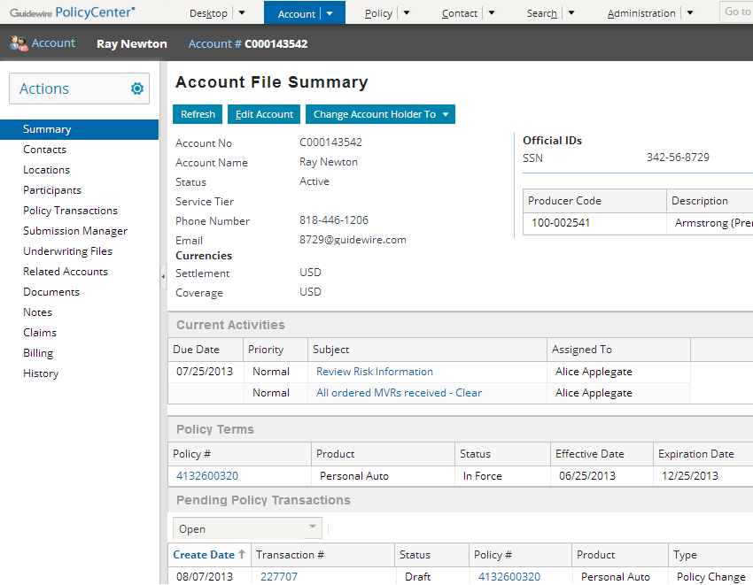
Account tab
Account-centric, listing work for this account (regardless of who is doing the work)
Notes:
The Account tab contains a series of screens about one account, list both information about the account itself, its contacts and locations, the policies held by the account, and policy transactions for the account which are in progress (such as submissions and renewals).
Note: The page has been edited to fit on the slide.

Slide 25
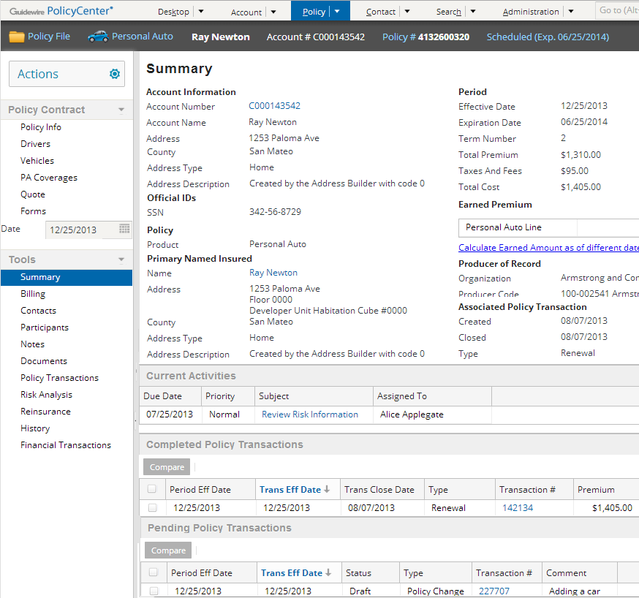
Policy tab
Policy-centric, listing work for this policy (regardless of who is doing the work)
Notes:
The Policy tab contains the "policy file", a series of screens about one policy. This includes both the "policy contract" data (what is covered on the policy) and the "policy tools" data (what historical information is available about the work done on the policy, such as notes, bills, risk analysis, and so on).
Note: The page has been edited to fit on the slide.

Slide 26
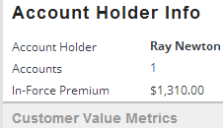
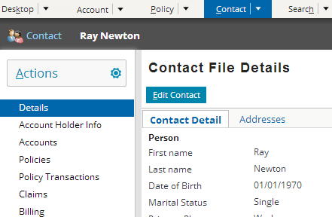

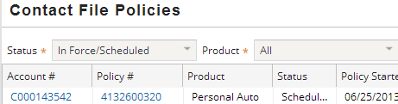
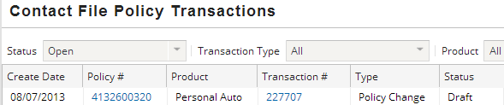
Contact tab
360 degree view of a client across Guidewire Suite
Notes:
The Contact tab provides a user the ability to work from a contact-centric starting point. A contact file is maintained similar to account and policy files so that configuration users can easily expand this functionality as needed.
A user can:
Edit contact information
Create new accounts with this contact
Create new contacts of type person or company
Search for contacts the same way as they can search for an account or a policy
View and link to accounts, policies, and policy transactions associated with the contact. There are filters on each of the pages to view policy or transactions of a particular status or product type.
The Addresses tab displays a list-detail view of addresses of the Contact.
Users can also view contacts that only exist externally through the Contacts tab but these contacts are not editable within PolicyCenter.
The Claims for the contact will be displayed if PolicyCenter is integrated with claims system.
The Billing for the contact will be displayed if PolicyCenter is integrated with a billing system.

Slide 27
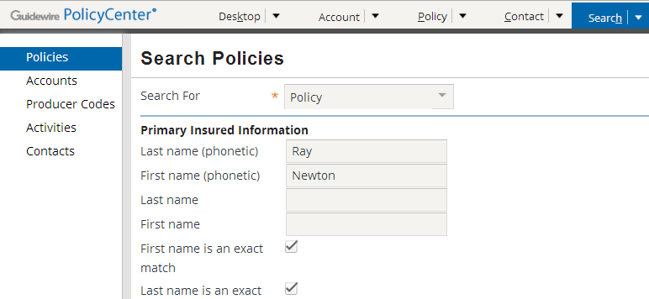
Search Tab
Use Search tab to find:
Policies, Accounts, Producer Codes, Activities, and Contacts
Text fields are treated as "starts with" conditions
Notes:
The Search tab gives users the ability to search for different types of objects. Some fields on search screens are text fields. Whenever you enter text into one of these fields, PolicyCenter treats the field as a "starts with" criteria. For example, if you entered "Smith" into the last name field, then the search will return any user whose last name starts with 'Smith', which includes "Smith", "Smithers", and "Smith-Collins".

Slide 28
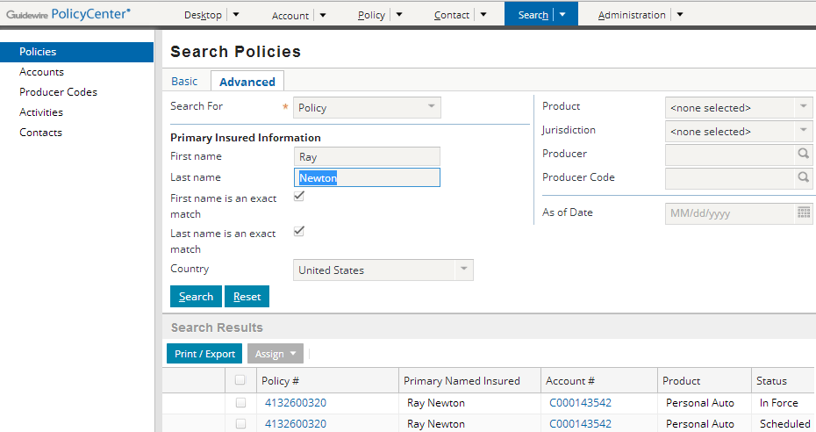
Two types of search for policies: Basic, Advanced
Basic and Advanced tabs display if Free-Text Search is enabled
Advanced tab search is same as Search → Policies
Notes:
PolicyCenter includes two types of searches: basic and advanced. Advanced search uses database search, which directly searches the PolicyCenter database. PolicyCenter includes advanced search for policies, accounts, producer codes, activities, and contacts. For large data sets, advanced search can take longer than basic search.

Slide 29
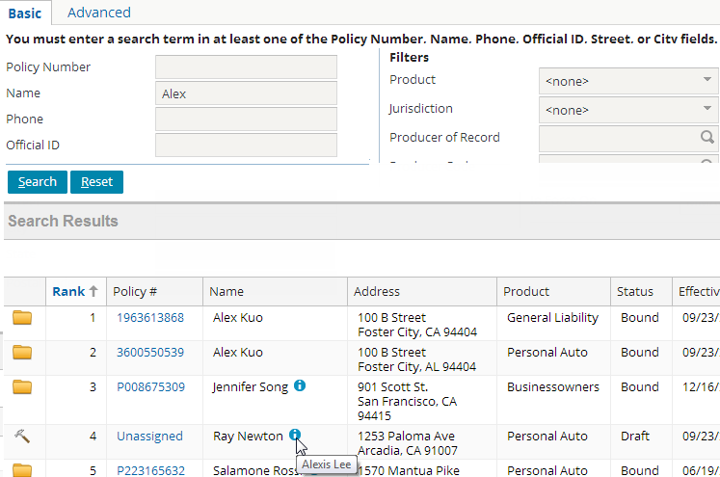
Basic Policy Search (Free Text Search if enabled)
Search → Policies → Basic tab
Bound policy icon
Unbound submission or change job
Notes:
Basic search is a free-text search for quick access against very large databases. Free-text search also provides exact and inexact matching. Inexact matching returns results that partially match, are synonyms, and sound-like the search criteria. In PolicyCenter, free-text search uses an integration with the full-text search engine Solr. Free-text search is disabled by default.
The first and last name of the person or the company name are returned by the search results. This field displays the primary named insured on the policy. The symbol (i) appears after the name if there are additional named insureds on the policy. Hover over the symbol to view the names of the additional named insureds.
For more information on enabling and configuring free-text search, see “Free-text Search Configuration” in the PolicyCenter Configuration Guide.

Slide 30
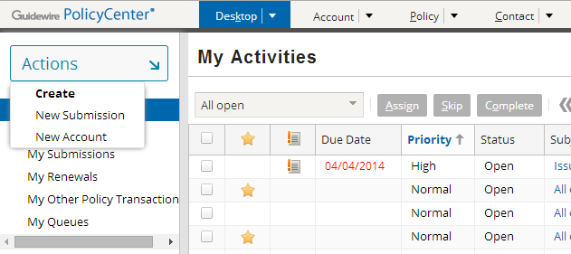
Actions menu
Tabs
Menu actions
Menu links
Each tab has unique menu links and actions
Menu links display new screens in screen area
Menu actions execute actions (which often display screens in the screen area or workspace frame)
Notes:
The side bar is the vertical bar running down the left side of the user interface. The side bar contains menu links and the Actions menu, which has embedded menu actions that navigate the user to different parts of the application and let the user create new objects and initiate new jobs. In this slide, the menu actions and links correspond specifically to the Desktop tab, highlighted in blue.
The behavior described above is true for base application menu links and menu actions. However, any clickable item can be configured to behave in any manner.

Slide 31
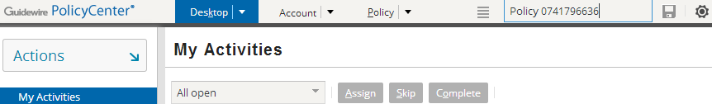
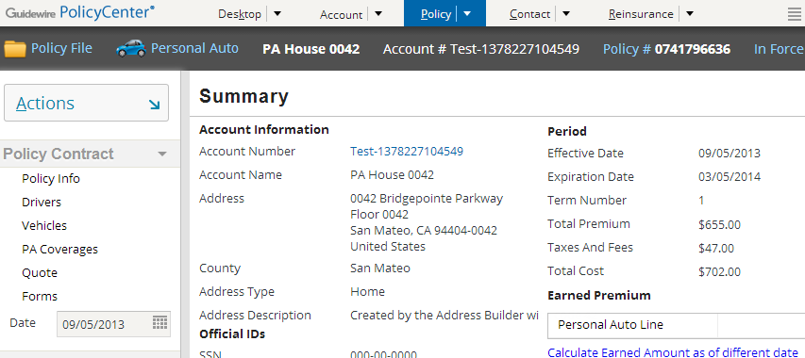
The "QuickJump" field
Alt + /, then “Policy 0741796636" and then Enter
Notes:
The QuickJump field is located in the upper-right corner of the user interface, though it can be accessed using a keyboard shortcut as well. The QuickJump field is designed to let users navigate to virtually any place in PolicyCenter without having to use their mouse.
For example, to navigate to policy 0741796636, a user could enter ALT+/ (to activate the QuickJump field) and then "Policy 0741796636" and then Enter. This navigates the user to that policy.

Slide 32
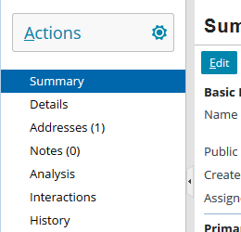
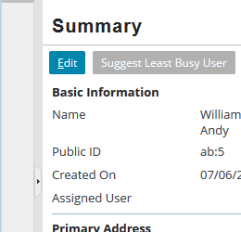
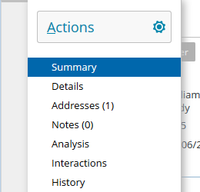
Side bar modes
Fixed mode
Collapsed mode
Floating mode
Remains fixed
Adjustable borders
Right and bottom scrollbars supported
Panel collapses
Center moves left and creates screen real estate
Click collapsed panel to trigger
Panel floats over center
Notes:
In the sidebar, the left navigation menu features second level navigation menu links.
PolicyCenter Overview - 32

Slide 33
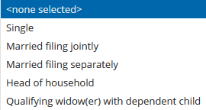

Drop-down list
Tax Filing Status
As you type, the list filters to the matching pattern
Filters as you type
When editing, the longest option value determines width of combo box
Drop-down lists are implemented and configured as combo boxes
Notes:
The Web UI framework renders drop-down lists as combo boxes. This implementation supports filtering the list as you type and sizing based on the type. When editing the specific field, the combo box grows to the longest size.
PolicyCenter Overview - 33

Slide 34
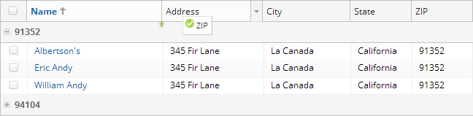
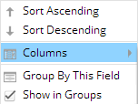
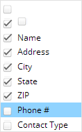
User configurable lists
1
5
3
2
Ascending and descending sort
Group by this field
By column data value
Collapse and expand
Re-arrange horizontally
Show and hide columns
Resize columns
4
User-configuration persists in browser local storage
Notes:
When working with lists, the user can control several user-configurable interactive columns. The end user can re-arrange, show and hide, resize, sort and group data by a column data value. Configurators no longer need to limit the data views contained in a ListView for end users.
User configurations are saved in the browser local data store.
PolicyCenter Overview - 34

Slide 35
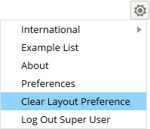
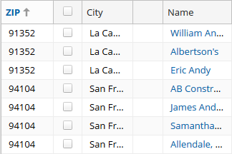
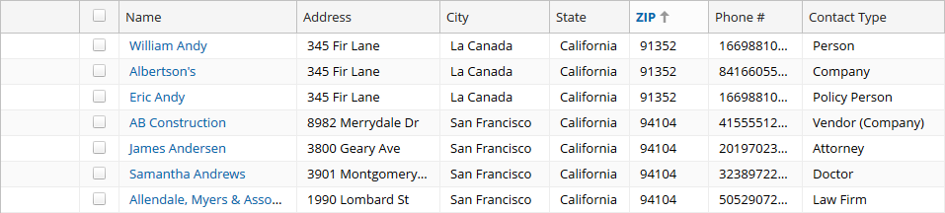
Clear layout preference
User configuration stored in browser Local Data store
Reset layout default with Settings → Clear Layout Preference
User configuration
Default configuration
Notes:
PolicyCenter Overview - 35

Slide 36
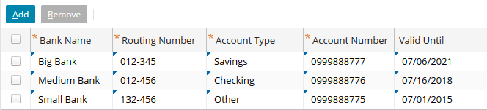

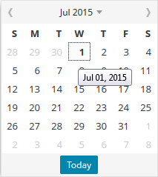
Editing lists
Editable cell indicator
Top left triangle:
Standard controls support
Watermark
Validation
Drop-down lists
Calendar
Notes:
PolicyCenter Overview - 36

Slide 37
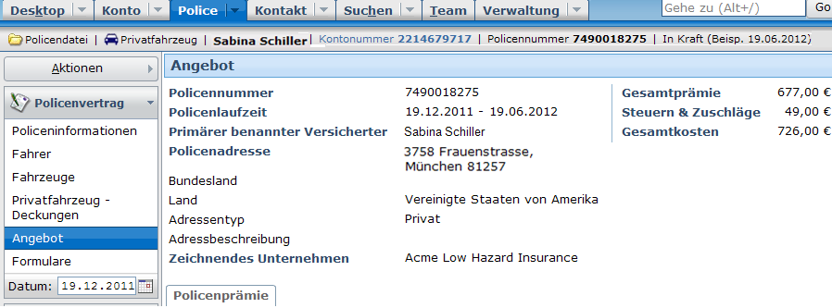
Localization
A locale can define how various elements of the UI are presented, including
Currency formats
Number formats
Date/time formats
Text labels
Notes:
The capability to localize the interface is identical for all Guidewire applications.

Slide 38
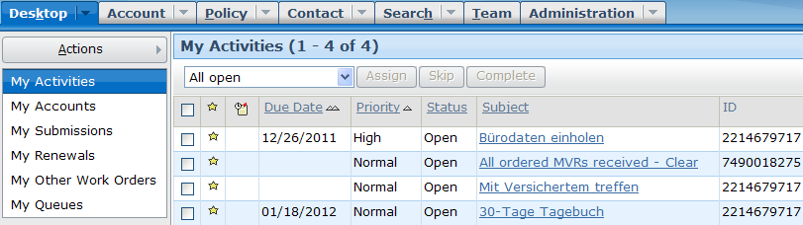
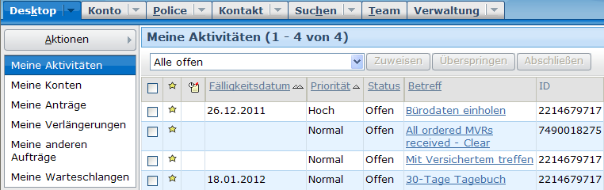

Setting user locale
Language and locale preference can be set per user
At logon
Via preferences

Slide 39
Lesson outline
PolicyCenter overview
Logging in
User Interface
PolicyCenter implementations

Slide 40
Guidewire implementation team
Business architect
Writes business requirements documents
Configuration developer
Configure product data model, user interface, and business logic
Integration developer
Create integration points to external systems to share data with Guidewire application
Reporting developer
Develops data warehouses and reports
Data migration developer
Migrates data from legacy system to Guidewire application
Notes:
A Guidewire implementation team consists of several people acting in several roles.
The following roles are relevant to every implementation:
Business architects are responsible for writing business requirements documents. They learn the functionality of the base application and then identify how the base application must be configured to meet the needs of a particular carrier.
Configuration developers configure the behavior of the application. This includes extending the application data model, modifying the application user interface, and writing business logic to enforce requirements.
Integration developers create integration points so that the Guidewire application can share data with external systems.
The following roles are relevant to an implementation only if the associated feature or functionality is to be implemented:
Reporting developers configure reporting functionality for the Guidewire application, such as creating data warehouses and creating reports to meet the business needs. This role is relevant only for carriers who are planning to implement the Guidewire reporting solution.
Data migration developers migrate data from legacy systems to the Guidewire application. This could include either administration data (such as users and groups) and/or business data (such as policies that are still in force, unpaid invoices, and/or open claims.) This role is relevant only for carriers who are planning to do a data migration.
PolicyCenter Overview - 40

Slide 41
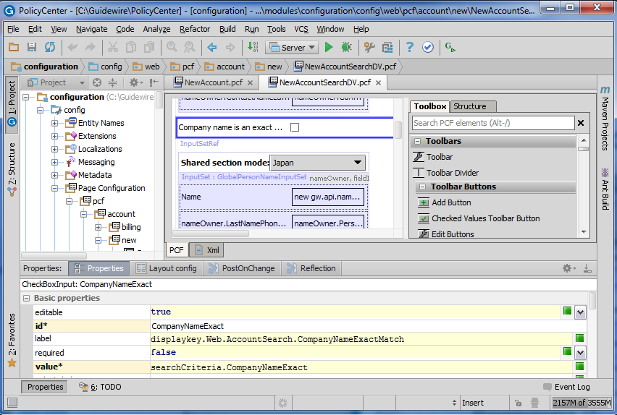
Configure PolicyCenter using Guidewire Studio
Configure product behavior, user interface, integration points and business logic
Notes:
Guidewire Studio is a development environment for the technical members of the implementation team. It lets you configure product behavior, write integration points, and complete other technical tasks. Studio provides graphical editors for most of the configuration files.
There are two modes of environment – Development environment and Production environment.
Development environment is used to build and test application customization before deploying your changes to a production server.
The Production environment is after your changes are deployed to a running application server. It generates web pages for browser-based client access to PolicyCenter.
Guidewire applications define their business logic through the following Gosu constructs:
Gosu business rules define actions to take based on conditional logic (if this is true, then do the following). Users write each one as a Condition and an Action. Each condition block must evaluate to either true or false. Within an action block, users can use the full range of the Gosu language to perform further condition evaluations, to create, manage, and manipulate business objects and entities.
Gosu classes behave in a similar fashion to Java classes in that they become objects when instantiated, contain data constructions to store data, and contain methods to manipulate that data.
Gosu enhancements are a feature of the Gosu language that users can use to augment classes and other types with additional concrete methods and properties.

Slide 42
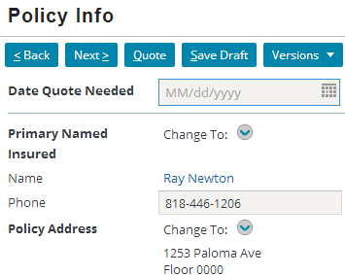
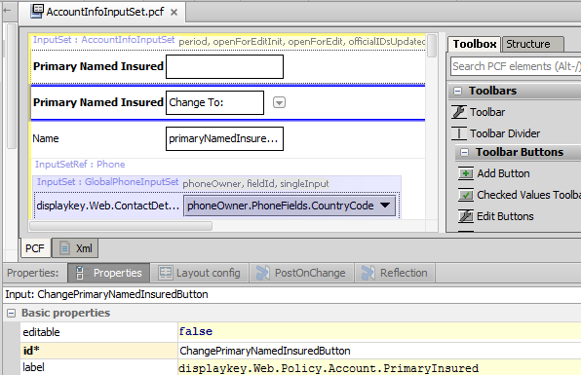
Example: Editing fields in the user interface
Use PCF Visual Editor to:
Add or remove widgets from UI
Rearrange widgets or modify label text
Create and modify detail views, list views, card views and listdetail views
Notes:
To modify the user interface, developers interact with a visual editor to modify PCF files and the screen elements they contain. PCF (Page Configuration File) is a proprietary version of XML used to define how the user interface behaves. The Studio PCF editor provides a visual way of adding or modifying the XML-defined screen elements.

Slide 43
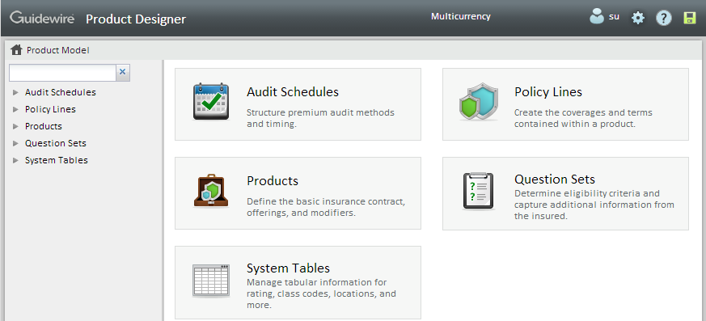
Product Designer
Product Designer is a web based tool for business users to edit product model information
Includes product model, system tables, and audit schedules information
Notes:
Product Designer is available within PolicyCenter. Product Designer is makes it easier for non-developers such as business analysts to configure the product model, system tables and audit schedules.

Slide 44
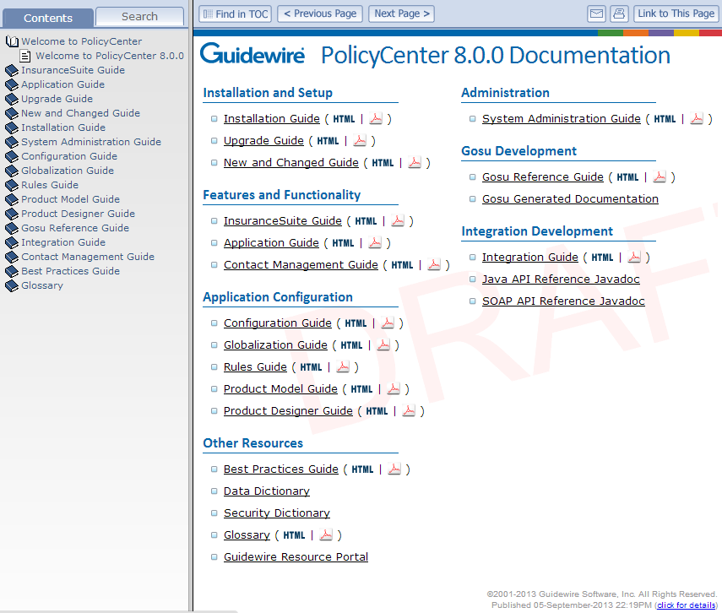
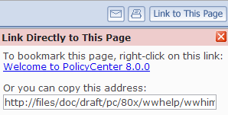
PolicyCenter Documentation
Table of contents
Documentation set
Publication date
Notes:
There are two types of PolicyCenter documentation that you can access from the PolicyCenter Welcome page:
Books that are immediately available in both HTML and PDF format
Dynamic documents that need to be generated
When you mouse-over the name of a document, a tooltip that describes the resource is displayed. For dynamic documents, the tooltip also provides instructions for generating the document.
Four tabs are provided for searching and navigating the documentation:
The Contents tab displays the table of contents for all books.
The Search tab allows you to perform a simple word search within the HTML documents. You can select a specific book or choose “All Available Books” to include in your search.
The following buttons are available:
“Find in TOC” displays the table of contents with the current topic highlighted.
“Previous Page” and “Next Page” help you navigate sequentially through a document. Note the difference in behavior between “Previous Page” and the back button in your browser: “Previous Page” takes you to the page that immediately precedes the current page whereas the back button redisplays the most recent page you visited.
E-mail opens a new email that includes a link to the current topic.
Print allows you to print the current page.
“Link to This Page” provides a URL for you to copy or bookmark in your browser.

Slide 45
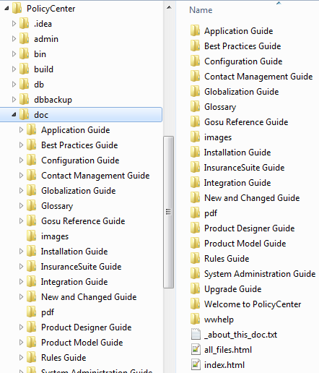
Location of Documentation
Available from <PolicyCenter home>\doc directory
API references are also available but must be generated
Documentation set in PDF
Always open this file to access full documentation set
Notes:
PolicyCenter is shipped with a full set of documentation in both HTML and PDF formats. The recommended way to access the full documentation set is to open the main index.html. You can then bookmark the URL in your browser.
In addition, there are multiple references that describe the current state of your implementation, but they must be generated. These references are discussed in the "PolicyCenter Application Configuration" and "PolicyCenter Application Integration" courses.

Slide 46
Lesson objectives review
You should now be able to:
Describe the role of PolicyCenter in the Guidewire InsuranceSuite products
Describe the process of logging on to PolicyCenter
Describe the structure and functionality of the user interface
Describe the typical implementation team members and tools that they use

Slide 47
Review questions
Name three external systems that are typically integrated with PolicyCenter.
What does an end user need to access a Guidewire application?
When a user attempts to log into PolicyCenter, what three pieces of information does the application attempt to determine?
Name two ways a user could identify if they have any unsaved work.
What is Guidewire Studio?
Notes:
1. Possible answers: Claim administration system, Address book, authentication system, reporting system or a billing system.
2. A supported web browser and a valid user name and password.
3. Whether or not the user can be authenticated, what are the user's roles (permissions), and what is the user's startup page.
4. The Unsaved Work menu is available. (It is available only when there is unsaved work.) If a user attempts to log off ClaimCenter and there is unsaved work, a dialog box alerts them to this fact.
5. Guidewire Studio is a development environment for the technical members of the implementation team. It lets you configure product behavior, write integration points, and complete other technical tasks.
PolicyCenter Overview - 47

Slide 48
Notices
Copyright © 2001-2014 Guidewire Software, Inc. All rights reserved.
Guidewire, Guidewire Software, Guidewire ClaimCenter, Guidewire PolicyCenter, Guidewire BillingCenter, Guidewire Reinsurance Management, Guidewire ContactManager, Guidewire Vendor Data Management, Guidewire Client Data Management, Guidewire Rating Management, Guidewire InsuranceSuite, Guidewire ContactCenter, Guidewire Studio, Guidewire Product Designer, Guidewire Live, Guidewire DataHub, Guidewire InfoCenter, Guidewire Standard Reporting, Guidewire ExampleCenter, Guidewire Account Manager Portal, Guidewire Claim Portal, Guidewire Policyholder Portal, ClaimCenter, BillingCenter, PolicyCenter, InsuranceSuite, Gosu, Deliver Insurance Your Way, and the Guidewire logo are trademarks, service marks, or registered trademarks of Guidewire Software, Inc. in the United States and/or other countries.
All other trademarks are the property of their respective owners.
This material is confidential and proprietary to Guidewire and subject to the confidentiality terms in the applicable license agreement and/or separate nondisclosure agreement.
This file and the contents herein are the property of Guidewire Software, Inc. Use of this course material is restricted to students officially registered in this specific Guidewire-instructed course, or for other use expressly authorized by Guidewire. Replication or distribution of this course material in electronic, paper, or other format is prohibited without express permission from Guidewire.
Guidewire products are protected by one or more United States patents.
Notes:
PolicyCenter Overview - 48

